Slide 1
Покупка билетов на самолет
Кудашов Аркадий

Slide 2
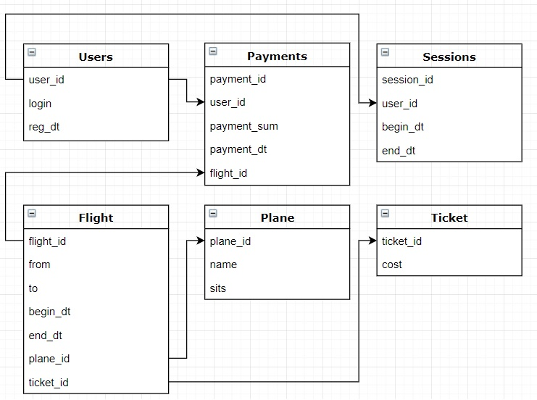
Схема базы

Slide 3
Созданные и заполненные таблицы
Demo
https://github.com/ark85/TrackDataBase2_project

Slide 4
Запросы
Возможность купить билет:
CREATE OR REPLACE VIEW sold_tickets AS
SELECT f.flight_id, SUM(IF(pay.payment_sum DIV t.cost > 0, pay.payment_sum DIV t.cost, 1)) AS 'ticket_count'
FROM flights f LEFT JOIN payments pay ON f.flight_id = pay.flight_id
LEFT JOIN tickets t ON f.ticket_id = t.ticket_id
GROUP BY f.flight_id;
SELECT f.flight_id, IF(p.sits > st.ticket_count, TRUE, FALSE) AS 'possibility_to_by_ticket'
FROM flights f
LEFT JOIN planes p ON f.plane_id = p.plane_id
LEFT JOIN sold_tickets st ON f.flight_id = st.flight_id

Slide 5
Запросы
Число проданных билетов:
SELECT f.flight_id, SUM(IF(pay.payment_sum DIV t.cost > 0, pay.payment_sum DIV t.cost, 1)) AS 'ticket_count'
FROM flights f LEFT JOIN payments pay ON f.flight_id = pay.flight_id
LEFT JOIN tickets t ON f.ticket_id = t.ticket_id
GROUP BY f.flight_id;

Slide 6
Запросы
Рейсы per user:
SELECT u.login, p.payment_sum, p.payment_dttm, f.*
FROM users u, payments p, flights f
WHERE u.user_id = p.user_id AND p.flight_id = f.flight_id
AND f.begin_dttm > '2018-10-01'

Slide 7
WAU

Slide 8
PPU

Slide 9
ARPPU

