Slide 1
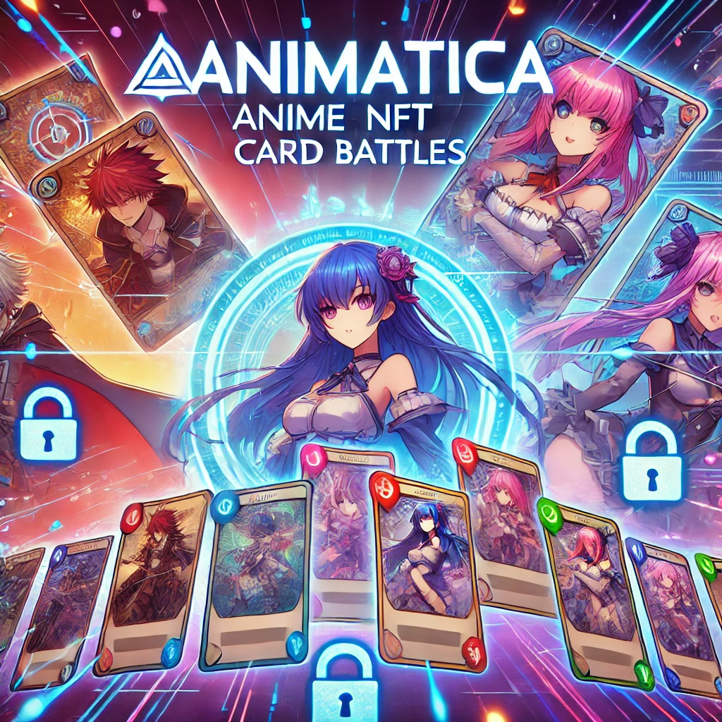
ANIMATICA Anime NFT Card Battles on BTTC
Decentralized, blockchain-based anime collectible card game.
Built on the BTTC Dona Testnet using zk-proof technology for privacy.
Players can own, trade, and battle anime character NFTs.

Slide 2
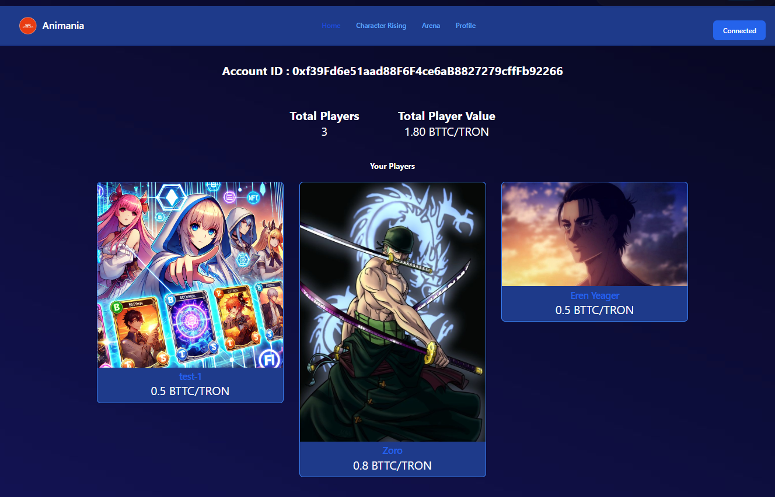
Project Overview
Animatica is a dApp combining anime and blockchain technology.
Built on the BitTorrent Chain (BTTC) for fast, low-cost transactions.
Players battle, trade, and collect custom-made anime NFTs in a fully decentralized environment.
Incorporates zk-proof technology for enhanced privacy and trust.

Slide 3
Vision
To create a decentralized anime card battle game.
Players upload custom anime-themed character cards with stats like Attack, Defense, Speed, and Health.
Engage in strategic battles, fully owning and trading NFTs in a trustless, transparent environment.
Why Blockchain and BTTC?
Fast Transactions: Ensures quick trades, battles, and NFT uploads.
Low Fees: Affordable gameplay without high transaction costs.
Decentralization: Full player control over assets, secured by BTTC.
Cross-Chain Compatibility: With Fluid Protocol, enables interaction across multiple blockchains (TRON, Ethereum, BTTC).

Slide 4
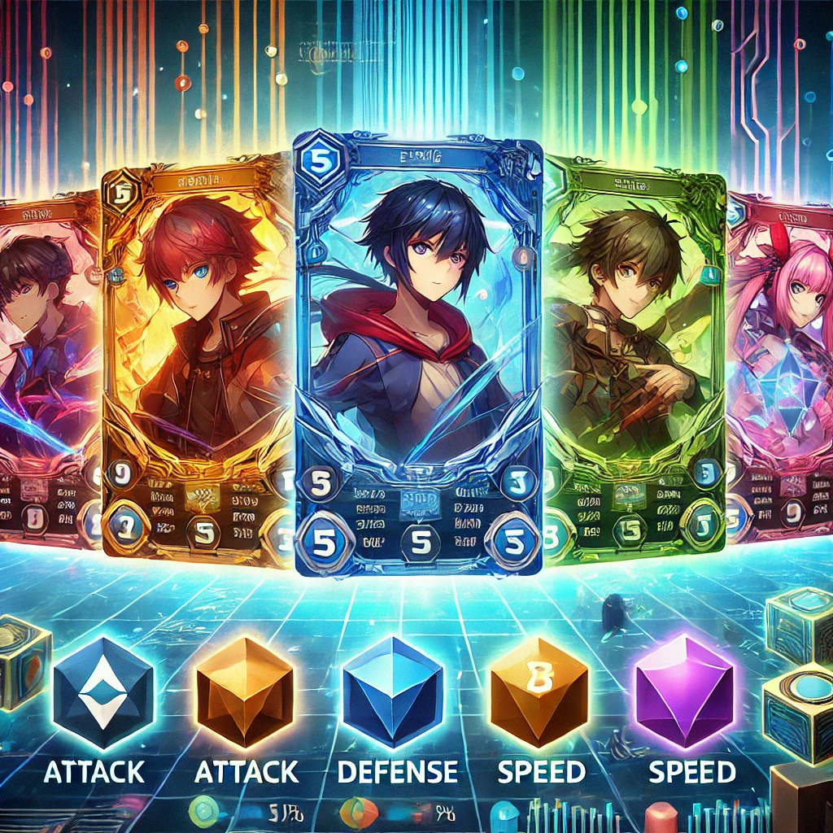
Key Features
1. zk-Proof Technology:
Privacy-preserving technology for trades and battles.
Players’ data remains confidential while still proving the integrity of their actions.
2. BTTC Dona Testnet:
Fast, low-cost, scalable gameplay on the BitTorrent Chain.
Enables seamless player interaction and low transaction costs.
3. Fluid Protocol Integration:
Ensures cross-chain functionality, allowing smooth transactions across different blockchain ecosystems.

Slide 5
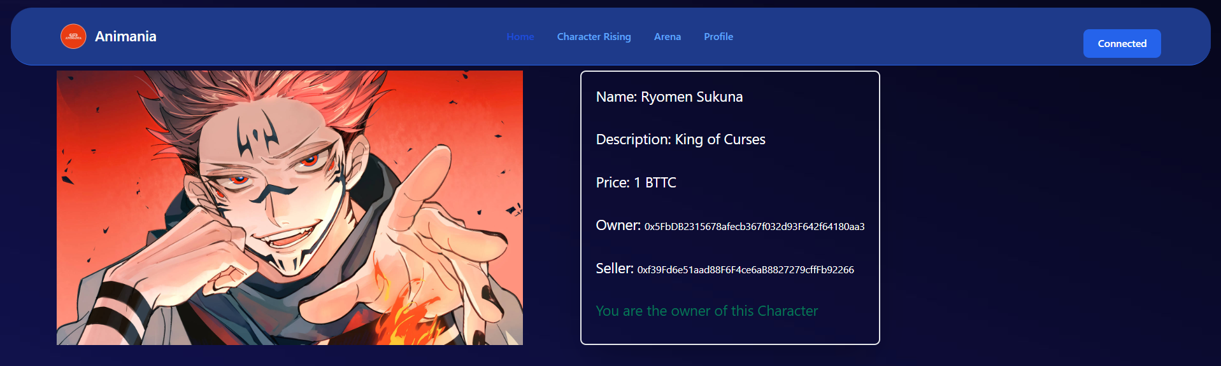
Tech Stack
Solidity: Smart contract development.
ReactJS & NextJS: Frontend development.
Hardhat: Blockchain development environment.
Tailwind CSS: Responsive UI design.
IPFS: Decentralized storage for character card uploads.
BTTC Dona Testnet: Primary blockchain for the dApp.

Slide 6
Gameplay Overview
Players can buy, sell, and trade anime NFTs in a decentralized marketplace.
Compete in anime-themed battles using NFTs with unique character stats.
Battle System: Players can challenge each other, and the winner receives the opponent’s NFT.
Admin transfers the winner’s NFT through a smart contract within 24 hours.
NFT Marketplace
Players upload their anime character cards as NFTs (ERC721).
Users can view NFTs in the marketplace, where they can buy or sell.
Players can view their owned NFTs in their profile section.

Slide 7
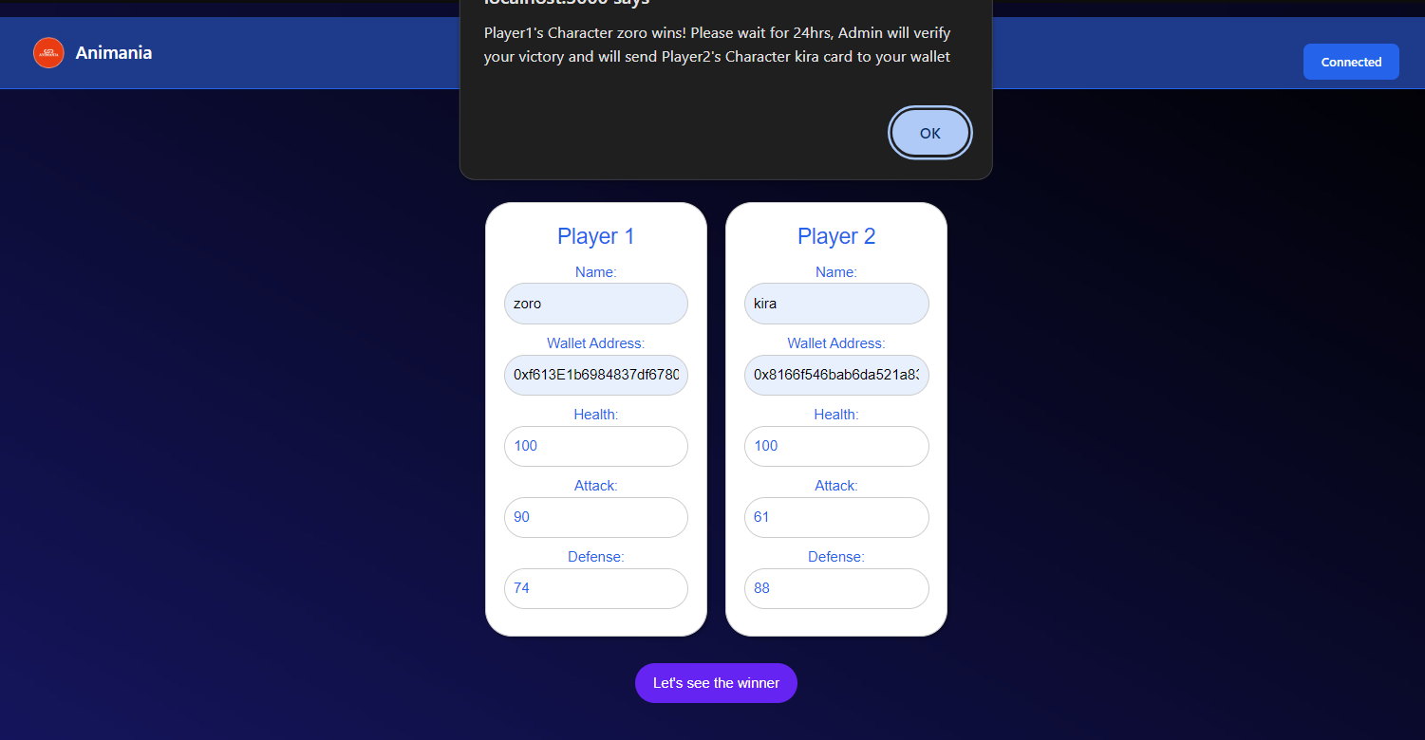
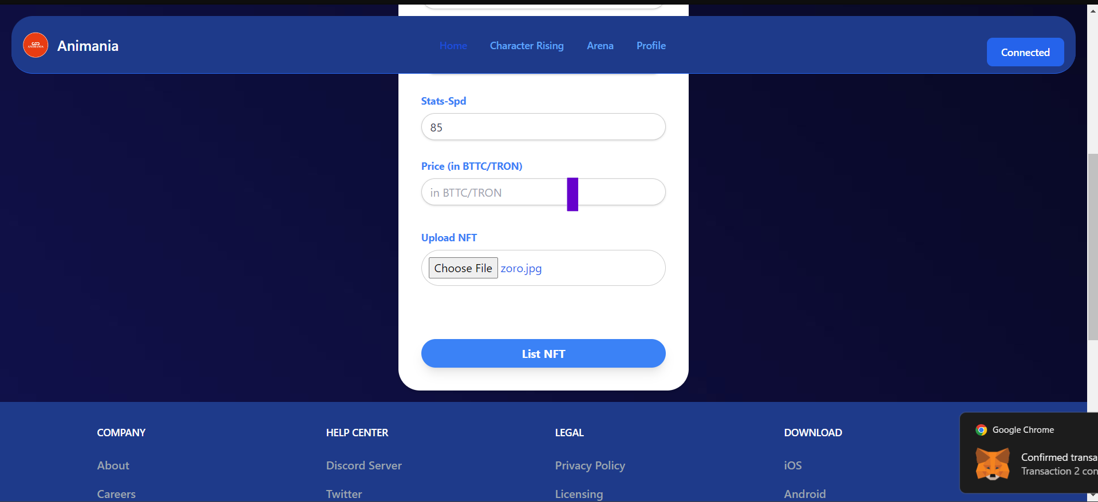
Cross-Chain Interactions
With Fluid Protocol, Animatica interacts across TRON, Ethereum, BTTC, and more.
Enables fluid transactions and scalability across different blockchain networks.
Challenges Faced
Implementing zk-proof technology while balancing performance.
Ensuring cross-chain compatibility between BTTC, TRON, and Ethereum.
Optimizing gas fees and debugging on the BTTC Dona Testnet.
Time management for development and feature integration.

Slide 8
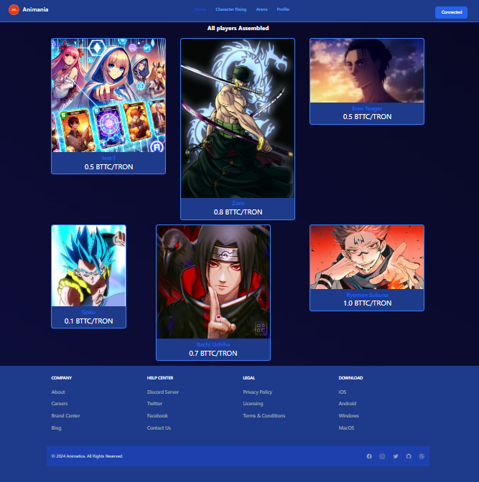
Accomplishments
Successfully integrated zk-proof technology for privacy.
Built a fully decentralized card battle platform on BTTC.
Enabled cross-chain transactions using Fluid Protocol.
Created a seamless user experience for buying, selling, and battling anime NFTs.
Future Plans
Introducing advanced zk-proof privacy measures.
Adding tournaments, rewards, and rare card drops for more excitement.
Expanding cross-chain support to allow more seamless interaction with other blockchain ecosystems.
Conclusion
Animatica revolutionizes anime-themed card games on blockchain.
Combines privacy-preserving technologies, decentralized gameplay, and fast cross-chain transactions.
Join the BTTC Dona Testnet and start battling with your anime NFTs today!

