Slide 1

SMART INDIA HACKATHON 2026
TITLE PAGE
Problem Statement ID – 26131
Problem Statement Title –
Early Detection and Management of Crop Diseases and Pest Infestations
Theme – Agriculture, Foodtech & Rural Development
PS Category – Software
Team Name – Farmstack

Slide 2
Farmstack: AI Crop-Health Detection & Advisory
Farmstack
A. PROBLEM
• Disease & pest threats often recognised after visible crop damage.
• Farmers may have limited access to timely expert guidance.
• Weather, crop, location & history are rarely considered together.
• Delayed / inappropriate management raises crop loss & input costs.
B. FARMSTACK SOLUTION
C. INNOVATION / UNIQUENESS
Combines crop-health detection with trusted knowledge and farmer-friendly assistance.
Crop-specific AI diagnosis
Farmer / Field Input
RAG-grounded agricultural guidance
AI Detection
Risk & Knowledge
Multilingual + voice interaction
Actionable Advisory
Monitoring
Integrated farmer + expert workflow
SIH EXTENSION
Pest + Weather Risk +
Geospatial Monitoring +
Expert Validation
CURRENT PROTOTYPE

Slide 3
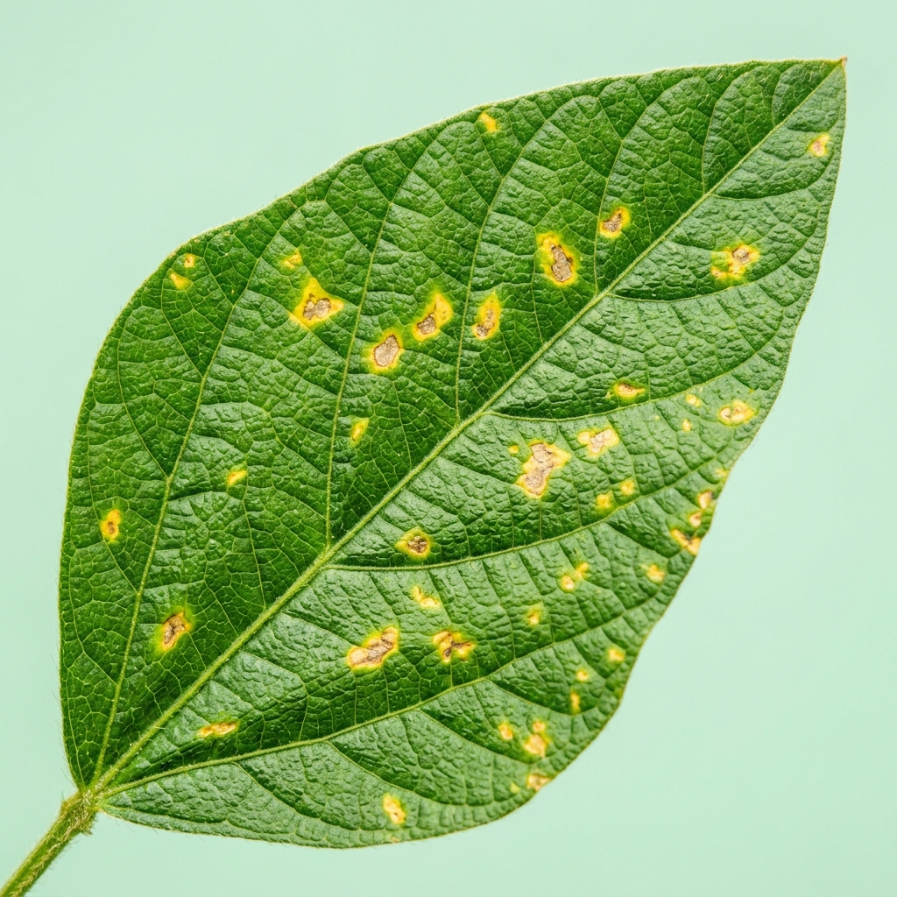
TECHNICAL APPROACH
Farmstack
CURRENT PROTOTYPE
Implemented workflow | DenseNet121 + RAG (SentenceTransformer + FAISS) + NLP/LLM
FARMER / FIELD INPUT
INPUT PROCESSING
TECHNOLOGIES
Crop Leaf Image
• DenseNet121 (crop-specific)
• Flutter mobile + FastAPI
• RAG + FAISS embeddings
• SentenceTransformer retrieval
• NLP + LLM (Gemini)
• Multilingual TTS / STT
• SQLite history + Expert dashboard
CROP-SPECIFIC DENSENET121
Voice / Text Query
DISEASE + CONFIDENCE (Argmax)
Crop / Field Information
RAG KNOWLEDGE RETRIEVAL
SentenceTransformer → FAISS Search
RELEVANT AGRICULTURAL KNOWLEDGE
NLP + LLM → Treatment / Prevention
MODEL RESULTS (Reported)
Crop Acc P R F1
Sugarcane 94% 0.95 0.94 0.94
Grapes 99% 0.99 0.99 0.99
Sunflower 90% 0.90 0.90 0.90
Cotton 93% 0.93 0.93 0.93
MULTILINGUAL TEXT / VOICE
DATABASE + HISTORY + EXPERT DASHBOARD
Sample leaf input (prototype)
PROPOSED SIH EXTENSION
Pest Detection | Pest Traps/Sensors | Weather Risk | Geospatial Hotspots | Expert Validation | Field Feedback

Slide 4
FEASIBILITY AND VIABILITY
Farmstack
1. TECHNICAL FEASIBILITY
• Computer Vision with crop-specific DenseNet121
• RAG + FAISS knowledge retrieval integrated
• NLP + LLM guidance grounded in retrieved text
• Mobile (Flutter) + FastAPI backend + history DB
2. FIELD FEASIBILITY
• Mobile-first farmer interaction workflow
• Multilingual UI and advisory support
• Voice input/output for accessible interaction
• Farmer-friendly treatment / prevention guidance
3. KEY RISKS
• Image quality, lighting & background variation
• Limited / noisy field data for some conditions
• Connectivity constraints in rural settings
• Prediction uncertainty on unseen disease stages
4. MITIGATION
• Confidence-aware results for uncertain cases
• Expert / lab referral pathway (SIH extension)
• Diverse field datasets & continuous validation
• Multiple data sources + low-connectivity-friendly design

Slide 5
IMPACT AND BENEFITS
Farmstack
FARMERS
• Earlier crop-health information
• Easier access to guidance
• Multilingual / voice interaction
Supports earlier awareness and actionable advisory — without claiming guaranteed yield outcomes.
AGRICULTURAL EXPERTS
• Organised prediction records
• Easier case review
• Improved monitoring support
FARMSTACK
EARLY
DETECTION
BETTER DECISION
SUPPORT
IMPROVED CROP-
HEALTH MANAGEMENT
ECONOMIC
• Supports timely management
• Potential reduction in avoidable crop losses / costs
ENVIRONMENTAL
• More targeted decision-making
• Supports reduction of unnecessary / inappropriate pesticide use
HOW IT HELPS
Current prototype delivers disease detection + RAG advisory.
SIH extension adds pest, weather, geospatial & expert validation.

Slide 6
RESEARCH AND REFERENCES
Farmstack
1. DenseNet
Huang, G., Liu, Z., Van Der Maaten, L., & Weinberger, K. Q. (2017). Densely Connected Convolutional Networks. CVPR.
2. Retrieval-Augmented Generation
Lewis, P., et al. (2020). Retrieval-Augmented Generation for Knowledge-Intensive NLP Tasks. NeurIPS.
3. Sentence-BERT / SentenceTransformer
Reimers, N., & Gurevych, I. (2019). Sentence-BERT: Sentence Embeddings using Siamese BERT-Networks. EMNLP.
4. Plant disease detection research
Mohanty, S. P., Hughes, D. P., & Salathé, M. (2016). Using Deep Learning for Image-Based Plant Disease Detection. Frontiers in Plant Science.
5. PlantVillage / dataset research
Hughes, D. P., & Salathé, M. (2015). An open access repository of images on plant health to enable the development of mobile disease diagnostics. arXiv:1511.08060.
Prototype stack: DenseNet121 • SentenceTransformer embeddings • FAISS • RAG • NLP/LLM • Flutter + FastAPI | PS 26131

