Slide 1
Machine Learning Enabled Estimation of Remaining Useful Life for Turbofan Engine using NASA CMAPSS Dataset
Presented by: Arka Bera
Date: 05/08/2024

Slide 2
Data description
Engine ID – 1 column
Time stamp – 1 column
Operating conditions – 3 columns
Sensor measurements – 21 columns
4 sets of data: FD001-4
Dataset | Training Data | Testing Data | Operating Conditions | Fault Modes
FD001 | 100 | 100 | 1 | 1
FD002 | 260 | 259 | 6 | 1
FD003 | 100 | 100 | 1 | 2
FD004 | 248 | 249 | 6 | 2

Slide 3
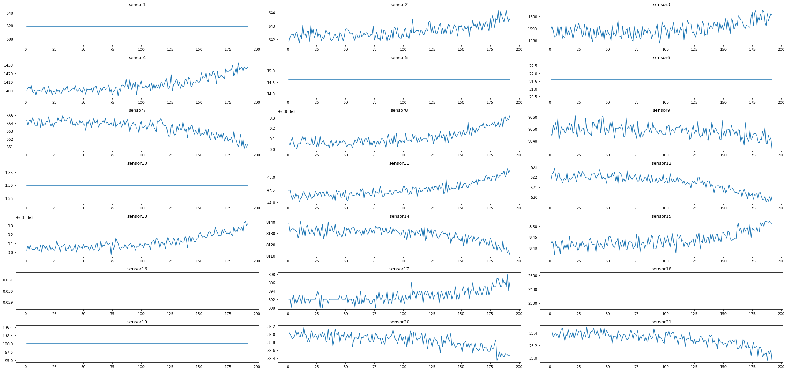
Data description

Slide 4
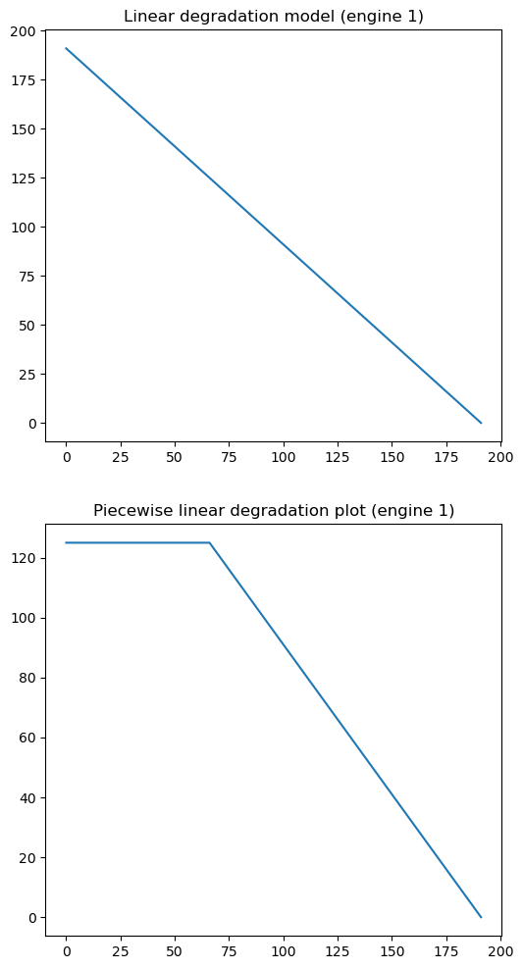
Data preprocessing
Only take sensor measurements
Scale using Min-Max between [-1,1]
Obtain RUL from number of cycles of each engine
Apply piecewise linear degradation model to RUL (R_{early} = 130)
Take windows of the scaled data (30/20/30/15 respectively)

Slide 5

Evaluation metrics
RMSE
$$\text{RMSE}\text{ = }\text{√}\text{(}\text{Σ}\text{(}\text{y} \text{− }\text{y}\text{̂}\text{)}\text{² }\text{/ }\text{n}\text{)}$$
Scoring parameter
$$s = Σ_{i=1}^{n} s_{i}$$
where $s_{i} = e^{−\frac{d_{i}}{13}}−1, if d_{i} < 0$
$$s_{i} = e^{\frac{d_{i}}{10}}−1, if d_{i} ≥ 0$$

Slide 6
Random Forest Regression
Baseline model for the project
Hyperparameter tuning implemented
n_estimators: 100, 200, 300, 400, 500, 1000
max_features: log2, sqrt
Scoring: neg_rmse
Dataset | RMSE | Score
FD001 | 18.15 | 958.09
FD002 | 28.59 | 10690.96
FD003 | 21.63 | 2833.31
FD004 | 30.09 | 8619.93

Slide 7
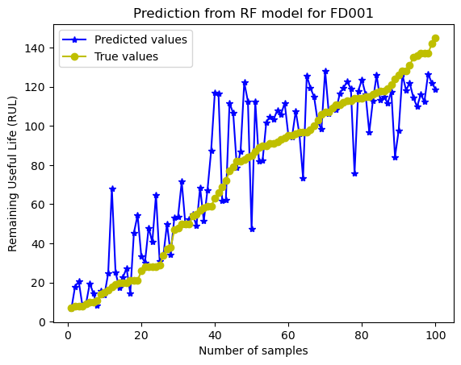
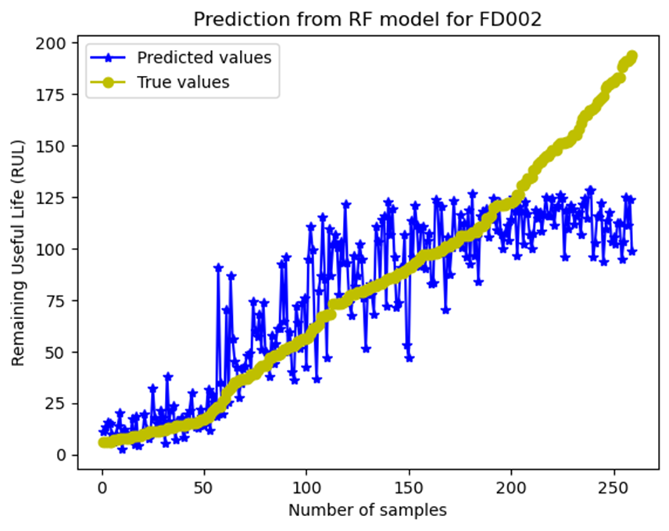
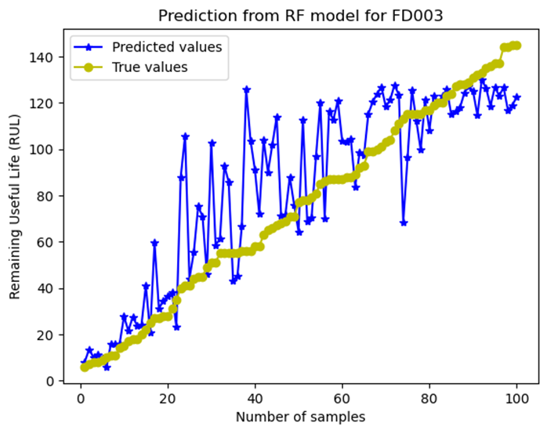
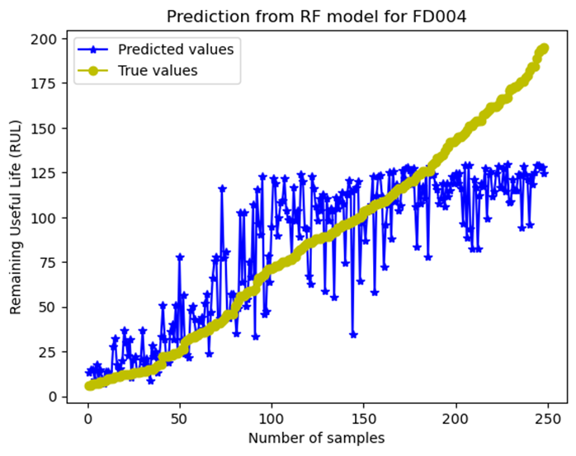

Slide 8
1D Convolutional Neural Network
3 convolutional layers with increasing no. of filters (32, 64, 128)
Adam optimizer and mse loss
Batch size 512
Trained for 150 epochs (first 50 at LR 0.001, then at LR 0.0001)

Slide 9
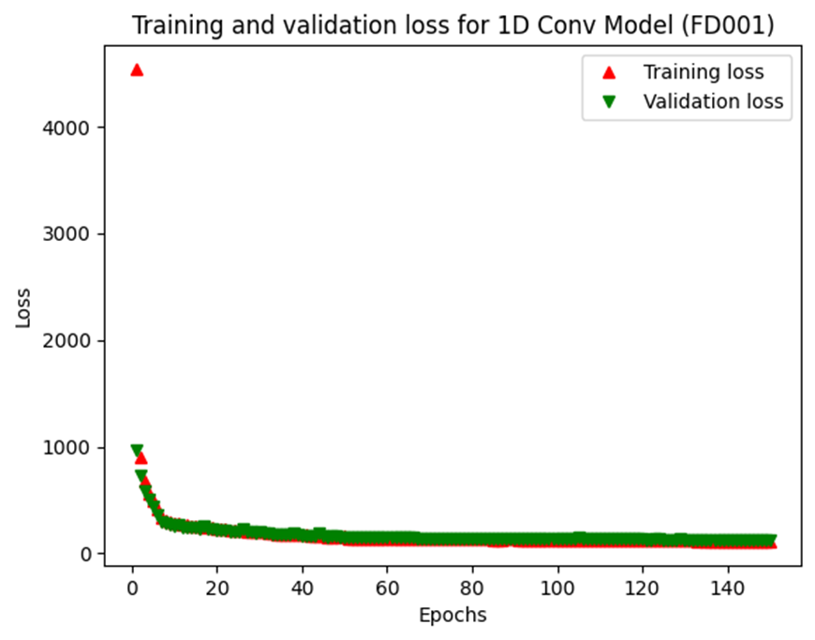
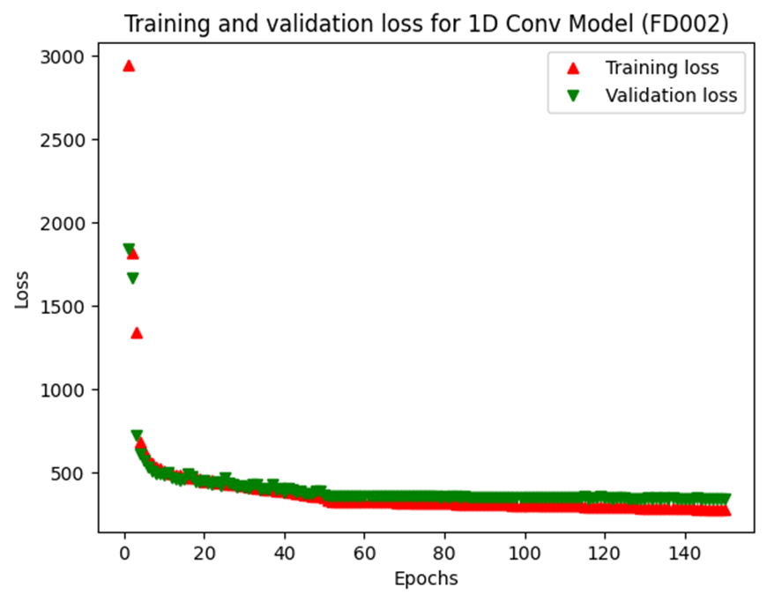
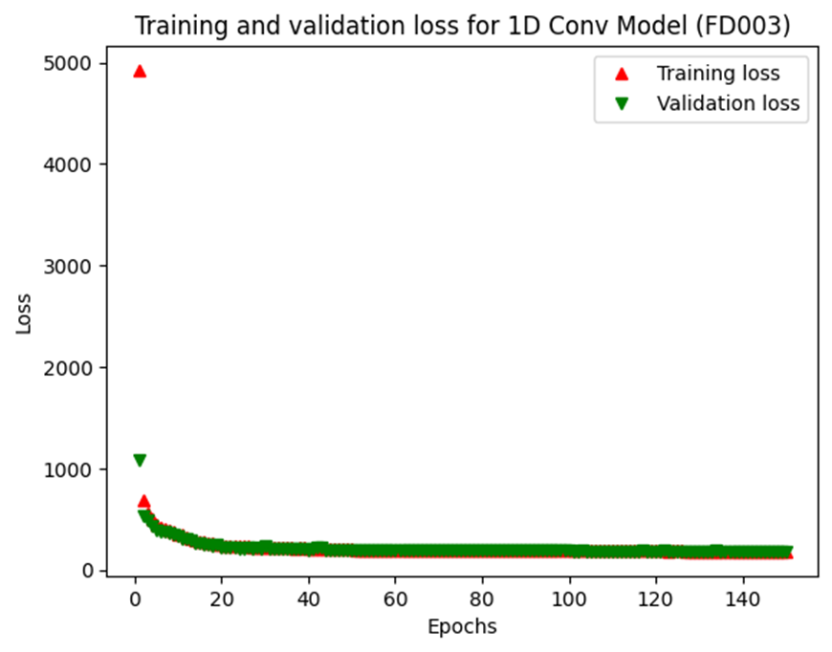
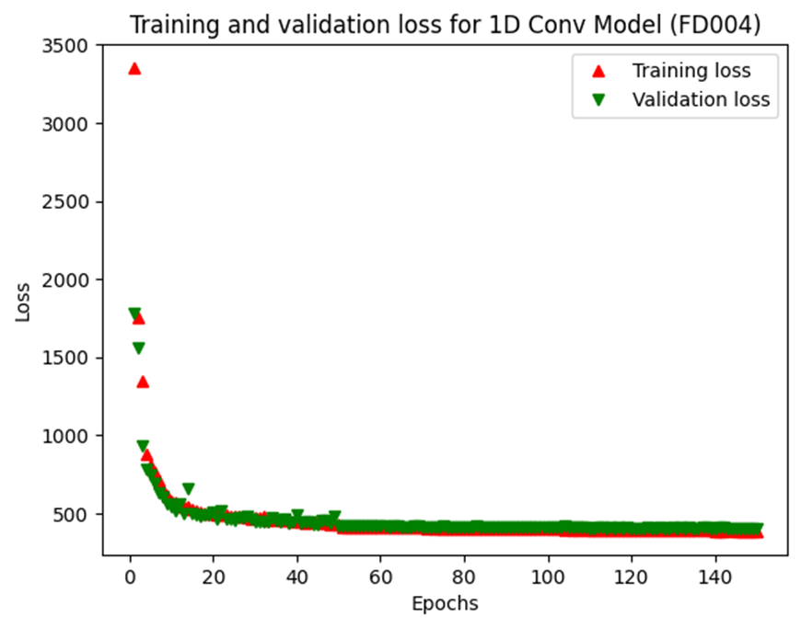

Slide 10
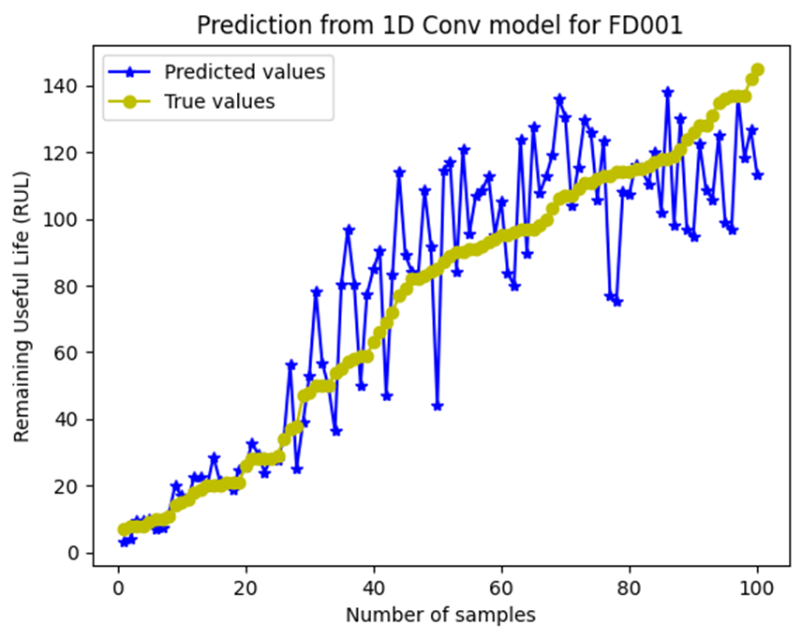
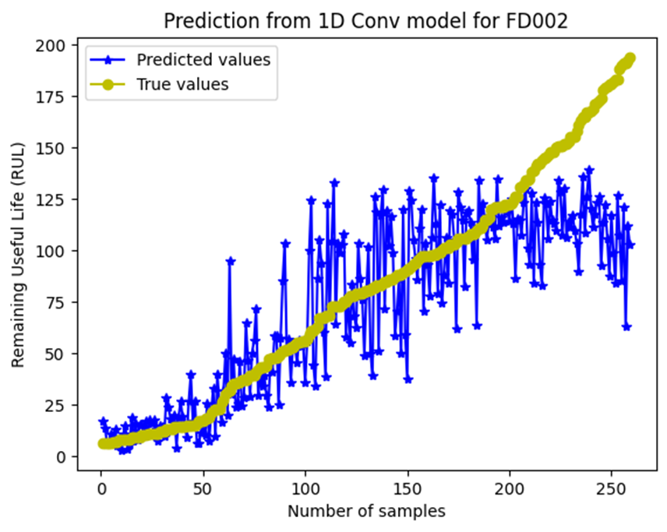
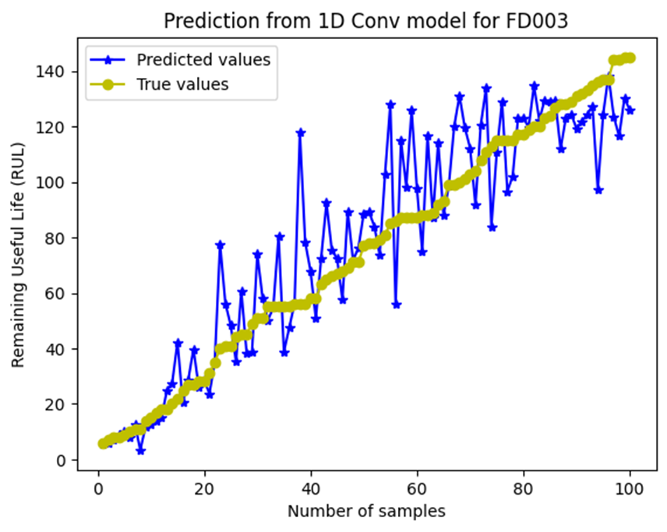
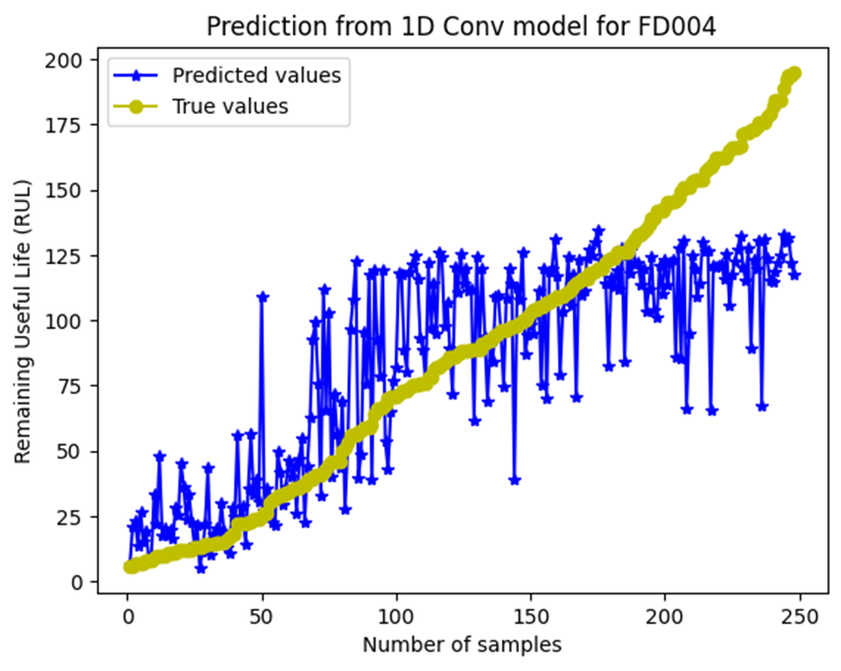

Slide 11
1D Convolutional Neural Network
Dataset | RMSE | Score
FD001 | 17.24 | 507.05
FD002 | 29.68 | 33331.88
FD003 | 16.26 | 920.78
FD004 | 32.72 | 19835.46

Slide 12
Conv+LSTM Model for FD001 Dataset
Two 1D-CNN layers (18, 36) followed by two LSTM layers
Dropout layers implemented to prevent overfitting
Adam optimizer and mse loss
Batch size 32
Trained for 10 epochs

Slide 13
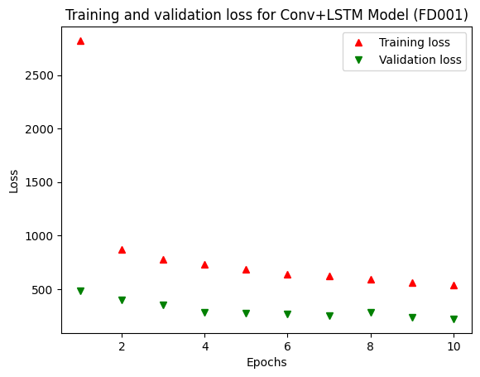
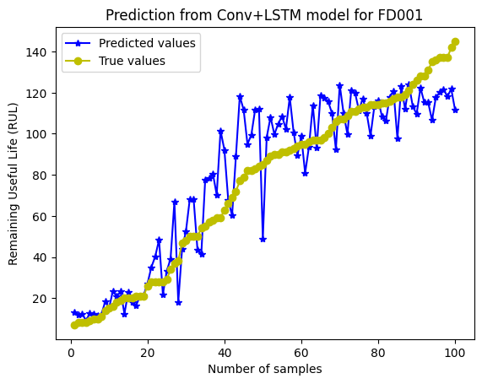
Conv+LSTM Model for FD001 Dataset

Slide 14
Conv+LSTM Model for FD001 Dataset
ML Model | RMSE | Score | No. of parameters
Random Forest | 18.15 | 958.09 | -
1D-CNN | 17.25 | 507.05 | 194409
Conv+LSTM | 16.19 | 440.40 | 111659

Slide 15
Comparison with reference paper
Dataset | Random Forest | 1D-CNN | Conv+LSTM | Literature*
FD001 | 18.15 | 17.25 | 16.19 | 12.61
FD002 | 28.59 | 29.68 | - | 22.36
FD003 | 21.63 | 16.26 | - | 12.64
FD004 | 30.09 | 32.72 | - | 23.31
*A. Saxena, K. Goebel, D. Simon and N. Eklund, "Damage propagation modeling for aircraft engine run-to-failure simulation," 2008 International Conference on Prognostics and Health Management, Denver, CO, USA, 2008, pp. 1-9, doi: 10.1109/PHM.2008.4711414.

Slide 16
Conclusion
Random Forest served as a good baseline model.
Temporal features are not captured efficiently.
1D-CNN improved on the RF model
With fewer parameters compared to existing literature, performance is comparable.
Conv-LSTM model provided best performance for FD001 model.
Fewer parameters and epochs needed compared to 1D-CNN.
Models provide good predictions where RUL values are low.
Models can be further improved with hyperparameter tuning.
Approach can be implemented where resources are limited.

Slide 17
Thank you!

