Slide 1
Analysis

Slide 2
Overview
4 dates have no action records
So, Outliers are any date from 18th July 2019 to 22nd July 2019
Also, 28th June has no values either.
Top 3 Open pages are – Home, VOD, NEWS
Some of the least viewed pages are DRV_DTL_LIVE, 2020_WaitList
Actions peaked on Sundays (especially on V and AD_BAN_IMP) followed by Mondays

Slide 3
Question
What is the bounce rate or retention rate of features (pages)? Which features perform the best, and which perform the worst?

Slide 4

Retention Rate
(57696/63620)*100 = 90.68
∴ Therefore, Retention rate is 9.32%.

Slide 5
Retention Rate
Users dropped 9.32% from previous of the last week to last week.

Slide 6
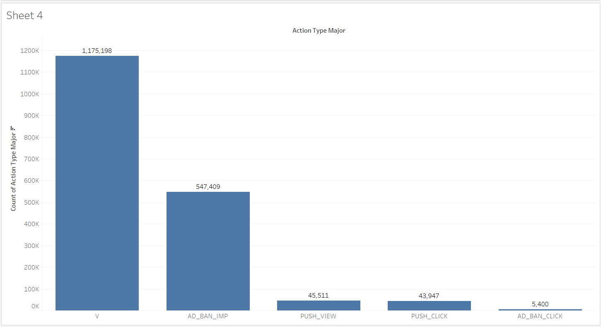
Most Used Features
Home
Banner Ad View
Push Notification View
Least Used
Push Notification Click
Banner Ad Click

Slide 7
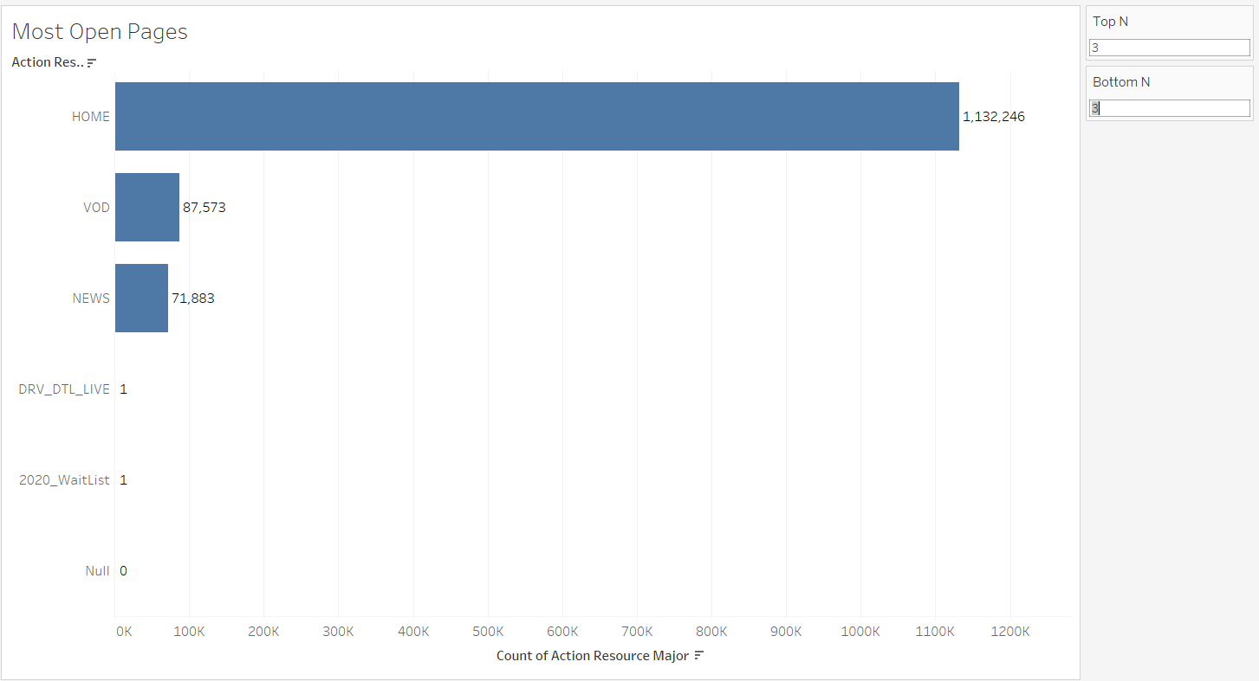
Most Open Pages (In General)

Slide 8
Question
Are advertisements more effective on certain pages of the app than others? At certain times? Where/when should advertisements be placed to get maximum yield?

Slide 9
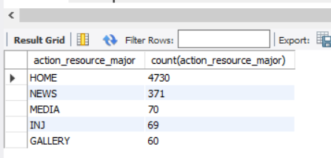
Ad viewed from Top 5 pages
Home
News
Media
INJ
Gallery

Slide 10
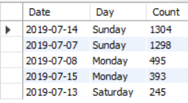
Top 5 DATES
2019-07-14 | Sunday
2019-07-07 | Sunday
2019-07-08 | Monday
2019-07-15 | Monday
2019-07-13 | Saturday

Slide 11

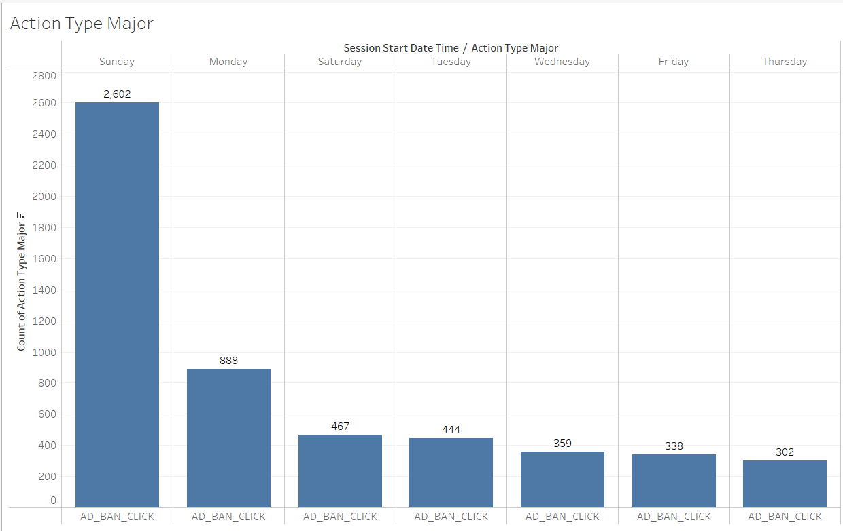
Most Ad Interactions on
Sunday
Monday
Saturday

Slide 12
Advertisement Target
Sundays we should target Home, News, DRV_DTL
Mondays we should target Home, News, Media
Saturdays we should target Home, News, Gallery
Advertisement should be placed on Sundays, Saturdays on Media

Slide 13
Question
When does engagement with push notifications peak, and when is it at its lowest point? When does push-notification engagement fall off after a game?

Slide 14
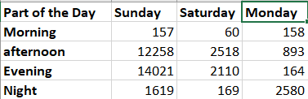
Push Notification Interaction Peaks

Slide 15
Answer
Push notifications are viewed mostly on Sundays from the Home Page between afternoon and evening.
We can target more ads on Saturdays in the evening more.

Slide 16
THE END

