Slide 1
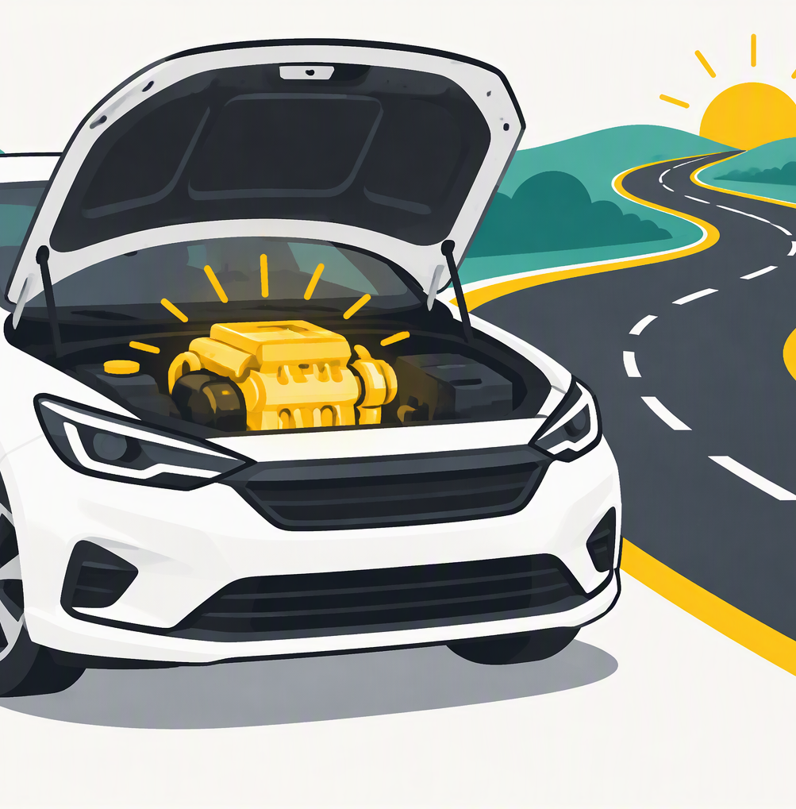
V01
Title: under the bonnet
Insert image V01 (see Visual Prompts doc)
Under the Bonnet
What you're really using when you use AI
Procurement AI Training | EQ Enterprise AI
1
Notes:
Welcome everyone, in the room in India and on Teams.
Don't announce the analogy yet. Say: today we're going to talk about cars.
Keep a straight face.

Slide 2
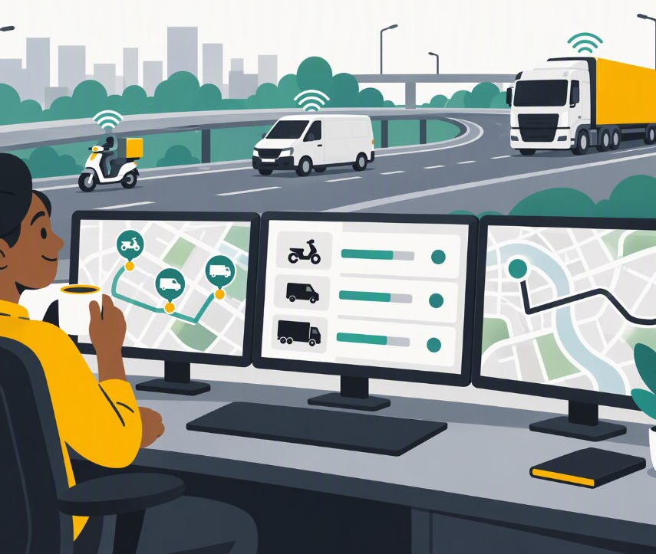
About me
V00
The dispatcher (intro)
Insert image V00 (see Visual Prompts doc)
Arek Kulpa, EQ Enterprise AI
Building with AI for a number of years
Running a small logistics firm of AI drivers every day
2
Notes:
Max 2 minutes.
- Who I am: AI/ML engineer, EQ Enterprise AI team (Data Office).
- How long I've been doing this: [X] years.
- Every day I run multiple agents doing autonomous work while I supervise. Like a dispatcher.
- Purpose today: not one tool. Understand what's under the bonnet so you get better results from any AI, anywhere.
- Real use cases: your colleagues (e.g. Vinay) do this better than me. I'll give you the understanding.

Slide 3
Today's talk is about cars
Bear with me.
3
Notes:
Deadpan. 'Before we get to AI, I need everyone to understand how cars work.'
This also makes sure nobody is lost on car concepts later. Not everyone drives, and not every vehicle type is familiar in every country.

Slide 4
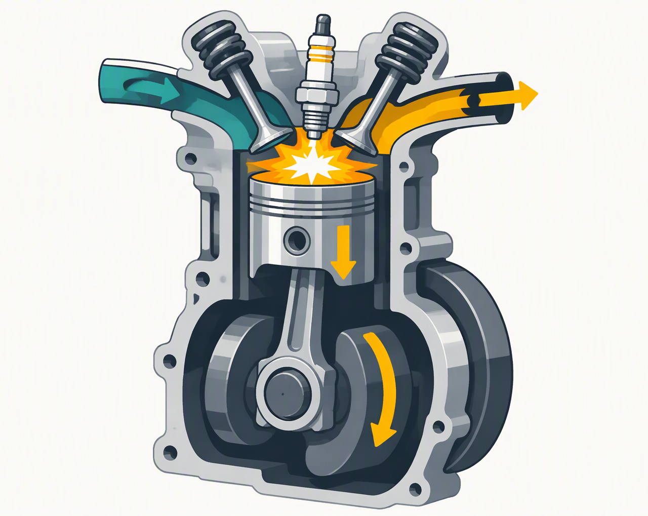
V02
The engine
Insert image V02 (see Visual Prompts doc)
CARS 101
The engine
One invention that makes everything move. Every car on the road runs on the same basic idea.
4
Notes:
Explain simply: fuel burns, pushes pistons, turns wheels.
The key point: it's the same core technology in almost every car. Brands differ; the engine idea doesn't.

Slide 5
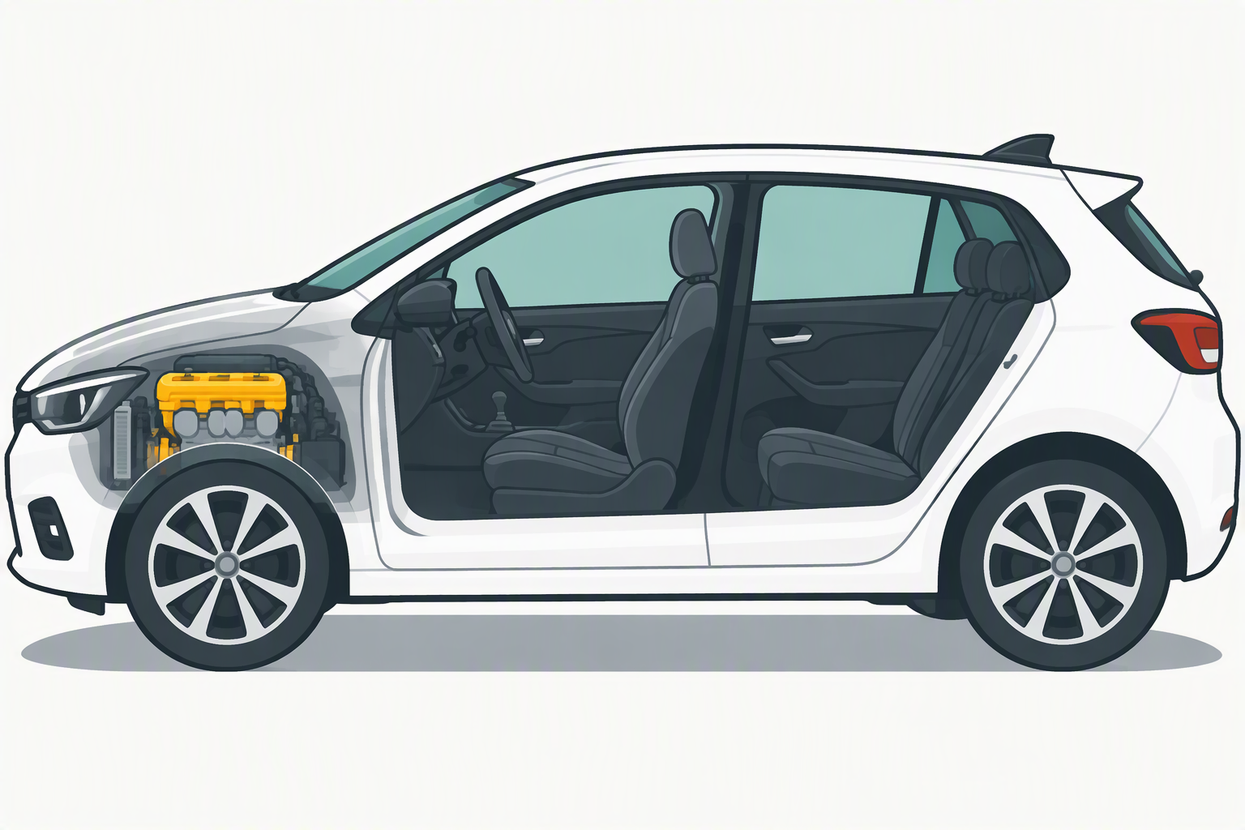
V03
The car
Insert image V03 (see Visual Prompts doc)
CARS 101
The car
The body around the engine: seats, steering, mirrors, boot. It decides what you can do with the engine.
5
Notes:
Same engine, different car: a hatchback, a van, a truck. The car decides where you can go, what you can carry, how safe it is.
An engine on its own takes you nowhere.

Slide 6
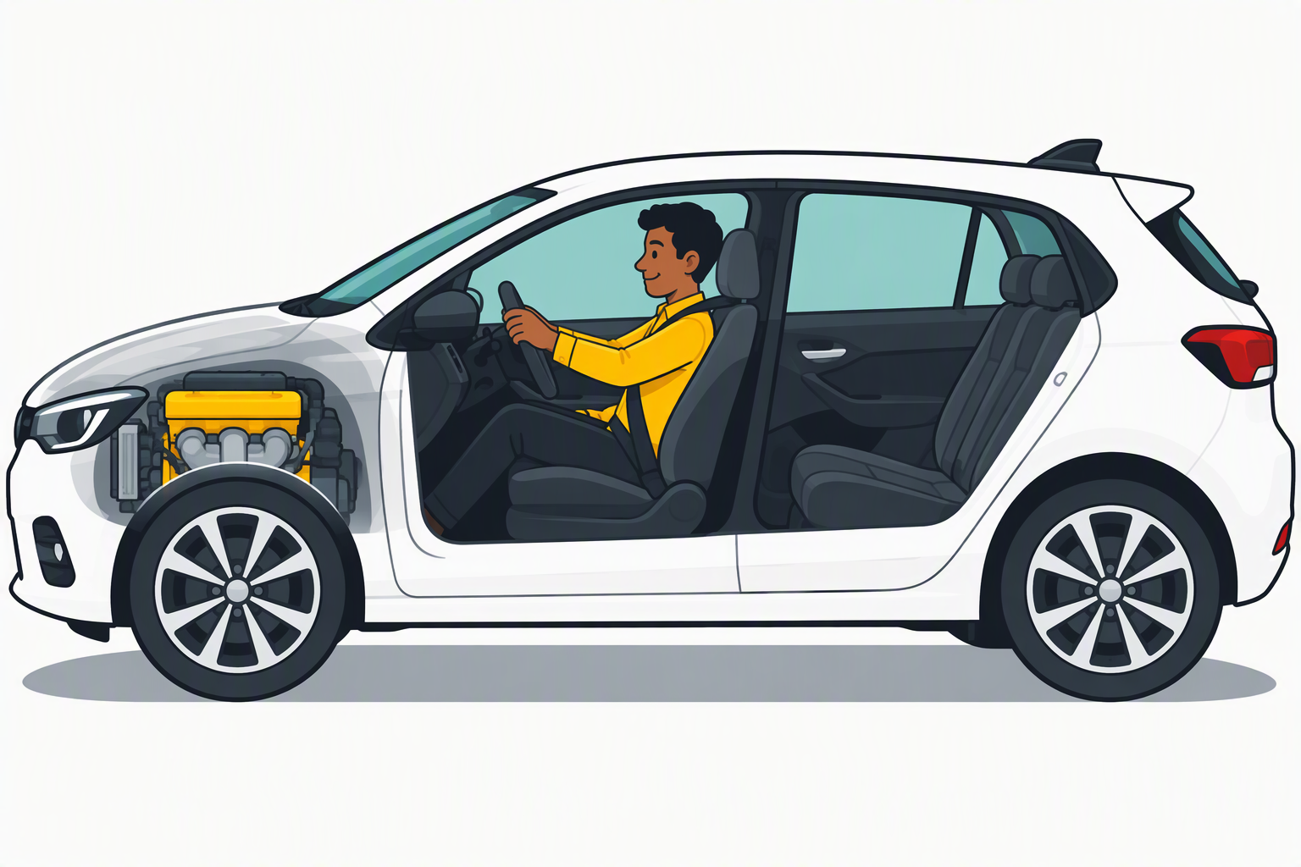
V04
The driver
Insert image V04 (see Visual Prompts doc)
CARS 101
The driver
Engine, car, driver: three separate things.
6
Notes:
Point at the three parts: engine, car, driver.
A great driver in a bad car underperforms. A great car with no driver goes nowhere.

Slide 7
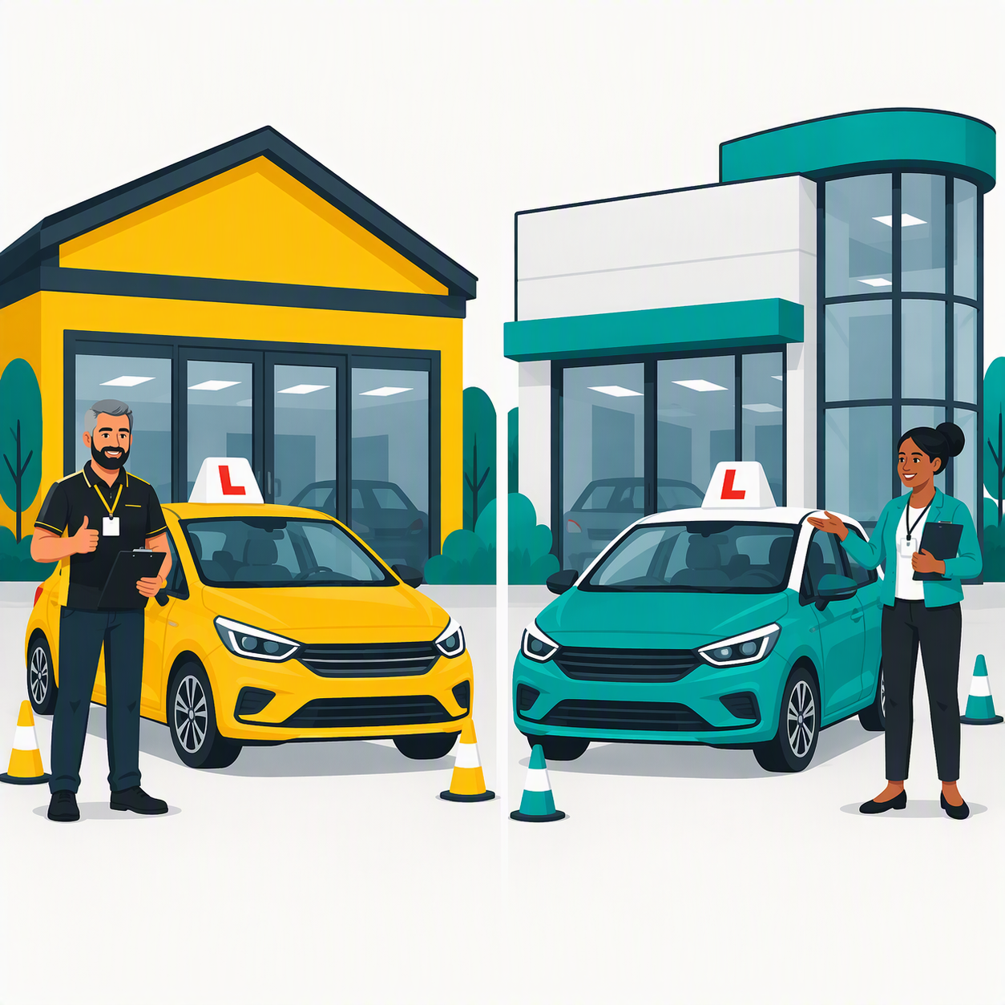
V05
Driving schools
Insert image V05 (see Visual Prompts doc)
CARS 101
Driving schools
Different schools, different habits.
7
Notes:
Drivers come out of different schools. Each school teaches its own style: some more cautious, some more confident.
Both schools train every kind of driver.

Slide 8
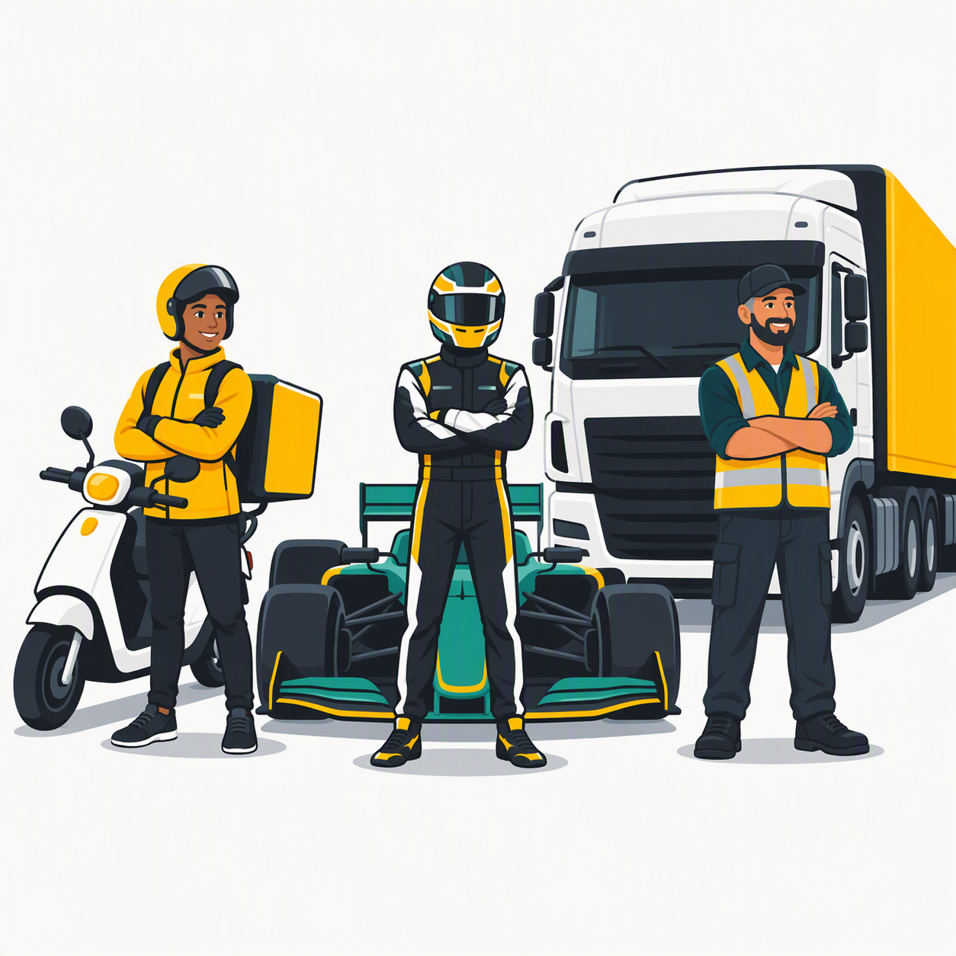
V06
Three kinds of driver
Insert image V06 (see Visual Prompts doc)
CARS 101
Three kinds of driver
Food delivery rider. Racing driver. Long-haul lorry driver.
8
Notes:
Moped rider: same short routes every day, cheap, very fast.
F1 racing driver: very fast and precise on a track they know well.
Long-haul lorry driver: plans the route, avoids traffic, slower and more expensive, handles the long complex journeys.
None is 'best'. Depends on the job.

Slide 9
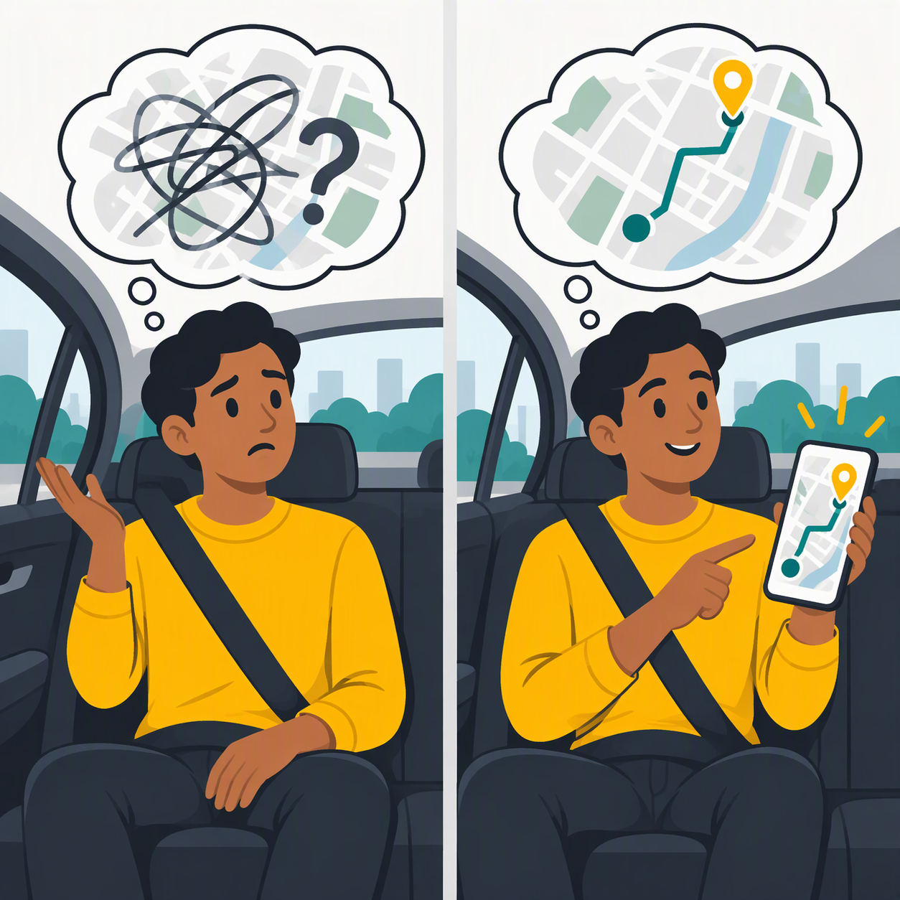
V07
Directions
Insert image V07 (see Visual Prompts doc)
CARS 101
Directions
"Somewhere nice" versus a full postcode.
9
Notes:
If you tell a driver 'somewhere nice', you get the driver's idea of nice.
Give a full address and you get where you wanted to go.

Slide 10
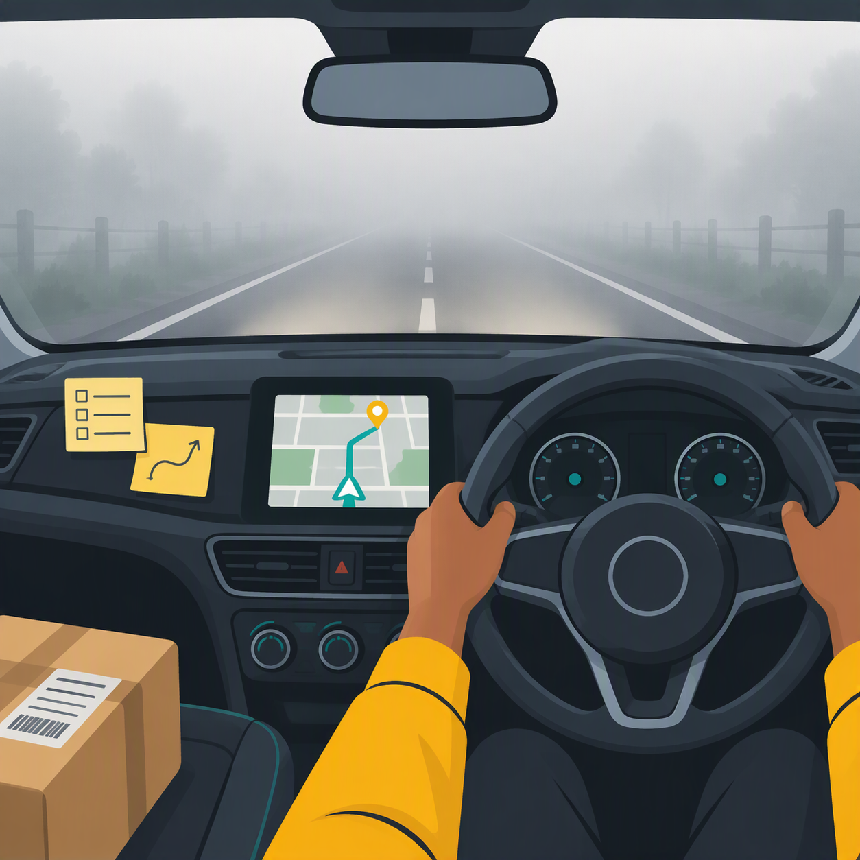
V08
What the driver can see
Insert image V08 (see Visual Prompts doc)
CARS 101
What the driver can see
Only what's in front of them right now. Everything else is fog.
10
Notes:
The road, the dashboard, the notes you stuck on it, the parcel label. That's it.
If it isn't visible, the driver guesses.

Slide 11
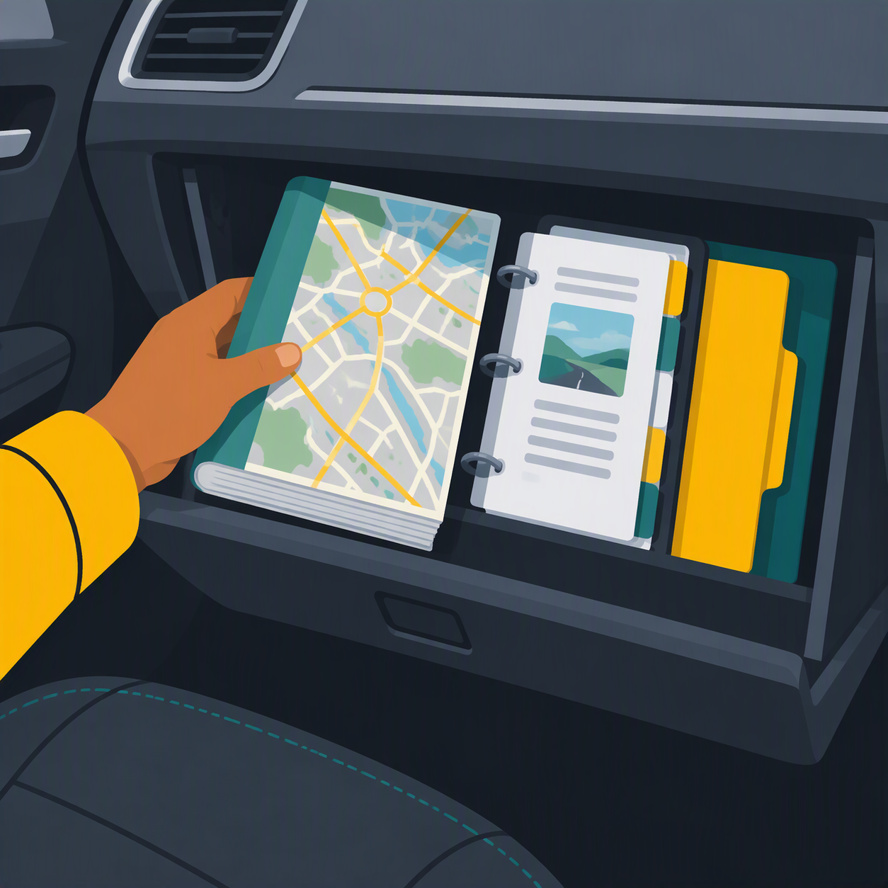
V09
Map book in the glovebox
Insert image V09 (see Visual Prompts doc)
CARS 101
The map book in the glovebox
Reference material the driver can look up when needed.
11
Notes:
Local maps, company reference sheets. Not memorised, but available in the car.

Slide 12
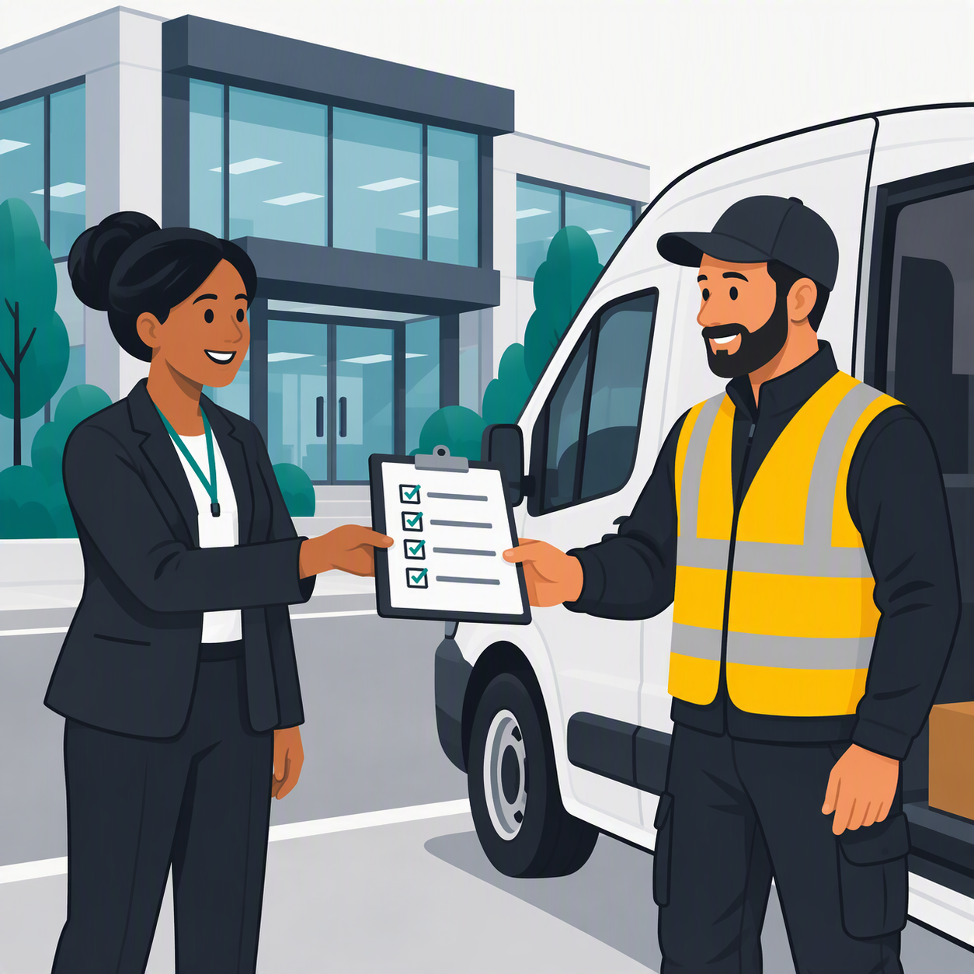
V10
Job brief from head office
Insert image V10 (see Visual Prompts doc)
CARS 101
The job brief from head office
"Only deliver parcels. Always get a signature."
12
Notes:
Before the shift, head office tells the driver what their job is and the rules.
Same driver, different brief = different behaviour.

Slide 13
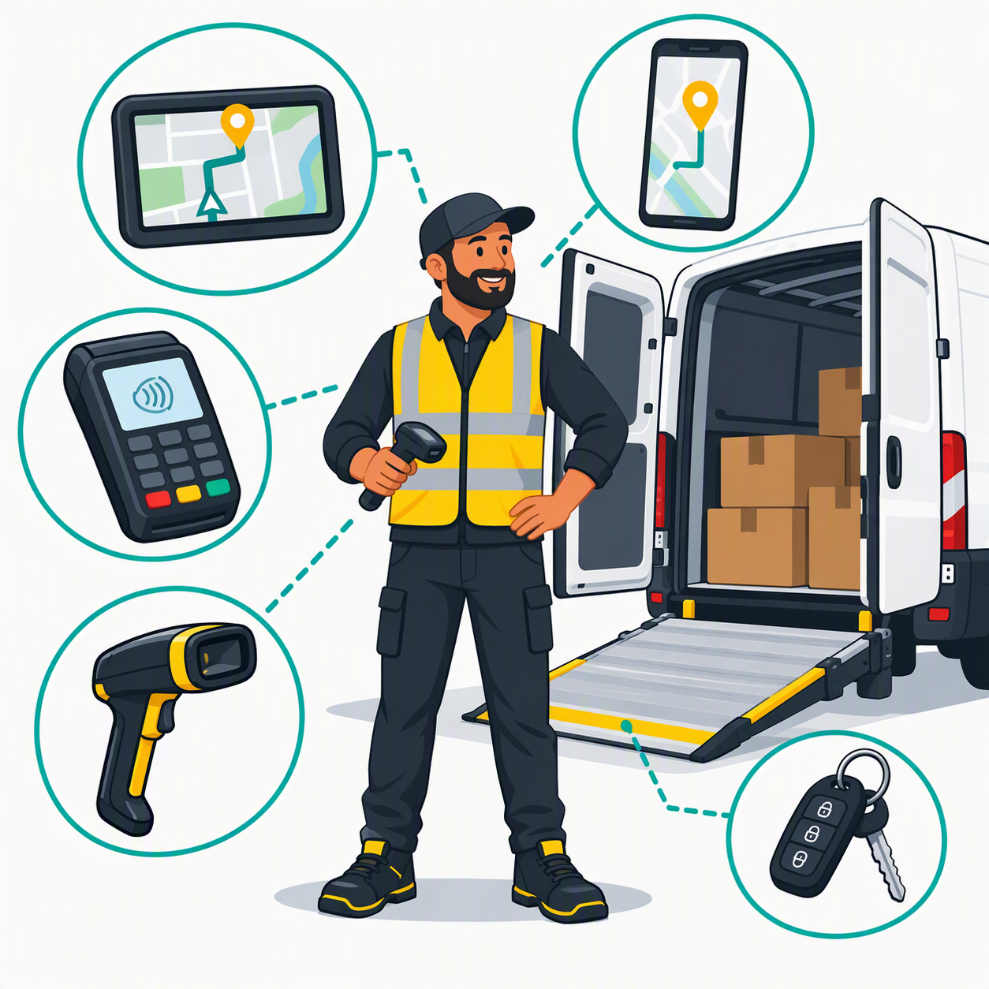
V11
The driver's kit
Insert image V11 (see Visual Prompts doc)
CARS 101
The kit
Satnav, phone, card reader, scanner, tail-lift, forklift.
13
Notes:
Without kit, a driver can only talk about delivering. With kit, they can actually do things: navigate, call, take payment, lift a pallet.
Plant the seed: not every driver knows how to operate every piece of kit (forklift, tail-lift). We'll come back to that.

Slide 14
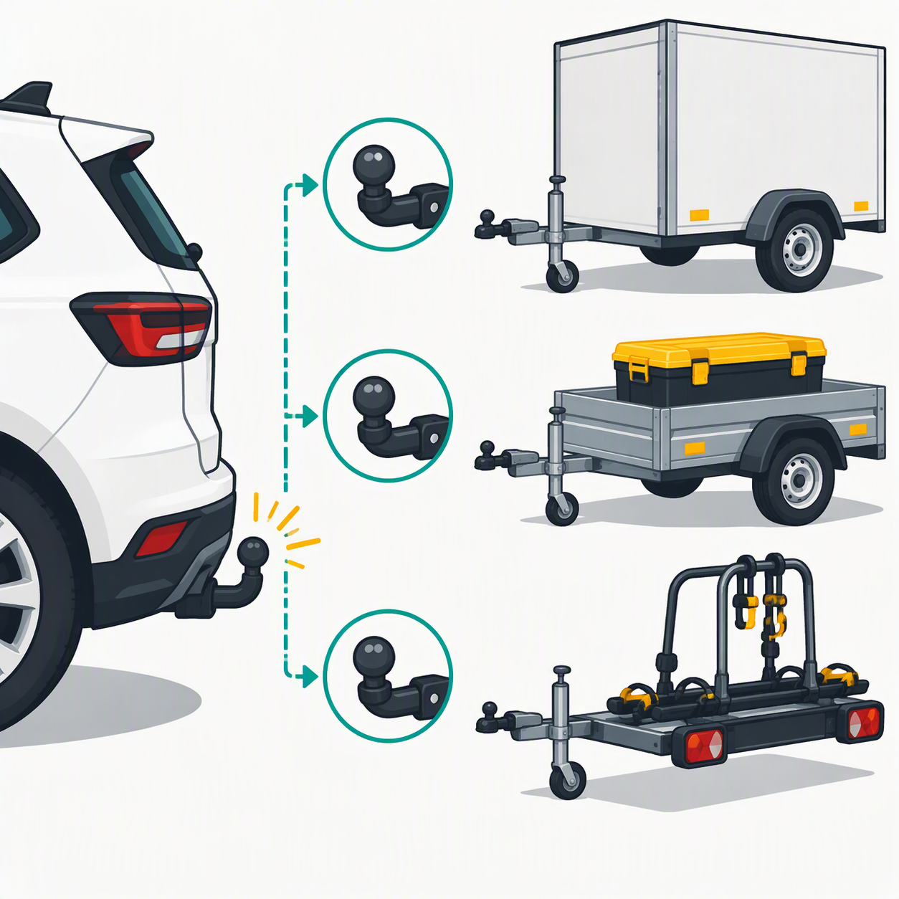
V12
Standard tow bar
Insert image V12 (see Visual Prompts doc)
CARS 101
The standard tow bar
One standard fitting. Any compatible trailer clips on.
14
Notes:
Because the fitting is standard, you don't need a custom car for every trailer.
Build the trailer once, use it on any car.

Slide 15
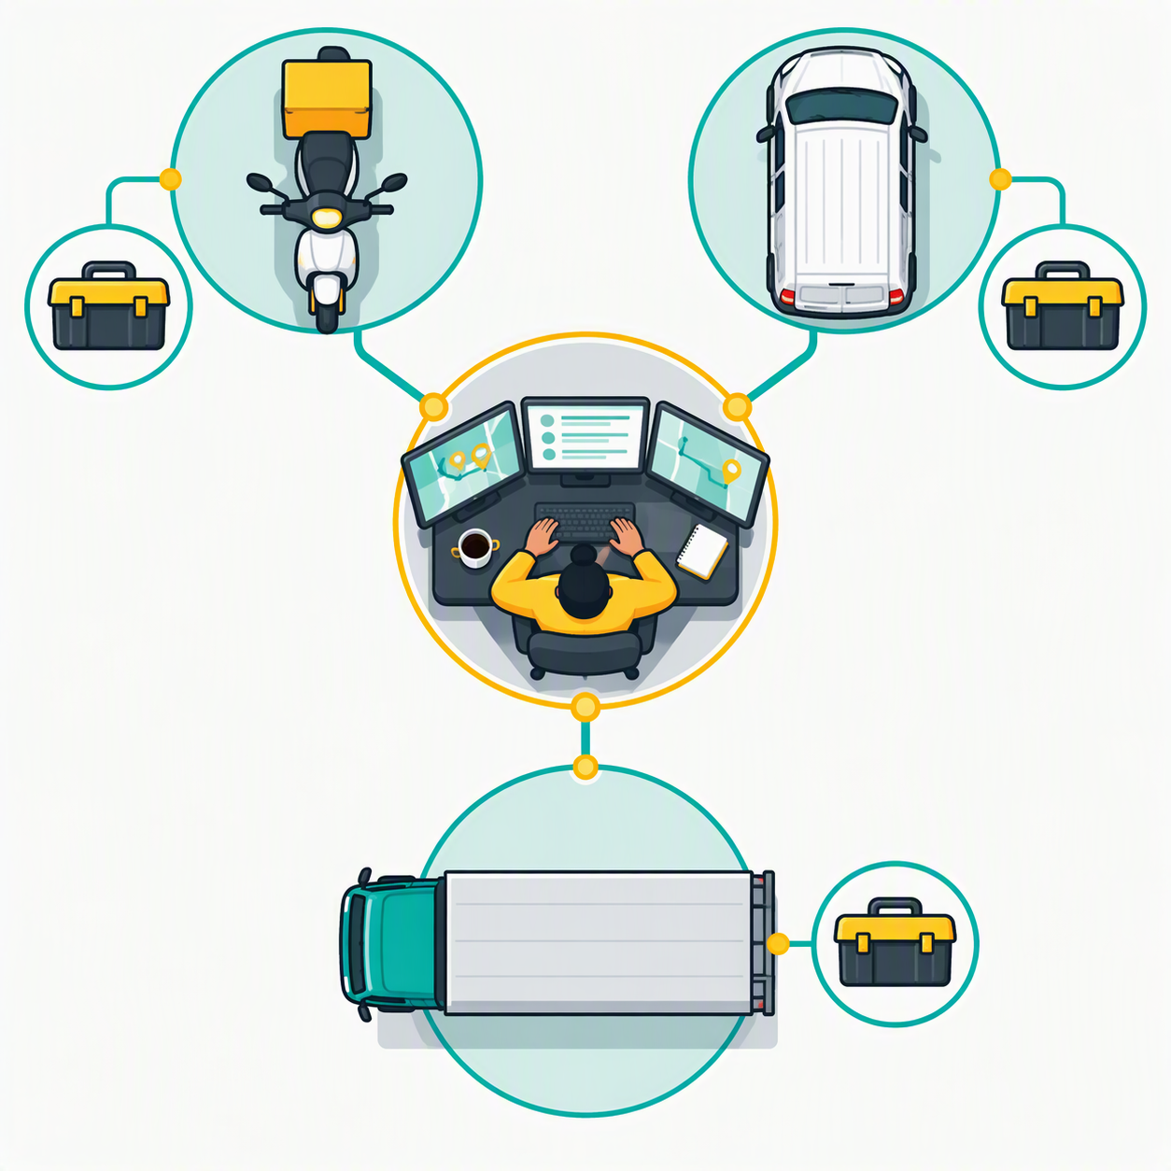
V13
The logistics firm
Insert image V13 (see Visual Prompts doc)
CARS 101
The logistics firm
A dispatcher hands jobs to specialist drivers, each with their own vehicle and kit.
15
Notes:
Scale up: one dispatcher, many specialists.
The dispatcher doesn't drive. They decide who's best for each job.

Slide 16
Plot twist
This was never a talk about cars.
16
Notes:
Pause. Let it land.
'Let's go through those slides again. But first, how did the engine get invented?'

Slide 17
Before: one shell at a time
How AI predicted the next word before 2017
Video: Moana, picking up shells (from 1:21)
If the embed doesn't load: Insert › Video › Online Video
https://www.youtube.com/watch?v=akN6KwOaXU4&t=81
17
Notes:
Max 90 seconds across this slide and the next.
- Play 15 to 20 seconds of the clip (starts at 1:21), then stop.
- Line: 'Older models worked like this. They looked at the last word, or the last few, and picked the next one. Following the trail one shell at a time, and anything further back faded.'
- Technically fair: the earliest models literally looked only at the last few words; later ones read word by word and lost the early words over long passages. The shell trail fits both.
Practical:
- If the video starts at 0:00 instead of 1:21, use the backup browser tab cued at 1:21: https://www.youtube.com/watch?v=akN6KwOaXU4&t=81
- Needs internet. In Teams, share with 'Include sound' on or remote attendees won't hear it.
- If the embed shows a blank box, delete it and use Insert > Video > Online Video with the watch link above.

Slide 18
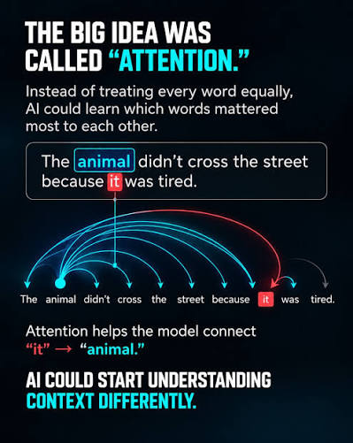
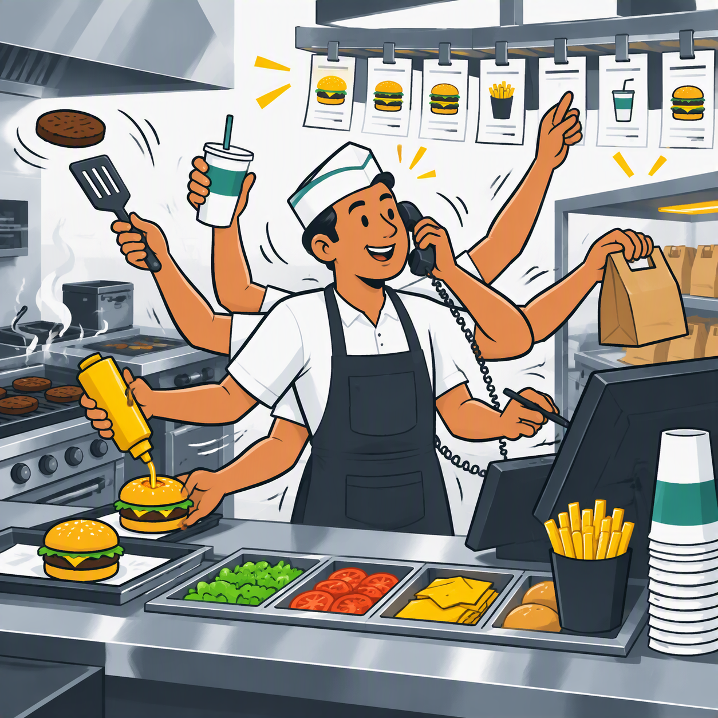
The engine
The transformer
2017: Attention Is All You Need (Google)
Looks at every word at once
Learns which words matter to each other
V36
SpongeBob GIF
insert here
18
Notes:
After the shells: 'In 2017 Google researchers published Attention Is All You Need. Instead of one shell at a time, the model looks at the whole beach at once.'
- Point at the example: 'The animal didn't cross the street because it was tired.' Attention connects 'it' to 'animal'. That's the model understanding context.
- SpongeBob for the laugh: 'Now it pays attention to everything at once.'
- Careful: SpongeBob looks like doing many tasks at once. Attention is weighing many words at once. Let the diagram do the explaining; SpongeBob is the joke.
- Link: that's why what you put in front of it changes the answer so much. Context is king.
- Every big AI product runs on this same engine idea.
GIF: pick a specific SpongeBob GIF from Tenor (not the search page) and insert as a picture into the small box; animated GIFs play in slideshow. Check EQ comms guidance on TV characters.

Slide 19
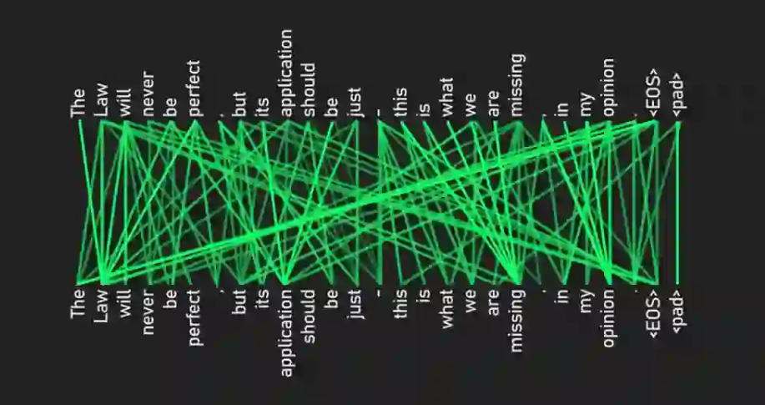

Slide 20
V03
The car
Insert image V03 (see Visual Prompts doc)
The car
The harness (the app)
M365 Copilot, ChatGPT, Elissa, Claude Code
Decides what the AI can see, use and remember
Car and driver don't always match
19
Notes:
The harness is the app you use to talk to AI.
M365 Copilot = company fleet car: built for Microsoft roads (your emails, files, Teams). Microsoft now offers drivers from both schools (GPT and Claude) in some features, depending on EQ's admin settings.
Claude Code = off-road expedition vehicle from the same school as its driver: surveys the terrain first, uses its kit freely, makes agentic decisions. One line only; this audience won't use it.
CAR AND DRIVER DON'T ALWAYS MATCH:
'Sometimes car and driver don't match. Put an HGV driver in a van with no tail-lift and his skills go unused. That's what I saw when Claude first arrived in preview inside other companies' apps: its agentic abilities weren't fully used. Or the car has kit the driver was never trained on, like a forklift. Same driver, different car, different results.'
(Keep this to own experience; don't name specific product limits, they change quickly.)
Tip: use the car that already sits on your data. Copilot in Excel for spreadsheets, Outlook/Teams Copilot for threads. Copy-paste loses context.
'Copilot is worse than ChatGPT' often compares cars, not drivers.

Slide 21
V04
The driver
Insert image V04 (see Visual Prompts doc)
The driver
The model
GPT, Claude, Gemini
Arrives already trained, with habits built in
e.g. thinking before answering (chain of thought)
20
Notes:
The published model already has some habits drilled in, like reasoning step by step before answering.
Same model in a different app behaves differently, because the car is different.

Slide 22
V05
Driving schools
Insert image V05 (see Visual Prompts doc)
Driving schools
AI labs
OpenAI, Anthropic, Google
Different training, different habits
Every school trains every kind of driver
21
Notes:
Anthropic trains Claude against a written set of principles: tends to be more careful and nuanced, strong on long documents and natural writing.
OpenAI's GPT: the all-rounder, quick, versatile, strong on voice and images.
Neither is best at everything. Latest releases came out days apart and each claims wins on different tasks.
Check current model names on the day.

Slide 23
V06
Three kinds of driver
Insert image V06 (see Visual Prompts doc)
Three kinds of driver
Model sizes
Moped rider = Haiku / GPT mini class
Racing driver = Sonnet / standard GPT
Long-haul = Opus / GPT Thinking & Pro class
22
Notes:
Haiku / mini: classifying, extracting, high-volume repeat jobs. Cheap and fast.
Sonnet / standard GPT: fast and precise on well-understood tasks. The everyday default.
Opus / GPT Thinking-Pro: complex, multi-step, ambiguous work. Slower, more expensive.
Caveat: 'racing driver' is not 'best driver'. Sonnet is the all-rounder most people use daily.
Match the driver to the journey.

Slide 24
V07
Directions
Insert image V07 (see Visual Prompts doc)
Directions
The prompt
Vague in, average out
Say what, why, for whom, in what format
23
Notes:
A prompt is directions. If the model has to guess, it gives you the average answer.
The full detail comes in the practical part later.

Slide 25
V08
What the driver can see
Insert image V08 (see Visual Prompts doc)
What the driver can see
Context
Everything in front of the model right now
Your message, files, chat history
Not in context = a guess
24
Notes:
Context is king. Link back to attention: it weighs everything it can see, like 'it' and 'animal'.
The model has no idea about EQ, your supplier or your deadline unless it's in front of it.

Slide 26
V09
Map book in the glovebox
Insert image V09 (see Visual Prompts doc)
The map book
Knowledge
Files and sites loaded in advance
EQ policies, SharePoint, reference docs
Still context, just pre-packed
25
Notes:
Knowledge = context someone prepared for the agent in advance, so you don't have to paste it every time.

Slide 27
V10
Job brief from head office
Insert image V10 (see Visual Prompts doc)
The job brief
System prompt (instructions)
Researcher and Analyst = the same driver on a different brief
Specialised instructions, slightly different kit
Not a different brain
26
Notes:
Every agent starts with a system prompt: the job description you never see.
Researcher and Analyst in Copilot are mostly specialised instructions on the same engine, with some extra kit (web search, code execution).
Takes the mystery out of 'agents'.

Slide 28
V11
The driver's kit
Insert image V11 (see Visual Prompts doc)
The kit
Tools
The model asks to 'call this function with these inputs'
Search, read a file, run code, send an email
From talking to acting
27
Notes:
Developers taught models to say 'call this function with these details' instead of only producing text. The app then runs the function and hands back the result.
That's the moment AI went from talking to acting.
Callback: not every driver can use every tool well. That's the car/driver mismatch from the harness slide.

Slide 29
V12
Standard tow bar
Insert image V12 (see Visual Prompts doc)
The standard tow bar
MCP
Model Context Protocol
A standard way to package groups of tools
Build once, plug into any compatible AI app
28
Notes:
MCP = a box of tools with a standard fitting. E.g. a 'Workday' toolbox or a 'SharePoint' toolbox any agent can pick up.

Slide 30
The logistics firm
Multi-agent systems
An orchestrator agent delegates to specialist agents
Each specialist has its own toolboxes (MCP)
Specialisation creates complex architecture
29
Notes:
One level higher: an agent that calls other agents, each with their own tools.
This is how we build complex systems. Next: two examples we built.

Slide 31
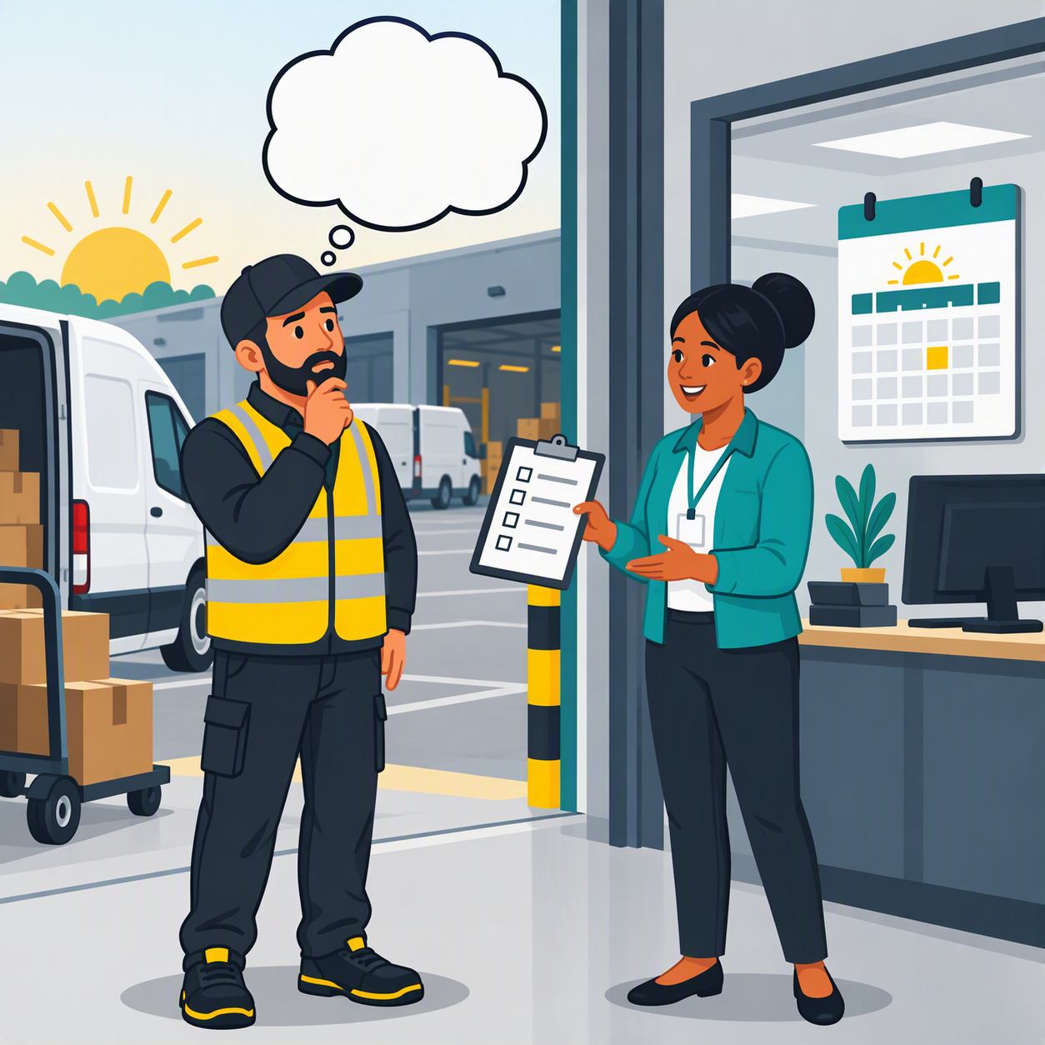
Where the analogy breaks
V14
Every journey starts with amnesia
Insert image V14 (see Visual Prompts doc)
A real driver learns your routes over time
An AI driver starts every journey with amnesia
It only knows what the car hands it each time
30
Notes:
Say this out loud; it makes the rest of the analogy more credible.
The model doesn't learn from your chat. Memory features are the car handing it notes.
That's why you must give context every time.

Slide 32
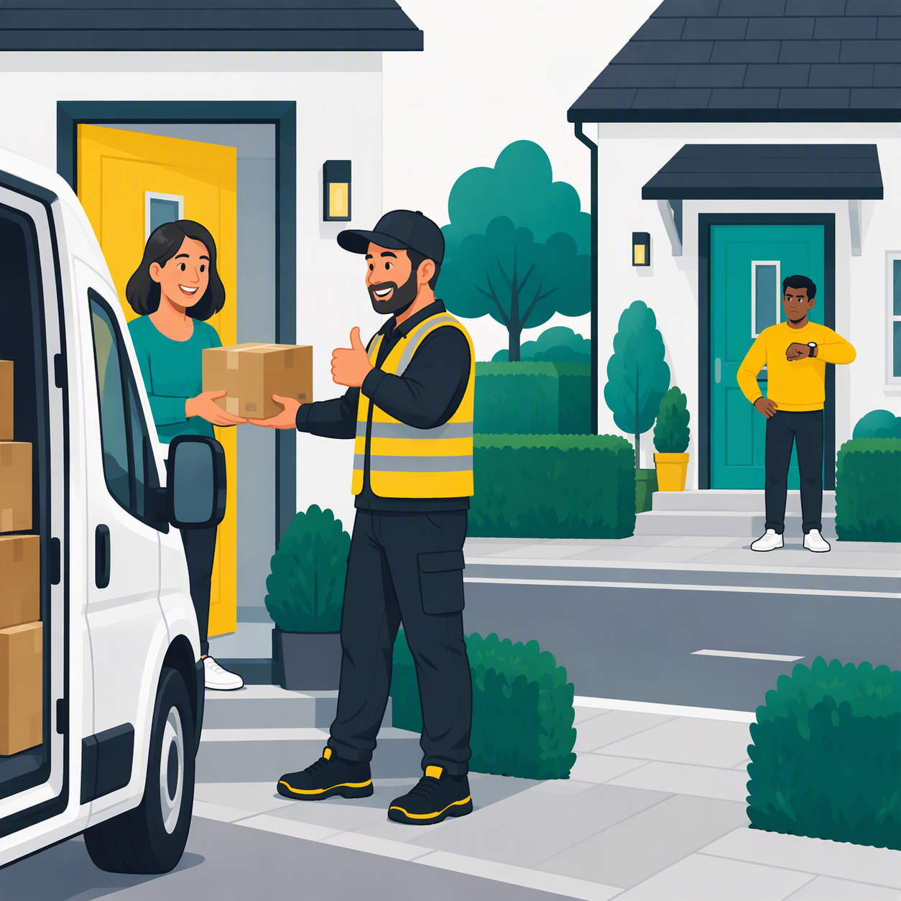
Hallucination
V15
Confident wrong delivery
Insert image V15 (see Visual Prompts doc)
Confident delivery to the wrong address
Happens to every driver
Cause: missing context + preferring to answer over admitting doubt
31
Notes:
Predicts the next word; doesn't look facts up.
Defences (detail later): give the source, ask it to cite, ask what it isn't sure about.

Slide 33
How hard should the driver think?
Same journey, different drivers, different effort
32
Notes:
Most AI tools now let you (or the app) set reasoning effort: low, medium, high. Same for OpenAI and Anthropic models.

Slide 34
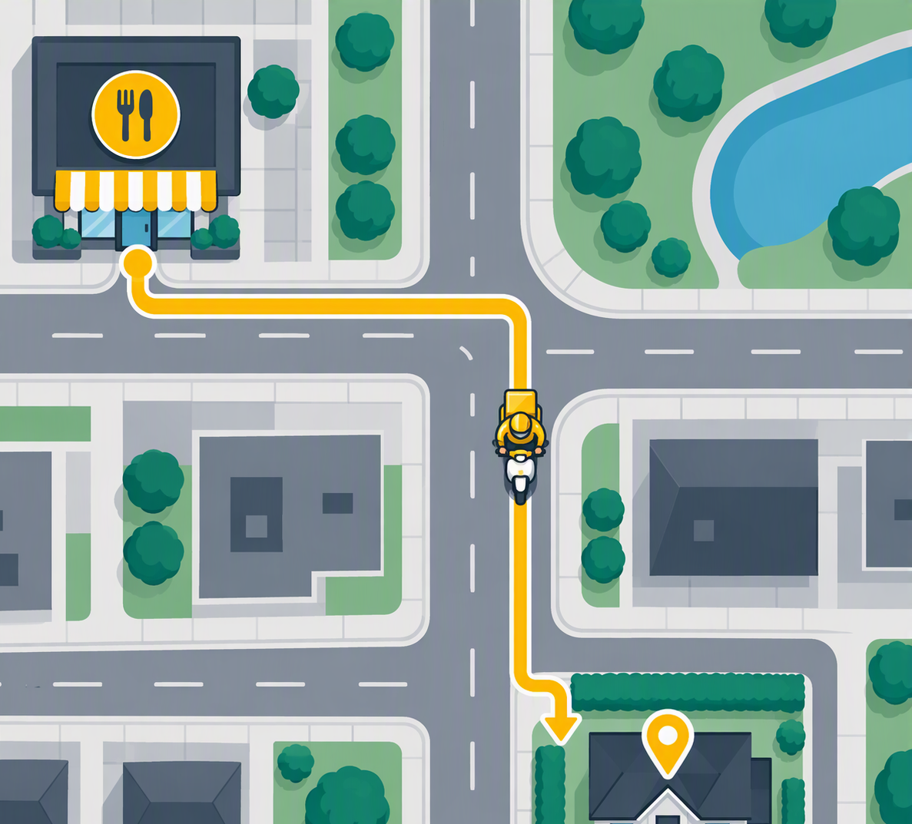
Moped: short and repeatable
V16
Route: moped delivery
Insert image V16 (see Visual Prompts doc)
Short known route, done fast and cheap
Haiku / GPT mini class
33
Notes:
Perfect for repeat, simple jobs. Wasteful to send a lorry here.

Slide 35
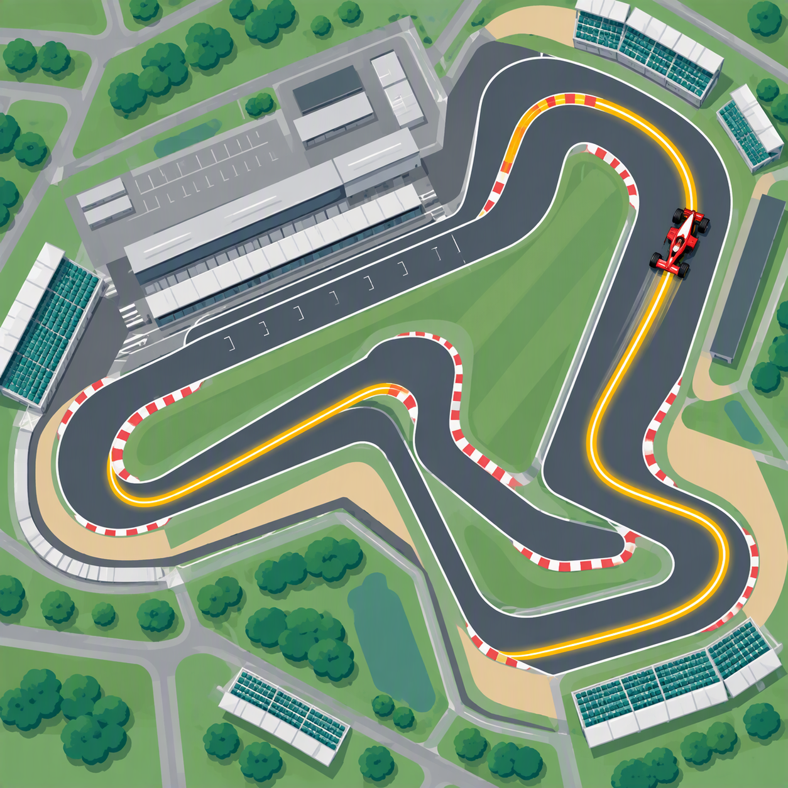
Racing driver: fast on a known track
V17
Route: F1 racing driver
Insert image V17 (see Visual Prompts doc)
Very quick on well-understood tasks
Sonnet / standard GPT
34
Notes:
Superb when the track is well known: well-defined tasks the model has seen a lot of.

Slide 36
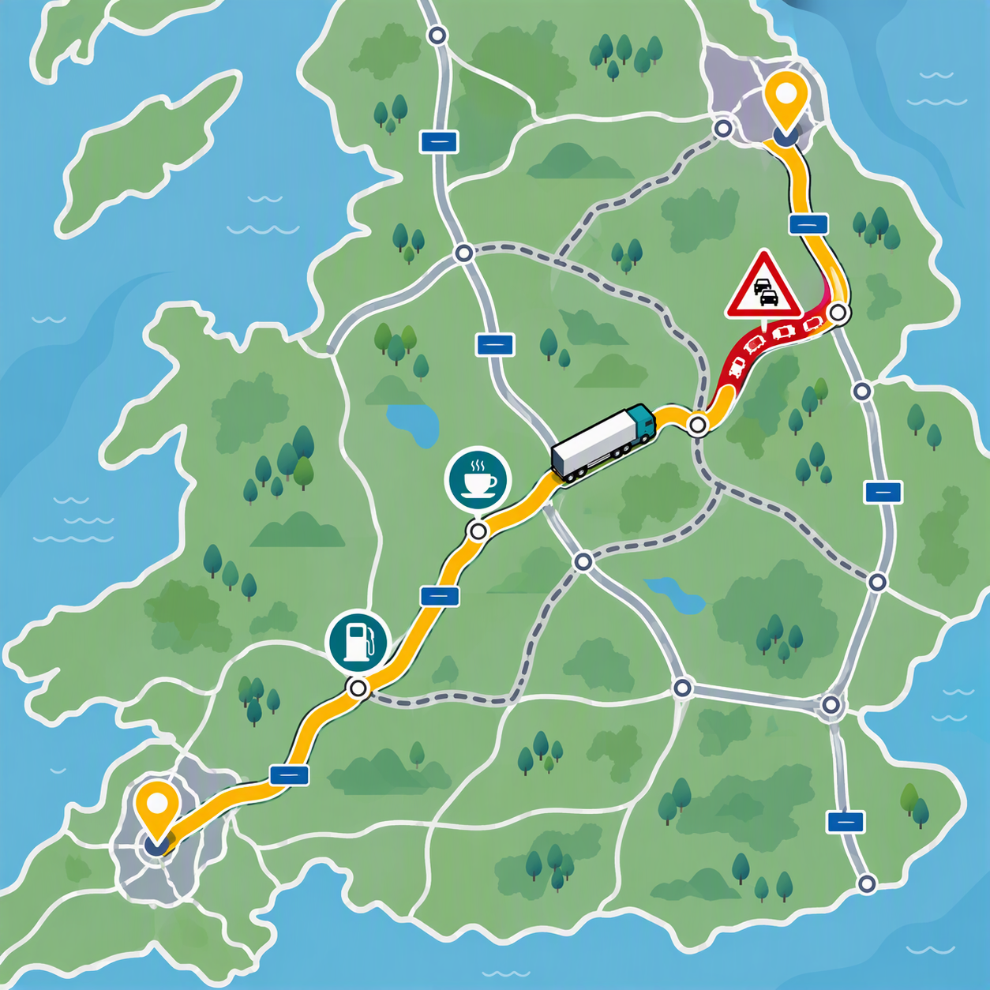
Long haul: plans the route
V18
Route: long-haul HGV
Insert image V18 (see Visual Prompts doc)
Considers options, avoids traffic
Slower, costs more fuel
Opus / GPT Thinking & Pro class
35
Notes:
For long, complex, ambiguous journeys. Worth the time when the route is genuinely hard.

Slide 37
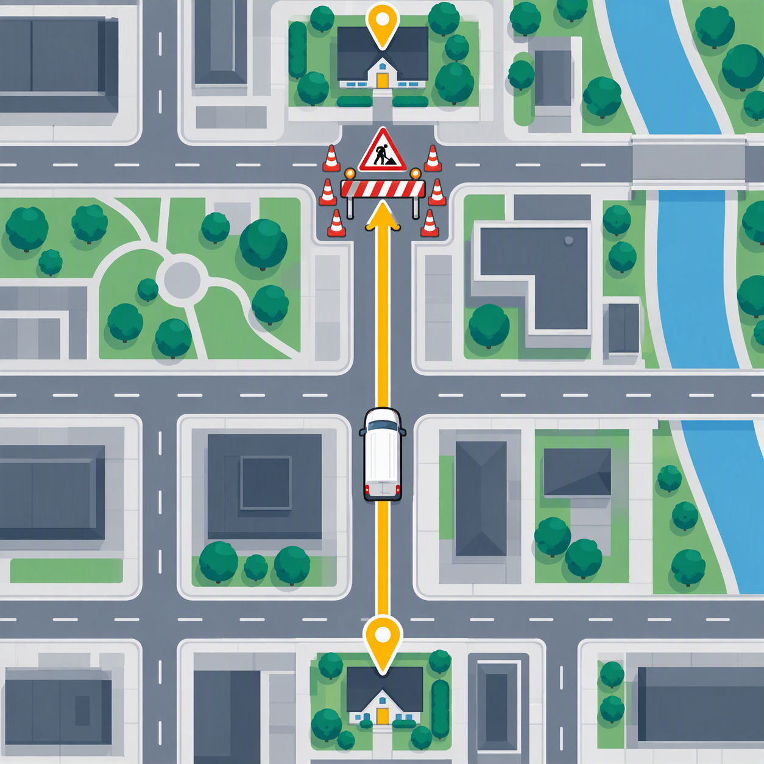
Low effort
V19
Same journey: low effort
Insert image V19 (see Visual Prompts doc)
Takes the obvious road
No alternatives, no edge cases
Hits the roadworks
36
Notes:
Path of least resistance. Fine on a route you know; misses hazards.

Slide 38
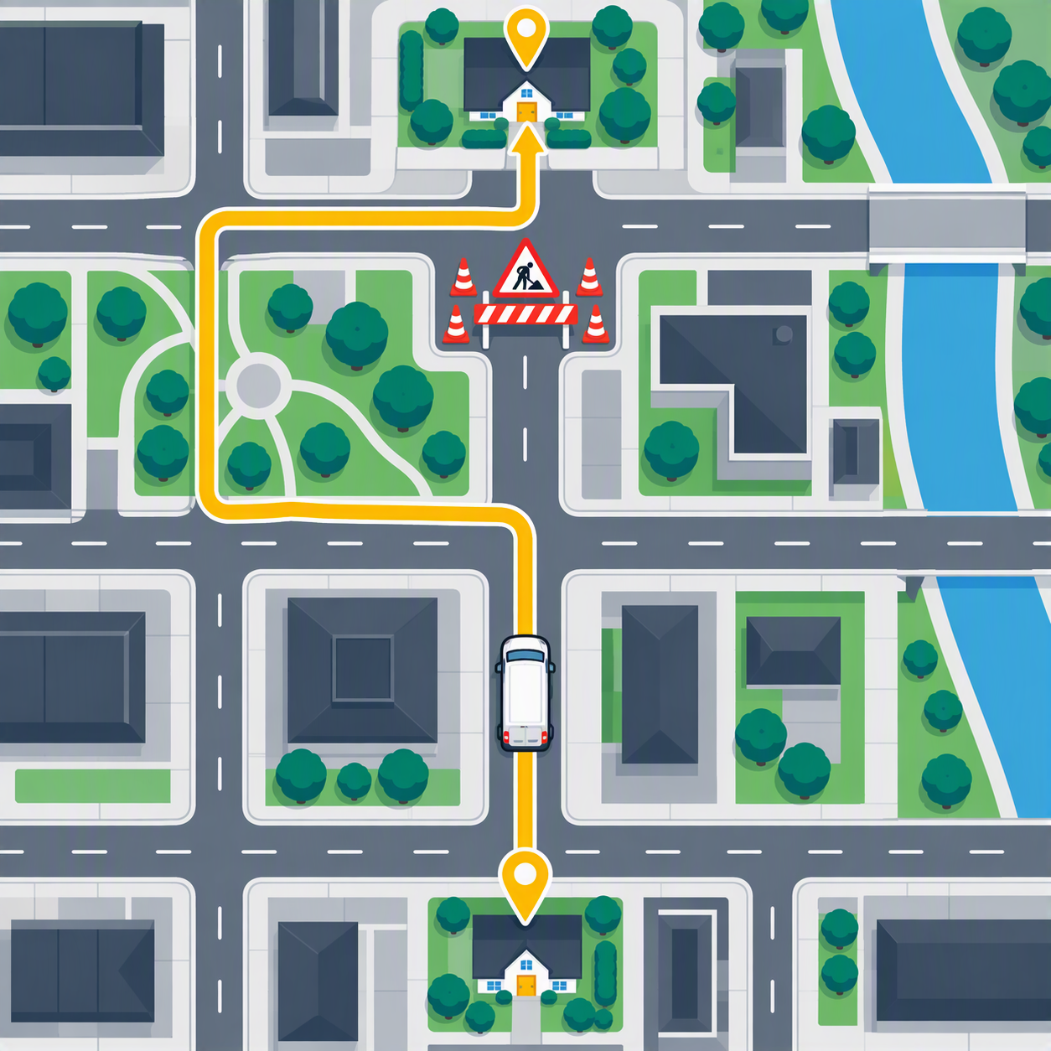
Medium effort (default)
V21
Same journey: medium effort
Insert image V21 (see Visual Prompts doc)
Checks the map once
Picks a sensible route
Right for most jobs
37
Notes:
From an Anthropic workshop: the default is often the best balance.

Slide 39
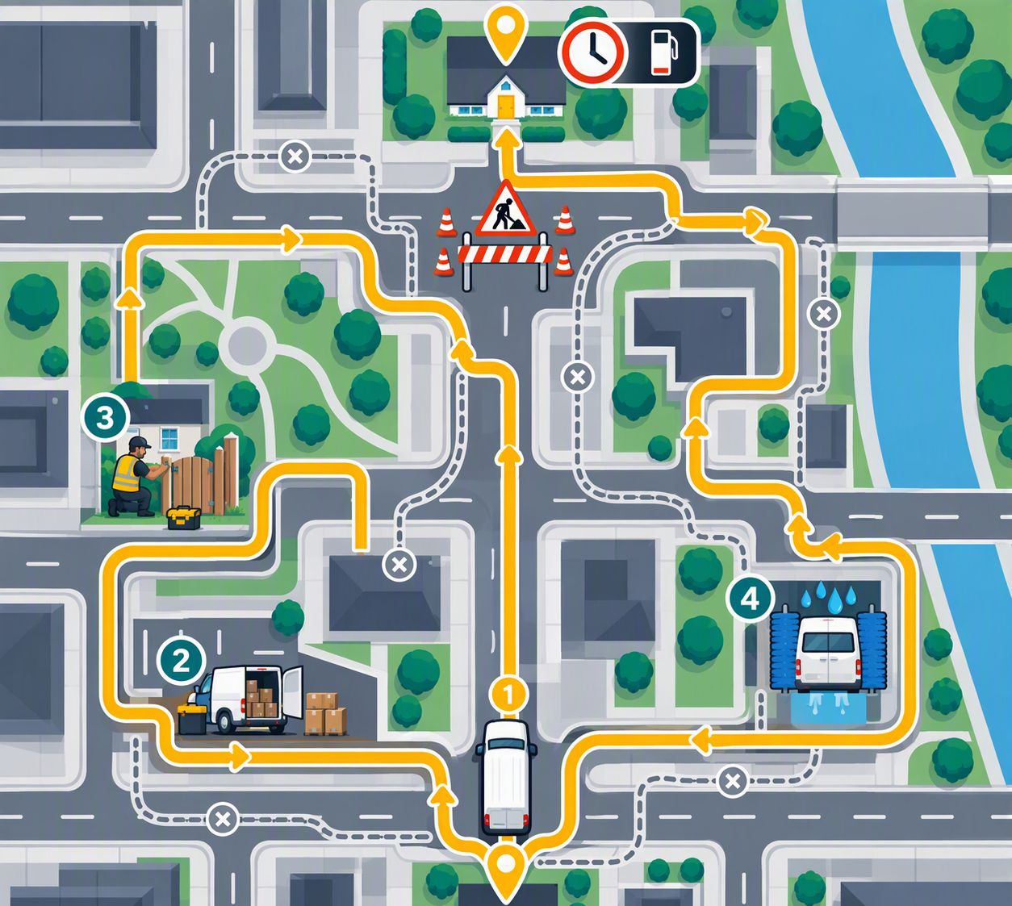
High effort
V20
Same journey: high effort
Insert image V20 (see Visual Prompts doc)
Considers five routes, backtracks when in doubt
Fixes the customer's gate on the way
More fuel, more time. Better only if there was a real hazard
38
Notes:
Anthropic workshop point: high effort can be worse than medium. It's over-thorough: tries many things, finds problems that aren't the task, touches things it wasn't asked to.
Thoroughness becomes scope creep.
Takeaway: match effort to the journey, and say clearly what's out of scope.

Slide 40
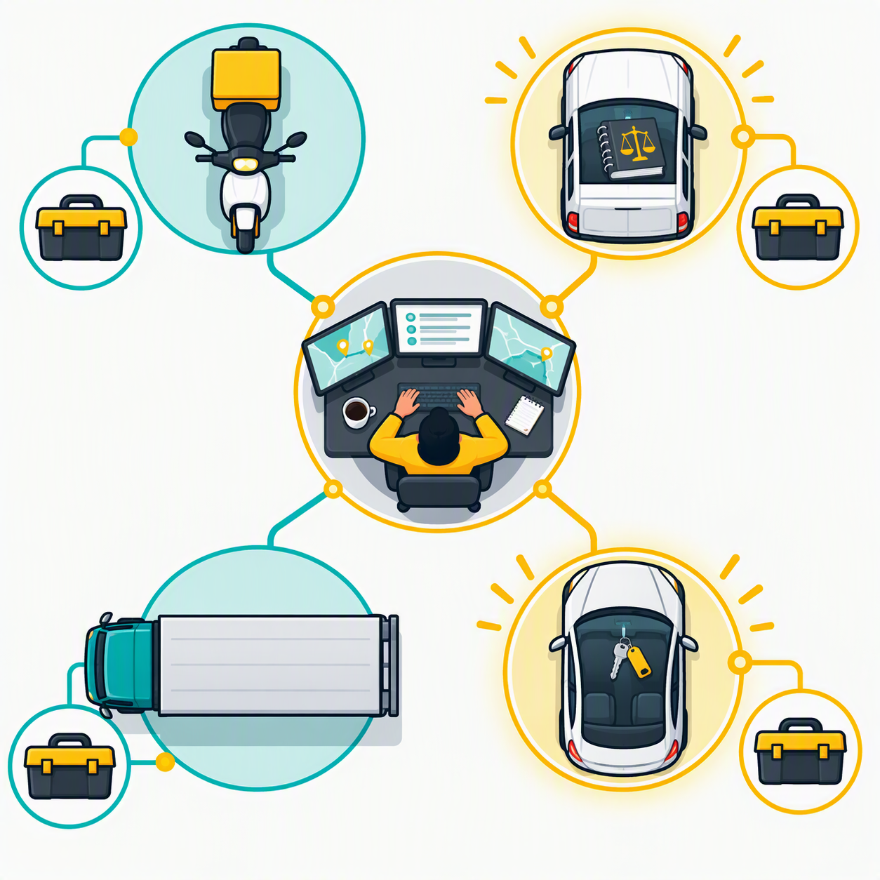
Two vehicles we built
V22
Fleet with our vehicles
Insert image V22 (see Visual Prompts doc)
ProcureAI: purpose-built for one route
Elissa: EQ's own fleet car, your keys
39
Notes:
Bridge into live demos. Point at the diagram: these are the same parts you just learned.

Slide 41
LIVE DEMO
ProcureAI
Speaker points in notes
40
Notes:
2 minutes. Pre-run output ready in a tab.
- Show one request where it applies the rules and routes or refuses (e.g. Poland gate or P-Card rules).
- Behind the scenes, 2 minutes: policies gathered, decision checks written down, knowledge files prepared, testing.
- Key line: the engine was the easy part. Writing the rulebook and the map was the work.
- Point back: brief (instructions) + map book (knowledge) + kit (tools).

Slide 42
LIVE DEMO
Same driver, different brief
Copilot Chat vs Researcher
Speaker points in notes
41
Notes:
Pre-generated in tabs.
- Same question in plain Copilot Chat, then in Researcher.
- Different behaviour comes from a different brief and kit, not a different brain.
- Optional: Model Council (GPT and Claude side by side), only if enabled in EQ's tenant (admin must allow Anthropic models; Frontier access). Agreement = more confidence; disagreement = check yourself.
- Researcher: outward-looking (supplier due diligence, market scans, news).
- Analyst: your own data (normalising bids, weighted scoring, spend breakdowns).

Slide 43
LIVE DEMO
Elissa
The logistics firm in action
Speaker points in notes
42
Notes:
Pre-generated.
- Show the orchestrator routing to a specialist; map it onto the logistics-firm diagram.
- No M365 Copilot licence needed.
- Reads your own emails, files and Teams via Graph; sees only what you can (signs in as you, Entra ID).
- Procurement Contract Agent already plugged in.
- Coming: Workday, Azure DevOps, ServiceNow connections; handbooks and SOPs per business area.
- 'Ask EQ Anything' relaunch: 2 November to 11 December. You'll be early users.

Slide 44
So how does this help you?
Two pillars, one destination
43
Notes:
Switch from understanding to using. Should be around minute 30.

Slide 45
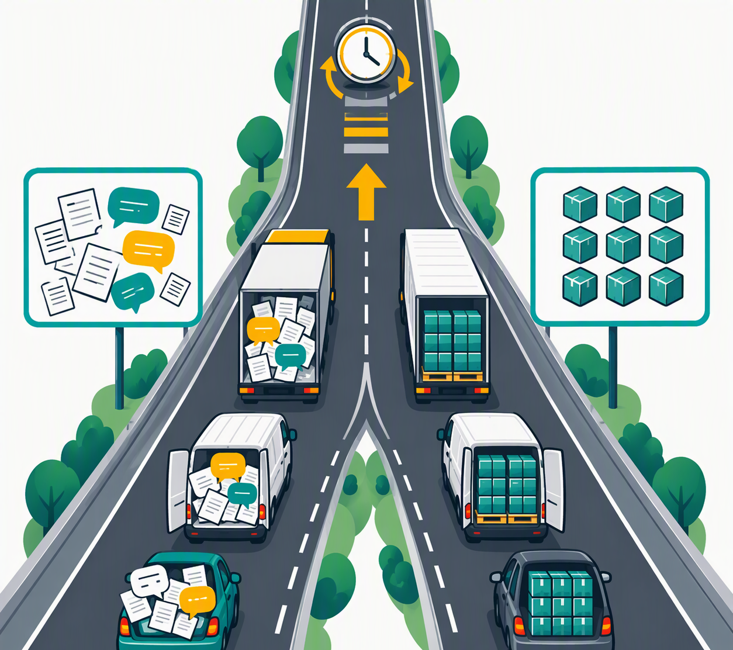
Text and data lead to automation
V23
Two pillars
Insert image V23 (see Visual Prompts doc)
Text: how you talk to AI and judge its answers
Data: how your work actually flows
Both lead to automating the task
44
Notes:
Text = unstructured: flow of ideas, documents, emails.
Data = structured: files, tables, steps of a process.
Both roads merge into automation.

Slide 46
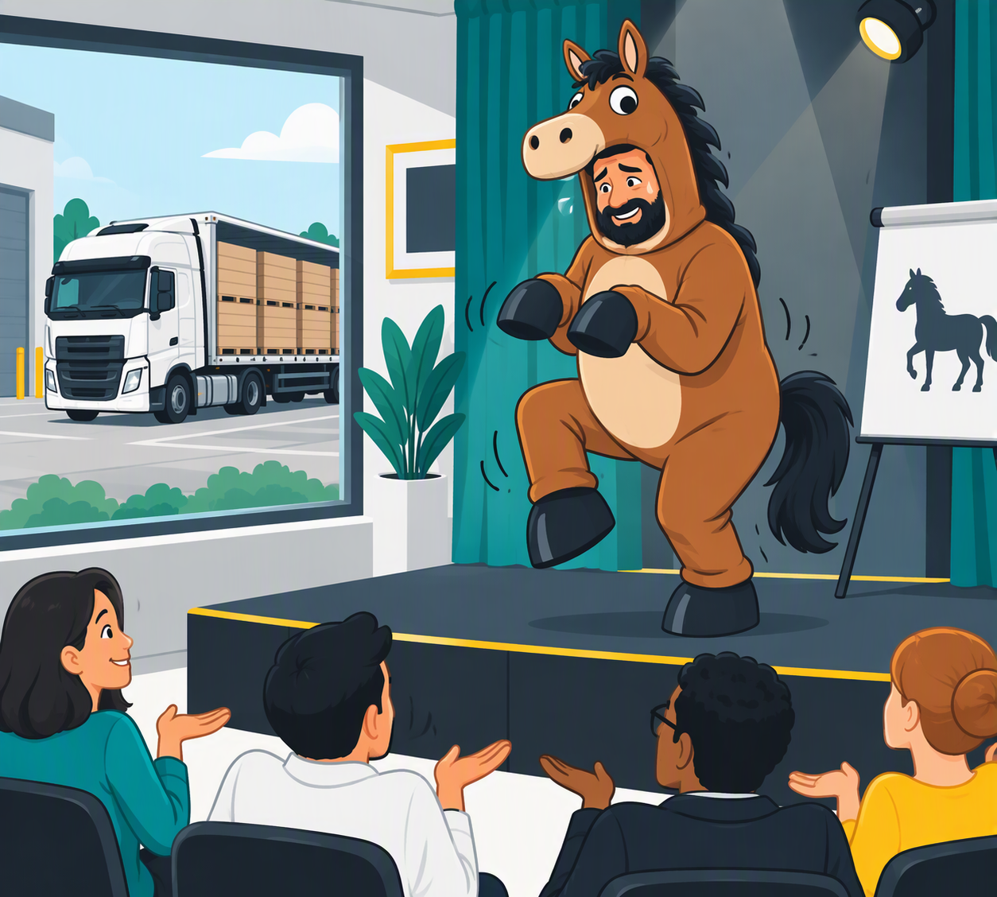
Wrong job, not a bad driver
V24
Wrong job, not a bad driver
Insert image V24 (see Visual Prompts doc)
Asking an AI voice to be a horse, then calling AI stupid
Hire a lorry driver, ask him to dance
The skill is matching the job to the tool
45
Notes:
Reference the recent meme: asking ChatGPT voice to pretend to be a horse.
Misapplied AI, not stupid AI. Judging AI by party tricks is like judging Excel by its drawing skills.

Slide 47
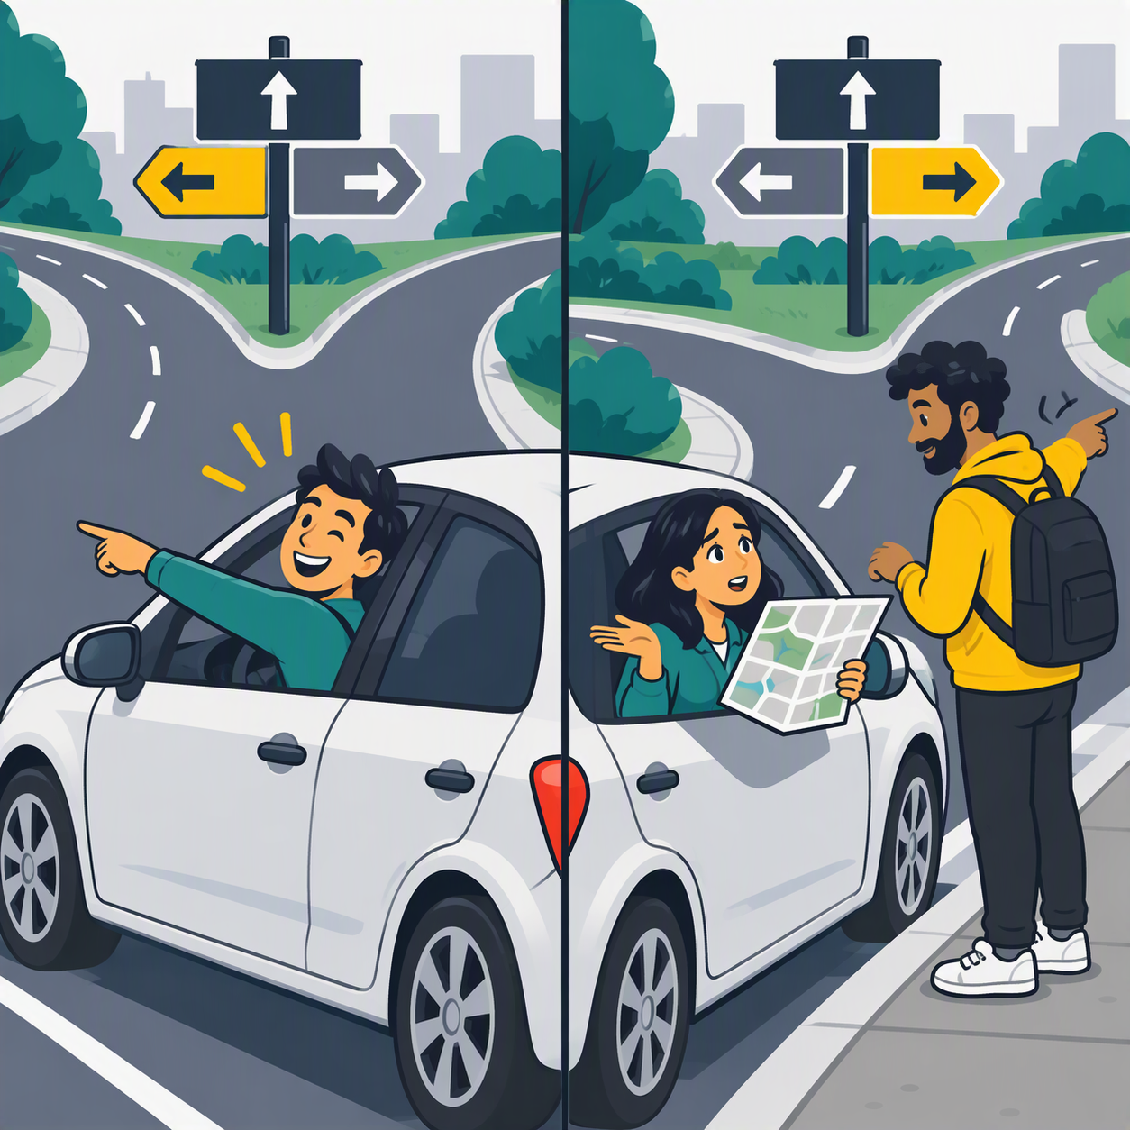
From confidently wrong to honest
V25
Confidently wrong vs asks for directions
Insert image V25 (see Visual Prompts doc)
'Confidently wrong' became a phrase about AI
Newer models are more likely to say when they're unsure
Treat caveats as signals, not padding
46
Notes:
Earlier models failed with total confidence.
Newer models, Anthropic's especially, more often flag uncertainty and add disclaimers.
They still hallucinate: keep checking. Ask any model to rate its confidence.

Slide 48
SIDE BY SIDE
Same question, three levels of context
You be the judge
Speaker points in notes
47
Notes:
Use Vinay's vendor proposal. Outputs pre-run.
1. Question only: 'Which vendor should we pick?'
2. + proposals attached.
3. + weighted criteria, our constraints, output as a table.
Show side by side. Don't mark them; ask the room which is best and why.

Slide 49
TIPS
Talking to AI
Speaker points in notes
48
Notes:
- Ask it to interview you first: 'Before you answer, ask me the 5 questions you need answered.'
- New topic = new chat. Old context leaks.
- Show one example of the output you want.
- Ask for sources and for what it isn't sure about.
- Use voice to talk through a rough idea for 2 minutes, let AI organise it.
- First answer = draft. Two rounds of feedback beat one perfect prompt.
- Match effort to the journey.

Slide 50
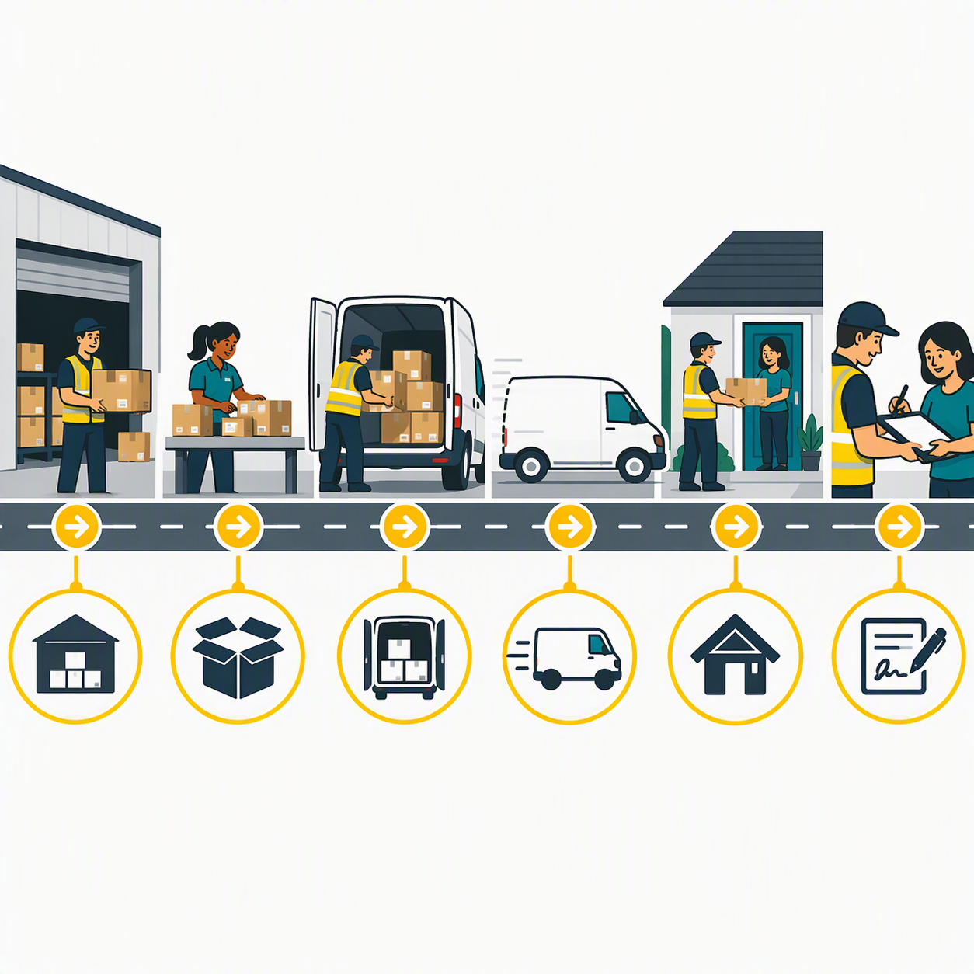
Your workflow is the route
V26
Your workflow is the route
Insert image V26 (see Visual Prompts doc)
AI work isn't a soup of text
It sits inside a task, inside a process
Map the legs before you hand any to AI
49
Notes:
Inputs, steps, decisions, outputs. Once the legs are visible, it's obvious which ones AI can take.
Smaller task = better result. Grow scope as you learn what it can do.

Slide 51
COLLEAGUE EXAMPLE
How Vinay compares vendor proposals
Speaker points in notes
50
Notes:
3 to 4 minutes, Vinay presents.
If he isn't presenting: walk through his Excel files as a process map (inputs, steps, decisions, outputs).
Link back to ProcureAI: process map first, agent second.

Slide 52
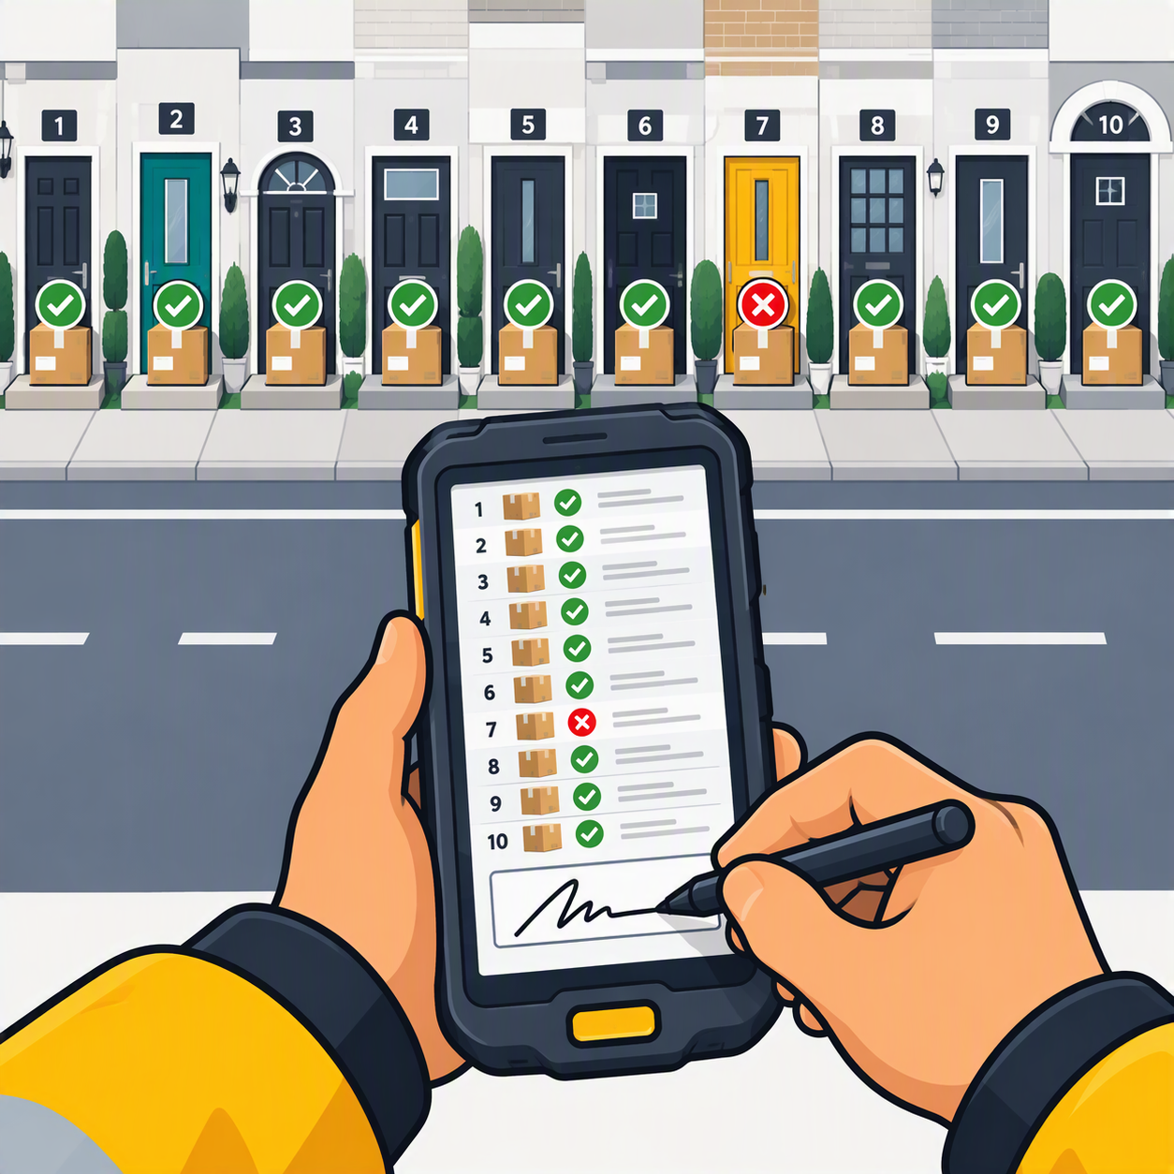
Check until 9 out of 10
V27
Proof of delivery 9/10
Insert image V27 (see Visual Prompts doc)
Verify every delivery until you trust it
Only then make it a regular round
51
Notes:
Verify everything until you can trust it 9 times out of 10. Then automate.
The 1 in 10 is why a human still signs off.

Slide 53
TIPS
Working with data
Speaker points in notes
52
Notes:
- Give it files, not pasted text. Columns and headings keep their meaning.
- Name the columns and the rules: 'Price is ex-VAT, annual; lower is better.'
- Check one row by hand before trusting the whole table.
- Copilot in Excel for spreadsheets; Analyst for heavier analysis.
- Keep a shared note of prompts that work: step one of automation.

Slide 54
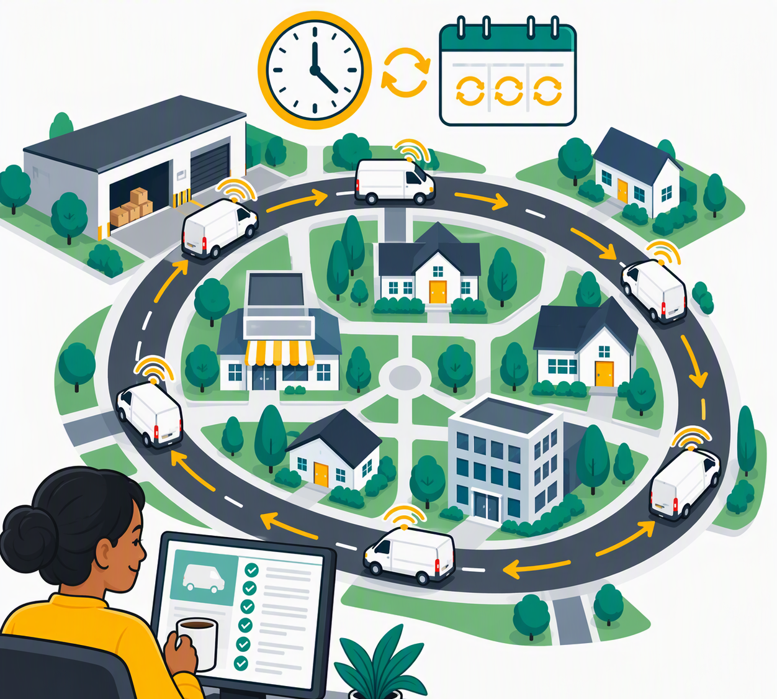
Automation: the scheduled round
V28
The scheduled round
Insert image V28 (see Visual Prompts doc)
Same route, every time, on schedule
You check the report, not every drop
53
Notes:
Once a leg is trusted, it becomes a scheduled round. Start small: one leg, not the whole journey.

Slide 55
Which vehicle do you get into?
Security is about the vehicle, not only the luggage
54
Notes:
Same image-based teaching. Car meaning first, then AI.

Slide 56
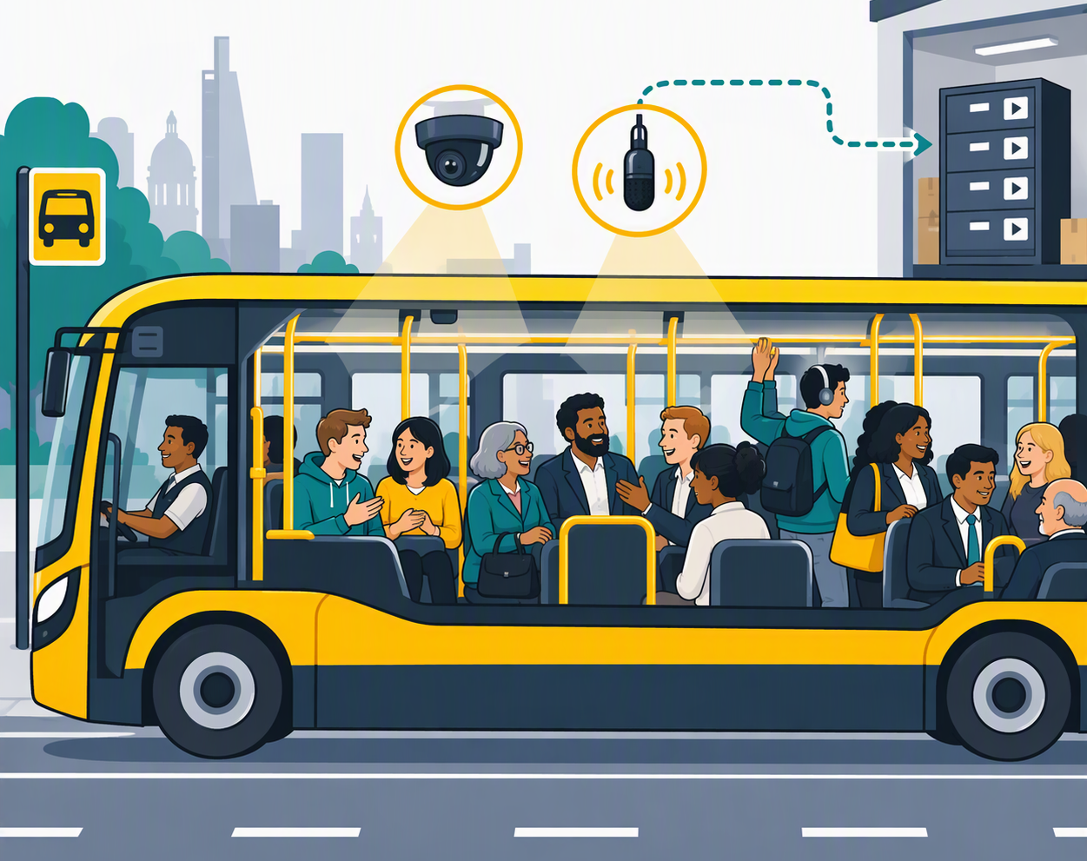
V29
The bus
Insert image V29 (see Visual Prompts doc)
CARS 101
The bus
Public. Everyone hears you. The operator keeps the recordings.
55
Notes:
Explain the vehicle first: public transport, shared, recorded.

Slide 57
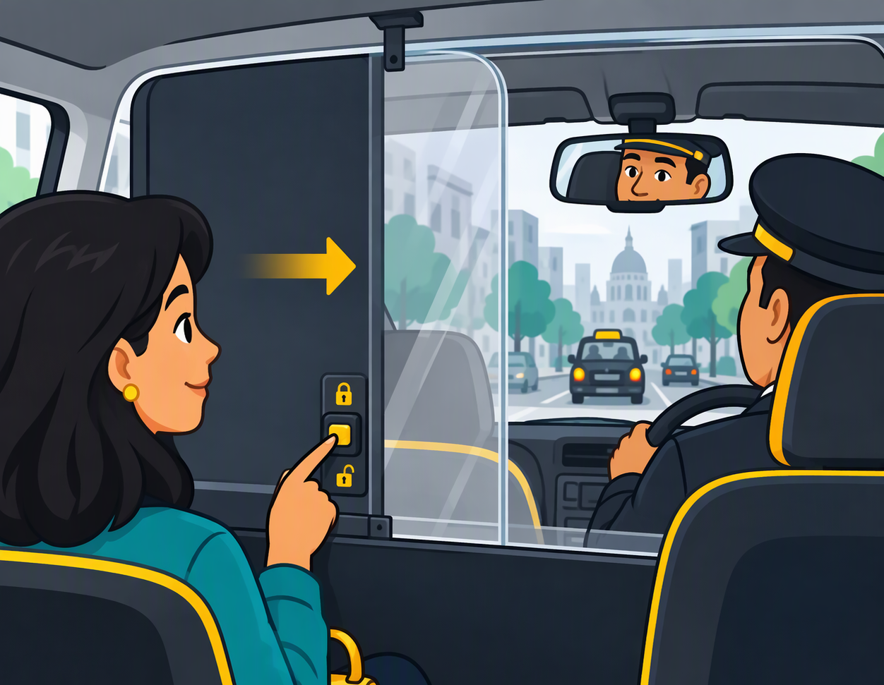
V30
The taxi
Insert image V30 (see Visual Prompts doc)
CARS 101
The taxi
Private ride, but on the taxi firm's terms. Privacy only if you flip the switch.
56
Notes:
A taxi is yours for the journey, but the company sets the rules.

Slide 58
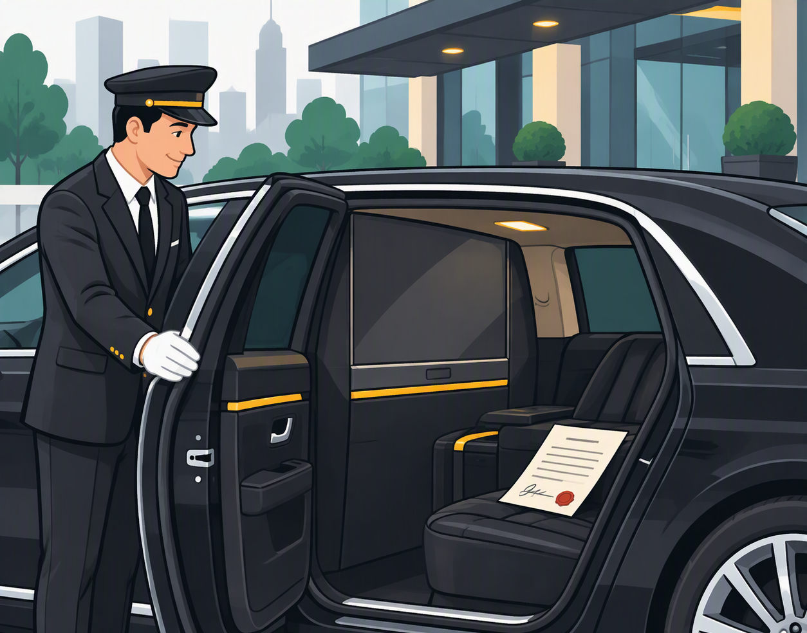
V31
The corporate limousine
Insert image V31 (see Visual Prompts doc)
CARS 101
The corporate limousine
Confidentiality is part of the contract.
57
Notes:
A chauffeur hired by the company, under contract. What happens in the car stays in the car.

Slide 59
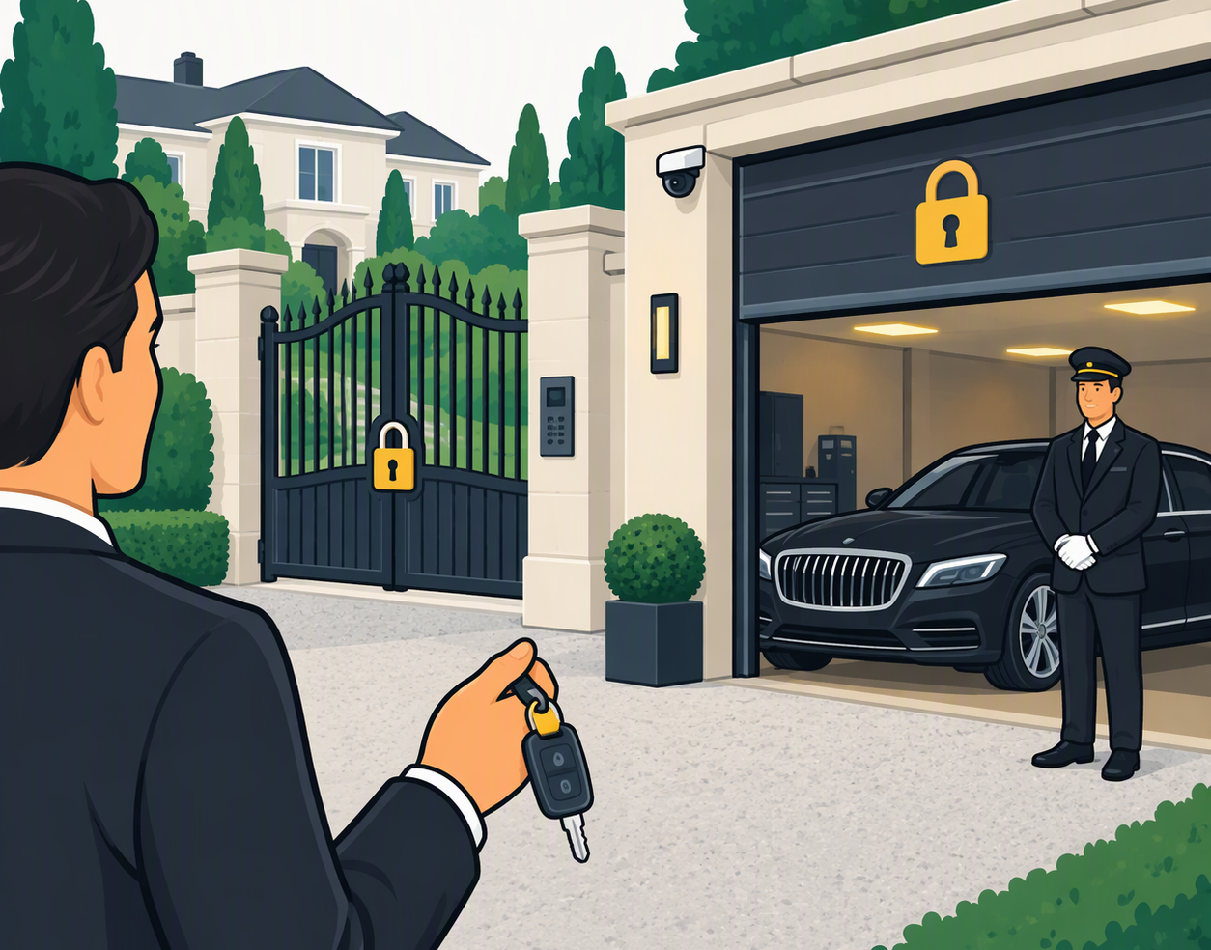
V32
The private driver
Insert image V32 (see Visual Prompts doc)
CARS 101
The private driver
Your car, your garage, your keys. Only as safe as your locks.
58
Notes:
Highest control. But you're responsible for the estate and the garage.

Slide 60
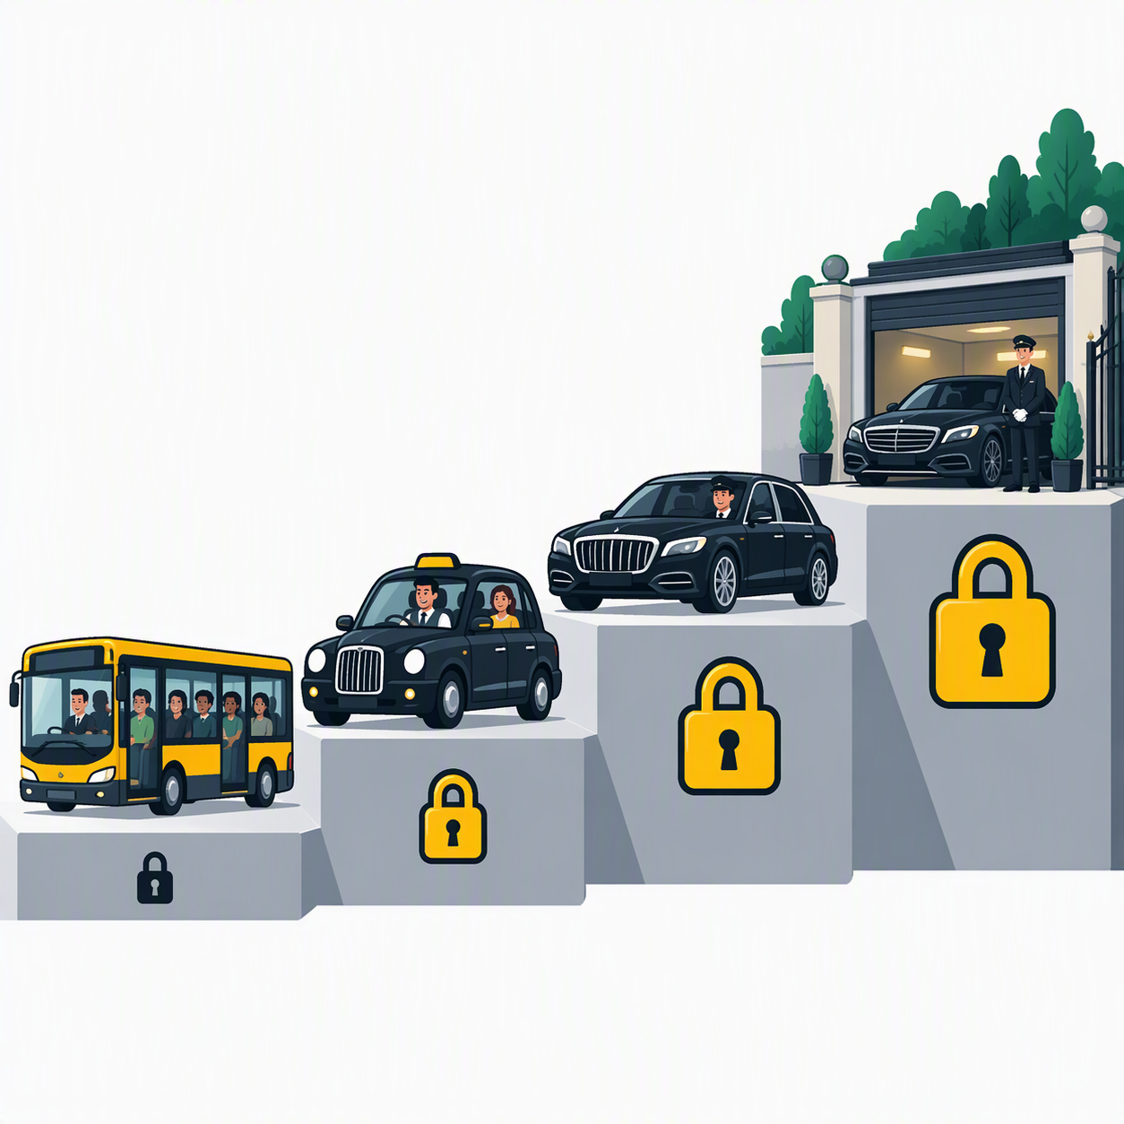
The AI transport ladder
V33
The transport ladder
Insert image V33 (see Visual Prompts doc)
Bus = free ChatGPT and similar
Taxi = personal paid subscriptions
Limo = M365 Copilot, Elissa
Private driver = self-hosted model
59
Notes:
Main message: the choice of vehicle IS the security decision.
Removing PII doesn't make the bus safe: the conversation can be kept and used to train future models. A breach in principle.
Accidentally including PII in licensed M365 Copilot is contained within EQ's boundary and permissions.
For EQ business: never take the bus or a taxi. Use EQ's limo.
Check current vendor terms before the session.

Slide 61
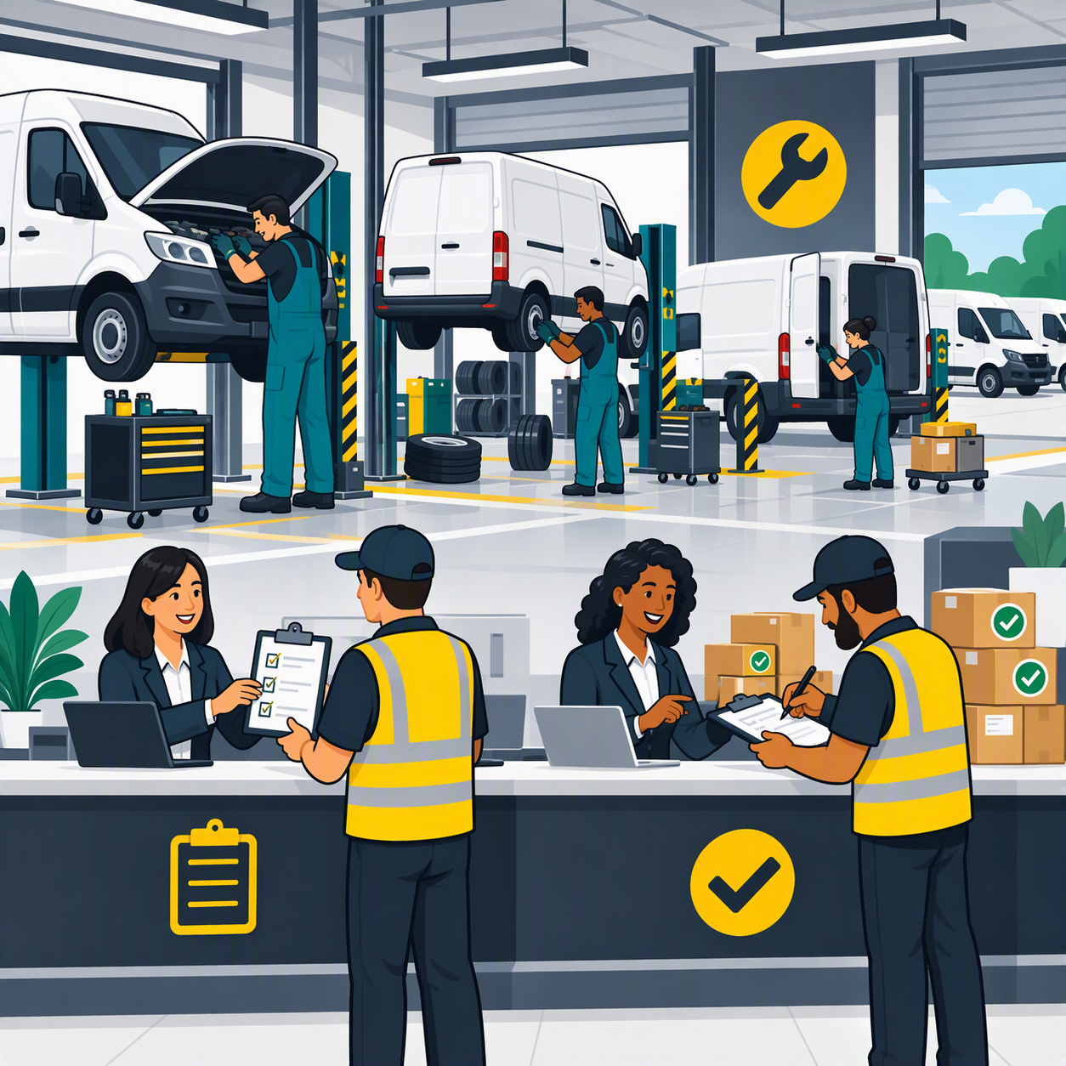
EQ Enterprise AI: fleet operator and garage
V34
Fleet operator and garage
Insert image V34 (see Visual Prompts doc)
We enable building and maintain the vehicles
We step in to build complex workflows and automations
You bring the routes and sign for the deliveries
60
Notes:
You bring the use cases and check whether it works.
Close: 'That's exactly what you do with AI every day, just at a bigger scale.' Ties back to 9 out of 10.

Slide 62

V35
Closing: the open road
Insert image V35 (see Visual Prompts doc)
Questions?
Engine. Car. Driver. Directions.
EQ Enterprise AI
61
Notes:
Collect requests for follow-up sessions.
Mention the Elissa relaunch dates again.

