Slide 1
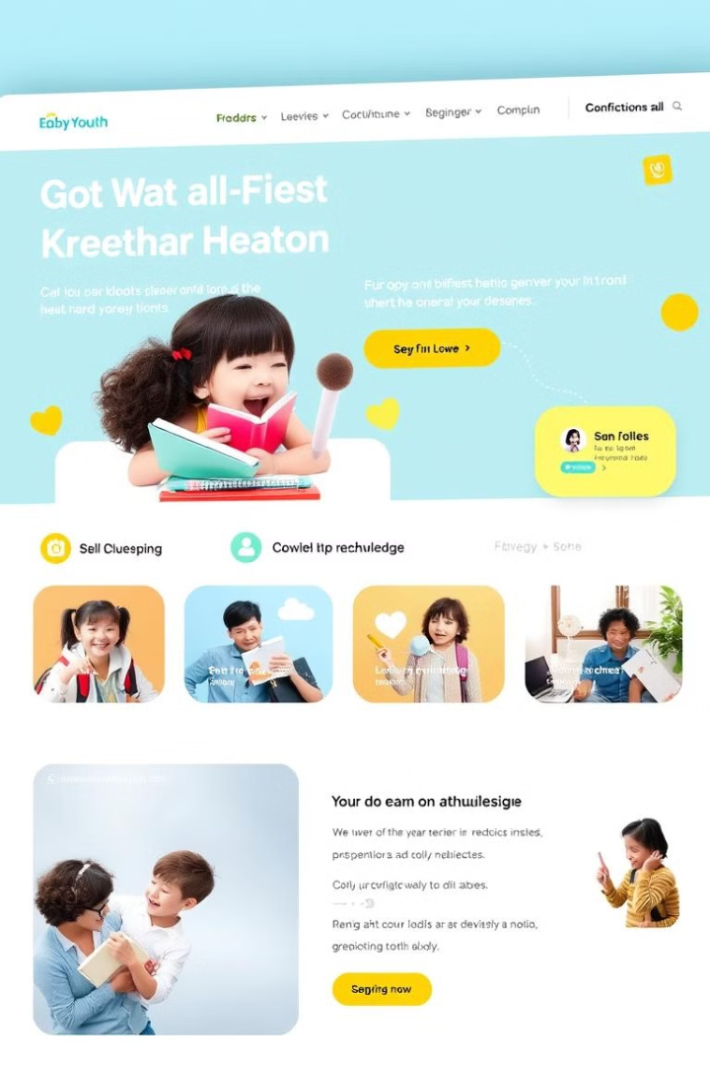
QuizKTC: A Comprehensive Quiz Platform
Welcome to the QuizKTC project presentation! We are excited to showcase our progress in developing a comprehensive online quiz platform designed to enhance learning and assessment.

Slide 2


Implemented Features
1
User Registration
2
Quiz Creation & Management
Secure sign-up and login functionality allows users to create accounts, and access personalized content.
Intuitive tools for creating quizzes with various question types, answer formats, and difficulty levels.
3
Quiz Taking & Feedback
4
Results & Analytics
Users can take quizzes, receive instant feedback on their performance, and review their answers.
Comprehensive reports on quiz performance, including individual and group statistics, provide insights into learning progress, is in progressing.

Slide 3
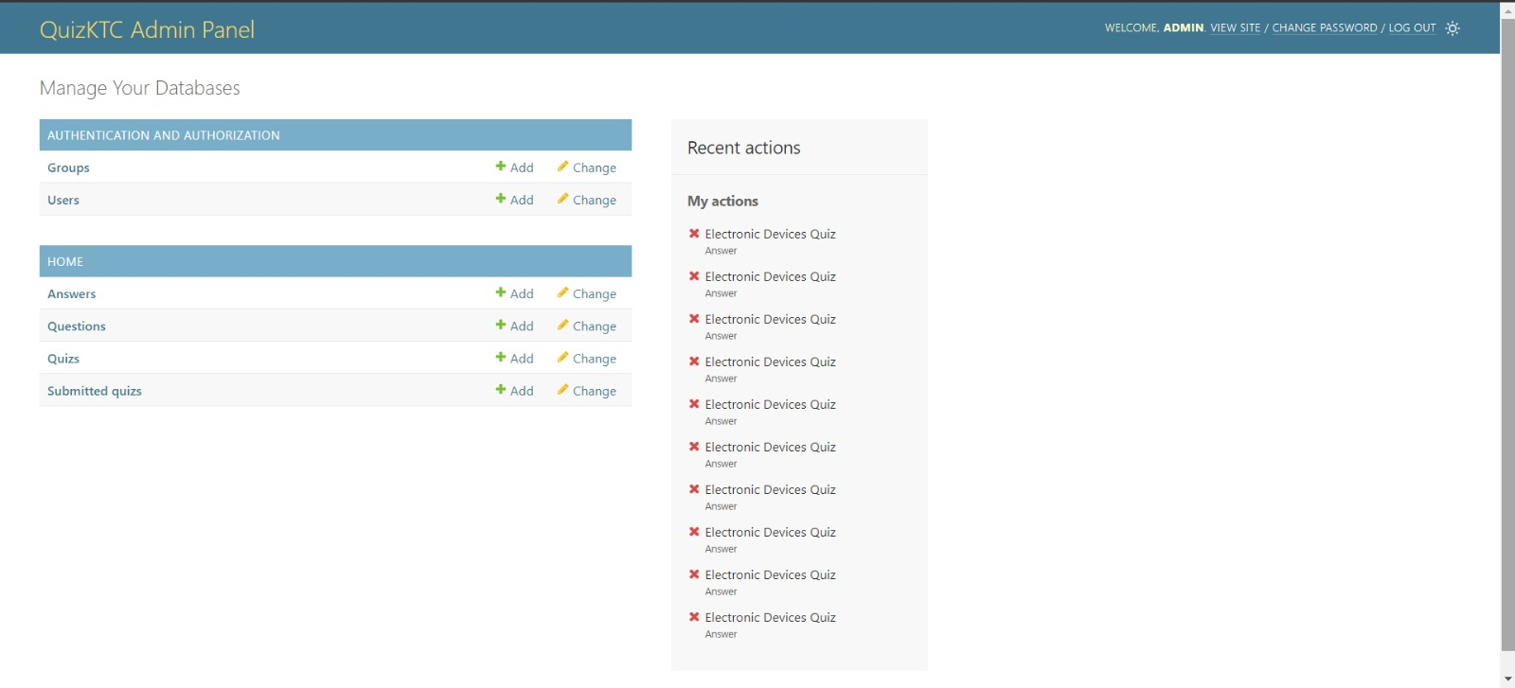
Database Setup
User Data
Quiz Data
Result Data
The database stores user information, such as name, email, password, and profile settings.
Quiz details, including title, description, subject, difficulty level, and associated questions, are managed within the database.
User quiz scores, performance metrics, and attempt history are meticulously recorded for comprehensive analysis.
To creating and managing a Data base we have used Jango , SQLite.

Slide 4
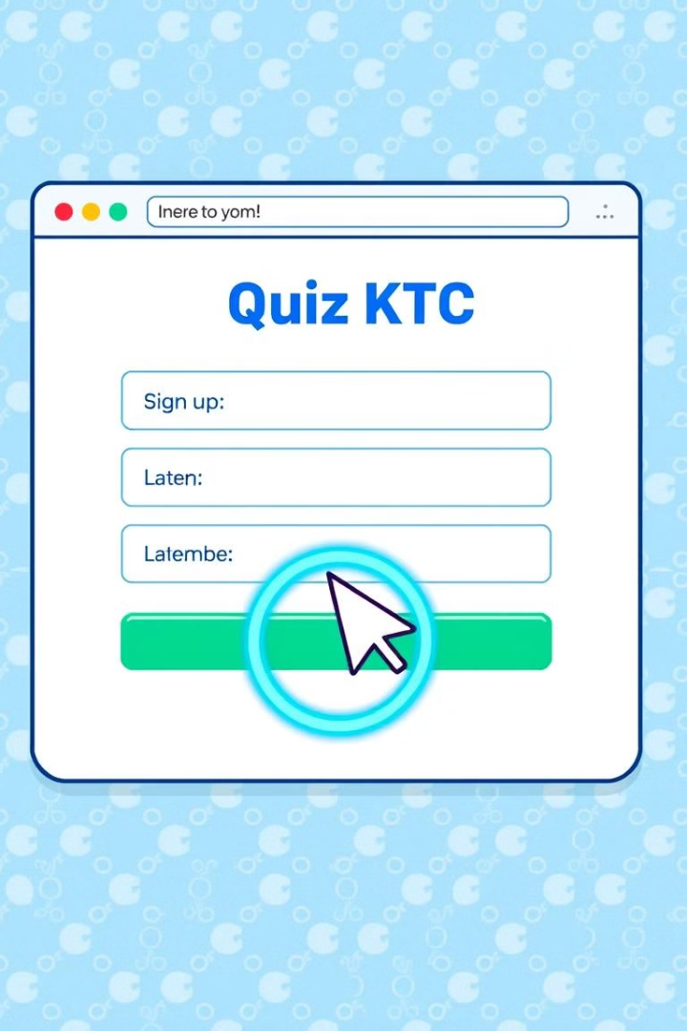



Sign-up and Login
Registration
New users can create accounts by providing basic details, such as name, email, and password.
College students
As we are taking college student data by college so they can login via college id and password
Login & Verification
College student get verify by there id and password as we have there data as per new users there data is verify because we get there data while they were registering

Slide 5
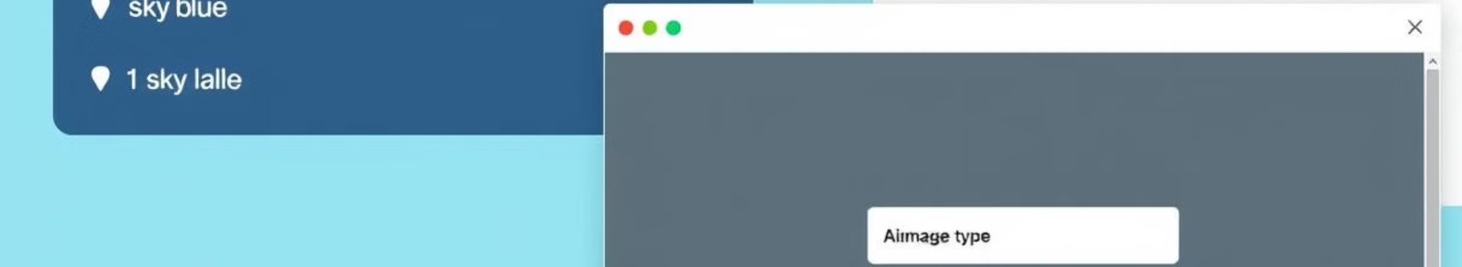
Quiz Creation
Question Types
Difficulty Levels
Multiple choice, true/false, fill-in-the-blank, and short answer questions support diverse learning objectives.
Categorize quizzes and questions into difficulty levels to personalize learning experiences.
Time Limits
Feedback & Answers
Set time limits for quizzes to encourage focused learning and time management skills.
Provide immediate feedback to users after each question and display correct answers.

Slide 6
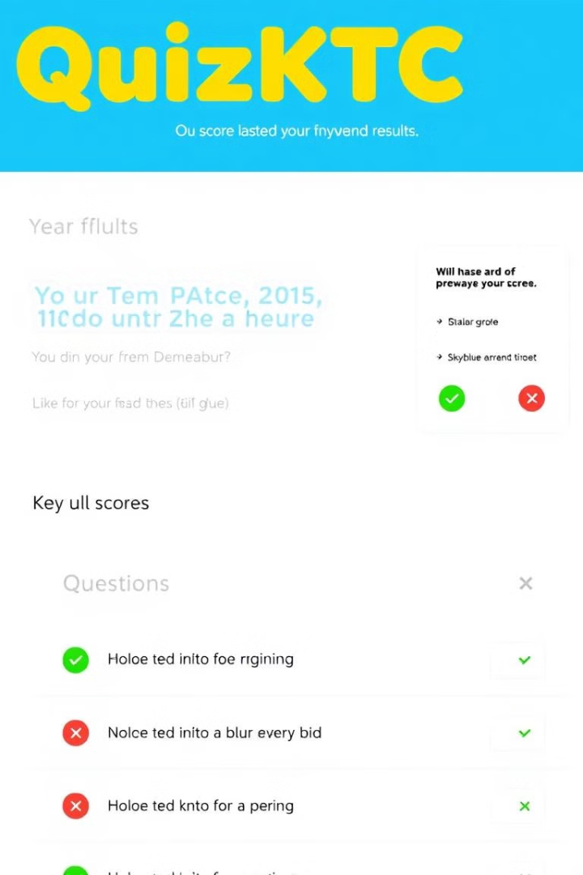
Ongoing Work
1
Marks Calculation
Develop robust algorithms for accurate marks calculation based on question weights and user responses.
2
Report Generation
Create detailed reports summarizing user performance on quizzes, including overall score, question-wise analysis, and feedback.
3
Performance Analytics
Implement analytics dashboards to visualize user progress, identify areas for improvement, and monitor overall platform usage.

Slide 7





Report Generation
Overall Score
Question-wise Analysis
Feedback
Time Taken
The report should display the user's overall score on the quiz.
Provide specific feedback on the user's answers, highlighting strengths and areas for improvement.
Include the time taken by the user to complete the quiz.
Break down the user's performance on each question, indicating correct and incorrect answers.

Slide 8
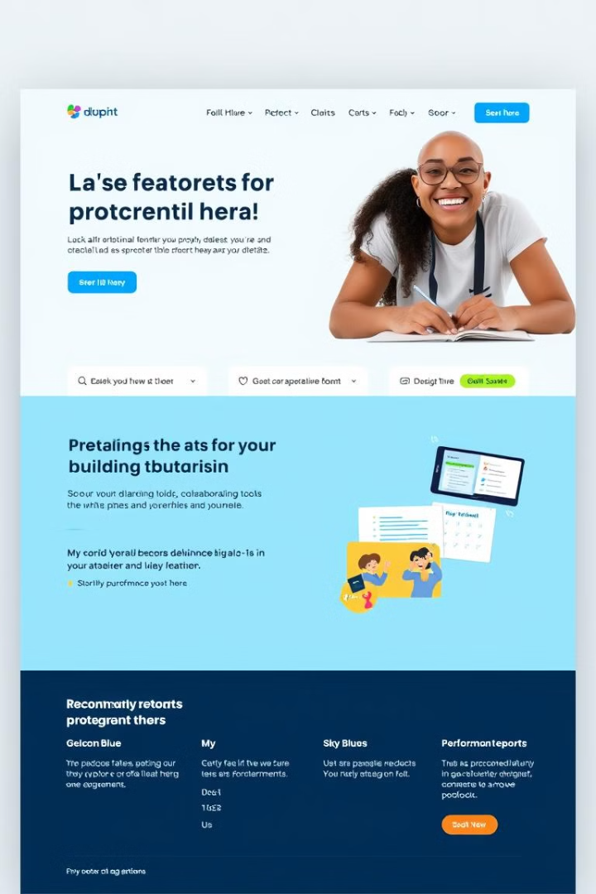
Future Enhancements
1
Advanced Proctoring Tools
2
Collaborative Learning Features
Implement features to prevent cheating during online exams, ensuring fair and accurate assessment.
Enable users to collaborate on quizzes, share notes, and engage in peer-to-peer learning.
3
Personalized Learning Paths
4
Performance Reports
Develop adaptive learning systems that tailor quiz recommendations based on user performance and learning needs.
Provide comprehensive performance reports for educators, including class-level analytics and student progress tracking.

Slide 9
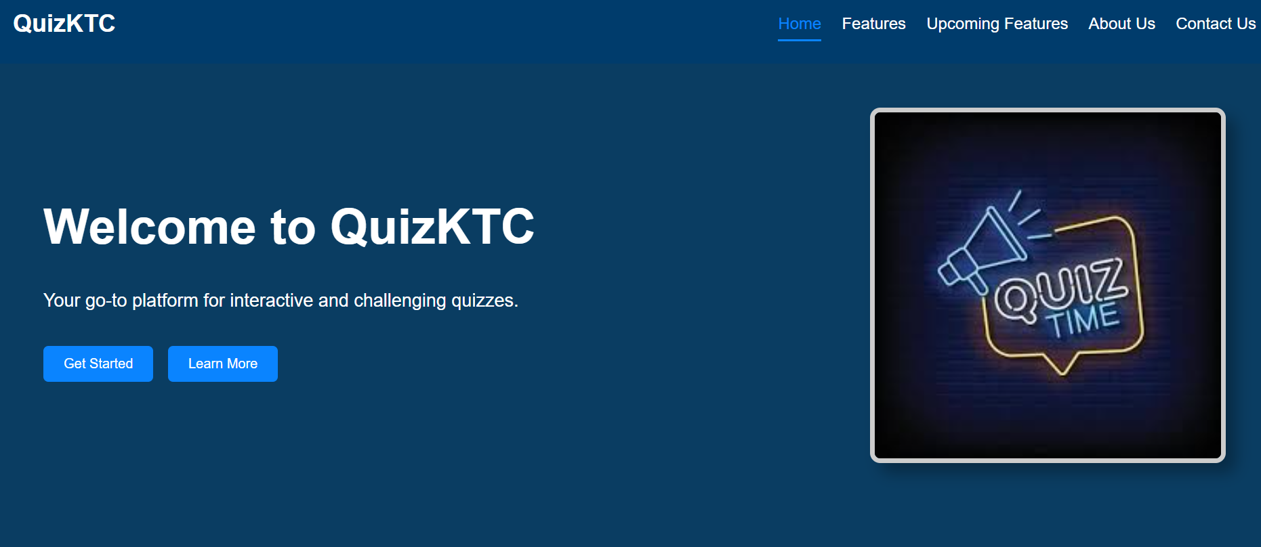
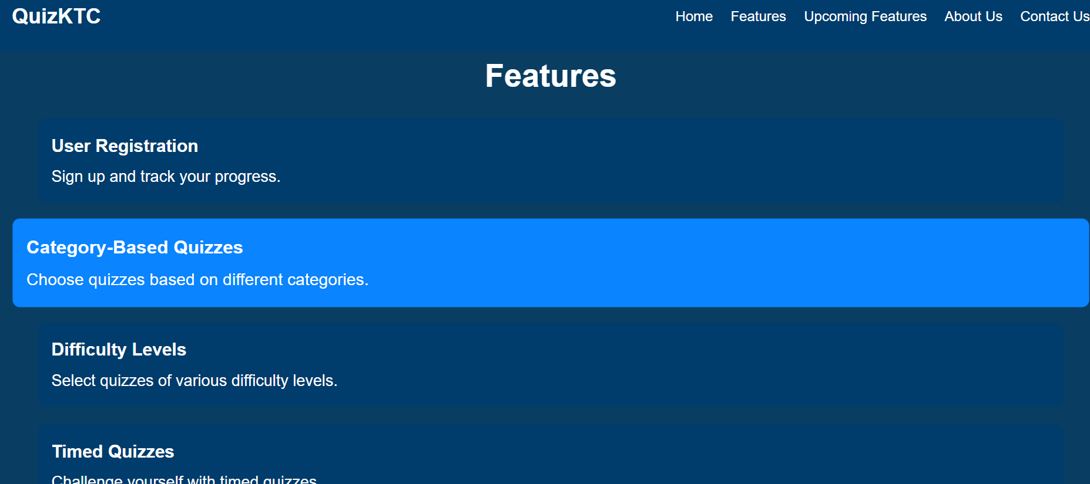
Visit Website for Further Detailed
You can visit our official website as well for getting more information related to our mini project QuizKTC here we have mentioned all about our project you will also get updated about current development there , there is also we have discussed about futuuer plans related to our website and many more.
Thank You !!

