Slide 1
Risk Scenarios 7th Biweekly Meeting
Danger Zone
Yan Ai, 12/16/2025

Slide 2
Traffic Direction Handling
Observation: Generated adversarial traffic scenarios are all right-hand.
Question: How did STRIVE handle the left-hand scenarios in Singapore?
Findouts
All Singapore maps are flipped vertically (about the x-axis).
Trajectories are flipped too (in src/datasets/nuscenes_dataset.py).
The flipping is done during data loading.
Model is trained on right-hand data only and outputs right-hand scenarios too.

Slide 3
CISS data for fine tuning
Required data: json files.
Steps:
Heading computation — heading[i] = np.arctan2(y[i+1] - y[i], x[i+1] - x[I])
Data splitting: 4 past time steps and 12 future steps (past+future is needed for fine tuning, but for adv_scenario_gen, past is input)
STRIVE needs 6 states for past and 4 states for future
Past format — [x, y, hx, hy, s, hdot]
Future format — [x, y, hx, hy]
Vehicle length and width
Vehicle types (sedan, truck, etc.)

Slide 4
Fine tuning using CISS data
I used 1-29-2023-088-10 case prepared by Eun Young, in Boston map.
Training succeeded.
Time taken: ~1h30min
Next step:
Improve the current CISS data convert script, to make it able to handle a batch of data at one time.

Slide 5
New model testing
2025-12-15_21:43:24 Using device cuda:0...
2025-12-15_21:44:04 Using bicycle model as output parameterization of model...
2025-12-15_21:44:04 Using mlp past/future encoder...
2025-12-15_21:44:04 Loaded checkpoint from epoch 108...
2025-12-15_21:44:04 Num model params: 1093202
2025-12-15_23:36:17 Final =====================================
2025-12-15_23:36:17 Test Mean loss = 4.964716
2025-12-15_23:36:17 Test Mean recon_loss = 3.682352
2025-12-15_23:36:17 Test Mean kl_loss = 1.087525
2025-12-15_23:36:17 Test Mean pos_err = 0.691543
2025-12-15_23:36:17 Test Mean ang_err = 1.614891
2025-12-15_23:36:17 Test Mean z_logprob = 18.496666
2025-12-15_23:36:17 Test Mean z_mdist = 0.762572
2025-12-15_23:36:17 Test Mean pos_minADE = 1.347401
2025-12-15_23:36:17 Test Mean pos_minFDE = 2.816271
2025-12-15_23:36:17 Test Mean ang_minADE = 2.419151
2025-12-15_23:36:17 Test Mean ang_minFDE = 3.252725
2025-12-15_23:36:17 Test Mean APD = 2.596891
2025-12-15_23:36:17 Test (sample_, _map) Collision Freq = 0.036004
2025-12-15_23:36:17 Test (sample_, _veh) Collision Freq = 0.039374
2025-12-15_23:36:17 Test time: 6732.783926 s

Slide 6
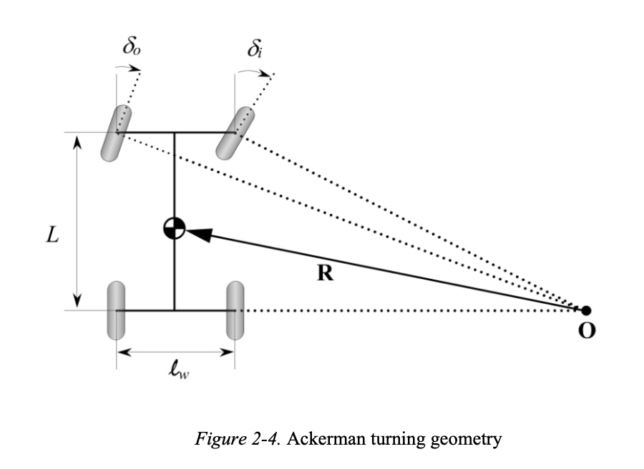
Bicycle model to 4-Wheel model
I used Acherman model from Vehicle Dynamics & Control, pp.24-26 (Rajamani, 2012).
Files relevant:
Src/models/common.py
Src/datasets/utils.py
Src/models/traffic_model.py

Slide 7
Retraining using nuScenes dataset
The vehicle dynamics model impacts the decoder in the traffic model. Therefore, after changing to Acherman model, retraining is necessary.
Code implementation √
Training still in process: already more than 16h

