Slide 1
Introduction to SMV
Arie Gurfinkel (SEI/CMU)
based on material by Prof. Clarke and others

Slide 2
Symbolic Model Verifier (SMV)
Ken McMillan, Symbolic Model Checking: An Approach to the State Explosion Problem, 1993.
Finite-state Systems described in a specialized language
Specifications given as CTL formulas
Internal representation using ROBDDs
Automatically verifies specification or produces a counterexample

Slide 3
Overview of SMV
SMV Input Language
Backend
Finite State Kripke Structure
ROBDD based
Symbolic Model
Checking
Yes
Specification –
CTL Formula
No
CounterExample

Slide 4
SMV Variants
Cadence SMV
NuSMV
CMU SMV
Strong abstraction functions
GUI
New language
Two versions
2.x: Open Source, many new features, BDD and SAT based backends
1.x: Original version, had a GUI
Oldest Version
No GUI

Slide 5
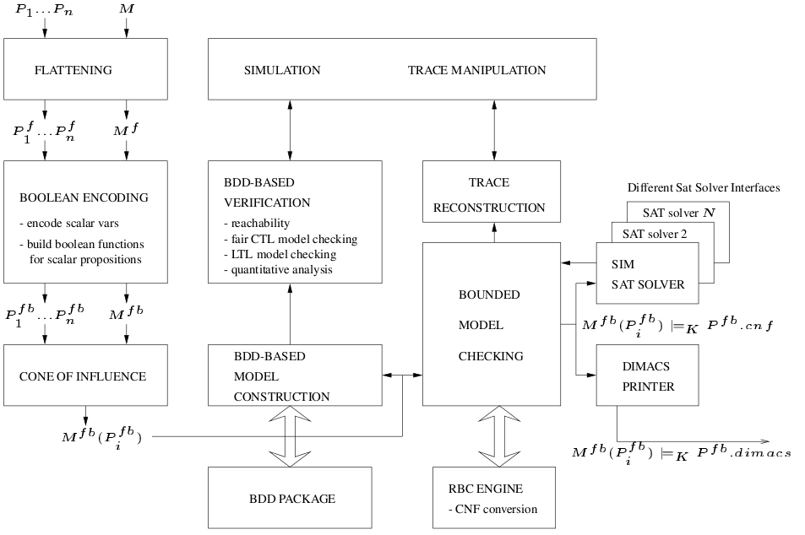
NuSMV2 Architecture

Slide 6
SMV Language
Allows description of completely synchronous to asynchronous systems, detailed to abstract systems
Modularized and hierarchical descriptions
Finite data types: Boolean and enumerated
Parallel-assignment syntax
Non-determinism

Slide 7
A Sample SMV Program (short.smv)
MODULE main
VAR
request: boolean;
state: {ready, busy};
ASSIGN
init(state) := ready;
next(state) := case
state=ready & request: busy;
TRUE : {ready, busy};
esac;
SPEC AG(request -> AF (state = busy))

Slide 8
Kripke structure
Computation tree
ready
request
ready
!request
busy
!request
busy
!request
busy
request
holds after one step
busy
request
ready
request
busy
request
holds in the initial state
AG(request -> AF (state = busy))

Slide 9
A Sample SMV Program (short.smv)
MODULE main
VAR
request: boolean;
state: {ready, busy};
ASSIGN
init(state) := ready;
next(state) := case
state=ready & request: busy;
TRUE : {ready, busy};
esac;
SPEC AG(request -> AX (state = busy))
what if AF is changed to AX ?

Slide 10
AG(request -> AX (state = busy)) is false
ready
!request
busy
!request
ready
request
busy
request

Slide 11
SMV Syntax: Expressions
Expr ::
atom -- symbolic constant
| number -- numeric constant
| id -- variable identifier
| “!” Expr -- logical not
| Expr & Expr -- logical and
| Expr | Expr -- logical or
| Expr -> Expr -- logical implication
| Expr <-> Expr -- logical equivalence
| “next” “(“ id “)” -- next value
| Case_expr
| Set_expr

Slide 12
The Case Expression
Case_expr :: “case”
expr_a₁ “:” expr_b₂ “;”
…
expr_a_{n} “:” expr_b_{n} “;”
“esac”
Guards are evaluated sequentially
The first one that is true determines the resulting value
Cases must be exhaustive
It is an error if all expressions on the left hand side evaluate to FALSE

Slide 13
Variables and Assignments
Decl :: “VAR”
atom1 “:” type1 “;”
atom2 “:” type2 “;”
…
Decl :: “ASSIGN”
dest1 “:=“ Expr1 “;”
dest2 “:=“ Expr2 “;”
…
Dest :: atom -- current
| “init” “(“ atom “)” -- initial
| “next” “(“ atom “)” -- next-state

Slide 14
Variables and Assignments (cont’d)
State is an assignment of values to a set of state variables
Type of a variable – boolean, scalar, user defined module, or array.
Assignment to initial state:
init(value) := FALSE;
Assignment to next state (transition relation)
next(value) := value xor carry_in;
Assignment to current state (invariant)
carry_out := value & carry_in;
Either init-next or invar should be used, but not both
SMV is a parallel assignment language

Slide 15

Circular Definitions
… are not allowed
init(a) := 0; next(a) := !b; init(b) := 1; next(b) := !a;
a := next(b); next(b) := c; c := a;

Slide 16
Nondeterminism
Completely unassigned variable model unconstrained input
{val_1, …, val_n} is an expression taking on any of the given values nondeterministically
next(b) := {TRUE, FALSE};
Nondeterministic choice can be used to:
Model an environment that is outside of the control of the system
Model an implementation that has not been refined yet
Abstract behavior

Slide 17
ASSIGN and DEFINE
VAR a: boolean; ASSIGN a := b | c;
declares a new state variable a
becomes part of invariant relation
DEFINE d := b | c;
a macro definition, each occurrence of d is replaced by (b | c)
no extra BDD variable is generated for d
the BDD for (b | c) becomes part of each expression using d

Slide 18
SPEC Declaration
Decl :: “SPEC” ctlform
Ctlform :: expr -- bool expression
| “!” ctlform
| Ctlform <op> Ctlform
| “E” Pathform
| “A” Pathform
Pathform :: “X” Ctlform
| “F” Ctlform
| “G” Ctlform
| Ctlform “U” Ctlform

Slide 19
Modules
Modules can be instantiated many times, each instantiation creates a copy of the local variables
Each program must have a module main
Scoping
Variables declared outside a module can be passed as parameters
Parameters are passed by reference.

Slide 20
Pass by reference
DEFINE
a := 0;
VAR
b : bar(a);
…
MODULE bar(x)
DEFINE
a := 1;
y := x;
DEFINE
a := 0;
b.y := 0;
b.a := 1;

Slide 21
Pass by reference
VAR
a : boolean;
b : foo(a);
…
MODULE foo(x)
VAR
y : boolean;
ASSIGN
x := TRUE;
y := FALSE;
VAR
a : boolean;
b.y : boolean;
ASSIGN
a := TRUE;
b.y := FALSE;

Slide 22
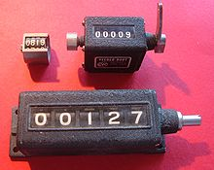
A Three-Bit Counter
MODULE main
VAR
bit0 : counter_cell(TRUE);
bit1 : counter_cell(bit0.carry_out);
bit2 : counter_cell(bit1.carry_out);
SPEC AG AF bit2.carry_out
MODULE counter_cell(carry_in)
VAR
value : boolean;
ASSIGN
init(value) := FALSE;
next(value) := value xor carry_in;
DEFINE
carry_out := value & carry_in;
value + carry_in mod 2

Slide 23
module instantiations
val
in
out
bit0
module declaration
val
val
in
out
in
out
bit1
val
in
out
bit2

Slide 24
AG AF bit2.carry_out is true
in
1
0
0
0
0
0
0
0
0
1
1
1
1
0
0
0
0
0
1
0
0
0
1
0
0
0
0
1
1
1
1
1
1
1
0
0
1
0
0
0
0
0
0
1
0
1
1
1
1
0
0
0
1
0
1
0
0
0
1
0
0
1
0
1
1
1
1
1
1
1
1
1
1
0
0
0
0
0
0
0
0
bit0
val
out
in
bit1
val
out
in
bit2
val
out
bit2.carry_out is ture

Slide 25
A Three-Bit Counter
MODULE main
VAR
bit0 : counter_cell(TRUE);
bit1 : counter_cell(bit0.carry_out);
bit2 : counter_cell(bit1.carry_out);
SPEC AG (!bit2.carry_out)
MODULE counter_cell(carry_in)
VAR
value : boolean;
ASSIGN
init(value) := FALSE;
next(value) := value xor carry_in;
DEFINE
carry_out := value & carry_in;

Slide 26
AG (!bit2.carry_out) is false
in
1
0
0
0
0
0
0
0
0
1
1
1
1
0
0
0
0
0
1
0
0
0
1
0
0
0
0
1
1
1
1
1
1
1
0
0
1
0
0
0
0
0
0
1
0
1
1
1
1
0
0
0
1
0
1
0
0
0
1
0
0
1
0
1
1
1
1
1
1
1
1
1
1
0
0
0
0
0
0
0
0
bit0
val
out
in
bit1
val
out
in
bit2
val
out
bit2.carry_out is ture

Slide 27
Module Composition
Synchronous composition
All assignments are executed in parallel and synchronously.
A single step of the resulting model corresponds to a step in each of the components.
Asynchronous composition
A step of the composition is a step by exactly one process.
Variables, not assigned in that process, are left unchanged.

Slide 28

Inverter Ring
MODULE main
VAR
gate1 : process inverter(gate3.output);
gate2 : process inverter(gate1.output);
gate3 : process inverter(gate2.output);
SPEC (AG AF gate1.output) & (AG AF !gate1.output)
MODULE inverter(input)
VAR
output : boolean;
ASSIGN
init(output) := FALSE;
next(output) := !input;
FAIRNESS
running

Slide 29
In asynchronous composition, a step of the computation is a step by exactly one component. The process to execute is assumed to choose gate0, gate1, and gate2 repeatedly.
in
0
0
0
0
0
0
0
1
1
0
0
0
0
1
1
0
0
1
1
0
1
0
0
1
1
0
0
1
0
1
1
0
0
1
1
0
0
1
0
1
1
0
0
1
1
0
1
0
0
1
1
0
0
1
1
0
1
0
0
1
gate0
out
in
gate1
out
in
gate2
out
(AG AF gate1.output) & (AG AF !gate1.output) is true

Slide 30
Fairness
FAIRNESS Ctlform
Assumed to be true infinitely often
Model checker only explores paths satisfying fairness constraint
Each fairness constraint must be true infinitely often
If there are no fair paths
All existential formulas are false
All universal formulas are true
FAIRNESS running

Slide 31
Synchronous vs Asynchronous
In Asynchronous process, need not combine transition relation of each process
Complexity of representing set of states reachable in n steps higher in asynchronous processes occasionally due to higher number of interleavings
SMV models asynchronous composition by a synchronous one

Slide 32
Implicit Modeling
INIT Expr
Boolean valued expression giving initial states
INVAR Expr
Boolean valued expression restricting set of all states of model
TRANS Expr
Boolean valued expression restricting transition relation of system

Slide 33
Implicit Modeling Example
MODULE main
VAR
gate1 : inverter(gate3.output);
gate2 : inverter(gate1.output);
gate3 : inverter(gate2.output);
SPEC
(AG AF gate1.out) & (AG AF !gate1.out)
MODULE inverter(input)
VAR
output : boolean;
INIT
output = FALSE;
TRANS
(next(output) = !input) | (next(output) = output)

Slide 34
TRANS
Advantages
Group assignments to different variables
Good for modeling guarded commands
IF guard THEN new state
Disadvantages
Logical absurdities can lead to unrealizable descriptions

Slide 35
Shared Data Example
Two users assign PID to Data in turn
MODULE main
VAR
data : boolean;
turn : {0,1};
user0 : user(0, data, turn);
user1 : user(1, data, turn);
ASSIGN
next(turn) := !turn;
SPEC
AG (AF data & AF (!data))
MODULE user(pid, data, turn)
ASSIGN
next(data) :=
case
turn=pid : pid;
TRUE : data;
esac;
Error: multiple assignment: next(data)

Slide 36
Shared Data Example with TRANS
MODULE main
VAR
data : boolean;
turn : {0,1};
user0 : user(0, data, turn);
user1 : user(1, data, turn);
ASSIGN
next(turn) := !turn;
SPEC
AG (AF data & AF (!data))
MODULE user(pid, data, turn)
TRANS
turn=pid -> next(data) = pid;

Slide 37
TRANS Pitfalls
TRANS
TRUE -> next(b) = 0 &
TRUE -> next(b) = 1 & …
Inconsistencies in TRANS result in an empty transition relation
All universal properties are satisfied
All existential properties are refuted

Slide 38
TRANS Guidelines
Use ASSIGN if you can!
Validate your model with simulation and sanity checks
Check that transition relation is total (-ctt option)
Write in a disjunction of conjunction format
Cover all cases
Make guards disjoint

Slide 39
MODULE main
VAR
send : {s0,s1,s2};
recv : {r0,r1,r2};
ack : boolean;
req : boolean;
ASSIGN
init(ack):=FALSE;
init(req):=FALSE;
init(send):= s0;
init(recv):= r0;
next (send) :=
case
send=s0:{s0,s1};
send=s1:s2;
send=s2&ack:s0;
TRUE:send;
esac;
next (recv) :=
case
recv=r0&req:r1;
recv=r1:r2;
recv=r2:r0;
TRUE: recv;
esac;
next (ack) :=
case
recv=r2:TRUE;
TRUE: ack;
esac;
next (req) :=
case
send=s1:FALSE;
TRUE: req;
esac;
SPEC AG (req -> AF ack)

Slide 40
Can A TRUE Result of Model Checker be Trusted
Antecedent Failure [Beatty & Bryant 1994]
A temporal formula AG (p ⇒ q) suffers an antecedent failure in model M iff M ⊧ AG (p ⇒ q) AND M ⊧ AG (¬p)
Vacuity [Beer et al. 1997]
A temporal formula ϕ is satisfied vacuously by M iff there exists a sub-formula p of ϕ such that M ⊧ ϕ[p←q] for every other formula q
e.g., M ⊧ AG (r ⇒ AF a) and M ⊧ AG (r ⇒ AF ¬a) and AG (r ⇒ AF ¬r) and AG (r ⇒ AF FALSE), …

Slide 41
Vacuity Detection: Single Occurrence
ϕ is vacuous in M iff there exists an occurrence of a subformula p such that
M ⊧ ϕ[p ← TRUE] and M ⊧ ϕ[p ← FALSE]
M ⊧ AG (req ⇒ AF TRUE)
M ⊧ AG TRUE
M ⊧ AG (req ⇒ AF FALSE)
M ⊧ AG ¬req
M ⊧ AG (TRUE ⇒ AF ack)
M ⊧ AG AF ack
M ⊧ AG (FALSE ⇒ AF ack)
M ⊧ AG TRUE

Slide 42
Detecting Vacuity in Multiple Occurrences
Is AG (req ⇒ AF req) vacuous? Should it be?
Is AG (req ⇒ AX req) vacuous? Should it be?
M ⊧ AG (TRUE ⇒ AF TRUE)
M ⊧ AG TRUE
M ⊧ AG (FALSE ⇒ AF FALSE)
M ⊧ AG TRUE
M ⊧ AG (TRUE ⇒ AX TRUE)
M ⊧ AG TRUE
M ⊧ AG (FALSE ⇒ AX FALSE)
M ⊧ AG TRUE

Slide 43
Detecting Vacuity in Multiple Occurrences: ACTL
An ACTL ϕ is vacuous in M iff there exists an a subformula p such that
M ⊧ ϕ[p ← x] , where x is a non-deterministic variable
Is AG (req ⇒ AF req) vacuous? Should it be?
Is AG (req ⇒ AX req) vacuous? Should it be?
Always vacuous!!!
M ⊧ AG (x ⇒ AF x)
M ⊧ AG TRUE
Can be vacuous!!!
M ⊧ AG (x ⇒ AX x)
can’t reduce

Slide 44
Run NuSMV
NuSMV [options] inputfile
-int interactive mode
-lp list all properties
-n X check property number X
-ctt check totality of transition relation
-old compatibility mode
-ofm file output flattened model

Slide 45
Using NuSMV in Interactive Mode
Basic Usage
go
prepare model for verification
check_ctlspec
verify properties
Simulation
pick_state [-i] [-r]
pick initial state for simulation [interactively] or [randomly]
simulate [-i] [r] s
simulate the model for ‘s’ steps [interactively] or [randomly]
show_traces
show active traces

Slide 46
Useful Links
NuSMV home page
http://nusmv.fbk.eu/
NuSMV tutorial
http://nusmv.fbk.eu/NuSMV/tutorial/v25/tutorial.pdf
NuSMV user manual
http://nusmv.fbk.eu/NuSMV/userman/v25/nusmv.pdf
NuSMV FAQ
http://nusmv.fbk.eu/faq.html
NuSMV on Andrew
/afs/andrew.cmu.edu/usr11/arieg/public/nusmv/2.5.3/
NuSMV examples
<NuSMV>/share/nusmv/examples
Ken McMillan, Symbolic Model Checking: An Approach to the State Explosion Problem, 1993
http://www.kenmcmil.com/pubs/thesis.pdf

