Slide 1

Why Every Dev. Team Needs Static Analysis

Slide 2
This Presentation Will Cover:
The Cost of Bugs in Software Development
The Advantages of Testing and Static Analysis
Debunking Static Analysis Myths
What Makes a Good Static Analysis Tool

Slide 3
The Cost of Bugs in Software Development

Slide 4
This is how we want development to be
A smooth journey from beginning to end

Slide 5
However, development more often than not turns out to be this
A bumpy journey from beginning to end

Slide 6
Sometimes we even have to go back to the beginning and start again

Slide 7

Bugs and Errors found in the Quality Assurance Process make the project cost exponentially more time and money than it should

Slide 8

The software industry spends approximately 50% of funds for development and maintenance on finding and fixing bugs
Bug finding costs about $312 billion a year

Slide 9
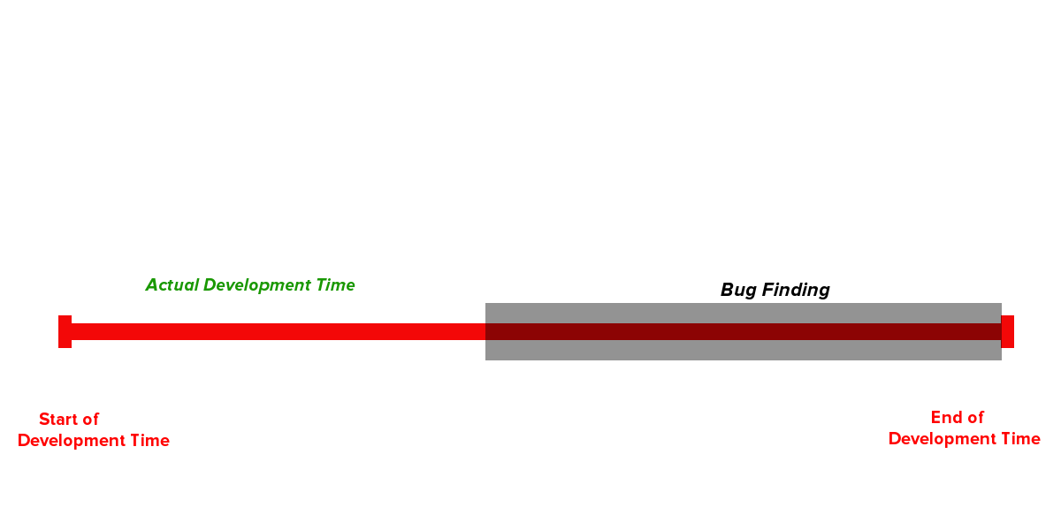
It takes up 50% of a developer’s programming time

Slide 10







Most forms of testing only find about 1 bug out of every 3 And all tests together barely remove 85% of bugs during testing
Even the best companies and organizations have released products with expensive (but sometimes simple to fix) bugs

Slide 11
The Advantages of Testing and Static Analysis

Slide 12
“
”
A synergistic combination of defect prevention, pre-test defect removal, and formal testing by certified personnel can top 99% in defect removal efficiency while simultaneously lowering costs and shortening schedules.
- Capers Jones, Software Defect Origins and Removal Methods
Using static analysis, unit testing, code inspections, peer review, QA, pre-test defect removal and prevention can reduce costs by as much as 50%

Slide 13
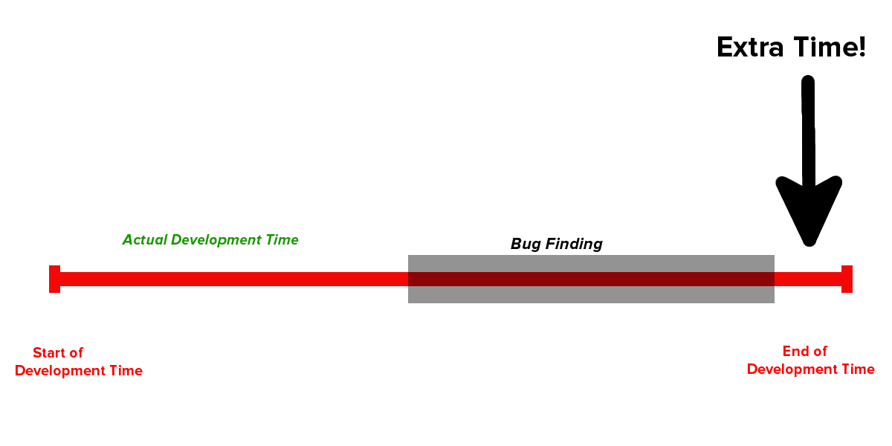
Using static analysis and dynamic analysis can save a team up to 500% more time.
Static analysis tools, specifically, have been shown to push defect detection and removal rates above 65%
Extra Time!

Slide 14
Debunking Static Analysis Myths

Slide 15
Myth #1
Static Analysis Tools Return Too Many False Positives

Slide 16
Strong static analysis tools let you customize code rules and metrics in order to fit your project's needs and your coding style
A lot of false positives might mean:
The tool hasn’t been configured specifically for your project
Developers don’t understand how the tool works
The tool is not being used properly in the development cycle

Slide 17
Myth #2
Static Analysis Tools Are Not Affordable or Cost-Effective

Slide 18

Static analysis tools are an investment in your company. They help…
Better communication between teams
Lessen time spent finding and fixing bugs
Meet deadlines more consistently
Cut costs in the QA process
Cut costs in post-delivery
Create happier customers and end-users

Slide 19
What Makes a Good Static Analysis Tool

Slide 20
A good static analysis tool should be:
Small
Reliable
Customisable
Dependable
Powerful
And it should help you:
Save Time
Save Money
Make your team happy
Make a better product

Slide 21
And help turn this

Slide 22
Into this

Slide 23
Presented by
CppDepend is a static analysis tool for C/C++. CppDepend supports a large number of code metrics, allows for visualization of dependencies using directed graphs, and dependency matrices. It also performs code base snapshots comparison, and validation of architectural and quality rules.
Sources:
Capers Jones, Software Defect Origins and Removal Methods
Andrey Karpov, 200 Open Source Projects Later: Source Code Static Analysis Experience
William B. Oliver Lawrence , Lawrence Livermore National Laboratory ,Quantifying the Value of Static Analysis, Date 5/19/2011
Challenging SCA Myths, published by Rogue Wave Software

