Slide 1
Model Checking in Ten Minutes
Edmund Clarke
School of Computer Science
Carnegie Mellon University

Slide 2
Temporal Logic Model Checking
Model checking is an automatic verification technique for finite state concurrent systems.
Developed independently by Clarke and Emerson and by Queille and Sifakis in early 1980’s.
Specifications are written in propositional temporal logic. (Pnueli 77)
Verification procedure is an intelligent exhaustive search of the state space of the design.

Slide 3
Model Checking
The Model Checking Problem (Clarke and Emerson 81):
Let M be a state-transition graph
Let f be a formula of temporal logic
e.g., a U b means “a holds true Until b becomes true”
Does f hold along all paths that start at initial state of M ?
a
a
a
a
b
Preprocessor
Model Checker
Formula f
Representation of M
True or Counterexample

Slide 4
Advantages of Model Checking
No proofs! (algorithmic not deductive)
Fast (compared to other rigorous methods)
No problem with partial specifications
Diagnostic counterexamples
Safety Property:
bad state unreachable
Initial State
Notes:
4

Slide 5
Advantages of Model Checking
No proofs! (algorithmic not deductive)
Fast (compared to other rigorous methods)
No problem with partial specifications
Diagnostic counterexamples
Safety Property:
bad state unreachable
Counterexample
Initial State
Notes:
5

Slide 6
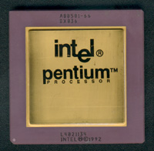
Many Industrial Successes
Try 4195835 – 4195835 / 3145727 * 3145727.
In 94’ Pentium, it doesn’t return 0, but 256.
Intel uses the SRT algorithm for floating point division. Five entries in the lookup table are missing.
Cost: $500 million
Xudong Zhao’s Thesis on Word Level Model Checking
Notes:
Pentium chip picture?

Slide 7
The State Explosion Problem
System Description
Combinatorial explosion of system
states renders explicit
model construction infeasible.
State Transition Graph
Exponential Growth of …
… global state space in number of concurrent components.
… memory states in memory size.
Feasibility of model checking inherently tied to handling state explosion.

Slide 8
CEGAR CounterExample-Guided Abstraction Refinement
Initial
Abstraction
Verification
C Program
Abstract
Model
No error or bug found
Model Checker
Property
holds
Counterexample
Refinement
Simulator
Simulation
sucessful
Abstraction refinement
Bug found
Spurious counterexample

Slide 9
Combating the State Explosion
Binary Decision Diagrams can be used to represent state transition systems more efficiently. → Symbolic Model Checking 1992
Semantic techniques for alleviating state explosion:
Partial Order Reduction.
Abstraction.
Compositional reasoning.
Symmetry.
Cone of influence reduction.
Semantic minimization.

Slide 10
Model Checking since 1981
1981 Clarke / Emerson: CTL Model Checking Sifakis / Quielle
1982 EMC: Explicit Model Checker Clarke, Emerson, Sistla
1990 Symbolic Model Checking
Burch, Clarke, Dill, McMillan
SMV: Symbolic Model Verifier
McMillan
1998 Bounded Model Checking using SAT
Biere, Clarke, Zhu
2000 Counterexample-guided Abstraction Refinement
Clarke, Grumberg, Jha, Lu, Veith
10⁵
10¹⁰⁰
1990s: Formal Hardware Verification in Industry: Intel, IBM, Motorola, etc.
10¹⁰⁰⁰

Slide 11
Model Checking since 1981
1981 Clarke / Emerson: CTL Model Checking Sifakis / Quielle
1982 EMC: Explicit Model Checker Clarke, Emerson, Sistla
1990 Symbolic Model Checking
Burch, Clarke, Dill, McMillan
SMV: Symbolic Model Verifier
McMillan
1998 Bounded Model Checking using SAT
Biere, Clarke, Zhu
2000 Counterexample-guided Abstraction Refinement
Clarke, Grumberg, Jha, Lu, Veith
CBMC
MAGIC

Slide 12
Grand Challenge: Model Check Software !
What makes Software Model Checking different ?

Slide 13
What Makes Software Model Checking Different ?
Large/unbounded base types: int, float, string
User-defined types/classes
Pointers/aliasing + unbounded #’s of heap-allocated cells
Procedure calls/recursion/calls through pointers/dynamic method lookup/overloading
Concurrency + unbounded #’s of threads
Notes:
Laundry list – but we don’t have to address all of these aspects to be a success
We will address some, but not all
Lots of meaty problems for research

Slide 14
What Makes Software Model Checking Different ?
Templates/generics/include files
Interrupts/exceptions/callbacks
Use of secondary storage: files, databases
Absent source code for: libraries, system calls, mobile code
Esoteric features: continuations, self-modifying code
Size (e.g., MS Word = 1.4 MLOC)
Notes:
Laundry list – but we don’t have to address all of these aspects to be a success
We will address some, but not all
Lots of meaty problems for research

Slide 15
Software Example: Device Driver Code
Also according to Wired News:
“Microsoft has developed a tool called Static Device Verifier or SDV, that uses ‘Model Checking’ to analyze the source code for Windows drivers and see if the code that the programmer wrote matches a mathematical model of what a Windows device driver should do. If the driver doesn’t match the model, the SDV warns that the driver might contain a bug.”

Slide 16
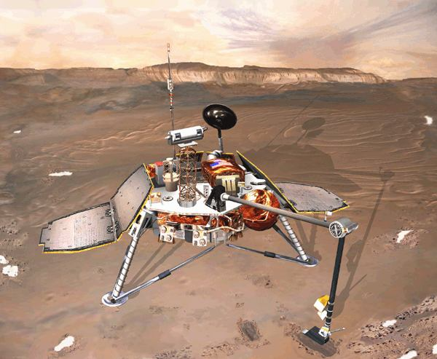
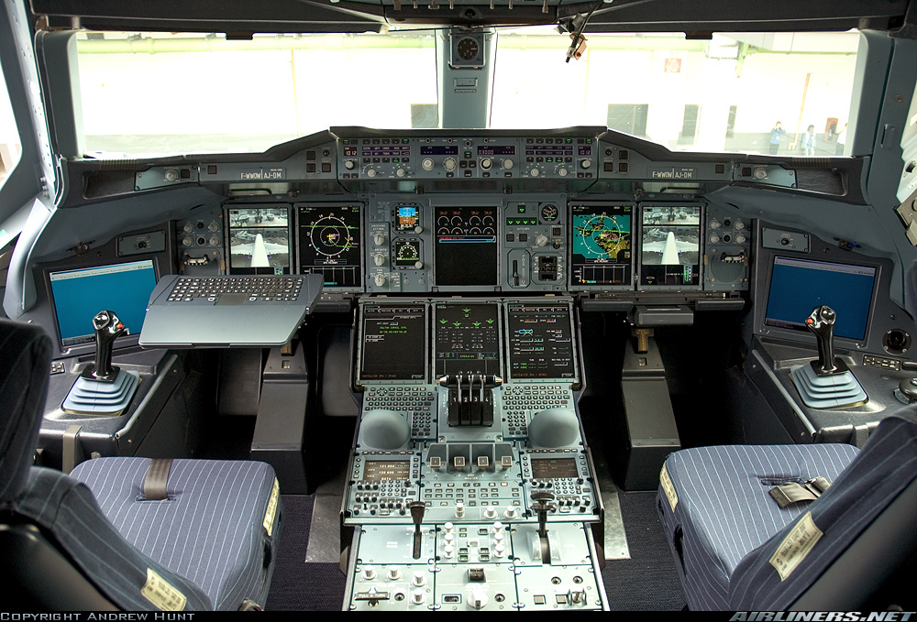
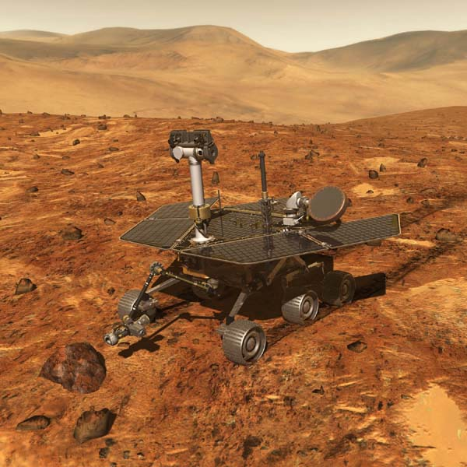
Aerospace Systems: Software Driven!
Mars Polar Lander (1999) landing-logic error
Airbus A380 Flight Deck
Mission Loss
Spirit Mars Rover (2004)
file-system error
Do you trust flight software?
16
Notes:
16
Can MCAI deal with these JPL errors?

Slide 17
Embedded Systems Need MCAI 2.0
Scalability: each new Mars mission employs more software than all previous Mars missions together
Often no models, only code: software written in C, sometimes without the help of formal models
MCAI 2.0 can be used to extract abstract models from source code, analyze generated models, drive C-code testers, …
17

