Slide 1
Static Analysis and Software Assurance
David Wagner
U.C. Berkeley

Slide 2
The Problem
Building secure systems is hard
  2/3 of Internet servers have gaping security holes
The problem is buggy software
  And a few pitfalls account for many vulnerabilities
Challenge: Improve programming technology
  Need way to gain assurance in our software
  Static analysis can help!

Slide 3
In This Talk…
I won’t discuss:
  Cryptographic protocols
  Information flow, covert channels
  Mobile and malicious code
I will discuss:
  Software security
  Three examples of interesting research challenges

Slide 4
Existing Paradigms
high
Formal verification
(sweet spot?)
Assurance
Testing
low
cheap
Cost
expensive

Slide 5
What Makes Security Hard?
Security is hard because of…
  language traps (buffer overruns)
  privilege pitfalls
  untrusted data
  … and many others that I won’t consider in this talk

Slide 6
Plan of the Talk
Security is hard because of…
  language traps (buffer overruns)
  privilege pitfalls
  untrusted data
  … and many others that I won’t consider in this talk

Slide 7
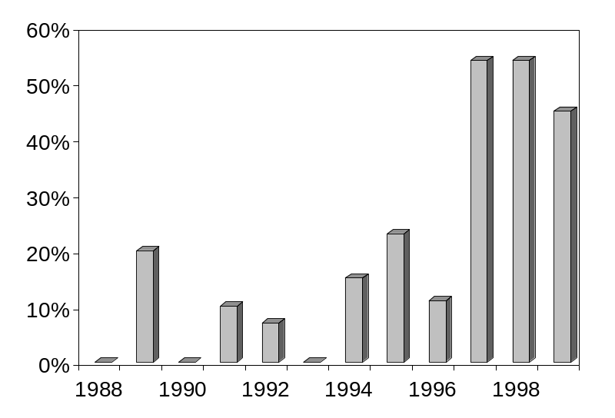
Buffer Overruns
An example bug:
char buf[80];
hp = gethostbyaddr(...);
strcpy(buf, hp->hp_hname);
Accounts for 50% of recent vulnerabilities
Percentage of CERT advisories due to buffer overruns each year

Slide 8
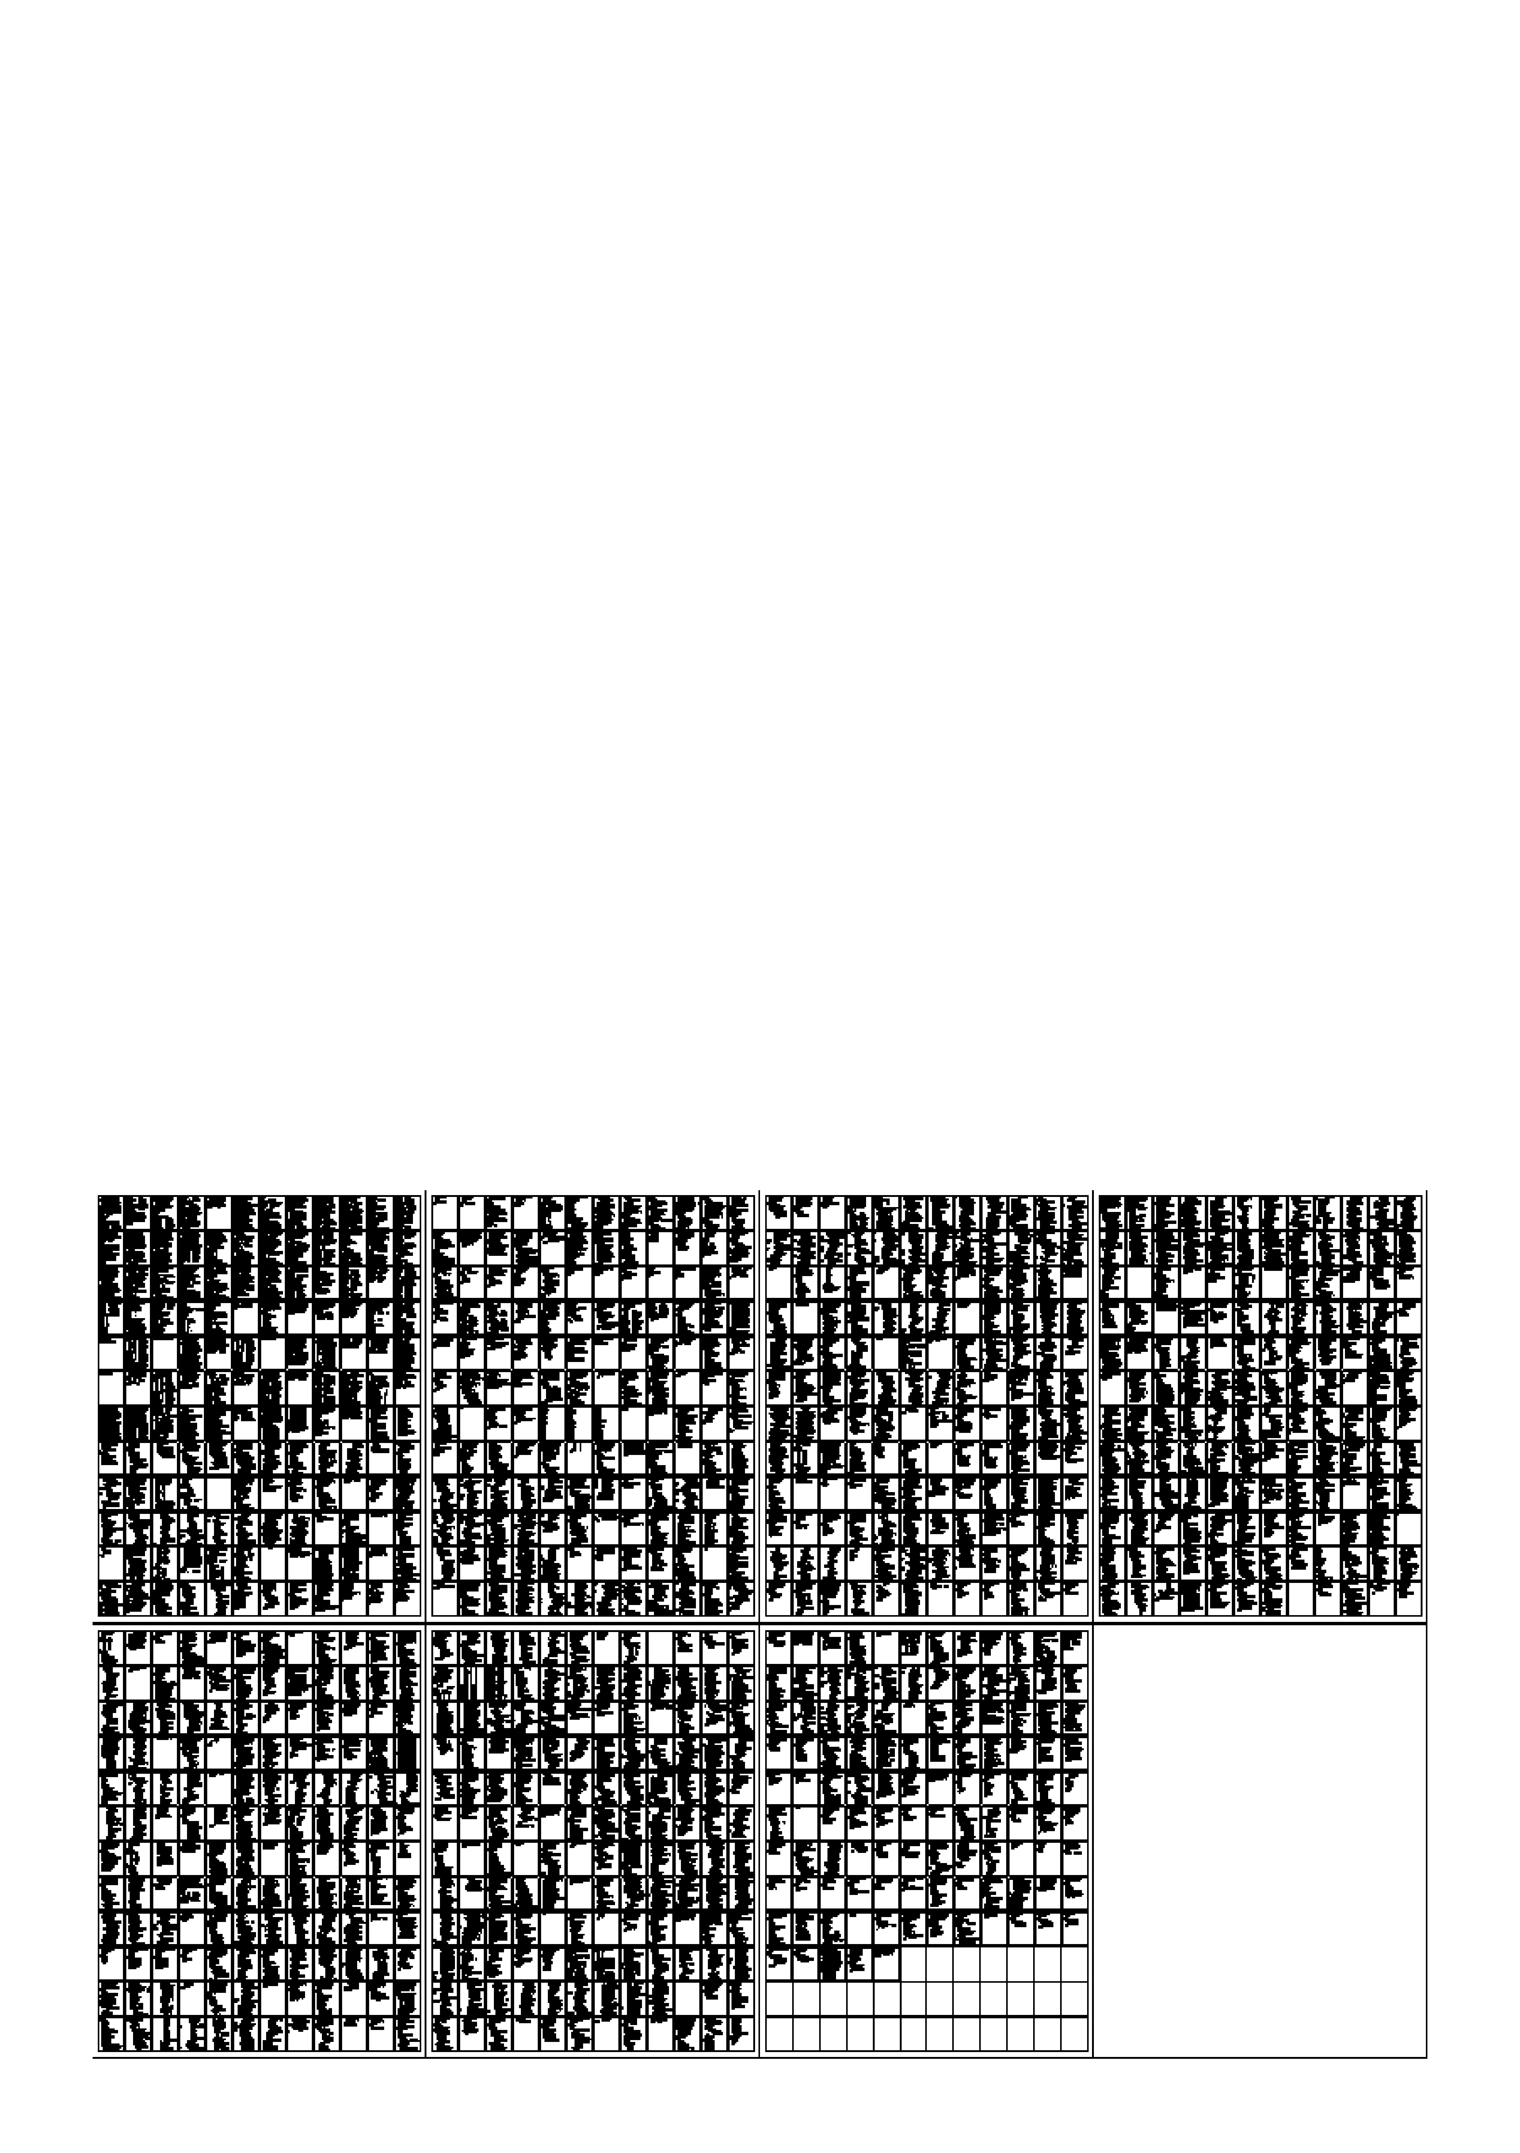
A Puzzle: Find the Overrun

Slide 9
Static Detection of Overruns
Introduce implicit variables:
  alloc(buf) = # bytes allocated for buf
  len(buf) = # bytes stored in buf
  Safety condition: len(buf) ≤ alloc(buf)
Check safety using range analysis
  Generate range constraints, and solve them
  y := x+5; X + 5 ⊆ Y
  New algorithm for solving range constraints
  E ::= n | E + n V C ::= E ⊆ V n ∈ Z, V ∈ Vars
  Warn user of all potential violations

Slide 10
Current Status
Experimental results
  Found new bugs in sendmail (30k LOC), others
  Analysis is fast, but many false alarms (1/kLOC)
  see also Dor, Rodeh, Sagiv
Research challenges
  Pointer analysis (support strong updates)
  Integer analysis (infer linear relations, flow-sensitivity)
  Soundness, scalability, real-world programs

Slide 11
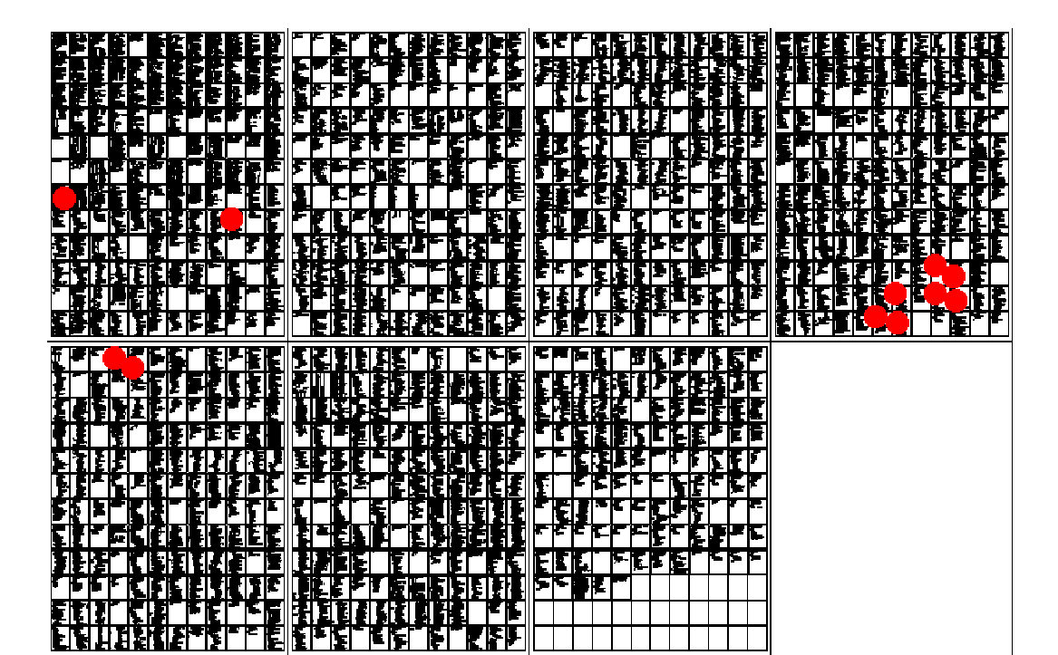
Solution to the Puzzle

Slide 12
Plan of the Talk
Security is hard because of…
  language traps (buffer overruns)
  privilege pitfalls
  untrusted data
  … and many others that I won’t consider in this talk

Slide 13
Pitfalls of Privileges
Spot the bug:
setuid(0);
rv = bind(...);
if (rv < 0)
return rv;
seteuid(getuid());
enablePriv()
checkPriv()
Bug! Leaks privilege
disablePriv()

Slide 14
A Common Language
Abstracting the operations on privileges
  S ::= call f() | S; S | S◊S (statements)
  | enablePriv(p) | disablePriv(p) | checkPriv(p)
  P ::= fun f = S | P P (programs)
Various interpretations are possible
  C: enablePriv(p) lasts until next disablePriv(p)
  Java: … or until containing stack frame is popped
  checkPriv(p) throws fatal error if p not enabled

Slide 15
Static Privilege Analysis
Some problems in privilege analysis:
  Privilege inference (auditing, bug-finding)
    Find all privileges reaching a given program point
  Enforcing privilege-safety (cleanliness of new code)
    Verify statically that no checkPriv() operation can fail
    … or that program behaves same under C & Java styles

Slide 16
One Possible Approach
Privilege inference/enforcement in cubic time:
  Build a pushdown automaton
  Γ = ProgPts × 2^{Privs} (stack symbols)
  (t,e)::s → (f,e)::(t’,e)::s (call f())
  (t,e)::s → s (return)
  (t,e)::s → (t’,e ∪ {p})::s (enablePriv(p))
  (t,e)::s → (t’,e)::s if p ∈ e (checkPriv(p))
  (t,e)::s → Wrong if p ∉ e (checkPriv(p))
  (t,e)::s → (t’,e \ {p})::s (disablePriv(p))
  Model-check this PDA
  see also Pottier, Skalka, Smith

Slide 17
Future Directions
Research challenges
  Experimental studies on real programs
  Handling data-directed privilege properties
  Other access control models

Slide 18
Plan of the Talk
Security is hard because of…
  language traps (buffer overruns)
  privilege pitfalls
  untrusted data
  … and many others that I won’t consider in this talk

Slide 19
Manipulating Untrusted Data
Spot the bug:
hp = gethostbyaddr(...);
printf(hp->hp_hname);
untrusted source of data
Bug! printf() trusts its first argument

Slide 20
Trust Analysis
Security involves much mental “bookkeeping”
  Problem: Help programmer keep track of which values can be trusted
One approach: static taint analysis
  Extend the C type system
  Qualified types express annotations: e.g., tainted char * is an untrusted string
  Typechecking enforces safe usage
  Type inference reduces annotation burden

Slide 21
A Tiny Example
a trust annotation
void printf(untainted char *, ...);
tainted char * read_from_network(void);
char *s = read_from_network();
printf(s);
… where untainted T ≤ tainted T

Slide 22
After Type Inference…
void printf(untainted char *, ...);
tainted char * read_from_network(void);
tainted char *s = read_from_network();
printf(s);
an inferred type
tainted
Doesn’t type-check! Indicates vulnerability
… where untainted T ≤ tainted T

Slide 23
Current Status
Experimental results
  Successful on real programs
    Able to find many previously-known format string bugs
    Cost: 10-15 minutes per application
  Type theory seems useful for security engineering
Research challenges
  Richer theory to support real programming idioms
  More broadly-applicable discipline of good coding
  Finer-grained notions of trust
  see also Myers et. al

Slide 24
Summary
high
Formal verification
(sweet spot?)
Assurance
Buffer overrun detection
Tainting analysis
Testing
low
cheap
Cost
expensive

Slide 25
Concluding Remarks
Static analysis can help secure our software
  Buffer overruns, privilege bugs, format string bugs
  Hits a sweet spot: cheap and proactive
Security as a source of interesting problems?
  Motivations for better pointer, integer analysis
  New problems: privilege analysis, trust analysis

Slide 26
Backup Slides

Slide 27
A Role for Static Analysis
Strong points of static analysis:
  Can detect vulnerabilities proactively
  Can focus on a few key properties with big payoffs
  Can reuse security specifications across programs
Application domains:
  Inference (program understanding, bug-finding)
    Appropriate for legacy code
  Enforcement (proving absence of bugs)
    Most useful when building new systems

