Slide 1
UCLID5
Duminda Wijesekera
CYSE 750, Spring 2026

Slide 2
Purpose
A tool for formal modeling of multi-modal systems, their verification, and synthesis.
Verification problems for heterogeneous systems: such as combinations of hardware and software
Use of syntax-guided and inductive synthesis to automate steps in modeling and verification.
Suitable for security and cyber-physical systems (CPS)
Code available at: https://github.com/uclid-org/uclid

Slide 3
More Explanations
Multi Modal = permits different modes of modeling
axiomatic and operational semantics
combinations of concurrent transition systems and procedural code
Offers a varied suite of specification modes
First-order formulas
Combination of logical theories,
Temporal logic
Inline assertions
Pre- and post-conditions
System invariants
Hyper-properties

Slide 4
Verification Techniques
Floyd-Hoare style proofs,
k-induction
Bounded model checking (BMC)
Syntax-guided and inductive synthesis
Satisfiability Modulo Theories
Synthesis modulo oracles

Slide 5
Basic Questions Addressed by UCLID5
In verification Mode:
If a model satisfies a given specification to a set of constraints that can be solved by an off-the-shelf SMT solver
In synthesis mode:
Reduces the problem of finding an interpretation for an uninterpreted function such that
The specification is satisfied into a SyGuS problem that can be solved by an off-the-shelf SyGuS solver
Where SyGuS = syntax-guided synthesis

Slide 6
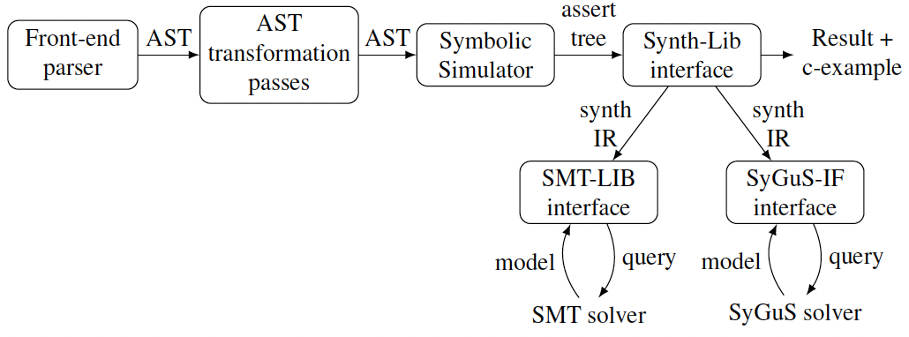
UCLID5 Architecture

Slide 7
Architectural Component 1: Front End Parser
Command-line front end:
Written in UCLID5 Language
Specifies:
Configurations
External SMT-solver or SyGuS-solver to be used,
Utilities such as automatically converting uninterpreted functions to arrays
Output:
An Abstract Syntax Tree (AST)

Slide 8
Example from UCLID5 Docs
uclid 0.9.5
Usage: uclid [options] <file> ...
-m, --main <Module> Name of the main module.
-s, --solver <Cmd> External SMT solver binary.
-y, --synthesizer <Cmd> Command line to invoke SyGuS synthesizer.
-g, --smt-file-generation <value>
File prefix to generate smt files for each assertion.
-X, --exception-stack-trace
Print exception stack trace.
-f, --sygus-format Generate the standard SyGuS format.
-e, --enum-to-numeric Enable conversion from EnumType to NumericType.
-u, --uf-to-array Enable conversion from Uninterpreted Functions to Arrays.
-t, --test-fixedpoint Test fixed point
--help prints this usage text
<file> ... List of files to analyze.

Slide 9
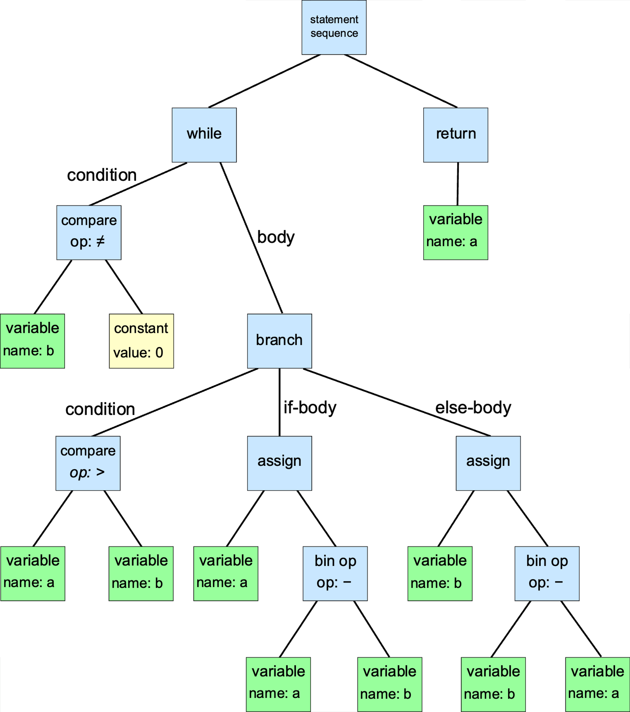
Abstract Syntax Tree
A data structure used to represent the structure of a program or code snippet.
It is a tree representation of the abstract syntactic structure of text (often source code) written in a formal language.
Each node of the tree denotes a construct occurring in the text.
while b != 0:
if a > b:
a := a - b
else: b := b - a
return a

Slide 10
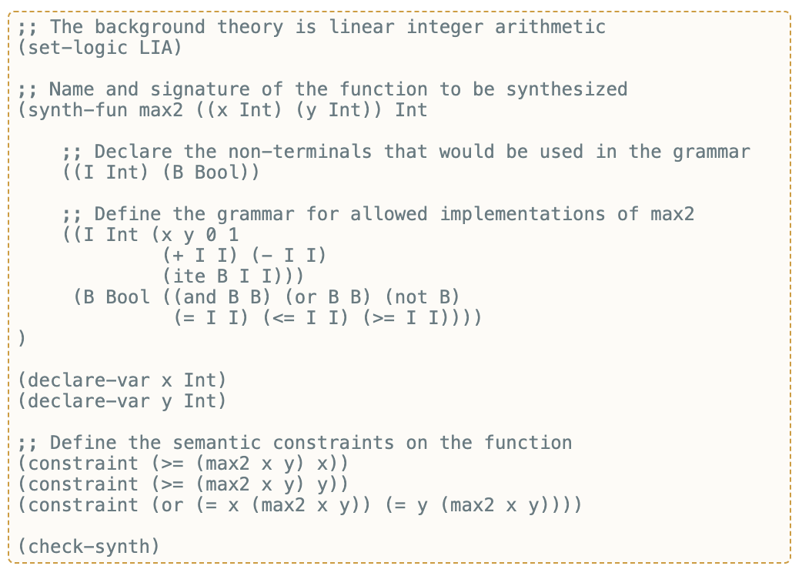
SyGuS Language
A standard language for specifying syntax-guided synthesis (SyGuS) problems
From https://sygus-org.github.io/language/
Based on SMT Lib 2.0
Provides an example syntax for specifying max2(x,y)

Slide 11
Architectural Component 2: AST Passes
Checks and transforms the AST
Type checks the AST
Inlining procedures
Provides an intermediate representation with
Limited control flow such as:
If statements and switch cases
Loops not permitted: Removed using
Unrolling,
replacement with user provided invariants or
Unbounded control flow represented by a transition system
Every module has its own
AST
Transition system

Slide 12
Architectural Component 3: Symbolic Simulator
Simulation of the transition system in the model, according to the verification command provided,
And produces a set of assertions.
Example:
If bounded model checking is used,
Will run the main module bounded # of time
Record each violation independent verification condition as an AST

Slide 13
Architectural Component 4: Synth-Lib Interface
Constructs either
a verification or
a synthesis problem
From the assertions generated by the symbolic simulator
The verification problems are passed to the SMT-LIB interface
converts each assertion in UCLID5’s intermediate representation to an assertion in SMT-LIB.
Synthesis problems are passed to the SyGuS-IF interface,
converts each assertion to an assertion in SyGuS-IF
problems are then passed to the appropriate provided external solver and he result is reported back to the user.

Slide 14
Multimodal Verification and Synthesis
Common specification methods
Inline assertions, assumptions in sequential code
Pre-conditions and post conditions for procedure calls
Global axioms and temporal invariants in LTL
Hyper Properties (i.e. those valid over multiple invocations)
Language features:
Hyperaxiom: Assumptions over multiple invocations of a module
Hyperinvariant: Invariant over multiple invocations of a module
Used mostly for k-safety

Slide 15
Example Hyper Properties
A variable from the m^{th} invocation of the module = x.m
The module can be invoked a maximum of n times
Hyperinvariant[2]: det_xy is y.1 == y.2
Available verification techniques:
Bounded Model Checking
Induction and k-induction
Pre-post conditions
Synthesis of hyper properties: next page

Slide 16
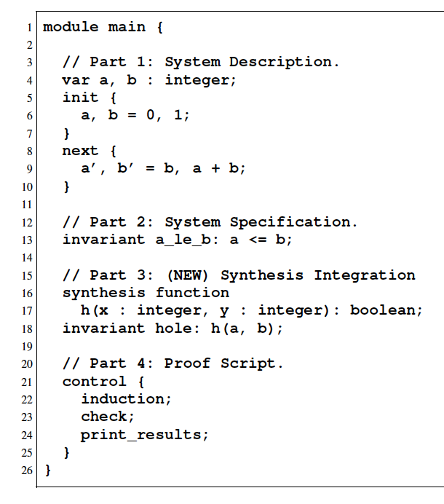
Example UCLID5 Code
Objective: (line 13) prove a_le_b
A non-inductive statement.
Normal Option: a user can strengthen to an inductive claim
UCLID5 can do this automatically!
Defined function h on lines 16-18
UCLID5 uses CVC (open SRC SMT) to generate an inductive assertion
(https://cvc5.github.io/)
CVC is an open source SMT solver
https://www-cs.stanford.edu/~preiner/publications/2022/BarbosaBBKLMMMN-TACAS22.pdf

Slide 17
Multi-Modal Modeling
Allows modeling concurrent executions as transition systems that are triggered within code from a main module.
The example we use is an abstracted version of the execution of trusted programming module
Requires execution and memory isolation at the hardware levels
Hardware updates systems concurrently

Slide 18
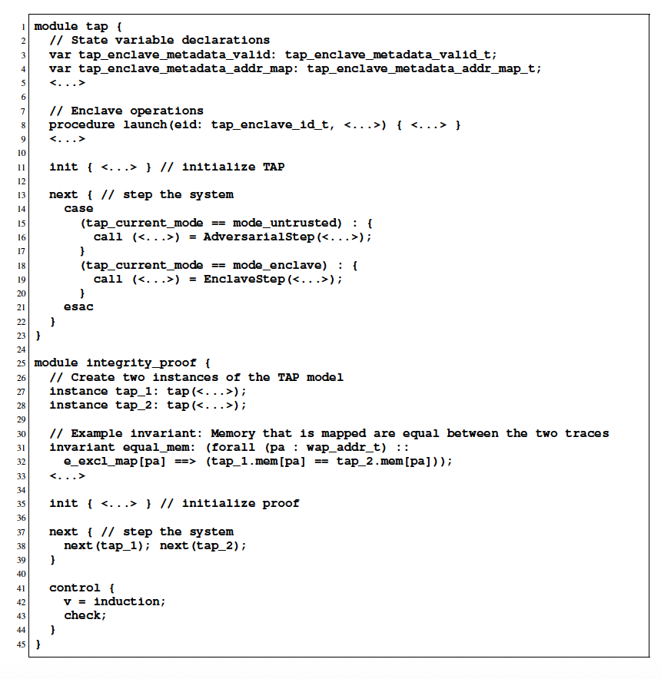
TPM in UCLID5
Launch (line 8) is a procedure call.
The next block (L 13-23) automatically executes:
Untrusted adv op
Trusted enclave
Proving the integrity hyper-property:
Integrity specified across both modules (L 31-32)
Proof initialized L 35
Uses inductive model checking
https://github.com/uclid-org/trusted-abstract-platform/
Papers: listed on the page
https://github.com/0tcb/TAP

Slide 19
Reasoning with External Oracles
Oracle function is a black box function provided without an implementation, but an externally callable binary that can be quired by the solver
Why this?
Using non-linear arithmetic - so SMT is hard, or
Difficult to model an implementation
Oracle functions are declared like normal functions
Function [isprime] Prime (x: integer) : boolean
Translated into
Satisfiability Modulo Theories and Oracles (SMTO) or
Synthesis Modulo Oracles (SyMO)

Slide 20
Combining Operational and Axiomatic Models
In axiomatic models, the system is specified as a set of properties over traces. Example – protocols
UCLID5 allows combining operational and axiomatic models.
μSpec on next page specifies a microarchitectural execution
Uses operational and axiomatic models

Slide 21
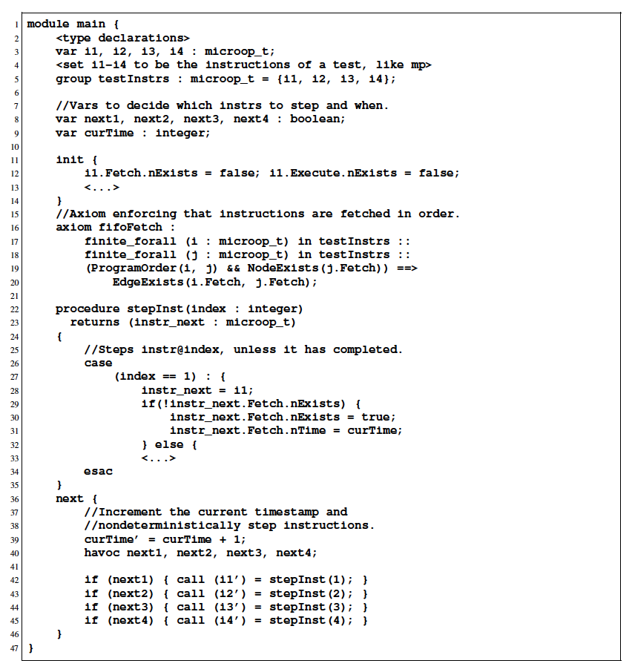
μSpec
Init (line 11) and next block (line 36) are operational
curTime (line 9) is the time at execution
Multiple instructions can step any time, execute at one timestep, but can take one step per time step
The fifoFetch axiom specifically enforces that instructions in program order on the same core must be fetched in program order.

Slide 22
More on μSpec
To fully specify μSpec, UCLID5 introduces twonew constructs
Groups: can have finitely many elements, but immutable after creation
Example: testInstrs (line 5)
Finite quantifiers: quantifies over group elements
Example: finite_forall (line 17,18)

