Slide 1

Synthetic Data Generator Tool

Slide 2

Introduction
One stop tool that generates synthetic data for your business needs. It combines the power of Large Language Models from OpenAI and Faker library with the robustness of LangChain. It comes with an intuitive and interactive interface built with Streamlit

Slide 3

Data Scarcity
The Challenges of Data Generation
Collecting enough real data can be expensive and time-consuming, especially for specific use cases or sensitive information.
Data Privacy Concerns
Using real data for testing or development can compromise user privacy and security, leading to ethical and legal issues.

Slide 4
1
LangChain
Provides a powerful framework for building data-driven applications by connecting different components, including LLMs and data sources.
Leveraging the power of LangChain, OpenAI and Faker
2
OpenAI
Offers advanced language models capable of generating realistic and diverse data, including text, code, and images.
3
Faker
A comprehensive library for generating realistic fake data for a wide range of use cases, including names, addresses, and phone numbers.

Slide 5

How the Synthetic Data Generator Works
1
Template Generation with User input
Users define the data requirements, such as the domain and number of records. The tool automatically leverages LLM power to detect the domain and generates the exact number of best suited columns relevant to the domain along with customization
2
Data Generation
The tool leverages LLMs or Faker based on user selection, and other libraries to populate the template with realistic and diverse data values.

Slide 6



User Input
The UI captures Domain and number of columns to be present as part of the template
Template Generation with User Input
Template Generation
Using real data for testing or development can compromise user privacy and security, leading to ethical and legal issues.
Customize Template
User gets to modify the column data types, remove and add columns along with the convenience to select foreign keys

Slide 7
Select Domain
Select the domain from the pre-generated template, no of records and upload the template configuration along with dependent csv which will be used to create relation with the generated data
Generation of Dataset
Data Generation
LLM reads the configuration uploaded and maps the best faker method to each column which is then evaluated and executed at runtime to create synthetic data which gets executed and populates the data accordingly
Association of Foreign Keys
In the same runtime, the developed custom service will check for foreign keys in the uploaded CSV and associate foreign keys from it to the generated dataset using data sampling

Slide 8




Template Generation User Input
1
Data Generation
Pyramid
Template Generation by LLM
2
Dataset Generation
User Input
3
Dataset Generation
by Faker
4

Slide 9
Template Generation Walkthrough

Slide 10
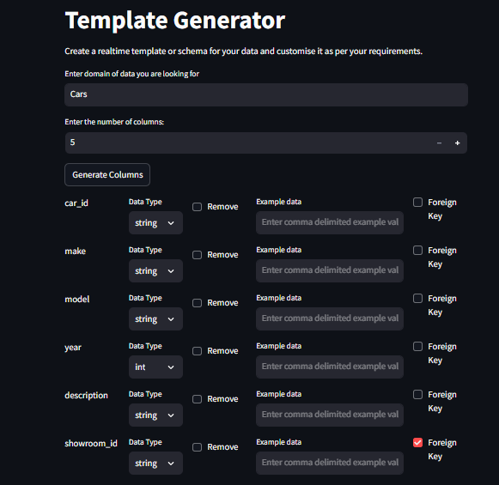
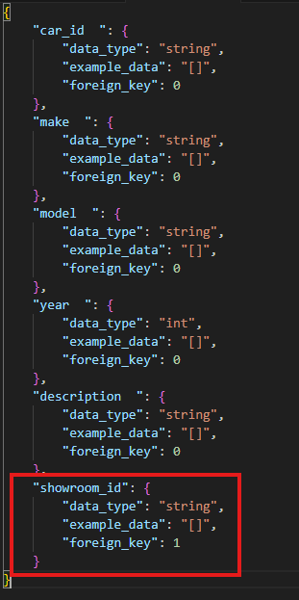
Template Generation Walkthrough (Cont.)
Template Configuration with Foreign Keys
If any existing column(s) or a newly added column(s) is/are marked as foreign key by the user, then it is captured in the template by the custom service which is leveraged later on in the process during dataset generation. Here’s an example where showroom_id is marked as foreign key in Cars Template and this is how it reflects in the Car Template configuration file

Slide 11
Dataset Generation Walkthrough

Slide 12
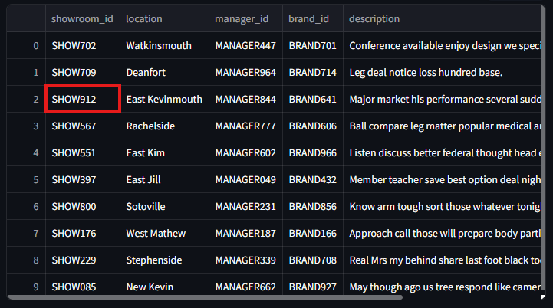
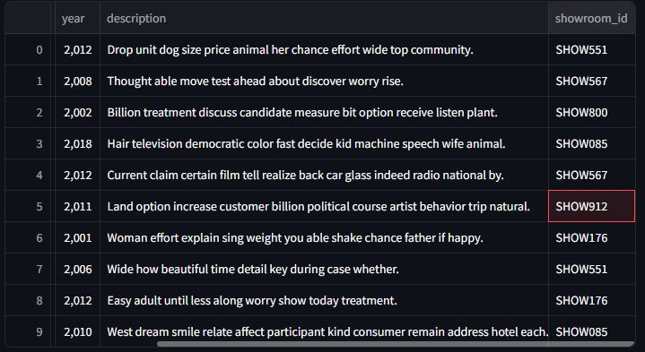
Dataset Generation Walkthrough (Cont.)
Dataset Generation with Foreign Keys
If any domain template has foreign key configured and during dataset generation if related CSV file containing the foreign keys is uploaded then the custom service takes care of it by randomly sampling the foreign keys into the foreign key id column(s) of the generated dataset.
Here’s an example where showroom_id is foreign key in Cars dataset and how the showroom_id is sampled into Cars dataset

Slide 13
Realistic Templates
The power of LLM is leveraged with the robustness of LangChain framework which generates a realistic and relevant data template specific to domain
Data Anonymity
Advantages of using the Tool
This tool uses Faker library solely for the purpose of data population as a result no PII data is generated
Efficient and Cost Effective
The tool leverages full power of LLM at the expense of minimal tokens. And since the dataset generation is done with Faker, the process becomes very efficient even during large dataset generation

Slide 14

Future of Synthetic Data Generation
As AI and data-driven technologies continue to evolve, synthetic data generation will play a crucial role in addressing data challenges and driving innovation across various fields. Expect to see a shift toward even more realistic and diverse synthetic data, further expanding its applicability and driving significant impact.

Slide 15

Thank You

