Slide 1
RIPPLE CARRY ADDER COMPUTER ORGANIZATION PCC-CS302 ARKAPRATIM GHOSH 13000121058 COMPUTER SCIENCE ENGINEERING

Slide 2
CONTENT
INTRODUCTION
- What is an adder ?
- Full Adder
RIPPLE CARRY ADDER
- Definition
- Circuit Diagram
- Logic Diagram
- Truth Table

Slide 3
INTRODUCTION
1
Let’s start with the BASICS

Slide 4
WHAT IS AN ADDER ?
An adder is a digital circuit that performs addition of numbers
They are operated on binary numbers
In processor it is used to calculate addresses, table operations

Slide 5
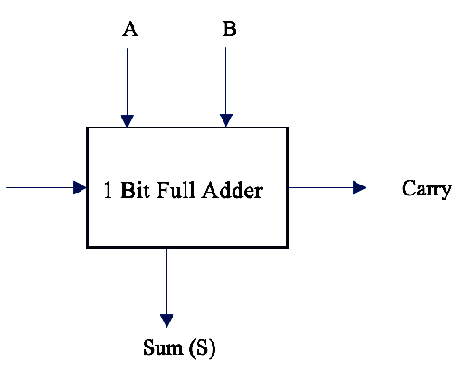
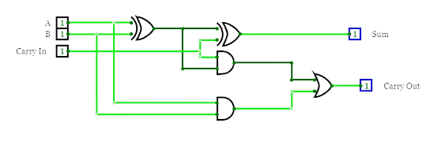
FULL ADDER
Used to add two input operand bits plus a carry in bit and outputs a carry out bit and sum bit
The sum is the XOR of the input bits and the carry is the AND of the input bits

Slide 6
RIPPLE CARRY ADDER
2
Definitions and representations

Slide 7
DEFINITION
It is constructed by cascading full block adders in series
Each carry bit gets rippled into the next stage
For two n-bit inputs we need n full adders

Slide 8
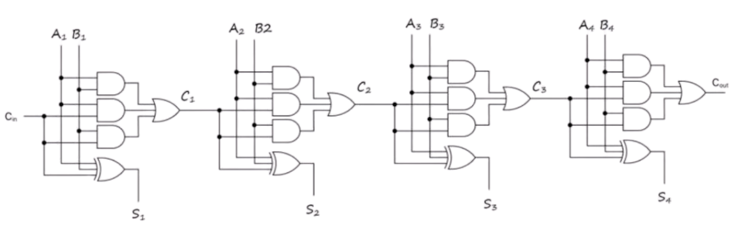
CIRCUIT DIAGRAM

Slide 9
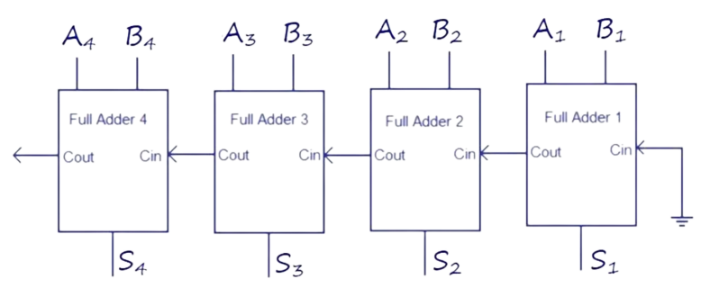
LOGIC DIAGRAM

Slide 10
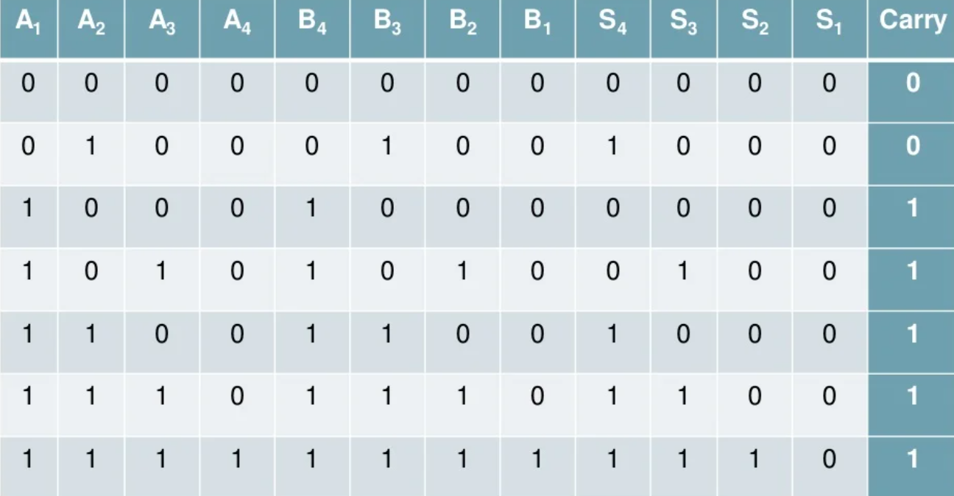
TRUTH TABLE

Slide 11


