Slide 1

CONVERGENT SEQUENCE
Mathematics-III (Differential Calculus)
Code: BSC-301
ARKAPRATIM GHOSH
13000121058

Slide 2
CONTENT
INTRODUCTION
• What is a sequence ?
• What is a convergent sequence ?
PROPERTIES OF CONVERGENT SEQUENCE
• A few basic theorems
APPLICATIONS
REFERENCE

Slide 3
SEQUENCE
A collection S of real numbers is said to be a sequence of numbers if corresponding to every positive integer n, there exists a unique element a_{n} of S.
Example: {5,7,9,11} is finite sequence. {1,½,1/3,¼,...} is harmonic sequence.

Slide 4


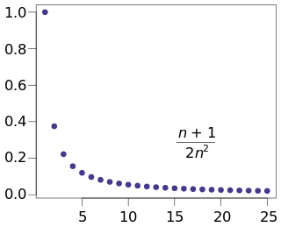
CONVERGENT SEQUENCE
A sequence {a_{n}} is said to be convergent if is finite.
Example: In {1,1/3,1/3²,…,1/3^{n},…} ,the sequence {an} where an = 1/3^{n} , is convergent since ,L=0 is finite.
A convergent sequence determines its limit uniquely. Every convergent sequence is bounded. A monotonic increasing or decreasing sequence which is bounded above or below respectively is said to be convergent.

Slide 5
APPLICATIONS
Convergence is a concept used throughout calculus in the context of limits, sequences, and series. A convergent sequence is one in which the sequence approaches a finite, specific value.
convergence is used to show that an algorithm is correct or behaves like it should, e.g. in machine learning and probabilistic algorithms.

Slide 6
REFERENCES
The information in this presentation has been taken from the book ENGINEERING MATHEMATICS Volume IIIA by B.K. Pal , K. Das.
analysis - Applications of Convergence of a series in Algorithms - Mathematics Stack Exchange

