Slide 1
PRODUCT OF SUM AND MAX-TERM REPRESENTATION
ANALOG & DIGITAL ELECTRONICS
ESC-301
ARKAPRATIM GHOSH
13000121058
COMPUTER SCIENCE AND ENGINEERING

Slide 2
CONTENT
INTRODUCTION
⦿ PRODUCT OF SUM
- Definition
- Example
STANDARD POS FORMS
⦿ DEFINITION
⦿ CONVERSION FROM ANY POS TO STANDARD POS
⦿ TRUTH TABLE
REPRESENTATION
MAX-TERMS
⦿ DEFINITION
⦿ TRUTH TABLE REPRESENTATION

Slide 3
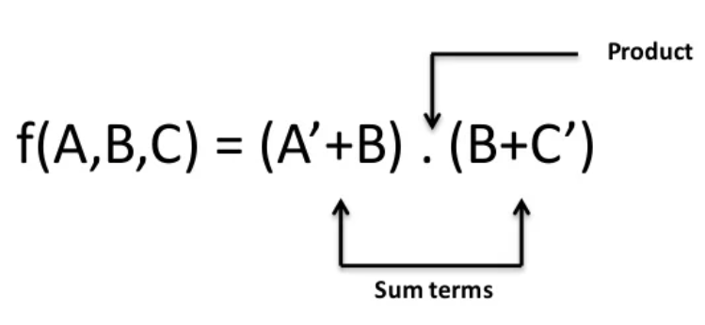
PRODUCT OF SUM
When two or more sum terms are multiplied together
EXAMPLE:

Slide 4
CANONICAL OR STANDARD POS FORM
⦿ In POS form all the terms do not involve all the literals
⦿ For example:
The expression A.(B+C)
-the first term does not contain B and C whereas the second term does not contain A
⦿ If each term of POS contain all the literals then it is known as STANDARD POS FORM
Lets take an example and convert it to Standard POS form
- f(a,b,c)= (A+B).(B+C).(A+C)

Slide 5
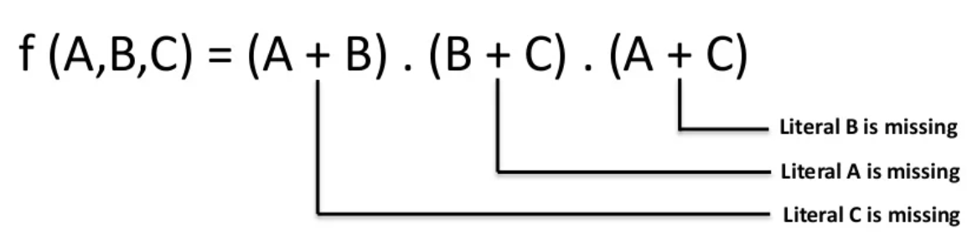
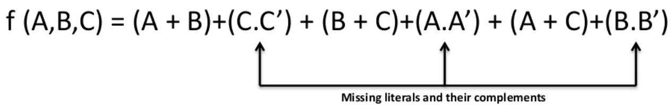
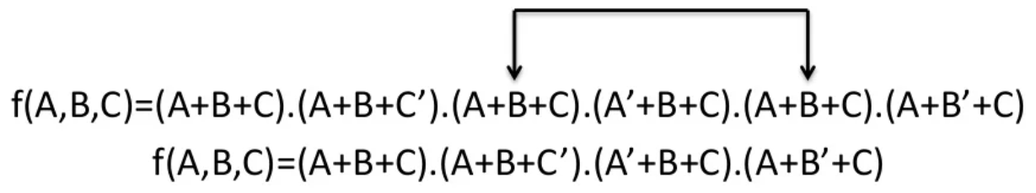
STEP-WISE CONVERSION TO STANDARD POS FORM
⦿ Find the missing literals in each sum term.
⦿ OR the sum term with missing literals and its complement.
⦿ Expand the term and reorder the literals and omit the repeated terms

Slide 6
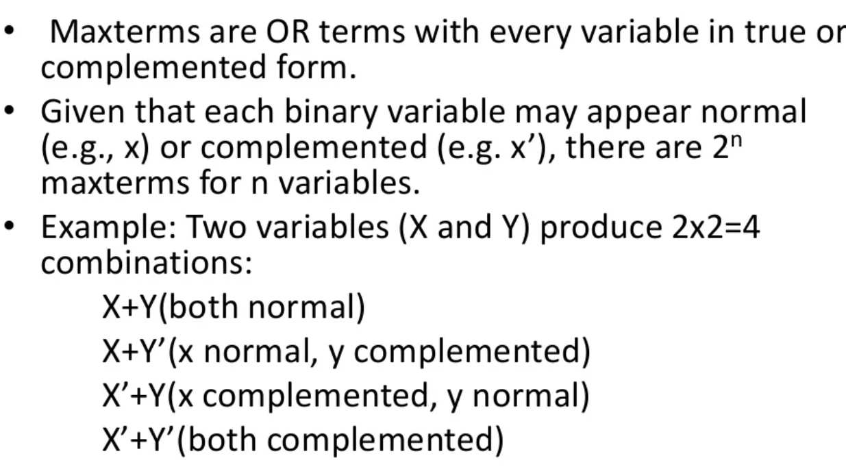
MAX-TERMS

Slide 7
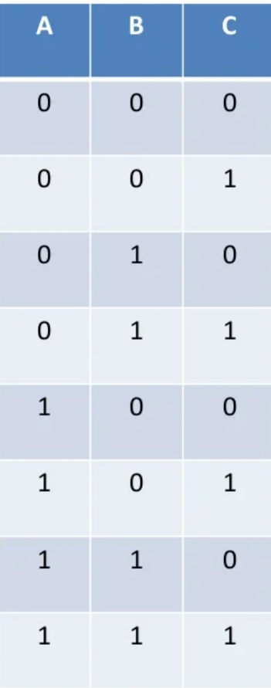
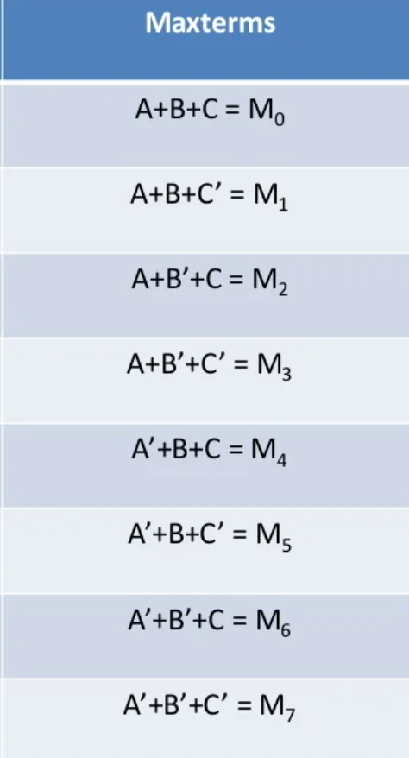
TRUTH TABLE REPRESENTATION OF MAX TERMS

Slide 8
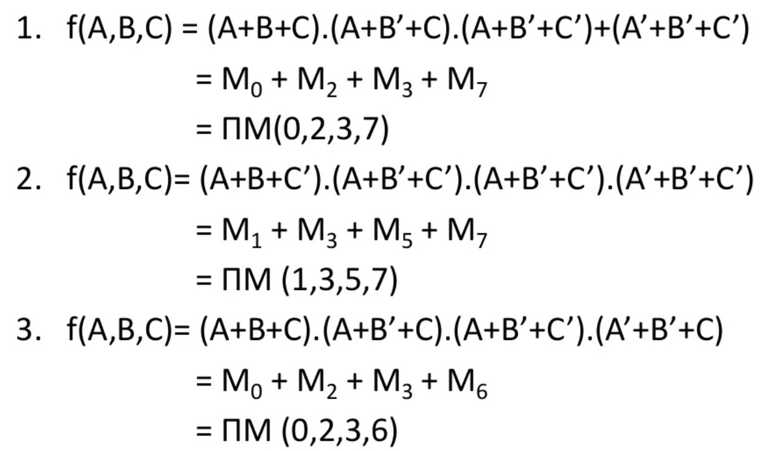
MAX-TERMS EXAMPLES

Slide 9
THANK YOU

