Slide 1

ABSTRACT DATA TYPES DATA STRUCTURE & ALGORITHM PCC-CS301 ARKAPRATIM GHOSH 13000121058 CSE-A

Slide 2

CONTENT
INTRODUCTION
⦿ What is a datatype?
⦿ User-defined datatype
ABSTRACT DATA TYPES
⦿ DEFINITION
⦿ IMPLEMENTATION
⦿ ADVANATGES

Slide 3
INTRODUCTION
1
Let’s start with the basics

Slide 4


WHAT IS A DATATYPE ?
A classification that indicates what a variable or object can hold
Defines a certain domain of values
Defines operations allowed on those values
int type – Takes integer values. Allows operations like addition, subtraction, multiplication, division etc.

Slide 5

USER DEFINED DATATYPE
The operations of user defined datatypes are specified by users
Examples: structure, union, enumerations
By using structure we are defing our own datatype by combining other datatypes
struct student{
int class;
int roll;
}

Slide 6
2
ABSTRACT DATATYPES (ADTs)
What’s so abstract about it ?

Slide 7
DEFINITION AND IMPLEMENTATION
ADTs are like user defined datatypes which defines operations on values using functions without specifying what is there inside the functions and how operations are performed
EXAMPLE: Stack ADT – consists of elements of same type arranged in a sequential order, implemented by using arrays and linkedlists
Operations:initialize()- initialising it to be empty.
push()- insert an element into the stack.
pop()- remove an element from the stack.
isEmpty()- checks if the stack is empty or not.
isFull()- checks if the stack is full or not.

Slide 8
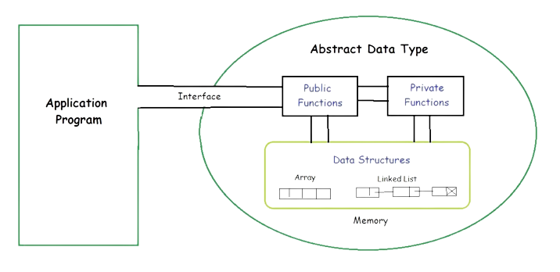
ADVANTAGES
Acts as a black box and interface.
A user’s actions are not affected if the underlying implementation of an ADT is changed as the client program has nothing to do with it.
ADT provides
ABSTRACTION

Slide 9


