Slide 1
COST ESTIMATION MODEL
Economics for Engineers (Humanities-II)
Code: HSMC-301
ARKAPRATIM GHOSH
13000121058

Slide 2
CONTENT
INTRODUCTION
Cost Estimation
INTRODUCTION
Cost Estimation
COST ESTIMATION MODELS
Per Unit Cost Model
Segmenting Model
Cost Indexing Technique
Power-Sizing Model
Learning Curve Model

Slide 3
1.
INTRODUCTION
Cost Estimation

Slide 4
COST ESTIMATION
Cost estimation is the development of the functional relationship between a cost object and its cost drivers for the purpose of predicting the cost
Cost estimates based on activity-based,
volume-based, structural, and
executional cost drivers facilitate
strategic positioning analysis, value-
chain analysis, target costing and life-
cycle costing

Slide 5
2.
COST ESTIMATION MODELS
Several models are available for estimating cost

Slide 6
PER UNIT MODEL
The per-unit model is a simple but useful model in which a cost estimate is made for a single unit, then the total cost estimate results from multiplying the estimated cost per unit times the number of units.
PER UNIT COST = TOTAL COST
NUMBER OF UNITS PRODUCED

Slide 7
SEGMENTING MODEL
The segmenting model partitions the total estimation task into segments. Each segment is estimated, then the segment estimates are combined for the total cost estimate.
segment | A1 | A2 | A3
No. of units produced | n1 | n2 | n3
Cost per unit | c1 | c2 | c3
Cost of segment | n1c1 | n2c2 | n3c3
n
TOTAL COST = Σ ni.ci
i=1
n
AVERAGE = Σ ni.ci
COST i=1
Σ ni
i=1

Slide 8
COST INDEXING TECHNIQUE
Cost indexes can be used to account for historical changes in costs. The widely reported Consumer Price Index (CPI) is an example. Cost index data are available from a variety of sources. Suppose A is a time point in the past and B is the current time. Let IVA denote the index value at time A and IVB denote the current index value for the cost estimate of interest. To estimate the current cost based on the cost at time A, use the equation:
Cost at time B = (Cost at time A) (IVB / IVA).

Slide 9
POWER SIZING MODEL
The power-sizing model accounts explicitly for economies of scale. To estimate the cost of B based on the cost of comparable item A, use the equation
Cost of B = (Cost of A) [ ("Size" of B) / ("Size" of A) ] x
where x is the appropriate power-sizing exponent, available from a variety of sources. An economy of scale is indicated by an exponent less than 1.0 An exponent of 1.0 indicates no economy of scale, and an exponent greater than 1.0 indicates a diseconomy of scale.

Slide 10
LEARNING CURVE MODEL
Learning curve cost estimating is based on the assumption that as a particular task is repeated, the operator systematically becomes quicker at performing the task.The learning curve slope indicates "how fast" learning occurs.
Let b = learning curve exponent
= log (learning curve rate in decimal form)/log2.0
Then TN = time estimate for unit N (N = 1, 2,...)
= (T1) (N)b
where T1 is the time required for unit 1.

Slide 11
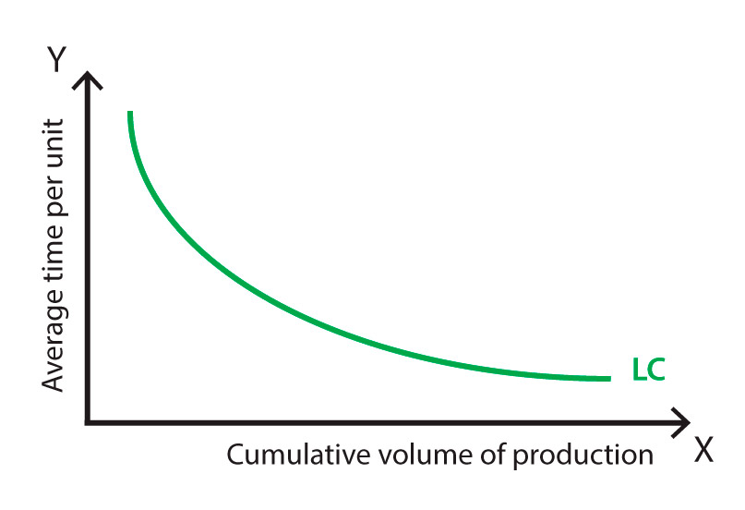
LEARNING CURVE : TIME V/S VOLUME OF PRODUCTION

Slide 12
THANK YOU

