Slide 1

TOPIC: QUESTION 19
NAME : Arkapratim Ghosh
Roll No. : 13000121058
Registration No. : 211300100110045
Paper Name: Database Management Systems
Paper Code: PCC-CS601
CSE, Sec-A, 6th Sem (2021-2025), CA-1

Slide 2
QUESTION 19
The Hudson Engineering Group (HEG) has contacted you to create a conceptual model whose application will meet the expected database requirements for the company’s training program. The HEG administrator gives you the description (see below) of the training group’s operating environment. The HEG has 12 instructors and can handle up to 30 trainees per class. HEG offers five “advanced technology” courses, each of which may generate several classes. If a class has fewer than 10 trainees, it will be cancelled. Therefore, it is possible for a course not to generate any classes. Each class is taught by one instructor. Each instructor may teach up to two classes or may be assigned to do research only. Each trainee may take up to two classes per year.
Construct an ER diagram.
List your assumptions and clearly indicate the cardinality mappings as well as any role indicators in your ER diagram.
Map the ERD in the relational model corresponding to the described application.
Also make sure to have the primary keys and foreign keys clearly

Slide 3
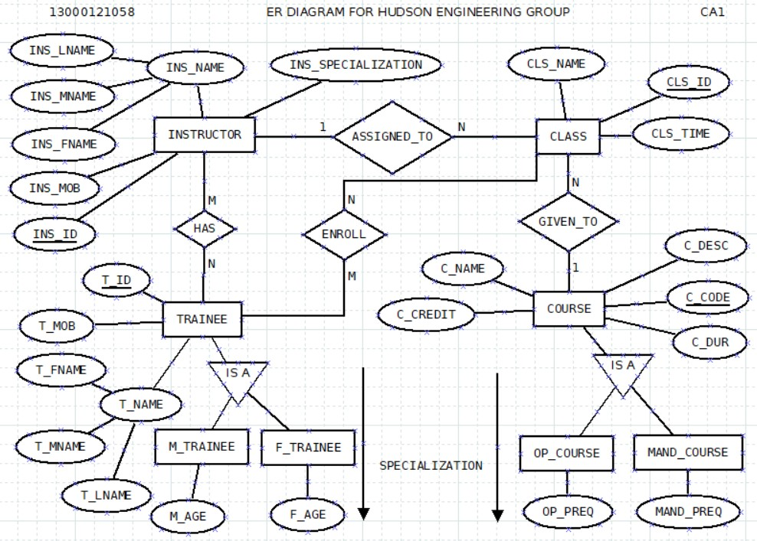
ER DIAGRAM

Slide 4
ENTITY AND THEIR ATTRIBUTES
INSTRUCTOR { INS_ID, INS_MOB, INS_FNAME, INS_MNAME, INS_LNAME, INS_SPECIALIZATION }
TRAINEE { T_ID, T_MOB, T_FNAME, T_MNAME, T_LNAME, T_SPECIALIZATION }
M_TRAINEE { M_AGE }
F_TRAINEE { F_AGE }
CLASS { CLS_ID, CLS_TIME, CLS_NAME }
COURSE { C_CODE, C_NAME, C_DESC, C_CREDIT, C_DUR }
OP_COURSE { OP_PREQ }
MAND_COURSE { MAND_PREQ }

Slide 5
ENTITIES AND RELATIONSHIPS
Cardinality with limits
ASSIGNED_TO
0..2
1..1
INSTRUCTOR
CLASS
An instructor can take 2 classes or none. A class can be taken by one instructor.
ASSIGNED_TO
1
N
INSTRUCTOR
CLASS
One to many relationship

Slide 6
ENTITY AND RELATIONSHIPS
Cardinality with limits
HAS
0..60
2..12
INSTRUCTOR
TRAINEE
An instructor has maximum 60 students. A trainee can have minimum 2 and maximum 12 instructors
HAS
M
N
INSTRUCTOR
TRAINEE
Many to many relationship

Slide 7
ENTITY AND RELATIONSHIPS
Cardinality with limits
ENROLL
0..2
10..30
TRAINEE
CLASS
A trainee can take maximum 2 classes in a year. A class should have all unique trainee
ENROLL
M
N
TRAINEE
CLASS
Many to many relationship

Slide 8
ENTITY AND RELATIONSHIPS
Cardinality with limits
GIVEN_TO
1..1
0..*
CLASS
COURSE
A course can generate any number of classes. A class can be given for one course
GIVEN_TO
N
1
CLASS
COURSE
Many to one relationship

Slide 9
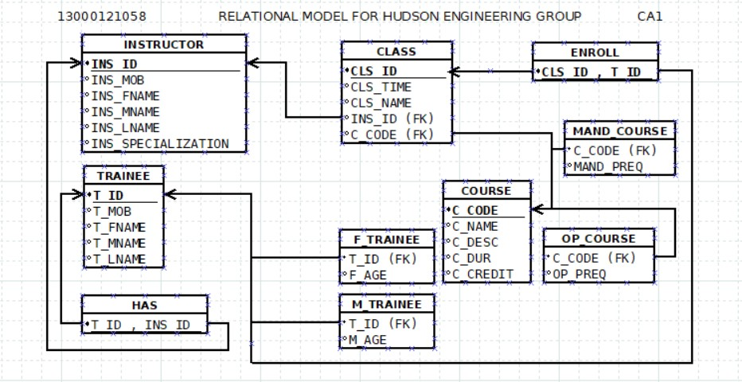
RELATIONAL MODEL

Slide 10
KEYS
PRIMARY KEYS | FOREIGN KEYS | COMPOSITE PRIMARY KEYS
INS_ID in table INSTRUCTOR | INS_ID in table CLASS | INS_ID , T_ID in table HAS
T_ID in table TRAINEE | T_ID in table F_TRAINEE , M_TRAINEE
CLS_ID in table CLASS |  | CLS_ID , T_ID in table ENROLL
C_CODE in table COURSE | C_CODE in table CLASS , MAND_COURSE , OP_COURSE

Slide 11
ASSUMPTIONS
An instructor can teach zero or more classes. According to the question the maximum number of class can be 2.
A class can be taught by one instructor at a time.
An instructor can have zero or more trainee. According to the question the maximum number of trainee can be 60 as one instructor can teach maximum 2 classes. A class can have maximum 30 trainee.
A trainee can be taught by one instructor in a class.
A trainee can enroll in multiple classes. The maximum number of classes is 2 in a year.
A trainee can be male or female.
A class has unique trainee. A class can have minimum 10 and maximum 30 trainees.
A course can be given to multiple classes.
A class can be given for one course at a time.
A course can be optional or mandatory depending on the prerequisites.

Slide 12
REFERENCES
Database System Concepts by Abraham Silberschatz Henry F. Korth S. Sudarshan
THANK YOU

