Slide 1
About Me - A Cosmic Dreamer
By Arka Provo Pal
Notes:
---

Slide 2
Introduction
Notes:
About Me

Slide 3
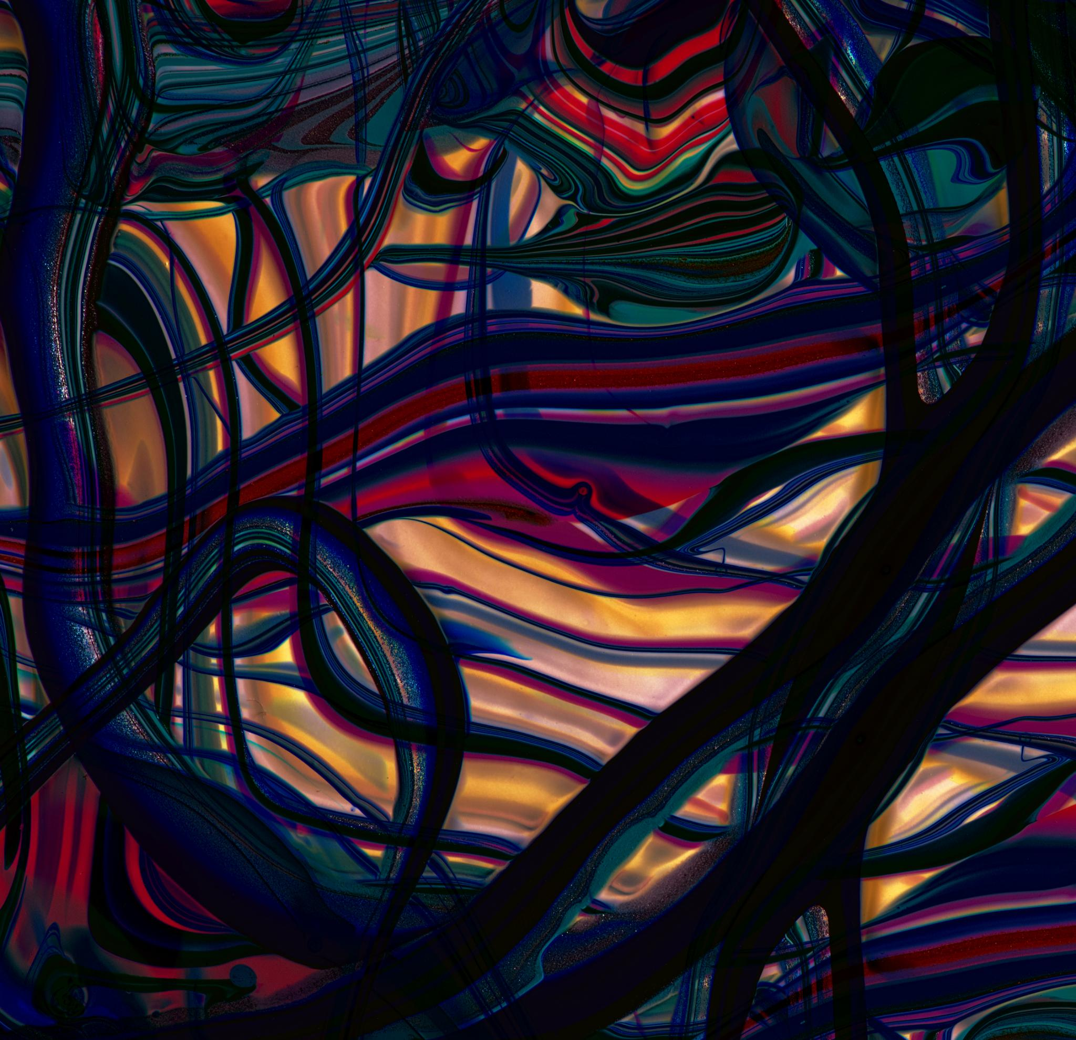
About Me
Personal Identity
  The presentation reveals a personal journey shaped by inner thoughts, emotions, and philosophical beliefs.
Dreams and Aspirations
  Dreams and hopes play a central role, guiding the narrative of the inner universe shared in the presentation.
Emotional and Poetic Expression
  Poetic and emotional reflections express how life’s complexities and love are perceived quietly amidst chaos.
Notes:
This presentation offers a glimpse into the essence of who I am, shaped by my thoughts, emotions, and philosophies. It is a journey through my favorite moments, my identity, my dreams, and my beliefs. Each slide reflects a part of my soul, revealing how I perceive life and navigate its absurdities. Through poetic expressions and introspective reflections, I aim to share the unique lens through which I view the world. This is not just a presentation; it is a narrative of my inner universe, where dreams reign supreme and love whispers quietly amidst chaos.

Slide 4
Favorite Time
Notes:
Dusk and November

Slide 5

Dusk and November
The Beauty of Dusk
  Dusk marks the serene transition from daylight to darkness, symbolizing change and peaceful endings.
November’s Reflective Mood
  November’s cool air and introspective ambiance inspire reflection and acceptance of life’s unpredictability.
Sanctuary of Mind
  Together, dusk and November create a peaceful sanctuary for introspection and poetic appreciation of life.
Notes:
Dusk is my favorite time of the day, a moment when the world transitions from light to darkness, embodying the beauty of change and the serenity of endings. November, my favorite month, encapsulates this feeling perfectly. It is a time of reflection, of embracing the absurdity of life, and finding peace in its unpredictability. The fading light of dusk symbolizes the quietude I seek, a pause in the chaos where I can truly connect with myself. November, with its cool air and introspective ambiance, becomes a canvas for my thoughts and dreams. Together, dusk and November represent my sanctuary, a space where I can appreciate the poetic nature of existence.

Slide 6
Identity
Notes:
Cosmic Dread Lover

Slide 7

Cosmic Dread Lover
Embracing Cosmic Vastness
  Acceptance of the infinite universe and its mysteries highlights wonder amidst existential dread.
Finding Beauty in Absurdity
  Appreciation for life's absurdity involves recognizing its beauty despite dark realities.
Dancing with Uncertainty
  Cherishing fleeting moments and loving deeply despite life's unpredictable chaos.
Notes:
I identify as the cosmic dread lover, a being who embraces the vastness and mystery of the universe while acknowledging the existential dread that accompanies it. This identity is rooted in a deep appreciation for the absurdity of life and a willingness to find beauty within it. I do not shy away from the darkness; instead, I find love and meaning in it. The cosmos, with its infinite possibilities and unknowns, mirrors my inner world—complex, enigmatic, and profoundly poetic. To be a cosmic dread lover is to dance with uncertainty, to cherish fleeting moments, and to love deeply despite the chaos.

Slide 8
Dream Philosophy
Notes:
Resilience in Dreams

Slide 9

Resilience in Dreams
Power of Imagination
  Imagination fuels resilience by allowing us to envision hope beyond present difficulties.
Dreams as Refuge
  Dreams serve as a refuge and guiding light during times of despair and challenge.
Enduring Spirit
  Resilience in dreaming reflects an enduring spirit that never ceases despite hardship.
Notes:
Dreaming is an integral part of my existence. Even when life betrays me, I continue to dream. Even when dreams abandon me, I hold onto the act of dreaming. This resilience is not born out of naivety but from a profound belief in the power of imagination and hope. Dreams are my refuge, my guiding light in times of despair. They allow me to transcend reality and envision a world where love, clarity, and peace prevail. My philosophy is simple yet powerful: never stop dreaming, for dreams are the essence of life and the foundation of my spirit.

Slide 10
My Balance
Notes:
Dreams vs Work

Slide 11

Dreams vs Work
Value of Dreams
  Dreams fuel passion, inspire thoughts, and shape one’s worldview as essential parts of being.
Work and Productivity
  Work often measures success by productivity and routine but may limit emotional depth and creativity.
Authentic Living
  Embracing balance between dreams and work enables authentic living beyond societal expectations.
Notes:
I often find myself dreaming too much and working too little. This imbalance is not a flaw but a reflection of my priorities. I value introspection, creativity, and emotional depth over productivity and routine. While society may measure success through work, I measure it through the richness of my inner life. My dreams fuel my passion, inspire my thoughts, and shape my worldview. They are not distractions but essential components of my being. By embracing this balance, I allow myself to live authentically, guided by my dreams rather than constrained by expectations.

Slide 12
My Belief
Notes:
Modern Luxury

Slide 13

Modern Luxury
Clarity of Mind
  Clear thinking helps navigate life with purpose amidst chaos and distractions.
Deep Restful Sleep
  Deep sleep rejuvenates the soul and is essential for well-being.
Slow, Mindful Movement
  Moving slowly fosters presence and mindfulness in daily life.
Quiet, Nurturing Love
  Quiet love nurtures relationships and fosters intimacy and grace.
Notes:
I believe that modern luxury is the ability to think clearly, sleep deeply, move slowly, and love quietly in a world designed to prevent all four. This belief stems from a desire to reclaim simplicity and mindfulness in an increasingly chaotic and fast-paced world. Clear thinking allows me to navigate life with purpose; deep sleep rejuvenates my soul; slow movement fosters presence; and quiet love nurtures my relationships. These luxuries are rare yet essential, offering a path to true fulfillment. In a society that values speed and noise, I choose clarity, rest, grace, and intimacy as my treasures.

Slide 14
Closing Thoughts
Notes:
Embracing Absurdity

Slide 15

Embracing Absurdity
Acceptance of Life's Absurdity
  Embracing life's unpredictability brings joy and meaning despite the chaos and challenges.
Guided by Dreams and Love
  Dreams and quiet love provide guidance and comfort in navigating life's madness.
Journey of Introspection and Resilience
  The personal journey involves introspection, resilience, and poetic self-expression.
Inspiration for Authentic Living
  Sharing this journey inspires others to dream, love, and live authentically amid absurdity.
Notes:
Life is absurd, unpredictable, and often challenging. Yet, I embrace it with open arms, guided by dreams and quiet love. This acceptance allows me to find joy in the chaos and meaning in the madness. I do not seek perfection or certainty; instead, I cherish the moments of clarity, the whispers of love, and the sparks of imagination. My journey is one of introspection, resilience, and poetic expression. Through this presentation, I hope to share a piece of my soul and inspire others to dream, love, and live authentically amidst the absurdity of life.

