Slide 1

Intelligent Flood Warning System
By Team DELENITORS

Slide 2
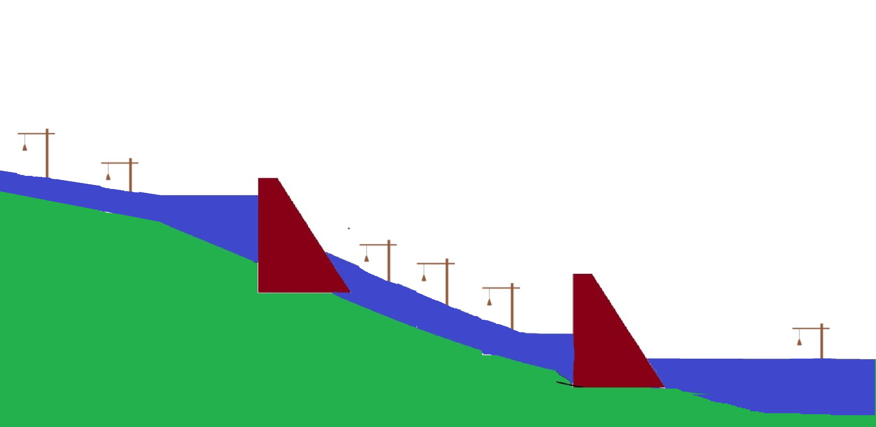
SENSOR STATION PLACEMENT SCHEMATIC
DAM 1
DAM 2

Slide 3

ACCIDENTAL BLOCKAGE LOCATION DETECTION
Higher altitude side
Lower altitude side
Station 1
Station 2

Slide 4
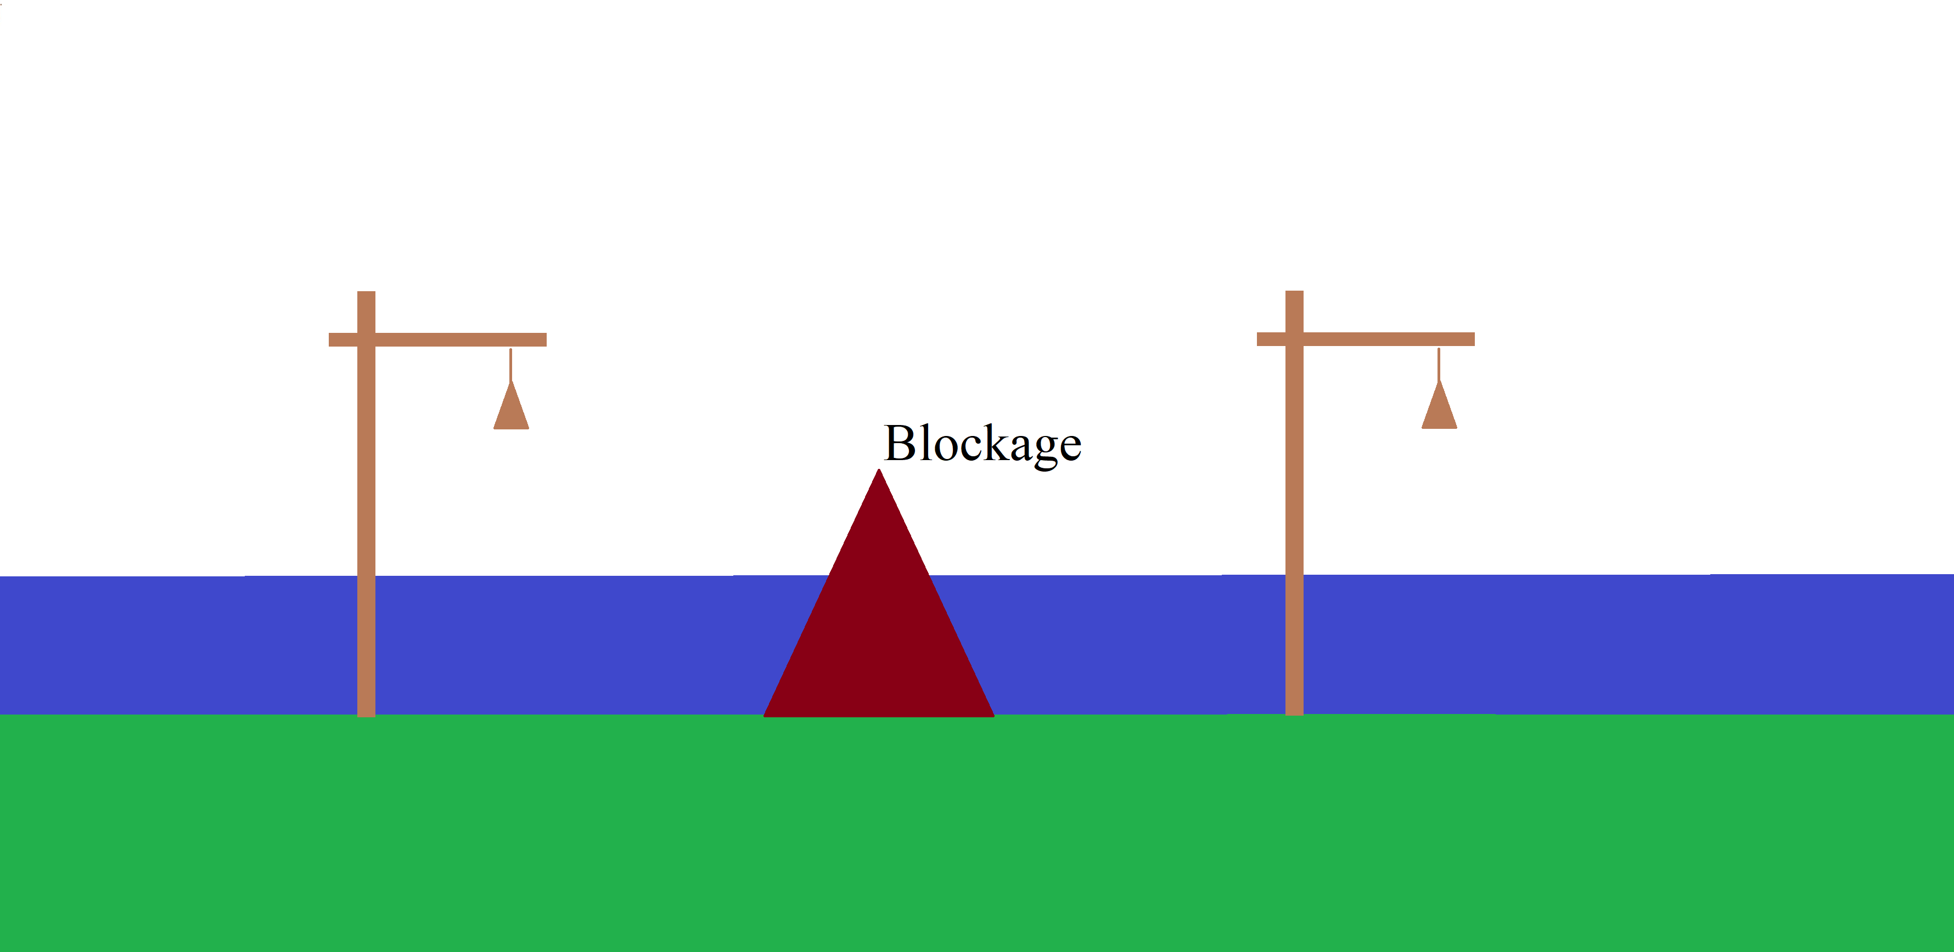
ACCIDENTAL BLOCKAGE LOCATION DETECTION
Higher altitude side
Lower altitude side
Station 1
Station 2

Slide 5
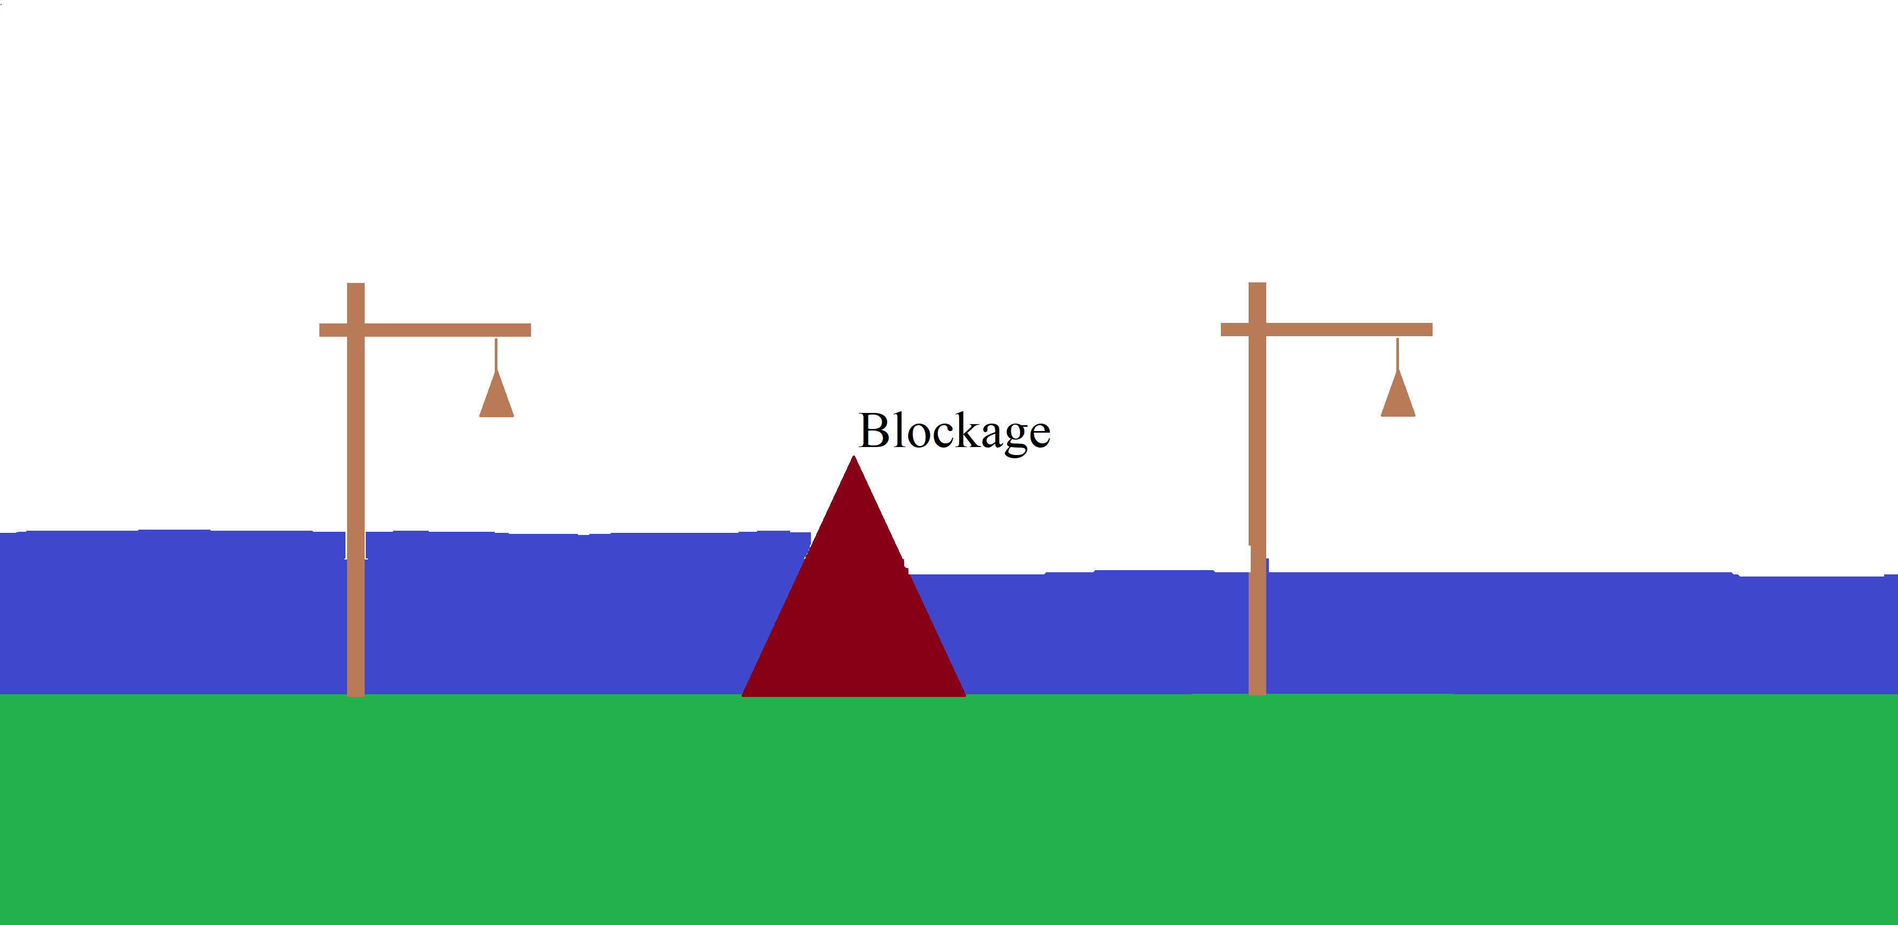
ACCIDENTAL BLOCKAGE LOCATION DETECTION
Higher altitude side
Lower altitude side
Station 1
Station 2

Slide 6
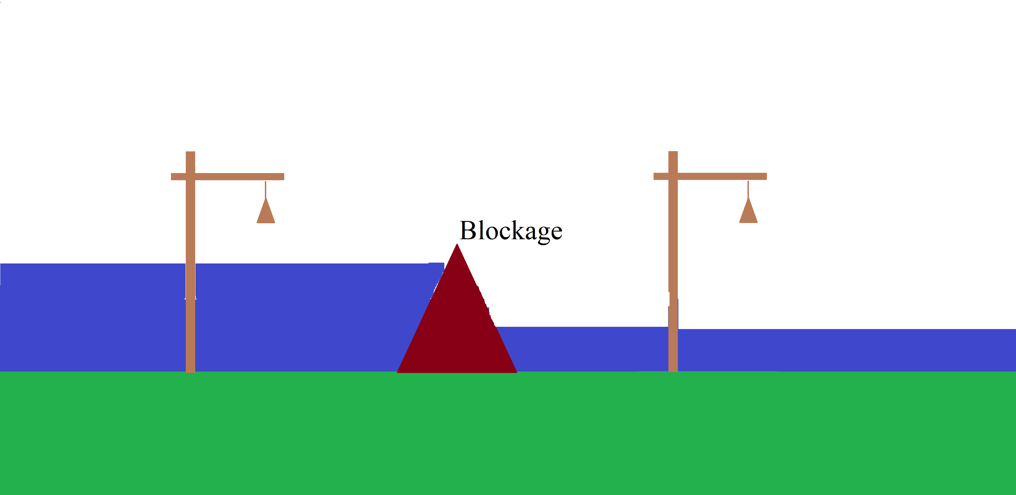
ACCIDENTAL BLOCKAGE LOCATION DETECTION
Higher altitude side
Lower altitude side
Station 1
Station 2

Slide 7
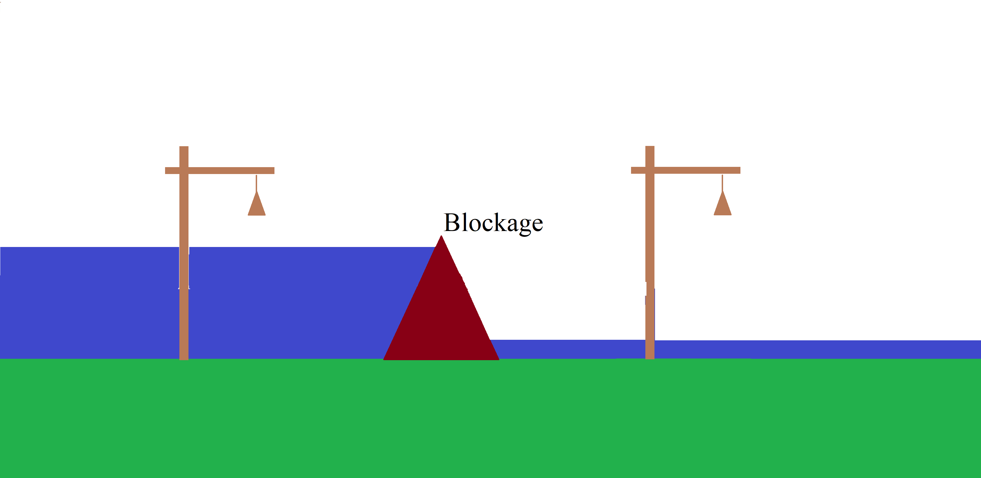
ACCIDENTAL BLOCKAGE LOCATION DETECTION
Higher altitude side
Lower altitude side
Station 1
Station 2

Slide 8
SNOW FALL RUNOFF FORECAST SCHEMATIC
Input data from weather forecast API
Snow depth
Snow fall forecast
Temperature forecast
Rainfall forecast
Air temperature
Forecasting model
Expected snow melt runoff
Logical equations
Rainfall (Rain-in-snow)
At Dam reservoir
At river origin

Slide 9
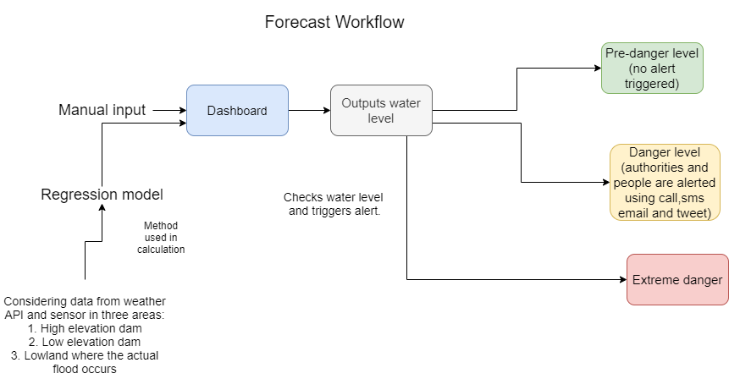

Slide 10
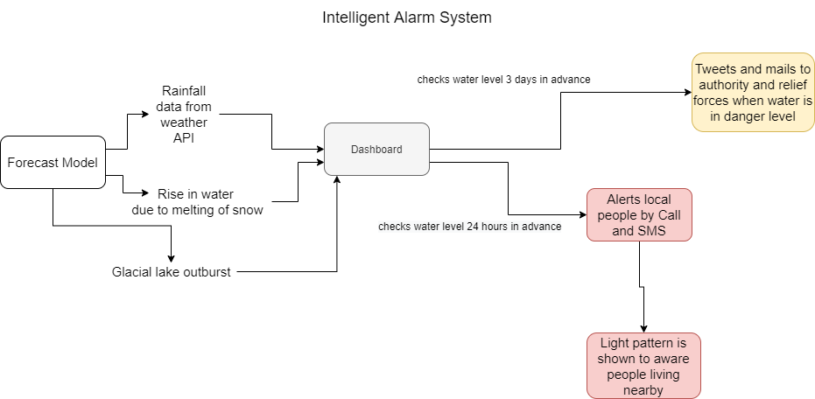

Slide 11
Thank You!
- Team DELENITORS

