Slide 1



Maven Overview

Slide 2
You will learn how to …
Create Maven projects with Eclipse
Add dependencies to Maven pom.xml file
Build and run Maven projects

Slide 3
Practical Results
Cover the most common Maven tasks that you will need on daily projects
•
Not an A to Z reference … for that you can see Maven Reference Manual
•
But don’t worry, I will give you links to
•
Maven Reference Manual

Slide 4
Free Maven Resources
Maven Reference Manual
https://maven.apache.org/guides/

Slide 5
What is Maven?
•
Maven is a Project Management tool
•
Most popular use of Maven is for build management and dependencies

Slide 6
What Problems Does Maven Solve?
•
When building your Java project, you may need additional JAR files
•
For example: Spring, Hibernate, Commons Logging, JSON etc…
•
One approach is to download the JAR files from each project web site
•
Manually add the JAR files to your build path / classpath

Slide 7








My Project without Maven
My Super Cool App
Spring JAR files
Spring Hibernate
Commons Logging
JSON
…
Hibernate JAR files
developer
Apache Commons JAR files
JSON JAR files

Slide 8
Maven Solution
Tell Maven the projects you are working with (dependencies)
Spring, Hibernate etc ….
•
Maven will go out and download the JAR files for those projects for you
•
And Maven will make those JAR files available during compile/run
•
Think of Maven as your friendly helper / personal shopper :-)

Slide 9

My Project with Maven
Maven Central Repository (remote)
My Super Cool App
Spring JAR files
Hibernate JAR files
Spring Hibernate
Commons Logging
JSON
…
developer
Maven
Apache Commons JAR files
JSON JAR files

Slide 10









Maven - How It Works
Maven Local Repository
Check local repo
(your computer)
Project Config file
2
Spring Hibernate
Commons Logging
JSON
…
developer
Read config file
4
Save in local repo
1
Maven
Maven Central Repository (remote)
5
Build and Run
3
Get from remote repo

Slide 11
Handling JAR Dependencies
•
When Maven retrieves a project dependency
•
It will also download supporting dependencies
•
For example: Spring depends on commons-logging …
•
Maven will handle this for us automagically

Slide 12
Building and Running
•
When you build and run your app …
•
Maven will handle class / build path for you
•
Based on config file, Maven will add JAR files accordingly

Slide 13
Standard Directory Structure
•
Normally when you join a new project
•
Each development team dreams up their own directory structure
•
Not ideal for new comers and not standardized
•
Maven solves this problem by providing a standard directory structure

Slide 14

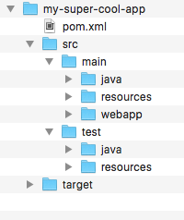
Standard Directory Structure
Directory | Description
src/main/java | Your Java source code
src/main/resources | Properties / config files used by your app
src/main/webapp | JSP files and web config files other web assets (images, css, js, etc)
src/test | Unit testing code and properties
target | Destination directory for compiled code. Automatically created by Maven

Slide 15

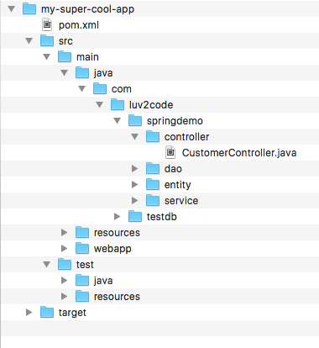



Standard Directory Structure
Place your Java source code here

Slide 16

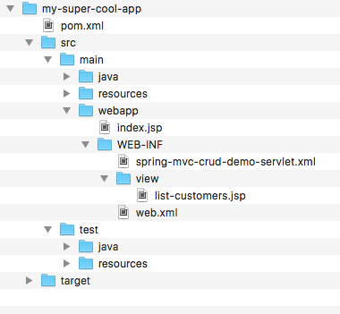



Standard Directory Structure
Place your Web assets here

Slide 17

Standard Directory Structure Benefits
•
For new developers joining a project
•
They can easily find code, properties files, unit tests, web files etc …

Slide 18
Standard Directory Structure Benefits
Most major IDEs have built-in support for Maven
Eclipse, IntelliJ, NetBeans etc
IDEs can easily read/import Maven projects
•
Maven projects are portable
Developers can easily share projects between IDEs
No need to fight about which IDE is the best LOL!

Slide 19
Advantages of Maven
Dependency Management
Maven will find JAR files for you
No more missing JARs
•
Building and Running your Project
No more build path / classpath issues
•
Standard directory structure

Slide 20
My Personal Best Maven Benefit(s)
•
Once you learn Maven, you can join a new project and be productive
•
You can build and run a project with minimal local configuration

Slide 21
Maven Key Concepts

Slide 22
Maven Key Concepts
POM File - pom.xml
Project Coordinates

Slide 23


POM File - pom.xml
•
Project Object Model file: POM file
•
Configuration file for your project
Basically your “shopping list” for Maven :-)
•
Located in the root of your Maven project

Slide 24




Simple POM File
Project name, version etc Output file type: JAR, WAR, …
<project ...>
<modelVersion>4.0.0</modelVersion>
<groupId>com.luv2code</groupId>
<artifactId>mycoolapp</artifactId>
<version>1.0.FINAL</version>
<packaging>jar</packaging>
<name>mycoolapp</name>
<dependencies>
<dependency>
<groupId>junit</groupId>
<artifactId>junit</artifactId>
<version>3.8.1</version>
<scope>test</scope>
</dependency>
</dependencies>
<!-- add plugins for customization -->
</project>
List of projects we depend on Spring, Hibernate, etc…
Additional custom tasks to run: generate JUnit test reports etc…

Slide 25



Project Coordinates
Project Coordinates uniquely identify a project
Similar to GPS coordinates for your house: latitude / longitude
Precise information for finding your house (city, street, house #)
City
<groupId>com.luv2code</groupId>
<artifactId>mycoolapp</artifactId>
<version>1.0.FINAL</version>
Street
House Number

Slide 26

Project Coordinates - Elements
Name | Description
Group ID | Name of company, group, or organization. Convention is to use reverse domain name: com.luv2code
Artifact ID | Name for this project: mycoolapp
Version | A specific release version like: 1.0, 1.6, 2.0 … If project is under active development then: 1.0-SNAPSHOT
<groupId>com.luv2code</groupId>
<artifactId>mycoolapp</artifactId>
<version>1.0.FINAL</version>

Slide 27


Example of Project Coordinates
<groupId>com.luv2code</groupId>
<artifactId>mycoolapp</artifactId>
<version>1.0.RELEASE</version>
<groupId>org.springframework</groupId>
<artifactId>spring-context</artifactId>
<version>5.0.0.RELEASE</version>
<groupId>org.hibernate</groupId>
<artifactId>hibernate-core</artifactId>
<version>5.2.11.Final</version>

Slide 28

Adding Dependencies
<project ...>
...
<dependencies>
<dependency>
<groupId>org.springframework</groupId>
<artifactId>spring-context</artifactId>
<version>5.0.0.RELEASE</version>
</dependency>
<dependency>
<groupId>org.hibernate</groupId>
<artifactId>hibernate-core</artifactId>
<version>5.2.11.Final</version>
</dependency>
...
</dependencies>
</project>

Slide 29

Dependency Coordinates
To add given dependency project, we need
Group ID, Artifact ID
Version is optional …
Best practice is to include the version (repeatable builds)
DevOps
•
May see this referred to as: GAV
Group ID, Artifact ID and Version

Slide 30
Maven Archetypes

Slide 31

Maven Archetypes
•
Archetypes can be used to create new Maven projects
•
Contains template files for a given Maven project
•
Think of it as a collection of “starter files” for a project
Java Project, Web Project, etc
archetype := starter project

Slide 32
Common Archetypes
Archetype Artifact ID | Description
maven-archetype-quickstart | An archetype to generate a sample Maven project.
maven-archetype-webapp | An archetype to generate a sample Maven Webapp project.
… others … | …
http://maven.apache.org/archetypes

Slide 33
Archetypes
•
You can create new projects using Maven Archetypes (starter project)
From the command-line with Maven
•
From an IDE
•
Eclipse, IntelliJ, NetBeans etc…

Slide 34
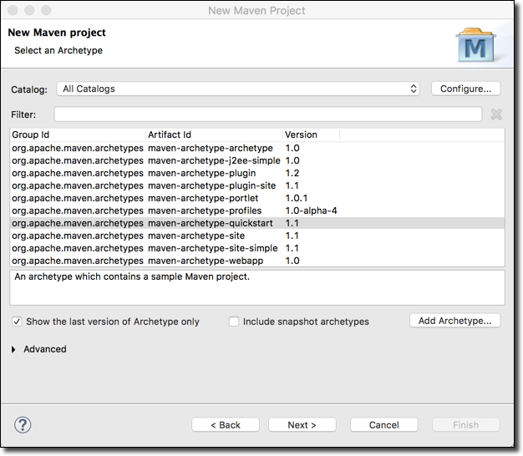
List of Archetypes - Eclipse
File > New Maven Project

Slide 35
Quickstart Archetype
•
maven-archetype-quickstart contains a sample Maven project
project
pom.xml
src/main/java/App.java src/test/java/AppTest.java

Slide 36
Webapp Archetype
•
maven-archetype-webapp contains a sample Maven webapp project
project
pom.xml src/main/webapp/index.jsp
src/main/webapp/WEB-INF/web.xml

Slide 37
Creating a Simple Maven Project

Slide 38
The Game Plan
Learn about Eclipse’s support for Maven
Create a simple Maven Project with Eclipse
Explore the generated files and directories
Run our App
Update the Java version settings

Slide 39
Eclipse and Maven
•
Most recent versions of Eclipse have built-in support for Maven
Use the m2eclipse plugin
•
There is no need to download/install Maven separately
•
Can create Maven projects, add dependencies all inside of Eclipse

Slide 40
Maven Repositories

Slide 41




Maven - How It Works
Maven Local Repository
Check local repo
(your computer)
Project Config file (pom.xml)
2
Spring Hibernate
Commons Logging
JSON
…
Read config file
4
Save in local repo
1
Maven
Maven Central Repository (remote)
5
developer
Build and Run
3
Get from remote repo

Slide 42
Local Repository
Located on developer’s computer
MS Windows: c:\Users\<users-home-dir>\.m2\repository
Mac and Linux: ~/.m2/repository
•
Maven will search this local repository first
Before going to Maven Central Repository
Your local cache

