Slide 1
Spring Security Overview

Slide 2
You will learn how to …
Secure Spring MVC Web Apps
Develop login pages (default and custom)
Define users and roles with simple authentication
Protect URLs based on role
Use JSP tags to hide/show content based on role
Store users, passwords and roles in DB (plain-text -> encrypted)
www.luv2code.com

Slide 3

Practical Results
•
Cover the most common Spring Security tasks that you will need on daily projects
•
Not an A to Z reference … for that you can see Spring Security Reference Manual
https://docs.spring.io/spring-security/reference/index.html

Slide 4
Spring Security Model
•
Spring Security defines a framework for security
•
Implemented using Servlet filters in the background
•
Two methods of securing a Web app: declarative and programmatic
www.luv2code.com

Slide 5
Spring Security with Servlet Filters
•
Servlet Filters are used to pre-process / post-process web requests
•
Servlet Filters can route web requests based on security logic
•
Spring provides a bulk of security functionality with servlet filters
www.luv2code.com

Slide 6






Spring Security Overview
/mytopsecretstuff
Protected Web Resource
Spring Security Filters
Web Browser
my app security configuration
users passwords roles
www.luv2code.com

Slide 7
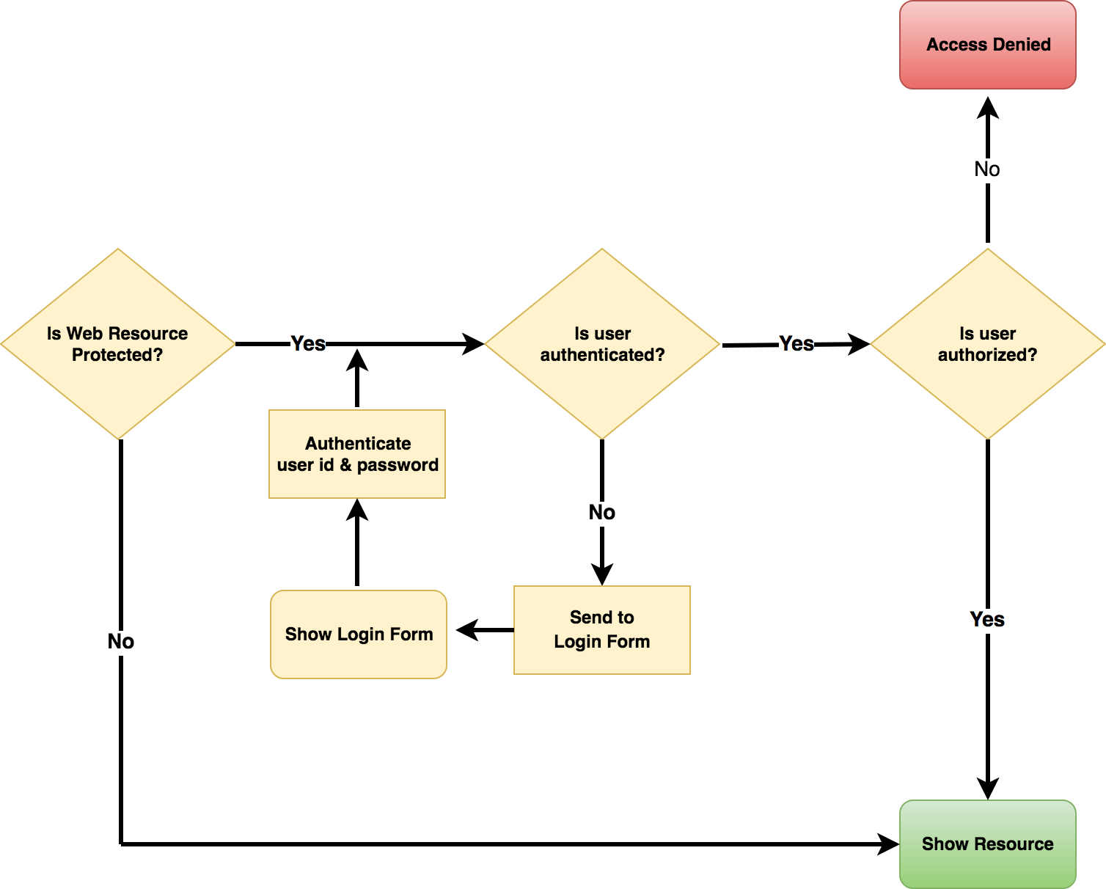



Spring Security in action
Spring Security Filters
Check if user id and password are valid

Slide 8
Security Concepts
•
Authentication
•
Check user id and password with credentials stored in app / db
•
Authorization
•
Check to see if user has an authorized role
www.luv2code.com

Slide 9
Declarative Security
•
Define application’s security constraints in configuration
All Java config (@Configuration, no xml)
or Spring XML config
•
Provides separation of concerns between application code and security
www.luv2code.com

Slide 10
Programmatic Security
•
Spring Security provides an API for custom application coding
•
Provides greater customization for specific app requirements
www.luv2code.com

Slide 11
Different Login Methods
HTTP Basic Authentication
•
Default login form
•
Spring Security provides a default login form
•
Custom login form
•
your own look-and-feel, HTML + CSS
www.luv2code.com

Slide 12
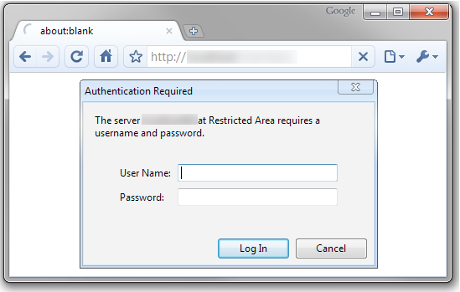

HTTP Basic Authentication
Built-in Dialog from browser
bleh!
www.luv2code.com

Slide 13
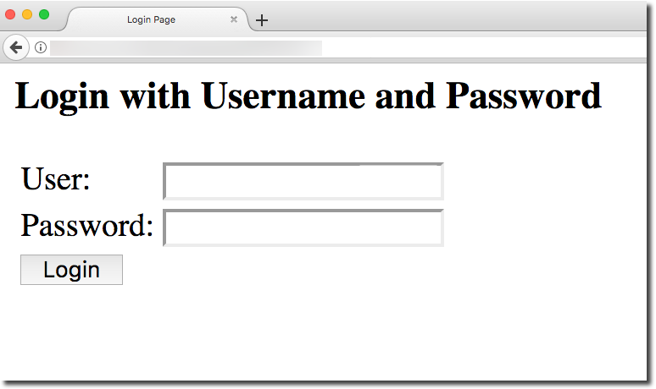

Spring Security - Default Login Form
Good for quick start
www.luv2code.com

Slide 14
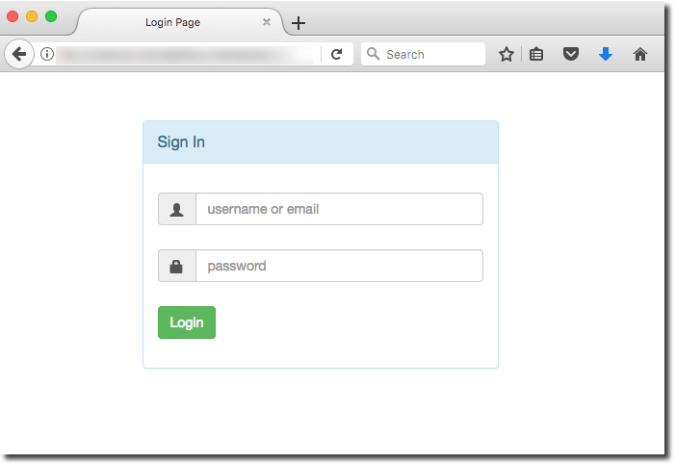

Your Own Custom Login Form
Your own custom look-and-feel HTML + CSS
www.luv2code.com

Slide 15


Authentication and Authorization
In-memory
JDBC
LDAP
Custom / Pluggable
others …
users passwords roles
We will cover password storage in DB as plain-text AND encrypted
www.luv2code.com

