Slide 1



Spring Boot Introduction
m

Slide 2
You will learn how to …
Quickly develop Spring Boot applications
Develop a REST API using Spring Boot
Create a Spring MVC app with Spring Boot
Connect Spring Boot apps to a Database for CRUD development
Leverage all Java configuration (no xml) and Maven

Slide 3
Practical Results
Introduction to Spring Boot development
•
Not an A to Z reference
•
For complete reference, see Spring Boot Reference Manual
https://spring.io/projects/spring-boot

Slide 4





The Problem
Building a Spring application is really HARD!!!
Q: What Maven archetype to use?
And that's JUST the basics
for getting started
Q: Which Maven dependencies do I need?
Q: How do I set up configuration (xml or Java)?
Q: How do I install the server? (Tomcat, JBoss etc…)

Slide 5

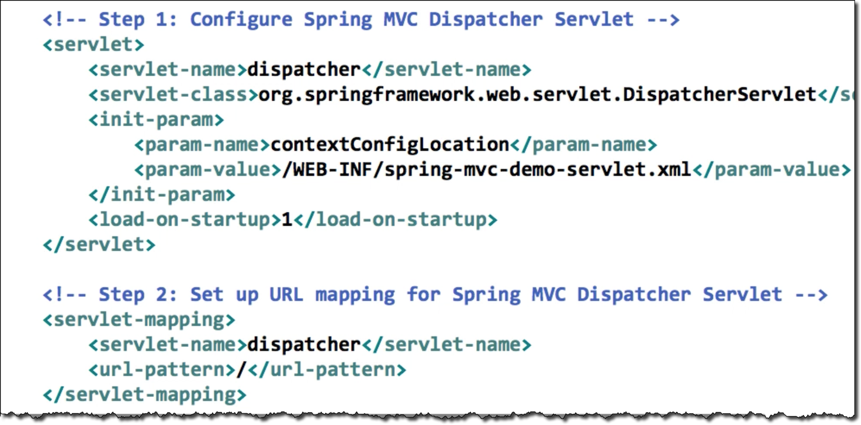
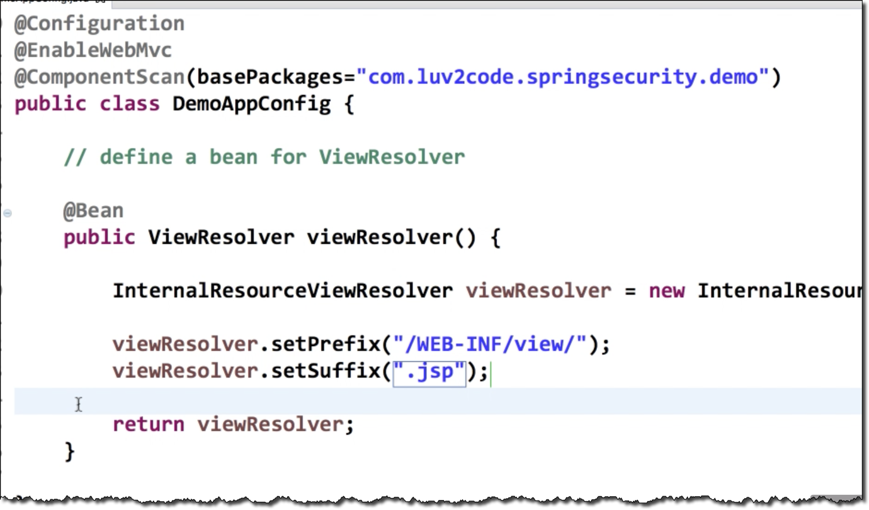
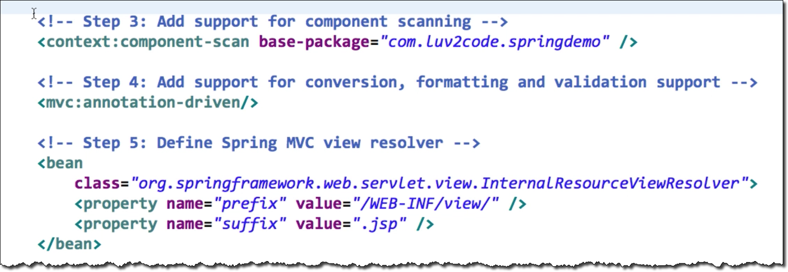
The Problem
Very error-prone
Easy to make a simple mistake
Tons of configuration

Slide 6

Spring Boot Solution
Make it easier to get started with Spring development
Minimize the amount of manual configuration
Perform auto-configuration based on props files and JAR classpath
Help to resolve dependency conflicts (Maven or Gradle)
Provide an embedded HTTP server so you can get started quickly
Tomcat, Jetty, Undertow, …

Slide 7
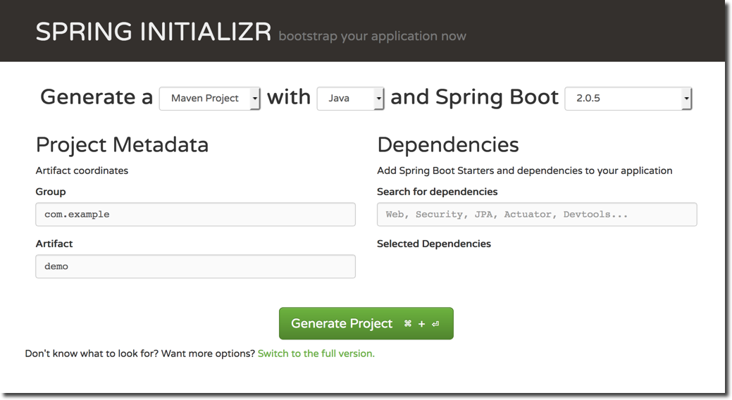
Spring Initializr
•
Quickly create a starter Spring project
http://start.spring.io
•
Select your dependencies
•
Creates a Maven/Gradle project
•
Import the project into your IDE
•
Eclipse, IntelliJ, NetBeans etc …

Slide 8


Spring Boot Embedded Server
•
Provide an embedded HTTP server so you can get started quickly
Tomcat, Jetty, Undertow, …
No need to install a server separately
•
Self-contained unit Nothing else to install
mycoolapp.jar
mycode
JAR file
includes your application code AND
includes the server
Tomcat

Slide 9


Running Spring Boot Apps
Spring Boot apps can be run standalone (includes embedded server)
Run the Spring Boot app from the IDE or command-line
mycoolapp.jar
mycode
> java -jar mycoolapp.jar
Tomcat
Name of our JAR file

Slide 10
Deploying Spring Boot Apps
Spring Boot apps can also be deployed in the traditional way
Deploy WAR file to an external server: Tomcat, JBoss, WebSphere etc …
Tomcat
mycoolapp.war travel.war shopping.war
mycode

Slide 11
Spring Boot Initializr Demo
m

Slide 12
Spring Initializr
•
Quickly create a starter Spring project
http://start.spring.io
•
Select your dependencies
•
Creates a Maven/Gradle project
•
Import the project into your IDE
•
Eclipse, IntelliJ, NetBeans etc …

Slide 13
Development Process
Step-By-Step
1. Configure our project at Spring Initializr website
Download the zip file
Unzip the file
Import Maven project into our IDE
http://start.spring.io

Slide 14
Spring Boot - Create REST Controller
m

Slide 15
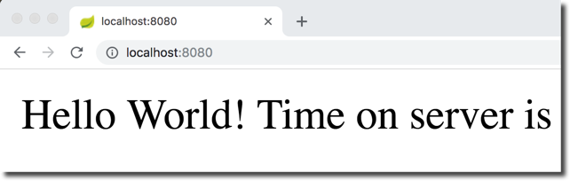
REST Controller
Let's create a very simple REST Controller

Slide 16
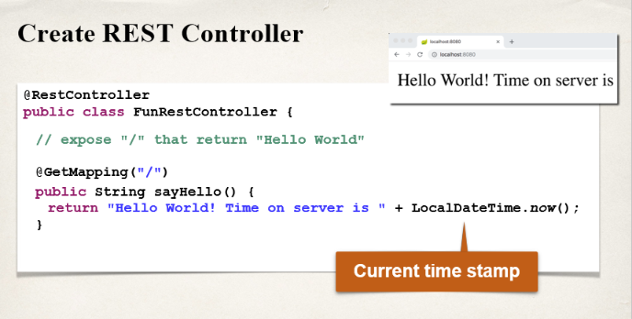

Slide 17
Spring Boot Project Structure
m

Slide 18

Spring Initializr
Spring Initializr created a Maven project for us
http://start.spring.io
Let's explore the project structure

Slide 19

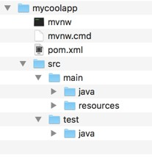
Maven Standard Directory Structure

Slide 20




Maven Wrapper files
•
mvnw allows you to run a Maven project
No need to have Maven installed or present on your path
If correct version of Maven is NOT found on your computer
Automatically downloads correct ve and runs Maven
rsion
> mvnw clean compile test
•
Two files are provided
mvnw.cmd for MS Windows
mvnw.sh for Linux/Mac
$ ./mvnw clean compile test

Slide 21

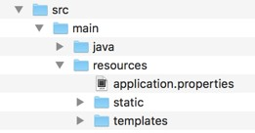

Application Properties
•
By default, Spring Boot will load properties from: application.properties
Created by Spring Initializr
Empty at the beginning
Can add Spring Boot properties
server.port=8585
Also add your own custom properties
coach.name=Mickey Mouse

Slide 22



Application Properties
•
Read data from: application.properties
# configure server port server.port=8484
@RestController
public class FunRestController {
# configure my props coach.name=Mickey Mouse team.name=The Mouse Crew
@Value("${coach.name}") private String coachName;
@Value("${team.name}") private String teamName;
}

Slide 23


Static Content
By default, Spring Boot will load static resources from "/static" directory
Examples of static resources
HTML files, CSS, JavaScript, images, etc …

Slide 24



Templates
Spring Boot includes auto-configuration for following template engines
FreeMarker
Thymeleaf
Mustache
By default, Spring Boot will load templates from "/templates" directory
Thymeleaf is a popular template engine We will use it later in the course

Slide 25

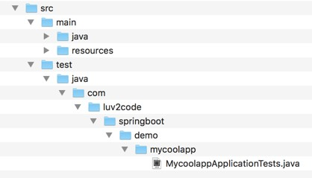

Unit Tests
Spring Boot unit test class
Created by Spring Initializr
You can add unit tests to the file

Slide 26
Spring Boot Dev Tools
m

Slide 27
The Problem
When running Spring Boot applications
If you make changes to your source code
Then you have to manually restart your application :-(

Slide 28
Solution: Spring Boot Dev Tools
spring-boot-devtools to the rescue!
Automatically restarts your application when code is updated
Simply add the dependency to your POM file
No need to write additional code :-)

Slide 29
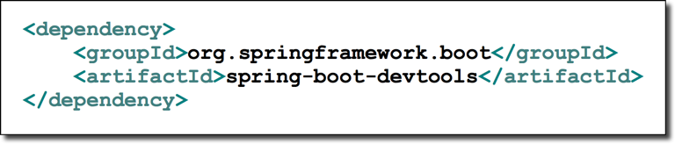

Spring Boot Dev Tools
Adding the dependency to your POM file
Automatically restarts your application when code is updated

Slide 30
Development Process
Step-By-Step
Edit pom.xml and add spring-boot-devtools
Add new REST endpoint to our app
Verify the app is automatically reloaded

Slide 31
Spring Boot Actuator
m

Slide 32
Problem
How can I monitor and manage my application?
How can I check the application health?
How can I access application metrics?

Slide 33
Solution: Spring Boot Actuator
Exposes endpoints to monitor and manage your application
You easily get DevOps functionality out-of-the-box
Simply add the dependency to your POM file
REST endpoints are automatically added to your application
No need to write additional code!
You get new REST endpoints for FREE!

Slide 34
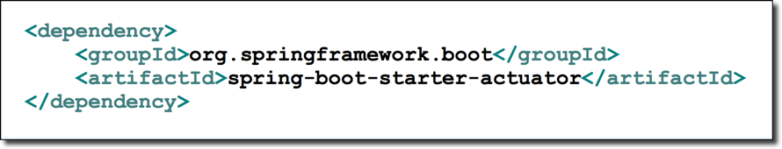
Spring Boot Actuator
Adding the dependency to your POM file

Slide 35




Spring Boot Actuator
Automatically exposes endpoints for metrics out-of-the-box
Endpoints are prefixed with: /actuator
Name | Description
/health | Health information about your application
/info | Information about your project
…

Slide 36
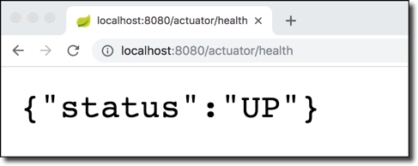

Health Endpoint
/health checks the status of your application
Normally used by monitoring apps to see if your app is up or down
Health status is customizable based on
your own business logic

Slide 37
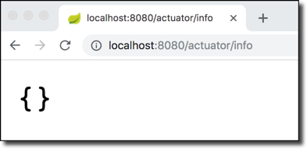
Info Endpoint
/info gives information about your application
Default is empty

Slide 38



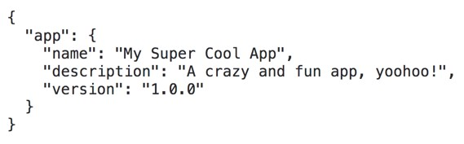
Info Endpoint
Update application.properties with your app info
File: src/main/resources/application.properties
info.app.name=My Super Cool App info.app.description=A crazy and fun app, yoohoo! info.app.version=1.0.0

