Slide 1
Hibernate Overview

Slide 2
Topics
•
What is Hibernate?
•
Benefits of Hibernate
•
Code Snippets

Slide 3


What is Hibernate?
•
A framework for persisting / saving Java objects in a database
www.hibernate.org
Your Java App
Hibernate

Slide 4
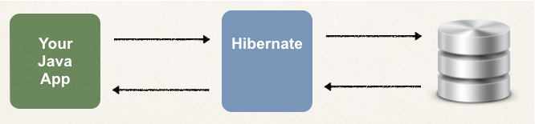
Benefits of Hibernate
•
Hibernate handles all of the low-level SQL
•
Minimizes the amount of JDBC code you have to develop
•
Hibernate provides the Object-to-Relational Mapping (ORM)

Slide 5
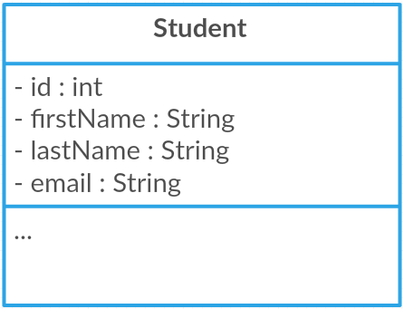
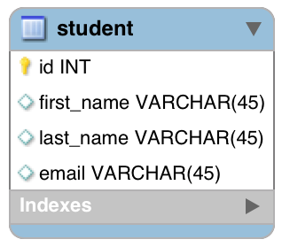
Object-To-Relational Mapping (ORM)
The developer defines mapping between Java class and database table
Java Class
Database Table
Hibernate

Slide 6

Saving a Java Object with Hibernate
// create Java object
Student theStudent = new Student(“John”, “Doe”, “john@luv2code.com");
// save it to database
int theId = (Integer) session.save(theStudent);

Slide 7

Retrieving a Java Object with Hibernate
// create Java object
Student theStudent = new Student(“John”, “Doe”, “john@luv2code.com");
// save it to database
int theId = (Integer) session.save(theStudent);
// now retrieve from database using the primary key
Student myStudent = session.get(Student.class, theId);

Slide 8

Querying for Java Objects
Query query = session.createQuery("from Student");
List<Student> students= query.list();

Slide 9
Hibernate CRUD Apps
Create objects
Read objects
Update objects
Delete objects

Slide 10

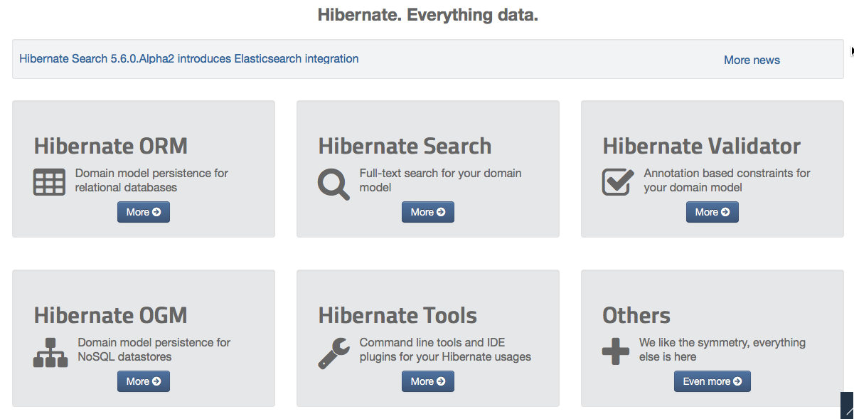

Hibernate is actually more than ORM!
www.luv2code.com

Slide 11
Hibernate and JDBC

Slide 12



Hibernate and JDBC
•
Hibernate uses JDBC for all database communications
Your Java App
Hibernate
JDBC

Slide 13
SET UP YOUR ENVIRONMENT

Slide 14
Required Software
To Build Hibernate Applications, you need the following:
Java Integrated Development Environment (IDE)
Database Server (install MySql)
Hibernate JAR files and JDBC Driver

Slide 15
Setup Database Table

Slide 16

Two Database Scripts
Folder: sql-scripts
create-user.sql
student-tracker.sql

Slide 17
About: 01-create-user.sql
1. Create a new MySQL user for our application
user id: hbstudent
password: hbstudent

Slide 18

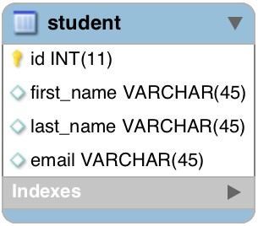
About: 02-student-tracker.sql
1. Create a new database table: student

Slide 19
Setup Hibernate in Eclipse

Slide 20
To Do List
Create Eclipse Project
Download Hibernate Files
Download MySQL JDBC Driver
Add JAR files to Eclipse Project … Build Path

Slide 21
Test JDBC Connection

Slide 22
Hibernate Dev Process - To Do List
Add Hibernate Configuration file
Annotate Java Class
Develop Java Code to perform database operations

Slide 23



Configuration File
Hibernate
JDBC

Slide 24

Terminology
Entity Class
Java class that is mapped to a database table

Slide 25
Object-to-Relational Mapping (ORM)
Java Class
Database Table
Hibernate

Slide 26
Two Options for Mapping
Option 1: XML config file (legacy)
Option 2: Java Annotations (modern, preferred)

Slide 27
Java Annotations
Step 1: Map class to database table
Step 2: Map fields to database columns

Slide 28

Step 2: Map fields to database columns
@Entity @Table(name="student") public class Student {
@Id @Column(name="id") private int id;
Java Class
Database Table
@Column(name="first_name")
private String firstName;
…
}

Slide 29
Save a Java Object

Slide 30
Hibernate Dev Process - To Do List
Add Hibernate Configuration file
Annotate Java Class
Develop Java Code to perform database operations

Slide 31





Two Key Players
Class Description
SessionFactory | Reads the hibernate config file Creates Session objects Heavy-weight object Only create once in your app
Session | Wraps a JDBC connection Main object used to save/retrieve objects Short-lived object Retrieved from SessionFactory

Slide 32

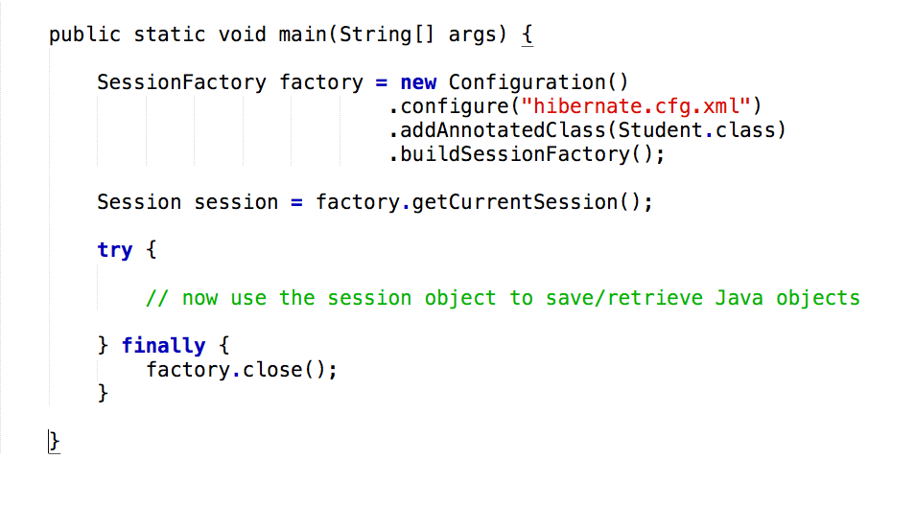
Java Code Setup

Slide 33

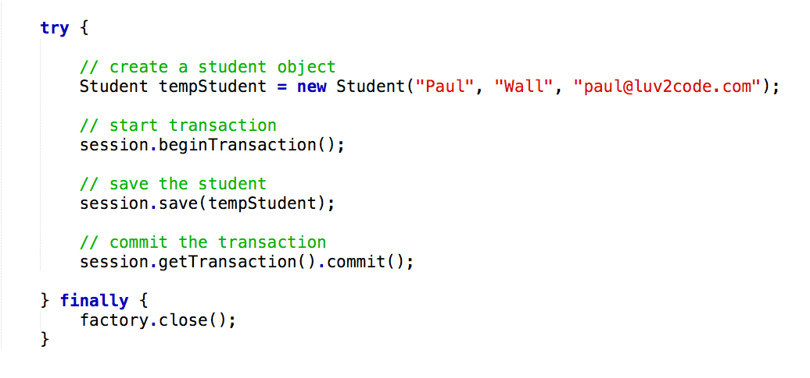
Save a Java Object

Slide 34
Hibernate and Primary Keys

Slide 35

Terminology
Primary Key
Uniquely identifies each row in a table Must be a unique value
Cannot contain NULL values

Slide 36

MySQL - Auto Increment
CREATE TABLE student (
id int(11) NOT NULL AUTO_INCREMENT,
first_name varchar(45) DEFAULT NULL, last_name varchar(45) DEFAULT NULL, email varchar(45) DEFAULT NULL, PRIMARY KEY (id)
)

Slide 37

Hibernate Identity - Primary Key
@Entity @Table(name="student") public class Student {
@Id @Column(name="id") private int id;
…
}

Slide 38

Hibernate Identity - Primary Key
@Entity @Table(name="student") public class Student {
@Id @GeneratedValue(strategy=GenerationType.IDENTITY)
@Column(name="id") private int id;
…
}

Slide 39





ID Generation Strategies
Name | Description
GenerationType.AUTO | Pick an appropriate strategy for the particular database
GenerationType.IDENTITY | Assign primary keys using database identity column
GenerationType.SEQUENCE | Assign primary keys using a database sequence
GenerationType.TABLE | Assign primary keys using an underlying database table to ensure uniqueness

Slide 40
•
You can define your own CUSTOM generation strategy :-)
•
Create implementation of org.hibernate.id.IdentifierGenerator
•
Override the method: public Serializable generate(…)

Slide 41
Retrieving an Object

Slide 42

Retrieving a Java Object with Hibernate
// create Java object
Student theStudent = new Student(“Daffy”, “Duck”, “daffy@luv2code.com");
// save it to database
session.save(theStudent);
…
// now retrieve/read from database using the primary key
Student myStudent =
session.get(Student.class, theStudent.getId());

Slide 43
Querying Objects

Slide 44
Hibernate Query Language (HQL)
Query language for retrieving objects
Similar in nature to SQL
where, like, order by, join, in, etc…

Slide 45

Retrieving all Students
List<Student> theStudents =
session
.createQuery("from Student”)
.getResultList();

Slide 46

Retrieving Students: lastName = ‘Doe’
List<Student> theStudents = session
.createQuery("from Student s where s.lastName='Doe'")
.getResultList();

Slide 47

Retrieving Students using OR predicate:
List<Student> theStudents = session
.createQuery("from Student s where s.lastName='Doe'"
+ " OR s.firstName='Daffy'")
.getResultList();

Slide 48

Retrieving Students using LIKE predicate:
List<Student> theStudents = session
.createQuery("from Student s where"
+ " s.email LIKE '%luv2code.com'")
.getResultList();

