Slide 1




ICT105 · UNIVERSITY CAPSTONE PROJECT
TEAM
RSU Nexus
Quartet
Arkar Moe
Campus Resource Marketplace
Thiri Shin Thant
A campus marketplace connecting Rangsit University students to share, borrow, lend, and request academic equipment, learning resources, and student services.
Min Khant Ko
Lin Htet Aung
Rangsit University
Education
Sharing
Community
Modern Technology Startup Style
RSU Nexus — Final Venture Pitch
1

Slide 2








Problem & Target Users
THE PROBLEM
TARGET USERS
Students have valuable resources — cameras, calculators, textbooks, lab equipment — but rely on Facebook groups, chat apps, or word-of-mouth, making it hard to find or share them.
Rangsit University students
Student clubs
Poor resource visibility
Student organizations
Wasted time searching
Tutors
Repeated purchases
Resource providers
Limited sharing opportunities
Problem
Difficult communication between students
Need trustworthy campus marketplace
RSU Nexus
RSU Nexus — Final Venture Pitch
2

Slide 3


Customer Discovery & Validation
The project was developed based on real user research with the RSU student community.
12
83.3%
Validation Scores
Customer Discovery
Usability
4.17
Testers
Task Success Rate
Interviewed university students
Interest
4.25
Identified problems finding campus resources
4.17/5
4.25/5
Usefulness
5
Students preferred one centralized platform
Avg Usability Score
Avg Interest
Main Positive Feedback
Main Improvements Suggested
✓ Easy navigation
• Better availability labels
✓ Modern interface
• Clearer request status
✓ Useful search
• Built-in messaging
✓ Clear categories
• Faster filtering
RSU Nexus — Final Venture Pitch
3

Slide 4




Solution & Value Proposition
RSU Nexus is a campus resource marketplace where verified students can:
Explore Marketplace
Search resources
Share equipment
Offer tutoring
Request resources
Track request status
Contact resource owners
CATEGORIES
Equipment
Learning Resources
Student Services
For Students
For Resource Providers
“One campus. One marketplace.”
• Save money
• Increase visibility
• Save time
• Help other students
Discover, borrow, rent, share, and offer equipment, learning resources, and student services — all in one trusted platform.
• Access more campus resources
• Better organize resource sharing
RSU Nexus — Final Venture Pitch
4

Slide 5
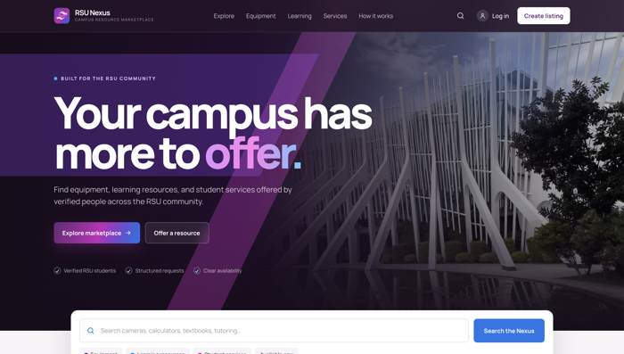
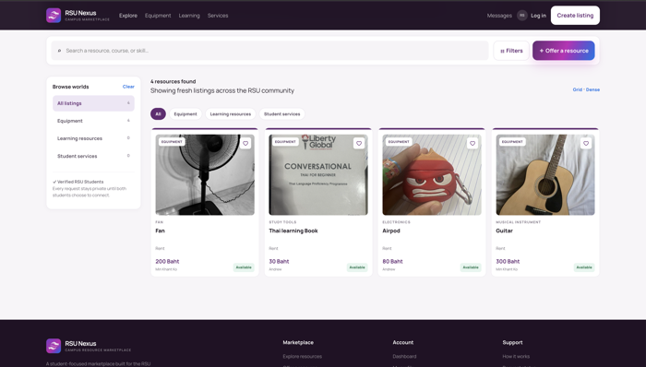
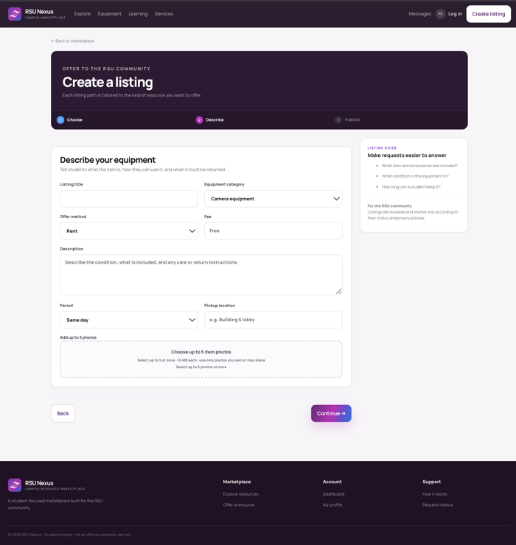
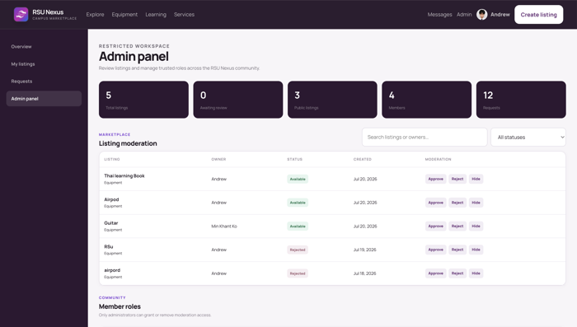
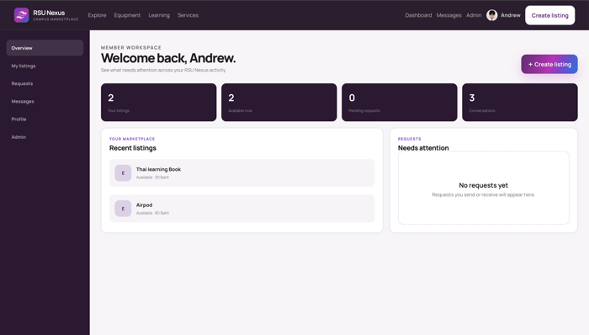
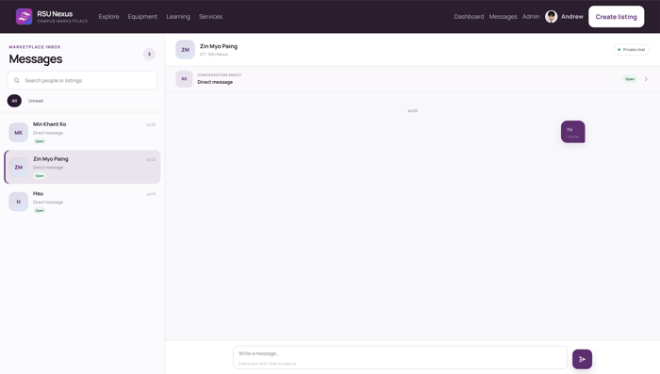
Final Prototype Demonstration Flow
Homepage → Explore Marketplace → Search/Filter → Resource Detail → Submit Request → Message Owner → Dashboard → Admin
1. Homepage
2. Explore Marketplace
3. Search / Filter
4. Submit Request
7-8
6
5
8. Admin Management
6. View Dashboard
5. Message Owner
RSU Nexus — Final Venture Pitch
5

Slide 6








Business Model Canvas
A one-page summary of how RSU Nexus creates, delivers, and sustains value.
Key Partners
Key Activities
Value Proposition
Customer Relationships
Customer Segments
• Rangsit University
• Resource management
• Trusted campus resource sharing
• Verified student accounts
• RSU students
• Student clubs
• User verification
• Direct communication
• Student organizations
Key Resources
Channels
• Supabase
• Web application
• Web platform
• University promotion
Revenue (Future)
Cost Structure
Premium listings • Sponsored university services
Hosting • Database • Maintenance
RSU Nexus — Final Venture Pitch
6

Slide 7

Product Metrics & User Testing
User Testing Results
12
83.3%
4.17/5
4.25/5
Testers
Task Success Rate
Average Usability
Average Interest
Top Positive Feedback
Top Improvements
83.3%
Task Success Rate
✓ Easy to use
• Better availability labels
Success
✓ Attractive interface
• Built-in messaging
✓ Helpful search
• More detailed status tracking
4.17
4.25
5
Usability
Interest
Usefulness
RSU Nexus — Final Venture Pitch
7

Slide 8








Technical Architecture & Data Handling
Frontend
Supabase
Deployment
HTML5
Authentication
Vercel
CSS3
PostgreSQL Database
Vanilla JavaScript
Storage
PROTOTYPE FEATURES
Responsible Data Handling
Responsive Web Design
User Authentication
Search & Filter
Verified student login
Request Management
Dashboard
Minimum personal data
Secure database
Role-based access
RSU Nexus — Final Venture Pitch
8

Slide 9







Final Improvements & Future Development
Modern roadmap: completed improvements in green, future plans in blue.
Completed Improvements
Future Development
✓
Improved homepage
Real-time messaging
✓
Better marketplace navigation
Push notifications
Better request workflow
Mobile application
✓
QR verification
✓
Dashboard improvements
AI-powered recommendations
✓
Validation messages
Rating & review system
✓
Responsive layout
Advanced analytics
RSU Nexus — Final Venture Pitch
9

Slide 10

Thank You
RSU Nexus helps students discover, share, and request campus resources through one trusted platform.
RSU Nexus — Campus Resource Marketplace
Team Quartet
Questions & Feedback Welcome
RSU Nexus — Final Venture Pitch
10

