Slide 1
CUSTOMER CHURN ANALYSIS & DASHBOARD
Data Analytics Project
Microsoft Excel | KPI Analysis | Data Visualization
Prepared by Vijay Kumar A G

Slide 2
Project Overview
Analyze customer churn and related business activity.
Calculate customer, subscription, support, and churn KPIs.
Identify churn patterns across business segments.
Build a professional Excel dashboard.

Slide 3
Objectives
Measure overall customer churn.
Compare churn by industry, country, plan, trial status, and referral source.
Analyze support-ticket performance and escalation.
Summarize churn reasons and refunds.
Communicate findings through a dashboard.

Slide 4
Tools & Analysis Areas
Microsoft Excel
Excel formulas and aggregation
Data analysis and KPI calculation
Charts and dashboard design
Accounts, Subscriptions, Feature Usage, Support Tickets, Churn Events

Slide 5
Key Performance Indicators
Total Customers
500
Churn Rate
22%
Total MRR
11,338,747
Total ARR
136,064,964
Support Tickets
2,000
Avg Satisfaction
3.98
Churn Events
600
Total Refunds
8,652.25

Slide 6
Dashboard Visualizations
Churn Rate by Industry
Churn Rate by Country
Churn Rate by Trial Status
Churn Rate by Subscription Plan
Churn Rate by Referral Source
Support Tickets by Priority
Support Tickets by Escalation Status

Slide 7
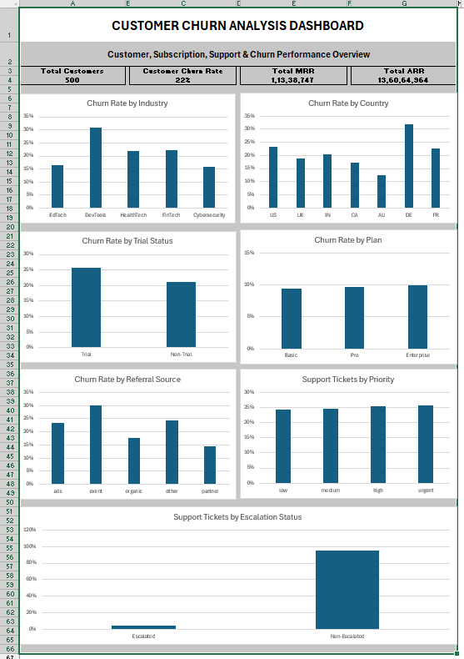
Dashboard Preview

Slide 8
Key Findings
Overall customer churn rate is 22%.
DevTools has the highest displayed industry churn rate.
Germany has the highest displayed country churn rate.
Trial customers show higher churn than non-trial customers.
Features is the leading churn reason with 114 events.
The highest refund amount is 1,905.90 for Features.

Slide 9
Support & Churn Event Insights
2,000 support tickets were analyzed.
Average resolution time: 35.86.
Average first response time: 88.48.
Average satisfaction score: 3.98.
95 tickets were escalated; escalation rate ≈ 4.75%.
600 churn events and 8,652.25 total refunds were recorded.
123 events followed an upgrade flag; 53 followed a downgrade flag.

Slide 10
Business Interpretation
Churn should be monitored at both overall and segment levels.
Higher-churn segments can be prioritized for retention analysis.
Features-related churn suggests an opportunity to investigate product capabilities and customer expectations.
Support metrics provide additional customer-experience context.
The dashboard is a starting point for deeper retention analysis.

Slide 11
Limitations & Future Enhancements
Current analysis is descriptive rather than causal.
Build a Power BI version with slicers and drill-through.
Use SQL/Python for automated data preparation.
Develop a machine-learning churn prediction model.
Add time-series churn and revenue trends.
Perform statistical testing to validate potential churn drivers.

Slide 12
Conclusion
The project demonstrates an end-to-end Excel customer churn analytics workflow.
It combines KPI calculation, segmentation, support analysis, churn-event analysis, and visualization.
The final dashboard provides a concise business view of customer churn and related performance.
The project can be extended into Power BI, SQL, Python, and machine-learning work.

Slide 13
Thank You
Vijay Kumar A G
Customer Churn Analysis & Dashboard

