Slide 1
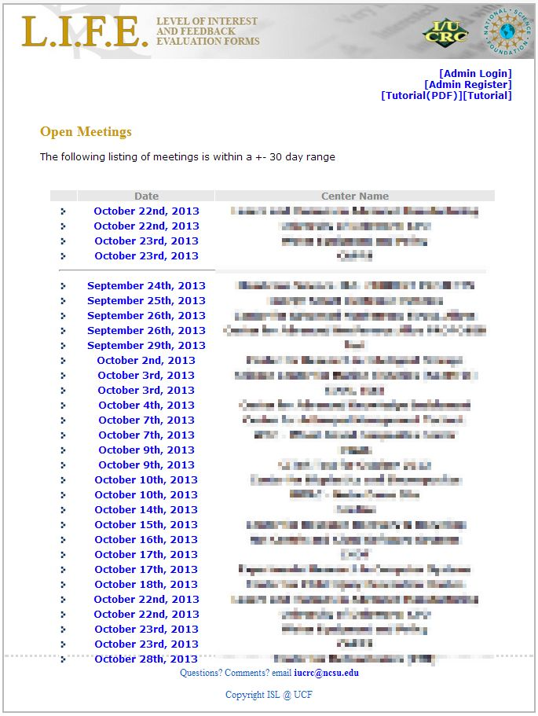
GETTING STARTED
Welcome to L.I.F.E., the Level of Interest and Feedback Evalulation Forms System!
This is a very user friendly tutorial which will get you going with the L.I.F.E. system very quickly.
Let’s get started!
Note: The tutorial works best if viewed in Slide Show mode.
Questions? Comments? email iucrc@ncsu.edu

Slide 2
WHAT’S “L.I.F.E.” ALL ABOUT?
As any good tutorial would do….let’s start with some quick basics.
Q: What is the purpose of the L.I.F.E. system?
A: This system was made to be used in a NSF Industry/University Cooperative Research Centers Program Industry Advisory Board (IAB) Meeting. It was created for the sole purpose of providing an electronic substitute to the hard copy (paper) L.I.F.E. forms that were previously used and to deliver instant compiled results which can be viewed in an easy to understand format. It allows users to use their laptop, tablet, or smart phone to provide and respond to feedback. We’ve also recently added a feature that allows for project phase specific rating scales.
Q: Ok…but why would I ever want to use this system?
A: If you are a participant in or want to host a NSF Industry/University Cooperative Research Centers Program IAB Meeting, then this system will provide a simple way for you to offer input into a meeting or create and organize your own meeting.
Q: Sounds good so far, but is this going to be some complicated new thing I have to learn just to do what I’ve always been doing in these meetings?
A: Not at all! This site was designed to streamline the process.
Q: Alright, you convinced me. So how do I use it?
A: See the rest of the tutorial!

Slide 3
YOUR ROLE
This is the main page you come to when you type iucrc.com into your web browser. There are 3 things you can do on this page.
Register yourself as a meeting Admin.
Login as a meeting Admin and set up a meeting.
Participate in an open meeting as an industry (IAB) or principal investigator (PI) user.
A meeting Admin is someone who uses this system to create and host their own meeting. Anyone else, like an IAB member or university PI, is a normal user who need not worry about the first 2 options.
Questions? Comments? email iucrc@ncsu.edu

Slide 4
To make this tutorial as short as possible for people, I have divided it into 3 categories (view this PP in presentation view).
For people who want to Administer their own meeting (Admin), please go to this section.
For industry people who want to participate in an already created meeting (Industry user) (or one that will be created soon), please go to this section.
For university people who want to respond to industry feedback on your projects in an already created meeting (university user) (or one that will be created soon), please go to this section.

Slide 5
Admin REGISTRATION
Ok, so you want to host your own meeting.
The first step is to register yourself as an Admin.
Please click on the button that says [Admin Register].

Slide 6
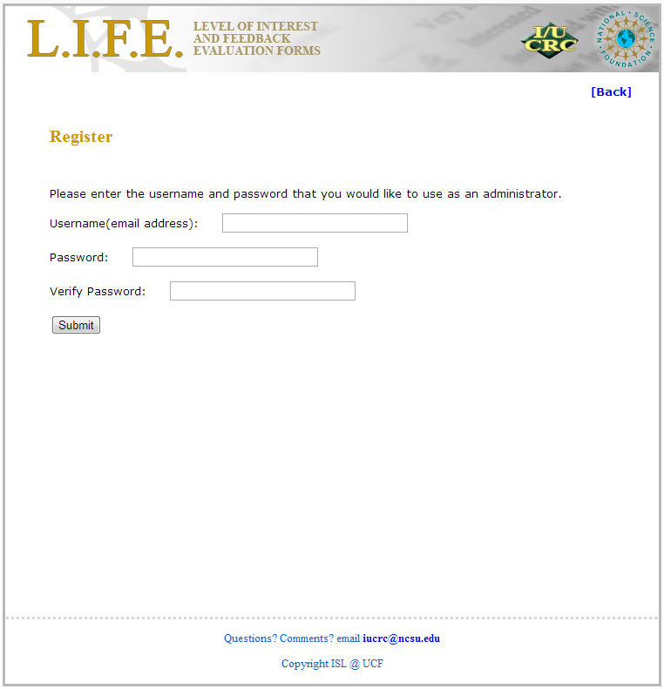
Admin REGISTRATION
This part is pretty self explanatory. Just fill out the form with your username (email address) along with a password of your choice. After verifying your password and pressing the “Submit” button, you will be taken to a confirmation screen and then back to the main page.

Slide 7
LOGIN
Now click on [Admin Login]
Questions? Comments? email iucrc@ncsu.edu

Slide 8
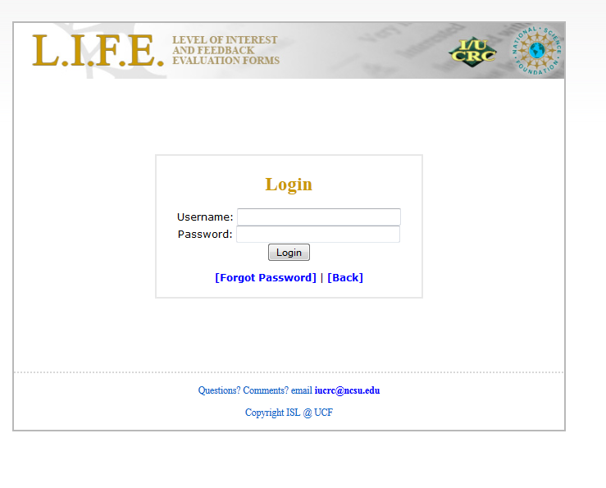
Now just simply type in the information that you just registered with and press “Login”.
Please note if you have forgotten your password you can also get a reminder sent to you by using the [Forgot Password] function.
Questions? Comments? email iucrc@ncsu.edu

Slide 9
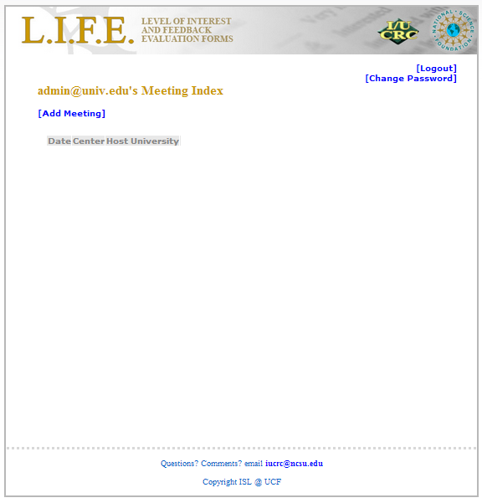
CREATE A MEETING
This is the Admin page. From here you can create as many meetings as you want and populate them with projects!
Click on [Add Meeting] to create a meeting.
You can logout at any time by clicking on [Logout] at the top right of the screen
Note: you can also change your password here

Slide 10
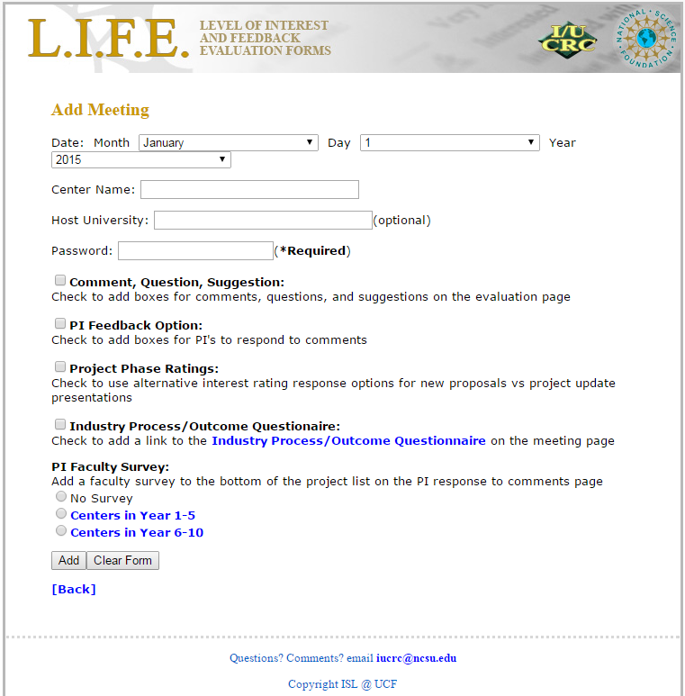
CREATE A MEETING
Once you get to this screen, choose the date of your meeting and fill out the rest of the information.
Host University is optional.
Passwords are required and ensure only people you give the password to can access the project list and rate projects.
The date you create here will be what shows up on the main page for users to click on.
This screen also provides you with several options:
  Comment, Question, Suggestion: will allow industry users to list project comments, questions and suggestions in separate text boxes and presort them by these groupings on the report output.
  PI Feedback Option: will provide text boxes that allow university PIs to provide brief responses to IAB feedback on their projects.
  Project Phase Ratings: will provide project phase specific response options. For New Proposals, response categories reflect level of interest ratings. For Project Updates, response categories reflect assessment of progress.

Slide 11
CREATE A MEETING
Industry Process/Outcome (P/O) Questionnaire: will create a link to the evaluator’s web-based Industry P/O questionnaire on the bottom of the project list presented to IAB users
PI Faculty Survey: allows you to select the appropriate version of the evaluator’s web-based Faculty P/O questionnaire to be linked on the bottom of the project list presented to PI users
Click “Add” to create the meeting.

Slide 12
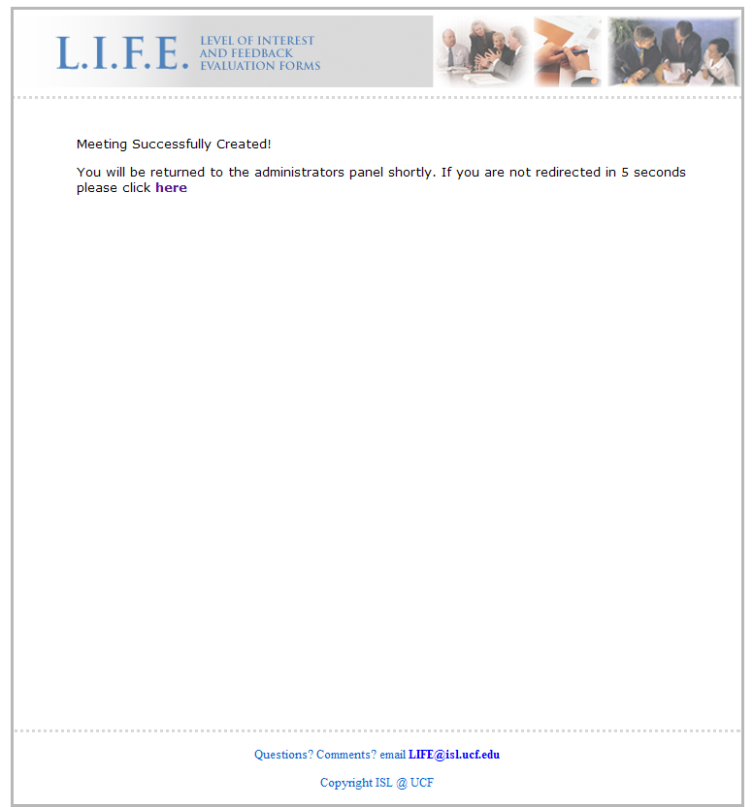
Congratulations, you’ve just created your first meeting!
Questions? Comments? email iucrc@ncsu.edu

Slide 13
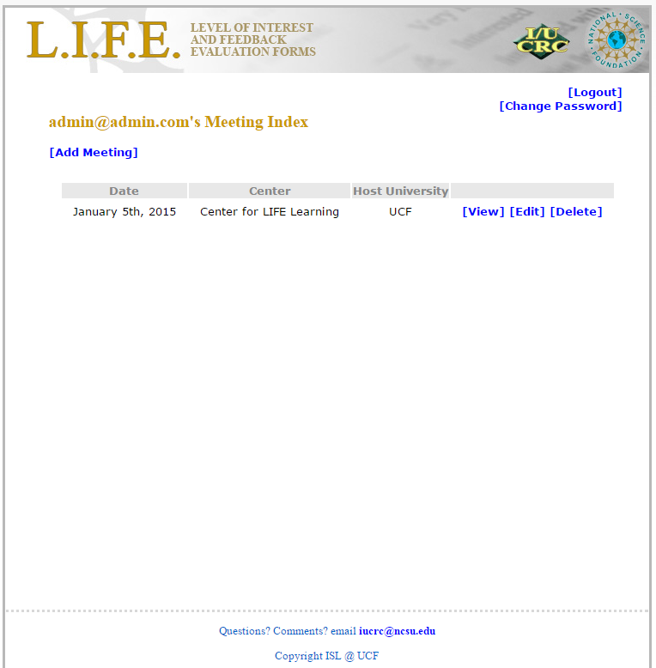
ADDING PROJECTS
Now we’re back to the Admin page. Remember this?
[Edit] allows you to change the features you just selected for this meeting. [Delete] allows you to delete the entire meeting.
[View] allows you to populate the meeting with specific projects for industry users to rate and select some reporting features. Let’s click on [View] to start adding some projects and eventually produce reports based on industry user ratings.
Select [View]
Questions? Comments? email iucrc@ncsu.edu

Slide 14
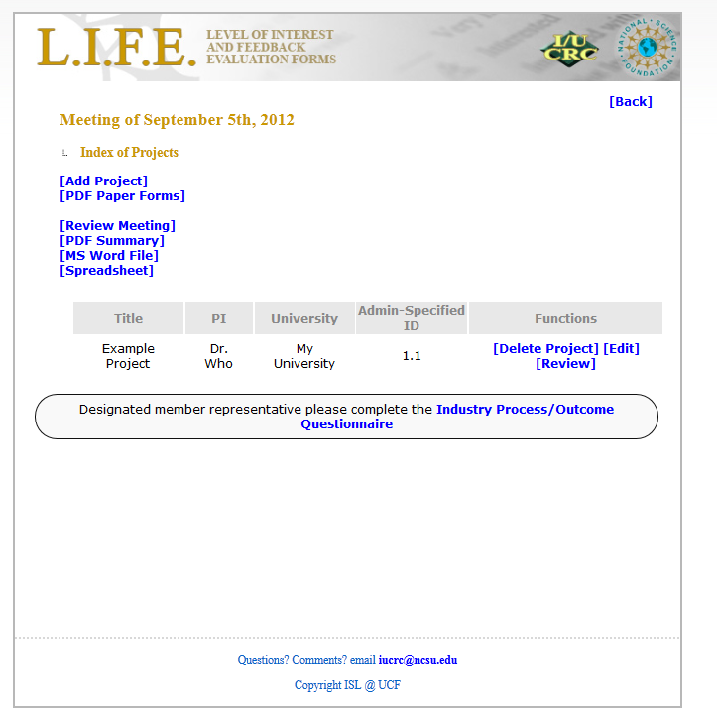
ADDING PROJECTS
Now we come to the meeting details page. This is where you populate your meeting with projects and generate the summary reports from industry user ratings. We will only concentrate on adding projects now.
Select [Add Project] to get started.
*Note*
You can go back at any time by pressing [Back] in the top right corner.

Slide 15
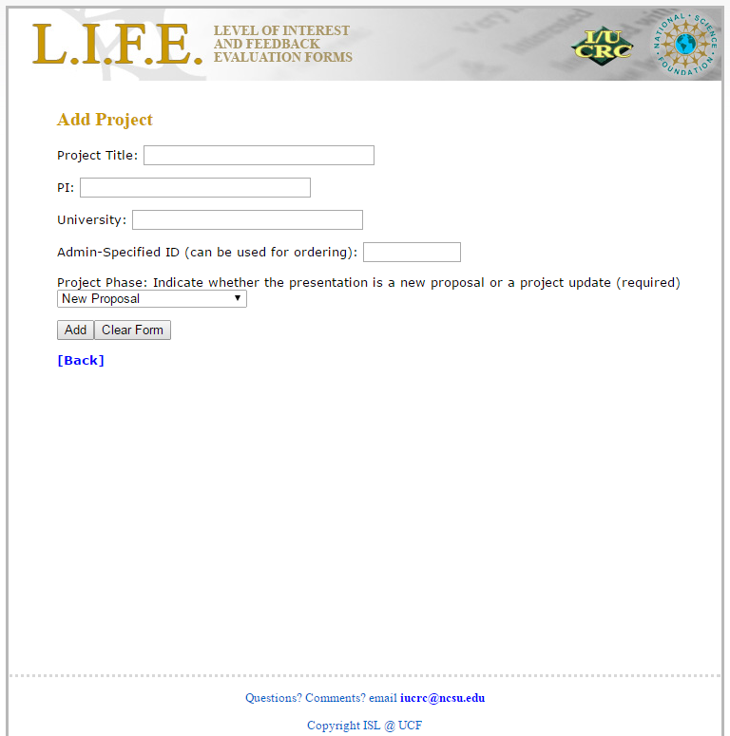
ADDING PROJECTS
You are now at the Add Project page. Simply fill in the parameters of your project.
Please note that it is now required that you specify Project Phase. Please select “New Proposal” or “Project Update” from the dropdown menu before you hit “Add”. If you have selected the option to use project phase specific response categories, they will be based on the project phase you indicate here.
If you want a special ID for your project that will insure your projects appear in a pre-determined order fill in the Admin-Specified ID field. This ID is totally up to the person creating the meeting.

Slide 16

Congratulations! You just created your first project!
Questions? Comments? email iucrc@ncsu.edu

Slide 17
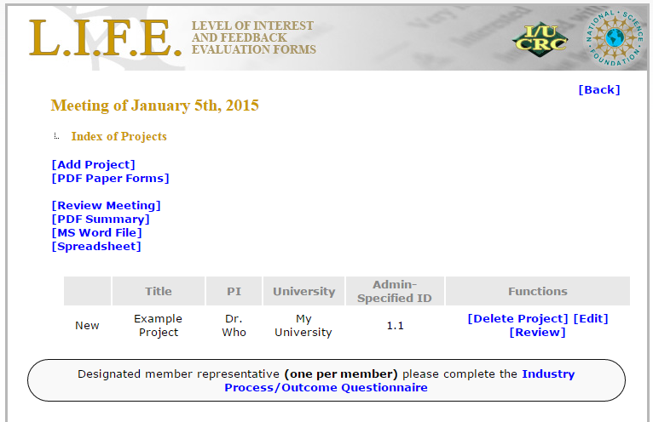
PRODUCE PAPER FORMS
Frequently, at least a few industry users will not bring their laptop or smart phone to a meeting. In these cases you will want to be able to provide them with a paper copy of the L.I.F.E. form. You can produce a complete set of forms for all the projects by selecting [PDF forms], opening the PDF file and printing those forms. Since you will want all ratings to be shared with the meeting attendees, we suggest using your own computer to enter those ratings.

Slide 18
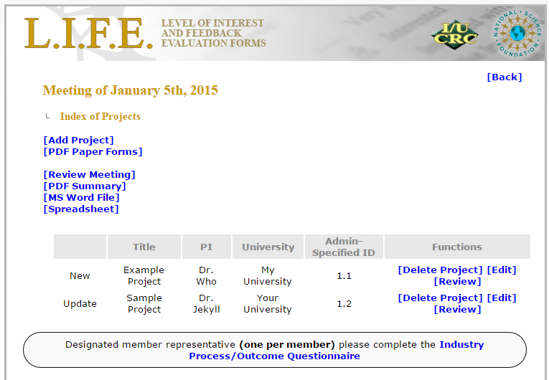
REVIEW FEEDBACK
You are now back to the details page (of the meeting you created earlier). Notice I’ve added a Project Update in addition to the New Proposal we created earlier.
There are three options next to your project. [Edit], [Delete] and [Review]. Because [Edit] and [Delete] are self explanatory, I won’t be going over those options. [Review] allows you to view and sort project evaluations provided by users.
Lets click on it and see what it does!

Slide 19
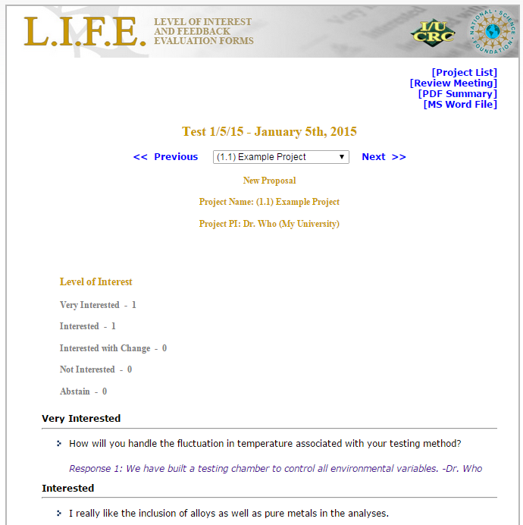
REVIEW FEEDBACK
This is the true L.I.F.E. form replica of compiled Interest ratings for a New Proposal. This page displays the project information, tally of Interest ratings and any comments that have been left by industry users. Below the industry user feedback are color coded responses from the university PIs. If you chose not to use the PI feedback option when you were setting up the meeting, those fields will not be there.
Use the navigation bar at the top to view all your projects without going back every time.
*Note: As Admin, you will be able to see the name of the industry user who provided each comment. This information will not be available to anyone else. However, university PI user responses will be identified by name for all.
Navigation Bar

Slide 20
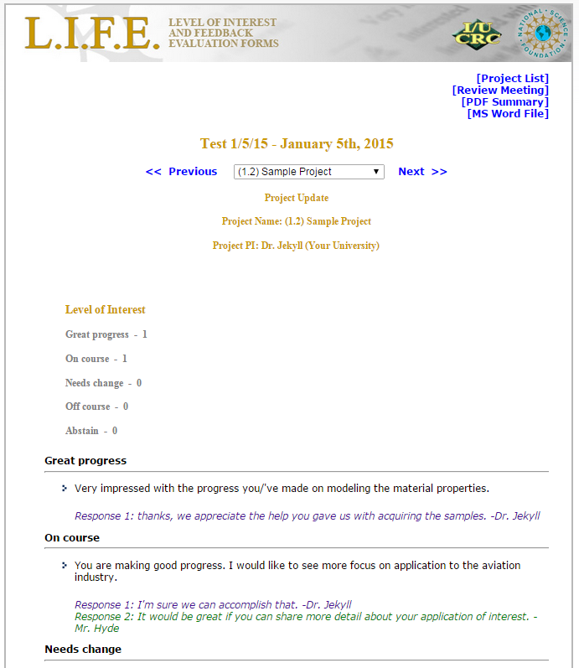
REVIEW FEEDBACK
If you selected the option to use project phase specific response options when you created the meeting, you will notice here that the compiled ratings displayed for this Project Update are different than those used to rate a New Proposal. The Project Update rating categories are assessments of project progress:
- Great Progress
- On Course
- Needs Change
- Off Course
- Abstain

Slide 21
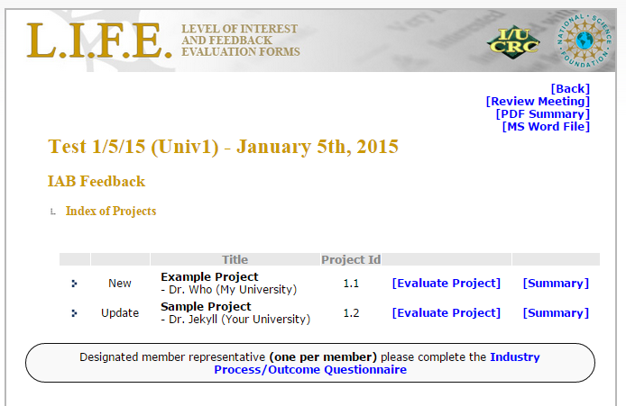
REVIEW ALL FEEDBACK
When the LIFE review process has been completed you can review the ratings and comments for all the projects using different formats.
Since you will want to maintain confidentiality for industry users during this process, you should logout of the Admin view and enter the user view and select this meeting.
In the upper right corner of the screen you will be able to select a way to view the summary. [Review Meeting] shows you a summary of all project ratings and you can click on the project name to view ratings summary and comments. If you’ve used the project phase specific response categories, you will see that projects are grouped by phase in the summary tables provided. PDF or MSWord outputs are also available. If you choose these options in the Admin view, the industry rater name will appear next to their comment. This may be valuable for internal distribution but not public display. University PI names will be visible in all report functions from the user and the Admin side.

Slide 22
Admin WRAP UP
That concludes the capabilities of the Admin side. Press [Back] as many times as you need to return to a certain desired screen. You may Login and Logout as many times as you want.
Remember when you actually use the L.I.F.E. system to be sure you have internet access and have alerted users to bring their laptop or smart phone.
If you want to view the industry user side of this tutorial go to the next slide. If you want to view the university PI user side of this tutorial, please click here. Otherwise, thank you for watching.

Slide 23
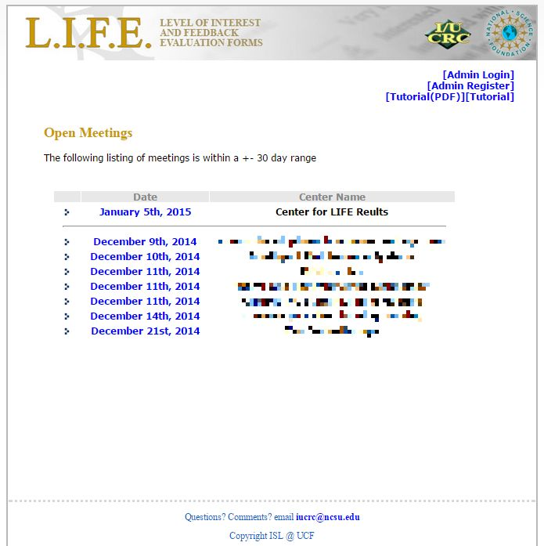
SELECT YOUR MEETING
This is the first page you will see as an industry user when you go to iucrc.com (iucrclife.chass.ncsu.edu).
You will see meetings that have already been created by Administrators which fall within +/- 30 days of today.
Click on the meeting you want to access. Let’s click on the “Center for LIFE Results” meeting on January 5, 2015.

Slide 24
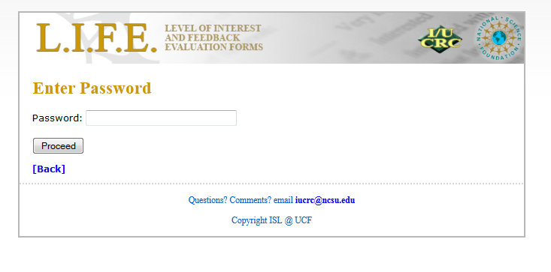
PASSWORDS
Here you will be prompted to enter the password provided by your meeting host. Simply enter the password and click “Proceed”.

Slide 25
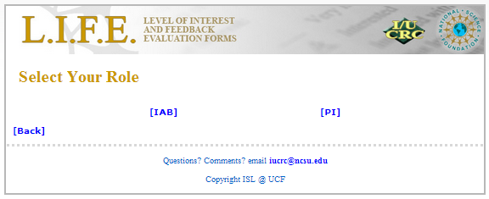
SELECT YOUR ROLE
If your meeting Administrator has set up the meeting to allow both industry user feedback and university PI user response, you will be asked to indicate whether you are an Industrial Advisory Board [IAB] member or a university researcher [PI]. Simply click on [IAB] to proceed to the project list. If your meeting Admin did not select the PI Response Option, you will be taken directly to the project listing for this meeting.

Slide 26
EVALUATE PROJECT
On this page you can view all the projects that have been created for this meeting by the Administrator.
Your job as an industry user is to evaluate the listed projects.
Let’s evaluate Project 1.1!
Please click on
[Evaluate Project]
*NOTE: If the Admin has included a link to the Industry Process/ Outcome Questionnaire, it will appear after the project list.
**NOTE: When all the projects have been rated you can use the [Review Meeting], [PDF Summary], or [MS Word File] to view a summary of all ratings and/or comments.
Optional Link to the Process/Outcome Questionnaire

Slide 27
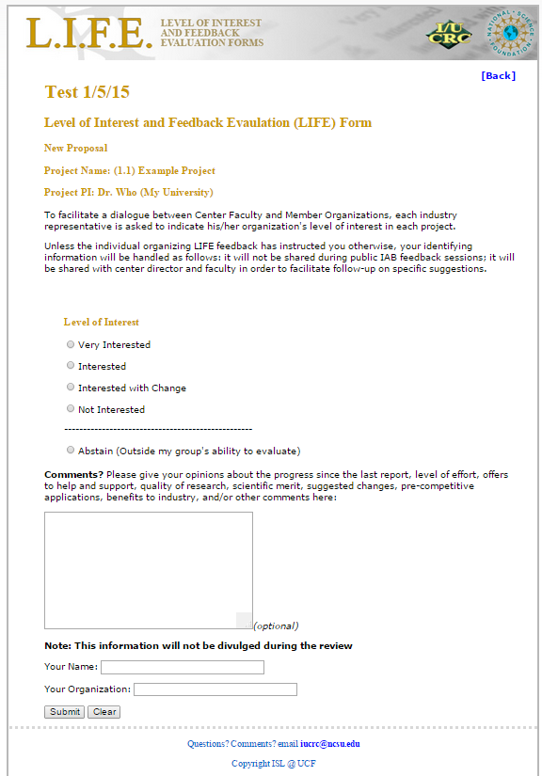
EVALUATE PROJECT
This is the LIFE form that you will fill out to submit your evaluation.
Note that your meeting Admin may have chosen to use project phase specific ratings. If so, you will see Interest rating categories for New Proposals, and Progress rating categories for Project Updates. Sample ratings for a New Proposal are presented here.
Select your Rating and then fill out your comment if you so choose.
Your form might provide separate boxes for “comments”, “suggestions” and “questions” if your meeting Administrator chose this option.
Include your name and organization and then press submit. When rating subsequent projects your name and organization should be filled in for you.

Slide 28
VIEW RATINGS
After a short screen indicating you have successfully submitted your evaluation, you will be returned to the meeting details page.
To view all the evaluations that have been submitted so far on this project, click on [Summary].

Slide 29
VIEW RATINGS
This is the true L.I.F.E. form replica of compiled ratings. This page displays the project information, tally of ratings and any comments that have been left by industry users.
Note that your meeting Admin may have chosen to use project phase specific ratings. If so, you will see Interest rating categories for New Proposals, and Progress rating categories for Project Updates. Sample ratings for a New Proposal are presented here.
Below the industry user feedback are color coded responses from the university PIs. If your meeting Administrator chose not to use the PI feedback option, those fields will not be there.
Notice how the comments are sorted by the rating that was provided and university PI responses appear under the feedback to which they are responding. If your meeting Admin chose to use the comments, questions, and suggestions form, responses will be sorted buy those categories instead.
Navigation Bar

Slide 30
INDUSTRY USER WRAP UP
That concludes the capabilities of the user side. Press [Back] as many times as you need to return to a certain desired screen.
If you want to view the university user side of this tutorial go to the next slide. Otherwise, thank you for watching.

Slide 31
SELECT YOUR MEETING
This is the first page you will see as a university PI user when you go to iucrc.com (iucrclife.chass.ncsu.edu).
You will see meetings that have already been created by Administrators which fall within +- 30 days of today.
Click on the meeting you want to access. Let’s click on the “Center for LIFE Results” meeting on January 5, 2015.

Slide 32
PASSWORDS
Here you will be prompted to enter the password provided by your meeting host. Simply enter the password and click “Proceed”.

Slide 33
SELECT YOUR ROLE
Since your meeting Administrator has set up the meeting to allow both industry user feedback and university PI user response, you will be asked to indicate whether you are an Industrial Advisory Board [IAB] member of a university researcher [PI]. Simple click on [PI] to proceed to the project list.

Slide 34
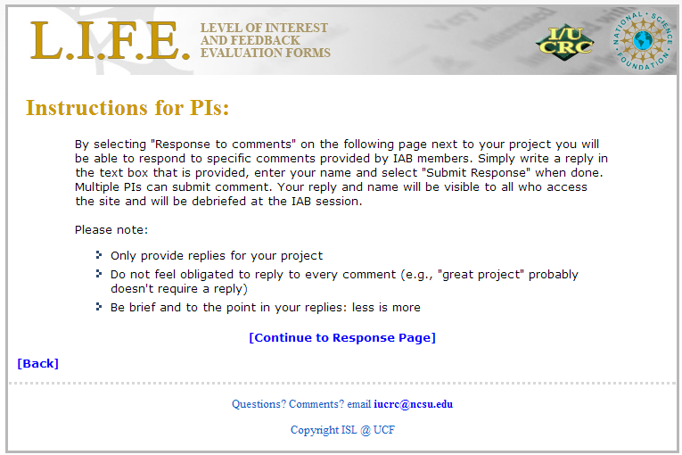
When you click on the PI role, you will receive the following instructions. Please read them carefully before clicking [Continue to Response Page].

Slide 35
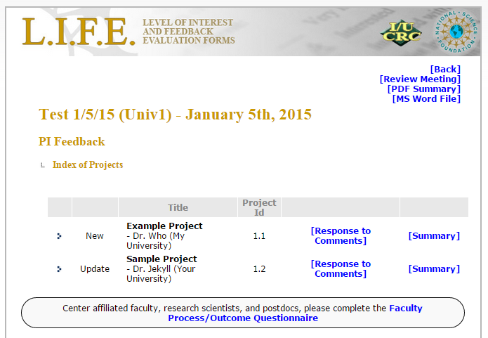
EVALUATE PROJECT
On this page you can view all the projects that have been created for this meeting by the Administrator.
You have the option as a university user to respond to industry feedback on your projects.
Let’s respond to feedback on Project 1.2!
Please click on
[Response to comments]
*NOTE: If the Admin has included a link to the Faculty Process/ Outcome Questionnaire, it will appear after the project list.
**NOTE: When all the projects have been rated you can use the [Review Meeting], [PDF Summary], or [MS Word File] to view a summary of all ratings and/or feedback and responses.
Optional Link to the Process/Outcome Questionnaire

Slide 36
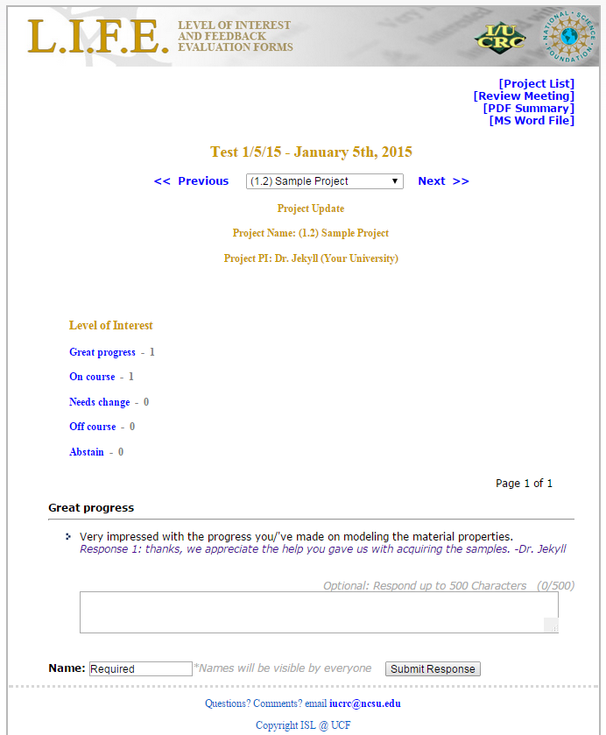
EVALUATE PROJECT
This is the LIFE form showing industry feedback on this project.
Here you can respond to industry feedback by typing your response, entering your name in the required name field and clicking “Submit Response”.
While any university researcher can comment on a project, we encourage you to only provide a response on projects in which you are directly involved. If there is more than one researcher involved, unique responses will appear in a different color text.
When responding to subsequent feedback your name should be filled in for you.
*NOTE: IAB comments on a project are grouped by rating or by response type, depending on the format chose by your meeting Admin. For Example, this page displays the comments for “Great Progress”. You can advance to the next set of comments by entering responses to the comments displayed and then clicking “Submit Response”, by clicking on the [Next 5 Comments] button, or by clicking on the linked response category for which you would like to respond to comments.

Slide 37
VIEW RATINGS
After a short screen indicating you have successfully submitted your response, you will be returned to the meeting details page.
To view all the evaluations, feedback, and responses that have been submitted so far on this project, click on [Summary].

Slide 38
VIEW RATINGS
This is the true L.I.F.E. form replica of compiled ratings. This page displays the project information, tally of ratings and any feedback that has been left by industry users.
Note that your meeting Admin may have chosen to use project phase specific ratings. If so, you will see Interest rating categories for New Proposals, and Progress rating categories for Project Updates. Sample ratings for a Project Update are presented here.
Below the industry user feedback are color coded responses from university PIs.
Notice how the comments are sorted by the rating that was provided and university PI responses appear under the feedback to which they are responding.

Slide 39
UNIVERSITY user WRAP UP
That concludes the capabilities of the user side. Press [Back] as many times as you need to return to a certain desired screen.
Thank you for watching.

