Slide 1

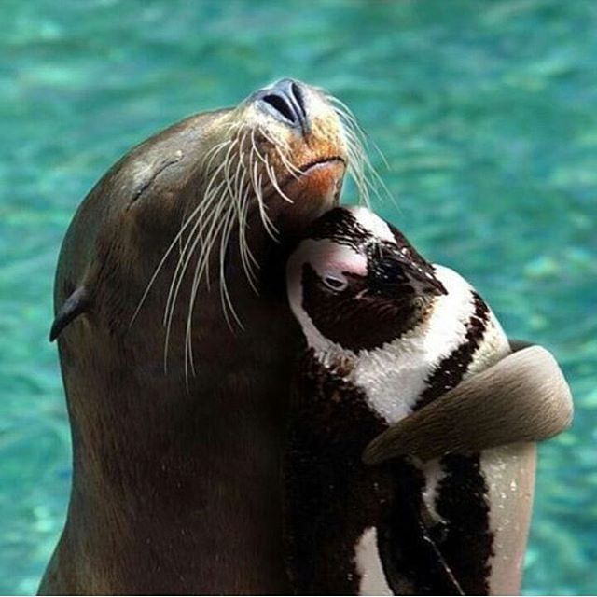
Trying to be as Perfect as a Potatoe
Claret Romain
Ryter Nils
Instagram
National-Geographics

Slide 2

JEE
Authentification
Mappé avec Glassfish
Base de données
CRUD complet
Utilisation d’un template
Bootstrap
Javascript inline
Instagram
National-Geographics

Slide 3
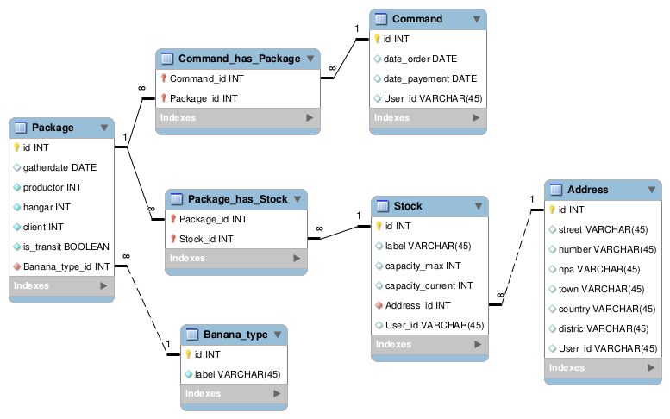
Base de données

Slide 4
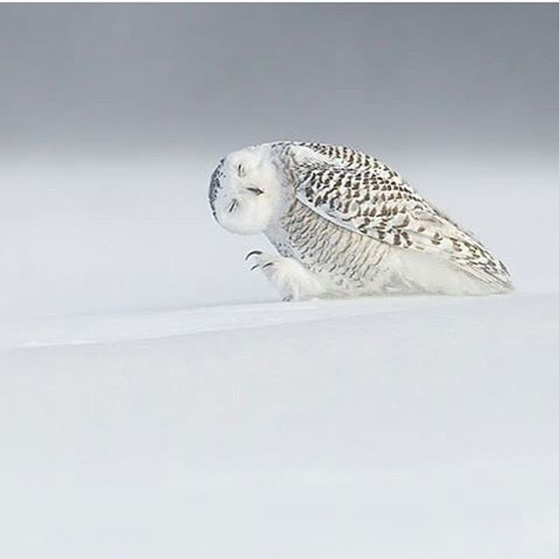
QdL
Spécifications des tests
Planification des tests
Bananatypes
Connexion
Performances
Selenium / jMeter
Instagram
National-Geographics

Slide 5

Démo
Instagram
National-Geographics

Slide 6
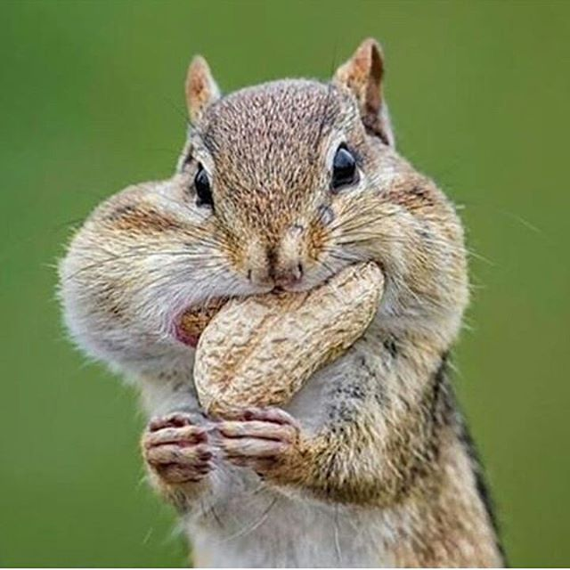
Les acquis
Glassfish
Mapping
Template
Scaffolding
Bootstrap magic
Planification
Tests
Charge
Risque
Instagram
National-Geographics

Slide 7
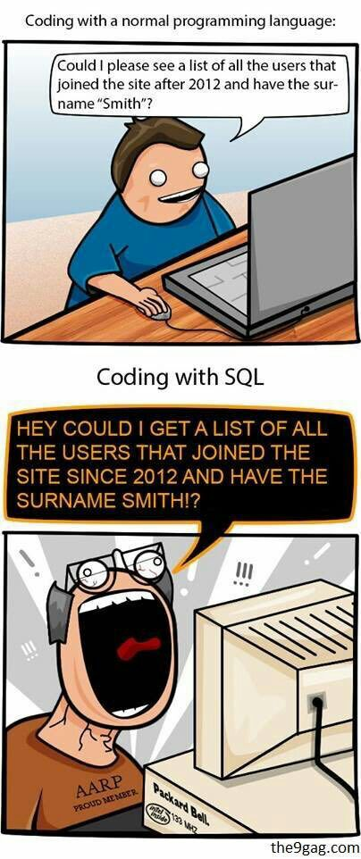
Questions

