Slide 1

Rooted for the Future
The DeepRoots Portal & Optimization plan
Notes:
DeepRoots Portal & Optimization, tour of everything built.

Slide 2
DEEPROOTS · PORTAL & OPTIMIZATION
What we’d build
The operating system we’d build for DeepRoots, a public site, an internal staff portal, a School Portal, and the data backbone beneath them.
Shown as working mockups, illustrative data throughout
Notes:
Overview of everything built for the DeepRoots Portal and the optimization/data track.

Slide 3
THE PICTURE
One system, three surfaces
three surfaces
Everything DeepRoots does would live in one operating picture and one design system, no scattered tools, no per-team restyling.
Public site
Staff portal
School Portal
Marketing · sign-ups
Hubs · inbox · flows
Self-serve onboarding
Shown here as working mockups, illustrative data throughout.
One dashboard as the single operating view.
The data behind it all: Salesforce, the learning platform, and one secure database

Slide 4
THE PLAN · BUILD PHASES
How we’ll build it, in three phases
1
PHASE 1
2
PHASE 2
3
PHASE 3
Goes live first
Next
Then
The public website
The operating platform
Intelligence & scale
The front-facing site, the first thing we take live.
One place for the whole team to work.
Real data, and smart help by role.
Marketing website
Staff portal & department hubs
Real data across every hub
Shop & checkout
School Portal & school pages
Role-aware assistant
Sign-up & contact forms
Inbox, workflows & hand-offs
Analytics & forecasting
Curriculum & resources
Social media dashboard
The advanced-features roadmap

Slide 5
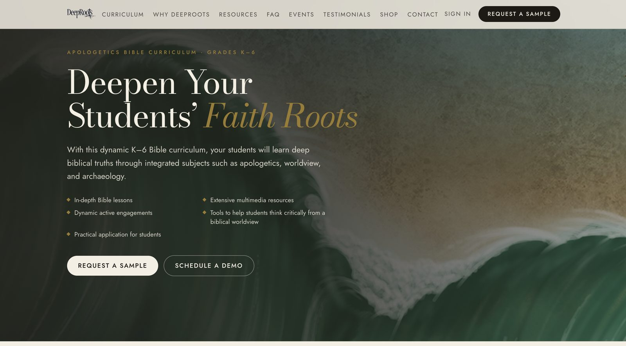
PHASE ONE · GOES LIVE FIRST
PHASE 1
The marketing website
The public, front-facing website: phase one, and the first thing we take live. Real content from deeprootsbible.com, with sign-up and contact forms that feed straight into the portal.
Home · Why · Curriculum (K–6 aligned, gaps “coming soon”)
Testimonials · FAQ + search · Resources · Shop & checkout · Events · Contact
Sign-up and contact forms feed the Marketing section

Slide 6
ACCESS · SIGN-IN
PHASE 2
Secure staff sign-in
portal · sign-in
Only invited staff can get in. They sign in with a one-time link or a 6-digit code, and an approved-email list controls who has access.
Portal sign-in
EMAIL ME A SIGN-IN CODE
Invite-only staff access
Proposed
Dev sign-in (local only)

Slide 7
PART ONE
The internal portal
The daily operating picture we’d give the DeepRoots team, one Overview, six department hubs, and the tools to run the work.

Slide 8
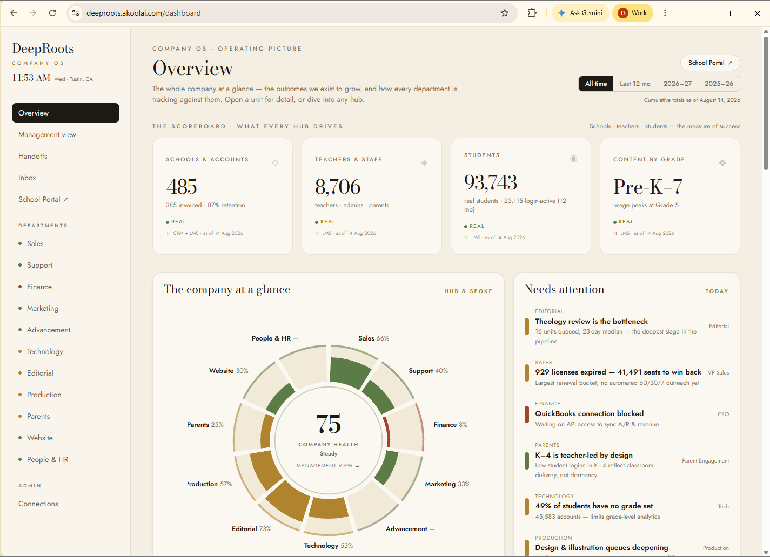
STAFF PORTAL · OVERVIEW
PHASE 2
Overview: the company at a glance
Headline numbers, the leadership wheel, and a “needs attention” list that surfaces what to act on today.
Company numbers
Illustrative mockup

Slide 9
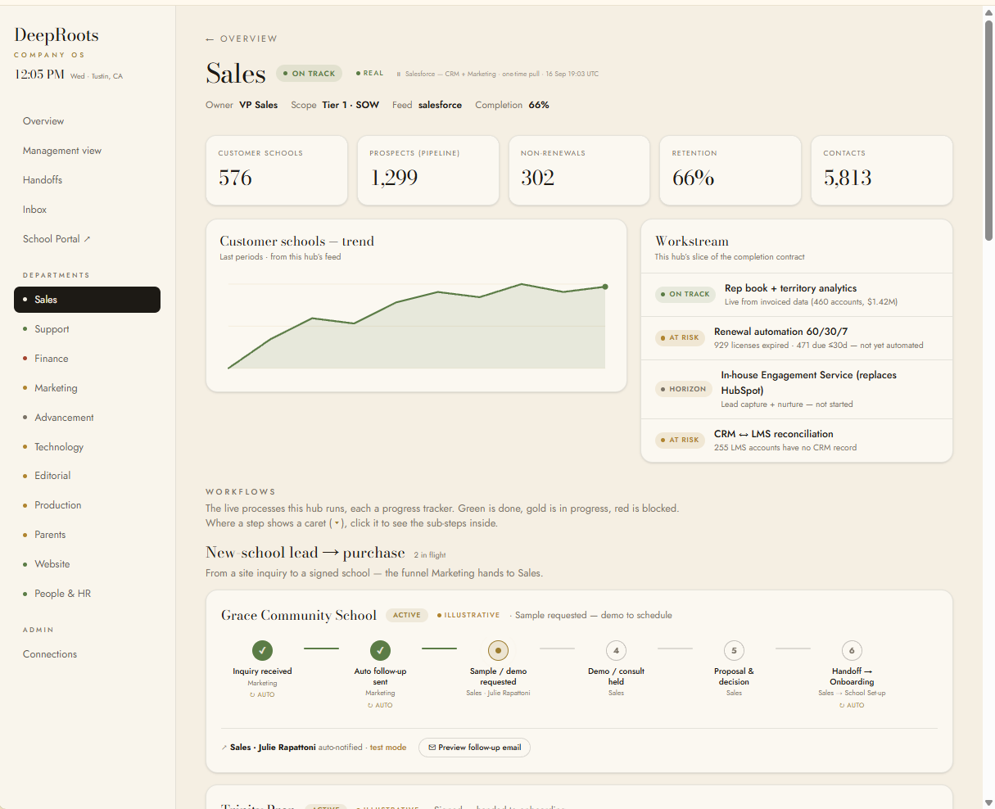
STAFF PORTAL · DEPARTMENT HUBS
PHASE 2
Department hubs
Every team would get the same operating view, metrics, signals, and tasks, in one shared look, not reinvented for each team.
Sales · Customer Success · Curriculum & Content
Editorial · Production · Marketing · Technology · People & HR
Metrics, signals & tasks

Slide 10
STAFF PORTAL · SOCIAL MEDIA
PHASE 2
A complete Social Media Dashboard
Plan, schedule, and track every social channel in one place, and feed the best moments straight to school pages.
FOLLOWERS
ENGAGEMENT
REACH
12.4k
4.8%
86k
IG
f
X
▶
in
♪
New unit spotlight
scheduled Tue 9:00
Schedule and queue posts across every platform
Track followers, engagement, and reach
Curate the spotlights that appear on school pages
Parent tip of the week
scheduled Wed 12:00
Classroom highlight
scheduled Thu 3:00
All channels, one place
Planned

Slide 11
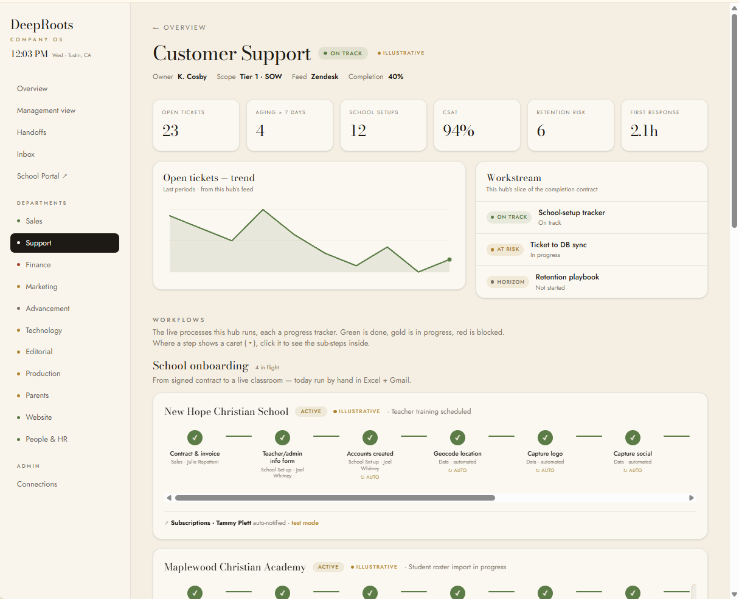
STAFF PORTAL · SUPPORT
PHASE 2
Customer Service hub
A ticket queue right in the Support hub body, so the team could work incoming issues without leaving the operating picture.
Sorted support requests
Proposed

Slide 12
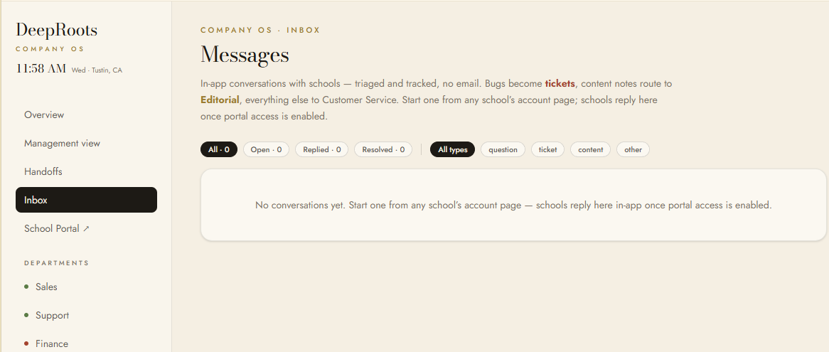
STAFF PORTAL · INBOX
PHASE 2
Inbox & messaging
Conversations with each school kept in one place and sorted automatically, so a tech issue goes to tech and a content note goes to editorial.
Auto-sorted & routed

Slide 13
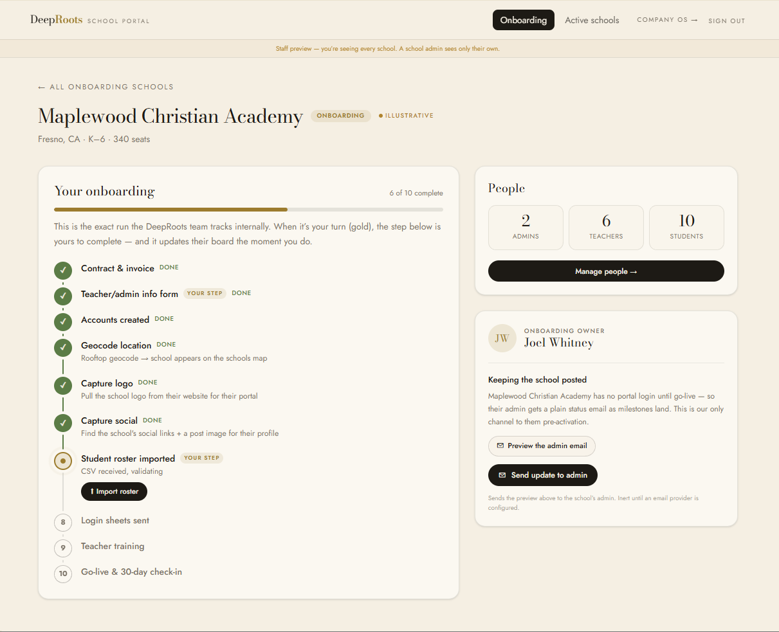
STAFF PORTAL · WORKFLOWS
PHASE 2
Workflows: the “pizza-tracker” engine
Every process runs as a simple step-by-step tracker (think pizza tracker) that nudges the next person automatically, across onboarding, offboarding, hiring, and new-school sign-ups.
Step-by-step tracking
Proposed

Slide 14
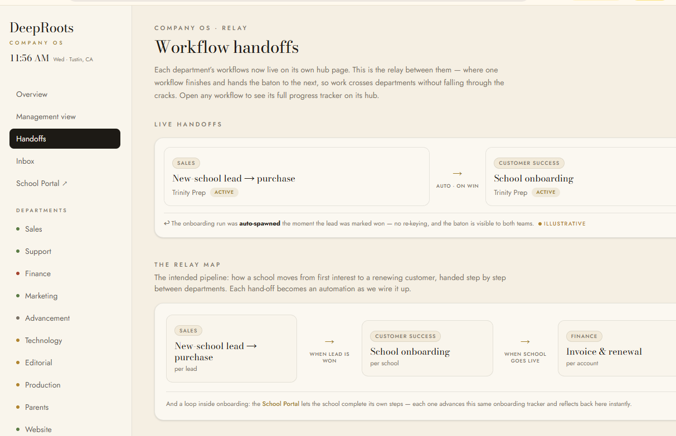
STAFF PORTAL · HAND-OFFS
PHASE 2
Workflow hand-offs
The relay between departments: when one workflow finishes it hands the baton to the next, so work crosses teams without falling through the cracks.
Sales → Success → Finance
Automatic hand-off

Slide 15
STAFF PORTAL · PEOPLE & HR
PHASE 2
People & HR
people · onboarding
New-hire onboarding and offboarding run as guided, step-by-step checklists in the portal, with a simple applicant list for hiring.
day 2/10
blocked
Guided step-by-step
Onboarding · Offboarding · Recruiting
queued

Slide 16
STAFF PORTAL · KNOWLEDGE BASE
PHASE 2
The Rooted Knowledge Base Wiki
Rooted Knowledge Base
One place to capture the company’s tribal knowledge: the how-tos, answers, and hard-won lessons that usually live in people’s heads. Any employee can add an article, search everything, and find the answer fast.
Search the knowledge base…
Onboarding
Sales
Tech
Curriculum
Reset a student login
Support
Anyone can add or edit an article
Search across every how-to and answer
Seeded with your existing team Q&A and FAQ content
Turns tribal knowledge into a shared, searchable library
New-school setup checklist
Success
Refund & billing policy
Finance
+ Add article
Everyone contributes
Planned

Slide 17
STAFF PORTAL · SETTINGS
PHASE 2
Connections & Vault
Connections
Turn each connection on or off from the portal. Passwords and keys go straight into a secure vault, never pasted into chat, with a dashboard showing what’s connected.
connected
not set
Connects Salesforce, the learning platform, email, and more
Managed by an admin
vault

Slide 18
PART TWO
The School Portal
The third surface, a Salesforce-powered directory and rich, self-serve pages for every partner school.

Slide 19
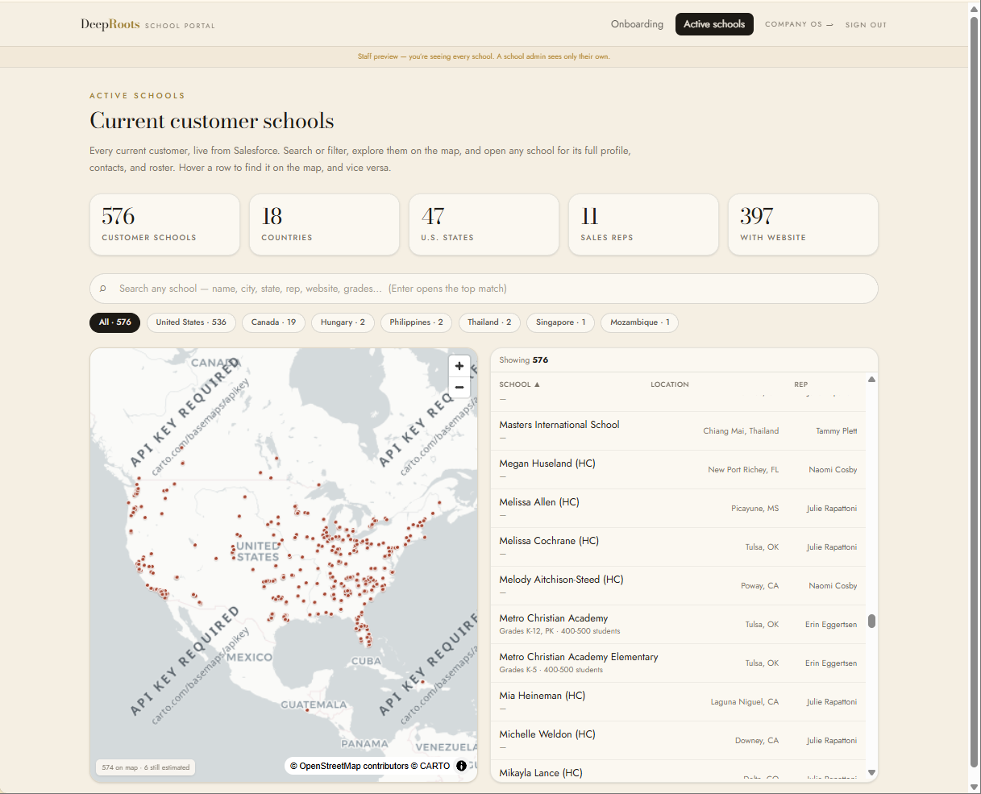
SCHOOL PORTAL · DIRECTORY
PHASE 2
Schools directory
A Salesforce-powered directory that separates schools still being set up from active customers, with a state filter and a rooftop map.
Live from Salesforce
Onboarding · Active

Slide 20
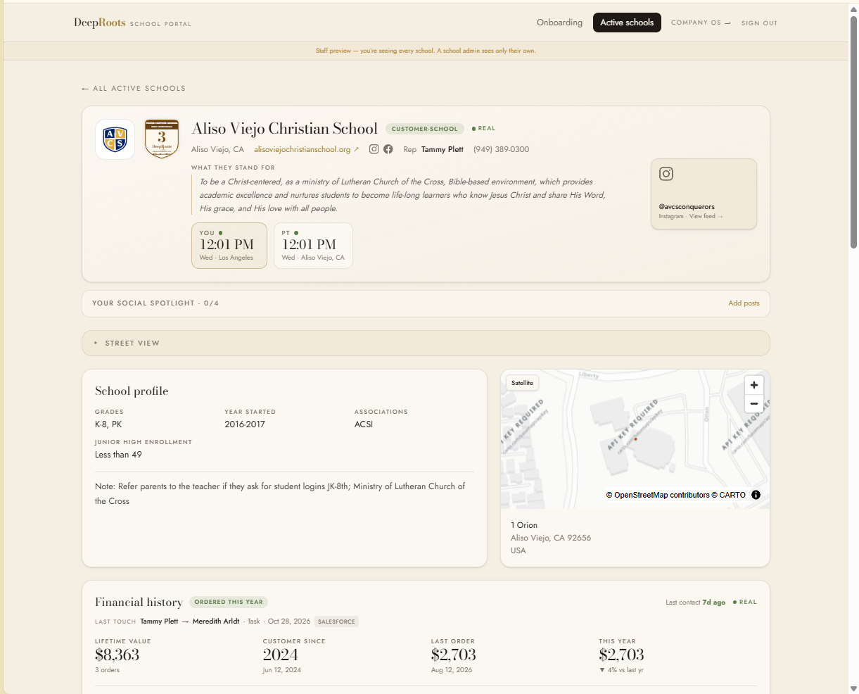
SCHOOL PORTAL · SCHOOL PAGE
PHASE 2
The school page
A rich per-school profile: every teacher and admin you can contact right here, analytics on who's logging into the curriculum, the school logo and tiered partner badge, a rooftop map, financial history from Salesforce, and a rotating social spotlight.
Partner tiers · Bronze to Navy
From Salesforce · planned

Slide 21
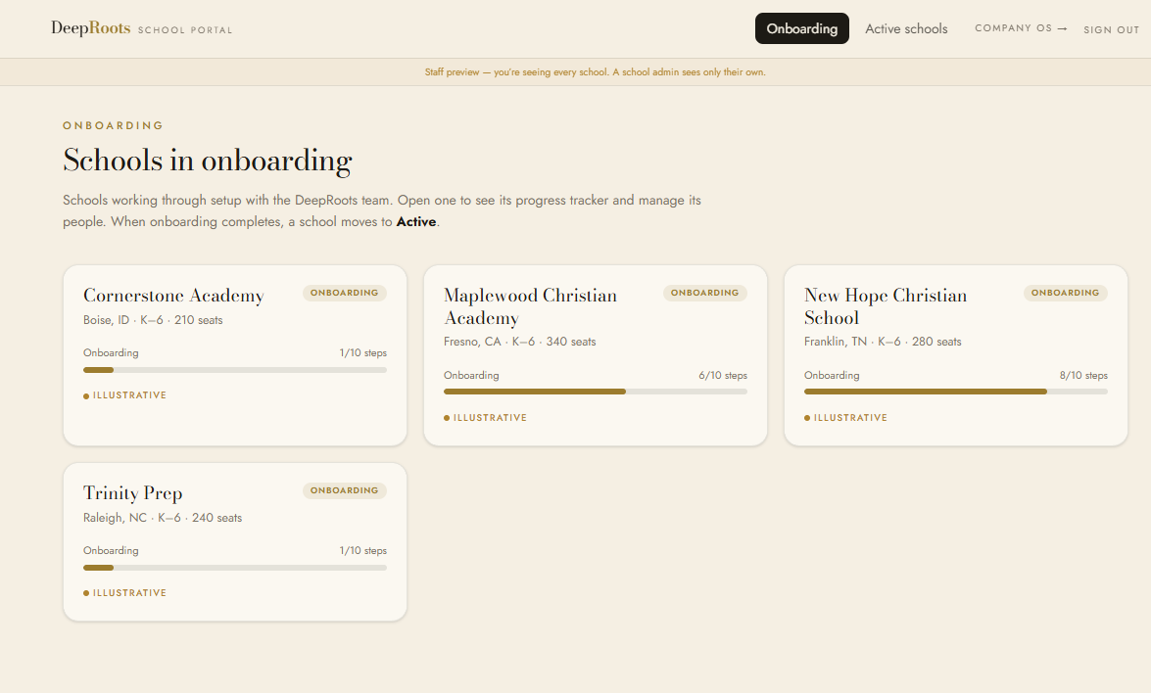
SCHOOL PORTAL · ONBOARDING
PHASE 2
Schools in onboarding
Schools working through setup with the DeepRoots team, each with a live progress tracker; when onboarding completes, a school moves to Active.
Per-school tracker
Illustrative

Slide 22
PART THREE
The optimization track
Behind the scenes: bringing in the real data, and moving DeepRoots off outdated systems.

Slide 23
BEHIND THE SCENES · THE DATA
PHASE 3
All your Salesforce data in one place
Salesforce sync
A complete, always-updating copy of your Salesforce records, pulled in safely and kept current so the dashboards run on real numbers.
✓
✓
3
4
done
A full copy of your Salesforce data
Planned
active

Slide 24
BEHIND THE SCENES · ONE PLATFORM
PHASE 3
All your tools, working together
one platform
Today the team juggles many separate tools, moving documents and data around the cloud by hand to keep customers happy. The new platform brings those tools together, so information flows on its own and people spend their time on customers, not on shuffling files between apps.
Salesforce
Learning platform
Email
Spreadsheets
Documents
Trello
↓
Many tools, one home
Planned
DeepRoots · one platform

Slide 25
BEHIND THE SCENES · FOUNDATION
PHASE 3
Data foundation & automation
company database
One secure database under everything, refreshed on a schedule, with a clear “last updated” stamp on every section.
UPDATES
SECURITY
on a schedule
locked per user
Real data only, anything illustrative is clearly labeled.
Each person sees only what they should; passwords in a secure vault.
FRESHNESS
SECRETS
last-updated stamps
in a secure vault

Slide 26
WHAT WE’D BUILD · ASSISTANT
PHASE 3
A DeepRoots helper that knows who you are
A built-in helper that answers questions and guides each person by their role. Sign in as a teacher and it points you to lesson help; as a new employee, straight to the Employee Handbook and where to find things.
Hi! I can help. What do you need?
Where is the Employee Handbook?
Teacher: “How do I reset a student login?”
New hire: “Where is the Employee Handbook?”
Sales Ambassador: “Which schools are due to renew?”
Here it is, plus your first-week checklist:
Employee Handbook
Ask DeepRoots…
↑
Knows your role
Planned

Slide 27
THE ROAD AHEAD
PHASE 3
More advanced features, as we go
This is the foundation. As development continues we’ll layer on deeper capabilities, prioritized with the team.
Automated renewal outreach
Real-time data across every hub
Parent engagement portal
Analytics & forecasting
Handbook & document library
Mobile app for teachers & parents
Prioritized with the team
Planned
Single sign-on across tools
Automated emails & reminders
Donor & fundraising tracking
Student progress insights
Spanish support

Slide 28
STATUS & ROADMAP
Where it stands and what’s next
roadmap
You can click through every screen, but this is early: what’s live today is mostly mockups, not real data yet. The build ahead is what makes each area real.
1
2
3
in progress
Today: mockups and workflow processes documented.
Next: connect the real data sources, aiming for an end-of-March go-live.
Roadmap: Pre-K → finish 8th grade → churches → self-taught path.
mockups only

Slide 29
DEEPROOTS · PORTAL & OPTIMIZATION
What we’d build
One operating picture: public site, staff portal, and School Portal over a modern data backbone. The system we’d build for DeepRoots, honest by design.
Approve Phase 1 to begin
Targeting an end-of-March go-live · tdwinkler@deeprootsbible.com
Notes:
Close: the proposed system, three surfaces over one data backbone. This is what we would build.

