Slide 1

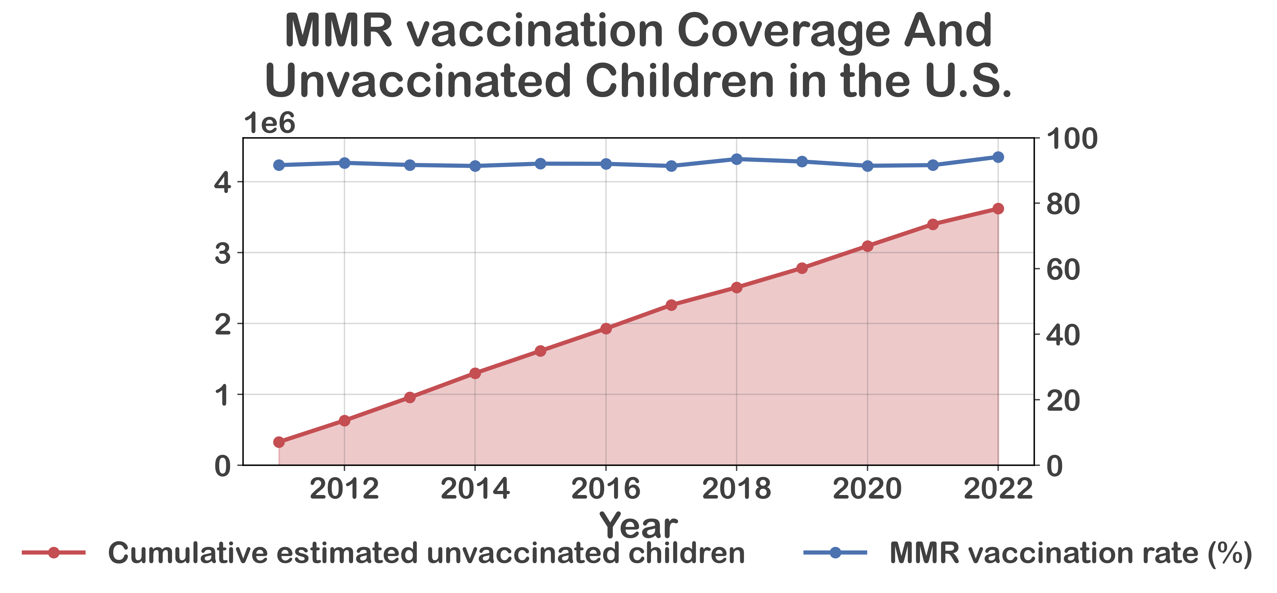

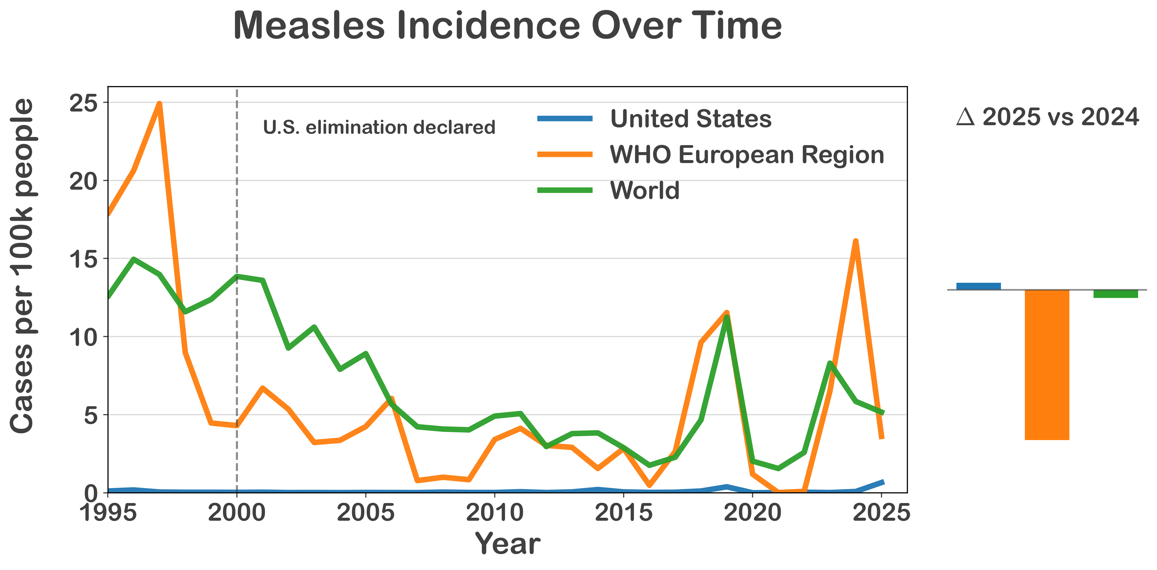
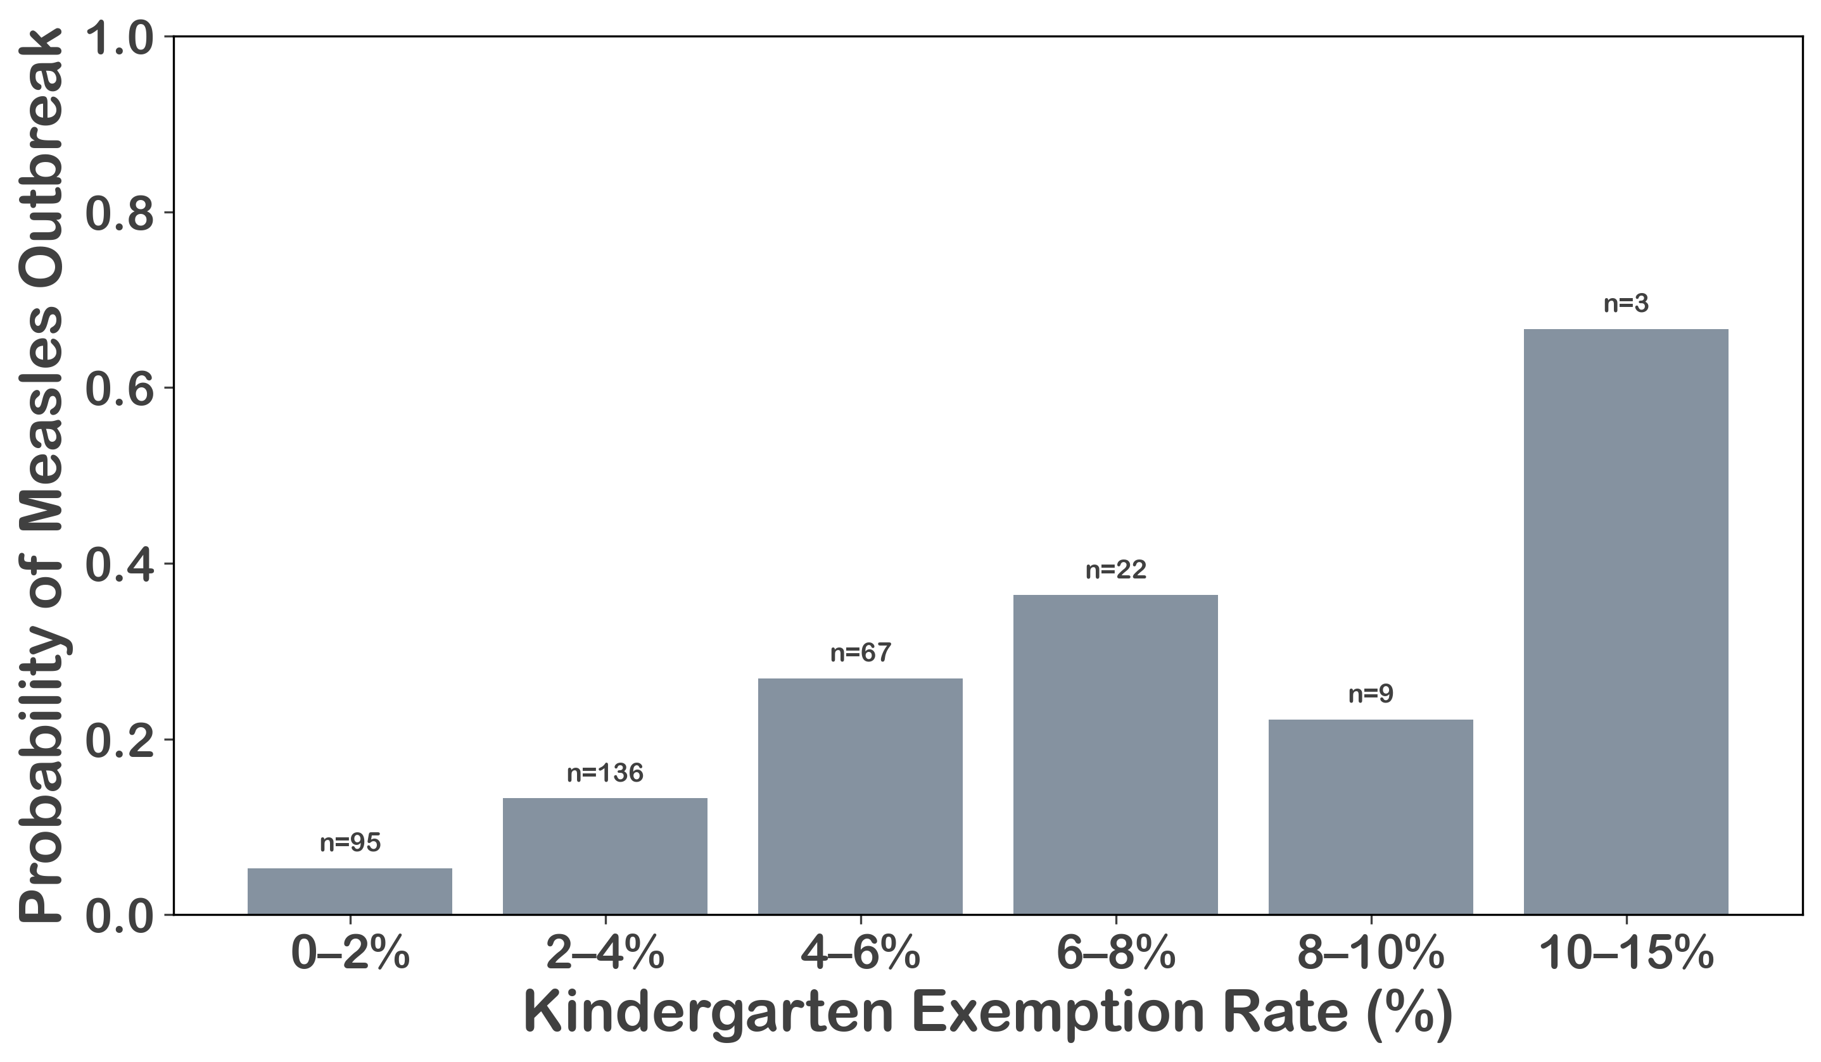


Measles is re-emerging where vaccination coverage drops and we need to do something about it.
Measles is Back: A Data-Driven Look at Vaccination Gaps in the U.S.
MMR Vaccination Coverage and
Unvaccinated Kids in the US
Arkesh Das
Measles Cases Over Time
Even slight drops in vaccination coverage produce a rapidly accumulating pool of unvaccinated children.
Higher Exemption Rates Correspond to Greater Outbreak Risk
While measles is declining globally and across Europe, the United States is seeing a renewed increase.
+
-
-
Where vaccination requirements are weaker, measles cases are higher, making a clear case for standardized national vaccine policies.
Scan to view the project on GitHub
Notes:
Notes:
In Powerpoint, click View > Guides
Keep text within gutter guides.
Author list: Don’t split names onto two lines (e.g., “Jimmy [break] Smith”). If that happens, use a new line, unless you need the space. Bold the first names of anybody who’s presenting in person.
Intro/methods/result: Do not drop below font size 28, but if you have extra space, jack up the font size until the space is full.
Do not use color in the sidebars except in graphs/figures. It’ll pull attention from the center and slow interpretation for passersby.

