Slide 1

Freddie’s uniform finder
Caption
A simple web service to help find Freddie’s uniform.
Arkesh Rath

Slide 2
About me
Software Engineer at Microsoft since 2021. Worked at Teletracking and Amadeus labs prior to 2019.
Worked primarily on creating scalable web services, data pipelines and infrastructure around our data platform for Microsoft Ads. Tech stack : Python, Flask, ADF, Clickhouse, Airflow, Kubernetes etc
Did my master’s from CMU, graduated December 2020.
Love to play soccer, play my guitar and cook.

Slide 3
Functional and Non Functional Requirements
Help take in a file with clues about Freddie’s missing uniform and perform ingestion and transformation on raw input data.
The service should handle invalid inputs when the clue file has been corrupted.
The latency and availability of the service should be 2 seconds and 99.95%.
The structure should lend itself to be horizontally scalable in the future to handle in heavier traffic loads.

Slide 4
API Definitions
/process-file : End user or application UI can hit this endpoint with a filename parameter to process the clue file.
  Returns 400 in case of bad input.
  Returns 405, in case of invalid access method.
  Returns 200 OK if file was successfully processed.
/ui/v1/uniform-finder : Boots up a demo UI component for purposes of demonstrations, can be used as a production grade UI in the future. Gives option to upload further clues.
/delete-file: Deletes an uploaded clues file.

Slide 5
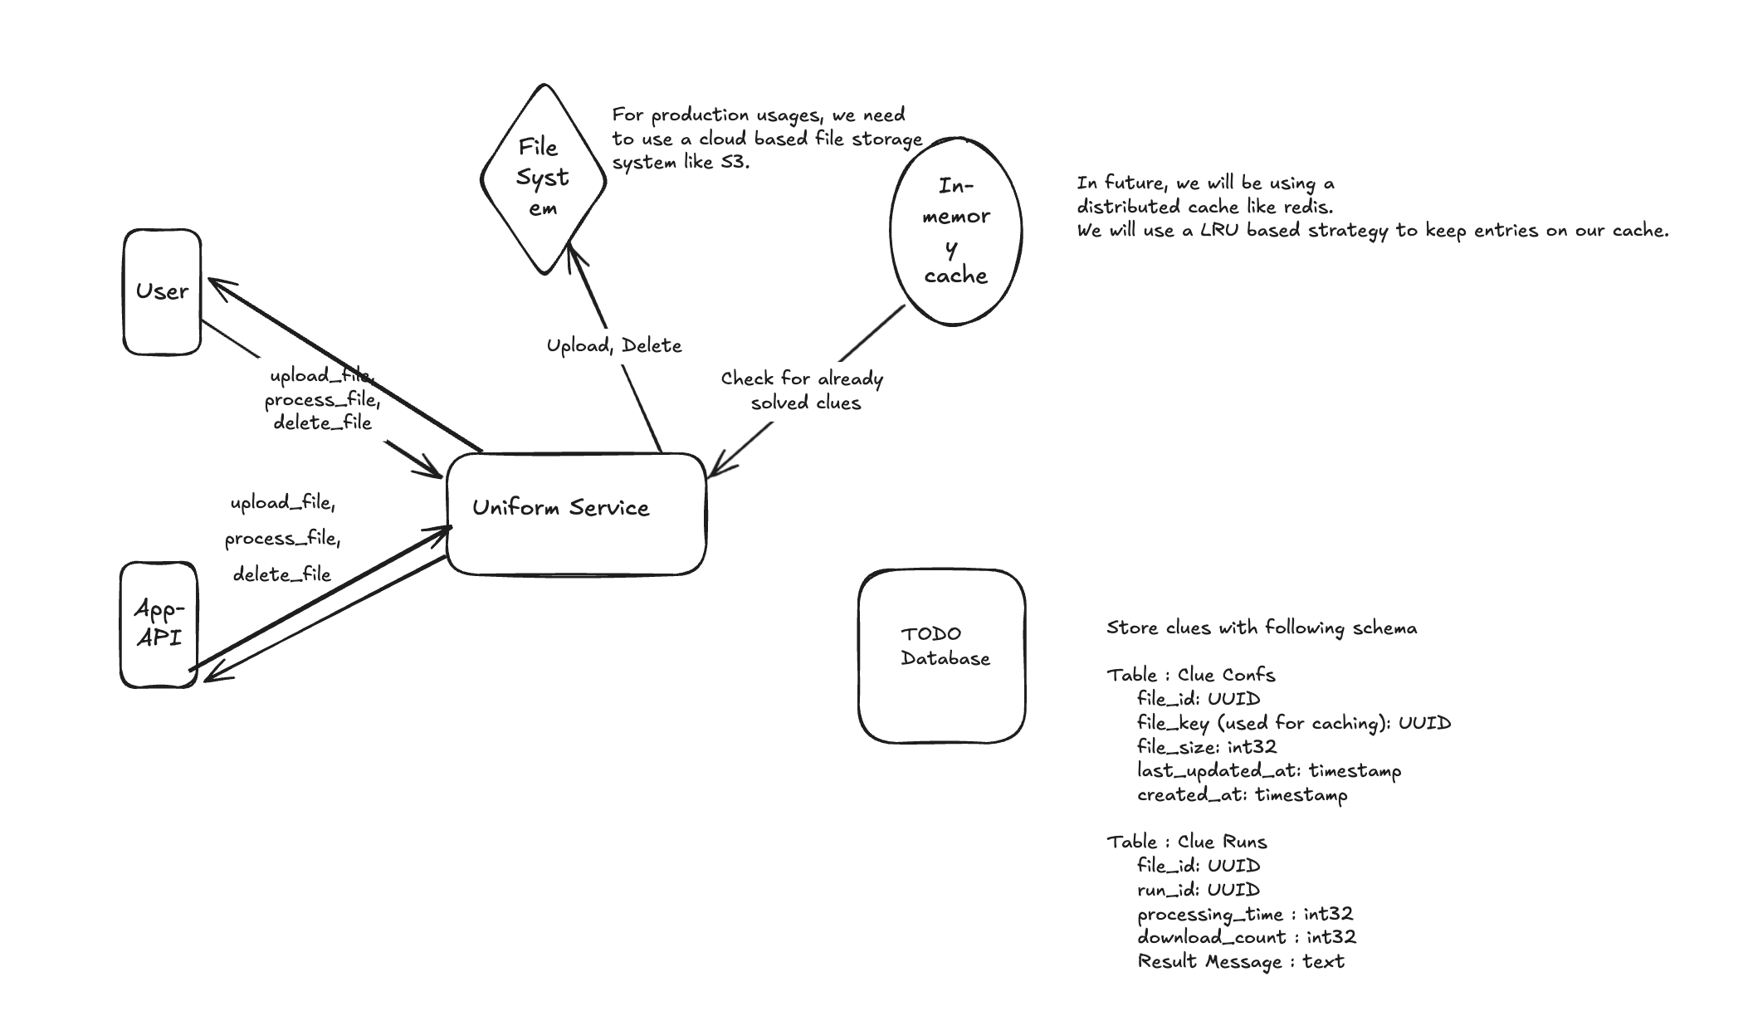
High Level Design

Slide 6
DEMONSTRATION

Slide 7
Future Enhancements
In-Memory Caching: An in-memory cache (TTLCache) is used for caching grid data with a TTL of 1 hour. This choice avoids the complexity of integrating a full-fledged caching solution like Redis but limits scalability.
File Uploads: Files are read from a local directory for simplicity. In a production environment, a more robust file storage solution (like AWS S3) would be preferred.
Error Handling: Basic error handling is implemented. For a production-grade service, more comprehensive error handling and validation would be necessary.
Folding Logic: The folding logic checks for the presence of black cells along the fold line and raises errors if present. This ensures that folds are valid but may need further optimization for large grids.
Scalability : Currently the web service is running with 1 worker thread, this is in order to show the caching implementation of the project. For production, we will be using multiple worker threads and can fine tune this number depending on our compute layer.
To perform analytics on service performance, we can store file metadata (file confs and runs) in a Sql database, with relevant information to gauge metrics like avg file processing time, file success rate etc.

Slide 8
Questions

