Slide 1
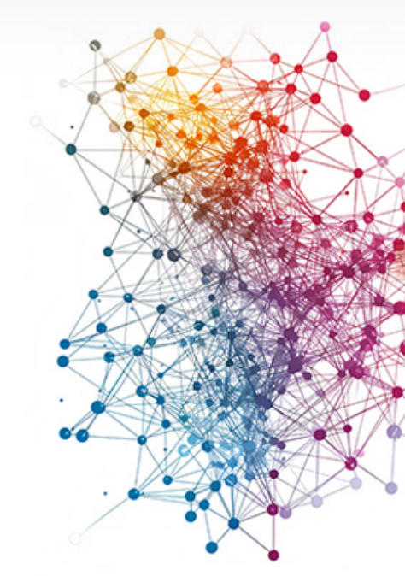
THE NEXT EVOLUTION OF ENTERPRISE SCALING GRAPH-BASED
Unlocking Multi-Hop Reasoning, Auditability, and ROI at Enterprise Scale

Slide 2
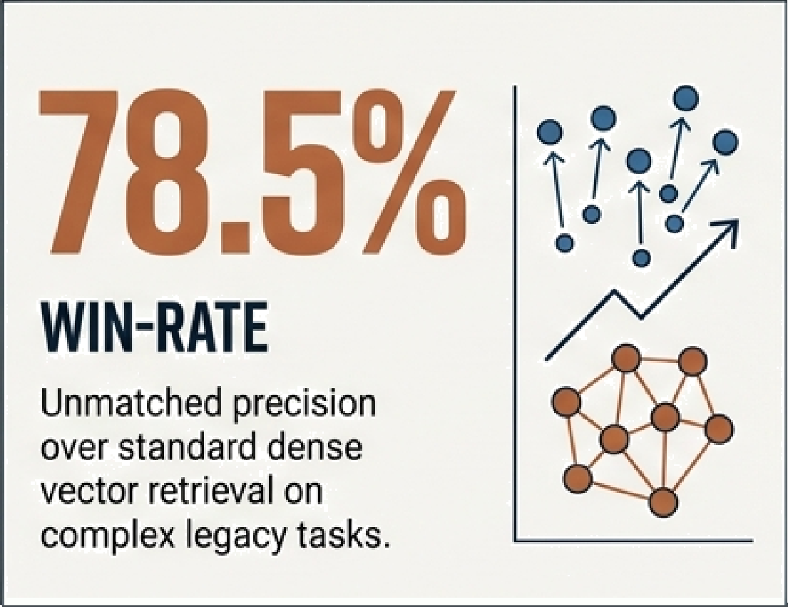
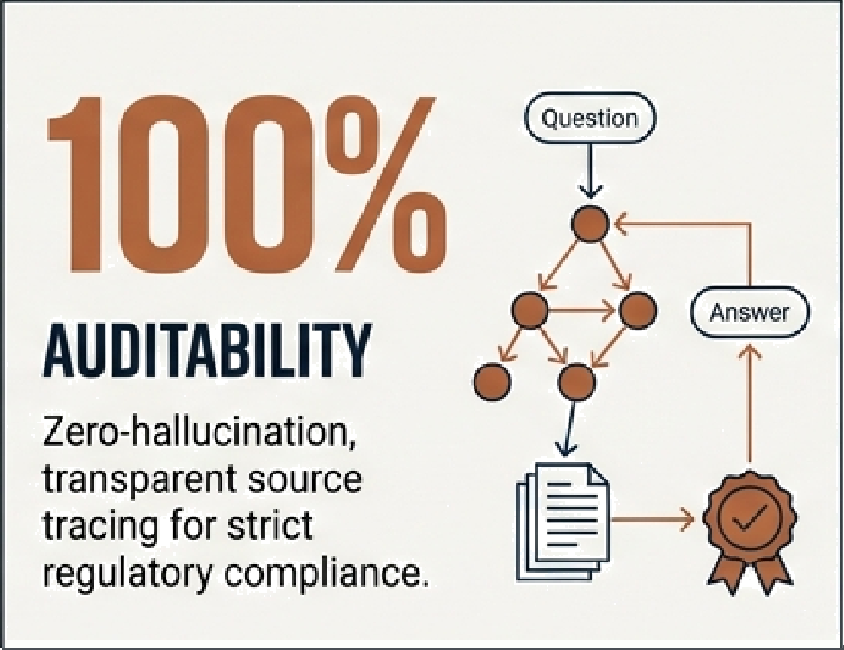
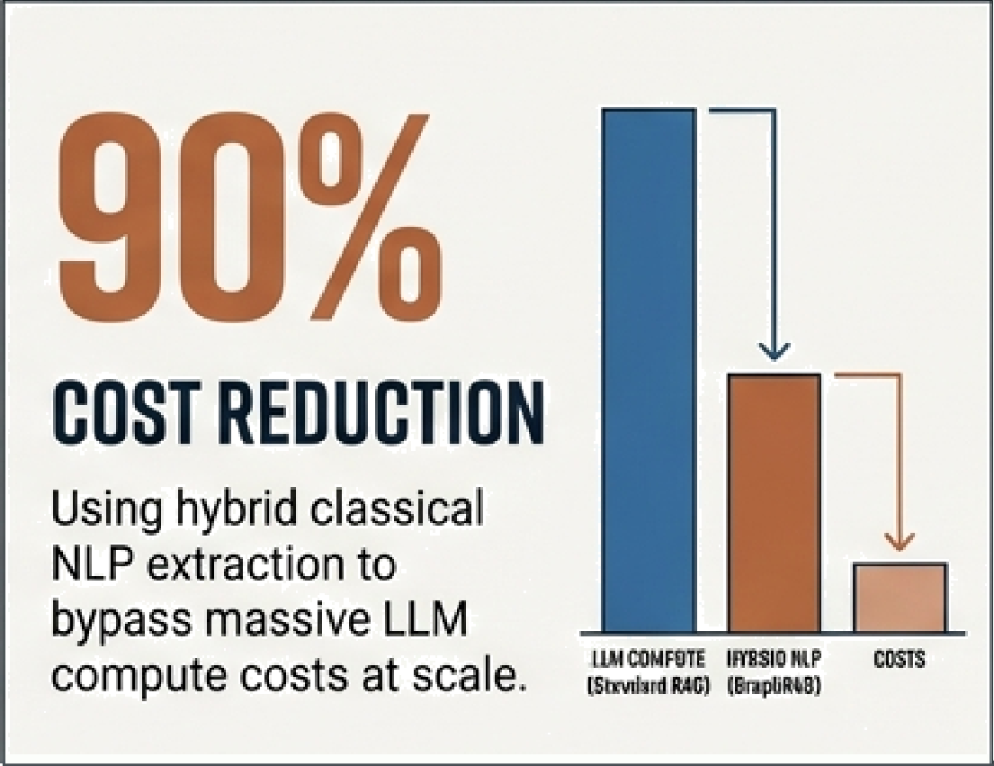
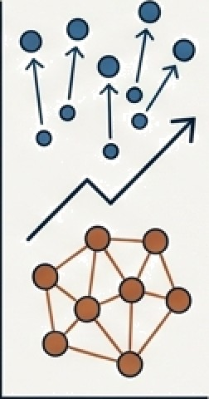
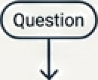
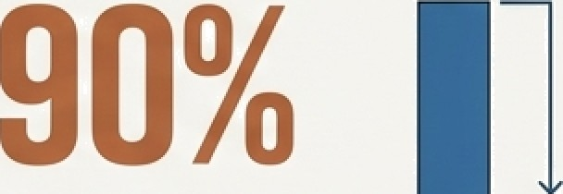
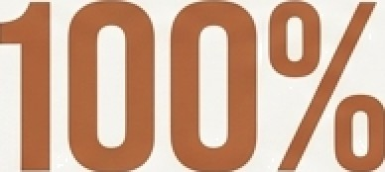
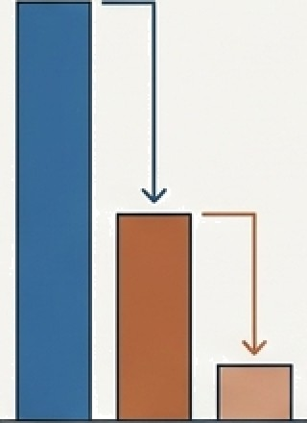


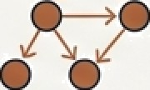

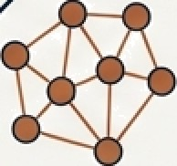



MECUTIVE SUMMARY: BREAKING
THE GENERATIVEAI CEILING
THE REALITY: Current Generative AI investments (Standard Vector RAG) are stalling on complex, highly- regulated enterprise data.
THE INTERVENTION: Graph-based Retrieval is the proven solution to unlock multi-hop reasoning, guarantee compliance, and reduce resolution times.
THE OBJECTIVE: Secure sponsorship to scale our hybrid, cost-optimized GraphRAG framework.
78.5% ••••••
\I¥IN-RATE
Unmatched precision over standard dense vector retrieval on complex legacy tasks.
AUBITABILITY
Zero-hallucination, transparent source tracing for strict regulatory compliance.
COSTREBUCTIßN
Using hybrid classical NLP extraction to bypass massive LLM compute costs at scale.
tr« @HrstE Iß9zIc aP
cfal5
G NotebookLM

Slide 3






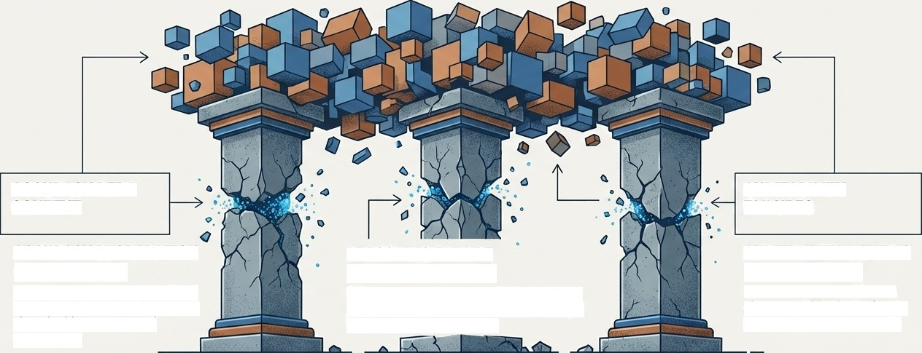

WALL
THE AI GROWTH CEI
STANDARD IS ITTI
ACCURACY DEDA CONTEXT
AUDITABILITY FAILURES
ACCURACY DEGRADATION
REASONING FAILURE
AUDITABILITY FAILURES (THE BLACK BOX)
(CONTEXT LOSS)
(THE MULTI-HOP GAP)
Struggles with dense, specialized
Fails to connect corrplez, distributed facts
Provides answers without a
enterprise data where documents
(A to B to C) necessary for answering high-
clear, verifiable chain of logic,
share highly concentrated
level operational questions.
that regulators cannot audit.
terminology.
W NotebaokLM

Slide 4

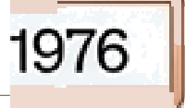



THE ROOT CAUSE: THE CHUNKING PROBLEM
NAIVE CHUNKING RELATIONAL PRESERVATION
Apple Computer, Inc. was founde
The Apple 11, released in 1977, wa
in 1976.
a major
CApop empuItnce
success. The Apple Li a, introduced in 1985,
Apple II
RELEASED_IN
1977
was one of the first p‹ rsonal com uters
with a GUI. The created in
Macintosh
Macintosh
CREATED IN
1984
1984, became iconic.
i a«.
Apple Lisa
INTRODUCED IN
1983
Steve Jobs returned ii period of innovation.
1997,leadi g a
Steve Jobs
RETURNED_IN
1997
Slices enterprise knowledge into rigid blocks, creating proximity bias and destroying structural relationships (e.g., inaccurately attributing the Macintosh creation to1983).
Graph structures capture the actual logic and conditions of the text, preserving the whole thought intact regardless of document length.

Slide 5
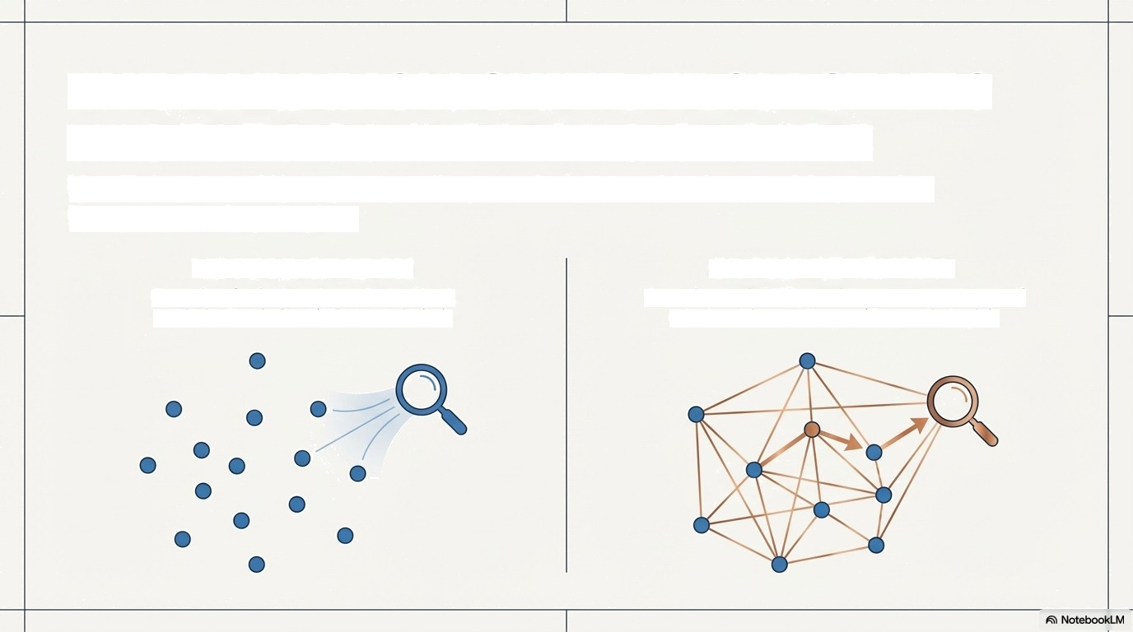
THE PARADIGM SHIFT: FROM STATIC
VECTORS TO DYNAMIC GRAPHS
Key Takeaway: We are upgrading our AI from a simple matching engine into a reasoning engine.
VECTOR SEARCH
Querying for isolated words that look statistically similar. (Blind proximity).
GRAPH RETRIEVAL
Querying an intelligent, interconnected map of relationships and keys. (Semantic logic).

Slide 6










ENTERPRISE DIAGNOSTIC:
VECTOR RAG VS. GRAPH RAG
EVALUATION DIMENSIONS | VECTOR RAG | GRAPH RAG
Data Handling | Flat isolated documentchunks | Interconnected entity networks
Complex Queries | Fails at multi-hD synthesis | Excels at multi-hop reasoning and composition
Auditability & Compliance | Black Box (opaque origins) | FUIIytransparent (100⁰/o source-traced relationships)
Enterprise Readiness | High hallucination risk on dense data | High fidelity, condition- aware precision

Slide 7
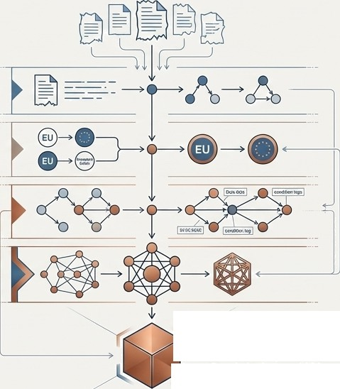
How It Works: The MDER Refinement Engine
Shift the Workload: By compressing multi-hop evidence into entity-centric summaries during indexing, we eliminate slow traversal during retrieval.
Map
Extract raw subject-predicate-object trlples from unstructixed tmt.
Disambiguate
Unlly fragmented or re‹ indet entitl
(e.g., EU and European Union).
Enrich
Reintroduce contedual nuance(conditions, dates, qualillersl to the structural oonnectlons
Reduce
Consolidate Into pristine, hop-frae
Entlty Summary
] Entity Summary
Ready for instant LLM consumption.

Slide 8
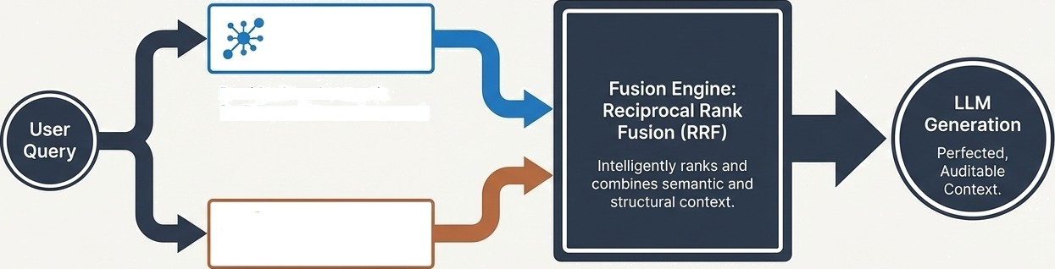
The Best of Both Worlds: Hybrid Retrie'vaI Architecture
A cascaded retrieval strategy that guarantees high recall without sacrificing accuracy.
Dense Vector
Search
Provides broad semantic
flexibility and contextual recall.
W
1-Hop Graph Traversal
Provides precise, multi hop relational logic and structure.

Slide 9
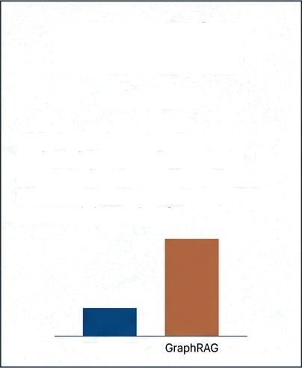
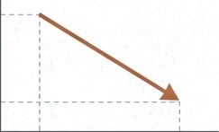

GraphRAG is Proven
Industry Outcomes: The ROI of
28.6%
Drop in Resolution Time
Linkedln: Reduced mean customer service issue resolution from 40 hours to 15 hours by parsing tickets into
intra-issue trees and inter-issue graphs.
1st Place
Benchmark Accuracy
78.5%
Win-Rate
SAP: Overpowered dense vector retrieval in complex legacy code migration (ABAP to S/4HANA) by understanding transaction-to-screen structural dependencies.
Writer: Defeated 7 enterprise vector
systems. Enabled AI in regulated
healthcare/finance by exposing exact
reasoning snippets and ensuring
zero-hallucination auditability.
40 Hours
15 Hours
Start
End
Oense Vector

Slide 10
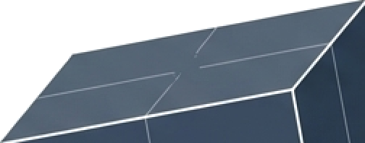
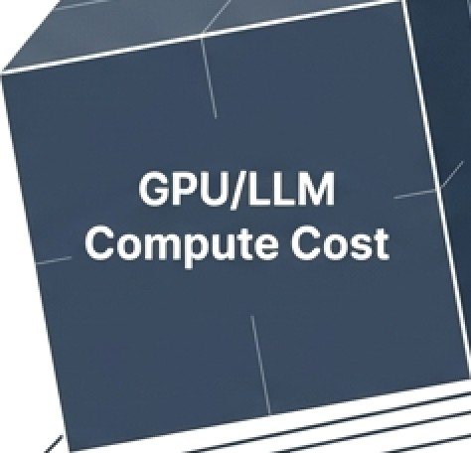
The Elephant in the Room: Cost & Scalability
Standard GraphRAG architectures trade retrieval accuracy for unsustainable indexing costs.
Graph Benefits
The Problem: Extracting billions of graph nodes using LLMs (like GPT-4) is prohibitively expensive and incredibly slow.
The Bottleneck: Traditional graph databases choke on complex traversal operations at query time as enterprise data scales into terabytes.

Slide 11
Pragmatic, Scalable Intervention
Classical NLP Engine
Hybrid JSON Storage
Cost
Accuracy
90%
drop
04s retained
accuracy: 65.8% to 61.8%
1. Cost-Efficient Extraction
(The SAP Method):
We deploy classical NLP (Dependency Parsing) for knowledge extraction instead of expensive LLMs.
2. Hybrid Storage (The Writer Method):
We store graph data points as JSON in fast, existing Lucene-based search engines, preventing scaling bottlenecks.
LLM | NLP | LLM | NLP
Method | Method | Method | Method
 |  | (GraphRAG) | (Classical
 |  |  | NLP)
W NotebaokLM

Slide 12
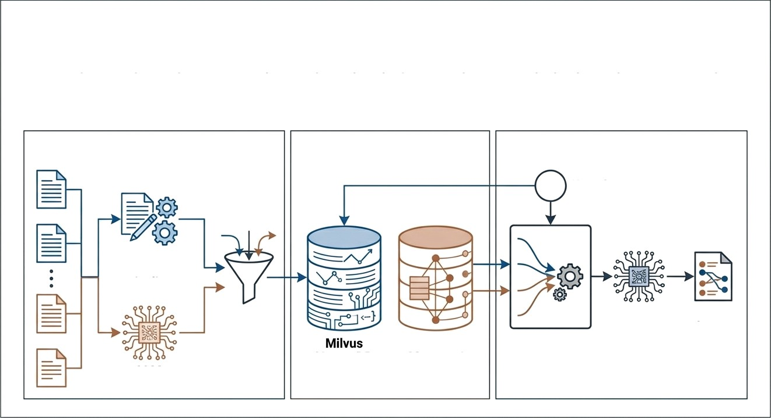
Blueprint: Our Target Enterprise Architecture
An end-to-end, production-ready pipeline that balances theoretical ideals with operational realities. Built for scale, engineered for efficiency.
Cost-Efficient Indexing Hybrid Storage Relational Generation
NLP Parser
User Query
Dual Extraction Pipeline
MDER
Process
LLM
Auditable
Output
iGraph Memory / Lucene JSON
RRF Fusion Engine
Vector DB
LLM
W NotebaokLM

Slide 13
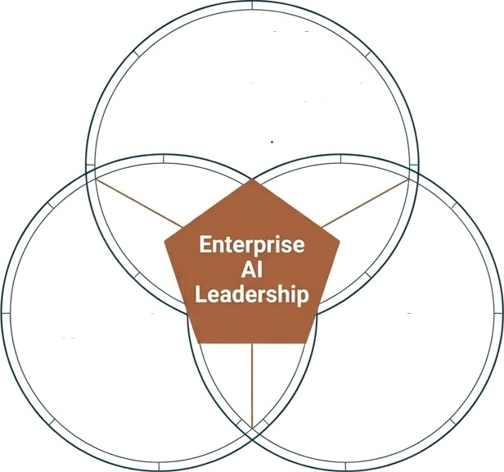
Strategic Business Outcomes
Unmatched Accuracy
Conquer complex, specialized legacy data with multi-hop reasoning and holistic entity summaries.
Linear scaling and bounded latency. Slash resolution times by 20°4+ while bypassing massive LLM compute costs during indexing.
Operational Efficiency
Regulatory Compliance
Eliminate the black box. Expose exact reasoning processes, subqueries, and transparent audit trails for every Al-generated response.
W NotebaokLM

Slide 14
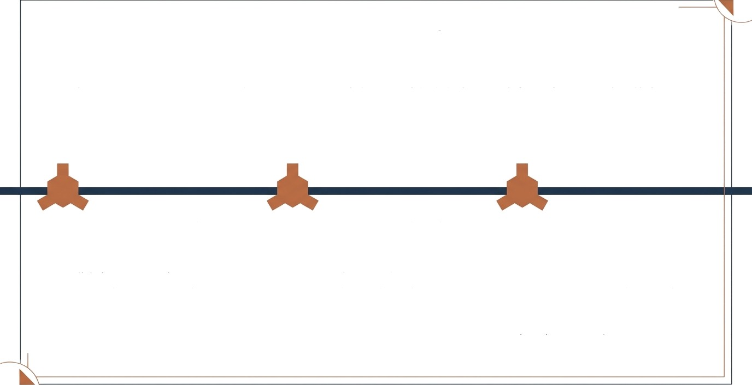
The Ask: A 90-Day Sprint to ROI
The Request: Executive sponsorship and initial seed funding to build the MVP of our hybrid GraphRAG pipeline.
Phase 1: Foundation
(Days 1-30)
Build the Dependency Parsing (NLP) extraction pipeline to ensure cost- efficiency from day one.
Phase 2: MVP Pipeline (Days 30-60)
Deploy the hybrid storage and Reciprocal Rank Fusion (RRF) retrieval engine.
Phase 3: Pilot Readout
(Days 60-90)
Run a live pilot on our most complex legacy dataset (e.g., code migration or customer service tickets) and deliver a hard ROI readout.

Slide 15
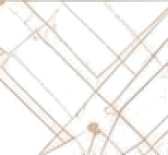
The Future of Enterprise
AI is Connected
Data without relationships is just noise. By shifting
from static vectors to dynamic graphs, we are not just , upgrading an algorithm we are building an auditable,
.
reasoning brain for the entire enterprise.
Ready for Strategic Deployment.

Slide 16
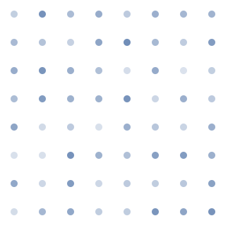
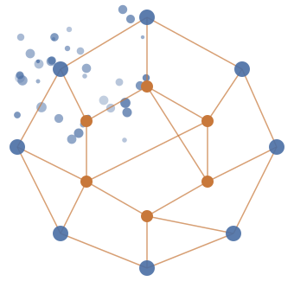
THE NEXT
EVOLUTION OF
ENTERPRISE AI:
SCALING
GRAPH-BASED
RAG
Unlocking Multi-Hop Reasoning,
Auditability, and ROI at
Enterprise Scale
🔖 NotebookLM

Slide 17


EXECUTIVE SUMMARY: BREAKING
THE GENERATIVE AI CEILING
THE REALITY: Current Generative AI investments (Standard Vector RAG) are stalling on complex, highly-regulated enterprise data.
THE INTERVENTION: Graph-based Retrieval is the proven solution to unlock multi-hop reasoning, guarantee compliance, and reduce resolution times.
THE OBJECTIVE: Secure sponsorship to scale our hybrid, cost-optimized GraphRAG framework.
78.5%
100%
90%
WIN-RATE
AUDITABILITY
COST REDUCTION
Unmatched precision over standard dense vector retrieval on complex legacy tasks.
Zero-hallucination, transparent source tracing for strict regulatory compliance.
Using hybrid classical NLP extraction to bypass massive LLM compute costs at scale.
LLM
NLP
Cost
🔖 NotebookLM

Slide 18
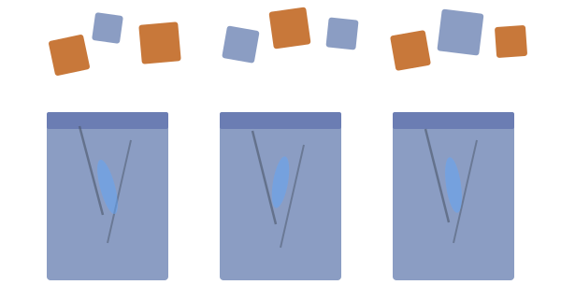
THE AI GROWTH CEILING:
STANDARD RAG IS HITTING A WALL
ACCURACY DEGRADATION
(CONTEXT LOSS)
REASONING FAILURE
(THE MULTI-HOP GAP)
AUDITABILITY FAILURES
(THE BLACK BOX)
Struggles with dense, specialized enterprise data where documents share highly concentrated terminology.
Fails to connect complex, distributed facts (A to B to C) necessary for answering high-level operational questions.
Provides answers without a clear, verifiable chain of logic, that regulators cannot audit.
🔖 NotebookLM

Slide 19
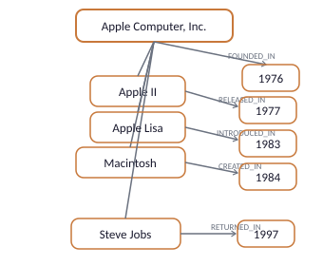
THE ROOT CAUSE: THE CHUNKING PROBLEM
NAIVE CHUNKING
RELATIONAL PRESERVATION
Apple Computer, Inc. was founded in 1976. The Apple II, released in 1977, was a major success. The Apple Lisa, introduced in 1983, was one of the first personal computers with a GUI. The Macintosh created in 1984, became iconic. Steve Jobs returned in 1997, leading a period of innovation.
Slices enterprise knowledge into rigid blocks, creating proximity bias and destroying structural relationships (e.g., inaccurately attributing the Macintosh creation to 1983).
Graph structures capture the actual logic and conditions of the text, preserving the whole thought intact regardless of document length.
🔖 NotebookLM

Slide 20

THE PARADIGM SHIFT: FROM STATIC
VECTORS TO DYNAMIC GRAPHS
Key Takeaway: We are upgrading our AI from a simple matching engine into a reasoning engine.
VECTOR SEARCH
GRAPH RETRIEVAL
Querying for isolated words that look
statistically similar. (Blind proximity).
Querying an intelligent, interconnected map of
relationships and keys. (Semantic logic).
🔖 NotebookLM

Slide 21
ENTERPRISE DIAGNOSTIC:
VECTOR RAG VS. GRAPH RAG
EVALUATION DIMENSIONS | VECTOR RAG | GRAPH RAG
Data Handling | Flat, isolated document chunks | Interconnected entity networks
Complex Queries | Fails at multi-hop synthesis | Excels at multi-hop reasoning and composition
Auditability & Compliance | Black Box (opaque origins) | Fully transparent (100% source-traced relationships)
Enterprise Readiness | High hallucination risk on dense data | High fidelity, condition-aware precision
🔖 NotebookLM

Slide 22
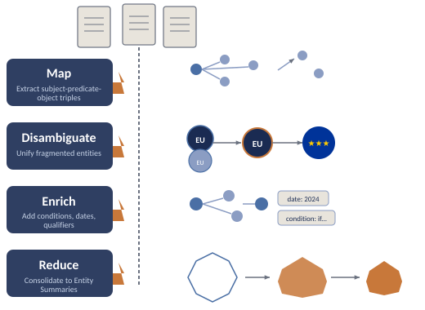
How It Works: The MDER Refinement Engine
Shift the Workload: By compressing multi-hop evidence into entity-centric summaries during indexing, we eliminate slow traversal during retrieval.
Map
Extract raw subject-predicate-object triples from unstructured text.
Disambiguate
Unify fragmented or redundant entities (e.g., EU and European Union).
Enrich
Reintroduce contextual nuance (conditions, dates, qualifiers) to the structural connections.
Reduce
Consolidate into pristine, hop-free Entity Summaries.
Entity Summary — Ready for instant LLM consumption.
🔖 NotebookLM

Slide 23
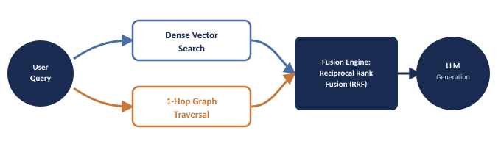
The Best of Both Worlds: Hybrid Retrieval Architecture
A cascaded retrieval strategy that guarantees high recall without sacrificing accuracy.
🔖 NotebookLM

Slide 24
Industry Outcomes: The ROI of
GraphRAG is Proven
28.6%
1st Place
78.5%
Drop in Resolution Time
Benchmark Accuracy
Win-Rate
LinkedIn: Reduced mean customer service issue resolution from 40 hours to 15 hours by parsing tickets into intra-issue trees and inter-issue graphs.
Writer: Defeated 7 enterprise vector systems. Enabled AI in regulated healthcare/finance by exposing exact reasoning snippets and ensuring zero-hallucination auditability.
SAP: Overpowered dense vector retrieval in complex legacy code migration (ABAP to S/4HANA) by understanding transaction-to-screen structural dependencies.
40 Hours
15 Hours
Start
End
Dense
Vector
Graph
RAG
🔖 NotebookLM

Slide 25
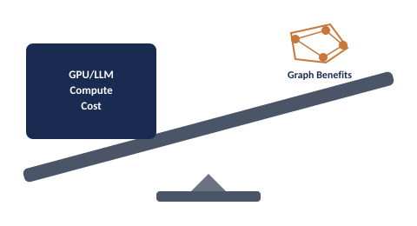
The Elephant in the Room: Cost & Scalability
Standard GraphRAG architectures trade retrieval accuracy for unsustainable indexing costs.
The Problem: Extracting billions of graph nodes using LLMs (like GPT-4) is prohibitively expensive and incredibly slow.
The Bottleneck: Traditional graph databases choke on complex traversal operations at query time as enterprise data scales into terabytes.
🔖 NotebookLM

Slide 26
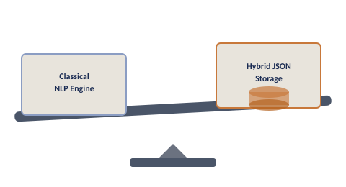
Our Pragmatic, Scalable Intervention
Cost
Accuracy
90%
drop
LLM
Method
NLP
Method
94% retained accuracy
65.8% to 61.8%
LLM
(GraphRAG)
NLP
(Classical)
1. Cost-Efficient Extraction (The SAP Method):
2. Hybrid Storage (The Writer Method):
We deploy classical NLP (Dependency Parsing) for knowledge extraction instead of expensive LLMs.
We store graph data points as JSON in fast, existing Lucene-based search engines, preventing scaling bottlenecks.
🔖 NotebookLM

Slide 27
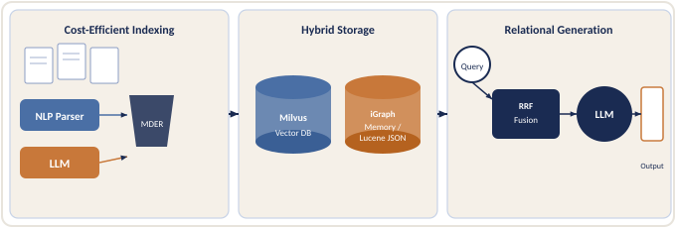
Blueprint: Our Target Enterprise Architecture
An end-to-end, production-ready pipeline that balances theoretical ideals with operational realities. Built for scale, engineered for efficiency.
🔖 NotebookLM

Slide 28
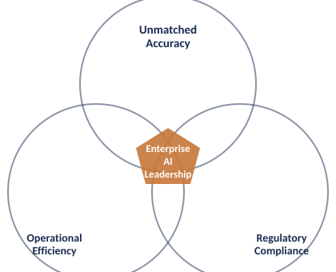
Strategic Business Outcomes
Linear scaling and bounded latency. Slash resolution times by 20%+ while bypassing massive LLM compute costs during indexing.
Eliminate the black box. Expose exact reasoning processes, subqueries, and transparent audit trails for every AI-generated response.
🔖 NotebookLM

Slide 29
The Ask: A 90-Day Sprint to ROI
The Request: Executive sponsorship and initial seed funding to build the MVP of our hybrid GraphRAG pipeline.
Phase 1: Foundation
(Days 1-30)
Phase 2: MVP Pipeline
(Days 30-60)
Phase 3: Pilot Readout
(Days 60-90)
Build the Dependency Parsing (NLP) extraction pipeline to ensure cost-efficiency from day one.
Deploy the hybrid storage and Reciprocal Rank Fusion (RRF) retrieval engine.
Run a live pilot on our most complex legacy dataset (e.g., code migration or customer service tickets) and deliver a hard ROI readout.
🔖 NotebookLM

Slide 30
The Future of Enterprise
AI is Connected
Data without relationships is just noise. By shifting from static vectors to dynamic graphs, we are not just upgrading an algorithm—we are building an auditable, reasoning brain for the entire enterprise.
Ready for Strategic Deployment.
🔖 NotebookLM

