Slide 1
Advanced Algorithms
Piyush Kumar
(Lecture 2: Max Flows)
Welcome to COT5405
Slides based on
Kevin Wayne’s slides

Slide 2
Announcements
Preliminary Homework 1 is out
Scribing is worth 5% extra credit.
My compgeom.com web pages might not be accessible from inside campus(for now you can use cs.fsu.edu/~piyush pages.

Slide 3
Today
More about the programming assignment.
On Max Flow Algorithms

Slide 4
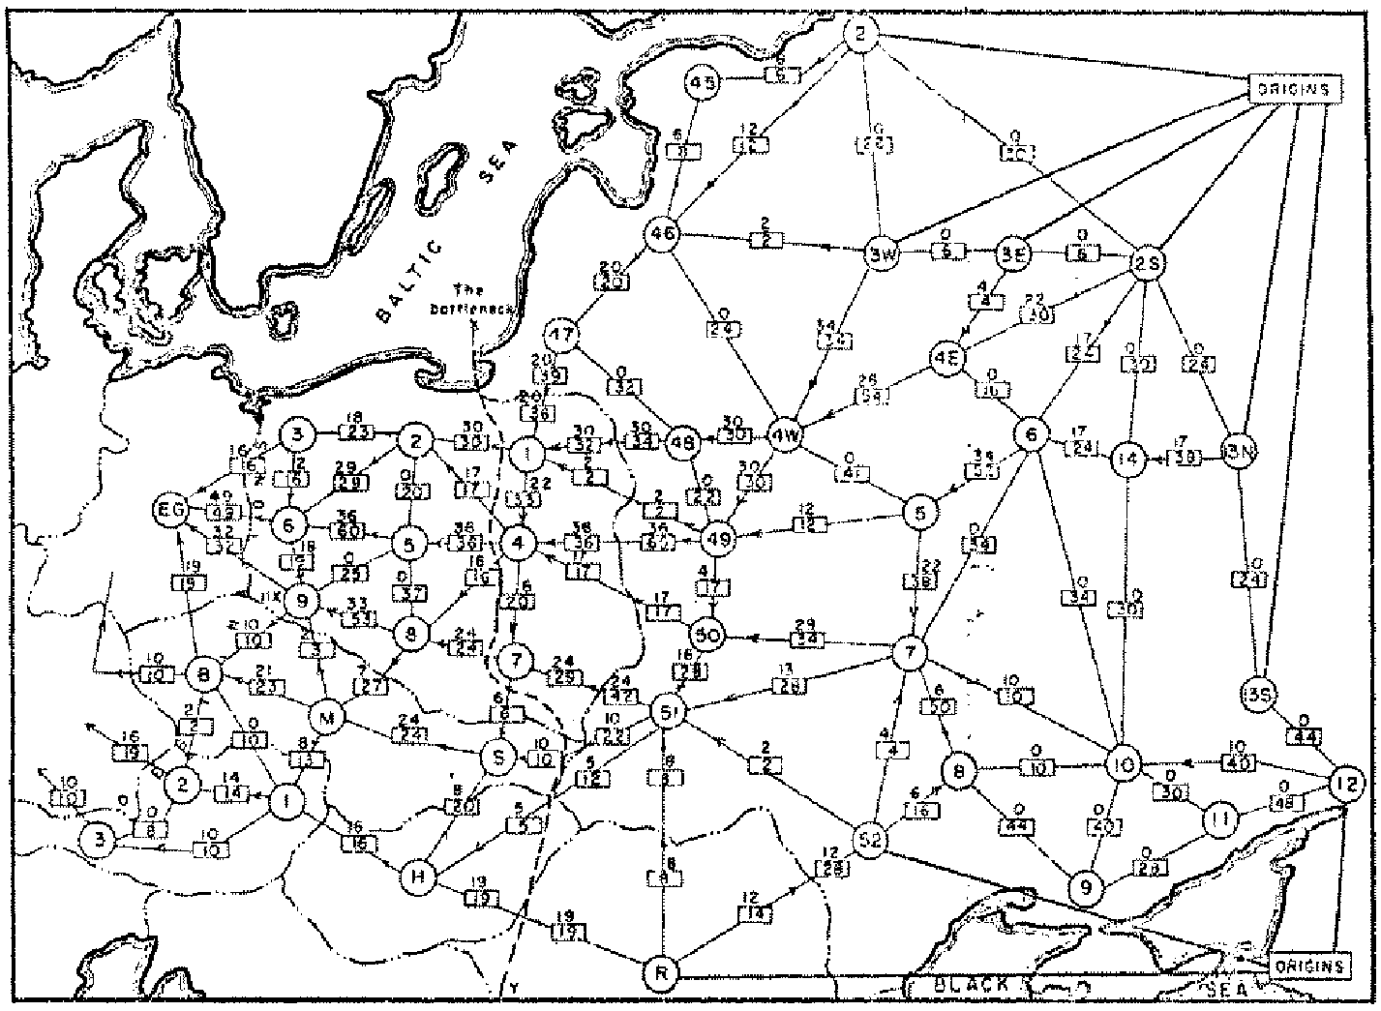
Soviet Rail Network, 1955
“The Soviet rail system also roused the interest of the Americans,
and again it inspired fundamental research in optimization.”
-- Schrijver
G. Danzig* 1951…First soln…
Again formulted by
Harris in 1955 for the
US Airforce
(“unclassified in 1999”)
What were they looking for?
Reference: On the history of the transportation and maximum flow problems.
Alexander Schrijver in Math Programming, 91: 3, 2002.
Notes:
Russian scientist A. N. Tolstoi investigated soviet rail network. Wanted to optimize amount of cargo that could be shipped from origins in Soviet Union (right) to destination satellite counties (Poland, Czechoslovakia, Austria, Eastern Germany) (left). American scientists Harris and Ross were also interested in Soviet rail system but from a different perspective. In a secret report (declassified at Schrijver's request in 1999), Harris and Ross calculated a "minimum interdiction" of 163,000 tons.
after aggregation, 44 vertices, 105 edges

Slide 5
Maximum Flow and Minimum Cut
Max flow and min cut.
  Two very rich algorithmic problems.
  Cornerstone problems in combinatorial optimization.
  Beautiful mathematical duality.

Slide 6
  Network reliability.
  Distributed computing.
  Egalitarian stable matching.
  Security of statistical data.
  Network intrusion detection.
  Multi-camera scene reconstruction.
  Many many more . . .
Applications
- Nontrivial applications / reductions.
  - Data mining.
  - Open-pit mining.
  - Project selection.
  - Airline scheduling.
  - Bipartite matching.
  - Baseball elimination.
  - Image segmentation.
  - Network connectivity.
Notes:
Network intrusion detection: http://www.ieee-infocom.org/2003/papers/46_02.PDF

Slide 7
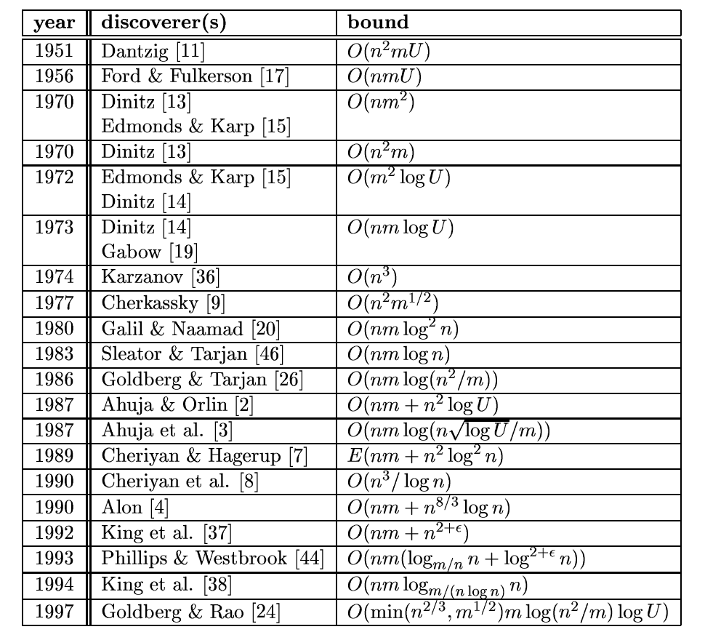
Some more history
Notes:
From: http://citeseer.ifi.unizh.ch/goldberg98recent.html

Slide 8
Minimum Cut Problem
Flow network.
  Abstraction for material flowing through the edges.
  G = (V, E) = directed graph, no parallel edges.
  Two distinguished nodes: s = source, t = sink.
  c(e) = capacity of edge e.
2
9
5
10
4
15
15
10
source
s
5
3
8
6
10
t
sink
4
6
15
10
capacity
15
4
30
7
Notes:
source = where material originates, sink = where material goes.
We use cut to mean s-t cut.

Slide 9
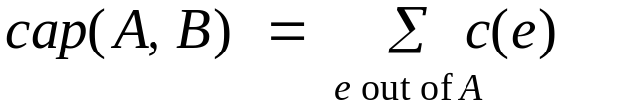
Cuts
Def. An s-t cut is a partition (A, B) of V with
s ∈ A and t ∈ B.
Def. The capacity of a cut (A, B) is:
2
9
5
10
4
15
15
10
s
5
3
8
6
10
t
A
4
6
15
10
15
Capacity = 10 + 5 + 15
= 30
4
30
7

Slide 10
Cuts
Def. An s-t cut is a partition (A, B) of V with s ∈ A and t ∈ B.
Def. The capacity of a cut (A, B) is:
2
9
5
10
4
15
15
10
s
5
3
8
6
10
t
A
4
15
15
6
10
Capacity = 9 + 15 + 8 + 30
= 62
4
30
7
Notes:
7->3 not counted

Slide 11
Minimum Cut Problem
Min s-t cut problem. Find an s-t cut of minimum capacity.
2
9
5
10
4
15
15
10
s
5
3
8
6
10
t
A
4
6
15
10
15
Capacity = 10 + 8 + 10
= 28
4
30
7

Slide 12
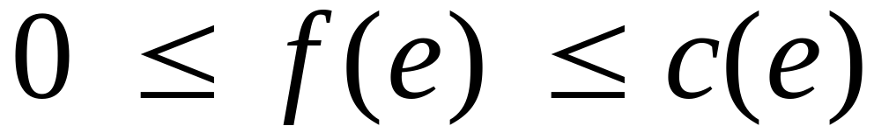
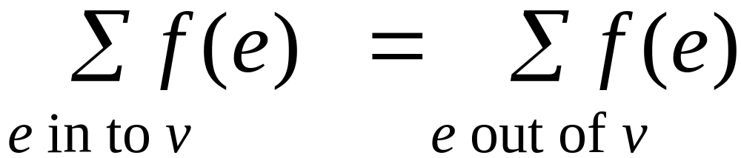
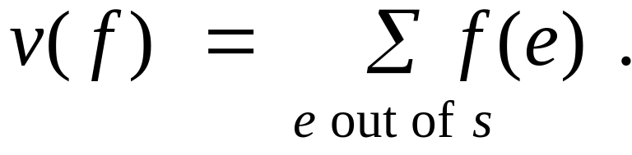
Flows
Def. An s-t flow is a function that satisfies:
  For each e ∈ E: (capacity)
  For each v ∈ V – {s, t}: (conservation)
Def. The value of a flow f is:
0
2
9
5
4
0
0
10
4
4
15
15
0
10
0
4
4
s
5
3
8
6
10
t
0
0
capacity
4
0
6
15
0
10
15
flow
0
0
Value = 4
4
30
7
Notes:
source = where material originates, sink = where material goes
flow conservation = otherwise warehouse overfills or oil pipe bursts
flow conservation is analogous to Kirchoff's law
* flow: abstract entity generated at source, transmitted across edges, absorbed at sink
* assume no arcs enter s or leave t (makes a little cleaner, no loss of generality)

Slide 13
Flows as Linear Programs
Maximize:
Subject to:

Slide 14
Flows
Def. An s-t flow is a function that satisfies:
  For each e ∈ E: (capacity)
  For each v ∈ V – {s, t}: (conservation)
Def. The value of a flow f is:
6
2
9
5
10
0
6
10
4
4
15
15
0
10
3
8
8
s
5
3
8
6
10
t
1
10
capacity
4
0
6
15
0
10
15
flow
11
11
Value = 24
4
30
7

Slide 15
Maximum Flow Problem
Max flow problem. Find s-t flow of maximum value.
9
2
9
5
10
1
9
10
4
0
15
15
0
10
4
8
9
s
5
3
8
6
10
t
4
10
capacity
4
0
6
15
0
10
15
flow
14
14
Value = 28
4
30
7
Notes:
Equalize inflow and outflow at every intermediate node.
Maximize flow sent from s to t.

Slide 16
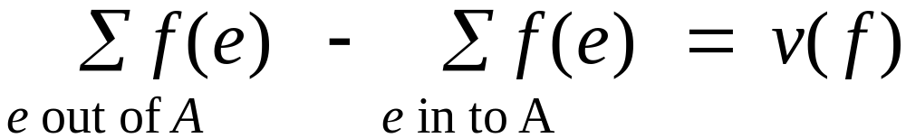
Flows and Cuts
Flow value lemma. Let f be any flow, and let (A, B) be any s-t cut. Then, the net flow sent across the cut is equal to the amount leaving s.
6
2
9
5
10
0
6
10
4
4
15
15
0
10
3
8
8
s
5
3
8
6
10
t
A
1
10
4
0
6
15
0
10
15
11
11
Value = 24
4
30
7

Slide 17
Flows and Cuts
Flow value lemma. Let f be any flow, and let (A, B) be any s-t cut. Then, the net flow sent across the cut is equal to the amount leaving s.
6
2
9
5
10
0
6
10
4
4
15
15
0
10
3
8
8
s
5
3
8
6
10
t
A
1
10
4
0
6
15
0
10
15
11
11
Value = 6 + 0 + 8 - 1 + 11
= 24
4
30
7
Notes:
total amount of flow that leaves S minus amount flow that "swirls" back

Slide 18
Flows and Cuts
Flow value lemma. Let f be any flow, and let (A, B) be any s-t cut. Then, the net flow sent across the cut is equal to the amount leaving s.
6
2
9
5
10
0
6
10
4
4
15
15
0
10
3
8
8
s
5
3
8
6
10
t
A
1
10
4
0
6
15
0
10
15
11
11
Value = 10 - 4 + 8 - 0 + 10
= 24
4
30
7

Slide 19
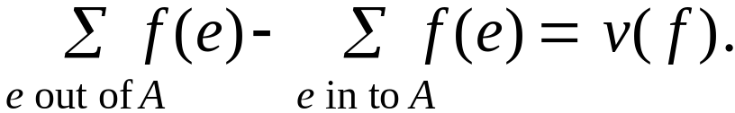
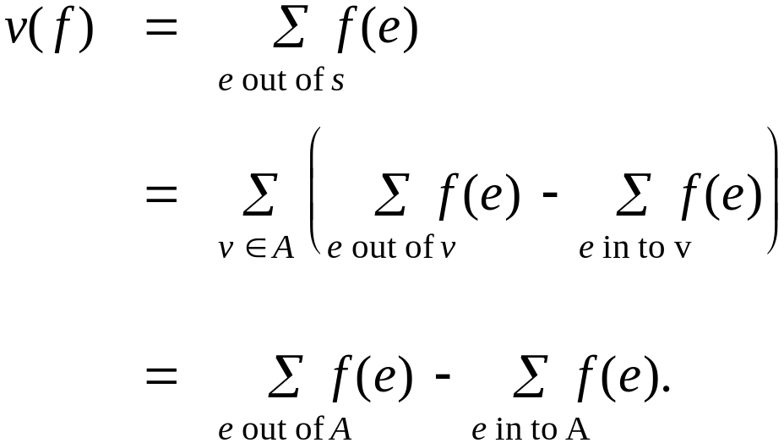
Flows and Cuts
Flow value lemma. Let f be any flow, and let (A, B) be any s-t cut. Then
Pf.
by flow conservation, all terms
except v = s are 0

Slide 20
Flows and Cuts
Weak duality. Let f be any flow, and let (A, B) be any s-t cut. Then the value of the flow is at most the capacity of the cut.
Cut capacity = 30 ⇒ Flow value ≤ 30
2
9
5
10
4
15
15
10
s
5
3
8
6
10
t
A
4
6
15
10
15
Capacity = 30
4
30
7

Slide 21
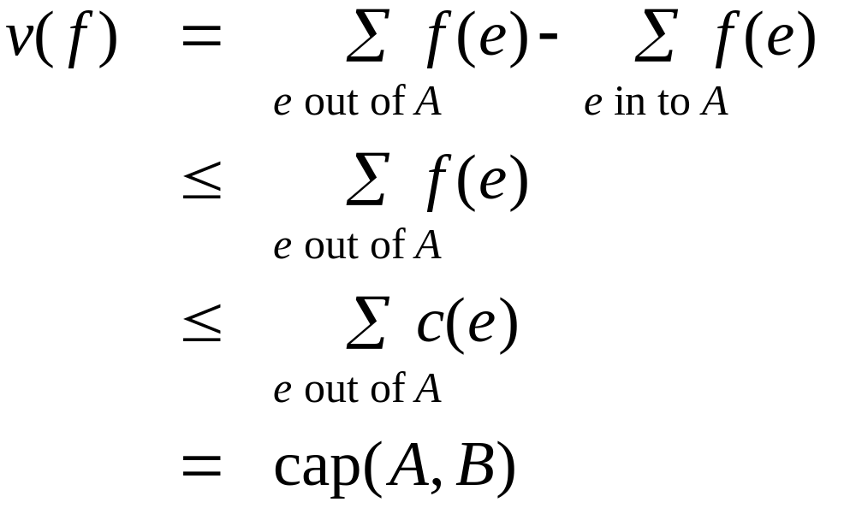
Flows and Cuts
Weak duality. Let f be any flow. Then, for any s-t cut
(A, B) we have
v(f) ≤ cap(A, B).
Pf.
A
B
4
8
t
s
7
6

Slide 22
Certificate of Optimality
Corollary. Let f be any flow, and let (A, B) be any cut.
If v(f) = cap(A, B), then f is a max flow and (A, B) is a min cut.
Value of flow = 28
Cut capacity = 28 ⇒ Flow value ≤ 28
9
2
9
5
10
1
9
10
4
0
15
15
0
10
4
8
9
s
5
3
8
6
10
t
4
10
A
4
0
6
15
0
10
15
14
14
4
30
7

Slide 23
Towards a Max Flow Algorithm
Greedy algorithm.
  Start with f(e) = 0 for all edge e ∈ E.
  Find an s-t path P where each edge has f(e) < c(e).
  Augment flow along path P.
  Repeat until you get stuck.
1
0
0
20
10
s
30
0
t
10
20
0
0
Flow value = 0
2

Slide 24
Towards a Max Flow Algorithm
Greedy algorithm.
  Start with f(e) = 0 for all edge e ∈ E.
  Find an s-t path P where each edge has f(e) < c(e).
  Augment flow along path P.
  Repeat until you get stuck.
1
20
0
0
X
20
10
30
0
20
t
s
X
10
20
0
0
20
Flow value = 20
X
2

Slide 25
Towards a Max Flow Algorithm
Greedy algorithm.
  Start with f(e) = 0 for all edge e ∈ E.
  Find an s-t path P where each edge has f(e) < c(e).
  Augment flow along path P.
  Repeat until you get stuck.
locally optimality ⇒ global optimality
1
1
20
0
20
10
20
10
20
10
s
30
20
t
s
30
10
t
10
20
10
20
0
20
10
20
greedy = 20
2
opt = 30
2

Slide 26
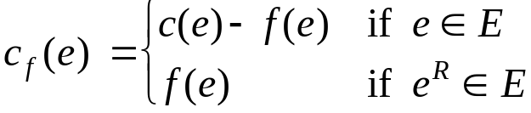
Residual Graph
Original edge: e = (u, v) ∈ E.
  Flow f(e), capacity c(e).
Residual edge.
  "Undo" flow sent.
  e = (u, v) and e^{R} = (v, u).
  Residual capacity:
Residual graph: G_{f} = (V, E_{f} ).
  Residual edges with positive residual capacity.
  E_{f} = {e : f(e) < c(e)} ∪ {e^{R} : c(e) > 0}.
capacity
u
17
v
6
flow
residual capacity
u
11
v
6
residual capacity

Slide 27
Demo

Slide 28
Augmenting Path Algorithm
Augment(f, c, P) {
b ← bottleneck(P)
foreach e ∈ P {
if (e ∈ E) f(e) ← f(e) + b
else f(e^{R}) ← f(e) - b
}
return f
}
forward edge
reverse edge
Ford-Fulkerson(G, s, t, c) {
foreach e ∈ E f(e) ← 0
G_{f} ← residual graph
while (there exists augmenting path P) {
f ← Augment(f, c, P)
update G_{f}
}
return f
}

Slide 29
Max-Flow Min-Cut Theorem
Augmenting path theorem. Flow f is a max flow iff there are no augmenting paths.
Max-flow min-cut theorem. [Ford-Fulkerson 1956] The value of the max flow is equal to the value of the min cut.
Proof strategy. We prove both simultaneously by showing the TFAE:
  (i) There exists a cut (A, B) such that v(f) = cap(A, B).
  (ii) Flow f is a max flow.
  (iii) There is no augmenting path relative to f.
(i) ⇒ (ii) This was the corollary to weak duality lemma.
(ii) ⇒ (iii) We show contrapositive.
  Let f be a flow. If there exists an augmenting path, then we can improve f by sending flow along path.

Slide 30
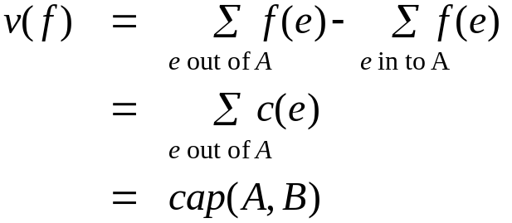
Proof of Max-Flow Min-Cut Theorem
(iii) ⇒ (i)
  Let f be a flow with no augmenting paths.
  Let A be set of vertices reachable from s in residual graph.
  By definition of A, s ∈ A.
  By definition of f, t ∉ A.
A
B
t
s
original network

Slide 31
Running Time
Assumption. All capacities are integers between 1 and U. The cut containing s and rest of the nodes has C capacity.
Invariant. Every flow value f(e) and every residual capacities c_{f} (e) remains an integer throughout the algorithm.
Theorem. The algorithm terminates in at most v(f*) ≤ C iterations.
Pf. Each augmentation increase value by at least 1. ▪
Corollary. If C = 1, Ford-Fulkerson runs in O(m) time.
Integrality theorem. If all capacities are integers, then there exists a max flow f for which every flow value f(e) is an integer.
Pf. Since algorithm terminates, theorem follows from invariant. ▪
Total running time?

Slide 32
7.3 Choosing Good Augmenting Paths

Slide 33
Ford-Fulkerson: Exponential Number of Augmentations
Q. Is generic Ford-Fulkerson algorithm polynomial in input size?
A. No. If max capacity is C, then algorithm can take C iterations.
m, n, and log C
1
1
1
0
0
1
0
0
X
X
X
1
C
C
C
C
1
0
t
1
0
1
0
t
s
X
1
s
X
X
C
C
C
C
0
0
1
0
0
1
X
1
X
X
2
2

Slide 34
Choosing Good Augmenting Paths
Use care when selecting augmenting paths.
  Some choices lead to exponential algorithms.
  Clever choices lead to polynomial algorithms.
  If capacities are irrational, algorithm not guaranteed to terminate!
Goal: choose augmenting paths so that:
  Can find augmenting paths efficiently.
  Few iterations.
Choose augmenting paths with: [Edmonds-Karp 1972, Dinitz 1970]
  Max bottleneck capacity.
  Sufficiently large bottleneck capacity.
  Fewest number of edges.

Slide 35
Capacity Scaling
Intuition. Choosing path with highest bottleneck capacity increases flow by max possible amount.
  Don't worry about finding exact highest bottleneck path.
  Maintain scaling parameter Δ.
  Let G_{f} (Δ) be the subgraph of the residual graph consisting of only arcs with capacity at least Δ.
4
4
110
102
110
102
s
1
t
s
t
122
170
122
170
2
2
G_{f}
G_{f} (100)

Slide 36
Capacity Scaling
Scaling-Max-Flow(G, s, t, c) {
foreach e ∈ E f(e) ← 0
Δ ← smallest power of 2 greater than or equal to max c
G_{f} ← residual graph
while (Δ ≥ 1) {
G_{f}(Δ) ← Δ-residual graph
while (there exists augmenting path P in G_{f}(Δ)) {
f ← augment(f, c, P)
update G_{f}(Δ)
}
Δ ← Δ / 2
}
return f
}

Slide 37
Capacity Scaling: Correctness
Assumption. All edge capacities are integers between 1 and C.
Integrality invariant. All flow and residual capacity values are integral.
Correctness. If the algorithm terminates, then f is a max flow.
Pf.
  By integrality invariant, when Δ = 1 ⇒ G_{f}(Δ) = G_{f}.
  Upon termination of Δ = 1 phase, there are no augmenting paths. ▪

Slide 38
Capacity Scaling: Running Time
Lemma 1. The outer while loop repeats 1 + ⎡log₂ C⎤ times.
Pf. Initially Δ < C. Δ drops by a factor of 2 each iteration and never gets below 1.
Lemma 2. Let f be the flow at the end of a Δ-scaling phase. Then the value of the maximum flow is at most v(f) + m Δ.
Lemma 3. There are at most 2m augmentations per scaling phase.
  Let f be the flow at the end of the previous scaling phase.
  L2 ⇒ v(f*) ≤ v(f) + m (2Δ).
  Each augmentation in a Δ-phase increases v(f) by at least Δ.
Theorem. The scaling max-flow algorithm finds a max flow in O(m log C) augmentations. It can be implemented to run in O(m² log C) time. ▪
proof on next slide

Slide 39
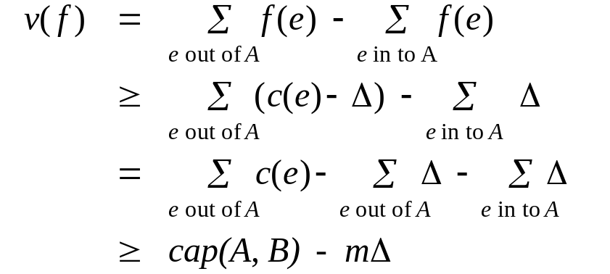
Capacity Scaling: Running Time
Lemma 2. Let f be the flow at the end of a Δ-scaling phase. Then value of the maximum flow is at most v(f) + m Δ.
Pf. (almost identical to proof of max-flow min-cut theorem)
  We show that at the end of a Δ-phase, there exists a cut (A, B) such that cap(A, B) ≤ v(f) + m Δ.
  Choose A to be the set of nodes reachable from s in G_{f}(Δ).
  By definition of A, s ∈ A.
  By definition of f, t ∉ A.
A
B
t
s
original network
Notes:
intuition: f is max flow in G_{f}(Δ). Adding back arc with capacity less than Δ can only increase capacity of cut by at most mΔ.

Slide 40
Bipartite Matching
Bipartite matching. Can solve via reduction to max flow.
Flow. During Ford-Fulkerson, all capacities and flows are 0/1. Flow corresponds to edges in a matching M.
Residual graph G_{M} simplifies to:
  If (x, y) ∉ M, then (x, y) is in G_{M}.
  If (x, y) ∈ M, the (y, x) is in G_{M}.
Augmenting path simplifies to:
  Edge from s to an unmatched node x ∈ X.
  Alternating sequence of unmatched and matched edges.
  Edge from unmatched node y ∈ Y to t.
1
1
1
s
t
X
Y

Slide 41
References
R.K. Ahuja, T.L. Magnanti, and J.B. Orlin. Network Flows. Prentice Hall, 1993. (Reserved in Dirac)
R.K. Ahuja and J.B. Orlin. A fast and simple algorithm for the maximum flow problem. Operation Research, 37:748-759, 1989.
K. Mehlhorn and S. Naeher. The LEDA Platform for Combinatorial and Geometric Computing. Cambridge University Press, 1999. 1018 pages.
On the history of the transportation and maximum flow problems, Alexander Schrijver.

