Slide 1
SGOS Checked Procedure for new build/modified SG9000 Tester

Slide 2
SGOS Check Procedure
1. Make sure AutoUpdate installed in tester.
2. Create shortcut of AutoUpdate on desktop
3. Check OSUpdate.ini setting
4. Check SG9000II.ini setting
5. Check interface type setting
6. Check EndLot.txt
7. Check SGSeting.ini

Slide 3
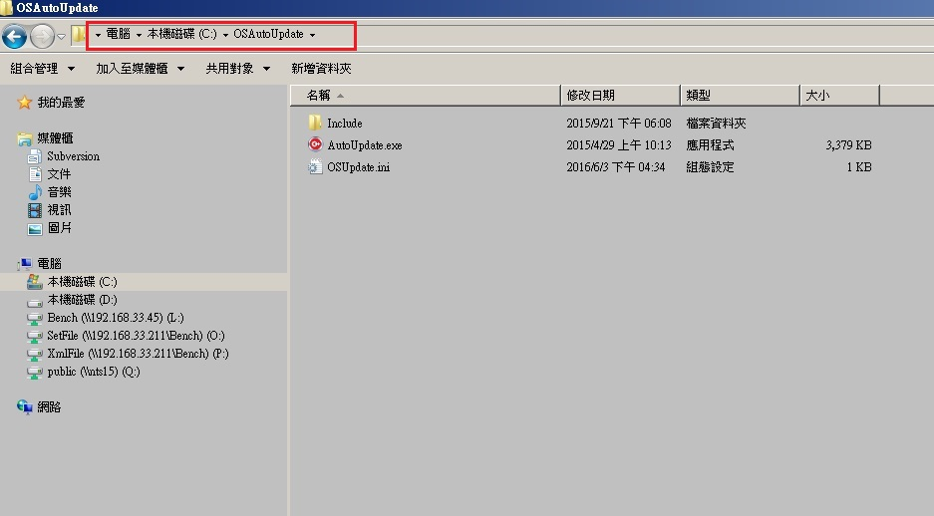
SGOS Check Procedure
1. Make sure AutoUpdate installed in tester.
2. Check OSUpdate.ini setting

Slide 4
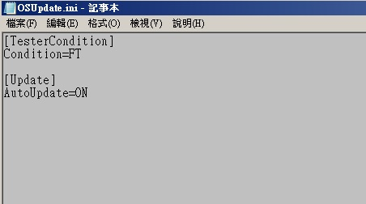
SGOS Check Procedure
OSUpdate.ini
*Condition = CP or FT
*AutoUpdate= ON or OFF

Slide 5
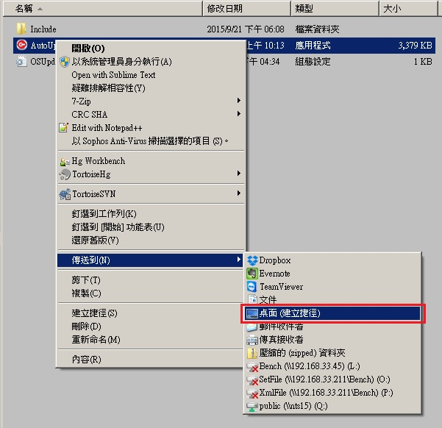

SGOS Check Procedure
1. Create shortcut of AutoUpdate.exe to desktop.
2. Rename the name of shortcut as “SG9000II.exe”.

Slide 6
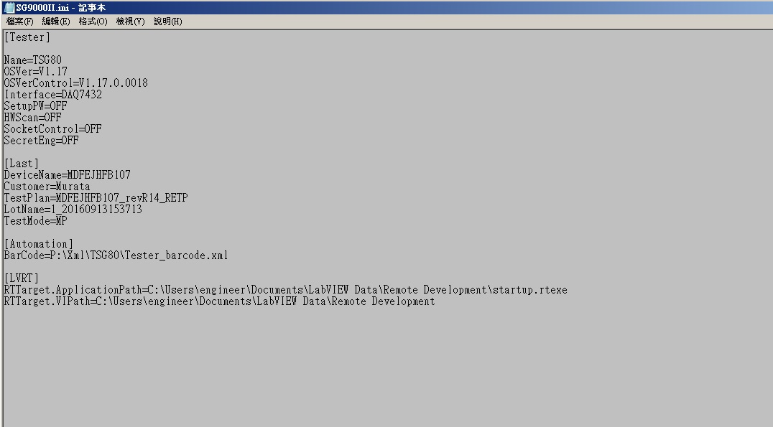
SGOS Check Procedure
1.Check OSVersion.
2.Check SG9000II.ini content and setting

Slide 7
SGOS Check Procedure
SG9000II.ini
[Tester]
Name=TSG80 #Tester No.
OSVer=V1.17 #OSVer
OSVerControl=V1.17.0.0018 #VerControl setting for auto-update
#if version number less than version on SGOS server, it will activate autoupdate procedure.
Interface=DAQ7432 #It decide what kind of interface to connect Handler
(DAQ7432. DAQ7230, DAQ6509, GPIBEPSON, GPIBUF200)
SetupPW=OFF #Turn on/off the password form of Setup Page
[Automation]
BarCode=P:\Xml\TSG80\Tester_barcode.xml #Indicate the location of Barcode file(Xml) for Autoload
Notes:
DAQ7432, DAQ7230,DAQ6509 : 利用TTL與Handler通訊, 通常用於Bowlfeeder類Handler如Ismeca, Tripod等做FT測試
GPIBEPSON: 藉由GPIB與Handler做溝通, 通常用於pick&place類Handler如EPSON 8000N等做FT測試
GPIBUF200: 藉由GPIB與Prober做溝通, 用於CP測試, 只能跟UF200型號Prober溝通

Slide 8
SGOS Check Procedure
Check Interface Type in SG9000II.ini.
SG9000 could use the interface type as follows:
1. DAQ7432, DAQ7230 – ADLink PCI Card for TTL, Connect Bow feeder Handler for Final Testing
2. DAQ6509 – NI 6509 Card for TTL, connect Bow feeder Handler for Final Testing
3. GPIBEPSON – GPIB Card for Pick-n-Place Handler, Connect EPSON N-Series Handler
4. GPIBUF200 – GPIB Card for Prober, Connect UF200 Series Prober.

Slide 9
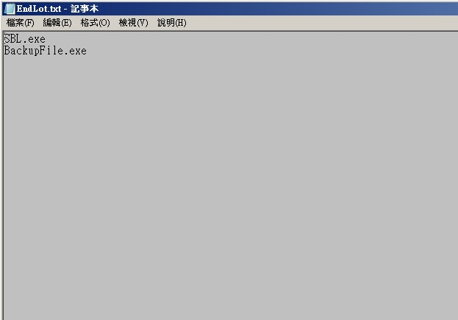
SGOS Check Procedure
Check EndLot.txt in /SYSTEM/Customer/ directory.
1. Put the filename of execute program when End-Lot into EndLot.txt
2. The content of EndLot.txt is customer related.

Slide 10
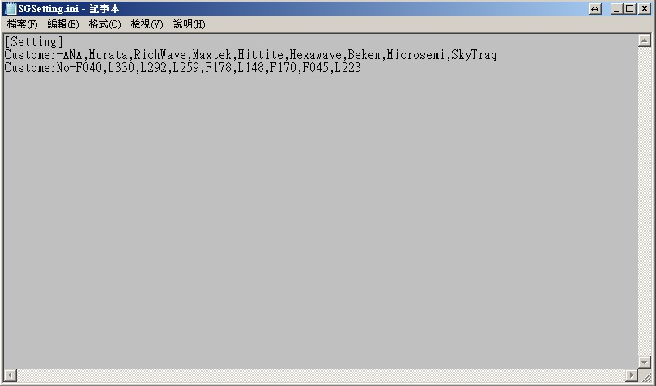
SGOS Check Procedure
Check SGSetting.ini in /Utility directory.
1. It’s related to the “Customer’ set in SPJT file and the AutoLotID module to know use which customer’s file rule
2. The key “Customer” mean customer name store as same as in SPJT file and split by comma.
3. The key “CustomerNo” mean the number indicate which customer that same as in barcode file.
Notes:
SGSetting.ini可用來讓AutoLotID或LotIDKey去知道要關聯那個客戶的naming rule.
在Setup module中, 會依靠此一檔案中的順序來判定MyModuleVar.Config.ProductType的數值
依照ProductType則可讓AutoLotID或LotIDKey取得要執行哪個函式
新增客戶則在Customer及CustomerNo的後面加上新客戶資訊即可, 而AutoLotID或LotIDKey則可依照ProductType來選擇naming rule

