Slide 1
SGOS Deploy to Test Floor SOP in CS
Rule:
1. Pick up a tester to update newer version SGOS then monitor 2-3 days.
2. If no related issues in monitored 3 days, upload new version SGOS to auto-update server to auto-update to every tester.

Slide 2
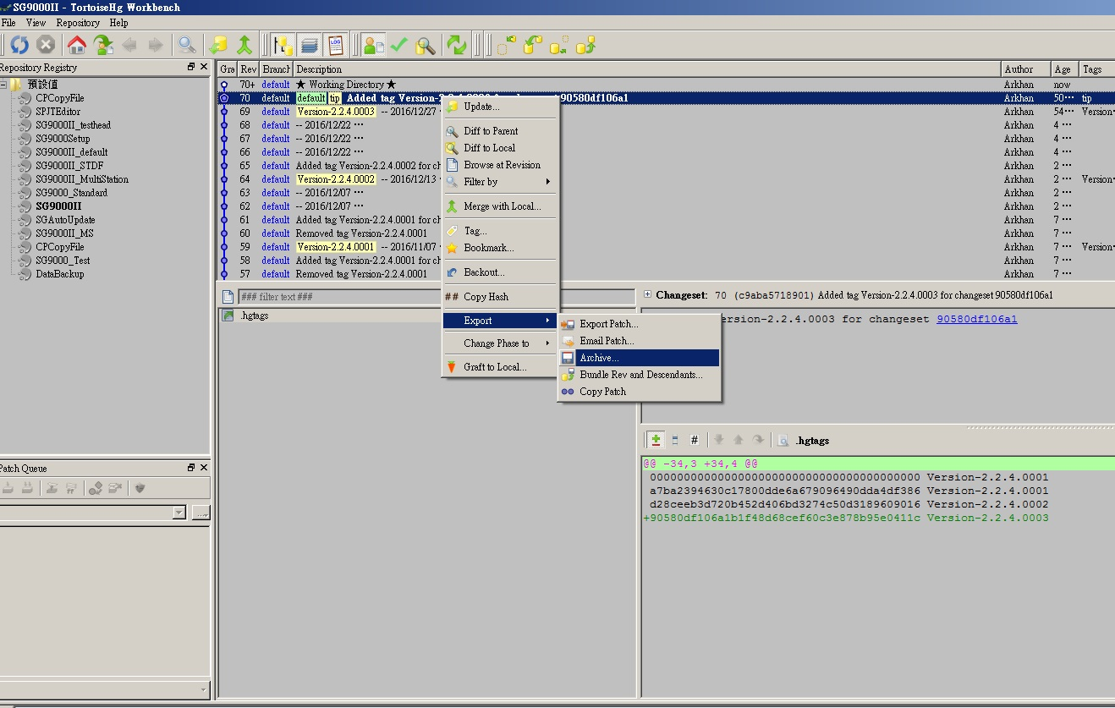
Export SGOS files for updating using TortoiseHg
選取要匯出的版本
匯出

Slide 3
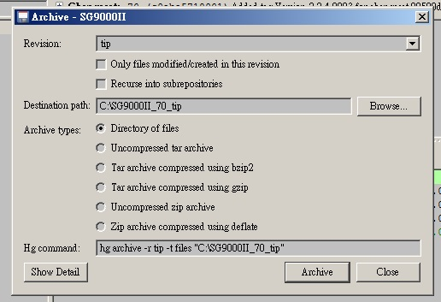
Export SGOS files for updating using TortoiseHg
設定匯出的目錄位置

Slide 4
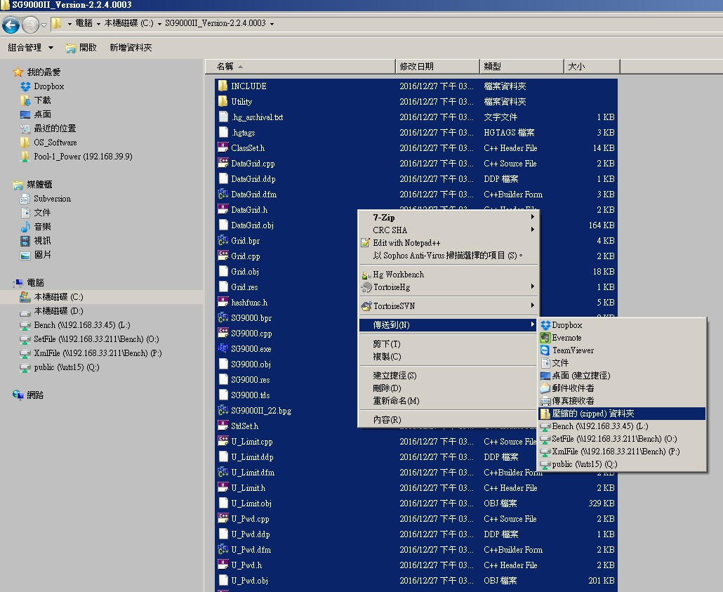
Zip the files
Then select all files and zip as zip file.

Slide 5
Steps of deploying SGOS to Auto-Update Server
Step 1. Upload the latest SGOS zipped file to server in BS (SMB File Server a.k.a. 網路磁碟機)
Step 2. Rename the older SGOS zipped file on server. (NewOS.zip -> OldOS.zip).
Step 3. Rename the uploaded SGOS zipped file to NewOS.zip.
Step 4. Set the correct version number in StandardOSAutoUpdate.ini

Slide 6
Auto-update server
SMB File Server:
IP : 192.168.39.9/192.168.5.191
Account : power
Password : power
Path:
\\192.168.5.191\Pool-1_Power\Temp\SG9000OS\OS Main
*從中興連線至北興時IP請輸入: 192.168.39.9, 在北興連線時IP請輸入: 192.168.5.191

Slide 7
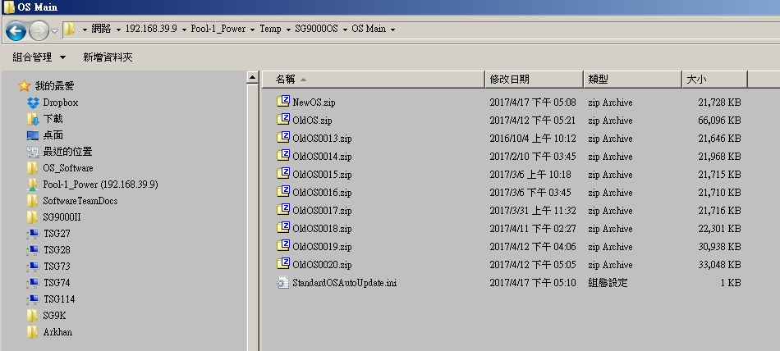
Auto-Update Server Note
存放OS壓縮檔及相關設定ini檔的路徑位置

Slide 8
Auto-Update Server Note - OS Main Folder
NewOS.zip
新版OS的壓縮檔
OldOS.zip
舊版(前一版)OS的壓縮檔
StandardOSAutoUpdate.ini
控制整個AutoUpdate系統的設定
*在OS Main資料夾下，必須包含上列3種檔案

Slide 9
Auto-Update Server Note - StandardOSAutoUpdate.ini Setting
[VerControl]
OSVer : 目前Tester OS的版本
OSVerControl : 要更新的OS版本
RecoveryOSVerControl : 前一版的OS版本
[Automation]
UpdateFile : 新版OS在Server上的位置
RecoveryFile : 前一版OS在Server的位置
LocalFile : 從Server下載到Tester的位置

Slide 10
Auto-Update Server Note - StandardOSAutoUpdate.ini Setting
[UpdateControl]
OpenServerUpdate : 允許Server上的新版OS可更新至Tester (ON/OFF)
OpenTesterUpdate : 開啟Tester端AutoUpdate功能 (ON/OFF)
OpenRecoveryUpdate : 開啟Server上Recovery Update功能 (ON/OFF)
[UpdateTime]
WeekDateType : 固定於某日或某範圍日內更新 (Above/Between)
HourType : 固定於某小時或某小時範圍內更新 (目前只有Between)
WeekDateStart : 要更新的開始日
WeekDateEnd : 要更新的截止日 (若WeekDateType為Above, 不判斷這項)
HourStart : 要更新的開始小時
HourEnd : 要更新的截止小時
***WeekDate : 代表星期幾，1:星期天, 2:星期一, 3:星期二,…… 7:星期六
(use DayOfWeek function)
WeekDateStart=2 (星期一)
WeekDateEnd=6 (星期五)
代表從星期一到星期五都會執行AutoUpdate

Slide 11
AutoUpdate Flow Chart
Normal Condition
After Recovery OS
FTP :
OSVer = new OS Version
OpenSerUpdate = ON
OpenTesterUpdate = OFF
OpenRecoveryUpdate = OFF
Tester :
AutoUpdate = ON
FTP :
OSVer change to last Version
OpenSerUpdate change to OFF
OpenTesterUpdate change to OFF
OpenRecoveryUpdate change to ON
Tester :
AutoUpdate change to OFF
After debugging and resetting
FTP :
OSVer change to new Version (administrator setting)
OpenSerUpdate change to ON (administrator setting)
OpenTesterUpdate change to ON (administrator setting)
OpenRecoveryUpdate change to OFF (administrator setting)

