Slide 1
SCM Server Management Guide

Slide 2
The Host PC to run SCM server
Host PC
IP : 192.168.33.177
Account : Administrator
Password : 0000
SCM server program website :
https://www.scm-manager.org/

Slide 3
SCM Server
What purpose is SCM server for?
1. Manage your project repository on a central server.
2. Co-work a project with team member at the same time.
3. Reach your project by web like as GitHub

Slide 4
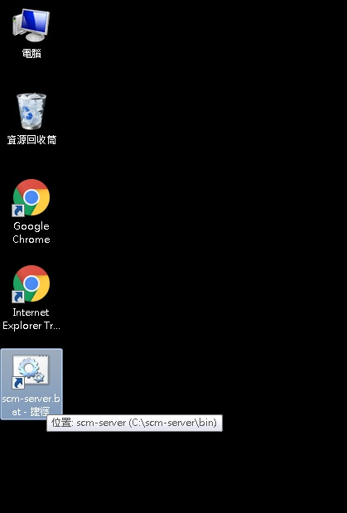
Start SCM Server
The bat to start SCM server is put on desktop of host pc.
To remote control the host pc, use the “遠端桌面連線” provided by MS Windows.

Slide 5
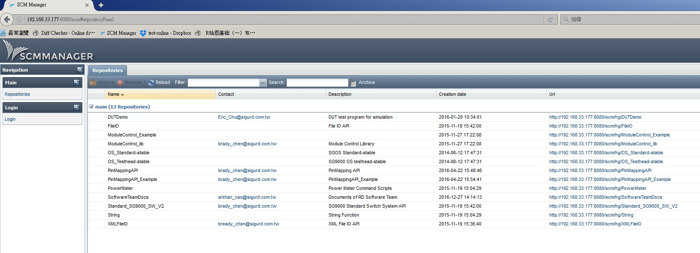
Open SCM Web Page
Link : http://192.168.33.177:8080/
Manager
Account: scmadmin
Password: scmadmin

Slide 6
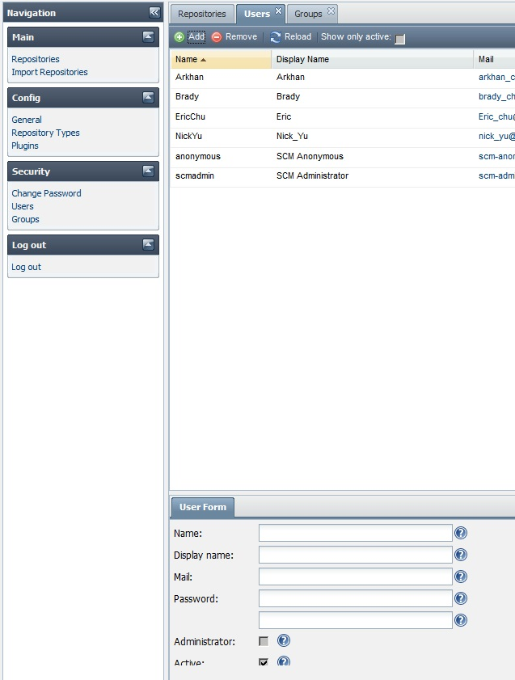
Add user account
1. Users
2. Add/Remove
3. Input user information.

Slide 7
Create/Add Repository
There are two ways to add repository into SCM.
I. Create/Add directly by web gui
II. Import repository that put on host pc hard drive into SCM.

Slide 8
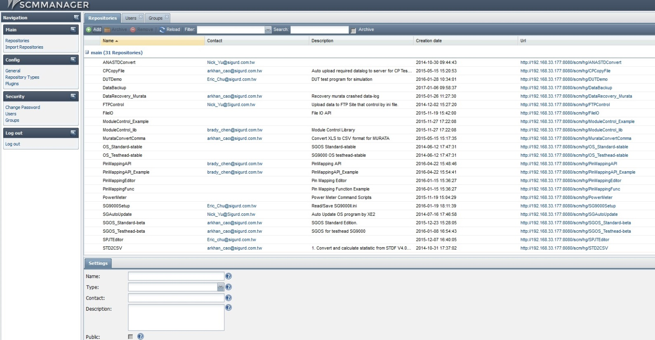
Create/Add Repository
Create/Add repository directly by web
I. Repository -> Add
II. Input Repository Information.
III. Create the link of the repository. You can browse or clone it to you computer by the link.
I.
I.
III.
II.

Slide 9
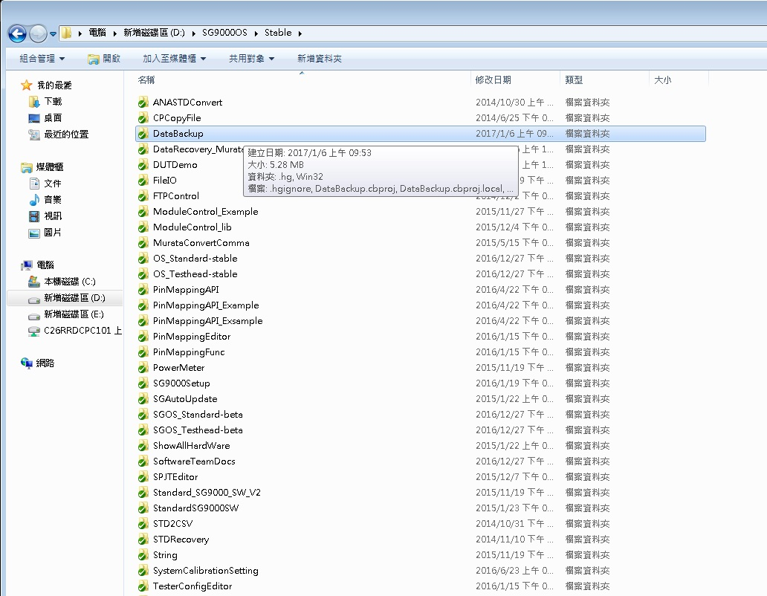
Import Repository
To import the repository, you can put the existed project on to the host pc or create a empty repository on the host pc in the following directory : D:\SG9000OS\Stable\

Slide 10
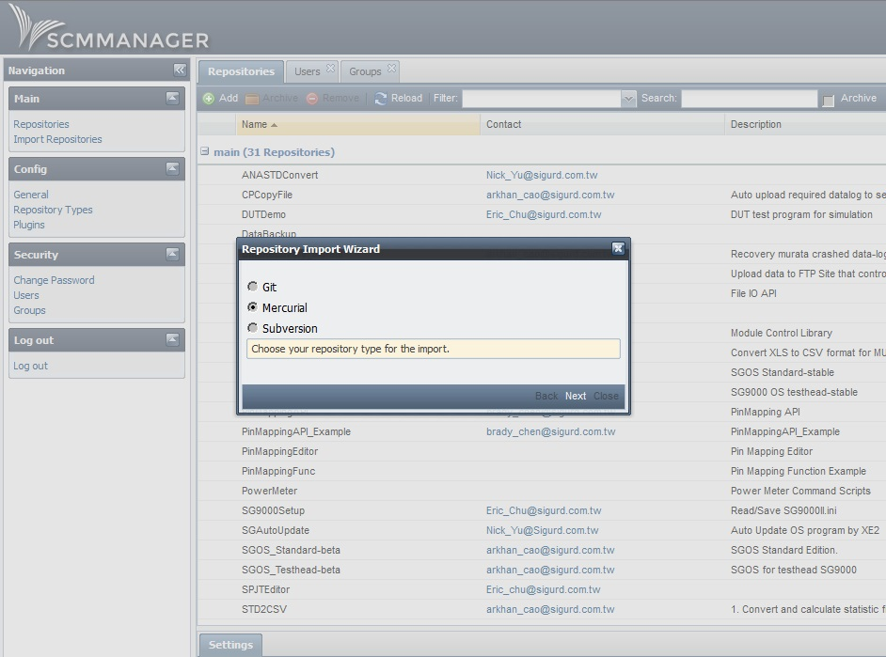
Import Repository
I. Import Repository -> choose Mercurial

Slide 11
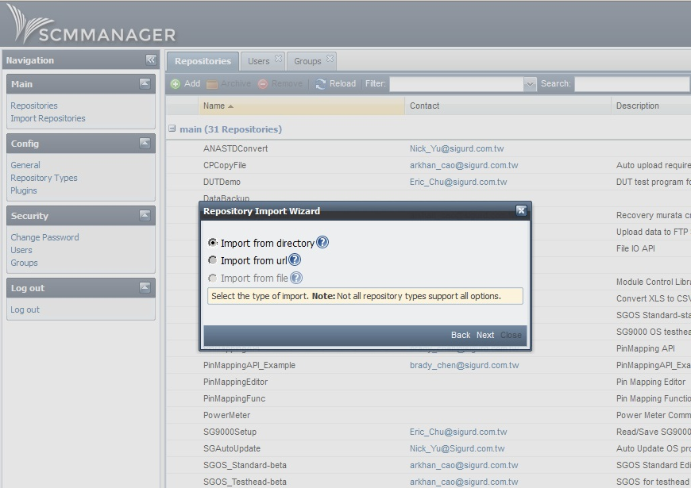
Import Repository
II. Choose “Import from directory”.

Slide 12
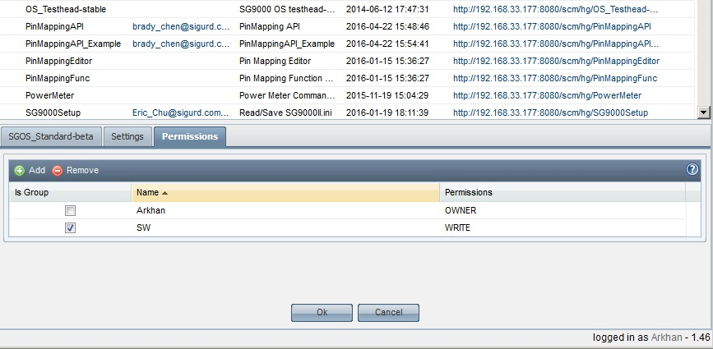
The authority of repository
You could set the permission of the repository to restrict which user/group can see the project.
I. Is Group : checked if the added name is a group which set in Group page.
II. Permissions: There are three type of permissions; OWNER, WRITE, READ. You can set if the user can only read, read/write, or owner.

Slide 13
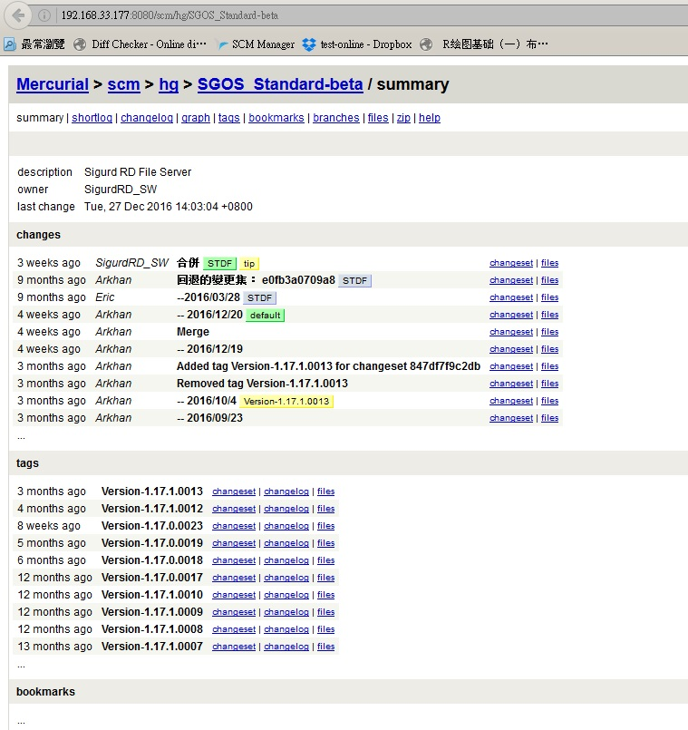
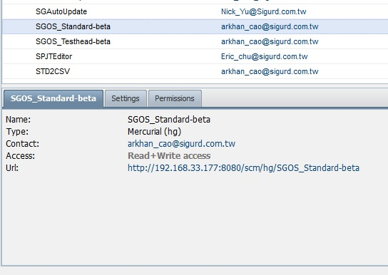
Browse the repository
By clicking the link, you can browse the status of the project. Or use the link to clone the repository to local pc by Tortoise-Hg(Mercurial)
To learn the Mercurial Hg, you can see the slides: Mercurial Introduction, Mercurial Tutorial – Basic & Mercurial Tutorial - Advanced

