Slide 1
J2EE Performance Tuning
Jayesh Patel
Northern Virginia Java/BEA User Group
January 11th, 2005.

Slide 2
Presenter’s Bio.
Jayesh Patel currently works on EDS’s TWAI project and responsible for J2EE application integration. He has also worked for BEA Systems for almost 5 years.
Jayesh has been involved with J2ee/WebLogic technologies for the past 5 years. He has experience in J2ee application development, performance tuning and resolving complex production issues.

Slide 3
Agenda
Performance Tuning Overview.
J2EE Tuning Zones.
Platform (OS) Tuning.
JVM Tuning.
WebLogic Core Tuning.
Continue..

Slide 4
Agenda
WebLogic Sub Systems Tuning.
  EJB Container, Servlet Engine, JDBC Pool, JMS.
Common Performance Problems.
  Memory Leak
  Application Hangs
J2EE Performance Monitoring.
J2EE Performance Standards & Tools.

Slide 5
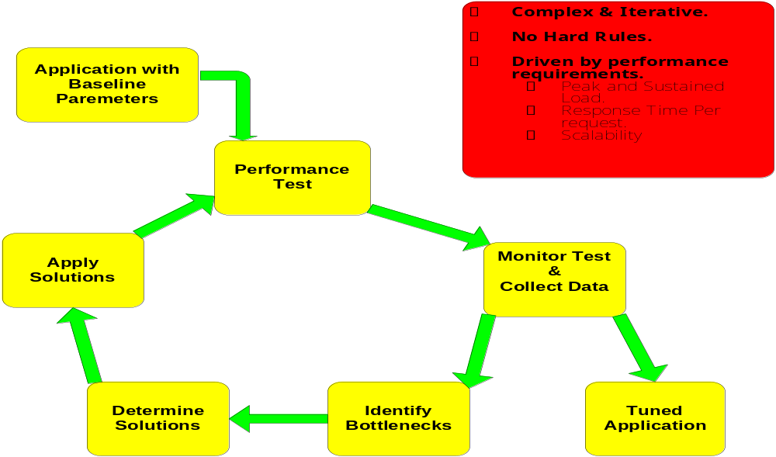
Performance Tuning Overview

Slide 6
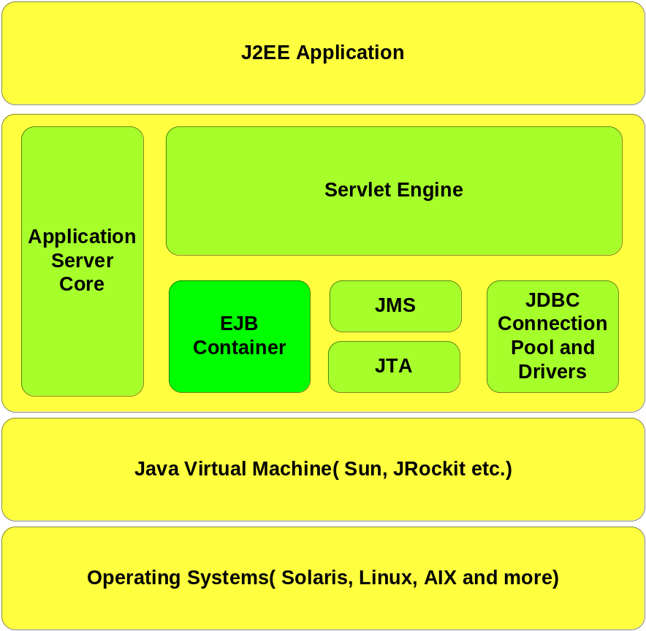
J2EE Tuning Zones

Slide 7
Platform (OS) Tuning
Key Tuning Parameters
TCP Parameters
  tcp_time_wait_interval
  tcp_keepalive_interval
  ndd -set /dev/tcp “parameter” “value”
File Descriptors
  /etc/system
    set rlim_fd_cur 8192 (Soft Limit)
    set rlim_fd_max 8192 (Hard Limit)
Notes:
Prior to Solaris 2.7, the tcp_time_wait_interval parameter was called tcp_close_wait_interval. This parameter determines the time interval that a TCP socket is kept alive after issuing a close call. The default value of this parameter on Solaris is four minutes. When many clients connect for a short period of time, holding these socket resources can have a significant negative impact on performance. Setting this parameter to a value of 60000 (60 seconds) has shown a significant throughput enhancement when running benchmark JSP tests on Solaris. You might want to reduce this setting further if the server gets backed up with a queue of half-opened connections.
Tip: Use the netstat -s -P tcp command to view all available TCP parameters
--------------------------------------
Hard limits are a kernel-configurable item, and users can't exceed them. Soft limits are the user defaults, and users can change that using the ulimit program or the limit/unlimit builtins. man setrlimit(2)
Basically, soft limits can be changed to anything up to the hard limit.
Think of soft limits as the warning barrier. When a user reaches the soft limit they will get an warning message but are still allowed to use more space up to the hard limit. Also, you can configure the system to set expiration times for users who have exceeded thier soft limit.
Just remember that the max file descriptors is 1024.

Slide 8
JVM Tuning
Options
JVM vendor and version.
  User Certified Versions.
JVM Heap Size Parameters.
Garbage Collection Schemes (Sun 1.4.2 JVM)
  Generational Collector (Default, Stop the world)
  Throughput Collector
  Concurrent Low Pause Collector
  Incremental Low Pause Collector
Unix Threading Model
  export LD_LIBRARY_PATH=/usr/lib/lwp
  One to One mapping between Java and O/S thread
Notes:
If Time Permits ----- We will see
Alternate threading library http://java.sun.com/docs/hotspot/threads/threads.html.

Slide 9
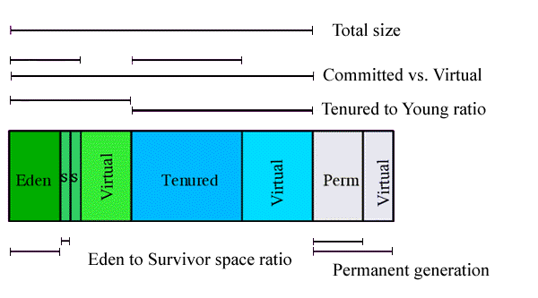
JVM Tuning
Java Heap

Slide 10
JVM Tuning
Heap Sizing Parameters
Heap Size
  -Xms, -Xmx
Young Generation Space
  - XX:NewRatio, -XX:NewSize, -XX:MaxNewSize,
Survivor Space
  -XX:SurvivorRatio
Permanent Generation
  -XX:PermSize & -XX:MaxPermSize
Aggressive Heap
  -XX:+AggressiveHeap
Notes:
-XX:NewRatio=3 - the young generation will occupy 1/4 the overall heap
-XX:NewSize - Size of the young generation at JVM init. Calculated automatically if you specify -XX:NewRatio
-XX:MaxNewSize - The largest size the young generation can grow to (unlimited if this value is not specified at command line)
XX:SurvivorRatio=6 - each survivor space will be 1/8 the young generation
The permanent generation may be a factor on apps that dynamically generate and load many classes (JSP, CFM application servers)
You may need to increase the MaxPermSize, eg: -XX:MaxPermSize=128m
Server application running alone on a large multi-processor server with 4gb of physical memory.
#java -server -XX:+AggressiveHeap
Two application instances running on a large multi-processor server with 4gb of physical memory. Each java application instance is allocated a part of total system memory by an explicit specification of the maximum and minimum heap sizes.
#java -server -XX:+AggressiveHeap -Xms1024m -Xmx1024m
Because this option sets heap size, do not use the -Xms or -Xmx options in conjunction with -XX:+AggressiveHeap. Doing so will cause the options to override each other's settings for heap size.
This option should be used with caution. Because it makes the JVM greedy with memory resources, it is not appropriate for many programs and makes it easier to run out of memory. For example, by using most of the 4GB address space for heap, some programs will run out of space for stack memory. In such cases -Xss may sometimes help by reducing stack requirements.

Slide 11
JVM Tuning
Garbage Collection Schemes
Garbage Collection Schemes | Young Generation Collectors | Old Generation Collectors
Default | Copying collector Default , Stop-the-world, Single threaded | Mark-compact collector Default, Stop-the-world, Single threaded
Throughput Collector | Parallel young generation collector -XX:+UseParallelGC | Mark-compact collector
Concurrent Low Pause Collector | Optional Parallel Young GC. -XX:+UseParNewGC Never use -XX:+UseParallelGC | Collects tenured collection concurrently. -XX:+UseConcMarkSweepGC
Incremental Low Pause Collector | Default Copying collector | Train Collector Collects a portion of the tenured generation at each minor collection -Xincgc
Notes:
http://www.petefreitag.com/articles/gctuning/
Garbage Collection tuning

Slide 12
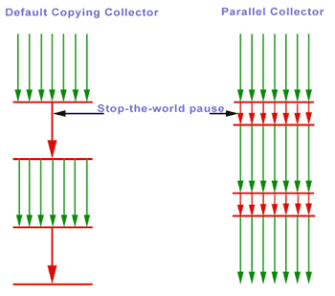
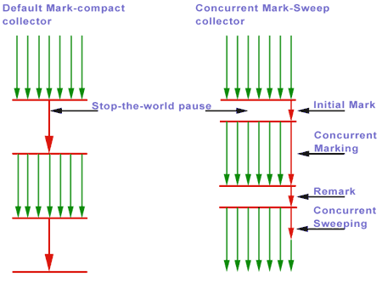
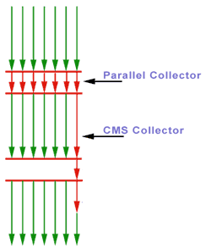
JVM Tuning
Garbage Collection Schemes
Young Generation | Old Generation | Parallel Young & Concurrent Mark- Sweep Old space

Slide 13
JVM Tuning
Guidelines
Understand default settings.
Try the default Garbage Collector first.
Configure –Xms = –Xmx
More heap size is not always better. Tune threshold to minimize overhead.
Understand Workload requirements to determine GC strategy.
Analyze Garbage Collections for
  Frequency, Pauses, Average Memory footprint.

Slide 14
WebLogic Core Tuning
Options
“NativeIO” Performance Packs.
Tuning Default ExecuteQueue.
Thread usage control.
StuckThreadDetection.
Connection Backlog Buffering.

Slide 15
WebLogic Core Tuning
Performance Packs
Uses a platform-optimized, native socket multiplexor.
Uses own socket reader threads and frees up weblogic threads.
Available for most of the Platform
  Solaris, Linux, HP-UX, AIX, Win
Can be configured using WebLogic Admin Console.
Notes:
Benchmarks show major performance improvements when you use native performance packs on machines that host WebLogic Server instances. Performance packs use a platform-optimized, native socket multiplexor to improve server performance. For example, the native socket reader multiplexor threads have their own execute queue and do not borrow threads from the default execute queue, which frees up default execute threads to do application work.
However, if you must use the pure-Java socket reader implementation for host machines, you can still improve the performance of socket communication by configuring the proper number of socket reader threads for each server instance and client machine.

Slide 16
WebLogic Core Tuning
Default Execute Thread Tuning
Number of simultaneous operations that can be performed by applications.
  Production Mode Default 25
Tuning criteria.
  Request turn around time.
  Number of CPUs
% Socket Reader Threads (Default 33%).
In 8.1 Execute Queue can be tuned for OverFlow condition
  Increases thread count dynamically.

Slide 17
WebLogic Core Tuning
Thread usage Control
Thread usage can be controlled by creating additional Execute Queues
  Performance Optimization for critical application.
  Throttle the performance
  To protect application from Deadlock
It can have Negative impact on overall performance

Slide 18
WebLogic Core Tuning
StuckThreadDetection & Connection Backlog Buffering.
StuckThread Detection
  Detects when execute thread can not complete work or accept new work.
  Warning purpose only, doesn’t change behaviour/state of the thread.
  Stuck Thread Max Time , Stuck Thread Timer Interval
Connection Backlog Buffering
  The number of backlogged TCP connection requests.

Slide 19
WebLogic Core Tuning
Guidelines
NativeIO gives better perfromance,
  consider Java IO if NativeIO is not stable.
High number of thread can have negative impact on performance.
  More threads does not imply that you can process more work.
Avoid application designs that require creating new threads.

Slide 20
JDBC Connection Pool Tuning
Options
Connection Pool Sizing and Testing.
Caching Statements.
Connection Pool Request Timeouts.
Recovering Leaked Connection.
PinnedToThread.

Slide 21
JDBC Connection Pool Tuning
Connection Pool Sizing and Testing
Sizing
  Initial capacity and Maximum capacity.
  Shrink Frequency.
Testing
  Test Frequency.
  Test Reserved/ Released Connections
  Maximum Connections Made Unavailable
  Test Table Name

Slide 22
JDBC Connection Pool Tuning
Caching Statements.
Reuses Callable and Prepared Statements in Cache.
Reduces CPU usage at Database side and Improve performance.
Cache Algorithms
  LRU (Least Recently Used)
  Fixed
Statement CacheSize
  Configured per connection pool.
  It cache size for each connection in pool.

Slide 23
JDBC Connection Pool Tuning
Recovering Leaked Connection.
Connection Request Timeout
Leaked Connection
  Forcibly reclaims unused connection.
  Inactive Connection Timeout.
Connection Request Timeout.
  Connection Reserve Timeout.
  Maximum number of request that can wait for connection.
PinnedToThread
  Pins Connection to ExecuteThread
  Connection.close() doesn’t return connection to pool.

Slide 24
JDBC Connection Pool Tuning
Guidelines
Configure initial capacity = maximum capacity.
In most cases, maximum number of connection used does not exceed number of execute threads.
Configure connection refreshing, if database calls fails because of stale connections.
Try to avoid PinnedToThread if database resource is limited.

Slide 25
EJB Tuning
WebLogic Specific EJB tuning.
  EJB Pool
  EJB Transaction attributes.
WebLogic CMP Tuning Knobs
EJB Tuning/Design Guidelines
Notes:
EJB Performance Tuning Guidelines
http://www.javaperformancetuning.com/tips/ejbdesign.shtml#REF13
User Design Patterns like, Composite Entity , Value Object , Session Facades, Service Locater, Value List Handler,

Slide 26
EJB Tuning
Pool Tuning.
initial-beans-in-free-pool (Default 0) , max-beans-in-free-pool (Default 1000)
  SLSB: Free Pool of the EJB’s with ID.
  MDB:Number of beans available for concurrent processing.
  Entity: pool of anonymous entity beans
max-beans-in-cache(Default 1000) for SFSB, Entity.
  Maximum number of objects of this class allowed in memory
  Passivates if limit is reached

Slide 27
EJB Tuning
Transaction Attributes
CMP Tuning
concurrency-strategy
  Default: Database
  Exclusive | Database | ReadOnly | Optimistic
CMP Tuning
  relationship-caching, Pre-fetching related entity bean
  enable-batch-operations, order-database-operations
    Sends batch of SQL for multiple instance of same EJB’s are updated in a transaction.
    Automatically sorts the database dependency between the operations to avoid database contraint.
  field-group
    Loads related subset fields of CMP and CMR field to improve performance.

Slide 28
EJB Tuning
Key Guidelines
Cache EJB references to avoid JNDI Lookup.
Start with default cache and pool settings.
Use Local EJB interface from client within same JVM.
Try application wide cache for EJB.

Slide 29
JMS Tuning
Options
JMS Persistence Store Tuning.
  JMS FileStore
  JMS JDBC Store
Message Paging
Tuning Distributed Destination.
  Message Load Balancing
  Server Affinity
Controlling the Flow of Messages.
Handling Expired Messages.

Slide 30
JMS Tuning
Persistence Store Tuning
JMSFileStore vs JMSJDBCStore
  N/W Traffic.
  Failure recovery.
  Storage management.
JMSFileStore
  Synchronous Write Policy
    Disabled :fastest , least reliable
    Cache-Flush: Default. Reliable, Scales well for large number of messages.
    Direct-Write: Speed depends on O/S caching.
JMSJDBCStore
  Distributing destination across multiple JMS Server.
Notes:
user-defined policy that determines how the JMS file store writes data to disk. This policy also affects the JMS file store's performance, scalability, and reliability. The valid policy options are:
Disabled - Transactions are complete as soon as their writes are cached in memory, instead of waiting for the writes to successfully reach the disk. This policy is the fastest, but the least reliable (that is, transactionally safe). It can be more than 100 times faster than the other policies, but power outages or operating system failures can cause lost and/or duplicate messages.
Cache-Flush - Transactions cannot complete until all of their writes have been flushed down to disk. This policy is reliable and scales well as the number of simultaneous users increases.
Direct-Write - File store writes are written directly to disk. This policy is supported on Solaris and Windows. If this policy is set on an unsupported platform, the file store automatically uses the Cache-Flush policy instead.
With on-disk caching enabled, the Direct-Write policy can be 2-5 times faster than the Cache-Flush policy, except in highly scalable cases where it may be slightly slower.
With on-disk caching disabled, the Direct-Write policy is faster than the Cache-Flush policy in one-to-many cases, but is much slower otherwise.
The Direct-Write policy scales well with on-disk caching enabled, but does not scale with it disabled. (Solaris does not allowing enabling the on-disk cache for direct writes).

Slide 31
JMS Tuning
Message Paging
Tuning Distributed Destination
Message Paging
  Free up virtual memory writing messages to disk.
  BytePaging or MessagePaging
Distributed Destination , is virtual JMS destination with multiple physical destination members.
  Load Balancing
    Producer Load balancing.
    Message Load balancing.
  Server Affinity, First attempt to load balance across co-located destinations.

Slide 32
JMS Tuning
Controlling the Flow of Messages.
Handling Expired Messages.
Flow Control
  Flow control is triggered, When destinations exceeds message threshold.
  Produced will adjust the production rate until destination is unarmed.
    Flow Maximum/Minimum, Flow Interval/Steps
    Byte/Message Threshold High/Low
Handling Expired Messages
  Active expiration in 8.1.
    None and Discard, Log, Redirect.
    Configurable scan period (Default is 30 seconds).

Slide 33
Servlet/JSP Tuning
HTTP Session Management.
Session Manangement criteria.
  Concurrent users, How long each session lasts.
  Heap size of WebLogic instance, Data need to be stored in Session.
Session Persistence.
  Memory (single-server, non-replicated)
  File system persistence, JDBC persistence
  Cookie-based session persistence
  In-memory replication (across a cluster)
Session Attributes.
  Session Timeout (Default 3600 seconds).
  CacheSize (JDBC and File based persistence)
  InvalidationIntervalSecs (Default 60 seconds)
Notes:
Avoid using shared modified class variables and hence,
synchronized blocks of code in servlets
ðJ Session creation is expensive
ðJ Invalidate sessions no longer needed
ðJ Use <%page session=false%> directive to prevent
automatic session creation in JSP
ðJ Do not store large object graphs in HttpSession to
avoid forced Java serialization
ðJ Do not use HttpSession as a cache for transactional
data, instead use “read-only” entity beans, if provided
by your container, to access cached transactional data
O Manage JSP session scope.

Slide 34
Servlet/JSP Tuning
Guidelines
Compile JSP using weblogic.jspc into WEB-INF/classes
Configure PageCheckSec to -1
Disable Servlet Reloading
Put aggregate objects rather than multiple single objects in session.
Use <%page session=false%> directive to prevent automatic session creation in JSP.
Invalidate Session no longer needed.

Slide 35
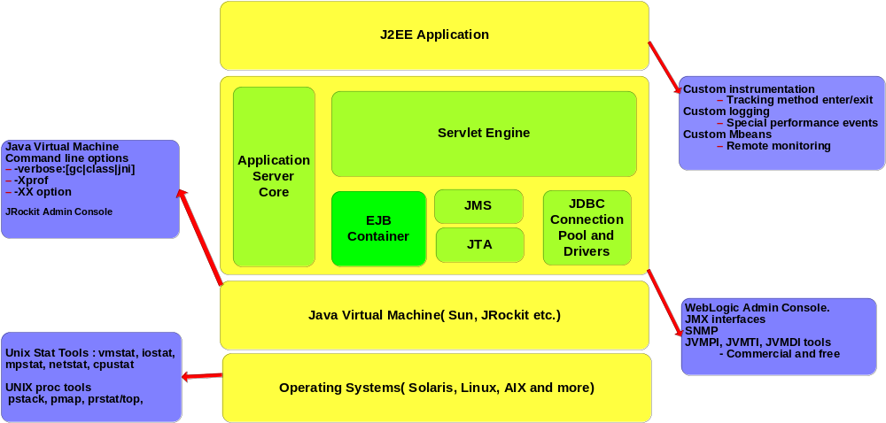
J2EE Monitoring Options
Notes:
Netstat: N/w activity and status of the each network call.
Vmstat : Swap memory and available free memory statistics.
r b w swap free re mf pi po fr de sr s0 s1 s6 s3 in sy cs us sy id
0 0 0 1962832 41504 31 168 41 20 23 0 4 6 6 0 4 708 201 144 14 15 70
Iostat : I/O activity for each disk unit.
tty sd0 sd1 sd6 sd37 cpu
tin tout kps tps serv kps tps serv kps tps serv kps tps serv us sy wt id
0 22 59 6 55 58 6 47 0 0 0 177 4 17 14 15 2 68
Mpstat : Each processor acitivity including intrupts and context switching.
Pstack : Native stack trace of the each light weight process and thread.
Pmap: address space map for each process, It includes listing of the .so file loaded.
Prstat/top: report active process statisics.
The -Xprof profiler is the HotSpot profiler. HotSpot works by running Java code in interpreted mode, while running a profiler in parallel. The HotSpot profiler looks for "hot spots" in the code, i.e. methods that the JVM spends a significant amount of time running, and then compiles those methods into native generated code.

Slide 36
Common Performance Problems
Memory Leak
java.lang.OutOfMemoryError , is a symptom , however it is not a proof.
Turn on verbose:gc for GC logs, i.e.
  [Full GC 154K->99K(32576K), 0.0085354 secs]
Analyze GC for following scenarios,
    Full Garbage collection does not get chance to run before OutOfMemory is thrown.
    OutOfMemory is thrown eventhough memory usage is not reached to upper limit of the heap
    OutOfMemory is thrown during the load test ramp up.
  Tune -XX:MaxPermSize, -Xms, -Xmx, -XX:NewSize, -XX:MaxNewSize XX:SurvivorRatio to resolve OOM.

Slide 37
Common Performance Problems
Memory Leak
Heap memory usage grows after each FULL GC at steady state condition of the load test – Potential memory leak
Check for more common leaking objects.
  Caching in the application , i.e EJB pool objects, HTTP Session objects , JMS Messages
Use Memory Profiler to pinpoint memory leaking code, i.e JProbe and OptimizeIT

Slide 38
Common Performance Problem
Server Hang
Server Hangs
  No Debug info available in log.
  Thread dump is essential for debugging.
Thread Dump
  Snapshot of all java threads
  Shows current stack trace and name of threads etc.
  Thread States
    Runnable: Running or ready to run.
    Waiting on monitor: Sleeping, Waiting on an Object, Waiting to be notified by another thread
    Waiting for monitor entry: Waiting to lock an object (some other thread may be holding the lock).
Collect Thread dump
  Unix( Solaris, Linux, HP/UX): kill -3 <pid>
  Windows: ctrl break

Slide 39
Common Performance Problem
Server Hang
Sample Thread Dumps.
Analyze thread dump for following scenarios.
  Java Deadlock: More than one thread waiting to release the lock.
  Threads blocked during n/w IO: Database or remote process nor responding.
  Infinite Looping in the code.
Multiple thread dump for with few seconds interval helps to debug slow response time.

Slide 40
Performance Standards and Tools
Standards
  ECPerf
    J2ee Benchmark for Application Servers
  SPECjAppServer2001
    Benchmark to measure Application Server performance
  SPEC JBB2000
    Server side JVM performance benchmark.
    http://www.spec.org/jbb2000/
Tools
  OptimizeIt, JProbe, PerformaSure.
  Mercury LoadRunner, WebLoad, Grinder(OpenSource)

