Slide 1
Practical Choreography with Spring Cloud
Bartosz Jedrzejewski

Slide 2


Slide 3
Communication between Microservices
When having multiple services it is key to solve the communication
We want to make communication easy to work with
We don’t want to chose a risky or unknown technology
We want that communication to be reliable
It would be nice if it was easy to add and remove services

Slide 4
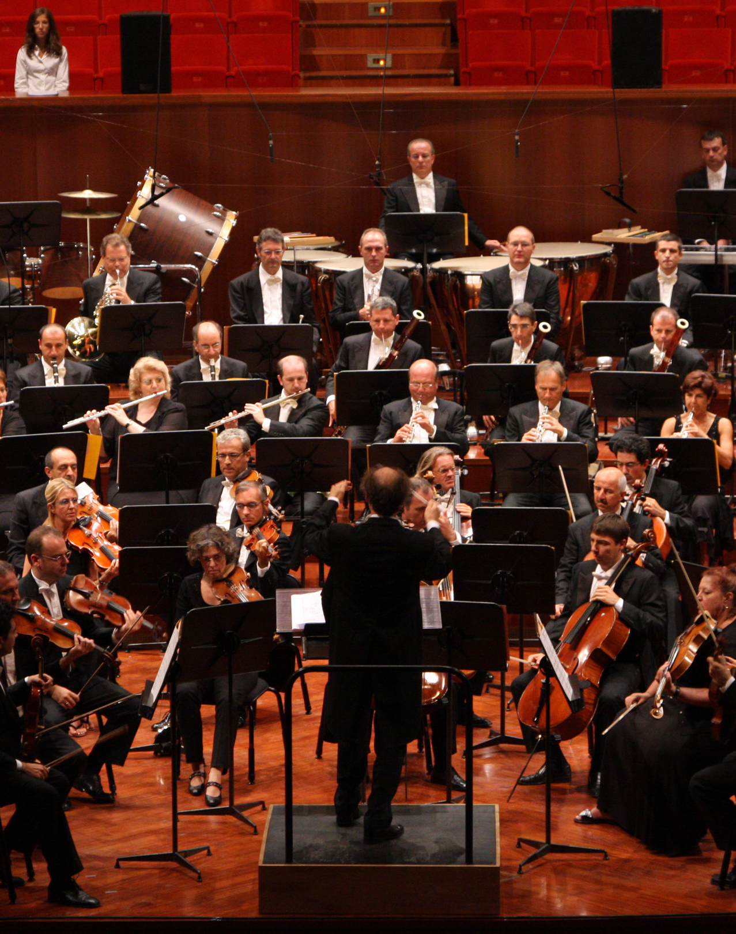
Introducing Orchestration

Slide 5
Orchestration is great
Making REST calls between services
The flow of execution is implicit
Most developers know how to get started
Not much extra middleware necessary…

Slide 6
Great Orchestration requires work
Load Balancing
Service Discovery
Reverse Proxy
Potential for tight coupling
Potential for God Service anti-pattern
Potential difficulty in adding new services

Slide 7

Introducing Choreography

Slide 8
Choreography is great…
Event driven / reactive microservices
Communication via message channels
Services know what to do without being explicitly told
Loose coupling is baked into the core concept
It is easy to add new services
It is easy to scale
World largest microservice deployments use this pattern

Slide 9

Challenges of Choreography and the Status Quo
It is more difficult to reason about
There is less experience among developers
It seems difficult to get started
It seems difficult to deal with Exceptions
It seems difficult to know what is happening with the system

Slide 10
Choreography is more difficult to reason about (?)
Choreography requires a bit different mindset than orchestration:
Orchestration
Choreography
Service
1
Service
2
Service
Service
3
Service
Message Broker
4
Service

Slide 11
There is less experience among the developers
Learn
Learn about solution of choice
Play
Play with it- maybe build a simple system
Learn
Learn some more- you will have questions based on what you tried
Teach
Teach others- your colleagues, people in your local meetup or maybe write a blog post

Slide 12

It seems difficult to get started
Chose an opinionated framework and learn it
Chose a popular framework- you don’t want to solve new problems in a framework you are not an expert
Play with the framework a bit before going with it in your company
I could not recommend Spring Cloud enough

Slide 13
It seems difficult to get started Choose your plan of attack
Don’t try to use choreography for everything if you are just starting
12 Factor App:
11. Logs – “Treat logs as event streams”
Logs, or rather domain events, fit naturally into the messaging / events pattern
With Logs as the baseline you will be able to incorporate more into your system as your experience grows
Look for long running business processes

Slide 14


It seems difficult to get started Choose your tools
Choose a messaging framework that makes working with the broker easy. I recommend Spring Cloud Stream
Choose a message broker that will be easy to work with. I recommend RabbitMQ, but Kafka is also amazing

Slide 15
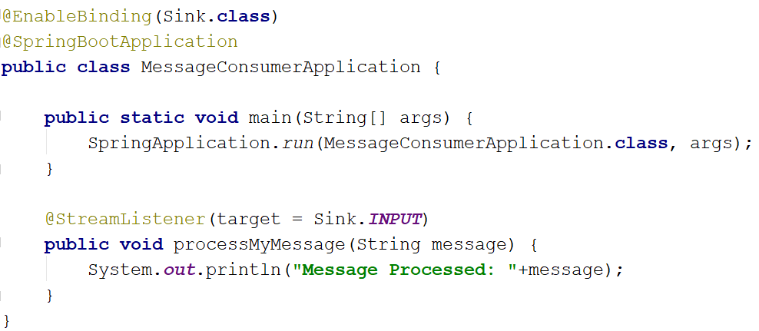
It seems difficult to get started Have a look at Spring Cloud Stream…

Slide 16
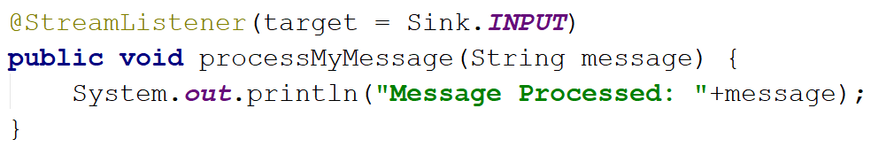
It seems difficult to get started Have a look at Spring Cloud Stream…

Slide 17
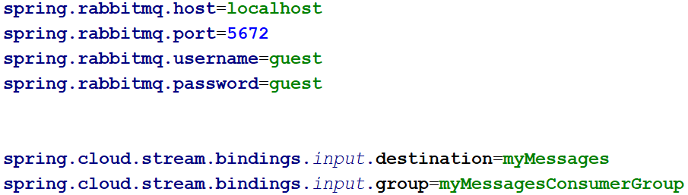
It seems difficult to get started Have a look at Spring Cloud Stream…

Slide 18
It seems difficult to deal with Exceptions
Exceptions happen in any microservices architecture and are never easy
With the Dead Letter Queue pattern it may be easier to deal with them in orderly fashion than in Orchestration
Switching it on in Spring Cloud Stream is quite easy…
This is a RabbitMQ concept, so we are leaving the Spring Cloud Streams a bit…

Slide 19
It seems difficult to know what is happening with the system

Slide 20
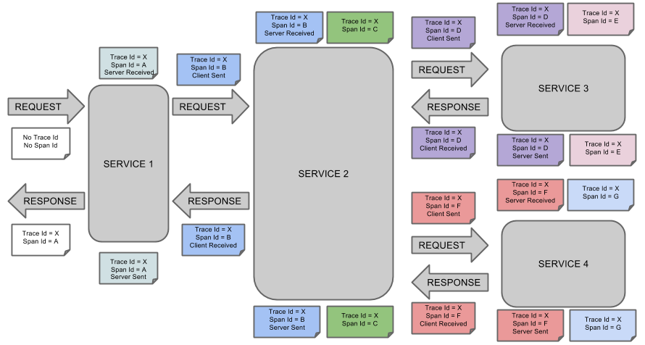
Spring Cloud Sleuth makes life easy

Slide 21
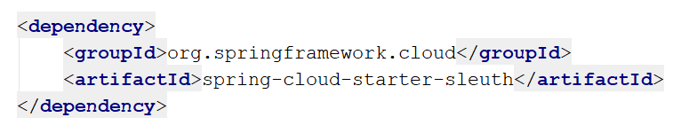
How do you get Spring Cloud Sleuth?

Slide 22



Make your logs searchable with ELK Stack

Slide 23
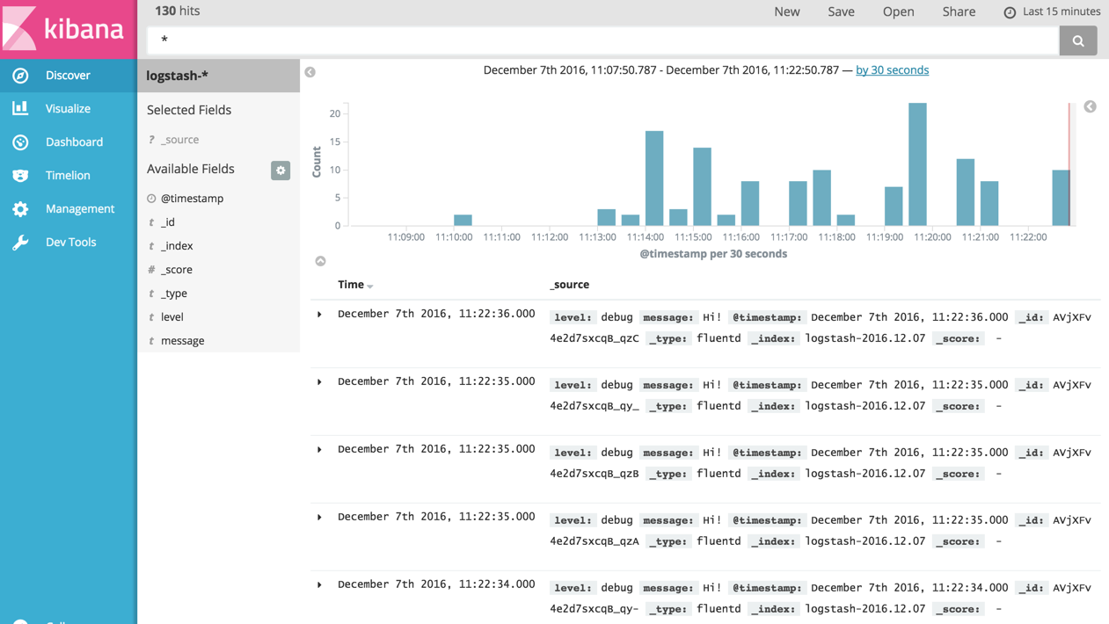
Kibana Example

Slide 24

For quick visualization and simple configuration there is Zipkin

Slide 25
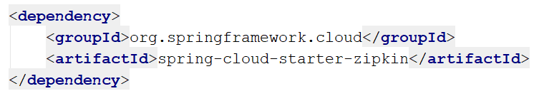
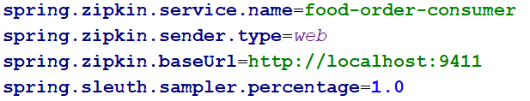
Zipkin Configuration is simple

Slide 26
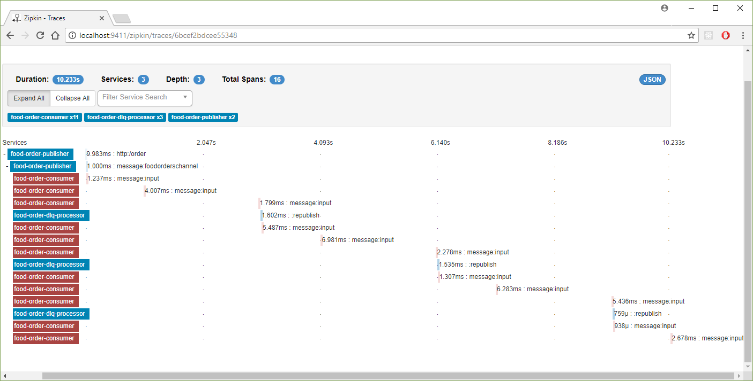
Use Zipkin for Visualization

Slide 27
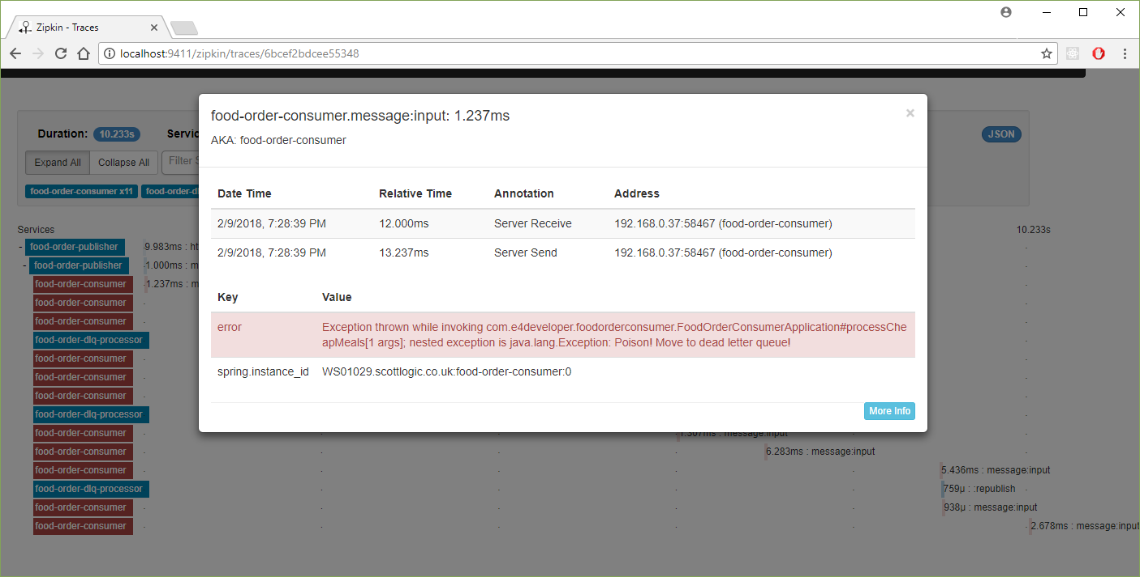
Error inspecting with Zipkin

Slide 28
Thank You
Check out Scott Logic tech blog: blog.scottlogic.com
Check out my microservices blog: e4developer.com
Follow me on twitter: @bartoszjd

