Slide 1




An early look at
Arkime 7
RC1 targeted for October 2026
7.0.0 release early 2027
Play with it today
Info at end, early work in progress
Tell us what breaks
Slack and GitHub issues, the earlier the better
Notes:
Arkime 7 is on the dev7 branch, about 400 commits ahead of main. RC1 is targeted for October 2026 and the 7.0.0 release for early 2027. demo7.arkime.com tracks it.

Slide 2







Demo first
The UI got a full rebuild on Vuetify. Easier to show than to describe, so here it is.
New UI and themes
Vuetify everywhere, ten built-in themes plus a shareable custom one, Material icons, theme follows you across all four apps
Dashboards
The Arkime tab is now widgets: sankey, connections graph, matrix heatmap, top talkers, all configurable and shareable
Session detail
Details / Packets / Shark tabs behind one toolbar, tshark dissection panel, find in content
Stats and Admin
Resource meters and a capture-centric node dashboard; Admin menu for users, roles, banner, ES admin
Featherprint
Passive device fingerprinting page: tracked devices, lookups, alerts
PCAPNG download, View Config, Shareables
Pick PCAP or PCAPNG per download; see the config an app is really running with; share column and spiview layouts
Notes:
Live demo on demo7. Everything on this slide is UI work; the rest of the deck is the non-Vue changes. Shark tab needs tshark >= 4.6.4 (tsharkPath). View Config page is gated by viewConfigMode (off, superAdmin default, appAdmin). Update check is opt-in via checkForUpdates.

Slide 3
Under the hood
The parts you cannot see in a demo
Node 24 · PCAPNG · GeoIP vendors · talker-pair sessions · protocol settings · XDP · ClickHouse (experimental) · Featherprint · security cleanups · config checks · breaking changes

Slide 4

Node 24 and leaner packages
Node 24, and the OS provides the libraries now
Node.js 24.21 required (24.x only)
easybutton no longer builds glib, curl, zstd, lua, or libpcap; the OS packages are used everywhere
EL9 and EL10 also use the OS yara, libmaxminddb, nghttp2, and librdkafka; AL2023 uses the OS libmaxminddb and nghttp2
rpm and deb packages now depend on those libraries instead of bundling static copies
Amazon Linux 2027 supported
# what the package pulls in now
$ rpm -qR arkime | grep -E 'yara|maxmind|nghttp2|rdkafka'
libyara.so.4()(64bit)
libmaxminddb.so.0()(64bit)
libnghttp2.so.14()(64bit)
librdkafka.so.1()(64bit)
# node
$ /opt/arkime/bin/node --version
v24.21.0
Notes:
#4218 moved to Node 24, #4253 pins 24.21.0. #4266 stops building glib, curl, zstd, lua, libpcap in easybutton. #4267 Amazon Linux 2027, which uses OS libs except yara and librdkafka. Smaller packages, faster builds, security updates come from the OS.

Slide 5

PCAPNG and multiple link types
One file, many interfaces, many DLTs, in and out
Read
PCAPNG with up to 255 interfaces per file, each with its own link type. Works on disk and over the http and s3 scheme readers.
Write
Copying PCAPNG input writes PCAPNG, so interfaces and DLTs survive. Classic inputs still write classic PCAP.
Download
Sessions and exports can be saved as PCAPNG. A classic PCAP download that would span multiple link types is refused with a hint to use PCAPNG.
Defaults
offlineFilenameRegex now matches .pcapng too. Classic downloads keep the source header bytes, including big-endian and short-header files.
Plugins
arkime_packet_set_dltsnap() is gone; readers and plugins call arkime_packet_set_interface(readerPos, interface, dlt, snaplen) and must be rebuilt.
Notes:
#4235 for the download side. Capture tracks per-file interface tables (ARKIME_MAX_INTERFACES_PER_FILE is 256) and records the block offsets per interface on the file record. Remote nodes merge their SHB/IDBs into one interface table for a combined PCAPNG.

Slide 6

Multiple GeoIP vendors
Not just MaxMind anymore
MaxMind GeoLite2 / GeoIP2, Country or City
GeoOpen, including the Country-ASN file that carries ASN data inside the country database
ipinfo, which bundles location and ASN in one file with its own field layout
db-ip
Vendor is detected from the mmdb database_type, so you just point at the file
Settings renamed to geoFile and geoASNFile; geoLite2Country and geoLite2ASN still work
# config.ini [default]
# MaxMind, as before
geoFile=/var/lib/GeoIP/GeoLite2-City.mmdb
geoASNFile=/var/lib/GeoIP/GeoLite2-ASN.mmdb
# ipinfo: one file does both
geoFile=/opt/arkime/etc/ipinfo_lite.mmdb
# GeoOpen country + ASN in one
geoFile=/opt/arkime/etc/GeoOpen-Country-ASN.mmdb
Notes:
db.c switches field paths based on metadata.database_type: ipinfo uses country_code/region_code/city and asn/as_name; GeoOpen uses country.iso_code and country.AutonomousSystemNumber/Organization; MaxMind uses country.iso_code, subdivisions[0].iso_code, city.names.en. City vs Country is detected for MaxMind. Old setting names are accepted with a deprecation.

Slide 7

Sessions per talker pair
lldp, xid, isis, esis, igmp, and pim stop lumping everything together
Before
Arkime 7
All traffic for one of these protocols landed in a single session per capture node
One giant session, no idea who was talking to whom
A session per talker pair, like every other protocol
Keyed by src/dst MAC for lldp, xid, isis, esis
Keyed by src/dst IP for igmp and pim
Expect more, smaller sessions for these protocols after upgrading. The stopped-sessions state file is now keyed by mProtocol too, so a tcp and udp session on the same 5-tuple no longer share stop state.
Notes:
#4210. Part of removing the internal session type concept: everything is per mProtocol now. Also fixed there: the packet thread used maxPackets instead of maxPacketsInQueue for its 75% full check, so session command processing throttled at 7,500 queued packets instead of 150,000. Busy sensors will do more work per packet.

Slide 8

Per-protocol settings
One section to tune any mProtocol
New [protocol-settings] section: idle, save, closing, packets, and streams per mProtocol
The default key applies to every protocol first, then protocol keys override it
The only way to set save/closing/packets for a non-TCP protocol
tcpSaveTimeout and tcpClosingTimeout are tcp only now; sctp and closeNow sessions read this section instead
streams: gives a protocol its own share of maxStreams
Values are range-checked at startup; a bad one refuses to start
[protocol-settings]
default=save:720;packets:10000
tcp=idle:600;closing:5
udp=idle:30
icmp=idle:10
sctp=closing:10
arp=idle:60;packets:100;streams:10000
Notes:
#4210. save defaults to 0 (off) for everything but tcp, matching old behavior. Streams default: tcp gets maxStreams, udp maxStreams/16, everything else maxStreams/256 roughly; see config.ini.sample. arkime_mprotocol_register() now takes flags instead of a session type, so custom parsers must be rebuilt.

Slide 9

XDP reader
pcapReadMethod=xdp: AF_XDP sockets, one per NIC receive queue
How it works
Use it when
Stay on afpacket when
One socket, one UMEM, one thread per rx queue; nothing shared
Queue count read from the NIC
Zero copy means NIC to Arkime with no kernel copy; Arkime may still copy packets internally, e.g. for reassembly or writing pcap. Falls back to copy mode with a warning
xdpMode auto, drv, or skb
afpacket cannot keep up on a fast link
The NIC driver supports native XDP and zero copy into user space
Linux with libxdp available at build time
You can dedicate the NIC's queues to capture
Virtual NICs or drivers without XDP
Jumbo frames: anything larger than the 4 KB frame is dropped by some kernels
You drop privileges: the XDP program stays attached on exit
It works today and the link is not the bottleneck
Notes:
#4214. Settings: xdpNumThreads (0 = every rx queue, the only setting that captures everything), xdpQueueStart, xdpFrameSize 2048-4096 (default 4096), xdpRingSize, xdpZeroCopy (default true), xdpMode (auto/drv/skb), xdpIgnoreQueueMismatch. Max packet is frameSize minus XDP headroom. Be precise on zero copy: it removes the kernel copy between the NIC and Arkime; it does not mean Arkime never copies a packet after that. If dropUser/dropGroup is set, remove the program with ip link set dev <if> xdp off.

Slide 10

ClickHouse, experimental
An experimental sessions store; everything else stays in ES
Set sessionsDbUrl and both capture and viewer route session SPI through ClickHouse
Users, files, fields, stats, hunts, history, views, crons stay in ES, so db.pl init and elasticsearch= are still required
Viewer translates the ES query DSL to SQL over a JSON column: expressions, CIDRs, wildcards, aggregations, date histograms, nested cert and dns
Capture bulk-inserts over HTTP and emits the *Tok fields itself, only when ClickHouse is on
db/ch.pl: init, upgrade, wipe, expire, info, disk-usage, monthly or daily partitions
Experimental: passes the test suite, no production miles yet, multiES support is partial
# config.ini [default]
sessionsDbUrl=clickhouse://ch.example.com:8123
clickhouseUser=arkime
clickhousePassword=...
clickhouseDatabase=arkime
clickhouseSessionsTable=sessions3
# experimental: expect schema changes
db/ch.pl clickhouse://ch:8123 init
# clickhouses:// or chttps:// for TLS
Notes:
#4133. Say experimental out loud: it passes the full test suite (5,451 tests) but has not seen production yet, and the schema may change between RCs. Known gaps: multiES per-period session indices and shortcut sync to remote ClickHouse nodes. TLS trust follows insecure/caTrustFile like other backends. Batch size via clickhouseMaxBatchDocs/Bytes.

Slide 11

Featherprint, under the covers
Passive device fingerprinting built from session metadata, nothing new in capture
Lives in viewer. No capture push, no WISE dependency. It polls sessions for ARP, DHCP, DNS/mDNS, NBNS, and SSDP signals
Per-subnet monitor with chunked backfill and a persisted cursor, so restarts pick up where they left off
Longest-prefix subnet policy tree decides what to watch and how
MAC source ranking: arp beats dhcp beats srcMac, and a weaker source never overwrites a stronger one
Rule-based classifier in featherprint.rules.yaml: iphone, printer, chromecast, raspberry_pi, nas, and more. Override the file with featherprintRulesFile
Three indices: featherprint, featherprint_history, featherprint_alerts (db.pl v89). Alerts on new or changed devices; ack state is shared and reversible, gated by featherprintAckRoles
Lookups honor the caller's forced expression and time limit
[featherprint-subnet]
10.1.0.0/16=alerts:true
10.1.50.0/24=alerts:false
[featherprint-defaults]
# applied to every subnet first
featherprintInterval=300
featherprintNotifier=slack-secops
featherprintAckRoles=arkimeAdmin
Notes:
#4226 and #4251. Settings: featherprintInterval (300s), featherprintMonitorEnabled, featherprintNotifier, featherprintHistoryLimit, featherprintLookupLimit, featherprintInitialLookbackDays (7), featherprintChunkSec, featherprintMaxChunksPerTick. The subnet section syntax on the slide is illustrative; check the sample config for the exact per-subnet keys.

Slide 12

The Shark tab runs tshark on the viewer
Dissectors are a big attack surface, so tshark is boxed in
Session detail gets a tshark dissection panel; needs tshark 4.6.4 or newer, found via tsharkPath
Always started with a scrubbed environment and an empty Wireshark profile dir
Reads the session pcap over a fifo in a private directory, never a shared path
Limits: tsharkMaxPackets, tsharkTimeoutMs, tsharkMaxConcurrent, tsharkMemoryLimitMB, all range-checked
Optional tsharkWrapper runs it inside bubblewrap or any sandbox you like
EL9 and EL10 do not ship a new enough tshark, so there is a build workflow for one
tsharkPath=/opt/arkime/bin/tshark;/usr/bin/tshark
tsharkMaxPackets=10000
tsharkTimeoutMs=30000
tsharkMaxConcurrent=3
# wrap it in bubblewrap
tsharkWrapper=bwrap;--unshare-all;
--die-with-parent;--new-session;
--cap-drop;ALL;--ro-bind;/usr;/usr;
--proc;/proc;--dev;/dev;
--bind;{tsharkDir};{tsharkDir};--
Notes:
#4219 hardened the integration; #4088 adds the manual EL9/EL10 tshark build workflow. {tsharkDir} is the private dir with the fifo and must be bind mounted into the sandbox. The tsharkWrapper line on the slide is abbreviated; config.ini.sample has the full bwrap invocation.

Slide 13

Insecure defaults, removed
Things we should have deleted a while ago
userAutoCreateTmpl
Removed. Use the [user-auto-create] section: one JavaScript expression per user field, run in strict mode, with an allow-list of fields.
simpleDEKEncoding
Removed. The data encryption key is always wrapped with aes-256-gcm now.
wise pin code
wiseService no longer invents a random config pin. Use --webcode <code> or each user's own TOTP.
demoMode
Removed along with User.isDemoMode(). Put a shared instance behind an external identity provider instead.
esAdminUsers
Removed. ES admin pages and index/shard/task actions need the dbAdmin role; superAdmin has it, arkimeAdmin does not.
Notes:
userAutoCreateTmpl was deprecated in 6.1.0 with a warning that 7 would remove it. [user-auto-create] example: userName=vals.arkime_user_name || vals.email || vals.sub, roles=vals.groups.includes('admin') ? ['arkimeAdmin'] : ['arkimeUser']. simpleDEKEncoding arrived in 6.x (#3833) as a compatibility knob and is gone. dbAdmin: db.pl <host:port> users-update '<glob>' --addRole dbAdmin, and pair it with arkimeUser.

Slide 14

Config is checked more
A setting that is silently ignored is worse than no setting
All four apps register settings with a type: int and float with min/max, bool, enum, regex, secret. Bad values are reported together at startup, then the app exits
Booleans must be true or false. Not 0, 1, or False
rotateIndex must be a value capture accepts; freeSpaceG must be a number or a percentage. '5G' used to mean 5 and 'five' became NaN, which stopped expiry
Hunt, tshark, and aggregation limits, timeouts, and ports must be numbers in range
Capture rejects unknown keys per reader or feature prefix, and [protocol-settings] values are range-checked
New View Config page shows the effective config, the -o overrides, and which settings came from the environment
$ viewer
ERROR - freeSpaceG is '5G', not a
number or percentage
ERROR - rotateIndex is 'hourly3',
must be one of hourly ... daily
ERROR - huntWarn is 'yes', not a
boolean. Use true or false.
$ capture
In section 'default' unknown key
'xdpThreads' in config file
Notes:
#4252 combined registerValidated and registerSecrets into registerSettings, shared ES connection settings registered once in arkimeConfig. Builds on 6.7.1 #4233 which validated access controls (userAuthIps, mcpAllowedIps, CIDRs, JWT skew, upload and query limits). The error text on the slide is representative, not verbatim.

Slide 15
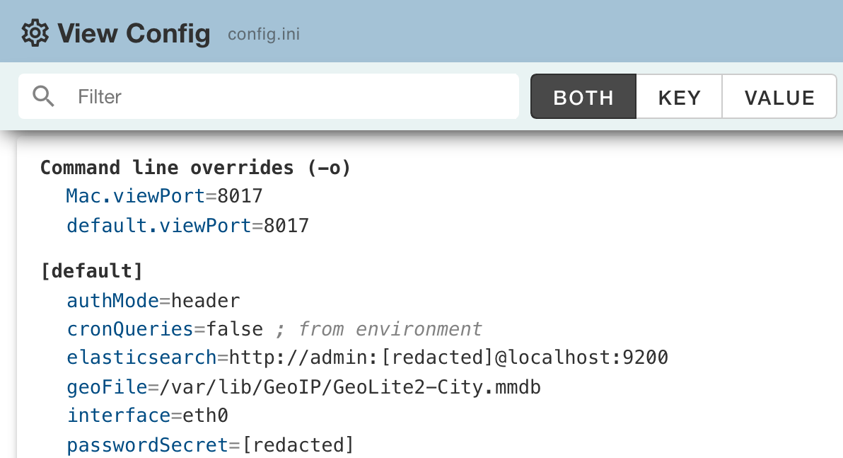
View Config
See the config an app is really running with
New admin page in viewer, cont3xt, parliament, and wise
Every effective setting, the -o command line overrides, and which values came from the environment
Secrets are redacted on the server: passwords, tokens, API keys, url credentials, and [keks] never reach the browser
Viewer can compare against another node and show only the differences
With two-factor set up you enter a TOTP code to unlock it, good for 10 minutes in that browser only
viewConfigMode decides who sees it: off, superAdmin (the default), or appAdmin
Notes:
Lives in common/viewConfig.js so all four apps share it. viewConfigMode: off removes the page and its APIs (404), superAdmin is the default, appAdmin opens it to the app's own admin role (arkimeAdmin, cont3xtAdmin, ...). Redaction is a server side denylist: keys matching secret, password, token, apikey, or basicauth, the userinfo of any url, key:value secrets packed inside a value, and the whole [keks] section. The TOTP unlock is a grant held in browser memory, so another tab or a reload asks again. Node compare goes over s2s, redacted values are not compared. The screenshot is a dev7 viewer started with -c config.ini -o viewPort=8017 and cronQueries set in the environment, with throwaway credentials, so it shows the override, environment, and redaction markers.

Slide 16

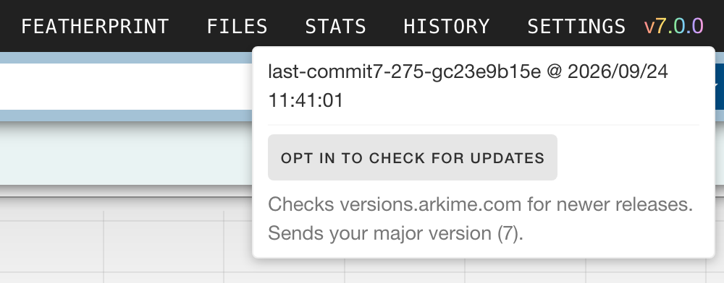
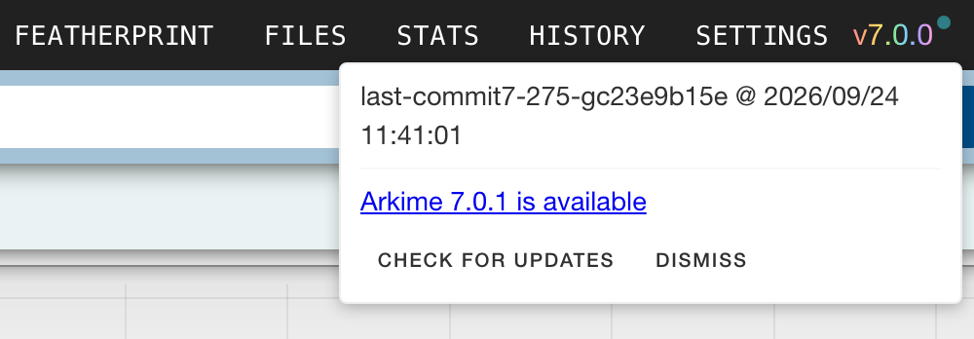
Update check
Know when a newer Arkime is out
The version menu in viewer, cont3xt, parliament, and wise shows when a newer release is out
checkForUpdates: manual (the default) sends nothing until someone clicks, auto checks once a day, off hides it
The browser fetches a static releases-v7.json: no cookies, no referrer, only the major version is revealed
A dot on the version flags it until dismissed; security releases and end of life majors are called out
updateCheckUrl can point at an internal mirror instead of versions.arkime.com
Notes:
UpdateCheckService.js in common, shown in the version menu of all four apps. The browser fetches <updateCheckUrl>/releases-v7.json, so the request itself only reveals the major version. It is a plain fetch with credentials omitted and no referrer, and when checkForUpdates=off the CSP connect-src blocks it too. Results are cached for 24 hours, failures for 1 hour. The file lists releases with version, date, url, and an optional security flag, plus eol for a retired major. versions.arkime.com is just a static site, so a mirror is a copy of the json. Screenshots are a dev7 build labelled 7.0.0 checking versions.arkime.com, whose 7.0.1 entry is a placeholder.

Slide 17




Probably still coming
Not in the RC yet, but we keep saying we will do them
Default rules that drop TLS
Settings without "es" in the name
Ship rules that stop saving packets for TLS sessions once the handshake is done. You keep JA4, certificates, SNI, and sizes, and lose the encrypted bytes you could never read anyway.
elasticsearch=, usersElasticsearch=, esAdmin... made sense when there was one backend. With ClickHouse, sqlite, and lmdb in the picture, the names should describe the job, not the product.
Other databases for non-session data
i18n more things
ClickHouse covers sessions today; users, files, hunts, history, and the rest still need OpenSearch. Users, Cont3xt, and Parliament already have sqlite and lmdb, so the pattern exists.
The browser side is translated. Server messages, error text, and the corners we skipped are not. Cont3xt got its first pass in 7, the rest is still on the list.
Notes:
Honest roadmap slide. None of these are committed to 7.0.0; they are the things that keep coming up. Ask the room which one they would want first.

Slide 18

Breaking changes
Read these before you upgrade
Session columns, info fields, and spiview layouts move from the user record to shareables. db.pl upgrade copies them; originals stay so 6 keeps working
/api/user/layouts/:type APIs removed; the config APIs no longer return colConfigs, infoConfigs, or fieldConfigs
userAutoCreateTmpl, simpleDEKEncoding, demoMode, esAdminUsers removed
wiseService needs --webcode or TOTP, no random pin
Node 24 required; packages depend on OS libraries
lldp, xid, isis, esis, igmp, pim: a session per talker pair, so more, smaller sessions
tcpSaveTimeout and tcpClosingTimeout apply to tcp only; use [protocol-settings] for the rest
The packet queue 75% throttle now triggers where it was meant to, so busy sensors do more work per packet
_flipSrcDst swaps the whole session, not just IPs and ports
Plugin API: arkime_packet_set_interface() and arkime_mprotocol_register() flags; custom readers and parsers must be rebuilt
Stricter config validation: values that were ignored now refuse to start
Notes:
Straight from the 7.0.0 Breaking section of the CHANGELOG. Also: offlineFilenameRegex default matches .pcapng, ARKIME_HTTP_PRIORITY_DROPABLE renamed to DROPPABLE, stoppedsessions file is version 2 and v1 files are ignored. Run db.pl <host:port> shareables-import all by hand if the automatic copy is skipped.

Slide 19
Help us break it
demo7.arkime.com · RC1 in October · 7.0.0 early 2027
Slack and GitHub issues, especially for the config validation and talker-pair changes
arkime.com

