Slide 1

Arkimeet 2026
What broke.
On Prem Elasticsearch => AWS Managed OpenSearch
Elyse Rinne
Yahoo! Paranoids
Principal Software Engineer
Notes:
I migrated Yahoo’s Office network Arkime database from self-managed Elasticsearch in our data centers to multi-region AWS Managed OpenSearch.
This is a story of what broke and what we changed in Arkime so it breaks for nobody else.

Slide 2
Issues I hit ⇒ Fixes you already have.
THE CENTRAL CHALLENGE
The Arkime cloud deployment does not control the network where the data is captured.
3 issues ⇒ 3 PRS
Notes:
We moved Arkime's session store to AWS Managed OpenSearch. Most of what went wrong was not a storage problem; disk on the internet is disk on the internet. Instead it was Arkime components assuming the capture end of a connection was something it owned.
I’ll describe three of these issues, each with the merged PRs it produced. If you run Arkime against a managed cluster, behind an identity proxy, or across a trust boundary, you already have the fixes.

Slide 3
But why!?

Slide 4
Datacenter Exit
BEFORE:
SELF-MANAGED ES
3 main managing nodes
7 managing nodes
54 data nodes
Bare metal
Elasticsearch 8.19.6
Everything hot, all of the time
Manual patching and sysadmin
Ansible
DURING:
REDUNDANCY
ES Proxy Tee
AFTER :
AWS MANAGED OS
3 main managing
12 hot
9 UltraWarm
3 AZ
OpenSearch 3.5
3 months hot & cold reattach 1y +
SigV4 short-lived creds
Terraform
Notes:
The datacenter that I have the Arkime Office Elasticsearch deployment is in a location that is being closed by the end of next year (2027)
Before => After
I dual-wrote to both clusters for the entire migration using the es proxy tee configuration option. Every issue in this talk happened on the cloud copy while the on-prem primary kept taking writes — rollback was always one config change away. If you are doing this migration, do that.

Slide 5
Relinquish control.
WHAT YOU GIVE UP
PUTting directly to the cluster
Rolling restarts
WHAT YOU GET
Tiered storage
ISM
Patching
snapshots
HA
IAM request signing
Notes:
WHAT YOU GIVE UP:
PUTting directly to the cluster, like /_cluster/settings. Gone. Tuning moves into index templates or is simply unavailable. This is by design. If you don’t like it, use self managed.
Rolling restarts. Every config change is a domain-wide blue/green, and the master goes unreachable for a few minutes each time.
WHAT YOU GET
Tiered storage. UltraWarm and cold are what make two-year retention affordable at all.
Index State Management instead of curator and cron.
Patching, snapshots, and multi-region high availability.
IAM request signing and fine-grained access control instead of one shared admin password.

Slide 6
What does FAST mean anyway?
TIER 01
Hot (EBS)
SEARCH LATENCY
57 ms
AGGREGATION
890 ms
NOTES
Read + write
TIER 02
Warm (S3)
SEARCH LATENCY
60 ms
AGGREGATION
3,967 ms
NOTES
Read-only
TIER 03
Cold (reattached)
SEARCH LATENCY
N/A
AGGREGATION
N/A
NOTES
Manual reattach then warm
Notes:
I didn’t test query times until after the migration was done. Not that it mattered, my directive was clear either way.
To make this cost effective AT ALL… we demoted metadata from a year and over to cold storage.
Cold indices do not exist to a query until you reattach them.
If you remember from my previous slides… we stored over 2 years of hot indices on prem. This is a severe downgrade from that. It was just too expensive to keep it all indexable.
The nice thing is that warm search is indistinguishable from hot. My analysts have 1 year of fast searches at least! However, warm aggregation is 4.5× worse. If your analysts live in the Sessions tab they will never notice the tier boundary thanks to our settings to disable aggregation queries for large time ranges (30 days by default).

Slide 7
Implement
Notes:
Now that you know why, let’s talk implementation!
I am going to walk you through three issues I hit and the corresponding PRs that spawned from them. I made the mistakes so you don’t have to.

Slide 8
0. First Problem
PROBLEMS
Sign ESProxy Tee traffic
OpenSearch has 10s index refresh
SYMPTOMS
403’s
Missing indices
Notes:
A managed cluster gates writes on IAM request signing, but esProxy had no way to sign anything.
Managed Opensearches’ Index refresh is not immediate. We all know that about elastic and open search right? Writes are not immediate, but managed opensearch is 10s whether you like it or not, so a write followed by a read inside the default window came back empty. Wait 10s, it was there. It didn’t honor Arkime’s index refresh setting.
What this looked like was:
403s we could not explain.
Sessions that were definitely written and definitely not findable, until after ten seconds.
The underlying cause of these problems is because Arkime assumes a lot about your deployment. AWS Managed Opensearch challenged many of those assumptions.

Slide 9
0. Fixed
#3789 Add SigV4 signing support to esProxy
#3763 Fix aws-managed OpenSearch cluster index refresh
Notes:
#3789 is the substantial one. esProxy can now sign its requests with short-lived credentials instead of a static, manually rotated password sitting in a config file. You can still read static credentials from your INI, but mTLS support is a first class citizen within esProxy now.
This all works independently for the primary tee target, which is what let us dual-write.
#3763 is just two lines and a lot of confusion saved. All it did was make Arkime wait for the refresh interval a hosted cluster actually has, instead of assuming its own.
Point esProxy at a managed cluster today and none of this happens to you.

Slide 10
1. Second problem
AUTHENTICATION FLOW
Okta User → AWS ALB → JWT Identity → Arkime
THE LIMITATION
Need Okta User, not just user ID
Notes:
I put the Arkime Cloud Viewer behind an ALB doing Okta OIDC. The ALB authenticates, then forwards the identity as a JWT in a request header to the AWS Arkime Viewer.
Arkime's header auth mode could only read that header as a plain-text userId. The existing header authentication mechanism was designed to process only flat text strings passed down through the proxy chain. A JWT is not a plain text userId.
I also wanted roles out of the token's claims, you know, arkimeUser, cont3xtUser, arkimeAdmin. Reading plain-text wasn’t going to cut it.

Slide 11
1. Fixed
#3878 Add JWT decoding support for header auth mode
authMode=header-jwt
Works behind any OIDC-terminating proxy
Notes:
Add JWT decoding support for header auth mode
With authMode=header-jwt. The viewer decodes the header as a JWT itself and takes the userId from a claim — no signature check, the proxy in front already verified it. Claims also reach [user-auto-create] and [user-role-mappings], so users and roles provision from the token
This all works behind any OIDC-terminating proxy - ALB, Cloudflare Access, Google IAP, etc. I just happen to be using an AWS ALB.

Slide 12
2. Third problem
PROBLEM A
PROBLEM B
Only one secret?
No multicluster PCAP!
The sessions receive route only checked that the S2S token decrypted, not that it was valid.
Notes:
The last problem was the sticky one. And it was the last piece that would allow me to call this migration a success.
Session data moved to the cloud, but the packets stayed on capture nodes on-prem in our offices. So a central viewer in AWS had to fetch PCAP from nodes in a whole other internet space.
The first issue I discovered was that multicluster pcap was never going to work with this deployment. As it stood, the server to server authorization always used the single default serverSecret. That is fine when there is one cluster and everybody shares it, and it fails the moment clusters have different secrets and don’t trust each other.
In this whole endeavor, I found another inconsistency too! The sessions receive route only checked that the S2S token decrypted, not that it was valid. Nobody noticed until there were clusters that did not trust each other!

Slide 13
2. Fixed
#3863
#4108
Fix S2S auth for cross-cluster PCAP retrieval in multiviewer
Validate full S2S auth token on the sessions receive route
Notes:
#3863 The mutiviewer pcap retrieval was a small fix in the server to server auth mechanism.
#4108 was not technically broken, just not implemented as intended. The sessions receive gate only checked that the token decrypted. Now it shares the s2s strategy's full validation.
Now, Arkime server to server auth these improvements and bug fixes! These things may have fixed esProxy and s2s authorization, but I still could not retrieve PCAP in private office space from my aws arkime viewer.

Slide 14
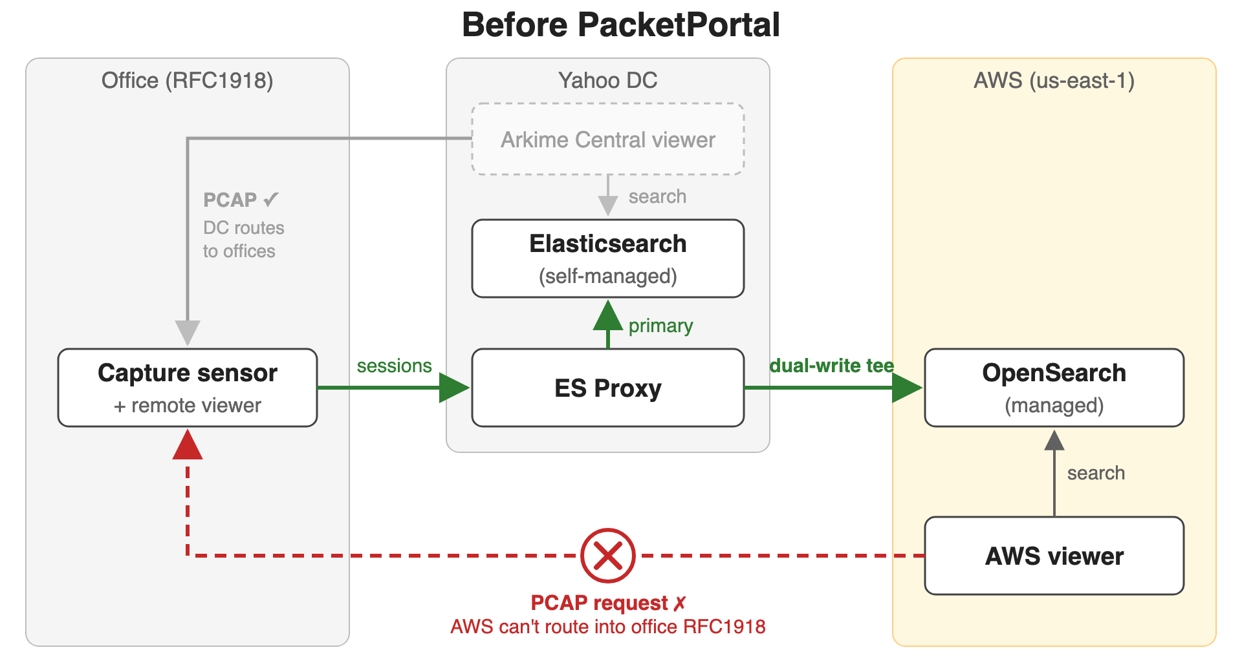
Notes:
Arkime makes another assumption here, it assumes the remote viewer holding the PCAP is reachable. Let’s talk about that next and how we solved it for good.

Slide 15
Packet Portal.
Notes:
And that’s how we came up with Packet Portal!

Slide 16
A remote viewer you cannot reach at all.
OUTBOUND
SECURITY
Remote Viewer Dials Out!
Maintains a long-lived HTTP/2 connection back to the Central Viewer.
S2S Auth
Configured via [packetportal-nodes]
Notes:
Fixing all those issues got us working, but it did not solve the real shape of the problem: a remote viewer the AWS Central Viewer cannot open a connection to at all. Anything behind NAT, behind a firewall, or behind an IP-locked reverse proxy was unavailable data to the central viewer.
So, what do you do with a remote viewer/capture sensor that you cannot reach at all?
Dial out instead! The remote viewer dials out by holding one long-lived HTTP/2 connection to the Central Viewer, and the Central Viewer sends its normal work on packet captures — fetching pcap, hunts, periodic queries — back down that same connection.
With no portal present everything falls back to ordinary node-to-node HTTP.
IT RIDES ON THE IDENTITY WORK
Every request over a portal is individually S2S authenticated, and only the token is trusted — not the source address, not userNameHeader.
Configure it with [packetportal-nodes] in your config.
—

Slide 17
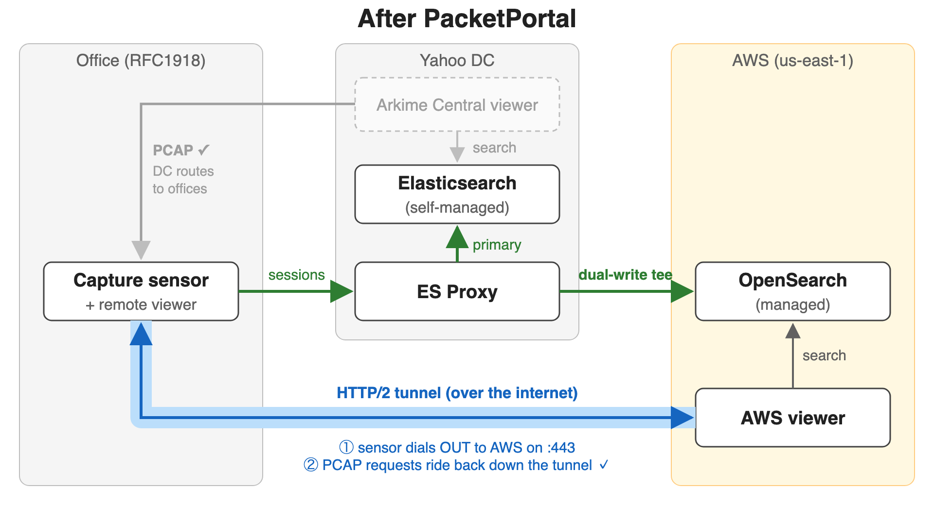
Notes:
And this is the final piece of the puzzle that allowed me to complete this eventful cloud migration.
Next, I get to turn off writes to self-managed Elasticsearch and watch it age out.

Slide 19
Questions?
Notes:
And THAT is my war story to migrate our Arkime Office Database to the cloud. Hit me with your questions!

Slide 20
APPENDIX · NOT PRESENTED · FLIP HERE IF ASKED
The deployment, for reference.
THE CLUSTER
Managed OpenSearch 3.5, us-east-1, 3 AZ
3 master · 12 hot (or2 family) · 9 UltraWarm
Cold storage enabled
ISM: hot 90d → warm 365d → cold 730d → delete
12 shards per index, 1 replica
index.codec zstd, in an order-100 override template
force_merge deliberately disabled
THE WRITE AND READ PATHS
4 esProxy hosts dual-writing on-prem → AWS
SigV4 + ExternalId, short-lived credentials
Viewer: ALB + OIDC → header-jwt, ASG across 3 AZ
nginx sidecar fronting the viewer for security headers
PCAP still served from on-prem capture nodes
On-prem side unchanged and still authoritative

Slide 21
APPENDIX · NOT PRESENTED · ANSWERS ARE IN THE SPEAKER NOTES
Questions I expect to get.
What did it actually cost?
Why not just self-manage on EC2?
Did you lose data during the six weeks?
Why is force_merge off?
Why not searchable snapshots?
Is zstd worth turning on?
Why basic auth on the viewer, not SigV4?
Could Packet Portal replace the dual-write?
Does UltraWarm hold up for hunts?
How long did the whole thing take?
Would you do it again?
What is still not finished?
Notes:
APPENDIX — not presented. Answers in slide order, plus two extras at the end.
MECHANICS if asked: Sensor dials out, one long-lived HTTP/2 link, Central Viewer sends normal node-to-node requests back down it. Falls back to plain node-to-node HTTP when no portal is present. Prefer a dedicated packetPortalPort over packetPortalListen so the portal gets its own firewall rules and is not subject to the main viewer port's proxy, header auth or IP restrictions. Viewer clocks within 2 minutes.
SECURITY if asked: only the s2s token is trusted over a portal — not the loopback source address, not userNameHeader. serverSecret proves the caller is *some* node, so [packetportal-nodes] binds the node-name claim to a per-node password and/or source IP; with neither, a node is pinned to the IP it first connects from, in memory only.
And the detail this room will like: [packetportal-nodes] falls back to [esproxy-sensors], so anyone already authenticating sensors to ES Proxy has portal identity for free.
1. WHAT DID IT ACTUALLY COST? More than the on-prem cluster — say that plainly, do not spin it. That hardware was sunk cost; this is a real run-rate. Shape of the bill: hot compute and EBS dominate; UltraWarm and cold are roughly 5x cheaper per GB than hot EBS, which is the only reason 24-month retention is affordable. Reserved instances were the biggest single lever, about half off the hot tier on a 3-year all-upfront. If pressed for the absolute figure: "I can't share that number."
2. WHY NOT SELF-MANAGE ON EC2? You keep every operational burden you were trying to shed — patching, HA, upgrades — and still get an EBS bill. The managed service's real value is UltraWarm and cold tiering. The honest cost: you lose PUT /_cluster/settings and a lot of knobs, and that bit us (see force_merge).
3. DID YOU LOSE DATA DURING THE SIX WEEKS? No. The on-prem primary took every write throughout and is still authoritative. The gap was in the cloud copy only. This is the entire argument for dual-writing through a migration.
4. WHY IS FORCE_MERGE OFF? On the pitfalls slide, item 05. OR1/OR2 use segment replication — the primary merges, then has to ship the merged segment to its replicas. Self-managed ES uses document replication, where each replica merges locally and nothing large crosses the network. Merge-to-1 completed on our primaries and left replicas hundreds of GiB behind with zero drain. We tune the merge policy instead: max merged segment size and merge thread count. Most likely deep question in the room — keep it sharp.
5. WHY NOT SEARCHABLE SNAPSHOTS? Not available on managed OpenSearch. Cold plus reattach is the only option — about 19 seconds for a ~200 GB index, then it performs like warm.
6. IS ZSTD WORTH TURNING ON? Yes, but calibrate. We measured ~12-13% over a full clean week, not the 25-30% we planned for. Measure on structurally identical index pairs — same shard count, same replica count, neither force-merged — or you will fool yourself. db.pl --compression exists (Andy's #3860); pitfalls item 03 is where to put it.
7. WHY BASIC AUTH ON THE VIEWER, NOT SIGV4? We proposed viewer-side SigV4 (#3901) and it was declined. The simpler answer won: keep basic auth to the cluster, do identity at the edge with ALB plus OIDC into header-jwt (#3878). No worse than the cluster we replaced, which also used basic auth.
8. COULD PACKET PORTAL REPLACE THE DUAL-WRITE? Different problem. Dual-write is two copies of the data during a migration; Packet Portal is reaching a viewer you cannot connect to inbound. They compose — portals are how you would reach edge sensors from a cloud-hosted central viewer, which is what I would build starting today.
9. DOES ULTRAWARM HOLD UP FOR HUNTS? Search is fine, ~60 ms against ~57 ms hot. Aggregations are ~4.5x slower. Hunts read a lot, so expect them slower on warm. Size the hot window around how far back people actually hunt, not around your retention number.
10. HOW LONG DID THE WHOLE THING TAKE? About a year, live and dual-writing for most of it. The long tail was never the data — it was auth, PCAP retrieval, and everything that assumed a flat trusted network.
11. WOULD YOU DO IT AGAIN? Yes, with two changes: alarm on lifecycle progress from day one, and treat every index setting as drift-prone with a detector on it.
12. WHAT IS STILL NOT FINISHED? PCAP retrieval from the cloud viewer back to the on-prem capture nodes. The on-prem viewer is still load-bearing for raw packets. That is a network dependency, not an Arkime one — and it is what Packet Portal is aimed at.
EXTRA A. SO DID YOU WRITE PACKET PORTAL? No — Andy implemented it. I wrote the PRD, raised the problem, consulted through the build, tested it and fed back fixes; my own code in it is one commit in #4233. Answer it exactly that way. It is accurate, it is generous, and it is a better story than claiming the code.
EXTRA B. WHY IS THERE A DECLINED PR ON A SLIDE? Because a talk that only shows the merged ones is a sales pitch. #3901 was the wrong shape and the review was right; the useful upstream lesson is that the smallest change that solves the problem is usually the one that lands.

