Slide 1




Welcome to
Arkimeet 2026
Grab your swag
Pick up a bag, shirt, and tattoo
Help yourself to refreshments
In the coolers and on the table
Happy Hour
Ornery Public House, 5:30 – 8:00
Notes:
Welcome everyone. Swag is on the table, drinks in the coolers. Happy hour tonight at Ornery Public House from 5:30 to 8.

Slide 2







Why packet capture still matters
Logs say what someone chose to record. Packets say what actually happened.
Ground truth
No agent required
Encryption is not a wall
Logs can be missing, misconfigured, or tampered with. The wire is the one record nobody edits, and you can replay it.
IoT, OT, printers, phones, appliances, the vendor box you cannot touch. Capture sees them all. That is why the ICS parsers and Featherprint exist.
JA4, certificates, SNI, DNS, sizes, and timing. You lose the payload, you keep who, when, how much, and what looks wrong.
Metadata is often enough
Response needs the bytes
It is affordable now
Arkime does not have to keep every packet. Rules can stop saving PCAP for a session after N packets, or never save it, while every field is still indexed and searchable.
Pull the exfiltrated file, the beacon, the exploit. Prove exactly what happened and what left, not just that something did.
zstd compression, S3 tiers, rules to drop what you do not need, and commodity hardware that keeps up. Cheaper than a breach investigation without it.
Notes:
Set the stage before the stats. The pitch: capture is not competing with logs and EDR, it is the thing that is still there when they are not. Tie each point back to something later in the deck: ICS parsers and Featherprint for agentless devices, JA4 for encrypted traffic, S3 schemes and zstd for cost, hunts and PCAP download for response. Metadata point: the _maxPacketsToSave rule action caps PCAP per session, dontSaveBPFs skips saving packets for matching traffic entirely, and capture can run with no pcap writer at all. Every field is still indexed either way, and 6.x saves sessions midway even when not writing packets.

Slide 3

Since the last Arkimeet
Arkime 4.3.2 → 6.8.0
CHANGES SINCE MAY 23, 2023
TOTALS TODAY
2,286
37
1,647
324
7,514
commits
releases
PRs merged
issues closed
GitHub stars
33
86
~30
310k
1,169
new parsers
new classifiers
contributors
lines added
forks
Commits counted across main, dev6, and dev7 (PRs are squash-merged, so main alone undercounts). Releases exclude RCs. Contributors are unique commit authors, bots excluded.
Notes:
Left group is everything that happened between May 23, 2023 and September 30, 2026, the day 6.8.0 shipped, from the arkime/arkime git history (unique commits across main, dev6, dev7) and the GitHub API. Right group is the repo as it stands today. Parsers: 45 -> 78 .c files in capture/parsers. Classifiers: 72 -> 158 registrations. Lines added is git diff insertions between the two commits.

Slide 4
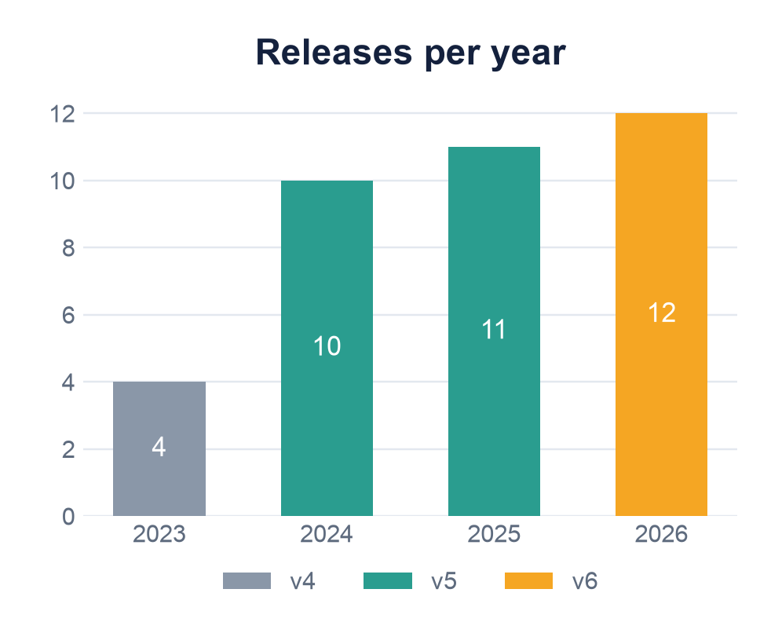
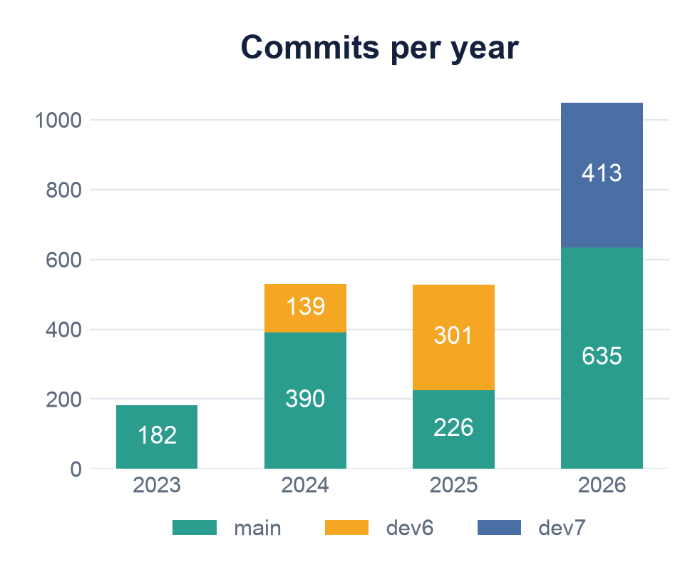
Shipping cadence
2023 from May 23; 2026 to date. dev6 / dev7 segments are branch commits not yet squashed into main. Releases exclude RCs.
Notes:
Roughly a release every month. Commits are counted across main plus the dev6 and dev7 branches, because PRs are squash-merged and main alone hides the branch work (2025 on main is only 226). 2026 is the biggest year we have had, and 6.8.0 on September 30 makes it 12 releases.

Slide 5
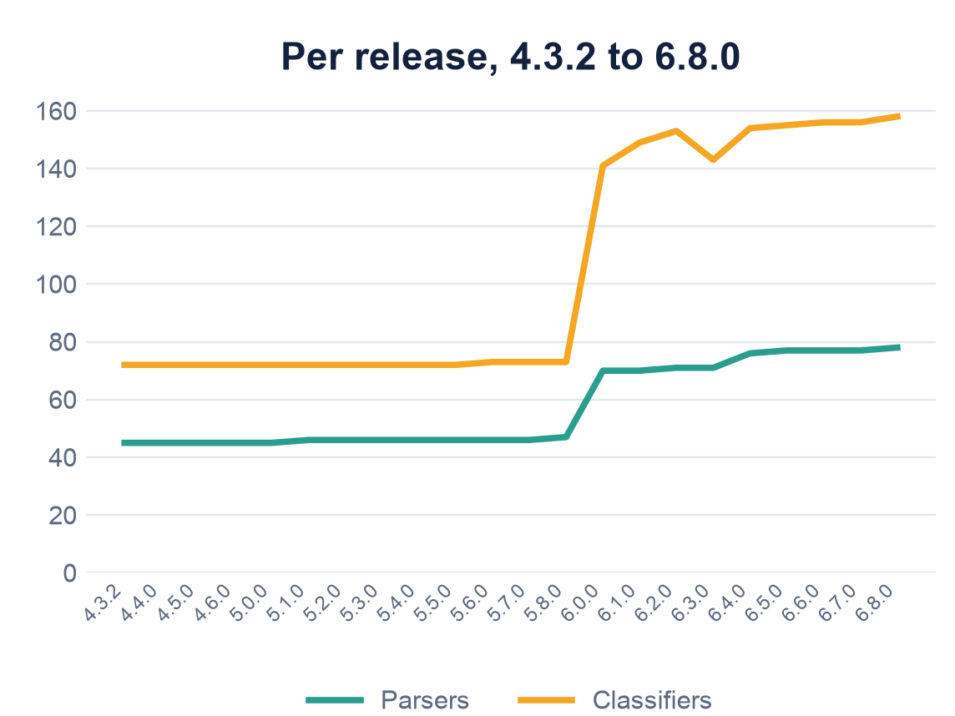
Protocol coverage
+73%
more parsers
+119%
more classifiers
Notes:
Parsers are .c files in capture/parsers. Classifiers are arkime_parsers_classifier_register calls. Most of the growth landed in the 6.0 release candidates.

Slide 6
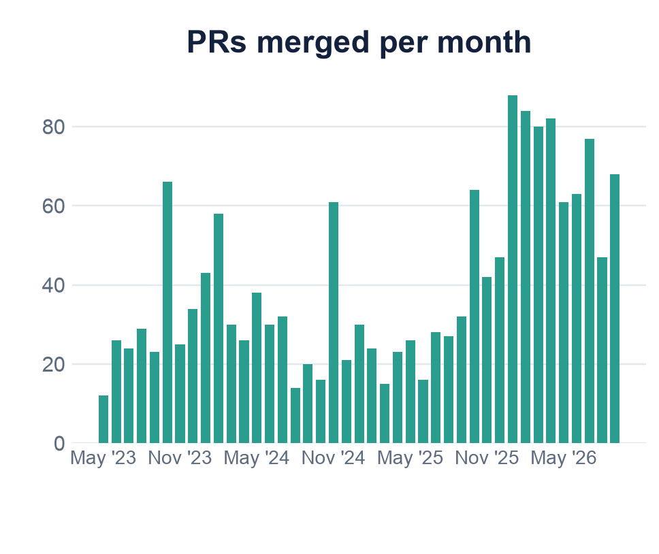
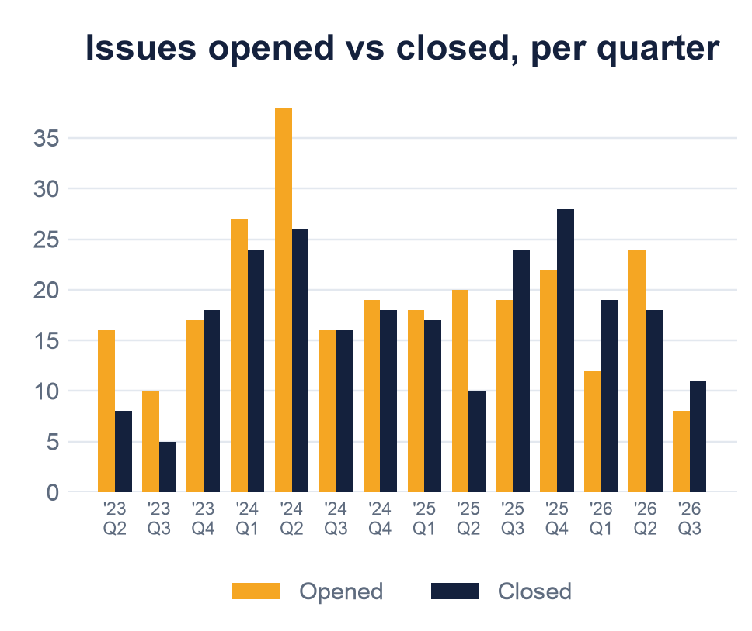
Pull requests & issues
PRs merged went from about 25 a month to 80+ once the 6.0 work started. Issues stay roughly balanced, and 35 are open today.
Notes:
PRs merged per month from the GitHub pulls API, 1,624 since May 2023. Issues opened and closed per quarter from the issues API: 266 opened, 242 closed in that window, 35 open right now. The jump in PRs from October 2025 onward is the 6.0 push and the parser wave.

Slide 7
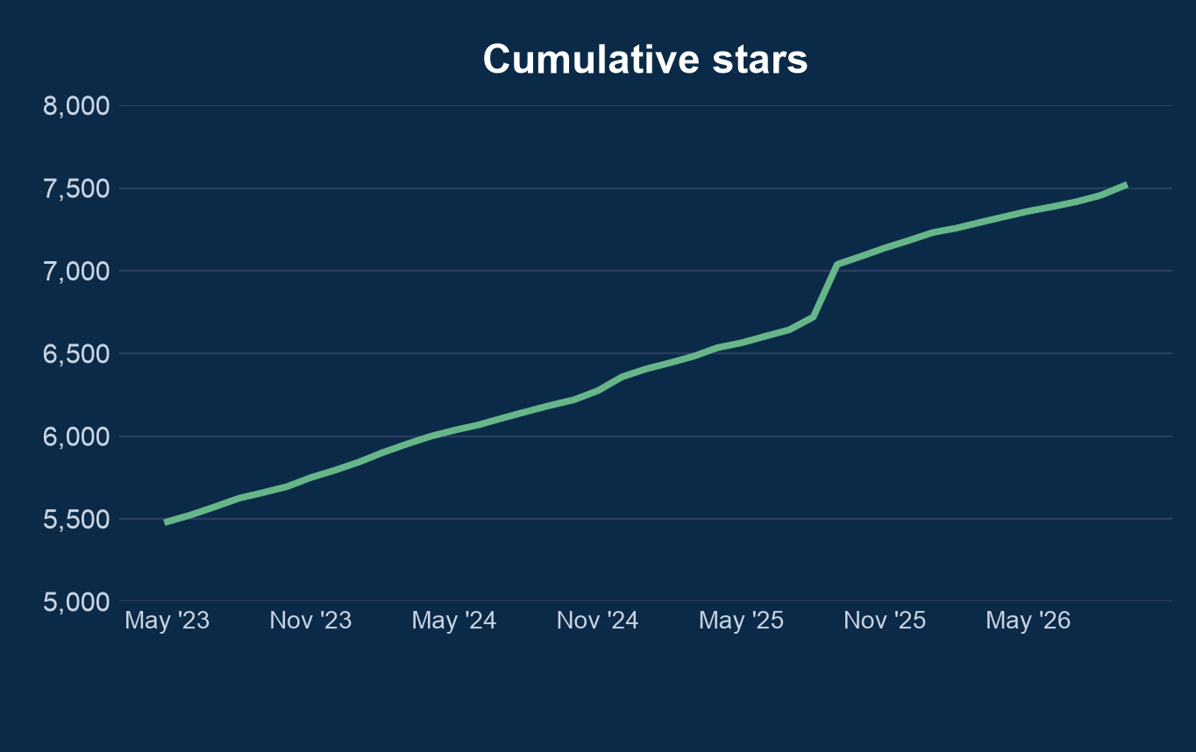
GitHub stars
5,447
stars at the last Arkimeet
7,514
stars today
+230
in two days, Sep 15–16, 2025
Notes:
Stargazer timestamps from the GitHub API. 5,447 stars before May 23, 2023, 7,514 now. September 2025 added 318 stars, 230 of them on September 15 and 16. Ask the room if anyone knows what happened that week.

Slide 8
Two major releases
Arkime 5
Arkime 6
February 6, 2024
March 2, 2026
Unified config: ini / json / yaml
Unified auth with authMode
JA4 fingerprints
PCAP schemes: S3, HTTP, SQS
Cont3xt bulk search
Official Docker images
Python parsers and classifiers
Corrupt / unknown packets as sessions
30+ new protocol parsers
5x faster PCAP, 2x faster hunts
Vue 3, Arkime Tab, Sankey, i18n
FreeBSD, Homebrew, Alkeme
arkime.com/release-v5
arkime.com/release-v6
Notes:
Arkime 5 shipped Feb 6, 2024 after four release candidates. Arkime 6 shipped March 2, 2026 after four RCs. Full notes at arkime.com/release-v5 and arkime.com/release-v6.

Slide 9
Arkime 5
February 6, 2024
Unified config, unified auth, JA4, PCAP schemes, Docker, Cont3xt bulk search
Notes:
Arkime 5 was the big consolidation release: every app configured and authenticated the same way.

Slide 10

Unified configuration
v5
Every Arkime app shares one config subsystem
capture, viewer, cont3xt, WISE, parliament, esproxy all read config the same way
Formats: ini, json, or yaml
json and yaml use native lists, no more semicolon strings
Load from a file, http(s), OpenSearch / Elasticsearch, or redis (v6)
Override anything with ARKIME__setting environment variables
# config.ini
[default]
interface=eth0;eth1
# config.yaml
default:
interface:
- eth0
- eth1
# pull config from a URL
capture -c https://cfg.example.com/arkime.yaml
Notes:
Arkime 5 #2316 and #2419. Config can be pulled from disk, http(s), or elasticsearch. Arkime 6 rc3 added redis:// for config.

Slide 11

Unified authentication
v5
One authMode setting for every app
Default changed from anonymous to digest
Parliament dropped its own JWT login and uses common auth
Map OIDC or header groups to Arkime roles with user-role-mappings
New settings: logoutUrl, authOIDCScope, login message for form auth
Arkime 6: users inherit permissions from their roles
digest
basic
form
basic+form
oidc
basic+oidc
header
header-jwt
headerOnly
header+digest
header+basic
s2s
anonymous
authMode values
Notes:
Arkime 5 #2299 #2308 #2408 #2463. Parliament needs a config file or [parliament] section before upgrading. Role inheritance is 6.0 #3552.

Slide 12

JA4 fingerprints
v5
JA4 built in, JA4+ as a plugin
tls.ja4
TLS client hello, including SMTP STARTTLS and DTLS. Ships in capture.
ja4plus plugin
JA4S, JA4H, JA4X, JA4T, JA4TS, JA4D, and JA4D6. Installed separately.
cert.ja4x
Certificate fingerprints, usable in rules and WISE.
Docker
Separate ja4 images if you want the plugin in a container.
Notes:
JA4 landed in 5.0 (#2409). DTLS JA4 and JA4S came in 5.x. The plugin was updated in 6.0 to match the Rust reference implementation on edge cases, and 6.7.1 fixes GREASE in the signature algorithms extension.

Slide 13

PCAP schemes
v5
Capture reads PCAP straight from a URL
file://
Local files and directories, processed in blocks
capture -r s3://bucket/2026/09/
capture -r https://x.io/a.pcap
capture -r file:///data/b.pcap
# v6: --scheme is the default,
# --libpcap for the old reader
s3://
Objects, prefixes, whole buckets. Standard AWS credentials, works with LocalStack
http(s)://
Any web server, including pre-signed S3 links
sqs://
Watch an SQS queue and process new S3 objects as they land
Notes:
Scheme reading arrived in 5.0 (#2571) and got --scheme as the faster method in 5.x. S3 directory support and SQS notifications came in 5.4. In 6.0, --scheme became the default for offline files.

Slide 14

Command socket
v5
Talk to a running capture over a unix socket
Start capture with --command-socket and it listens on a unix domain socket
Feed it PCAPs as they arrive with add-file and add-dir, no restart needed
Per-file overrides: --delete, --skip, --op field=value, --monitor a directory
--notify tells you when each file is done (or failed); file-status shows the queue
Also: set, config-list, packet-stats, plugins-list, version, shutdown
--command runs the same commands from the command line (5.6)
# start capture waiting for work
capture --scheme --command-wait \
--command-socket /var/run/arkime.sock
# hand it pcaps from anywhere
nc -U /var/run/arkime.sock
> add-file --notify /data/today.pcap
Added file
> add-dir --monitor --delete /data/inbox
> file-status
file-done /data/today.pcap
> shutdown
Notes:
Command socket arrived in 5.4.0 (#2873) with --command-wait (#2875) and add-dir overrides (#2877). 5.6 added --command to run commands from the command line. 6.1.1 added --notify completion messages and file-status, thanks to @wegman12. Handy for pipelines: a long-lived capture that other tools push pcaps into.

Slide 15

Docker docker docker
v5
Official images and a helper that does the boring parts
Official container on GitHub Packages, plus ja4 variants
Configure with ARKIME__setting environment variables
docker.sh: --init, --db, --ilm / --ism, --wait-for-db, --add-admin, --update-geo, --upgrade
TLS verification to OpenSearch / Elasticsearch on by default
Arkime 6 image is Debian 13 and bundles geoipupdate
docker run -d \
-e ARKIME__elasticsearch=https://es:9200 \
-e ARKIME__passwordSecret=changeme \
ghcr.io/arkime/arkime/arkime:6 \
/opt/arkime/bin/docker.sh viewer \
--init --add-admin --wait-for-db
Notes:
Official container since 5.x (#2992). docker.sh grew --init, --db, --add-admin, --ilm/--ism, --wait-for-db, --update-geo. The 6.0 container moved to Debian 13.

Slide 16





Cont3xt improvements
v5
Enrich many indicators in one query
Bulk queries
Rewritten UI
Paste a list of IPs, domains, hashes, or emails and get every integration's answer at once
Multi-column layout puts everything on one page with far less empty space
Severity emoji map
New integrations
Spot the indicators that matter with a glance down the list
Arkime, OpenSearch / Elasticsearch, CSV, JSON, Redis, and WISE as data sources
Notes:
Cont3xt bulk search was the headline Cont3xt feature of Arkime 5 (#2121). Also new in 5: viewRoles per integration, ownership transfer, keyboard shortcuts, punycode decoding, demoMode.

Slide 17


Viewer polish
v5
Session detail
Multiviewer
Two or three columns on wide screens
Label and value on the same line, long values wrap
Resize label width, collapse any section
Your layout preferences stick
Files, History, and Stats tabs get a cluster dropdown
Search every viewer or pick a few
All viewers selected by default
Also: uploadRoles, defaultTimeRange, footerTemplate, spiview category order
Notes:
Improved session detail display (#2523, #2607) and multiviewer dropdowns on Files/History/Stats (#2392). Plus resource ownership transfer and an editor for resources.

Slide 18
Arkime 6
March 2, 2026
Faster. Smarter. Ready for your network.
Notes:
Arkime 6 was about speed, a modern codebase, Python, parsers, and a lot of new UI.

Slide 19





A modern codebase
v6
Ten-year-old code, brought up to date
Vue 2 → Vue 3
Every UI migrated: viewer, cont3xt, parliament, WISE
Node.js 22
Requires 22.15 or newer; webpack tech debt removed
eslint 9
Vue files linted too, recommended rules enforced
Old stuff gone
v1 viewer APIs, old password storage, parseSMTP / parseSMB, Ubuntu 20.04
Notes:
The release page calls this out as making Arkime easier to maintain, more secure, and more welcoming to new contributors. Upgrading requires being on 5.2.0 or later.

Slide 20

Performance
v6
5x
2x
lock free
faster PCAP downloads
faster hunts
session ids (6.7)
Capture on busy links
Per-thread compression to OpenSearch / Elasticsearch
ArkimePacket free list to cut memory fragmentation
Structures aligned and needless atomics removed, so many packetThreads stop fighting over cache lines
Faster dedup and string matching; hunts only fetch the packet fields they need
Notes:
From the release-v6 page: PCAP downloads at least 5x faster, hunts at least 2x faster. #3479 per thread compression, #3481 packet free list, #3677 alignment, #3731 dedup, #4120 hunts, #4150 autoGenerateId=sequential.

Slide 21

Python parsers and plugins
v6
Write parsers in Python instead of C
Drop a .py file in the parsers directory and capture loads it
Three modules: arkime, arkime_session, arkime_packet
Register TCP, UDP, SCTP, and port classifiers, per-session parsers, and save hooks
Define fields, add tags, set values, read packet bytes
Type stubs (.pyi) for the arkime modules ship in the repo, so VS Code, Pylance, and PyCharm give autocomplete and type checking while you write one
Needs Python 3.12+ and disablePython=false
import arkime, arkime_session
def classify(session, data, direction):
arkime_session.add_protocol(session, "hello")
arkime_session.add_tag(session, "python")
arkime.register_parser(session, parse)
def parse(session, data, direction):
return 0 # -1 to unregister
arkime.register_tcp_classifier(
"hello", 0, b"HELLO", classify)
Notes:
Python support arrived in 6.0 (#3268). disablePython now defaults to true (rc4), so set disablePython=false. Not yet in the AL2023, Ubuntu 22, or Debian 12 packages. Type stubs live in capture/parsers/stubs: arkime.pyi, arkime_session.pyi, arkime_packet.pyi, types.pyi. They are maintained alongside the C API (each new binding lands with a stub update). Point your editor's extra paths at that directory, or copy the stubs next to your parser.

Slide 22




30+ new parsers
v6
ICS / SCADA
bacnet · dnp3 · enip · s7comm · opcua · c1222 · synchrophasor
Telecom / SS7
m3ua · sccp · tcap · camel · diameter · sctp
Infrastructure
sip · stun/turn · rdp · dcerpc · ntp · tftp · isakmp · mqtt · ptp · nbns · es-is · pana
Apps & mail
imap · pop3 · ftp · websocket · ssdp · adb · openvpn · tds7
New classifiers
wireguard · whatsapp · plex-gdm · samsung-smartview · ubiquiti · gearman · esio · nbds · xid
Notes:
Almost all of these landed in the 6.0 release candidates. Existing parsers also got improvements: krb5, snmp, rdp, mqtt, ntp, quic, dns RRSIG/DS/NSEC, DHCP session linking.

Slide 23

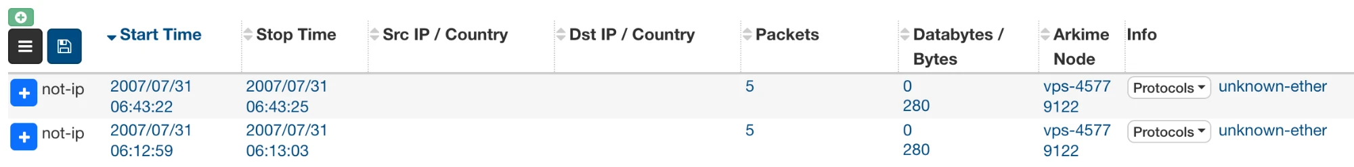
Corrupt & unknown packet saving
v6
Unknown and corrupt packets are now real Arkime sessions
One setting, saveUnknownPackets, replaces the old unkEthernet and unkIpProtocol plugins
They show up in the sessions list, are searchable, and expire like everything else
Choose what to keep: all, per ether type, per IP protocol, or just corrupt
saveUnknownPackets=all;corrupt
protocols == unknown-ether
protocols == corrupt-ip
Notes:
Arkime 6 removed the unkEthernet and unkIpProtocol plugins. saveUnknownPackets takes a semicolon list: all, ip:all, ether:all, ip:NAME, ether:NAME, -ip:NAME, -ether:NAME, corrupt. The sessions get protocols unknown-ether, unknown-ip, corrupt-ether, or corrupt-ip so you can search for them.

Slide 24


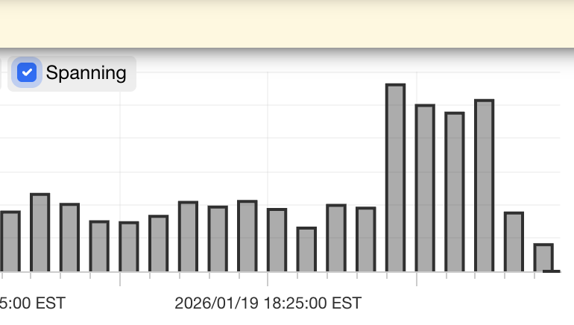
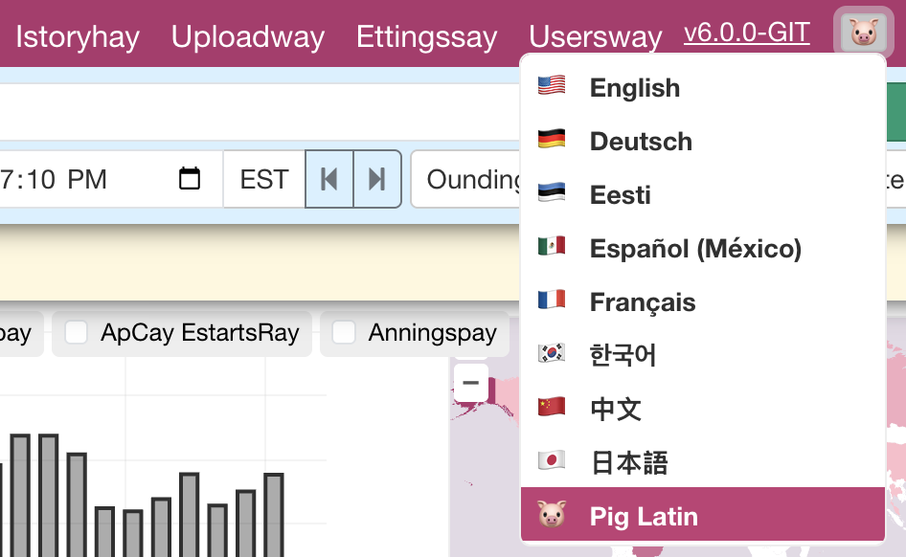
Session spanning & i18n
v6
Session spanning
Internationalization
Long-running sessions now appear in every interval they were active
Accurate graphs for connections that last hours or days
Needs sessions captured with Arkime 6
Menus, buttons, and labels translated in the browser
Ten languages so far, German to Japanese, plus Pig Latin
AI-assisted first pass, feedback welcome
Notes:
Session spanning uses the new packetRange field (#3566). i18n covers browser-side text; server errors are still English. pt-BR strings came in 6.1.

Slide 25

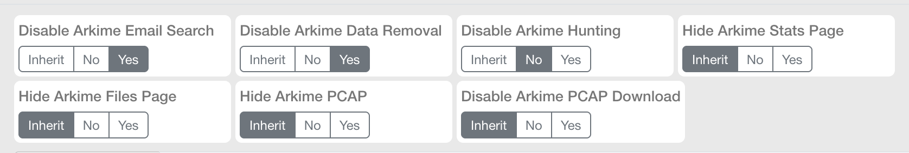
Permissions are inherited
v6
Permissions flow from roles, and the UI shows where each one came from
Roles can inherit permissions from other roles, so you build a few base roles and layer on top
Users inherit the extra permissions from their roles instead of every user being set by hand
Every permission is a three-way switch: Inherit, No, or Yes, so overrides are obvious at a glance
Pairs with user-role-mappings from Arkime 5 to map OIDC or header groups straight onto roles
Notes:
Role inheritance is 6.0 #3552 and the three-state permission toggles are #3552 as well. Users inherit the 7 extra permissions from their roles unless explicitly overridden, which is a behavior change worth calling out for upgrades.

Slide 26

Users without Elasticsearch/OpenSearch
v6
User, Cont3xt, and Parliament data can live outside OpenSearch
usersElasticsearch has long let users sit in a separate cluster; if unset, the main cluster is used
Since 6.1 it can also be sqlite://, lmdb://, or redis://. Same setting drives Cont3xt and Parliament storage
Small installs and standalone Cont3xt or Parliament no longer need an OpenSearch cluster just for users
sqlite, lmdb, and redis are regression tested in every build
changePasswordSecret.js re-encrypts every user's password and Cont3xt keys after a passwordSecret change (6.7)
AWS SigV4 signing for managed OpenSearch, and per-cluster serverSecret for multicluster PCAP
# config.ini [default]
# users in a file next to the app
usersElasticsearch=sqlite:///data/users.sqlite
# or an embedded key-value store
usersElasticsearch=lmdb:///data/users-lmdb
# or shared redis
usersElasticsearch=redis://redis.corp:6379/1
# cont3xt.ini: its own data too
dbUrl=lmdb:///data/cont3xt-db
Notes:
#3782 in 6.1.0 added sqlite for users, cont3xt and parliament and fixed up lmdb and redis; old redis user databases from before 6.1 are ignored. Parliament and Cont3xt pick their implementation from the URL scheme. #4128 changePasswordSecret.js is 6.7.0. #3789 SigV4 and #3863 per-cluster serverSecret are 6.1 and 6.2.

Slide 27

Also in 6.x
v6
Things that did not get a slide but you will want to know about
Packet Portal
zeekintel plugin
6.7, experimental. A NAT'd sensor viewer dials out to a central viewer, which sends its pcap, hunt, and cron requests back over that link
6.6. Loads Zeek intel framework files and tags sessions whose IPs, hosts, URLs, emails, or hashes match
entropy plugin
TCP handshake validation
6.5. Shannon entropy of the data bytes per direction, for spotting encrypted or packed payloads
6.7. tcp.synValidated, tcp.synAckValidated, and tcp.srcISNCnt for spotting spoofed or replayed handshakes
DCERPC interface labels
WISE sources and notifiers
6.5. AD CS, PrintNightmare, DfsCoerce, ShadowCoerce, WMI, BackupKey, EventLog6 named right in the session
phpIPAM, Cisco ISE pxGrid, urlapi sources. Teams, syslog, and snmp notifiers, and hunts can notify several at once
VLAN / VNI dedup
db.pl initorupgrade
6.1. Dedup keys include VLAN and VNI by default, so the same packet on two VLANs is not dropped
6.7. One command that inits a fresh cluster or upgrades an existing one, handy for automation
Notes:
Packet Portal #4163 (packetPortal* settings). zeekintel #4090. entropy #4013 (entropyChunkSize, entropyMaxUniqueValues). TCP handshake fields #4178 thanks @jeffreygolden. DCERPC labels and IPFIX/sFlow classifiers #3997. WISE sources #3801/#3806 thanks @waynieack, urlapi #3435. Notifiers #4194 Teams, #3865 syslog, #3866 snmp, multiple notifiers #3423. VLAN/VNI dedup #3786/#3797, dedupVlanVni=false to disable. initorupgrade #4162. Also: 24 new magicMode matches (#4149), dbTimestamp field (#4160), stateDir (#3958), trimEthernetPadding (#3954).

Slide 28


FreeBSD & Homebrew
v6
FreeBSD
Homebrew
Official FreeBSD 14 packages, built on 14.4
New reader-bpf for plain BPF capture
Netmap reader support for high speed capture
Same config, same viewer, same everything
Arkime tap for macOS and Linux
Great for laptops, demos, and offline PCAP analysis
brew install arkime/arkime/arkime
Notes:
FreeBSD builds landed in 6.0 (#3502) with netmap (#3517) and the new reader-bpf (#3501). The Homebrew tap is arkime/arkime.

Slide 29
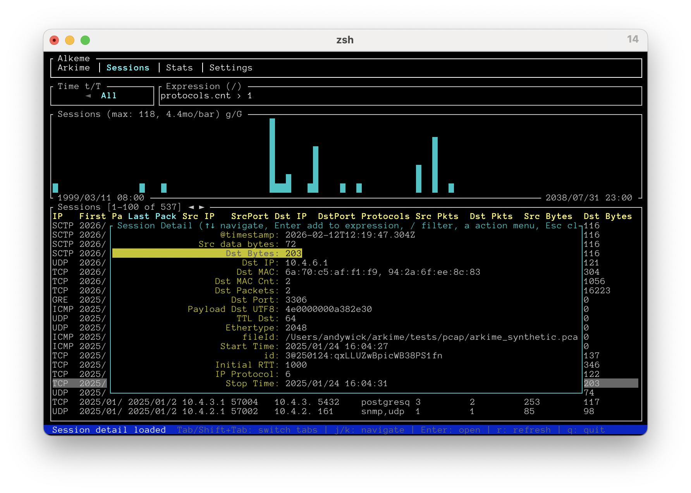

Alkeme
v6
A terminal UI for Arkime
Rust + ratatui, single static binary
Auto-detects Viewer, Cont3xt, WISE, Parliament
Sessions, expressions, histograms, hex dumps, stats, users, files
Cont3xt search with streaming cards; Parliament dashboard
Basic, digest, form, header, and Okta SSO with MFA
Written entirely by Claude
github.com/arkime/alkeme
Notes:
Alkeme requires Arkime 6. Pre-built binaries on the GitHub releases page. About 28k lines of Rust over 218 commits between February and May 2026, all generated by Claude.

Slide 30

MCP: let an assistant ask Arkime
v6
Viewer and Cont3xt speak Model Context Protocol (6.7)
POST /mcp on viewer and cont3xt, off by default
Users need the new mcpUser role on top of their normal role
Guard rails: mcpMaxQueryDays, mcpMaxResultBytes, mcpAllowedIps
Cont3xt search answers with the overview per indicator, not every raw integration blob
Every result links back to the same query in the web UI
# config.ini [default]
mcpEnabled=true
mcpAllowedIps=10.0.0.0/8
mcpMaxQueryDays=7
mcpDefaultView=Hunting
# give a user the role
db.pl host:9200 users-update alice \
--addRole mcpUser
Notes:
MCP server landed in 6.7.0 (#4134). Not on the release-v6 page, but the newest thing since. mcpUser role is included in superAdmin but not arkimeAdmin. In header auth mode, /mcp only allows localhost until mcpAllowedIps is set.

Slide 31
Yes, an AI slide. Sorry.
Everyone is tired of hearing about it. Here is what actually changed for us since the last Arkimeet.
2023
2025
Jan 2026
Feb 2026
Now
Autocomplete
Security reviews
Parsers
Synthetic PCAPs
Features & UI
Where we were at the last Arkimeet. Fancy tab completion.
Six months of AI-driven reviews of the codebase, each finding shipped with a fix.
AI helped write many of the 30+ new parsers. The hard part was finding test data.
Then it got good enough to generate the test traffic itself.
It helps with major features and whole UIs. Alkeme, MCP, and more.
Notes:
Acknowledge the fatigue up front. The point is the slope. Security reviews ran through the second half of 2025. From git: the parser wave started late January 2026 (bacnet, isakmp, dnp3...), synthetic pcaps landed February 8, 2026, Alkeme's first commit was February 9, 2026, and MCP shipped in 6.7 this summer.

Slide 32




It only works because of the foundation
None of this is useful without fifteen years of structure to plug into
Parsers plug in one way
Classifier, parser, field definitions. A new protocol never touches the core, so AI can add one safely.
Tests with real answers
199 test PCAPs and 60 test suites with expected output. When AI gets it wrong, the tests say so.
One config, one auth
Every app reads settings and authenticates the same way, so a change in one place is a change everywhere.
Fields drive everything
A field definition feeds the DB mapping, the search language, and the UI. Add one, and it shows up.
Conventions written down
CHANGELOG, docs, and CLAUDE.md tell an assistant how we do things, so its output looks like ours.
Notes:
The counter-point to the hype: AI is a multiplier on structure we already had. Parser integration model, the test corpus (199 pcaps, each with a .test expected-output file, and 60 .t suites), unified config and auth, field definitions, and written conventions. Without those, it would just be a faster way to make a mess.

Slide 33

Bugs the reviews actually found
A sample from four review passes, February to September 2026
ACCESS CONTROL
#4233
ACCESS CONTROL
#4264
A malformed userAuthIps entry silently allowed every source IP, and uploadFileSizeLimit=2g meant 2 bytes.
A sensor could reach any Elasticsearch API through esProxy by percent-encoding a ? or # in the URL.
MEMORY
#4143
MEMORY
#4097, #4143
Remote HTTP responses pre-allocated up to 2 GB from Content-Length, and SCTP reassembly could queue fragments without bound.
AWS credential refresh leaked memory every 280 seconds, and the SQS reader kept using a credentials pointer after it was freed.
PARSING
#4097, #3706
PARSING
#4100
Certificate isCA tested cRLSign instead of keyCertSign, and UTCTime timezone offsets were computed wrong.
SSH hassh could hash bytes from the following record when a KEXINIT name-list length was corrupt.
LOGIC
#3891
LOGIC
#4097
TCP reassembly had its partial and full retransmit branches swapped, so partial retransmits lost new data.
The packet queue backpressure throttle never engaged at 75% full, and rule ranges spanning 20+ values never matched.
Notes:
Concrete examples from the PRs: #3706 (Opus review, Feb 2026: ASN.1 tag masking, OID overflow, UTCTime offsets), #3891 (viewer security audit, Apr 2026: TCP reassembly branches swapped, role check bug), #4097 and #4100 (Fable 5 scan, Jul 2026: throttle never engaged, credential leak, isCA, hassh, rule ranges), #4143 (security scan, Jul 2026: 2GB pre-alloc, SCTP unbounded, use-after-free, IPv4 last fragment), #4233 (Sep 2026: access control settings silently ignored, /33 CIDR aborting via C++ assert, expired JWT still verifying), #4264 (esProxy percent-encoding bypass). The point: real bugs, some security relevant, each shipped with a fix and a test.

Slide 34

UI Demo
Notes:
Live demo. Suggested stops: Arkime Tab, SPI Graph Sankey, session spanning toggle, Cont3xt bulk search and overviews, Alkeme in the terminal.

Slide 35




Arkime runs on sponsors
Thank you, sponsors
We need more of you
100% open source. No paid-only features, no license fees
Sponsorship pays for development and bug fixes, demo and CTF infrastructure, domains, and Arkimeet
GitHub Sponsors (0% fees) or Buy Me a Coffee. Questions? Email arkime@arkime.com
Come find us at happy hour
Sponsoring Arkime so it stays free and open source.
arkime.com/sponsor · arkime@arkime.com
Notes:
Thank GreyNoise and Yahoo for sponsoring, and Blacksmith for CI. Then the ask: Arkime is free and stays free, but development, demo and CTF infrastructure, domains, and this event all cost money. GitHub Sponsors has 0% fees. Details at arkime.com/sponsor.

Slide 36
Thanks for coming
Happy Hour · Ornery Public House · 5:30 – 8:00
arkime.com

