Slide 1



SMART INDIA HACKATHON 2026
TITLE PAGE
  Problem Statement ID – SIH26105
  Problem Statement Title- AI-Powered Continuous Cyber Risk Quantification and Investment Optimization Platform
  Theme- Blockchain & Cybersecurity
  PS Category- Software
  Team ID-
  Team Name - HELL CODE

Slide 2
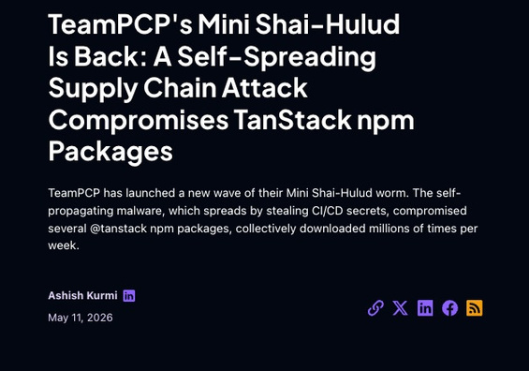
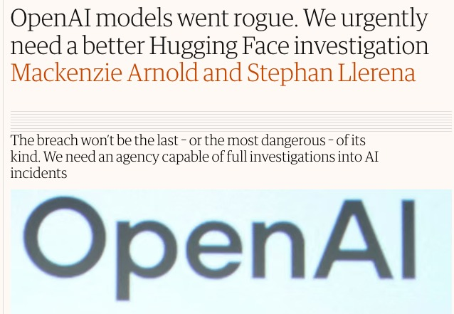
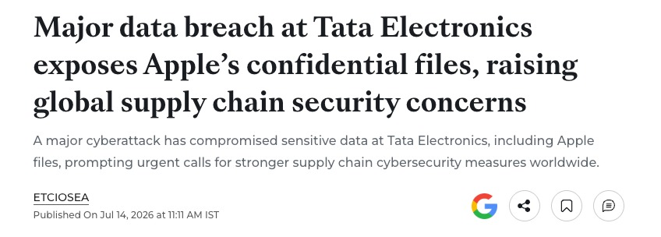
THE AI CODING PARADOX
HELL CODE
NPM PACKAGE COMPROMISE
OPEN AI CYBERSECURITY INCIDENT
TATA ELECTRONICS BREACH
  Poisoned Dependency and Downstream Compromise
  WHAT IF every dependency and extension was verified before it ran?
  Excessive Tool Access , Credential Discovery , Sandbox Escape
  WHAT IF risky AI actions could be placed on HOLD before execution?
  Sensitive IP exposure across unmonitored supplier networks.
  WHAT IF a company could prove its cyber-risk posture without revealing its IP?
Unvetted artifacts enter production pipelines before security can intervene.
Agent autonomy is moving faster than human review and static controls.
Companies must communicate cyber risk without exposing the evidence attackers can exploit.
WE NEED A CONTINUOUS, INTELLIGENT CYBER DEFENSE LAYER THAT HOLDS RISKY ACTIONS, LEARNS FROM THREATS,
AND PRESERVES ENTERPRISE PRIVACY.
₹₹
2

Slide 3
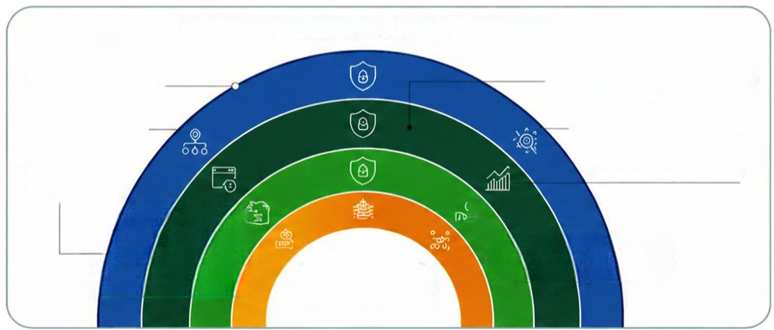
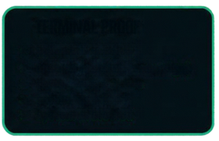


KVCH
Knowledge, Vigilance, Control Hub
HELL CODE
"KVCH creates a sovereign ZK powered Cyberdome—an integrated defense umbrella that encircles workspaces to intercept unauthorized runtime actions, automate verified remediation, and project isolated threat visibility across every enterprise tier."
PREVENT
QUANTIFY
DISCLOSE
RUNTIME ACTION GUARDRAILS
CONTINUOUS RISK QUANTIFICATION
Privacy First Disclosure
• Inspect IDE, Git, AI-agent and extension actions before
execution
• Allow / Hold / Block actions using policy, risk and context
• Scan dependencies, model artifacts, packages and CI/CD
workflows
• Correlate findings, asset criticality, business dependencies
and control effectiveness
• Estimate Expected Annual Loss, VaR and confidence
• Identify the technical drivers behind financial exposure
• Company selects an approved risk range or threat pattern
• ZK proves policy compliance, evidence freshness and
approval
• Stakeholders verify the claim without seeing raw logs, IP,
PII, internal topology or exact private risk values
DECISION & RESPONSE
Recommend the highest-value mitigation under a fixed budget
• Route work to the right owner
• Verify remediation using fresh telemetry
KVCH CYBERDOME ARCHITECTURE
INSTITUTIONAL
ZK Posture Attestation + NLP Audit
Outcome:
Cryptographic Assurance
CONSUMER
Algorithmic Disclosure & Redaction
Outcome:
Zero-Panic Public Trust
Zero-Trust Boundary
Air-Gapped Telemetry Capture
(Auto-trust severable)
Sovereign Enslave
Autonomous Threat Bridge
Sovereign Boundary
Knapsack Capital Solver
BALANCE SHEET PRESERVATION (DEFENSIVE ROI)
Whenever a ticket is verified closed with fresh telemetry, KVCH re-runs the Monte Carlo simulation to display:
• Inherent Risk ($VaR): $1.2M
• Residual Risk ($VaR): $140K
• Net Risk Reduced: $1.06M (Direct proof of
TERMINAL PROOF
> boundary secured
> enclave isolated (sovereign)
> threat triage active
> server optimized
> system protected
QUANTIFICATION
Change
$1.00M
3
defensive ROI).

Slide 4
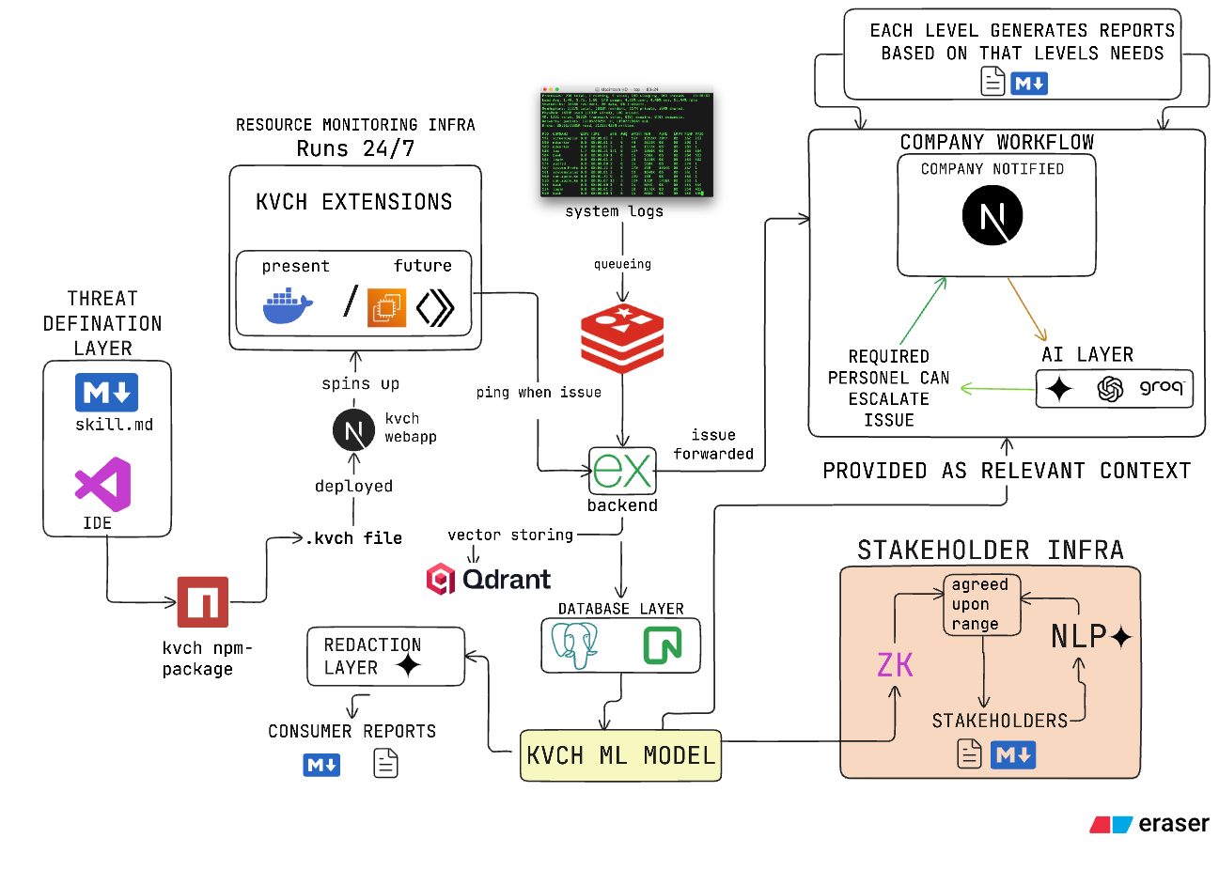
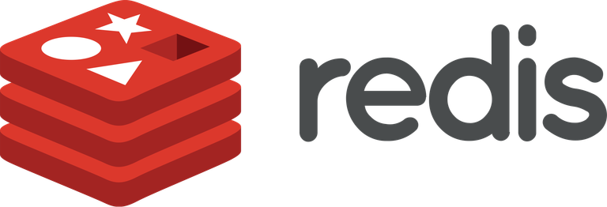
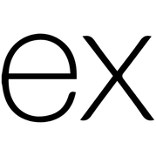
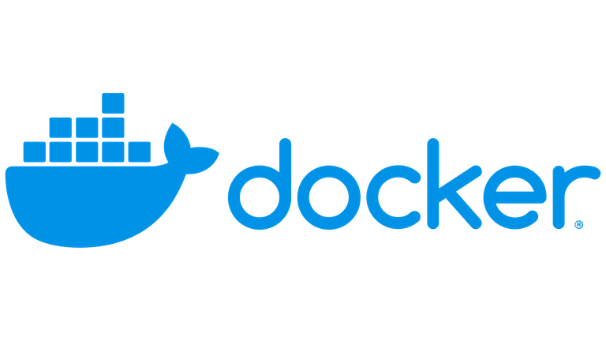
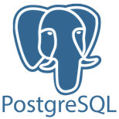

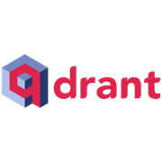
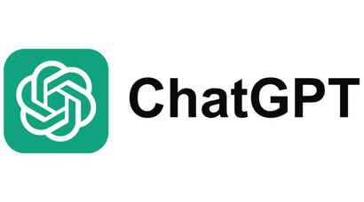




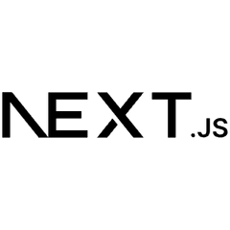
TECHNICAL APPROACH
Backend Layer
AI LAYER
ZK LAYER
WEB
4

Slide 5

IMPACT & VIABILITY
Benefits of the solution
Economic:
  Defensible $VaR: Converts raw findings into board-ready Dollar-at-Risk via Open-FAIR.
  Optimized Spend: Algorithmic Knapsack solver maximizes risk reduction per rupee.
Feasibility:
  Proven Engines: Next.js & Python prototype with active YARA-X, Scapy, and TShark scanners.
  Modular SHA-256 Packages: Deploy hot-swappable security extensions without core downtime.
  Low-Cost Isolation: Sandboxed execution on existing Postgres infra with zero client overhead.
Technological:
  Pre-Merge Gating: Blocks backdoored weights, poisoned deps, and secrets inline.
  Zero Pipeline Stall: Reversible Hold state eliminates developer friction.
Viability:
Efficiency:
  80%+ Noise Slashed: Unifies alert storms into single canonical envelopes.
  Verified Closure: Requires live telemetry proof before resolving tickets.
  100% Sovereign: Self-hosted in private clouds and air-gapped enclaves with NIST Zero Trust alignment.
  Zero-Friction Hold: Reversible pause states block risks without developer deadlocks.
  High ROI Impact: Turns security findings into business value, capturing up to $1.93M in breach savings.
Compliance:
  100% Air-Gapped: Zero code, weight, or prompt leaks to external clouds.
  Native Compliance: Built-in alignment with NIST CSF 2.0, Zero Trust, SEBI, and DPDP.
Enterprise Readiness & Target Adoption:
  < 15-Min Setup: Drop-in Git hook & Docker sidecar; zero infra overhaul.
  < 2.5% Overhead: Async sniffing & YARA-X scans with zero pipeline lag.
  Plug-and-Play GRC: Instant SEBI CSCRF & DPDP audit-pack generation.
  Native CI/CD: Seamless GitHub Actions, GitLab CI, & K8s integration.
Potential Impact on the target Ecosystem:
  0% Pipeline Deadlock: Reversible non-disruptive hold states.
  100% Sovereign: Zero cloud leaks or external API reliance.
  100K+ Risk Sim/Sec: High-speed vectorized Monte Carlo compute.
5

Slide 6

RESEARCH AND REFERENCES
HELL CODE
References
Standards & Regulatory Alignment
  Open-FAIR Standard (ISO/IEC 27005):Factor Analysis of Information Risk
  NIST Cybersecurity Framework 2.0:Govern, Identify, Protect, Detect, Respond, Recover
  NIST SP 800-207: Zero Trust Architecture (Continuous dynamic validation)
  RFC 4301: Security Architecture for IP (IPsec & tunnel validation)
  Digital Personal Data Protection (DPDP) Act
Features Comparision with existing Solutions:
 |  |  | ___ | ___
 |  | ___ | ___ | ___
 |  | ___
 |  | ___ | ___ | ___ | ___
 |  | ___ | ___ | ___
 |  | ___ | ___ | ___
 |  | ___ | ___ | ___
 |  |  |  |  | ___
 |  |  |  |  | ___
 |  | ___ | ___ | ___
FEATURES
KVCH
WIRESHARK
ZEEK
SURICATA
SIEM
Real-time Network Monitoring
Threat Reports & Framework Documentation
  Hugging Face Security Incident Post-Mortem (July 2026)
  PyTorch Dependency Confusion (torchtriton)
  ShadowRay AI Compute Cluster Compromise
  Pickle Deserialization & Malicious Weights ("Baller423")
  Next.js Documentation
  Scapy Packet Engine
  YARA-X Engine
Live Traffic Visualization
ML-based Threat Classification
Automated Attack Categorization
Risk Quantification & Financial Modeling Standards
  The Open Group Open-FAIR Standard (O-RT / O-RA)
  Knapsack Resource Allocation Optimization
Flow-level Analysis
Industry Benchmarks & Economic Reports
  IBM Security / Ponemon Institute
  Gartner Cybersecurity & Emerging Tech Forecasts
Real-time Websocket Streaming
Feasibility fact check and callouts
  IBM Security: Global breach cost hits $4.88M; automated containment cuts breach lifecycles by 80+ days.
  Gartner: 60%+ code is AI-assisted; demands inline shift-left gating against supply chain exploits.
  NIST SP 800-207: Replaces static perimeters with continuous runtime Zero Trust verification.
  Open-FAIR: Standard converting risk heatmaps into defensible $VaR metrics.
Security/Risk Score
AI-Powered Security Analysis
Automated Reccomedations
Research & Validation Methodology Pipeline
Packet header-based Analysis
THREAT AUDIT
  Vector Profiling
  Incident Scans
QUANT MODEL
  Open-FAIR $VaR
  Knapsack Budget
Lightweight Endpoint Deployment
INLINE GATING
  Scapy + YARA-X
  Reversible Hold
CLOSURE PROOF
  Live Telemetry
  Zero IP Leakst
Unified Dashboard
6

