Slide 1
PAYMAP
Programmable
payments.
User control.
Non-custodial recurring payments on Stellar.
BOUNDED
AUTHORITY
Level 5 submission deck · July 2026
PAYMAP · LEVEL 5
01
Notes:
Open with the user promise: recurring payments without surrendering wallet custody.
Sources:
- https://github.com/SachPlayZ/Paymap

Slide 2
PROBLEM
Recurring crypto payments force a bad tradeoff.
Automation usually means custody, unlimited approvals, or repeated manual signing.
01
02
03
Custody risk
Unlimited approval
Poor recovery
Merchants or intermediaries may control funds or keys.
Blanket token allowances expose more than one payment.
Users struggle to pause, revoke, or understand failed charges.
PAYMAP · LEVEL 5
02
Notes:
Frame the product around a clear trust boundary, not a generic payments pitch.
Sources:
- https://github.com/SachPlayZ/Paymap/blob/main/docs/threat-model.md
- https://github.com/SachPlayZ/Paymap/blob/main/docs/contract-invariants.md

Slide 3
SOLUTION
A mandate defines exactly what may happen.
The user signs bounded terms once; merchants request charges inside those limits.
1
2
3
Authorize
Charge
Control
Payer sets merchant, asset, amount, cadence, caps, and expiry.
Relayer submits a merchant request. Contract verifies every bound.
Payer can inspect, pause, resume, or revoke from the dashboard.
PAYMAP · LEVEL 5
03
Notes:
Walk through the three-step user model. Emphasize that the relayer has zero spending authority.
Sources:
- https://github.com/SachPlayZ/Paymap/blob/main/docs/architecture.md
- https://github.com/SachPlayZ/Paymap/blob/main/docs/security-checklist.md

Slide 4
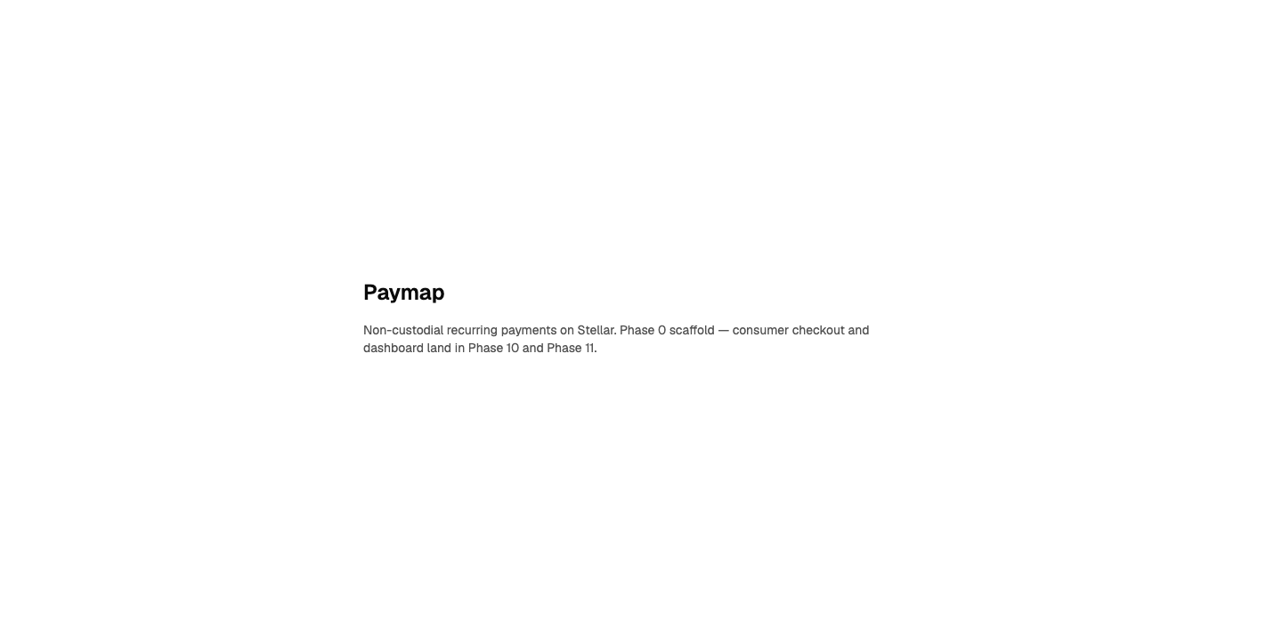
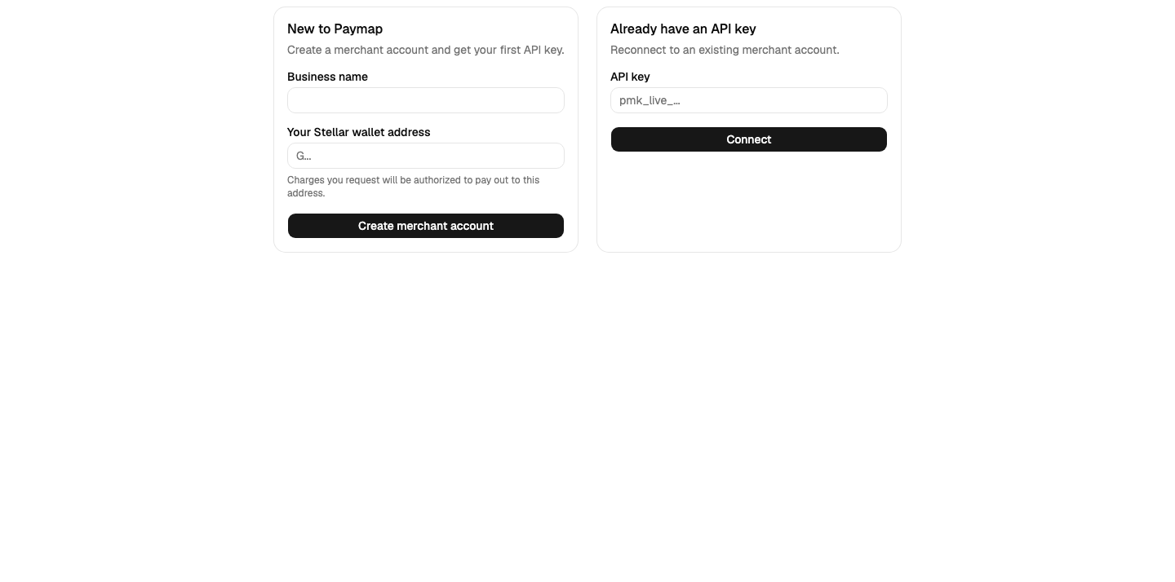
PRODUCT
One product, two clean journeys.
Consumers manage mandates. Merchants create checkout links and request eligible charges.
CONSUMER
MERCHANT
Inspect and control every mandate.
Create payment flows without custody.
PAYMAP · LEVEL 5
04
Notes:
Demo both roles. Start at the public frontend, then enter the merchant connection flow.
Sources:
- https://paymap-web.vercel.app
- https://paymap-web.vercel.app/merchant/connect

Slide 5
ARCHITECTURE
Authorization stays on-chain; operations stay observable.
A separated frontend, API, queue, relayer, indexer, and contract keep trust boundaries explicit.
Frontend
Merchant API
Queue + Relayer
Soroban Contract
Indexer
Vercel
Render
Render
Stellar Testnet
Payments + events
Payer signature
Scoped API key
Zero spending authority
Bounded enforcement
Confirmed state
PAYMAP · LEVEL 5
05
Notes:
Explain the request path, then the confirmed-chain reconciliation path. The API never invents payment state.
Sources:
- https://github.com/SachPlayZ/Paymap/blob/main/docs/architecture.md
- https://developers.stellar.org/docs/networks

Slide 6
TECHNICAL PROOF
A working testnet system—not a slideware prototype.
Evidence already in the repository; growth evidence remains a separate Level 5 gate.
20+
8
3
MEANINGFUL COMMITS
WEBHOOK EVENT TYPES
SCHEDULED RETRY WINDOWS
LIVE
paymap-web.vercel.app
Testnet transaction hashes and E2E results are linked in the README.
PAYMAP · LEVEL 5
06
Notes:
Show the live application and repository evidence. Do not present 50-user growth as complete until genuine responses exist.
Sources:
- https://github.com/SachPlayZ/Paymap
- https://paymap-web.vercel.app
- https://github.com/SachPlayZ/Paymap/blob/main/docs/demo-script.md

Slide 7
MARKET + GROWTH
Start where trust blocks repeat usage.
Focus on teams already accepting stablecoins but missing safe recurring authorization.
01
02
03
Subscriptions
Installments
Platforms
SaaS, creator memberships, and recurring services.
Education, commerce, and milestone-based plans.
Marketplaces and tools embedding merchant payments.
ACQUIRE
Merchant pilots → shared checkout links → verified user cohorts → integration partners
PAYMAP · LEVEL 5
07
Notes:
This is a focused go-to-market hypothesis, not a market-size claim. Validate segments through the Level 5 feedback cohort.
Sources:
- https://github.com/SachPlayZ/Paymap/blob/main/docs/roadmap.md

Slide 8
ROADMAP
Convert feedback into measured product decisions.
Every phase has an evidence gate and a linked implementation commit.
NOW
NEXT
THEN
50-user cohort
Feedback iteration
Production hardening
Collect wallets, ratings, use cases, and verified testnet transactions.
Rank friction by frequency and severity. Ship onboarding and reliability fixes.
Load/failure testing, alerting, recovery drills, and mainnet readiness review.
PAYMAP · LEVEL 5
08
Notes:
Describe the feedback loop: collect, analyze, prioritize, implement, verify, link the commit.
Sources:
- https://github.com/SachPlayZ/Paymap/blob/main/docs/level-5/google-form-spec.md
- https://github.com/SachPlayZ/Paymap/blob/main/docs/level-5/submission-evidence.md

Slide 9
PAYMAP
Recurring payments
without surrendering
control.
Live demo
Repository
paymap-web.vercel.app
github.com/SachPlayZ/Paymap
Built on Stellar · Testnet evidence linked in README
Notes:
End with the live product. Then run the demo flow from the walkthrough script.
Sources:
- https://paymap-web.vercel.app
- https://github.com/SachPlayZ/Paymap

