Slide 1
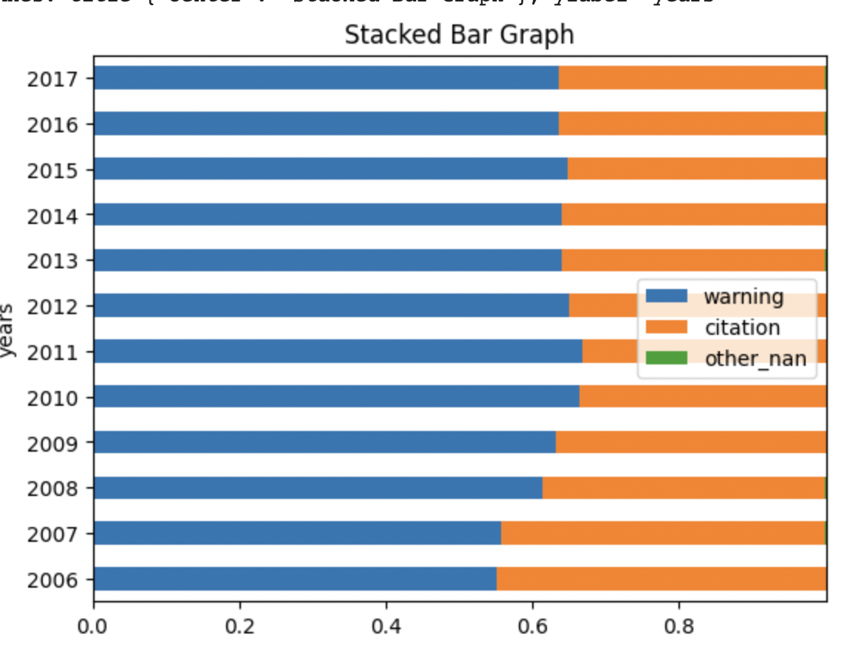
Variable definition:
"citation" = 1 means citation only OR citation + warning -> used as our target variable in the model
"Outcome" = 'citation' -> citation only OR citation + warning
= 'warning' -> warning only
A drop in citation rate = an increase in warning (only) rate.

Slide 2
border counties and non-border counties

Slide 3
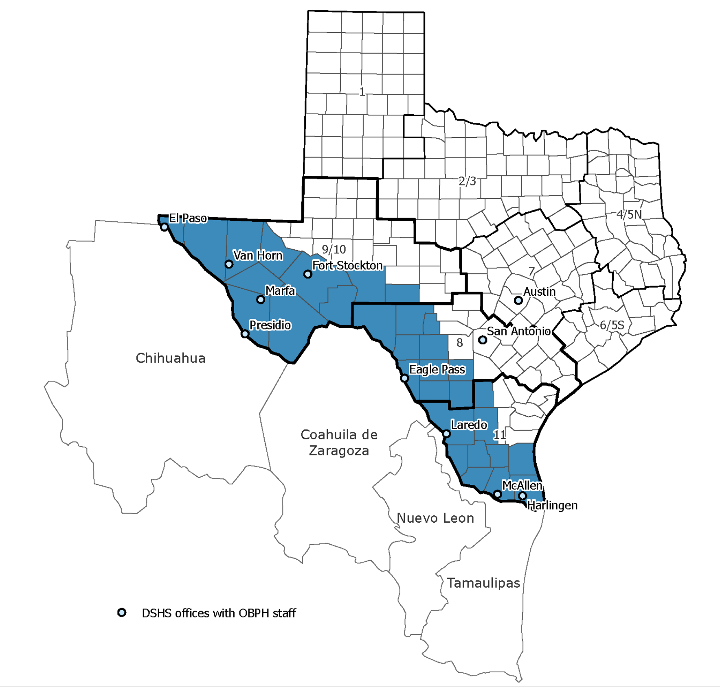
https://www.dshs.texas.gov/regional-local-health-operations/texas-border-health/map-dshs-border-area
The Department of State Health Services (DSHS) border area is defined as the area within 100 kilometers (or 62 miles) of the Rio Grande in the La Paz Agreement of 1983. This includes the 32 Texas Border Counties listed below and Mexico.

Slide 4
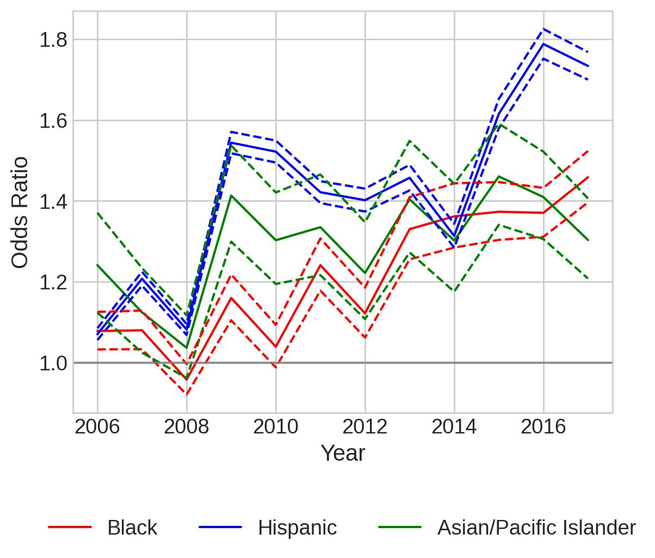
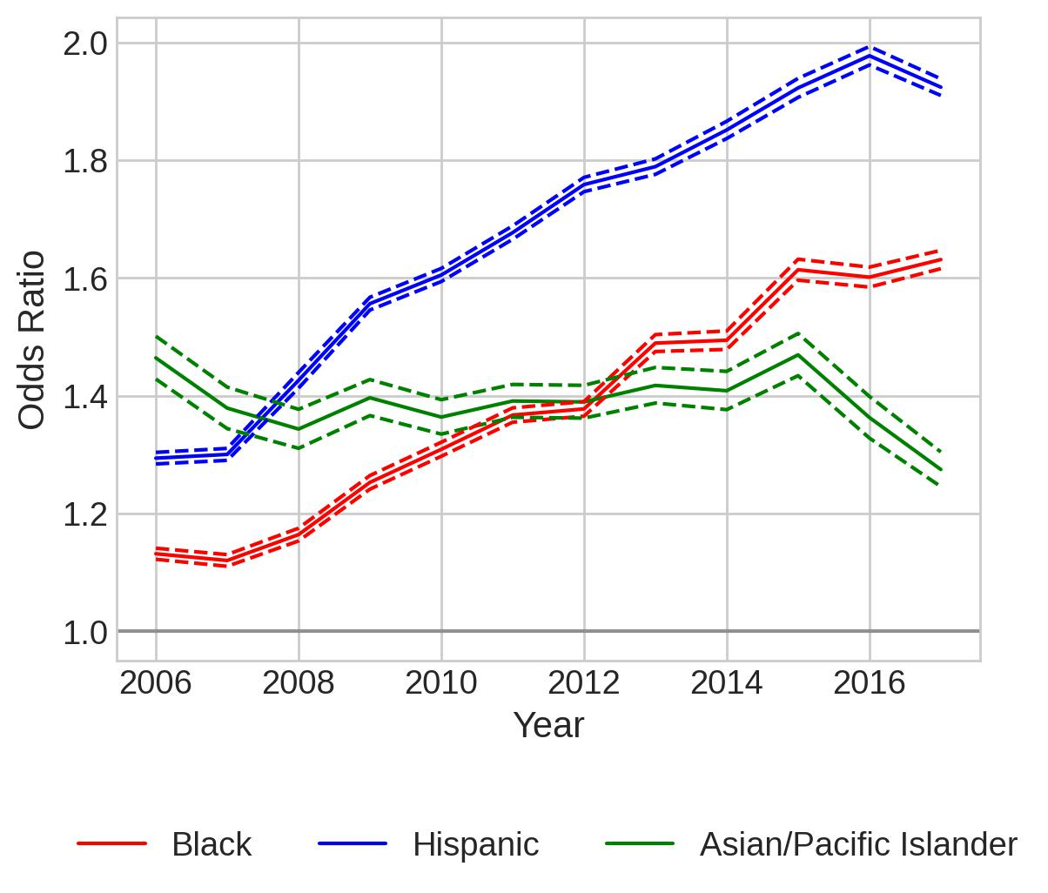
Separate Models for Border Counties and Non-border Counties
All Stops, Citation
Border Counties
Non-border Counties

Slide 5
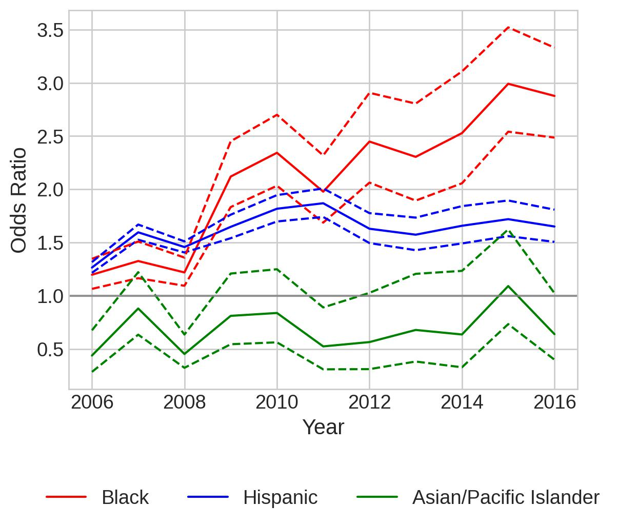
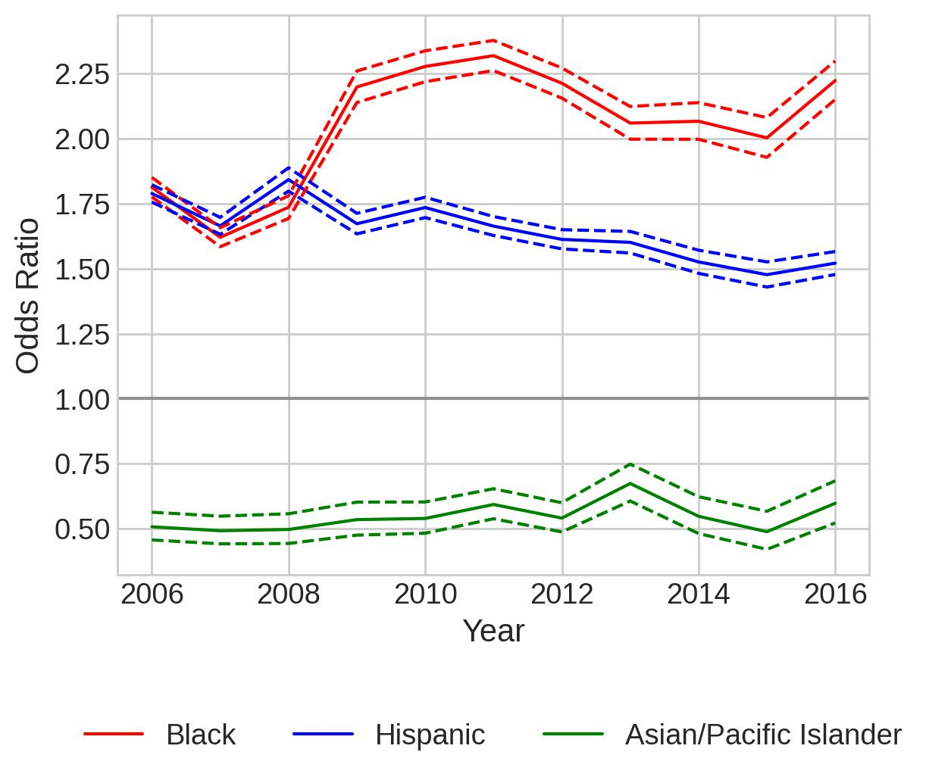
Separate Models for Border Counties and Non-border Counties
All Stops, Search
Border Counties
Non-border Counties

Slide 6
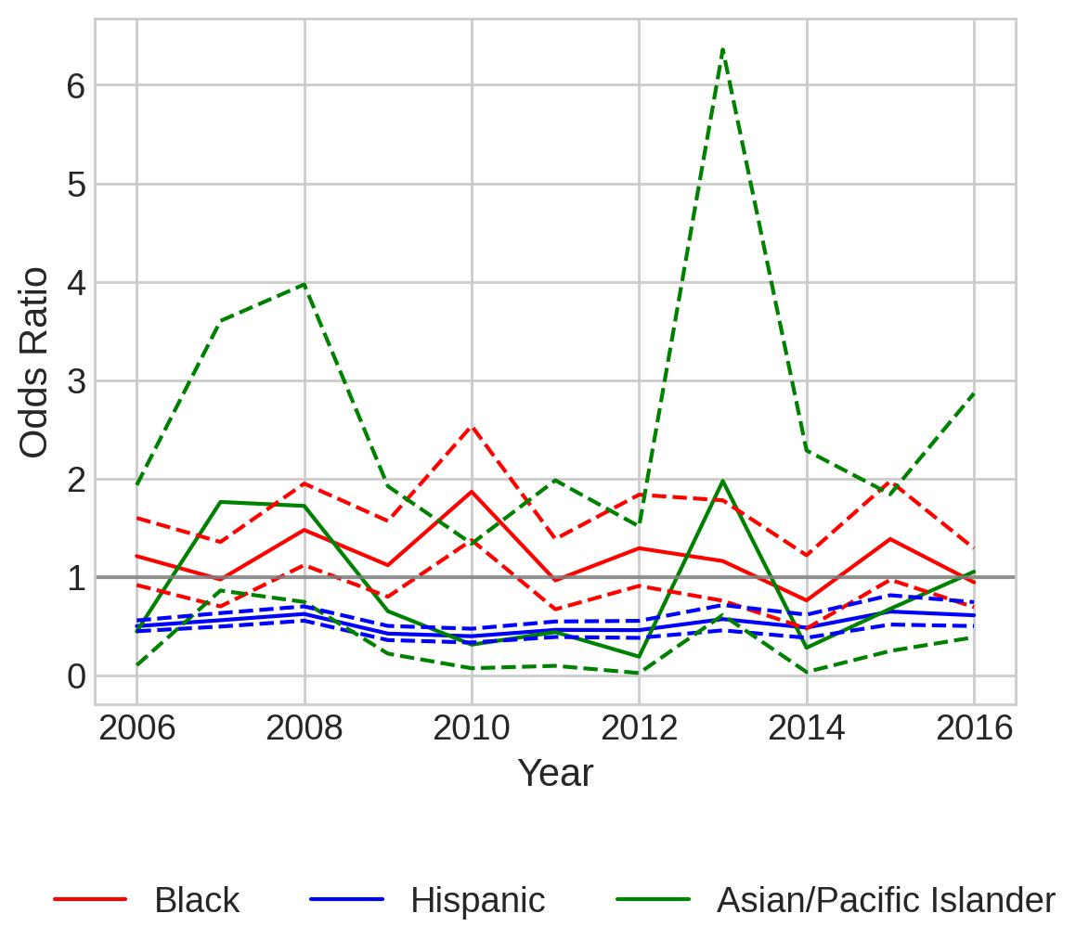
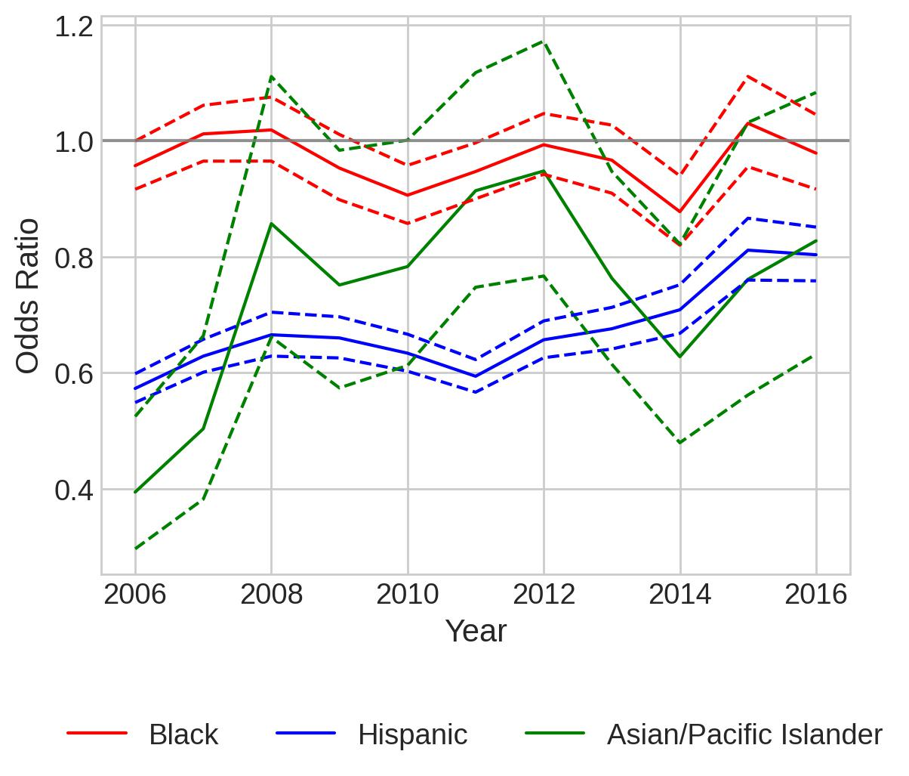
Separate Models for Border Counties and Non-border Counties
All Stops, Contraband
Border Counties
Non-border Counties

Slide 7
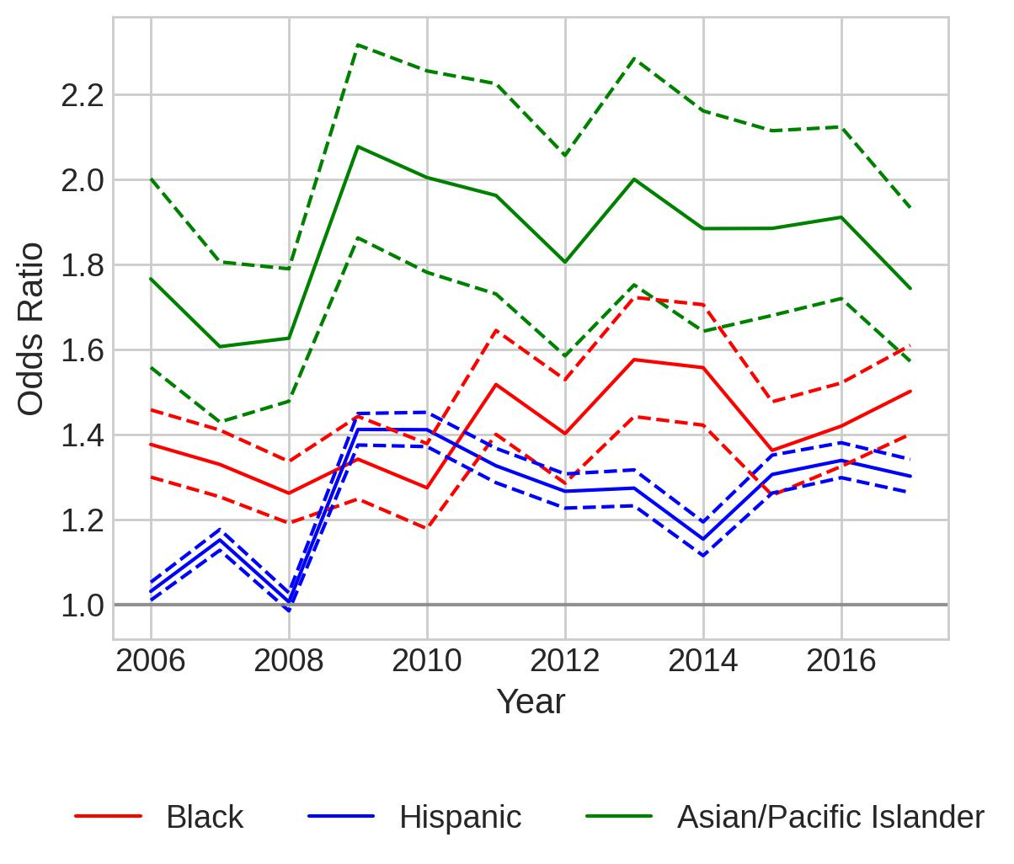
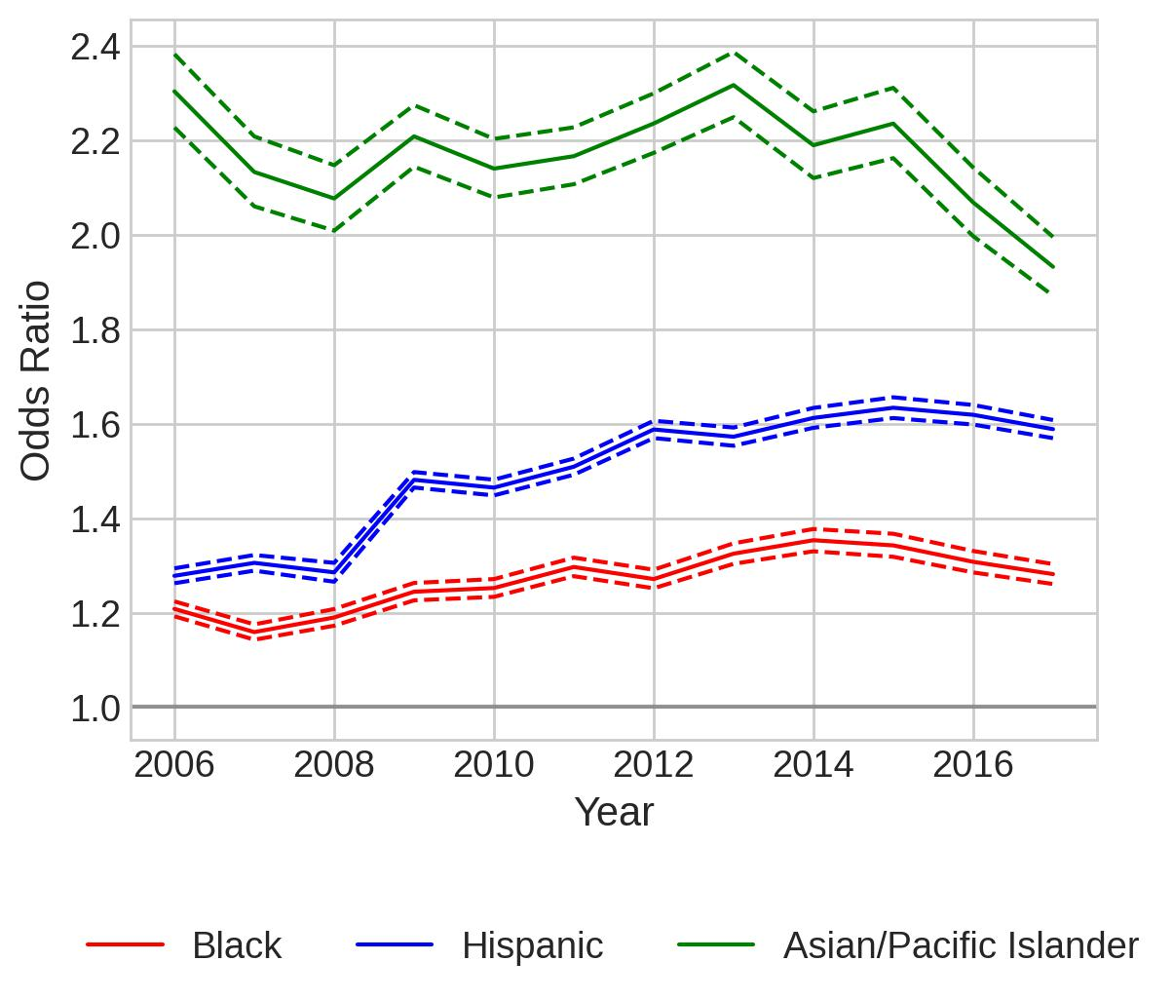
Separate Models for Border Counties and Non-border Counties
Speeding-only, Citation
Border Counties
Non-border Counties

Slide 8
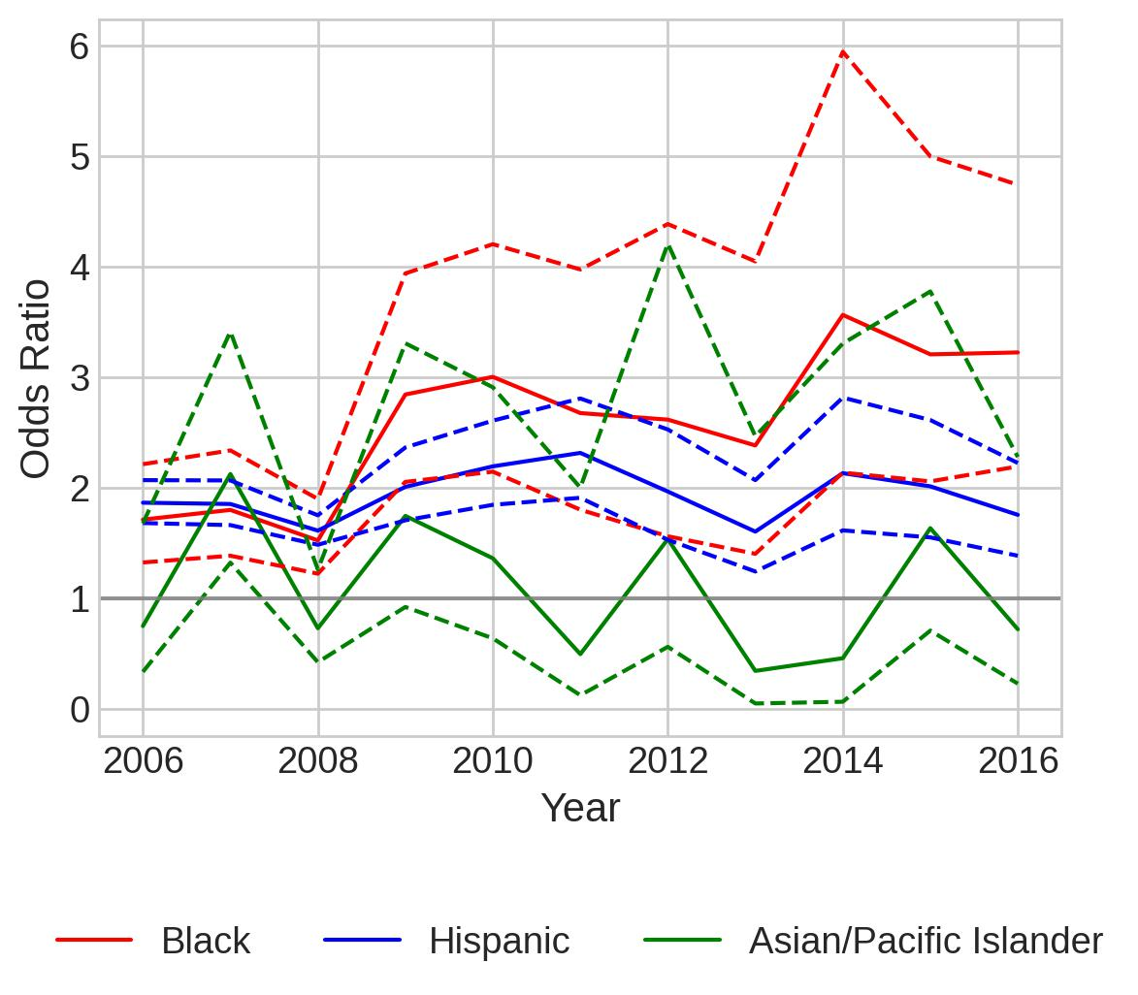
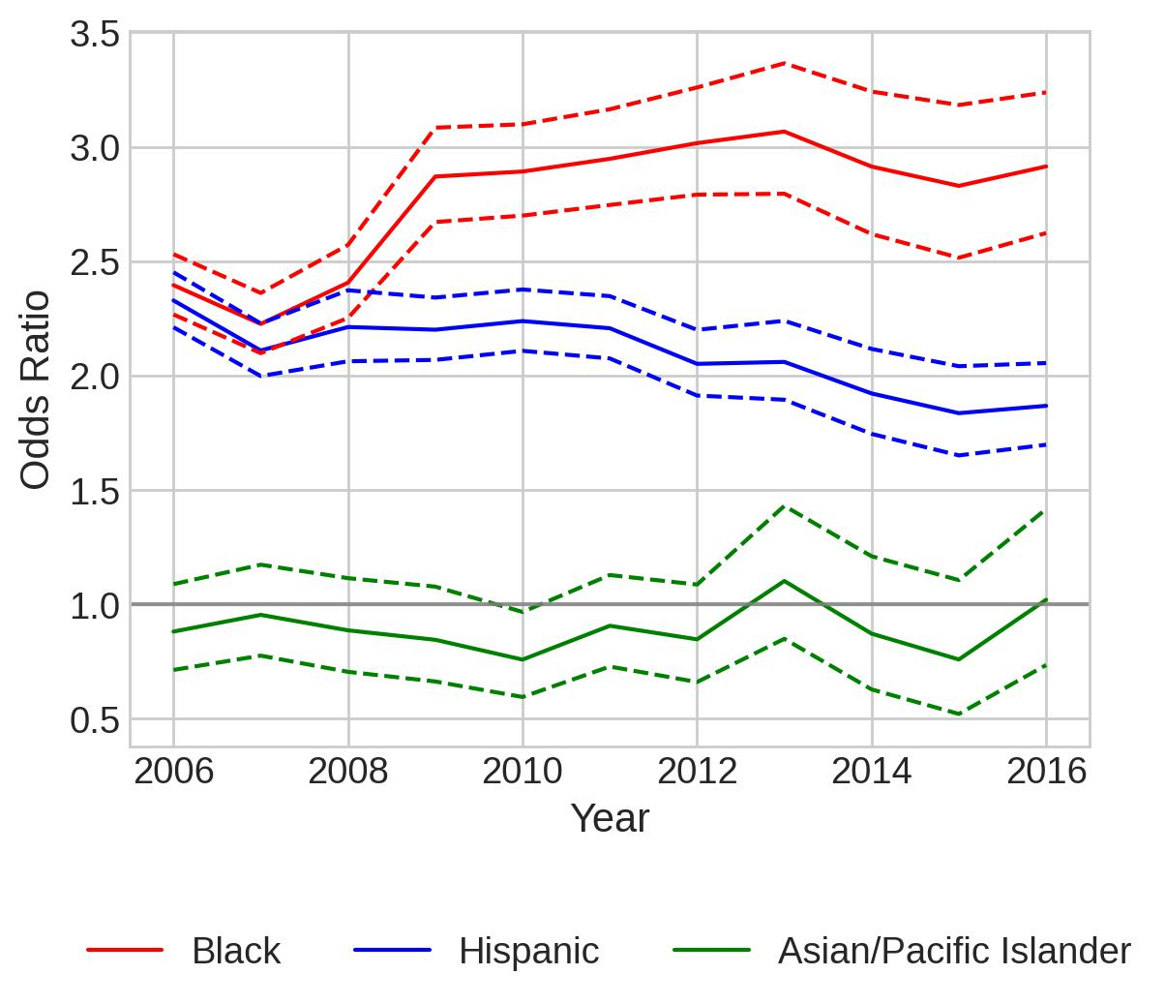
Separate Models for Border Counties and Non-border Counties
Speeding-only, Search
Border Counties
Non-border Counties

Slide 9
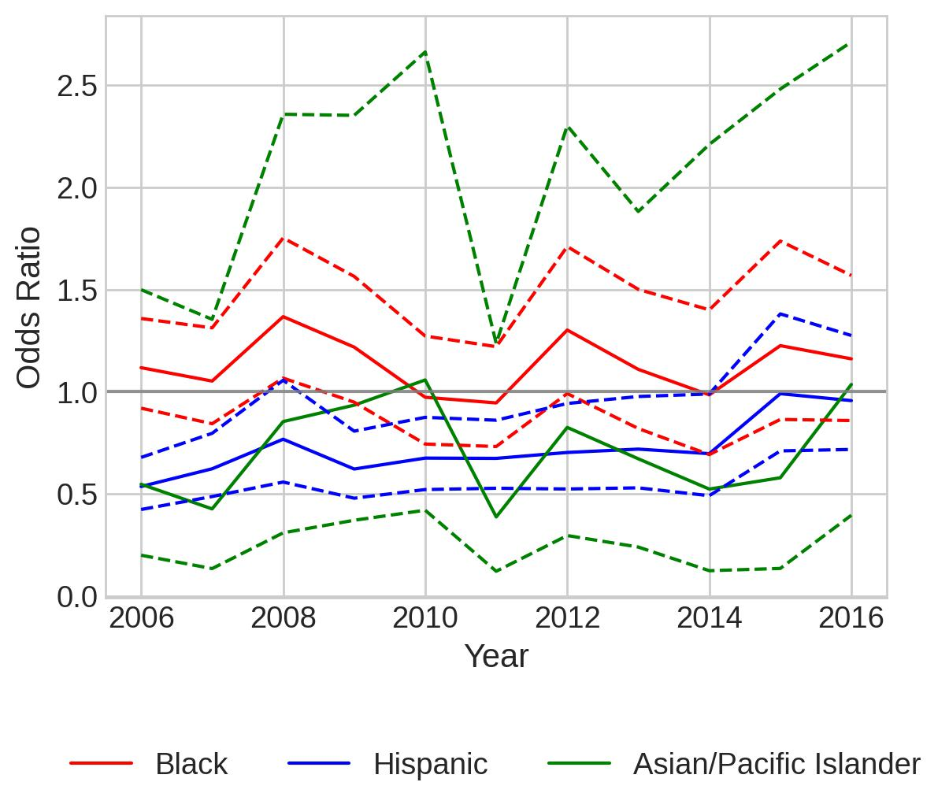
Separate Models for Border Counties and Non-border Counties
Speeding-only, Contraband
Border Counties
Non-border Counties
Warning: Maximum number of iterations has been exceeded.

Slide 10
Serious Offenses

Slide 11
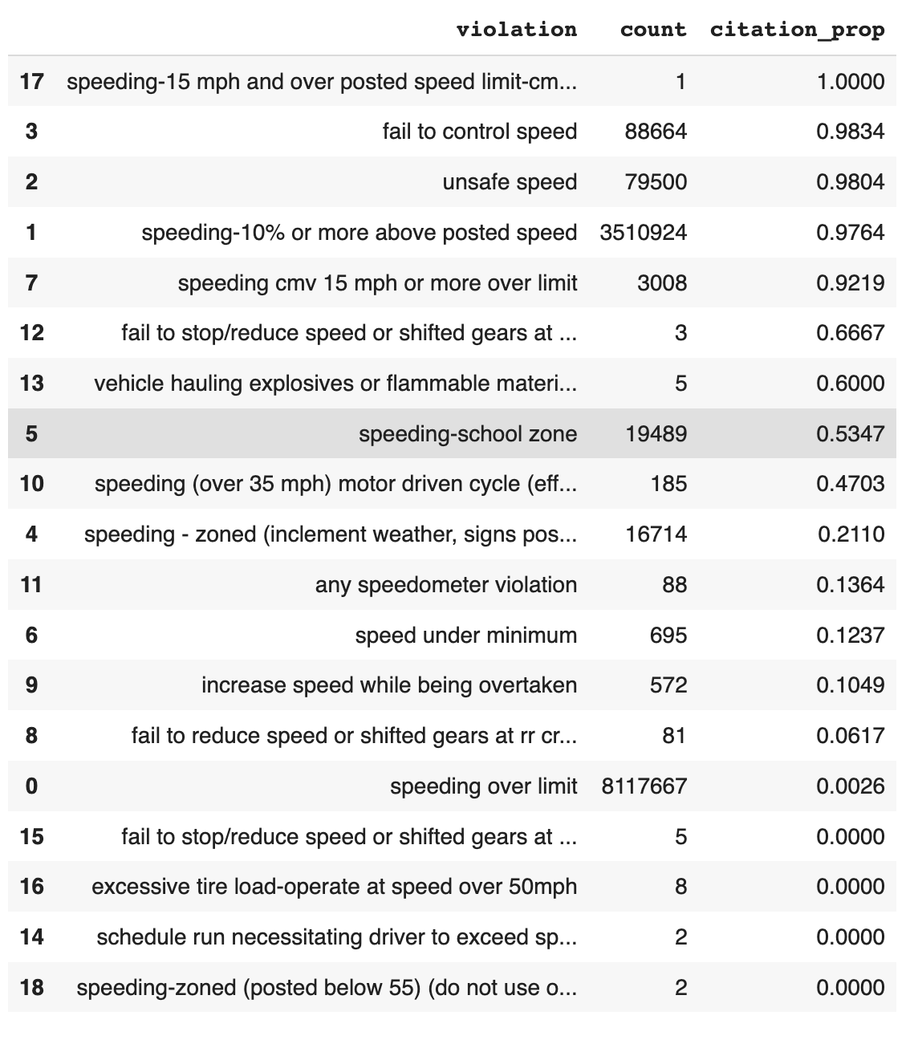
serious_speeding_violations = [
'fail to control speed',
'unsafe speed',
'speeding-10% or more above posted speed',
'speeding cmv 15 mph or more over limit'
]

Slide 12
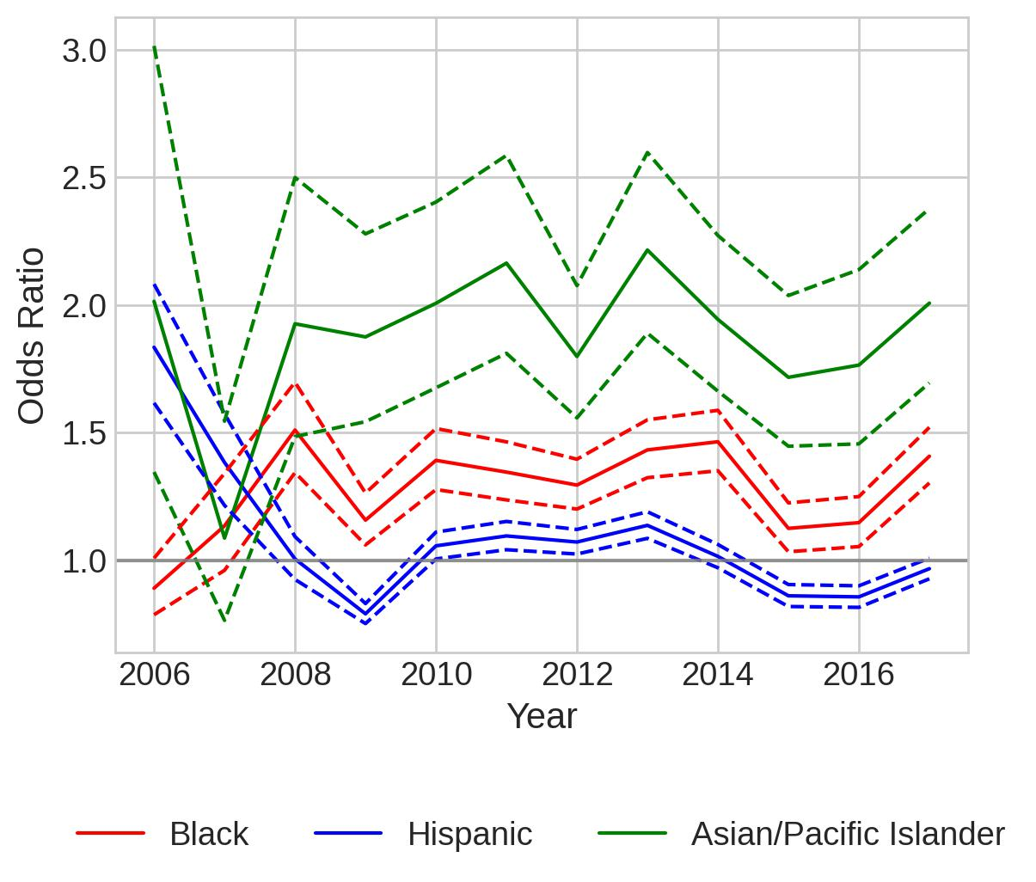
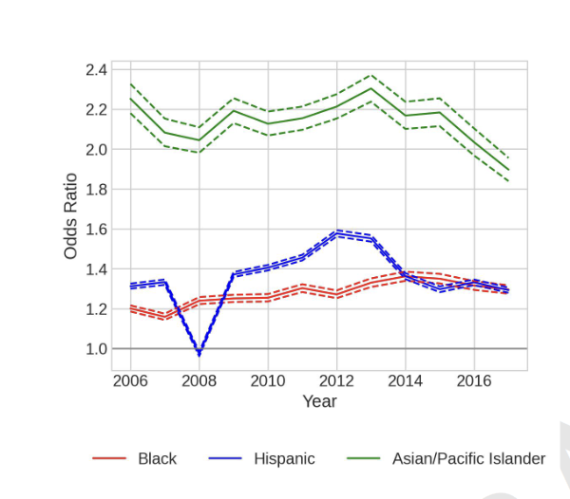
Citation
Model for most serious speeding offenses
Model for all speeding-only stops

Slide 13
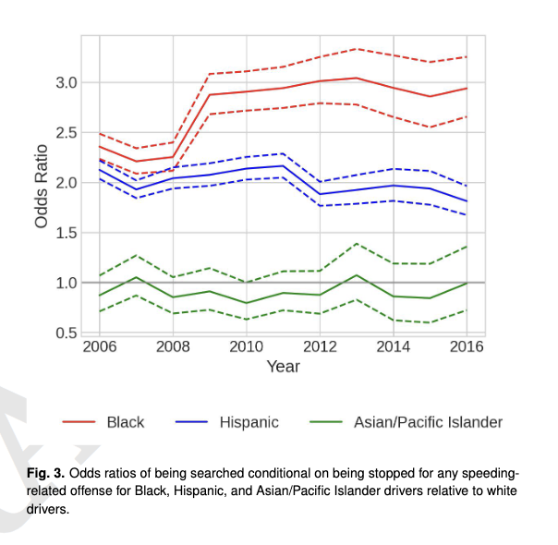
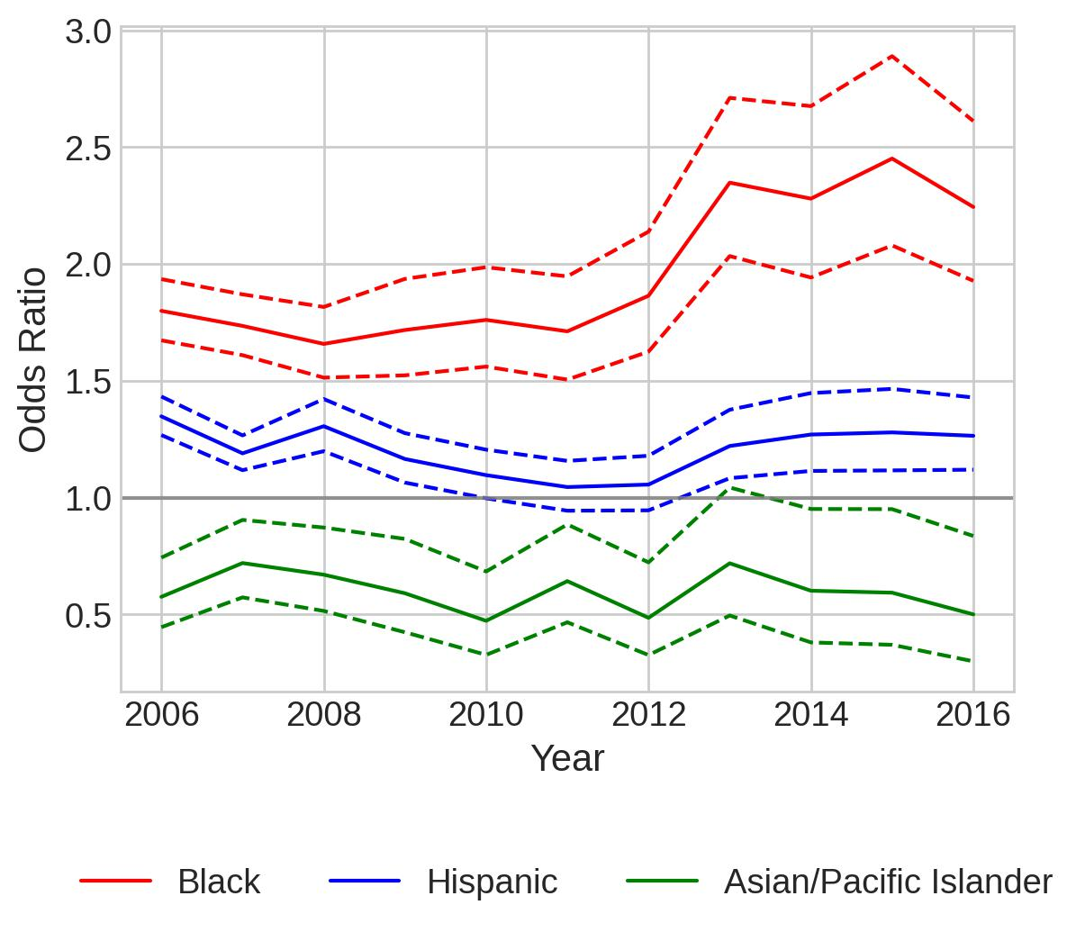
Search
Model for all speeding-only stops
Model for most serious speeding offenses

Slide 14
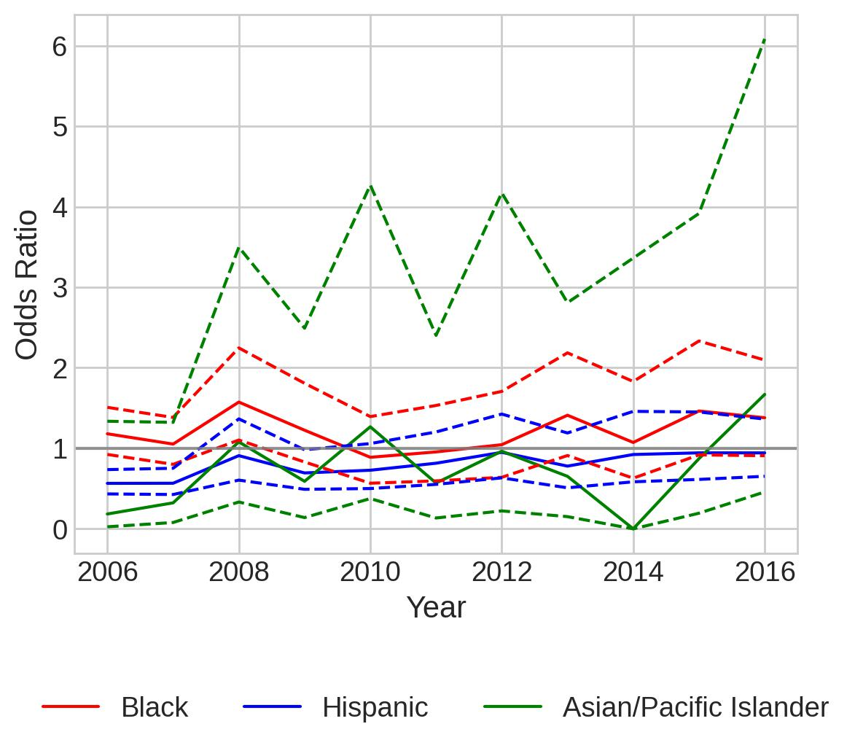
Model for most serious speeding offenses
Contraband

Slide 15
Demographics

Slide 16
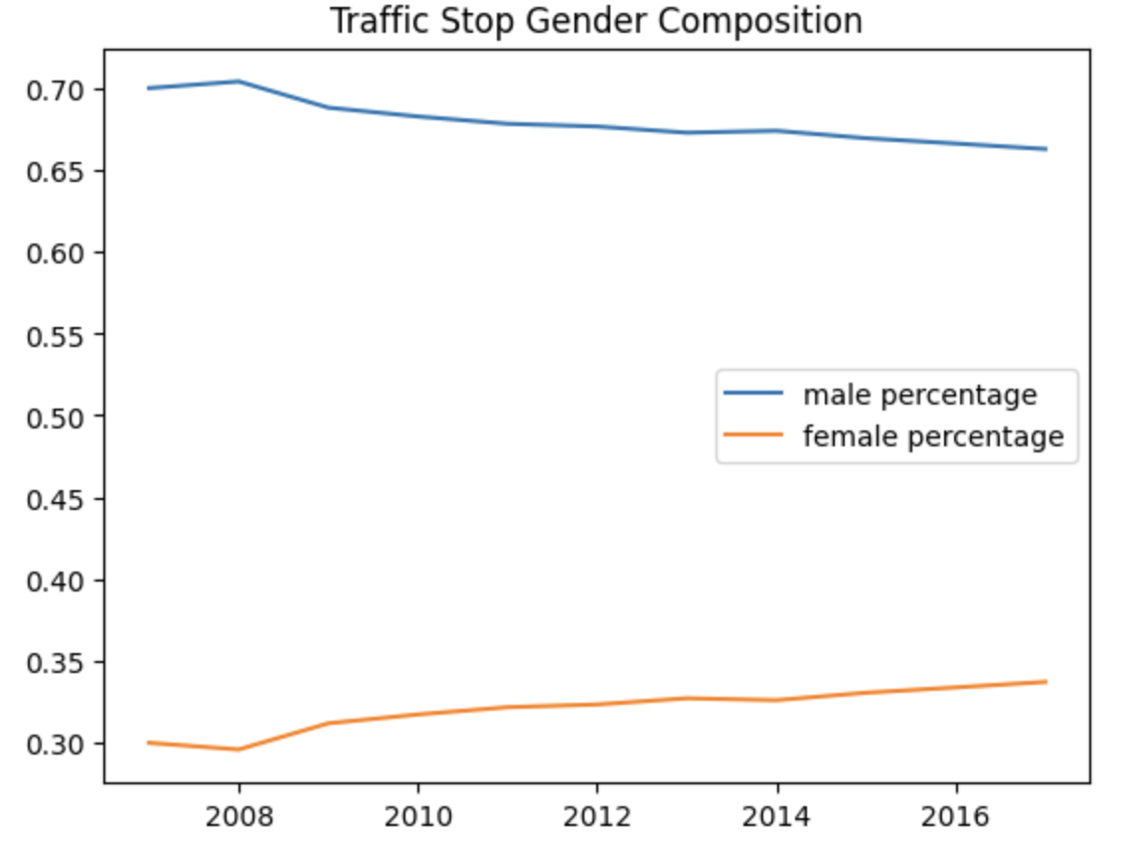
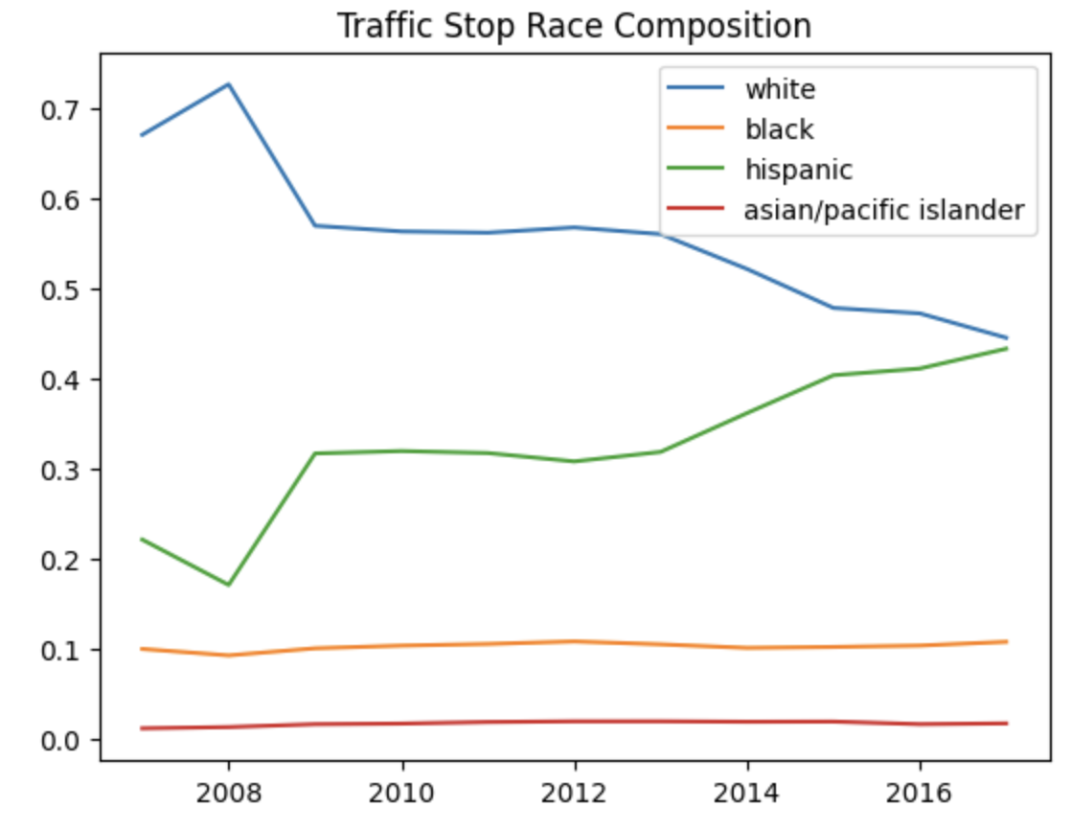
Descriptive Stats of the Demographics from the Stops Data
Source 1: Percent of male drivers of all licensed drivers(2019): 49.5%; female: 50.50%;
Source 2: In 2020 license issued applications: no "hispanic", white 77.6%, black 12.3%, asian 2.9%; female 31%, male 69%
Source: https://www.fhwa.dot.gov/policyinformation/statistics/2019/pdf/dl1c.pdf
https://www.dps.texas.gov/sites/default/files/documents/rsd/ltc/reports/2020calendar/byrace_sex/1licenseapplicationsissued.pdf
https://www.dps.texas.gov/sites/default/files/documents/rsd/ltc/reports/2019fiscal/byrace_gender/2licenseapplicationsdenied.pdf

Slide 17
Separate Model for metropolitan, micropolitan, and non-core

Slide 18
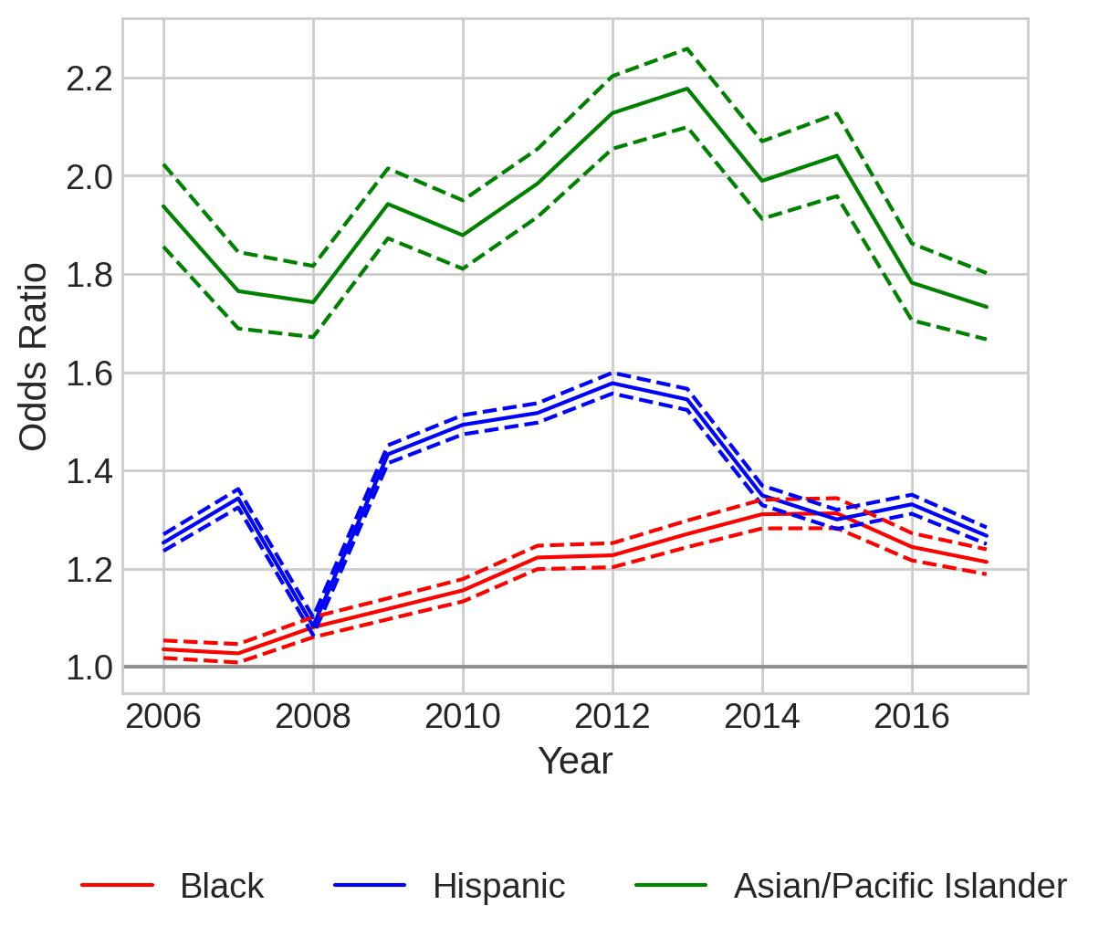
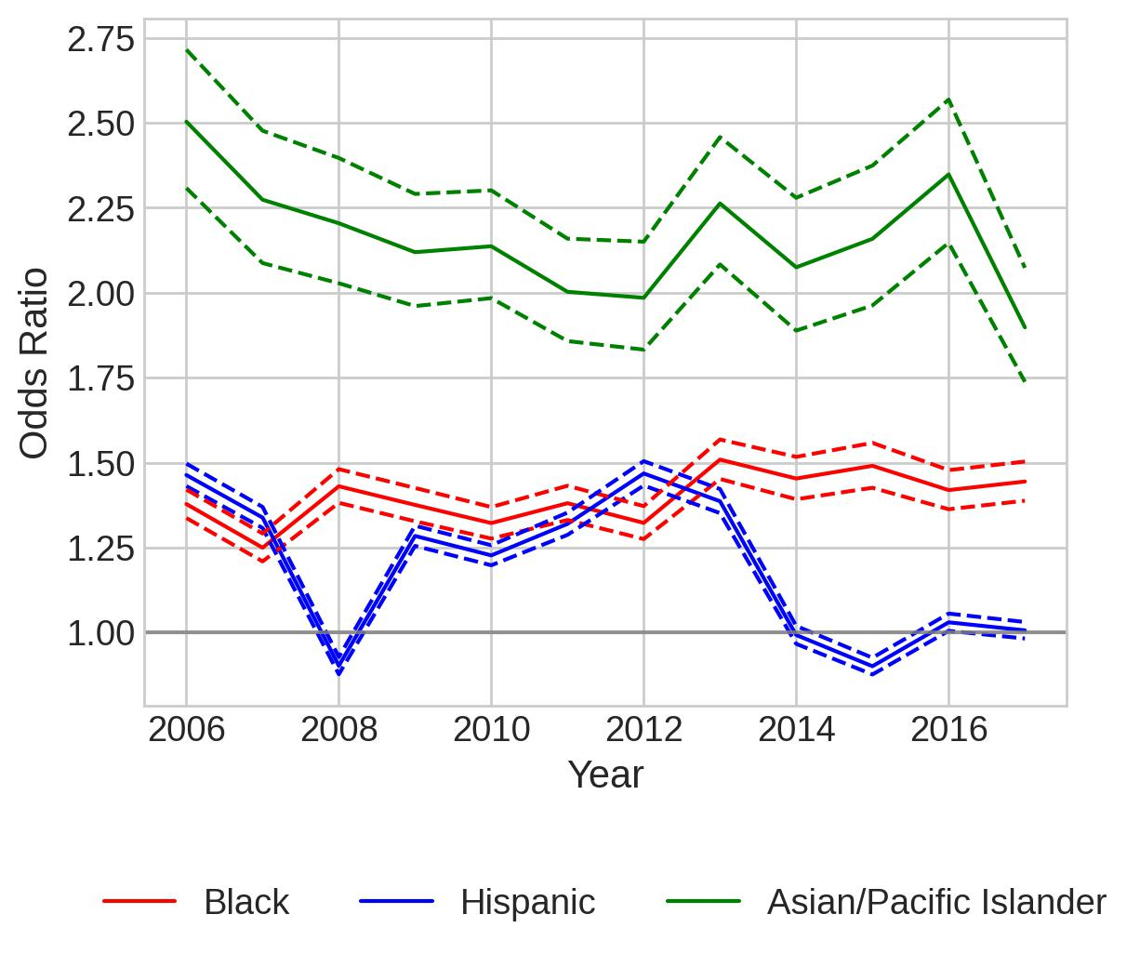
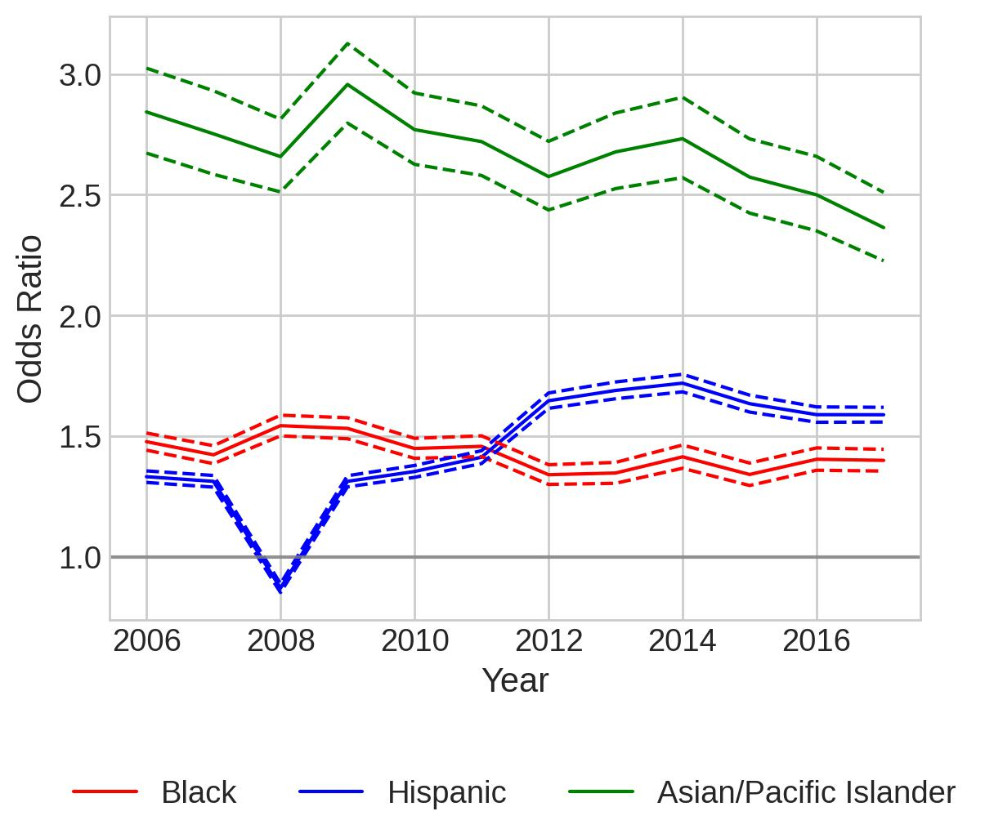
(speeding-only) Separate Logistic Regression Models and Odds Ratio Plots for Metropolitan, Micropolitan, and Non-core
citation
Metropolitan
Micropolitan
Noncore

Slide 19
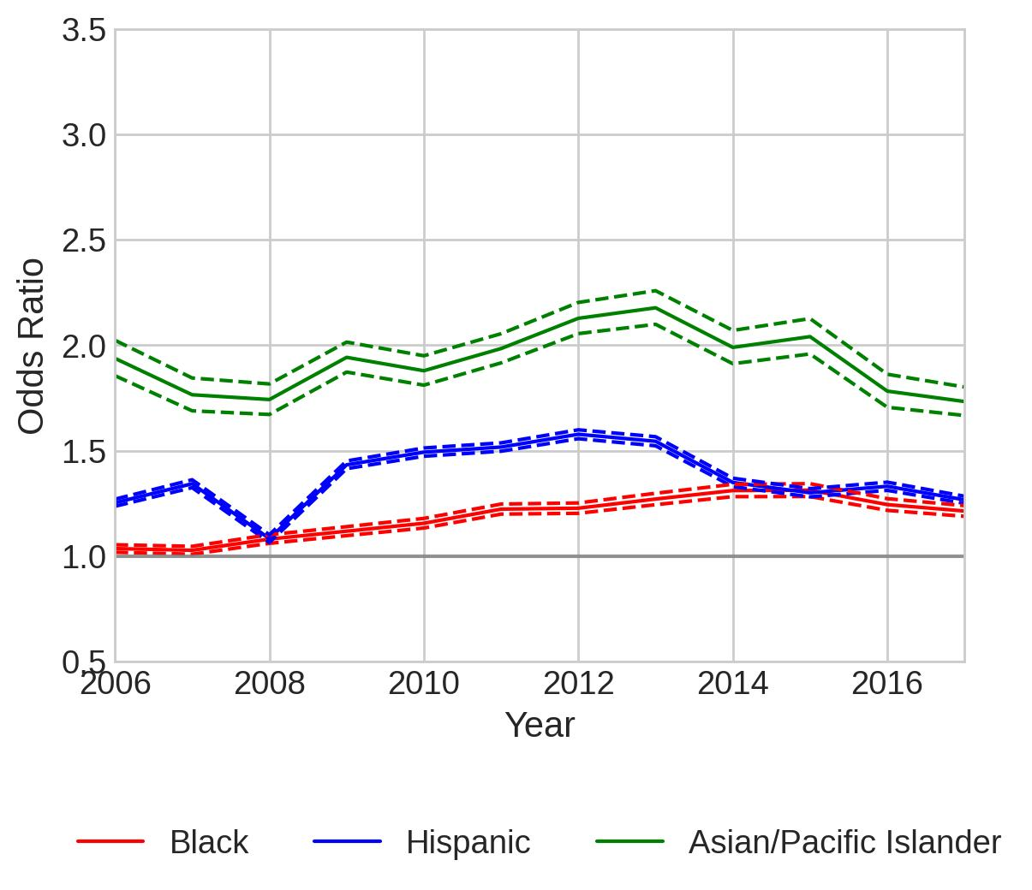
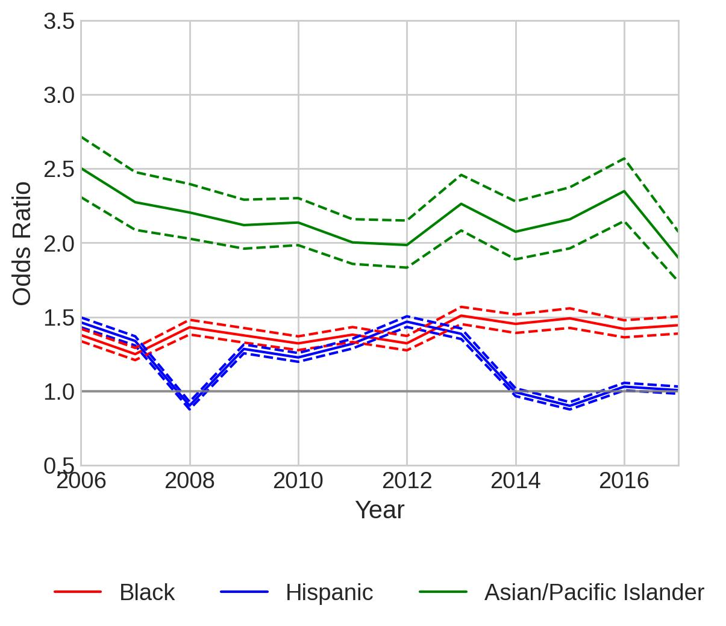
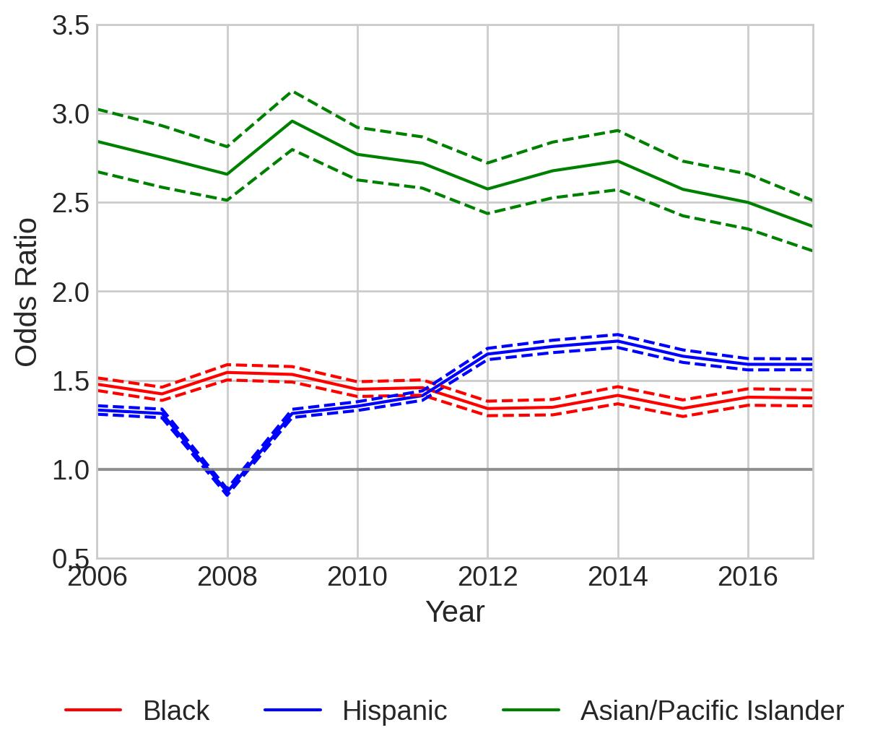
Same plots as the slide before. Add to paper(same y axis)
Metropolitan
Micropolitan
Noncore
(a)
(b)
(c)

Slide 20
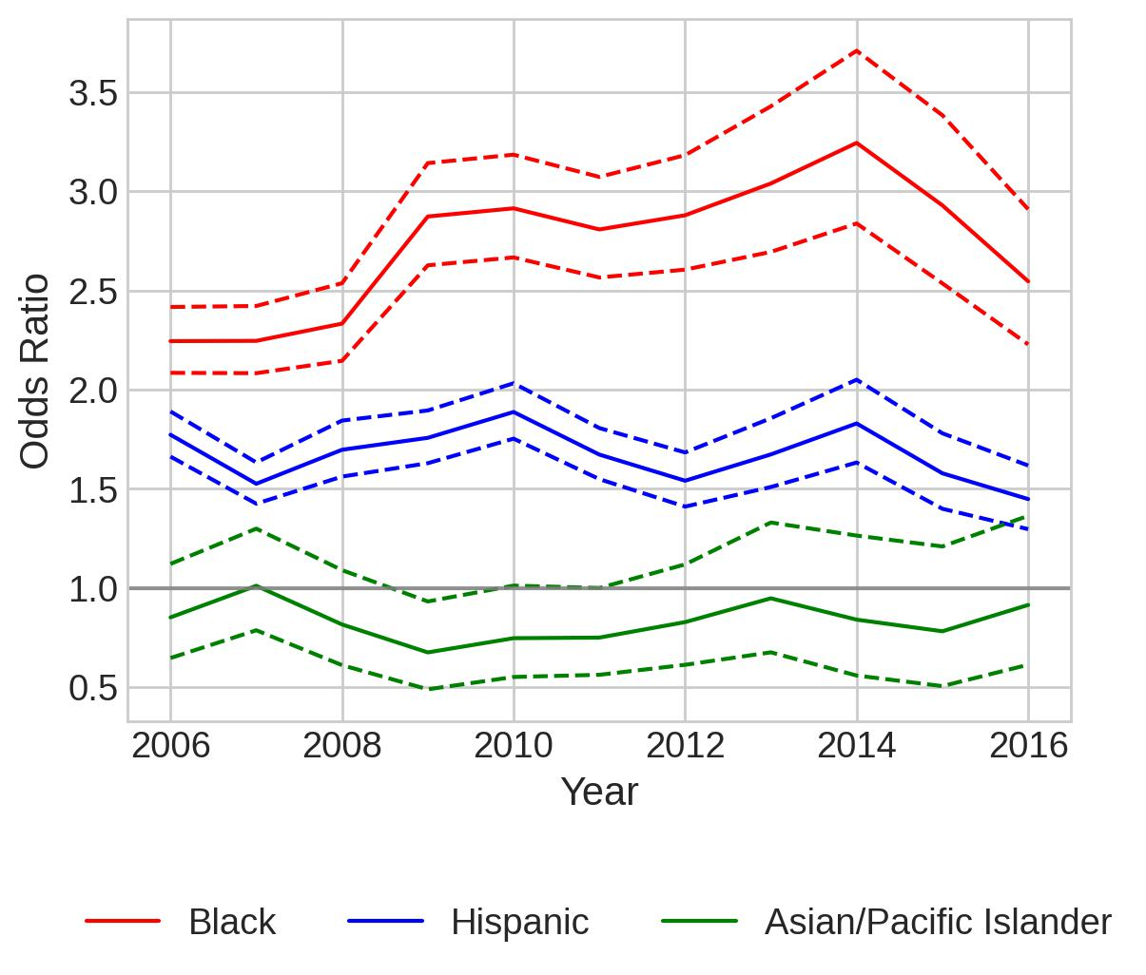
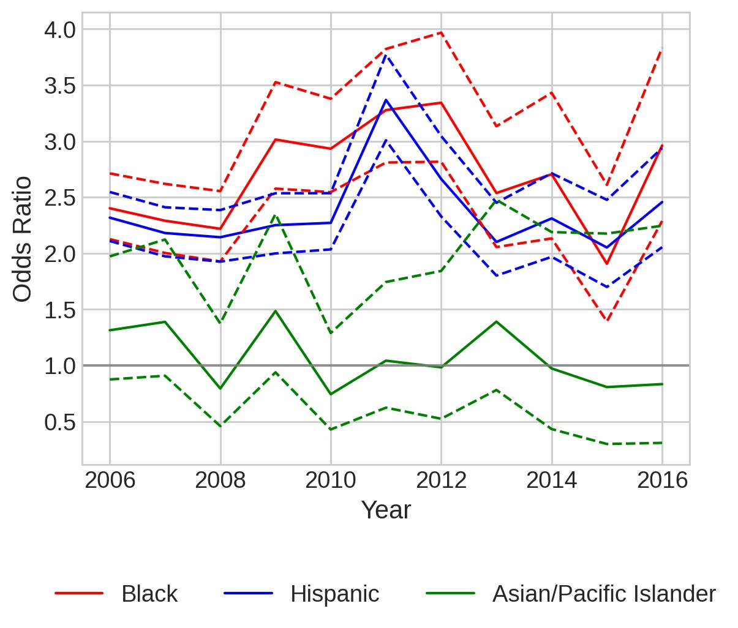
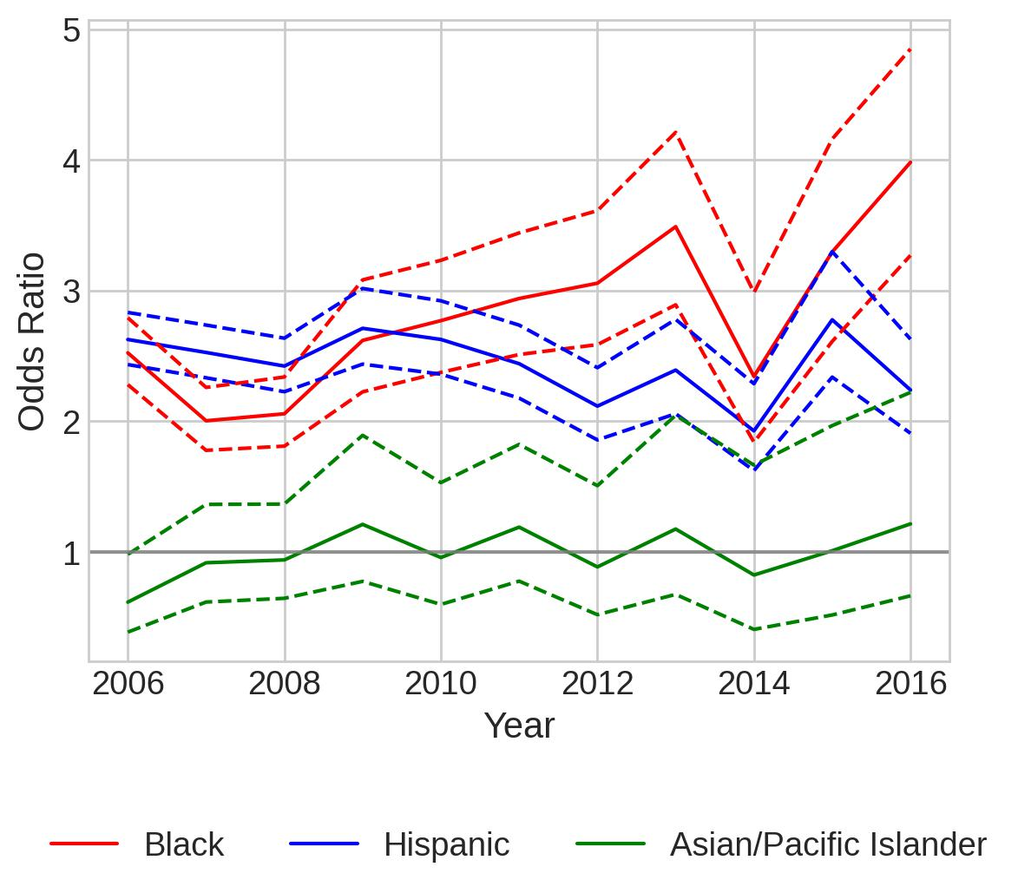
(speeding-only) Separate Logistic Regression Models and Odds Ratio Plots for Metropolitan, Micropolitan, and Non-core
Search
Metropolitan
Micropolitan
Noncore

Slide 21
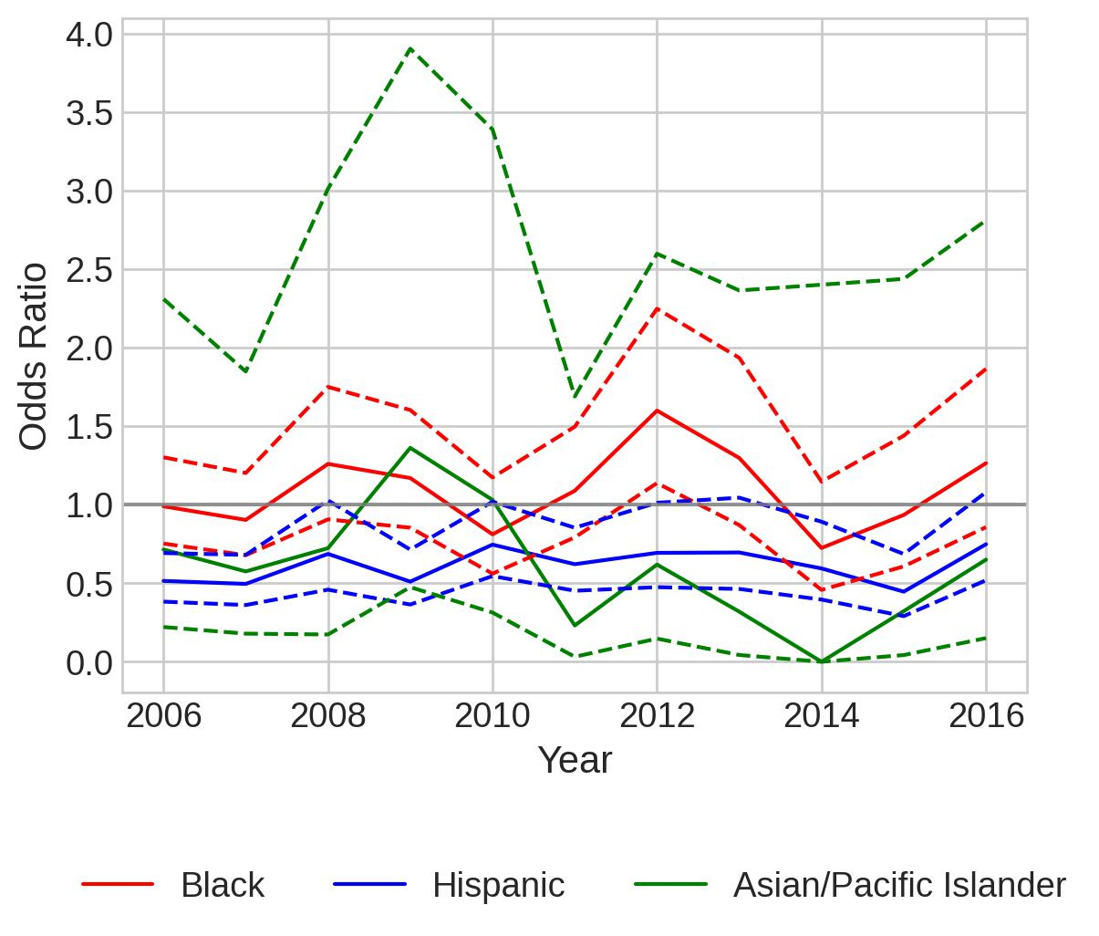
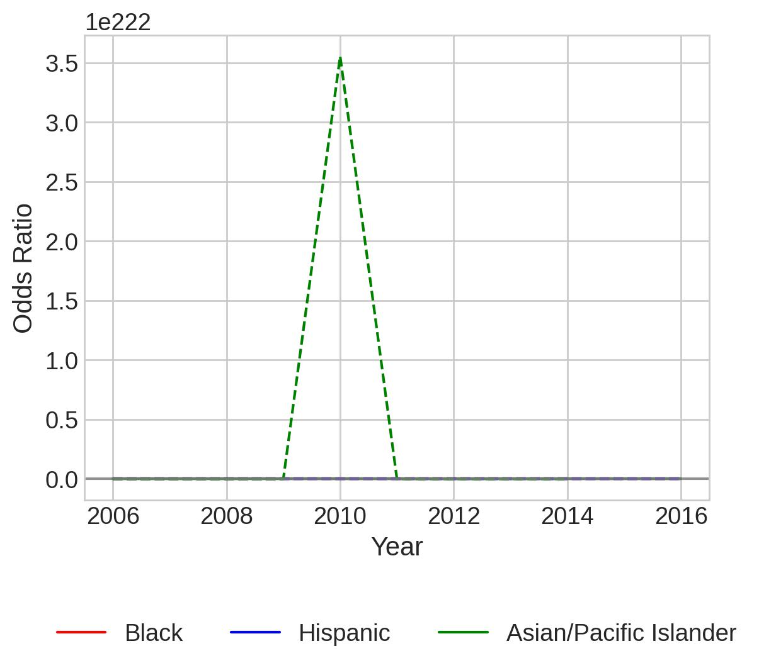
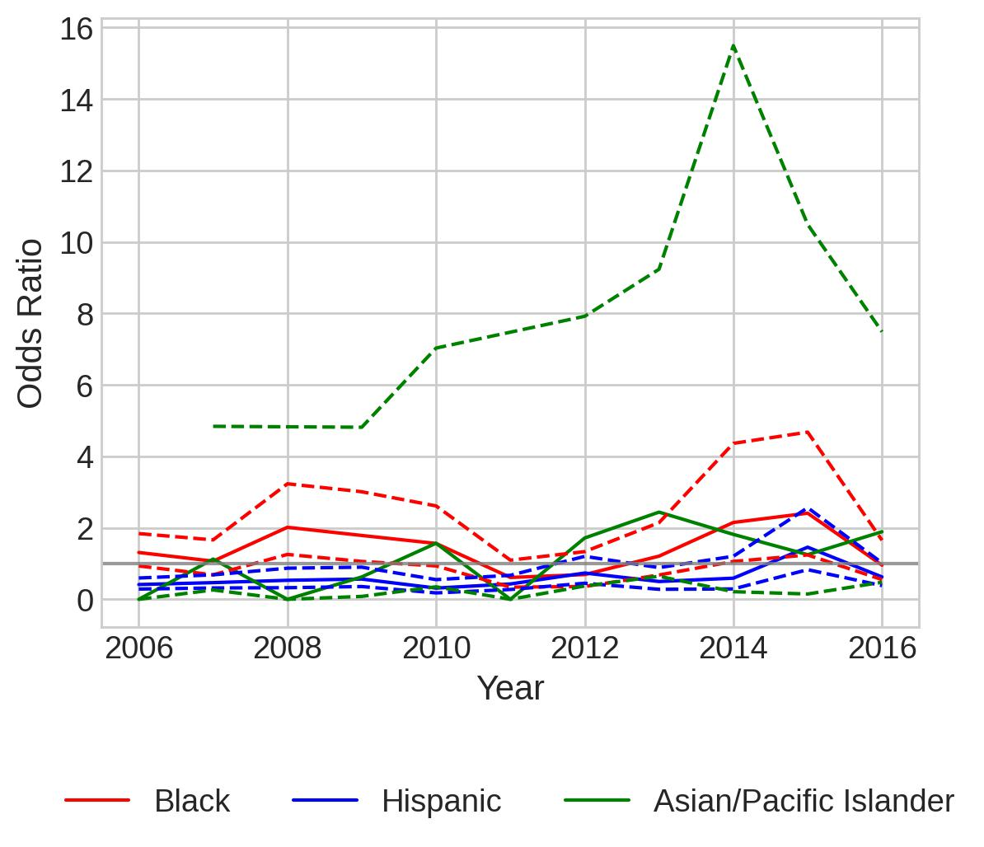
(speeding-only) Separate Logistic Regression Models and Odds Ratio Plots for Metropolitan, Micropolitan, and Non-core
Contraband
Metropolitan
Micropolitan
Noncore
For multiple years: Warning: Maximum number of iterations has been exceeded.
2006, 2011:
Warning: Maximum number of iterations has been exceeded.

Slide 22
Separate Models for 12 economic regions (Speeding-only)

Slide 23
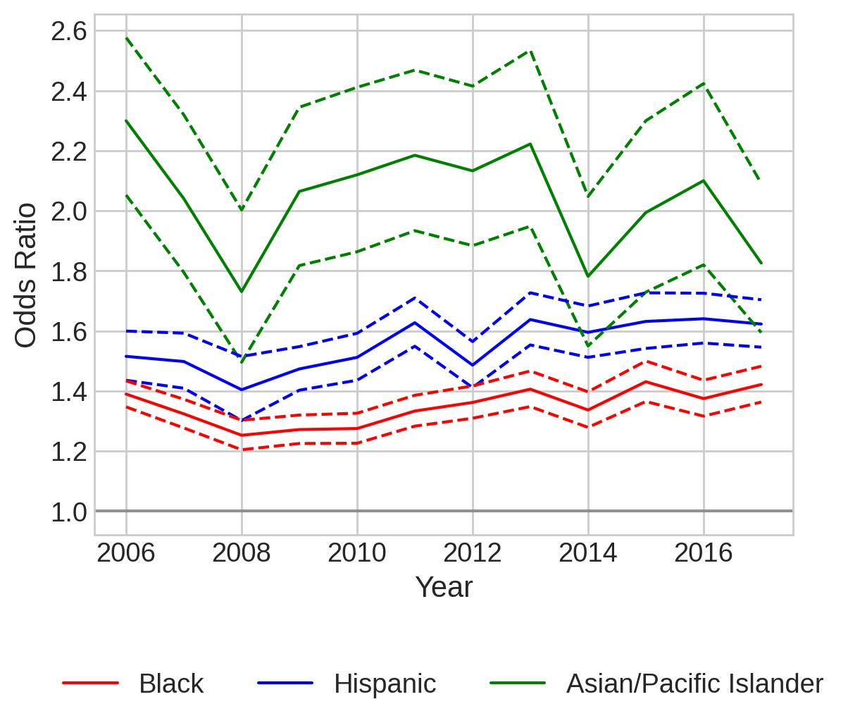
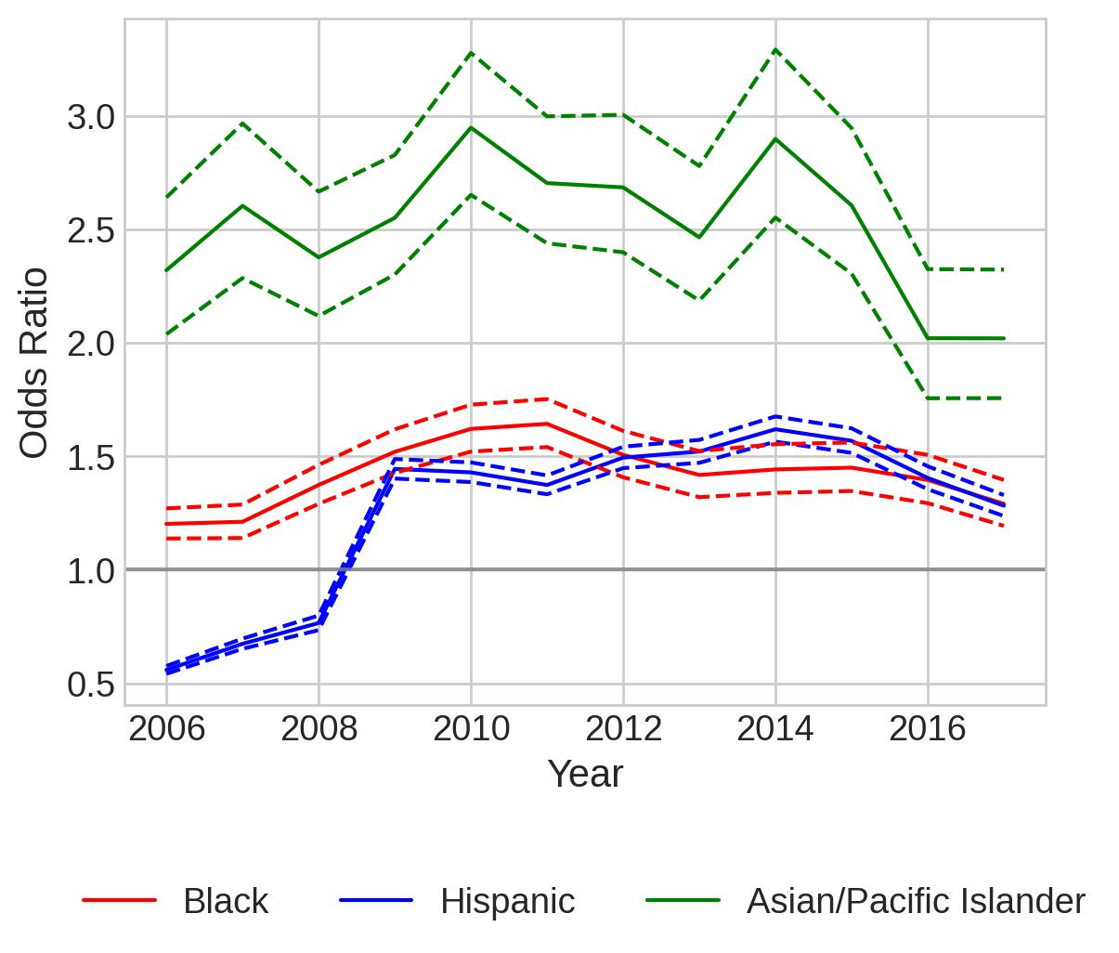
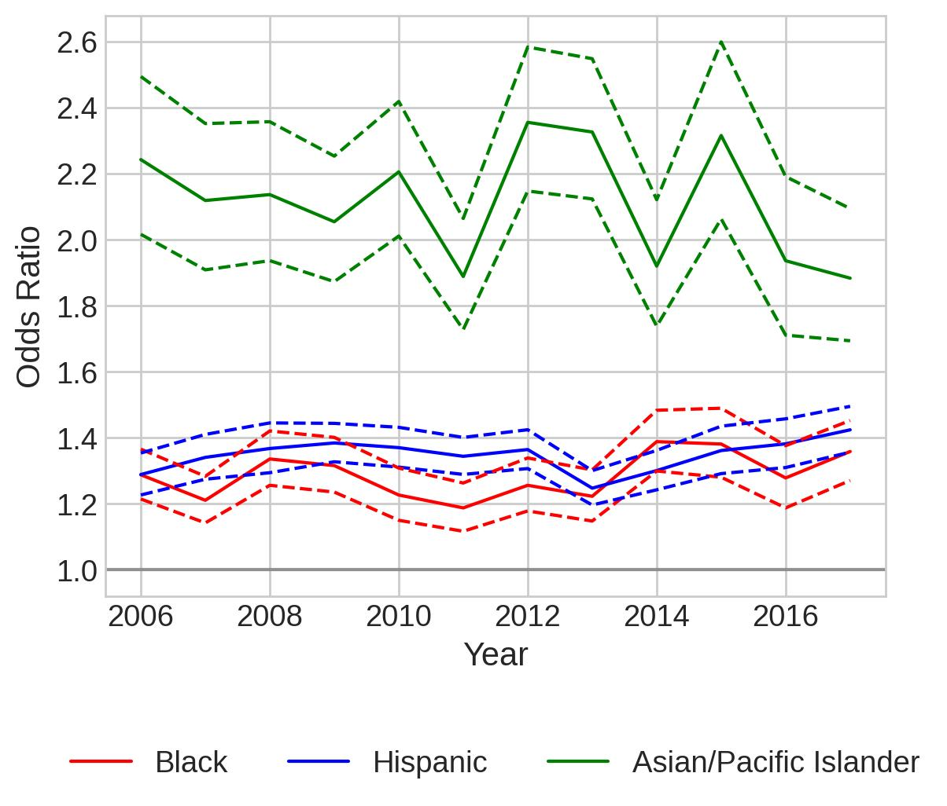
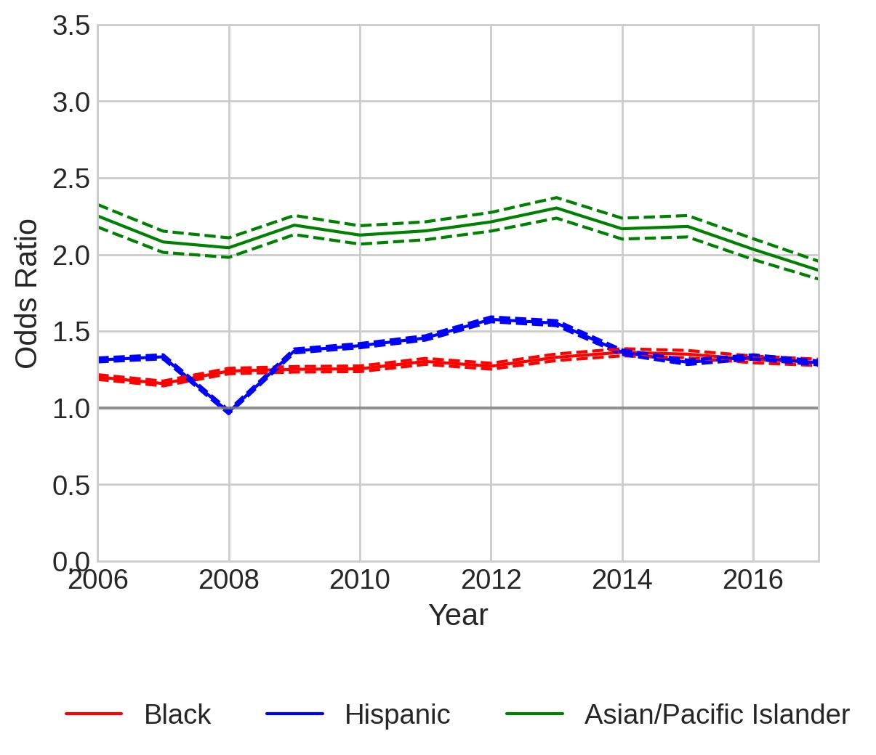
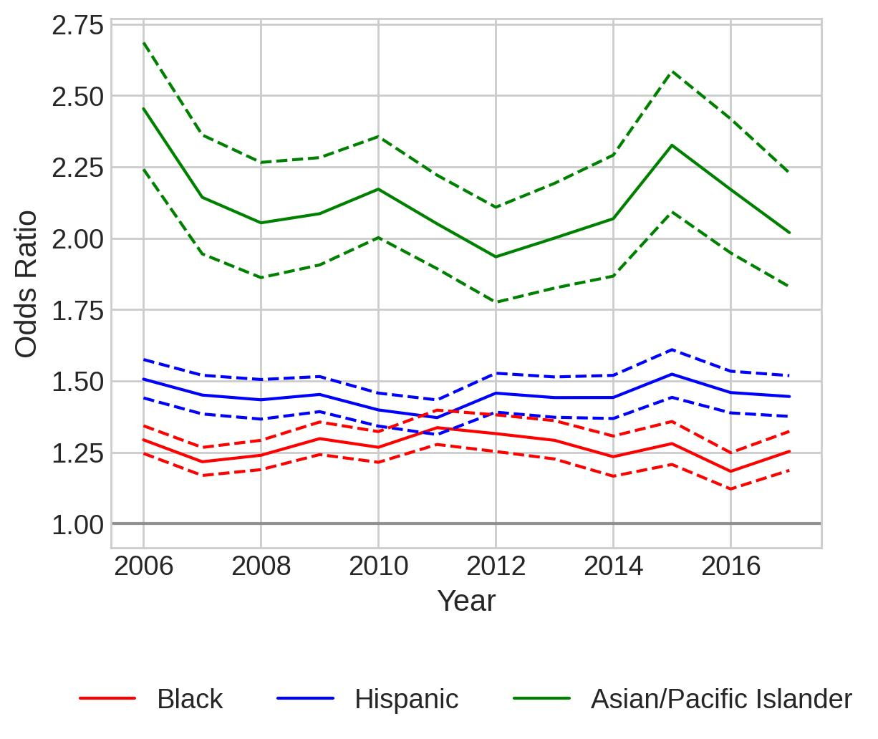
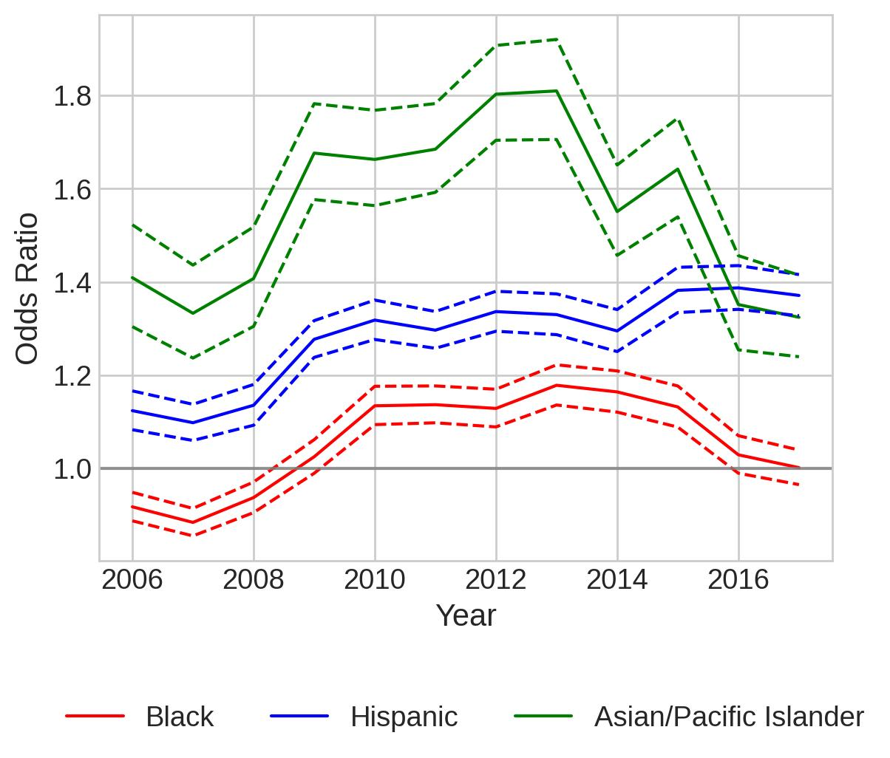
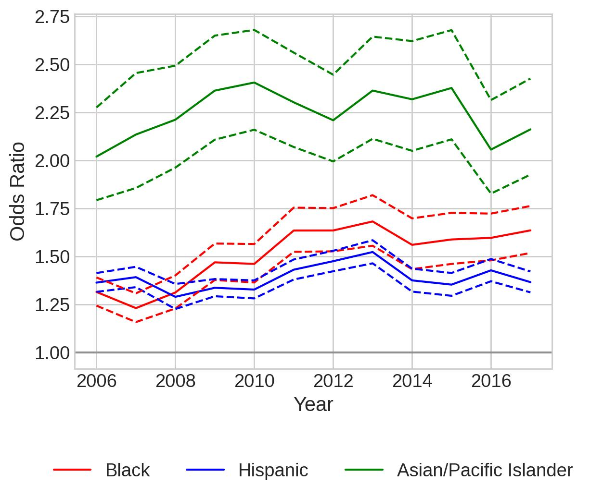
Speeding-only, citation(different y)
Upper East
Alamo
Capital
All Regions
Central Texas
Gulf Coast
High Plains

Slide 24
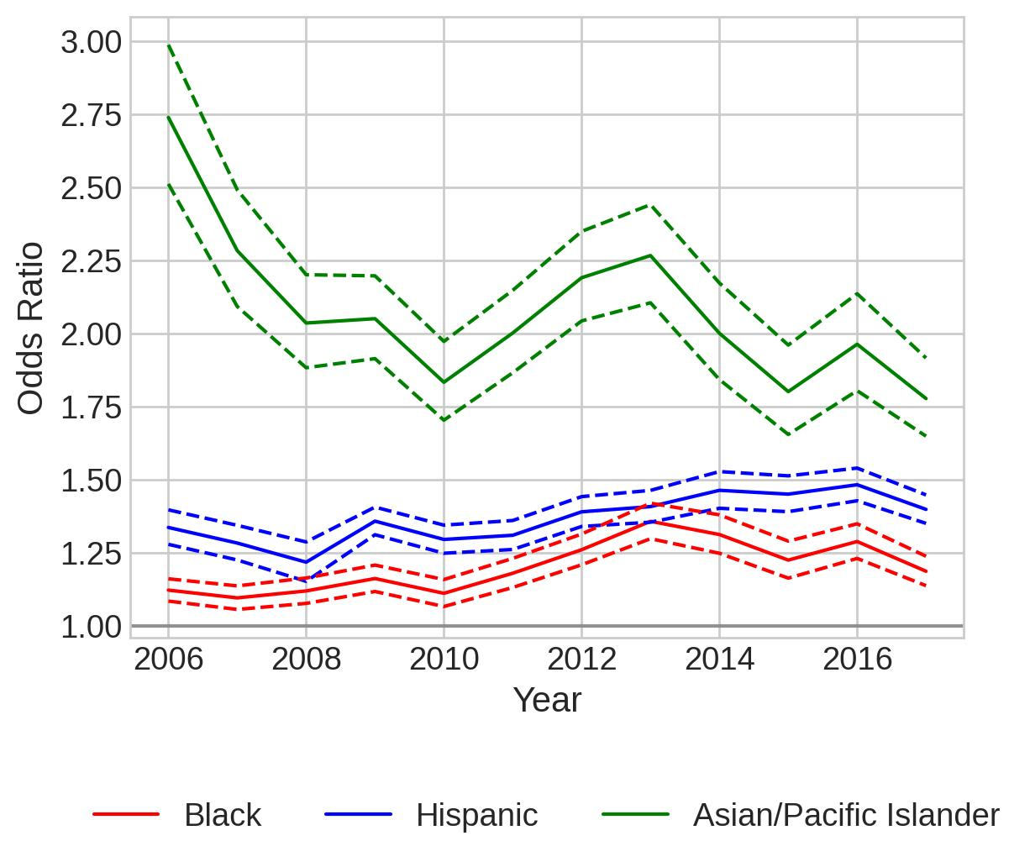
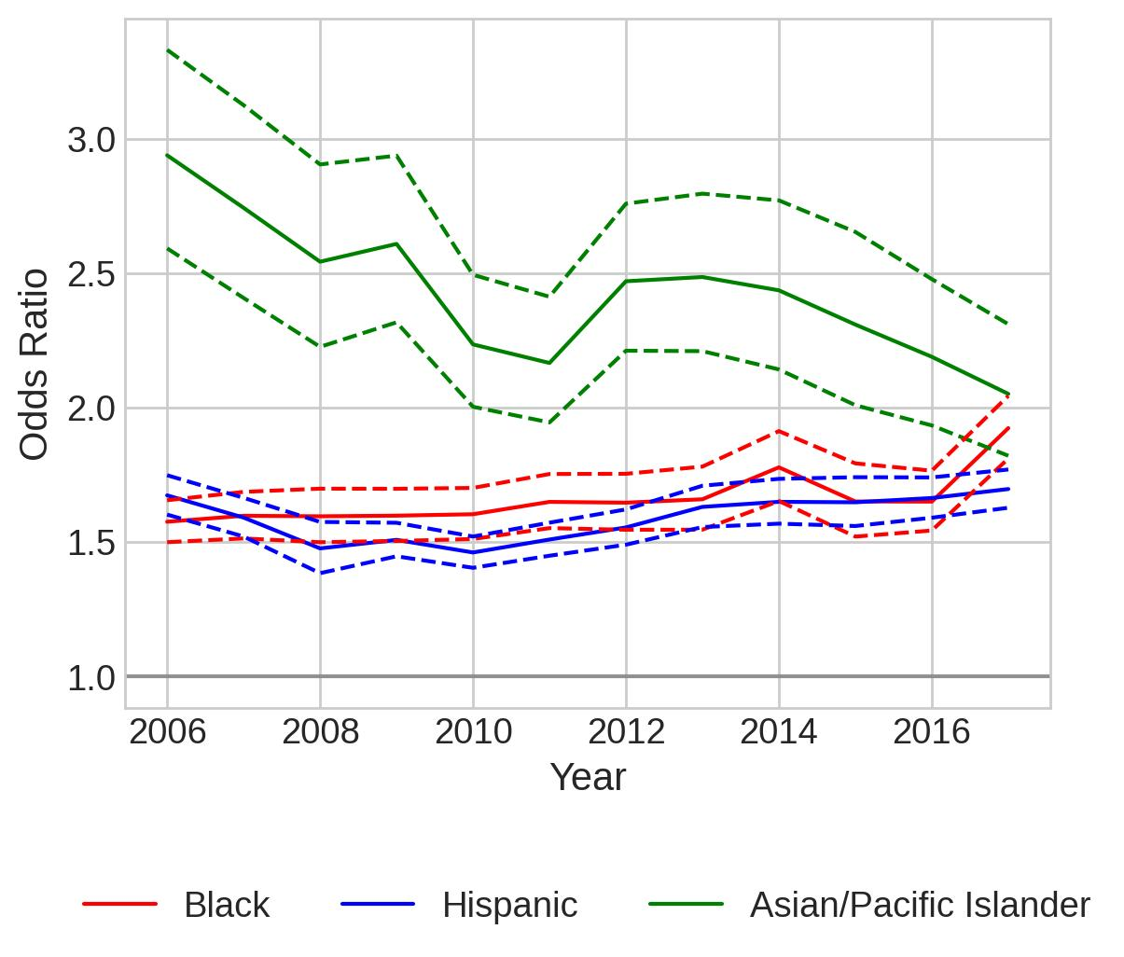
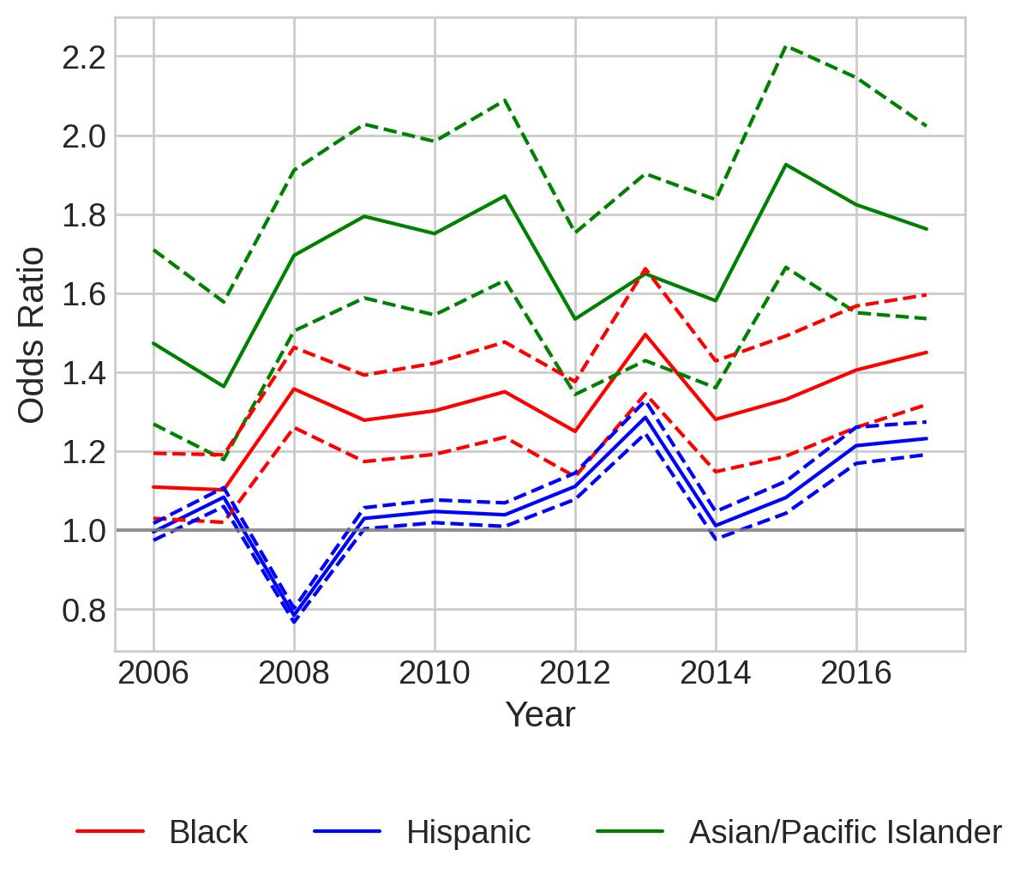
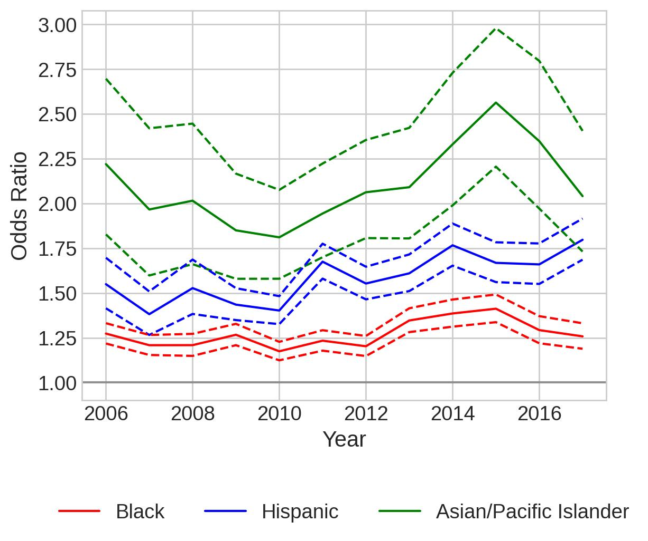
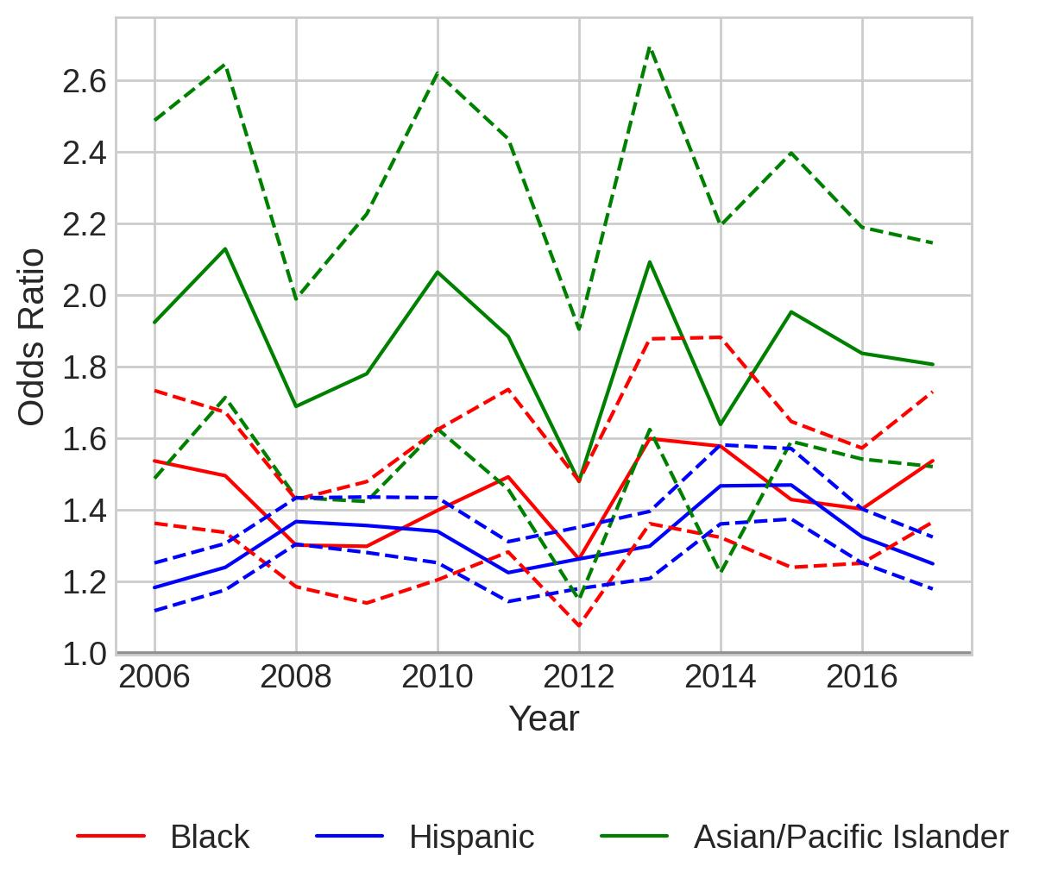
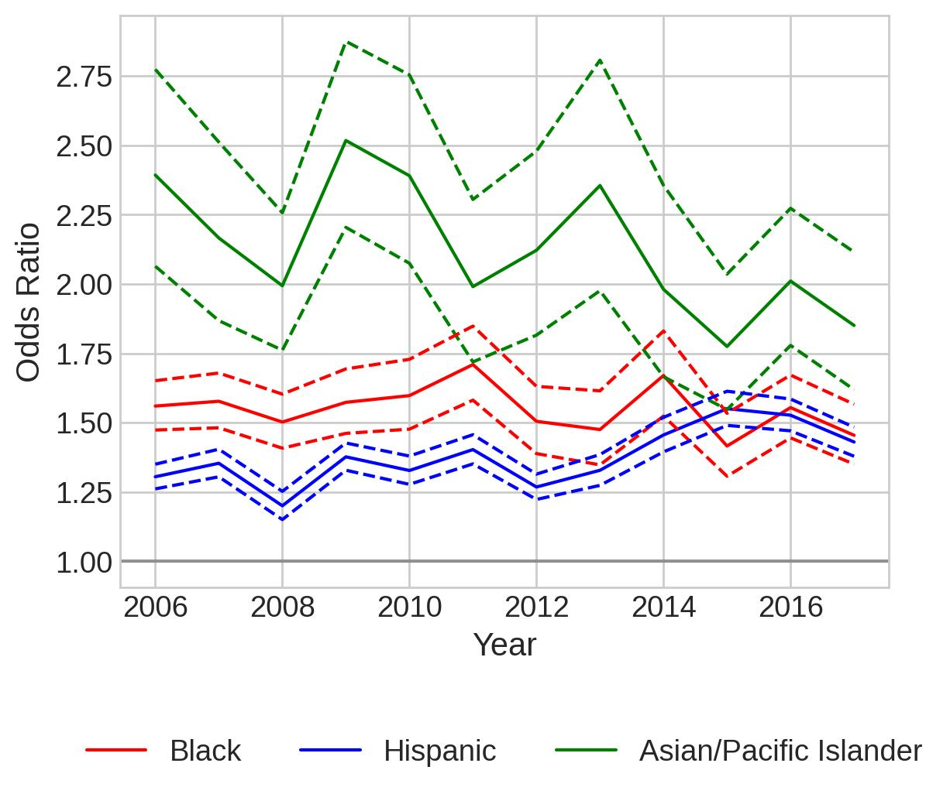
Speeding-only, citation(different y)
Metroplex
Northwest
South Texas
All Regions
Southeast
Upper Rio Grande
West Texas

Slide 25
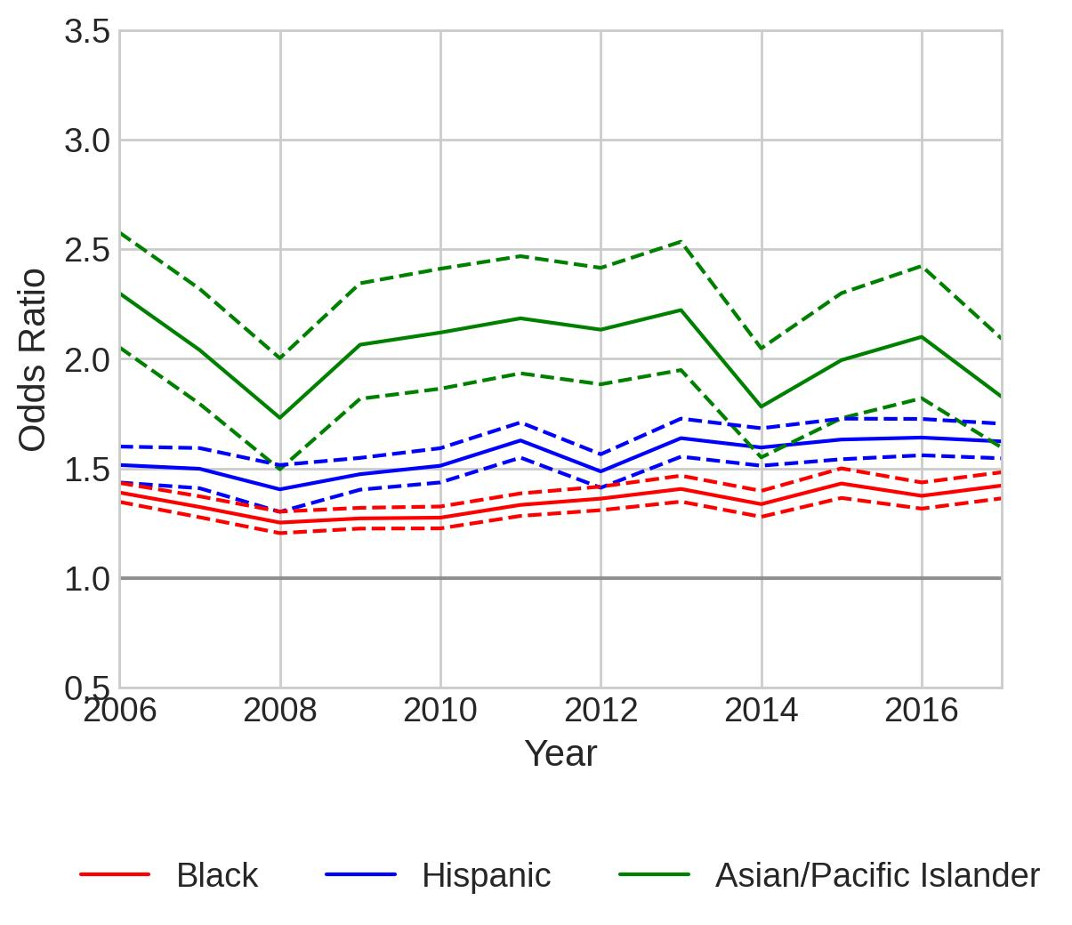
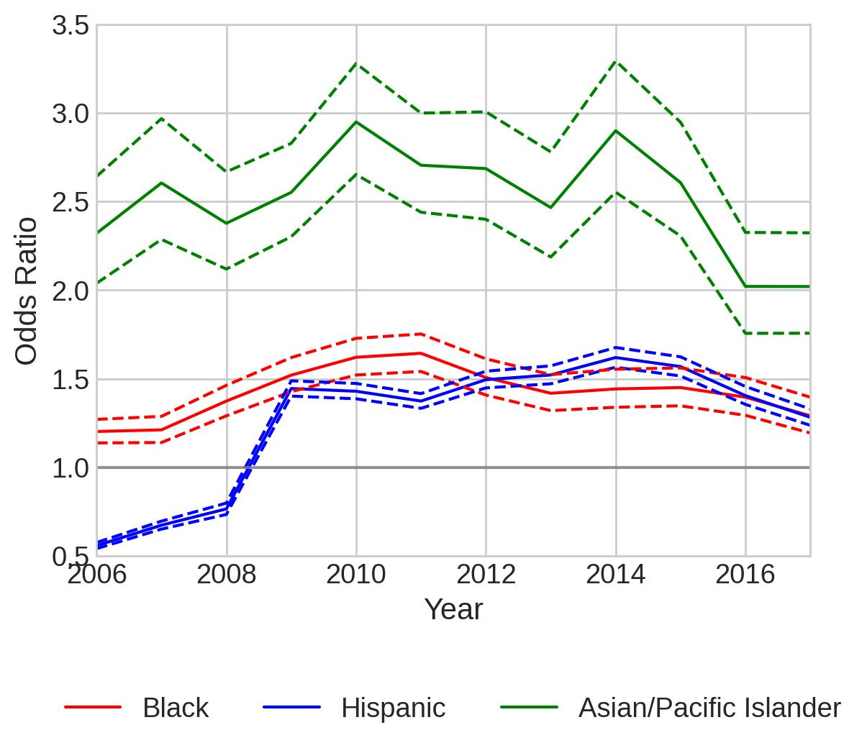
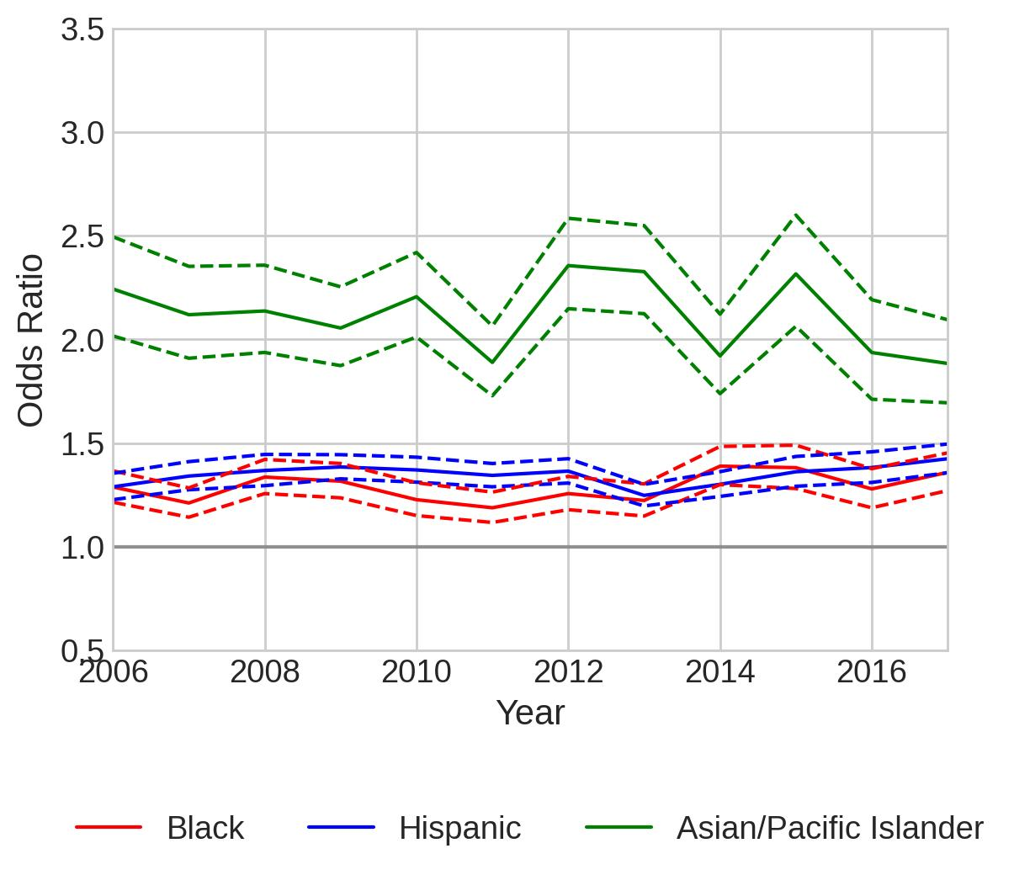
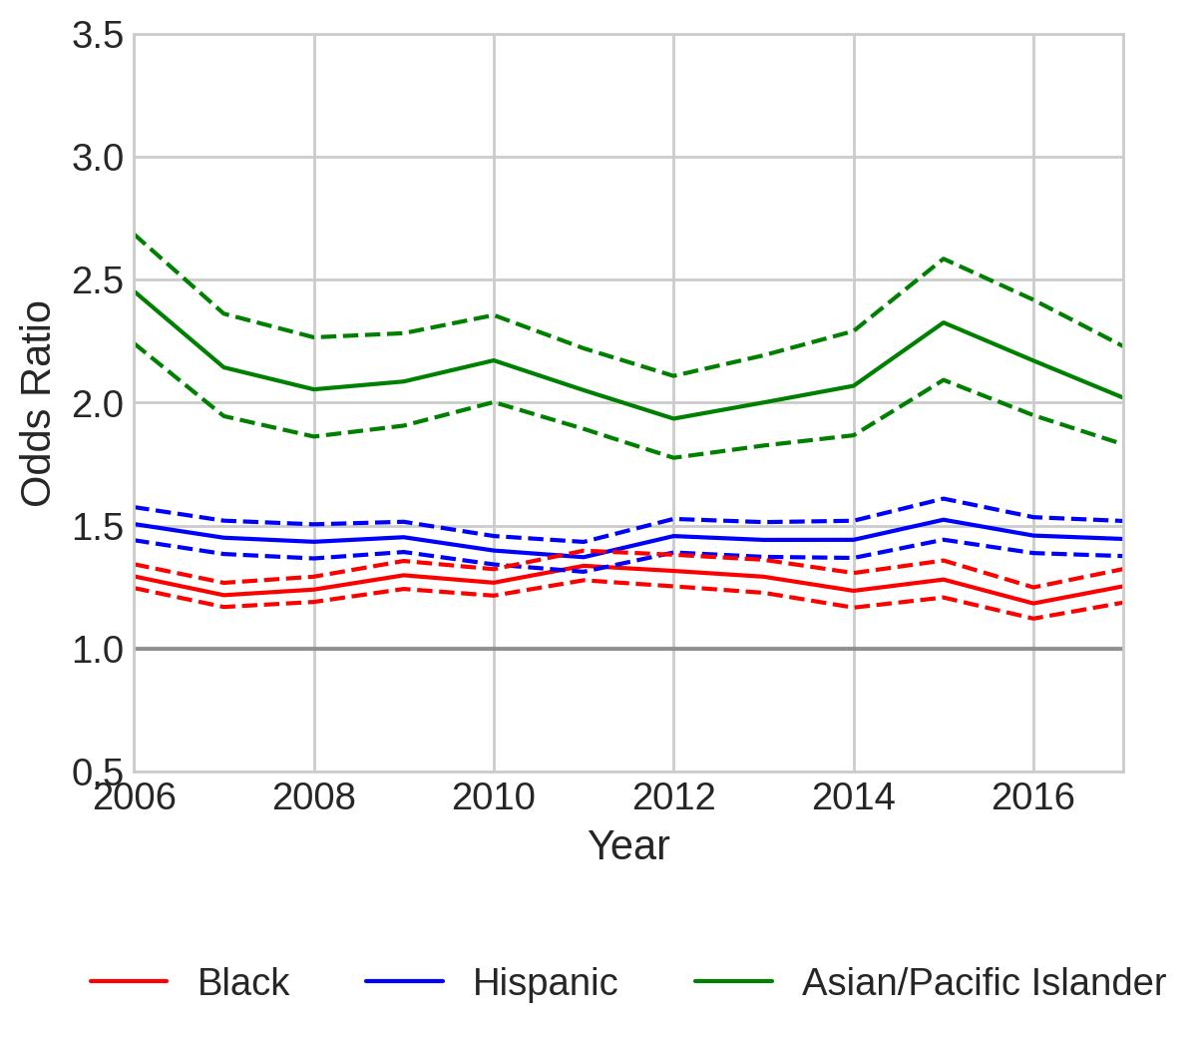


Speeding-only, citation
Upper East
Alamo
Capital
All Regions
Central Texas
Gulf Coast
High Plains

Slide 26






Speeding-only, citation
Metroplex
Northwest
South Texas
All Regions
Southeast
Upper Rio Grande
West Texas

Slide 27







Speeding-only, search(few records, wide CI, similar trends)
Upper East
Alamo
Capital
All Regions
Central Texas
Gulf Coast
High Plains

Slide 28






Speeding-only, search(few records, wide CI, similar trends)
Metroplex
Northwest
South Texas
All Regions
Southeast
Upper Rio Grande
West Texas

Slide 29
Speeding-only, contraband(few records, not meaningful
For example, Capital region has 100~200 records per year from 2013-2016.
This leads to singular matrix and the model cannot be fitted.

Slide 30

Can we use regional Diversity Index to explain?
Diversity Index(used by US census bureau for racial and ethnic diversity)
(https://www.census.gov/library/visualizations/interactive/racial-and-ethnic-diversity-in-the-united-states-2010-and-2020-census.html)
We use Simpson's Diversity Index, which is just a small modification(https://geographyfieldwork.com/Simpson'sDiversityIndex.htm)

Slide 31
Data Files:
pop_IShispanic_10.xlsx:
https://docs.google.com/spreadsheets/d/15F_5nVGlCR2r6kFLQpBZcSm11axe7Qdr/edit?usp=sharing&ouid=113991319145341460691&rtpof=true&sd=true
2. gini_2010_5year.csv:
https://drive.google.com/file/d/1-EcHfwFuqiqzQYrmGlJ1xLi6AWL5s4VI/view?usp=sharing
3. countyinfo.xlsx:
https://docs.google.com/spreadsheets/d/1qzXVsDOhRjnhoNXJyVWpMlj7wM7_vcGg/edit?usp=sharing&ouid=113991319145341460691&rtpof=true&sd=true
4. traffic_stop_countyDiversity.ipynb:
https://colab.research.google.com/drive/1YD4KWGc5RnOF67rF1V2sodDhaEarQ3O-?usp=sharing

Slide 32
Check out https://www.socialexplorer.com/explore-tables For racial composition of Texas population.
Rice email can be used to get a license for the professional plan provided by Rice University.
Select American Community Survey (5-year estimates). Reason: only 5 year estimates have enough data for each county. Both 3-year and 1-year estimates have a lot of null values – some counties do not have enough data available.
Select a time frame(e.g., American Community Survey(ACS) 2016-2020 (5-year estimates)) -> Begin Report
Select a geographic type -> choose 050 County
Select a state: Texas
Select one or more geographic areas and click 'add': All counties in Texas -> Click that "Add" button -> Click "Proceed to Tables"
Select one or more tables and click 'add': Choose "Hispanic or Latino By Race" -> Click that "Add" button -> Click "Proceed to Results"
Choose "Excel" -> With percentage -> Download.
Should find something similar to(exactly the same format, can directly use the same notebook on our github repo traffic_stop_countyDiversity.ipynb to analyze) pop_IShispanic_10.xlsx, which is downloaded from https://www.socialexplorer.com/tables/POPEST2010/R13060217
This is downloaded from the website two years ago and unfortunately I am not sure which data source/table it uses now

Slide 33

The American Community Service data is downloaded and uploaded to Github – External Data.
ACS2006_2010.xlsx ~ ACS2013_2017.xlsx
The data in ACS2006_2010.xlsx ~ ACS2013_2017.xlsx is processed into a summary file, tx_county_race_pop.csv, which is under the same folder in Github.
A snapshot of tx_county_race_pop.csv:
5-year estimates of 2006-2010 will have the value in the year column as 2010, etc. The diversity index is calculated as 1−∑n(n−1)/N(N−1), where n is the population count in each race group (for one county), N is the total number of population(for one county). The diversity_shannon index is calculated as -sum (p * math.log(p+0.000000001)), where p = n/N.
Diversity index is similar to Gini Index, shannon index is similar to Entropy. [measuring node impurity in tree algos.]

Slide 34

Alamo, Gulf Coast, NorthWest
0 – 1:
0 means everyone in the population has the same racial and ethnic characteristics. 1 means infinite diversity
All Regions
Northwest
Data: 2010 estimates, downloaded from: https://www.socialexplorer.com/tables/POPEST2010/R13060217

Slide 35
Alamo, Gulf Coast, NorthWest
0 – 1:
0 means everyone in the population has the same racial and ethnic characteristics. 1 means infinite diversity
All Regions
Alamo
Data: 2010 estimates, downloaded from: https://www.socialexplorer.com/tables/POPEST2010/R13060217

Slide 36
Alamo, Gulf Coast, NorthWest
0 – 1:
0 means everyone in the population has the same racial and ethnic characteristics. 1 means infinite diversity
All Regions
Gulf Coast
Data: 2010 estimates, downloaded from: https://www.socialexplorer.com/tables/POPEST2010/R13060217

Slide 37
Can we use regional Gini Index to explain?
"The Gini Index is a summary measure of income inequality. The Gini coefficient incorporates the detailed shares data into a single statistic, which summarizes the dispersion of income across the entire income distribution. The Gini coefficient ranges from 0, indicating perfect equality (where everyone receives an equal share), to 1, perfect inequality (where only one recipient or group of recipients receives all the income)."
Census data, 2010 – 2021
https://data.census.gov/table?q=gini+index+texas+counties&tid=ACSDT5Y2012.B19083
2012 – 5 year estimate is used for the plot on the next slide

Slide 38

0: perfect equality
1: perfect inequality
All Regions
Northwest
Alamo, Gulf Coast, NorthWest

Slide 39
0: perfect equality
1: perfect inequality
Alamo, Gulf Coast, NorthWest
All Regions
Alamo

Slide 40
0: perfect equality
1: perfect inequality
Alamo, Gulf Coast, NorthWest
All Regions
Gulf Coast

Slide 41


What if adding diversity indexes as independent variables?
Including Diversity Index and Gini Index in the model does not change the odds ratios much.
Speeding-only, Citation
Notebook: https://colab.research.google.com/drive/1oqLNfOKW34GWdvE5rBYU5R5jaFoi2ZLv?usp=sharing

Slide 42
Does adding independent variables change results? Violation types
['subject_race_asian/pacific islander', 'subject_race_black','subject_race_hispanic','subject_sex_female', 'county_type_Micropolitan', 'county_type_Non core',
'Speeding Over Limit',
'Speeding-10% or More Above Posted Speed',
'No/Improper License Plate Lamp',
'Ride, Not Secured By Safety Belt-Driver (12-1-85)',
'Operate Motor Vehicle Without License Plates (Or With One Plate)',
'No/Non-Compliant Head Lamps',
'Improperly Placed Or Obstructed License Plate',
'Display Expired License Plates/Registration',
'No/Improper Mud Flap',
'No/Improper Tail Lamp - not Motorcycle',
'Following Too Closely',
'Drive On Improved Shoulder When Prohibited',
'Fail To Signal Lane Change',
'Disregard Stop Sign',
'Fail To Drive In Single Lane',
'Ride, Not Secured By Safety Belt-Passenger (When Required)',
'Fail to Move Over or Slow Down for Certain Vehicles',
'Inoperable/Obscured Stop Lamp(s)',
'Use Of Vision Reducing Matter On Windows - Glass Coating Material',
'Unsafe Speed',
'Fail To Control Speed',
'Drive in Left Lane When Not Passing or Where Prohibited',
'others']
Criteria to select violation types to include as a variable: threshold at 5000: > 5000 records each year in our analysis.

Slide 43


Does adding independent variables change results? Violation types
All stops, with violations
All stops, without violations
The previous TA has run analysis with 12 economic regions and daytime(besides race, gender, metro/micro/noncore county types), with or without violations. Violation types, when included, are also mostly statistically significant.
Please do not use results on this slide. This is just for reference.
Including both metro/micro/noncore county types and 12 economic regions is problematic, multicollinearity leads to unstable and unreliable estimates(none of these variables are significant).
https://github.com/arkobarman/trafficStopProject/blob/main/final_outputs/ORCI_with_vios.csv

Slide 44


All stops, with/without violations
All stops, with violations
All stops, without violations
Run analysis with violation type info or without violation type info(race, gender, 3-category county type). The results are different for Asian/Pacific Islander. Hispanic estimates also change a bit, but are similar.
Most of the violation type variables are also statistically significant over the years.​
https://drive.google.com/file/d/156htI3XQa25YpMzftKHR979td6cNOSK5/view?usp=sharing​
​

Slide 45
Population and Vehicle Access Data
Texas population by race(2010-2017):
https://data.census.gov/table?q=texas+race&tid=ACSDT1Y2010.B02001
Similarly by gender(2014-2017): https://data.census.gov/table?q=texas+population+sex&tid=ACSSE2021.K200101
ACS Appendix: 1 year/5 year estimates
https://www.census.gov/content/dam/Census/library/publications/2018/acs/acs_general_handbook_2018_ch03.pdf
Texas car access:
https://nationalequityatlas.org/indicators/Car_access?geo=02000000000048000
2000, 2010, 2020
Might/might not helpful:
https://datausa.io/profile/geo/texas#demographics
For population data: American Community Survey: Population grouping: White alone; Black or Arican American alone; Asian alone; Native Hawaiian and Other Pacific Islander alone; Two or more races.
Does not have the 'Hispanic' group; only has data from 2010-2017.
For car access data: it is 5 year average. Only has data for 2010(average of 2006-2010), 2020(average of 2016-2020).
Hard to use this data to compute the Texas driver demographics and then compare to the year trend in the traffic stop data race breakdown.

Slide 46
Logistic Regression: Comparison of Coefficient Magnitudes and Comparison across Samples
In our manuscript, we compare coefficient estimates of the same model across time and regions.
However, previous research has shown that:
1) We cannot simply compare odds ratios from logistic regression model across samples or over time, as we need the strong assumption that "the unobserved heterogeneity is the same across the compared samples, groups, or points in time".
2) In a logistic regression model, even if a variable(xn) is not correlated with all the independent variables in the model and xn is not correlated with the target variable y, excluding that variable from the model may still affect the LnOR we get from logistic regression.
Please see the paper linked in the comment of this slide.
The previous TA did fixed effects models before(?)(control for 12 regions, eg, ORCI_region_speeding.csv in the github repository, all region dummies have 0.99 p value). It can help with omitted variable bias but doesn’t control for unobserved variables that change over time(regional economics, policing efforts are likely among the confounding factors but should change over time).

Slide 47
Can we apply the same analysis to the entire country?
Some other states? Yes. Countrywide? No.
Data Website: https://openpolicing.stanford.edu/data/
The website has 42 states' data(For these states, some cities might not have data).
Of these 42 states, 33 states have state patrol data.
To apply the same analysis, we need these variables present:(Stop Location, Race, Gender, Violation, Citation)
and the citation variable valid(not all True/False).
Variable Coverage Rate:
[MD]: violation 0.1%, location 23%;
[KY Louisville]: violation 76.5%;
LOC means it needs some kind of mapping from zip code or longitude+latitude to county ):

Slide 48
Can we apply the same analysis to the entire country? Some other states? Yes. Countrywide? No.
Valid
Not Valid
LOC: Need Mapping for County
Y = Citation
State | Region | Stops | Time Start | Time End | Stop Location | Race | Sex | Violation | Search | Contraband | Citation | Pedestrian Included | Citation Valid | Citation Percent | Usable
CT | State Patrol | 1175339 | 01/09/2013 | 01/09/2015 | TRUE | TRUE | TRUE | TRUE | TRUE | TRUE | TRUE | FALSE | TRUE | 47.50% | TRUE
IL | State Patrol | 12748173 | 01/12/2011 | 01/12/2017 | TRUE | TRUE | TRUE | TRUE | TRUE | TRUE | TRUE | FALSE | TRUE | 46.90% | LOC
KY | Louisville | 146560 | 01/12/2014 | 01/06/2020 | TRUE | TRUE | TRUE | TRUE | TRUE | FALSE | TRUE | FALSE | TRUE | 77.08% | LOC
MD | State Patrol | 3587052 | 01/12/2006 | 01/03/2014 | TRUE | TRUE | TRUE | TRUE | TRUE | TRUE | TRUE | FALSE | TRUE | 37.60% | FALSE
MT | State Patrol | 921216 | 01/12/2008 | 01/12/2017 | TRUE | TRUE | TRUE | TRUE | TRUE | FALSE | TRUE | FALSE | TRUE | 47.03% | TRUE
TN | Nashville | 3092351 | 01/12/2009 | 01/03/2019 | TRUE | TRUE | TRUE | TRUE | TRUE | TRUE | TRUE | FALSE | TRUE | 22.50% | LOC
TN | State Patrol | 3828141 | 01/12/1999 | 01/06/2016 | TRUE | TRUE | TRUE | TRUE | FALSE | FALSE | TRUE | FALSE | FALSE | 100% | FALSE
TX | Houston | 2045972 | 01/12/2013 | 01/11/2020 | TRUE | TRUE | TRUE | TRUE | FALSE | FALSE | TRUE | FALSE | FALSE | 100% | FALSE
TX | State Patrol | 27426840 | 01/12/2005 | 01/12/2017 | TRUE | TRUE | TRUE | TRUE | TRUE | TRUE | TRUE | FALSE | TRUE | 37.29% | TRUE
WI | Madison | 331450 | 01/09/2007 | 01/06/2020 | TRUE | TRUE | TRUE | TRUE | FALSE | FALSE | TRUE | FALSE | TRUE | 70.44% | LOC
WI | State Patrol | 1058816 | 01/12/2009 | 01/05/2016 | TRUE | TRUE | TRUE | TRUE | TRUE | TRUE | TRUE | FALSE | TRUE | 49.80% | TRUE
Y = CITATION and SEARCH and CONTRABAND FOUND
State | Region | Stops | Time Start | Time End | Stop Location | Race | Sex | Violation | Search | Contraband | Citation | Pedestrian Included | Citation Valid | Citation Percent | Usable
CT | State Patrol | 1175339 | 01/09/2013 | 01/09/2015 | TRUE | TRUE | TRUE | TRUE | TRUE | TRUE | TRUE | FALSE | TRUE | 47.50% | TRUE
IL | State Patrol | 12748173 | 01/12/2011 | 01/12/2017 | TRUE | TRUE | TRUE | TRUE | TRUE | TRUE | TRUE | FALSE | TRUE | 46.90% | LOC
MD | State Patrol | 3587052 | 01/12/2006 | 01/03/2014 | TRUE | TRUE | TRUE | TRUE | TRUE | TRUE | TRUE | FALSE | TRUE | 37.60% | FALSE
TN | Nashville | 3092351 | 01/12/2009 | 01/03/2019 | TRUE | TRUE | TRUE | TRUE | TRUE | TRUE | TRUE | FALSE | TRUE | 22.50% | LOC
TX | State Patrol | 27426840 | 01/12/2005 | 01/12/2017 | TRUE | TRUE | TRUE | TRUE | TRUE | TRUE | TRUE | FALSE | TRUE | 37.29% | TRUE
WI | State Patrol | 1058816 | 01/12/2009 | 01/05/2016 | TRUE | TRUE | TRUE | TRUE | TRUE | TRUE | TRUE | FALSE | TRUE | 49.80% | TRUE

Slide 49


SHAP Values
SHAP values are very slow to calculate. The following plots are generated using only 2000 data points. As we use one-hot encoding for our categorical variables, the contributions of the subject_race variable are also distributed to several different variables such as race_hispanic, race_white, etc. Additivity should apply here.
The results on the next slide is generated by shap.KernelExplainer()
An explanation of the Kernel SHAP can be found here: https://christophm.github.io/interpretable-ml-book/shap.html
Citation, All Stops

Slide 50






SHAP Values
Citation, Speeding-only
Search, Speeding-only
Contraband, Speeding-only

Slide 51
Figures for paper

Slide 52
Citation issued percent by race for speeding-related stops only

Slide 53
Odds Ratios for citation issued for every race wrt white

Slide 54
SHAP summary – feature importance of all variables in the model towards model output

Slide 55
Citation issued odds ratios by race wrt white for speeding stops during day vs night
Supplementary
Day
Night

Slide 56
Supplementary
Serious speeding violations citations issued odds ratio
Non-serious

Slide 57
Probabilities of serious and non-serious speeding by race
Serious
Non-serious

Slide 58
Split by county types – speeding only – odds for citation issued
Metropolitan
Micropolitan
Non-core

Slide 59
Border vs. non-border
Supplementary
Border
Non-border

Slide 60
Predicted probabilities for interactions – all 8 combinations of race and gender – bar graphs
Supplementary

Slide 61
Supplementary
Search conducted
Contraband found

Slide 62
Race – County Type Interactions – Probability of receiving a citation – speeding stops only
Supplementary

Slide 63
12 economic regions – odds ratio plots for 12 regions
Alamo
Capital
Central Texas
Gulf Coast
High Plains
Metroplex
Northwest
South Texas
Southeast
Upper East
Upper Rio Grande
West Texas

