Slide 1
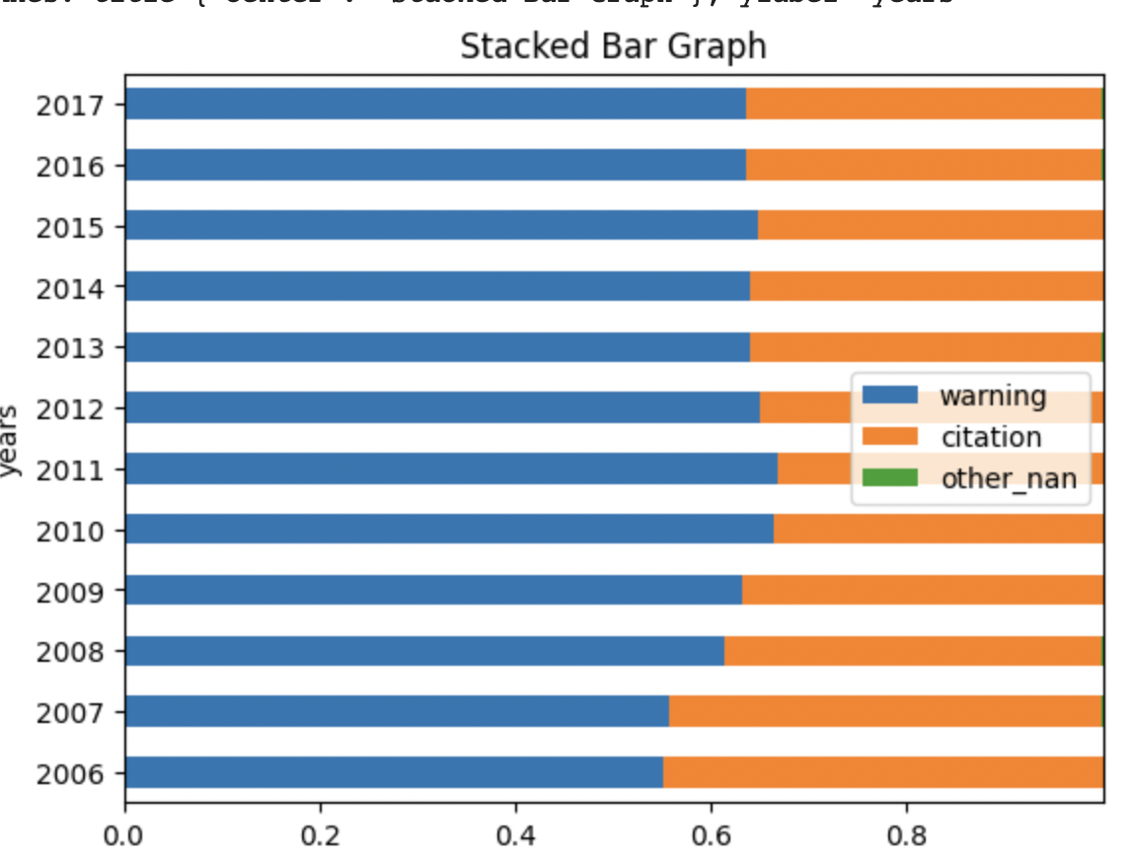
Variable definition:
"citation" = 1 means citation only OR citation + warning -> used as our target variable in the model
"Outcome" = 'citation' -> citation only OR citation + warning
= 'warning' -> warning only
A drop in citation rate = an increase in warning (only) rate.

Slide 2
border counties and non-border counties

Slide 3
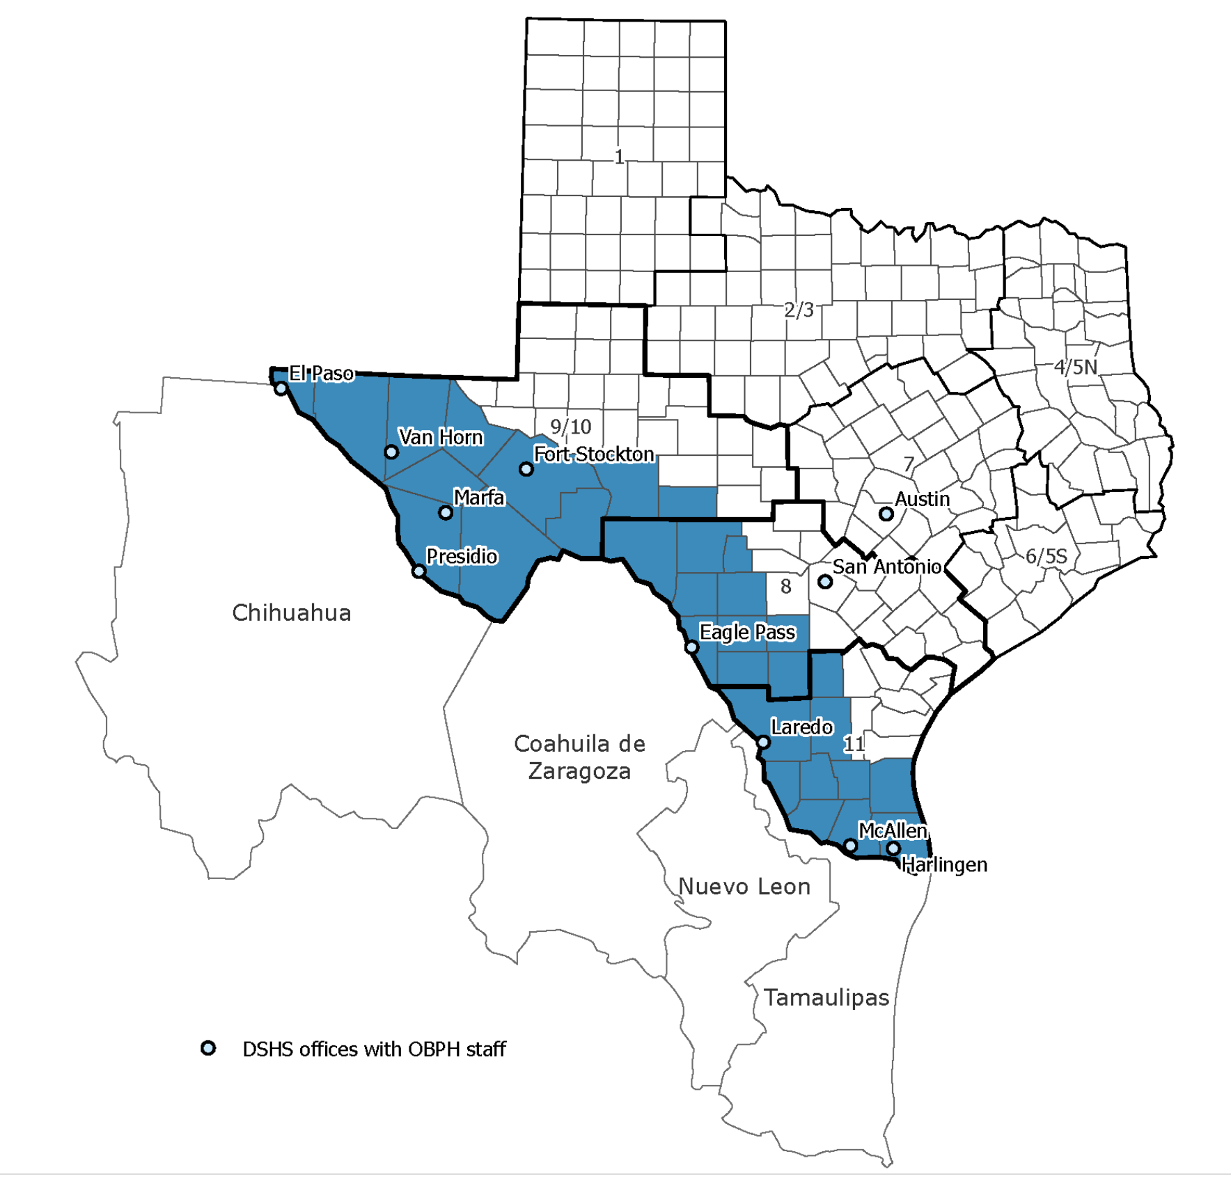
https://www.dshs.texas.gov/regional-local-health-operations/texas-border-health/map-dshs-border-area
The Department of State Health Services (DSHS) border area is defined as the area within 100 kilometers (or 62 miles) of the Rio Grande in the La Paz Agreement of 1983. This includes the 32 Texas Border Counties listed below and Mexico.

Slide 4
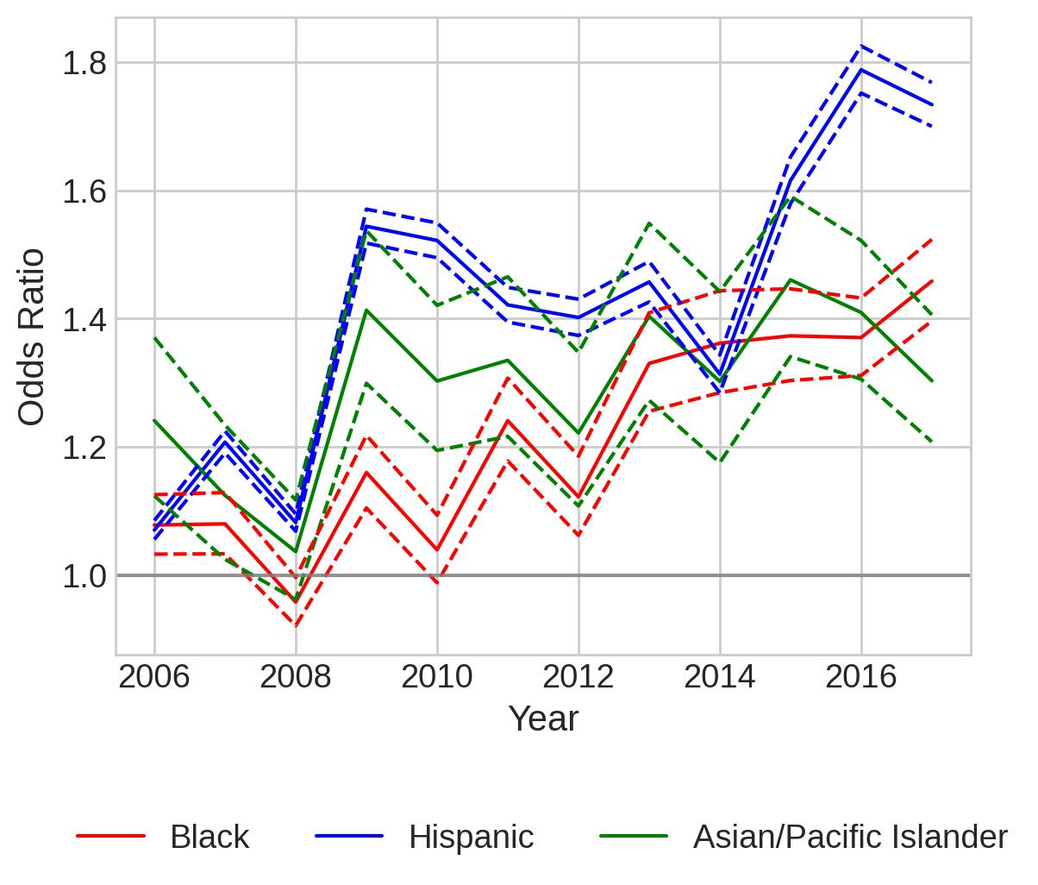
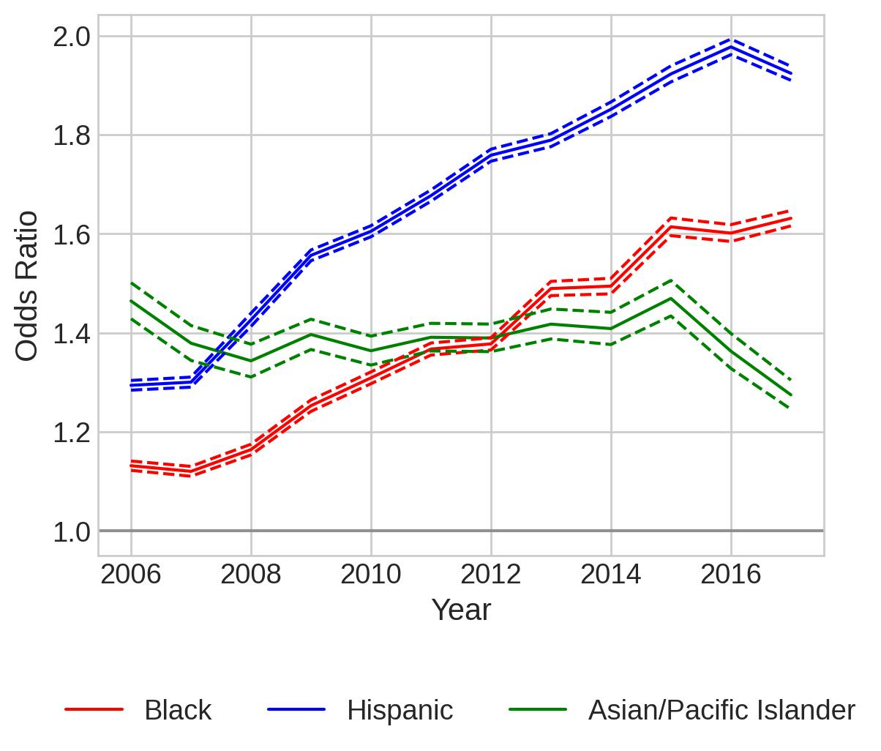
Separate Models for Border Counties and Non-border Counties
All Stops, Citation
Border Counties
Non-border Counties

Slide 5
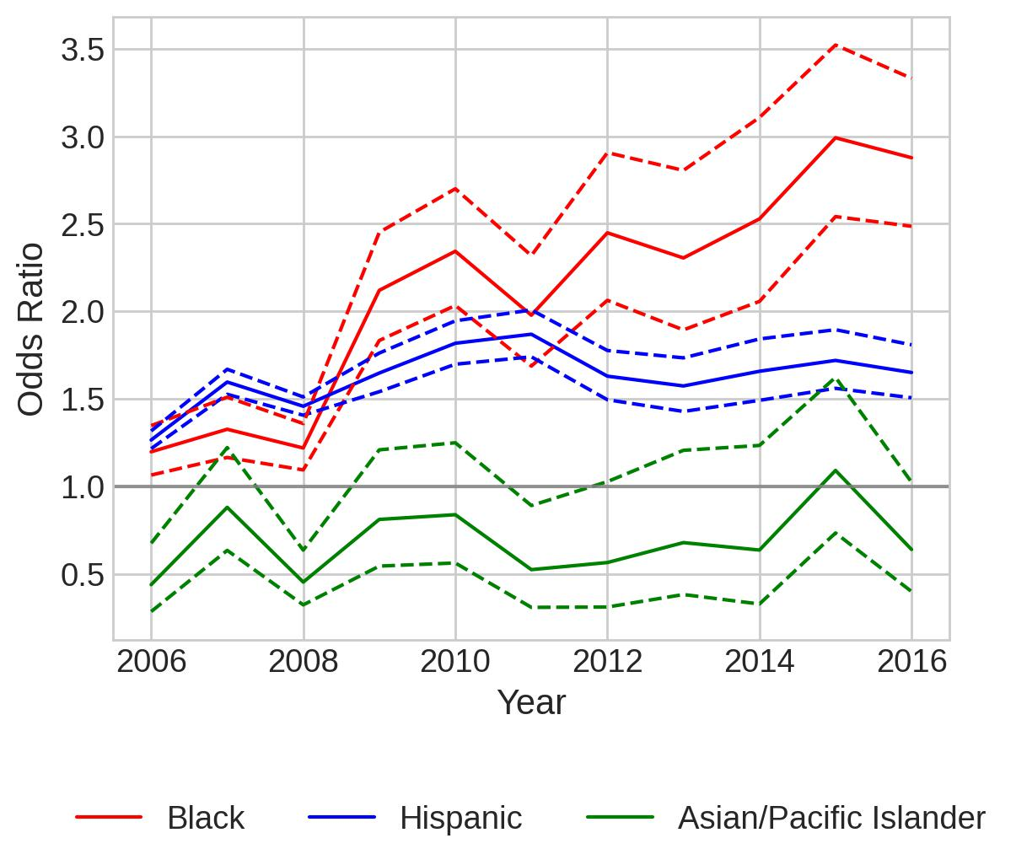
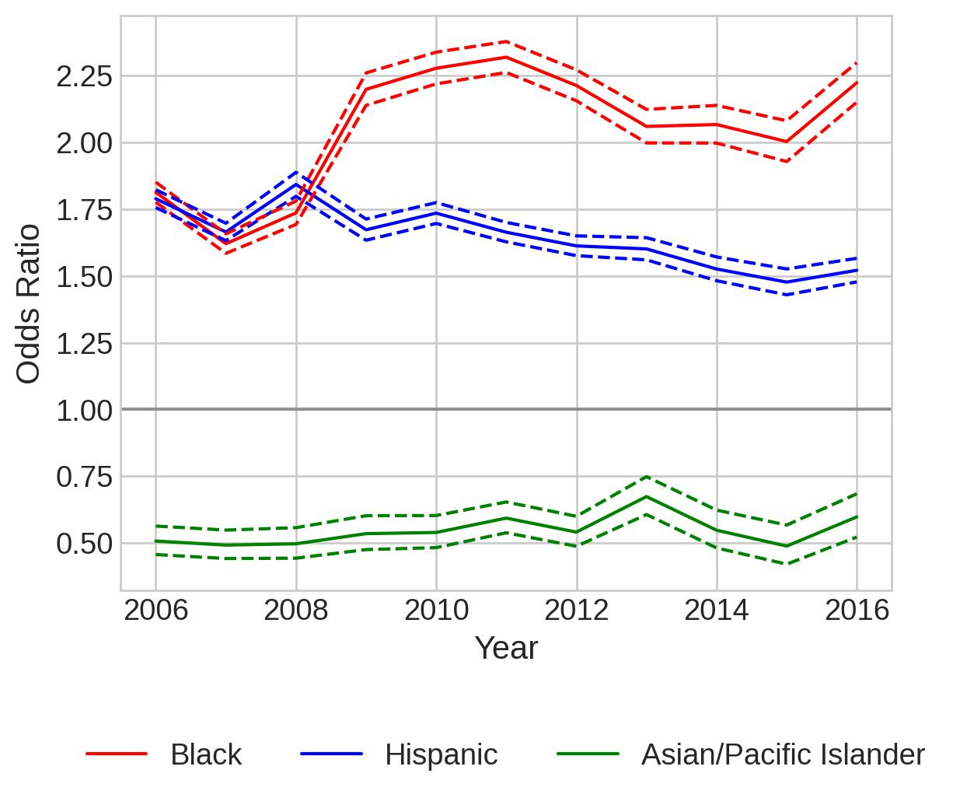
Separate Models for Border Counties and Non-border Counties
All Stops, Search
Border Counties
Non-border Counties

Slide 6
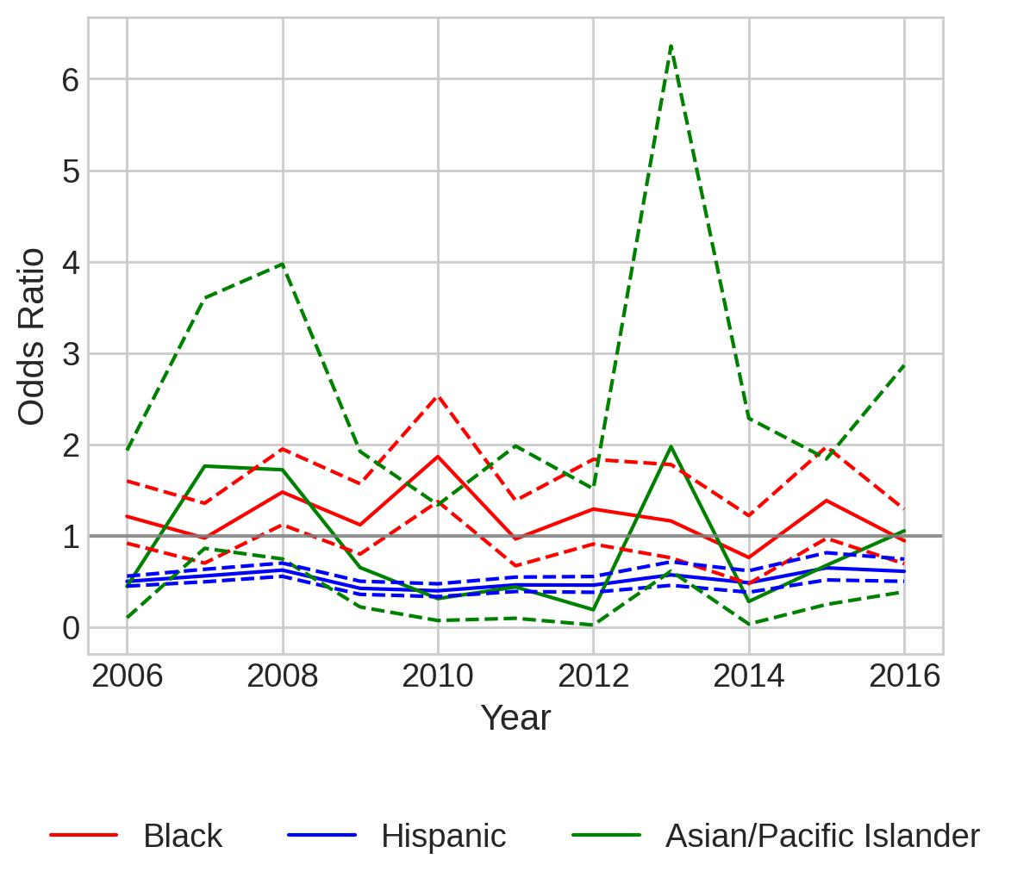
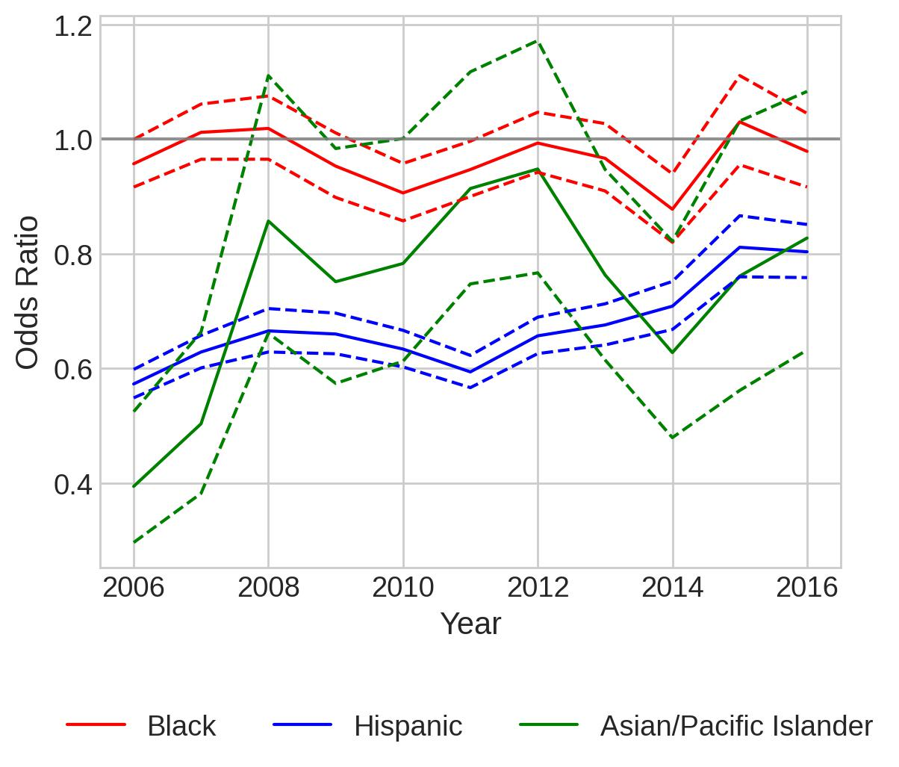
Separate Models for Border Counties and Non-border Counties
All Stops, Contraband
Border Counties
Non-border Counties

Slide 7
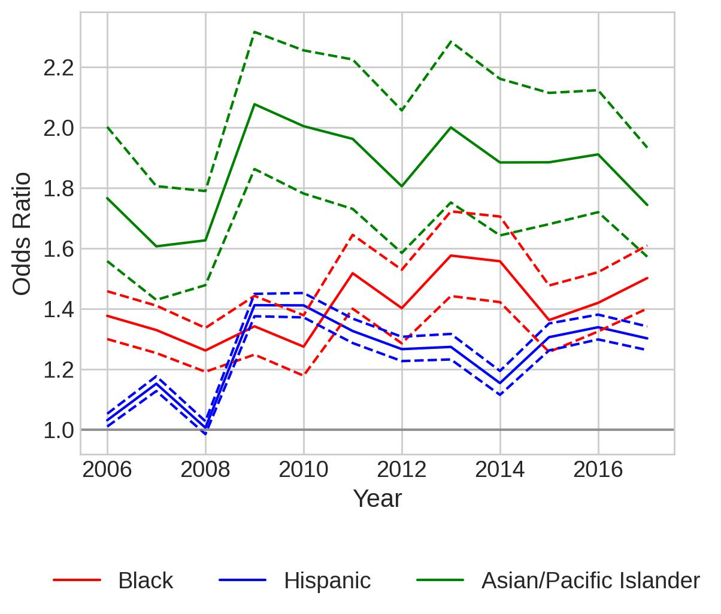
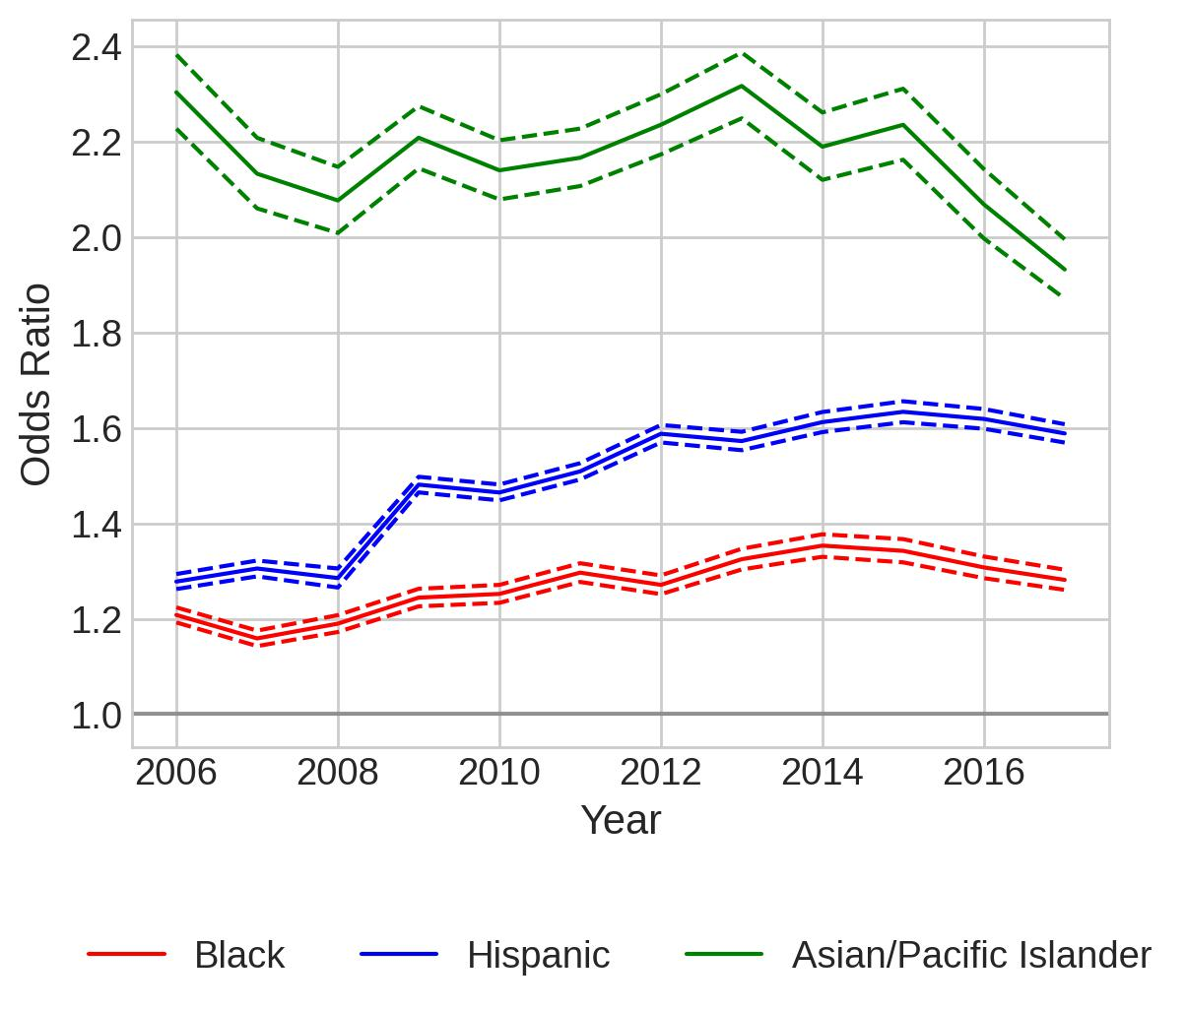
Separate Models for Border Counties and Non-border Counties
Speeding-only, Citation
Border Counties
Non-border Counties

Slide 8
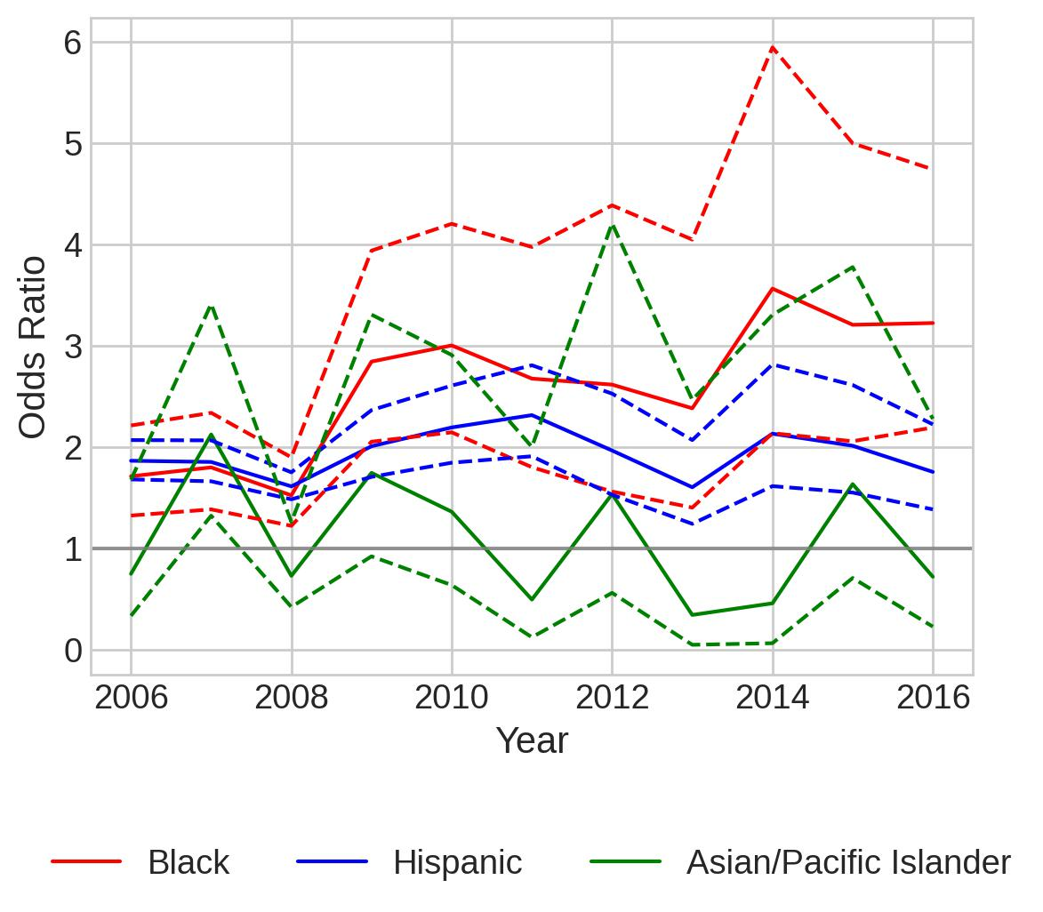
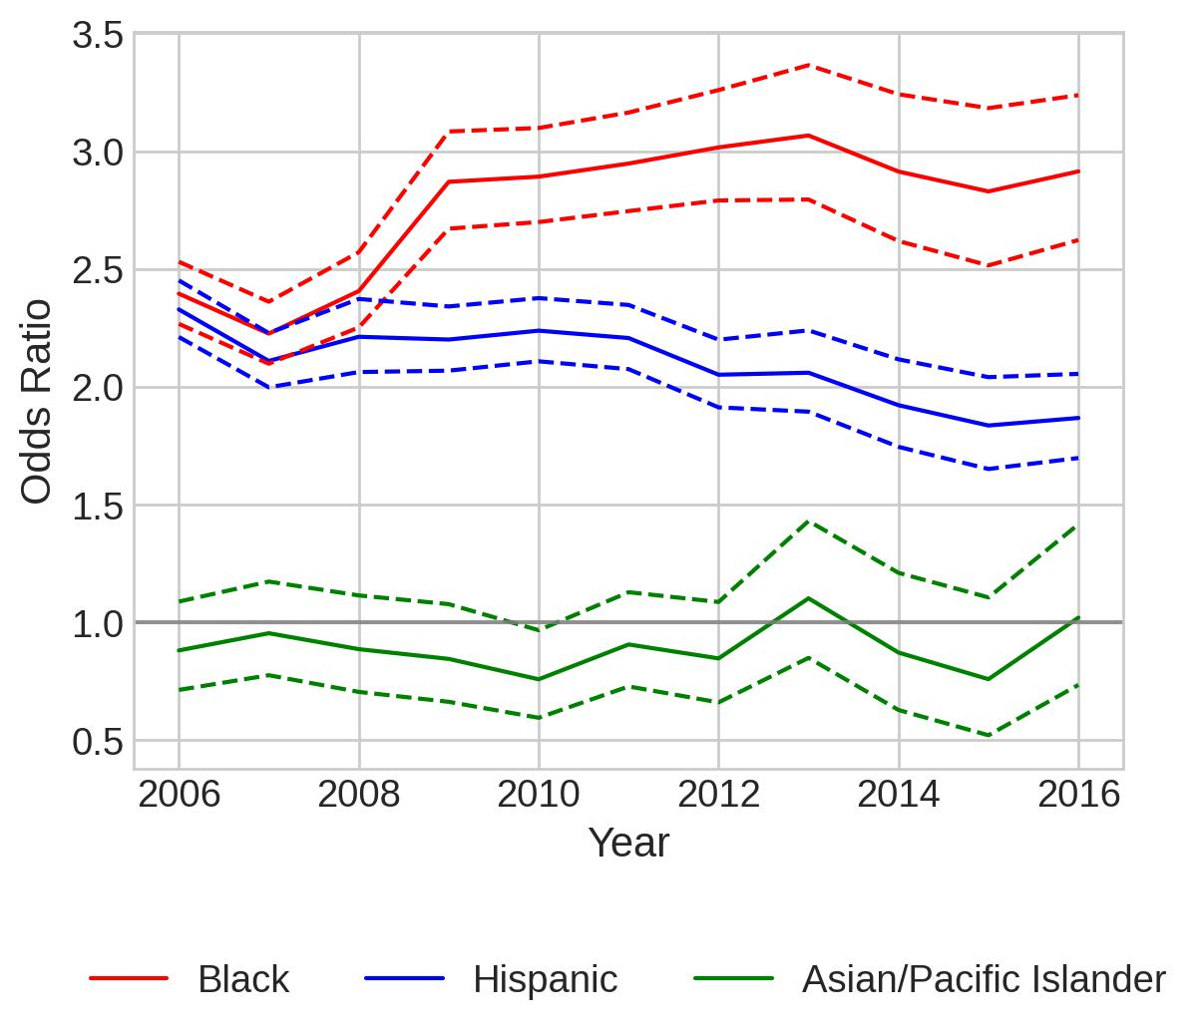
Separate Models for Border Counties and Non-border Counties
Speeding-only, Search
Border Counties
Non-border Counties

Slide 9
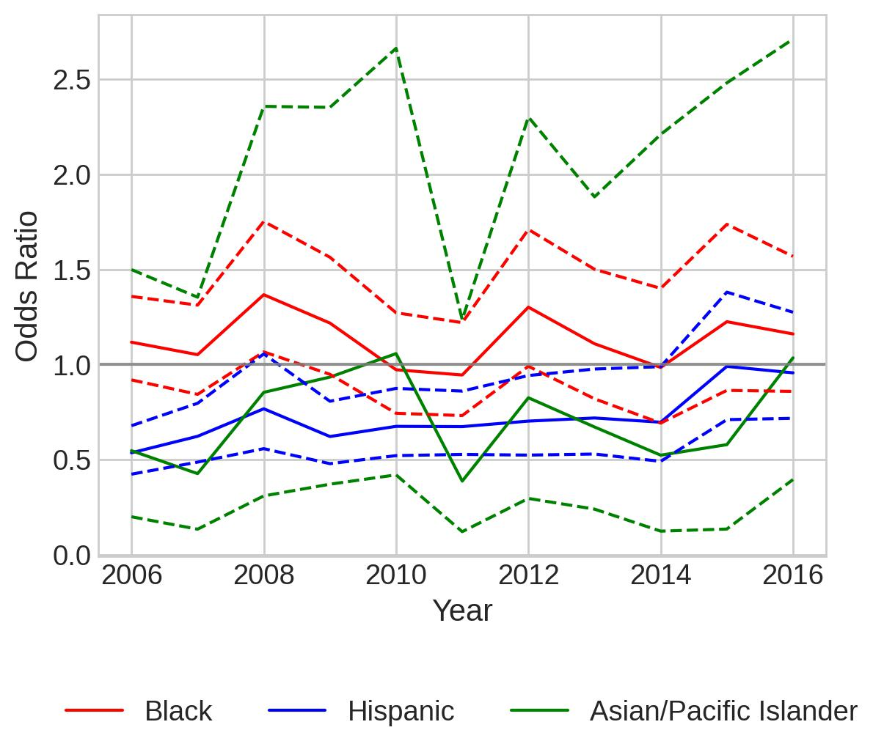
Separate Models for Border Counties and Non-border Counties
Speeding-only, Contraband
Border Counties
Non-border Counties
Warning: Maximum number of iterations has been exceeded.

Slide 10
Serious Offenses

Slide 11
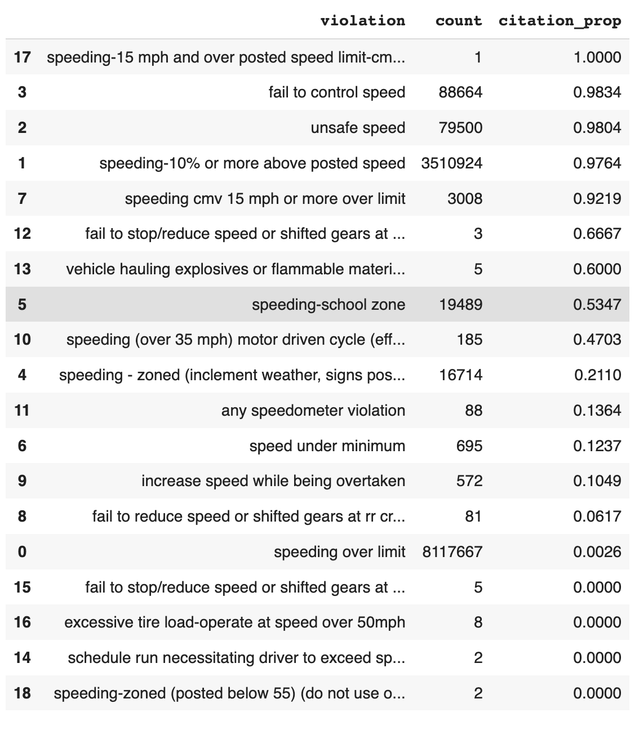
serious_speeding_violations = [
'fail to control speed',
'unsafe speed',
'speeding-10% or more above posted speed',
'speeding cmv 15 mph or more over limit'
]

Slide 12
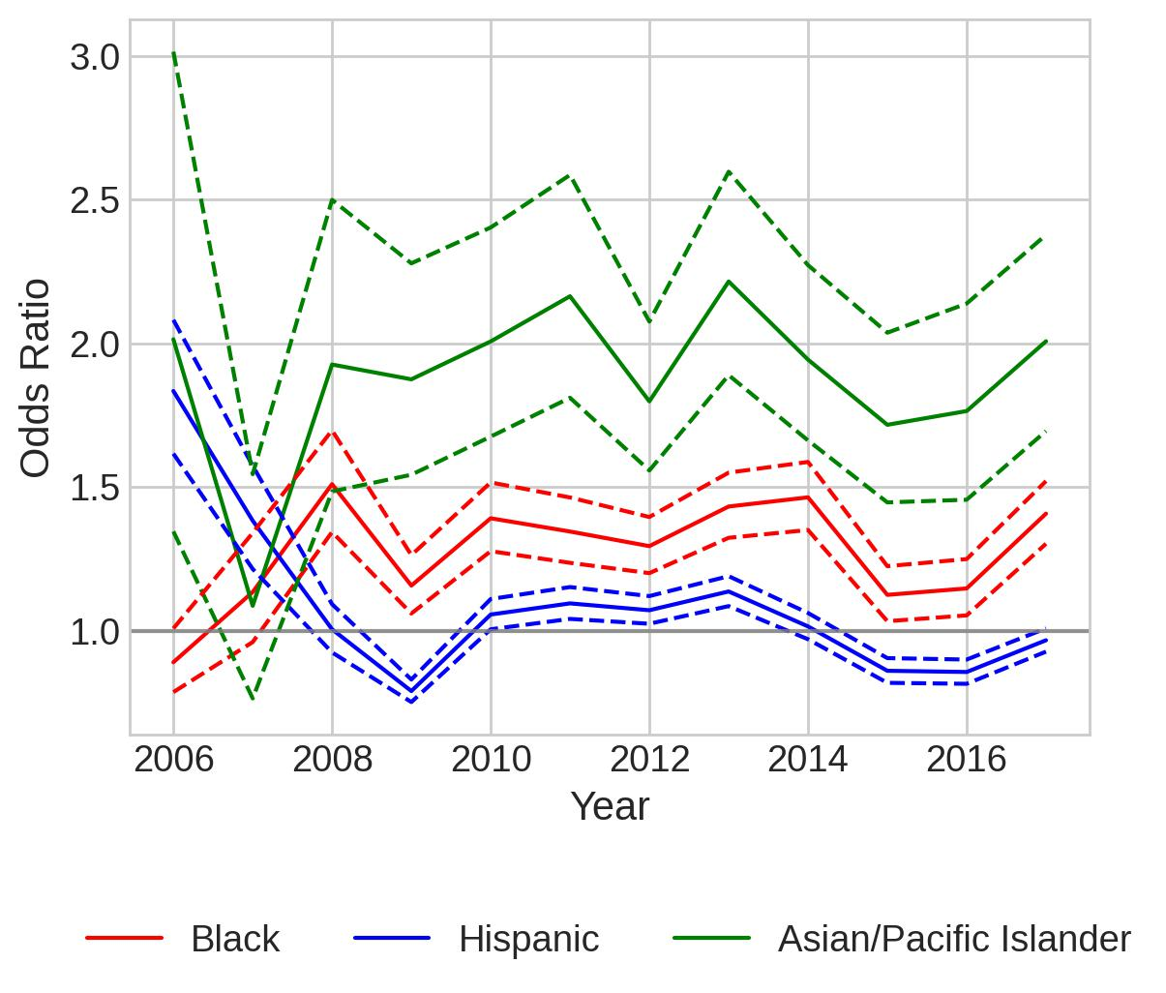
Model for most serious speeding offenses
Citation

Slide 13
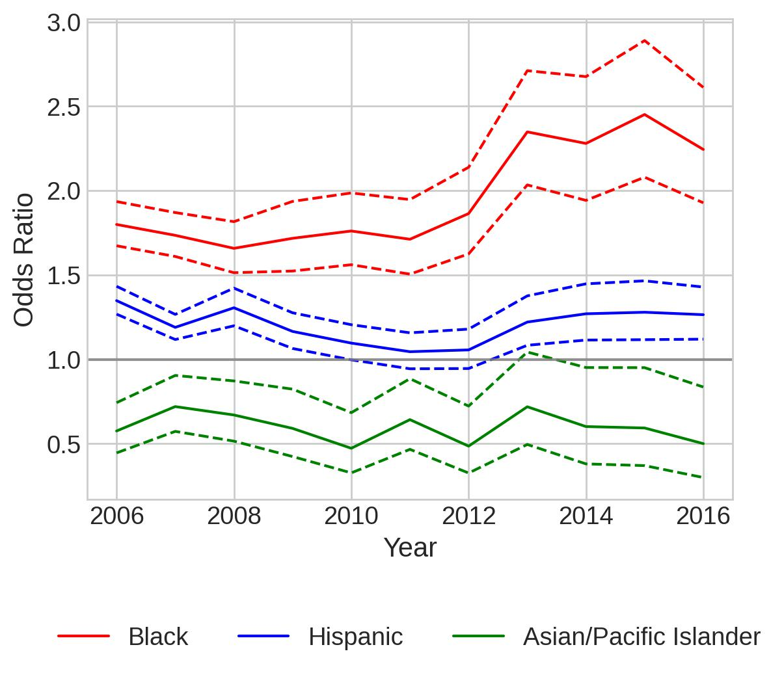
Model for most serious speeding offenses
Search

Slide 14
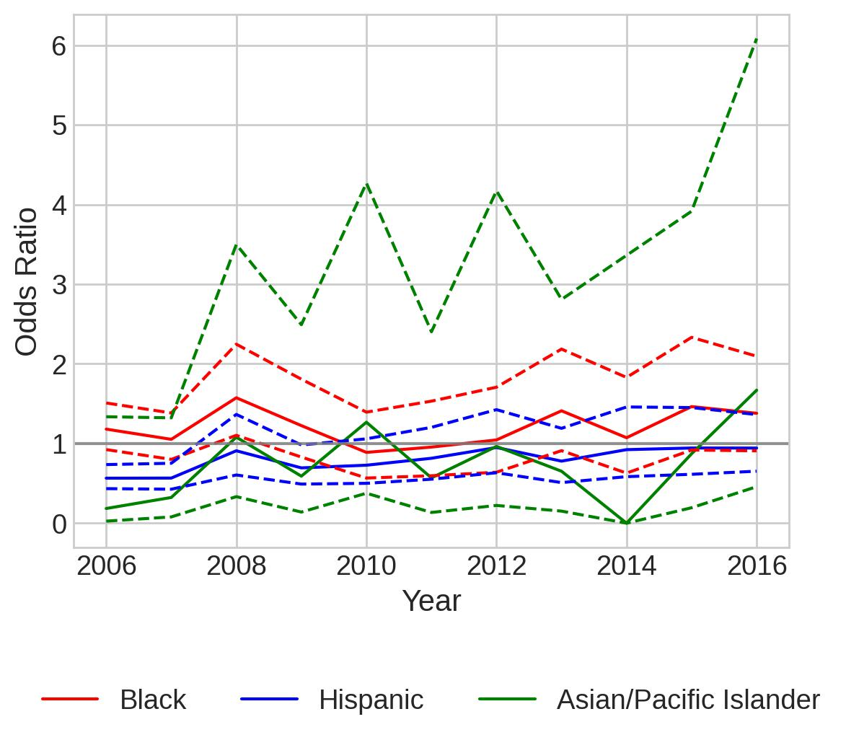
Model for most serious speeding offenses
Contraband

Slide 15
Demographics

Slide 16
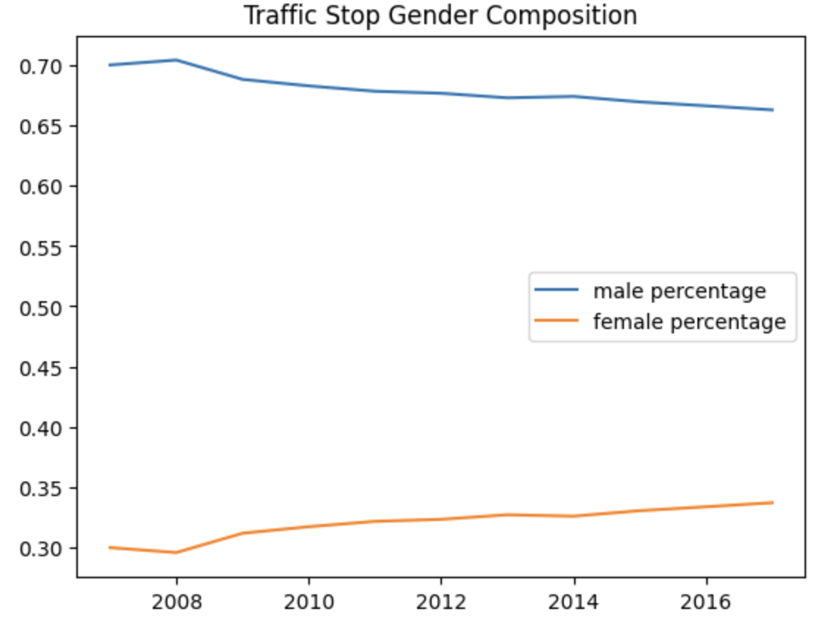
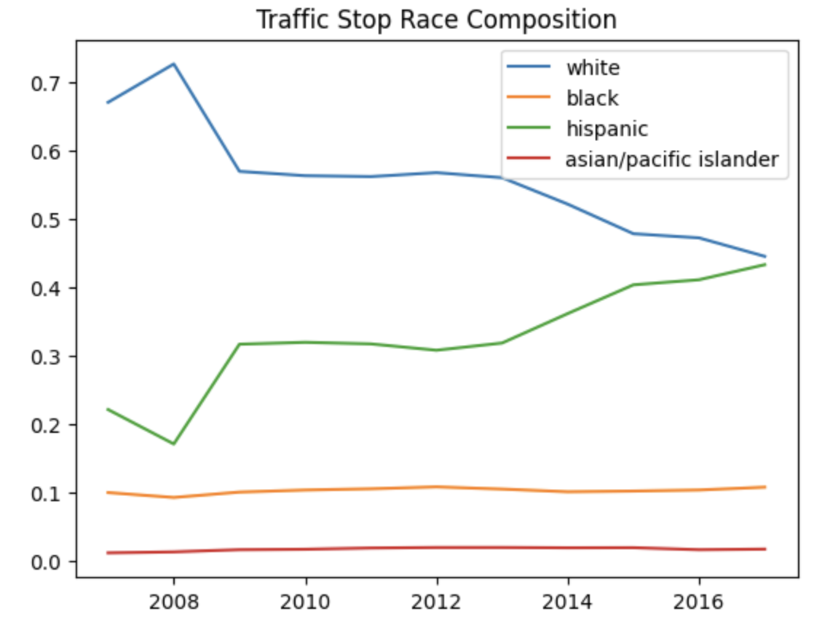
Descriptive Stats of the Demographics from the Stops Data

Slide 17
Separate Model for metropolitan, micropolitan, and non-core

Slide 18
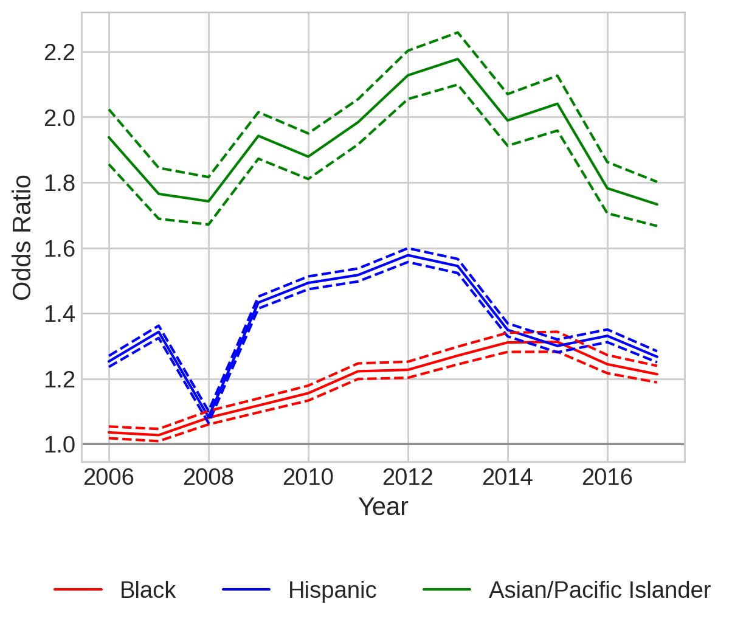
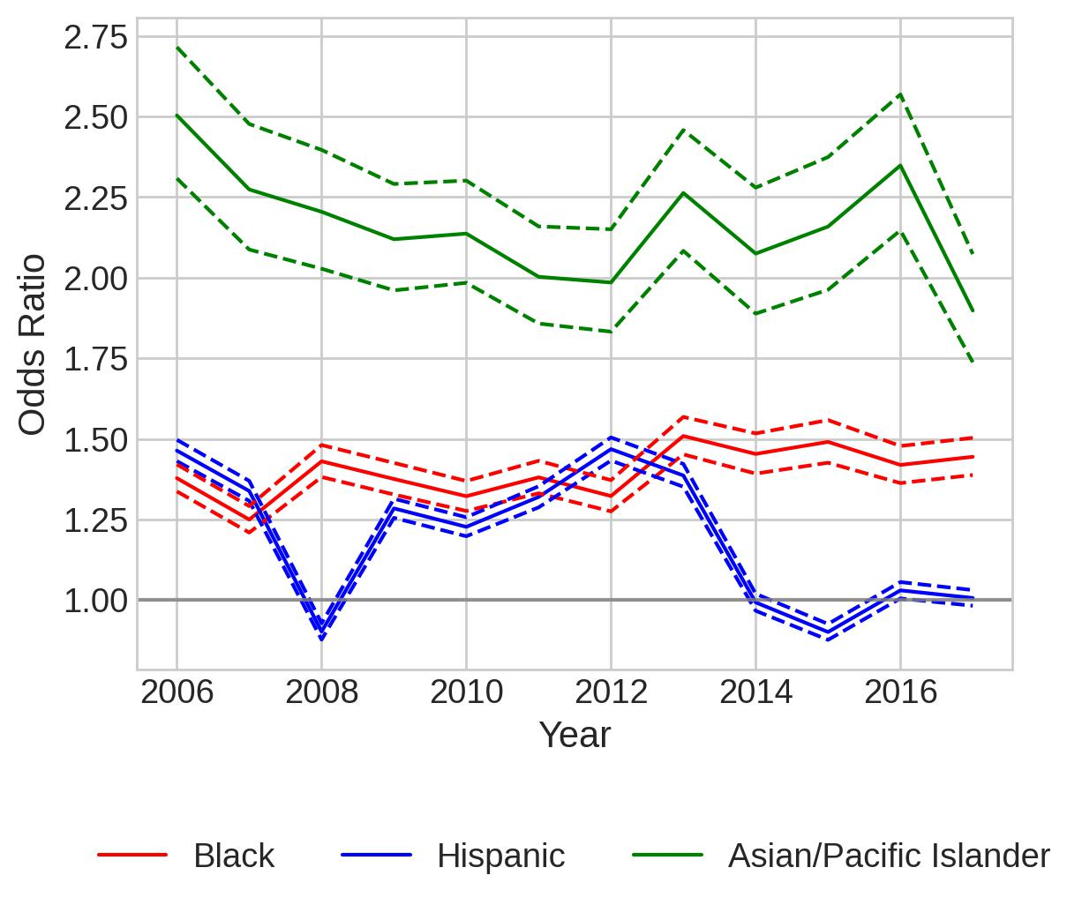
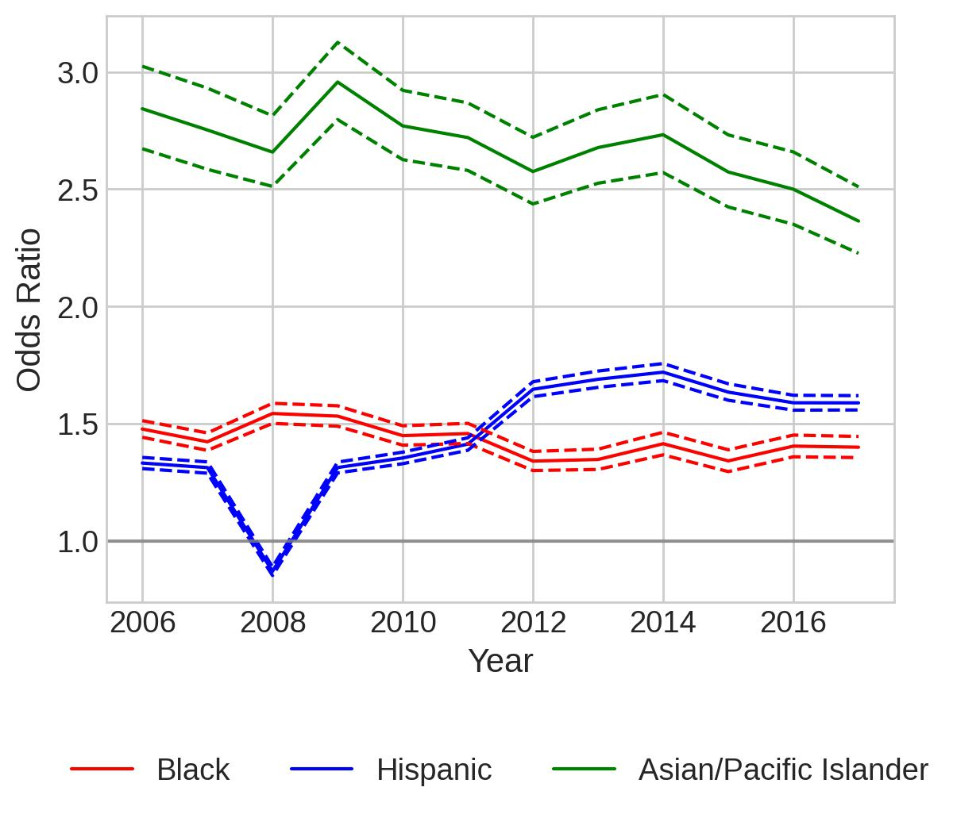
(speeding-only) Separate Logistic Regression Models and Odds Ratio Plots for Metropolitan, Micropolitan, and Non-core
citation
Metropolitan
Micropolitan
Noncore

Slide 19
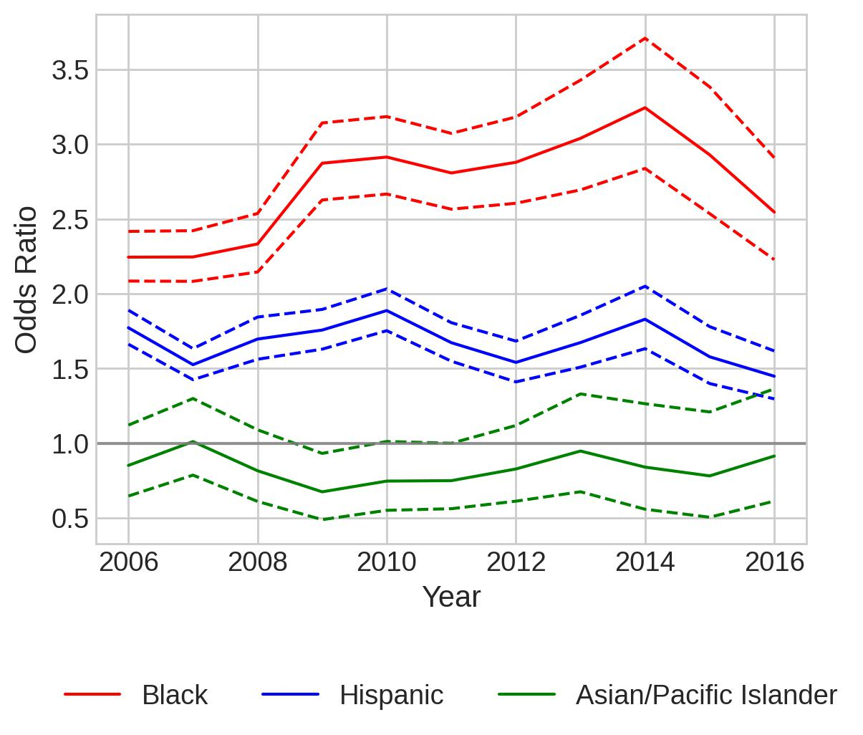
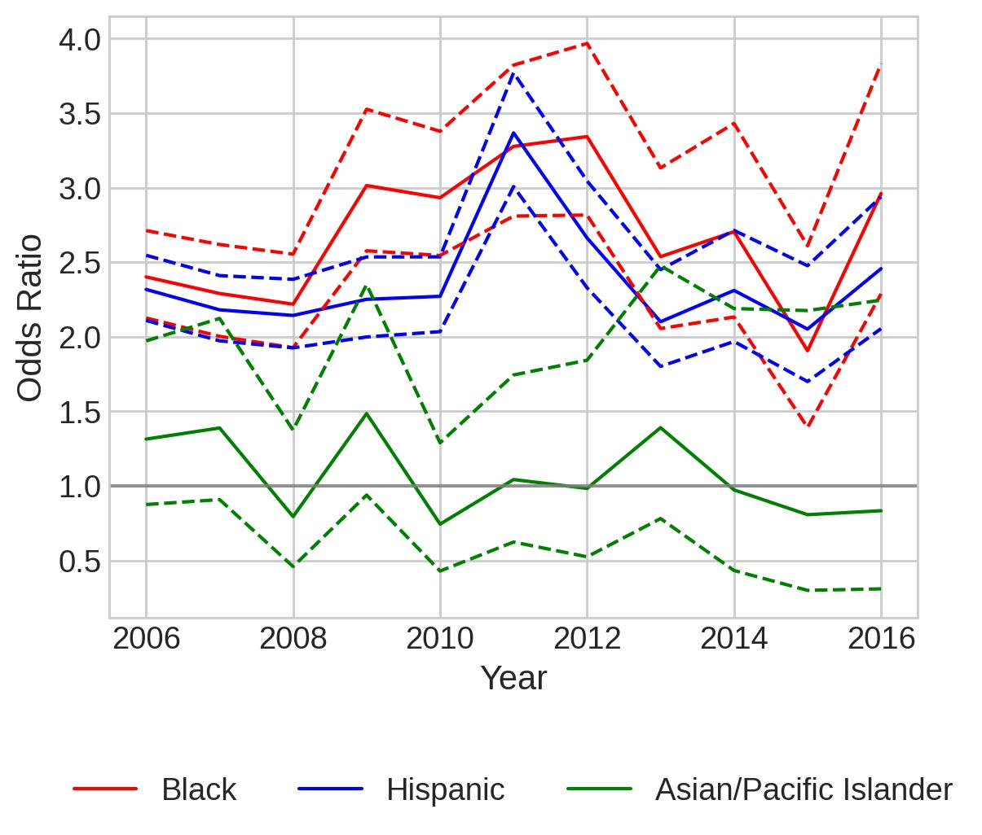
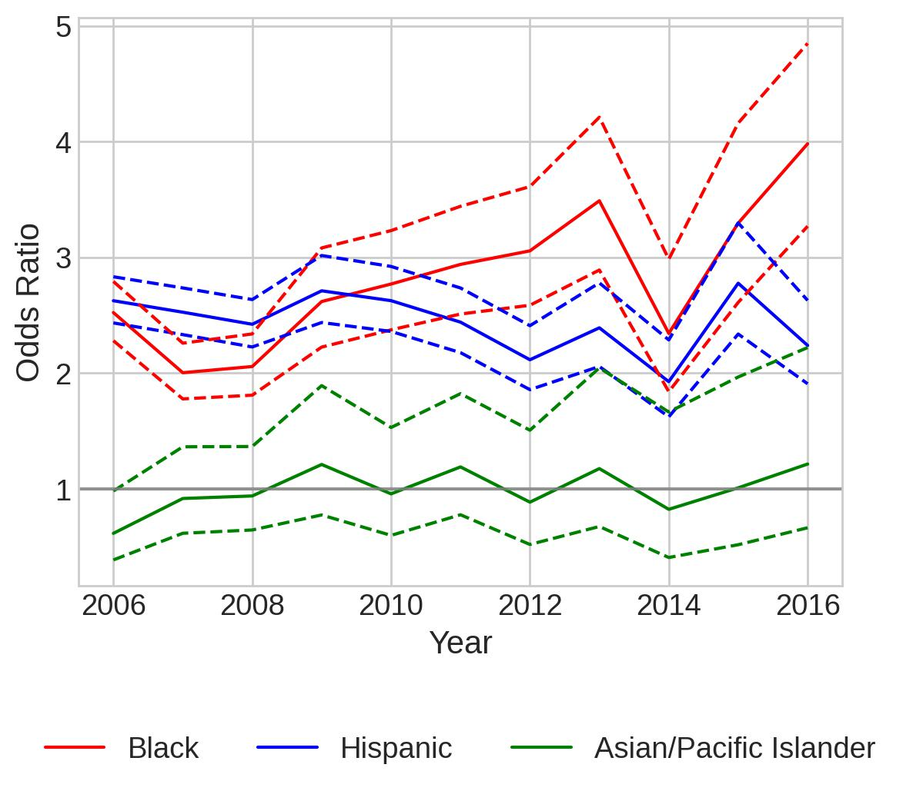
(speeding-only) Separate Logistic Regression Models and Odds Ratio Plots for Metropolitan, Micropolitan, and Non-core
Search
Metropolitan
Micropolitan
Noncore

Slide 20
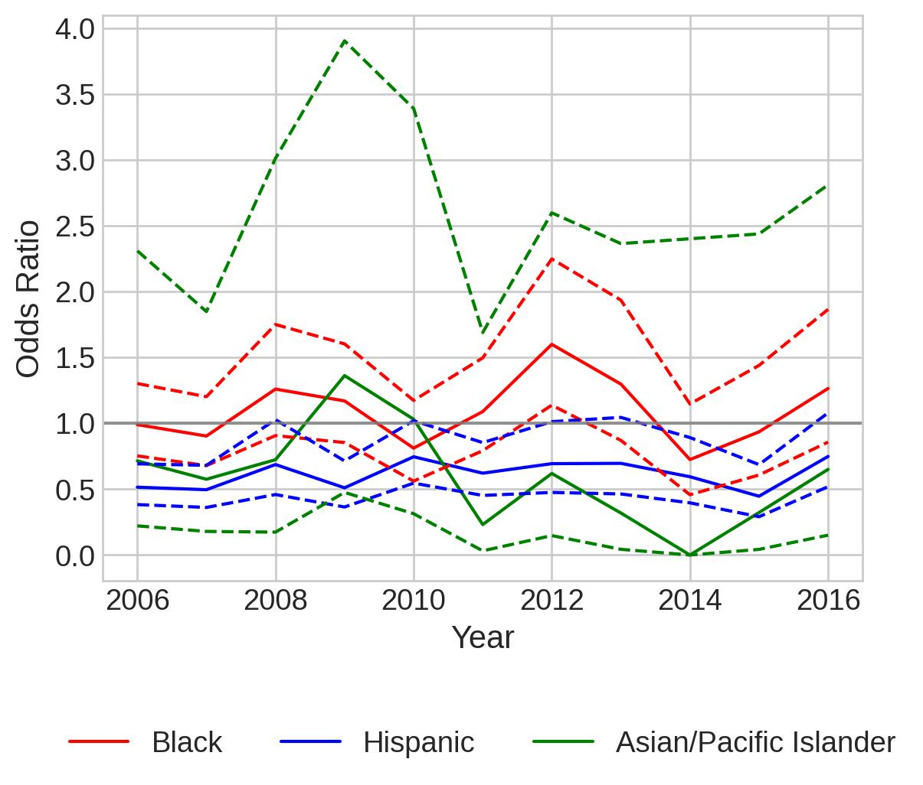
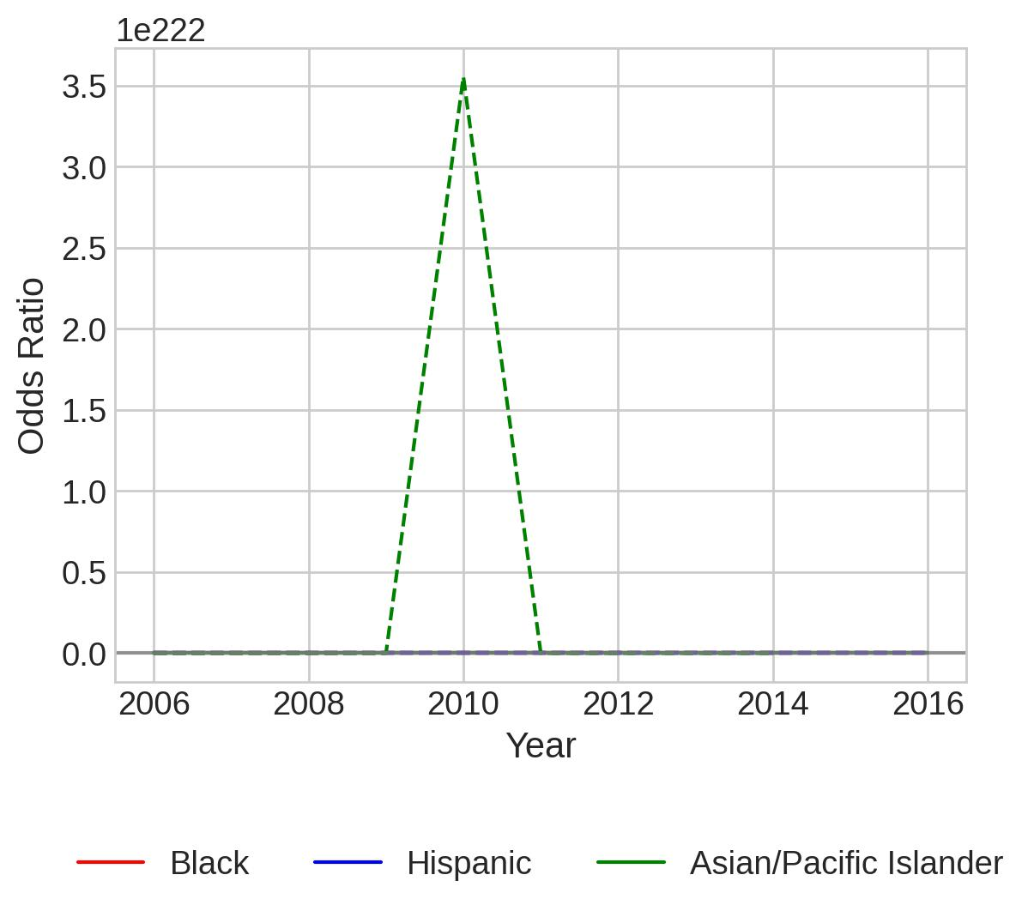
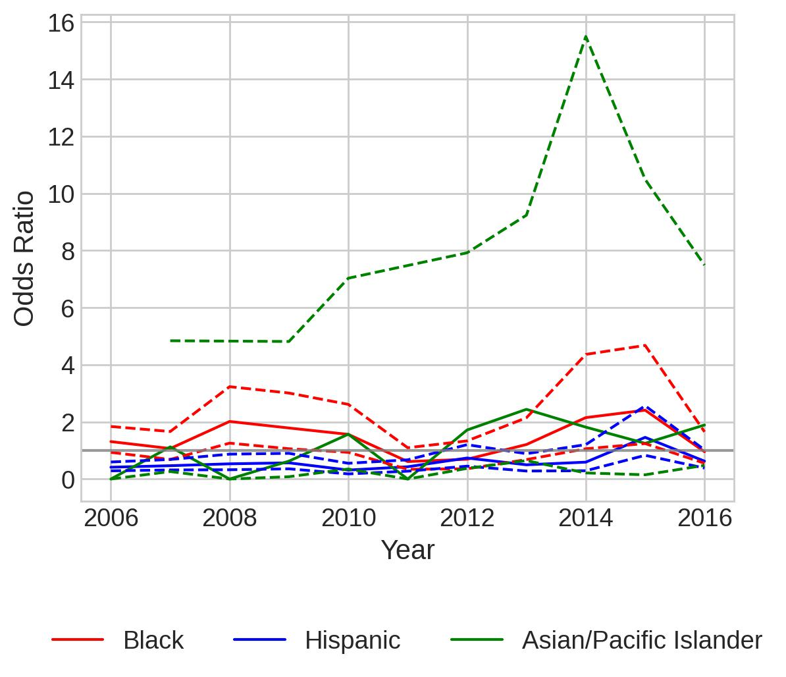
(speeding-only) Separate Logistic Regression Models and Odds Ratio Plots for Metropolitan, Micropolitan, and Non-core
Contraband
Metropolitan
Micropolitan
Noncore
For multiple years: Warning: Maximum number of iterations has been exceeded.
2006, 2011:
Warning: Maximum number of iterations has been exceeded.

