Slide 1
Telecommunication Networks and integrated Services (TNS) Laboratory
Department of Digital Systems
University of Piraeus Research Center (UPRC)
University of Piraeus
A secure SDN infrastructure
Name: Argyris Koudounas
Email: arkon6@outlook.com

Slide 2
Summary
For this thesis, I researched and analyzed in detail the network concept of Software Defined Networking, a new type of network infrastructure that offers centralized controller over a network. The research focused around its infrastructure and the security implementations and capabilities.
At the same time, I tested the integration of legacy security tools, like Snort and iptables, into an SDN infrastructure visualized using Mininet, in order to see the viability of such an implementation.
The test results has led us to the conclusion that SDN can be secure and cost-effective using legacy security tools, and proved to be a viable solution for any SDN network.

Slide 3
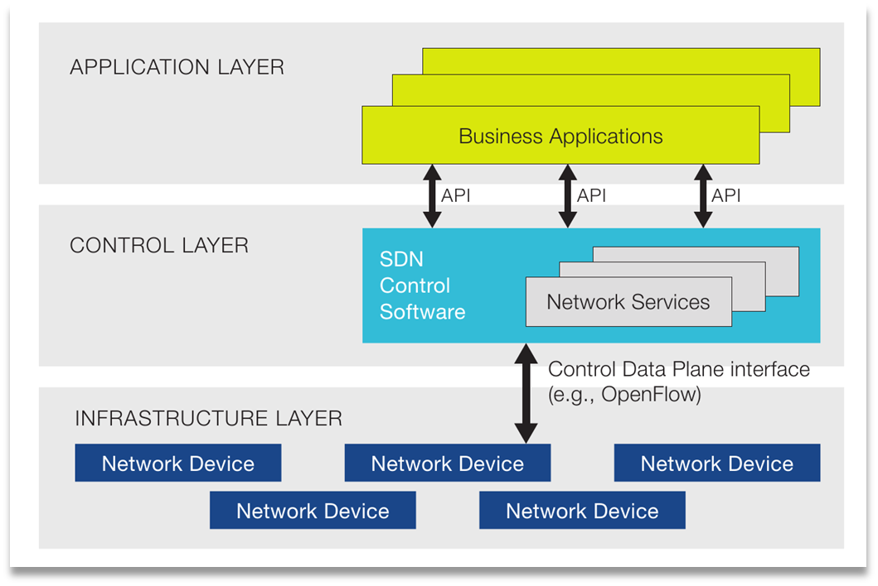
What is SDN?
Software-defined networking (SDN) is an architecture purporting to be dynamic, manageable, cost-effective, and adaptable, seeking to be suitable for the high-bandwidth, dynamic nature of today's applications.
SDN architectures decouple network control and forwarding functions, enabling network control to become directly programmable and the underlying infrastructure to be abstracted from applications and network services.

Slide 4
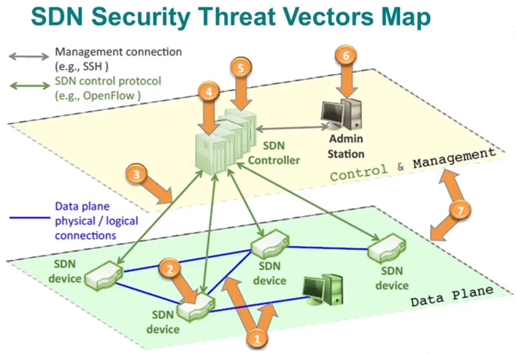
SDN Challenges
SDN is exposed to various sources of security risk from its network architecture design perspective, which includes the control plane, application plane and data plane layers:
The controllers are a particularly attractive target for attack in the SDN architecture
Potential malicious attack is the denial of service (DoS) attack
Vulnerabilities of traditional networks persist in SDN network

Slide 5
Security in networks and SDN
All types of networks are vulnerable to malicious behaviors that aim to either harm parts of the infrastructure or steal/alter information on their target.
Legacy networks have an array of security mechanisms to protect them from active and passive attacks, on the entirety of their reference model, and implement security services correctly.
SDN is not exception, with malicious people targeting such networks even more, because of how new the software defined infrastructure is and its lack of viable security mechanisms.
Since SDN function similarly to traditional networks, when it comes to traffic protocols, integrating legacy security tools is possible and could prove to be a viable and cost-effective solution, until viable SDN-specific mechanisms appear.

Slide 6
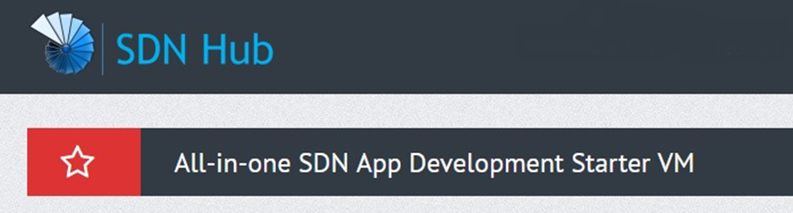
Testing Environment
Everything that has been mentioned until now has been performed in Ubuntu 14.04, running on a VM
The specific distribution includes all the necessary tools to work on SDN development
It is distributed by SDN Hub

Slide 7
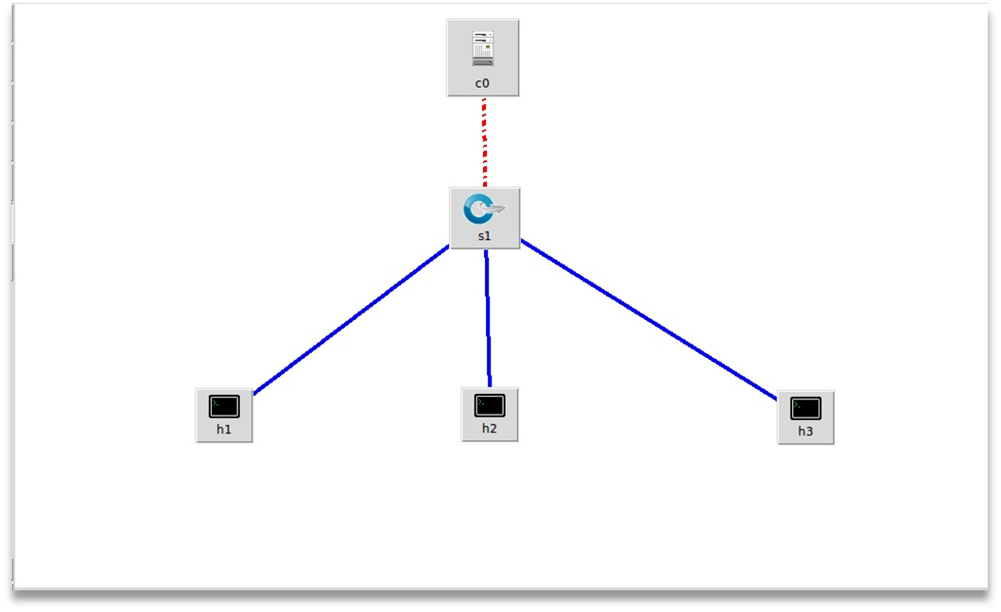
SDN Infrastructure Test bed
Network simulation was achieved using Mininet, a linux-based OS specialized in SDN network simulation, using OpenFlow protocol.
The simulation was set up using the remote controller Ryu.
In the example in the picture, we are simulating a network of 3 hosts, connected to 1 switch, which is directly connected to our controller, C0.

Slide 8
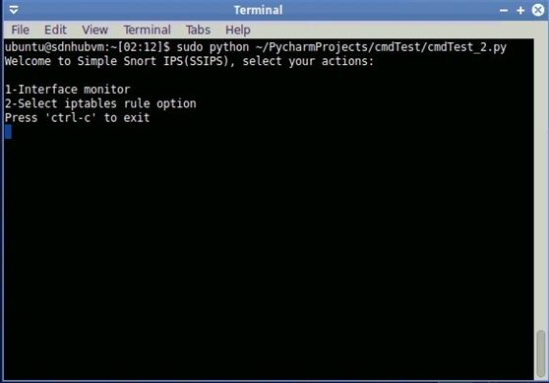
Automation and Scalability solution
Combining Snort’s alerts with python, along specific libraries, and Linux default firewall, I was able to prepare a basic IPS solution, that was implemented successfully on SDN.
The final product applied firewall rules based on alert output and administration choices.

Slide 9

Experimentation

Slide 11
Experiments results
In the following board, we can see the average results from every experiment, before, during and after an attack:
Test | Bytes count (H2->H1) | Bandwidth (H3->H1)
BEFORE | 335 Byte
DURING | 26520.9 Kb
AFTER | 43847.9 Kb

Slide 12
Conclussions
Based on the tests we run, in our simulated SDN environment, we came to the following conclusions:
  Snort, a legacy network tool, was integrated successfully into the SDN infrastructure
  Legacy network attacks work similarly on SDN, therefore similar attributes and characteristics apply on their functionality and countermeasures
  Network anomalies are detected immediately, based on the ruleset we select.
  Simulated environment is a bit restricted, when it comes to interface, node discovery and performance measurements.
  Scalability is an issue, since Snort needs to be activated individually for each interface a network infrastructure has.
  IPS script offer immediate actions to attacks, as a temporary solution before more solid actions are taken.

