Slide 1
PID
Ara Kourchians

Slide 2
Physical
World
Control
Desired
World

Slide 3
Open Loop
Physical
World
Control
Desired
World
Notes:
Simple autonomous mode that follows a script
Sprinkler system on a timer
Motor + battery
You “trust” that it works and assume ideal conditions

Slide 4
Closed Loop
Physical
World
Control
Sensing
Desired
World
Notes:
Air Conditioners
Airplanes auto-pilot
Drones

Slide 5
??? Loop
Notes:
- Based on the previous definition, is this a closed or open loop system?

Slide 6
Closed Loop
X
Sensing

Slide 7
Closed Loop
X
Sensing
Control
Notes:
- Explain how the students observe where the robot is and come up with a control command to give the robot, but this has a problem….

Slide 8
Closed Loop
X
Sensing
Control
Notes:
This requires training, learning, ‘piloting’
Robot might not drive perfectly straight
Might slip, or be going uphill and will require the driver to manually add more power
So far, the driver has had to learn each robot.. and every robot is different

Slide 9
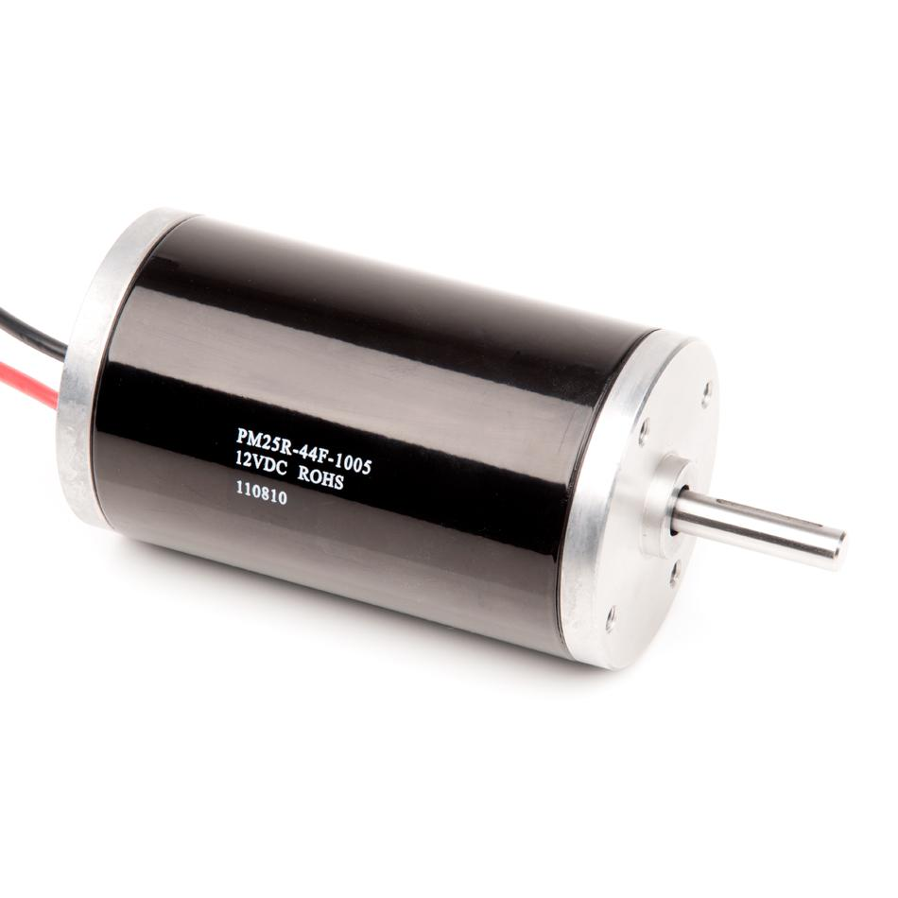
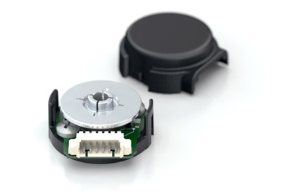
Some terminology
Motor
Encoder
State
Target
Error
Notes:
The story is different for autonomous mode

Slide 10
Autonomous Mode
State
Target
X
Error
Notes:
The story is different for autonomous mode

Slide 11
Autonomous Mode
autonomous.c
State
Target
X
Error

Slide 12
Autonomous Mode
autonomous.c
0
void go()
{
..
robot.drive(X);
..
}
X
Notes:
How do you actually write this in terms of motors and sensors?

Slide 13
Autonomous Mode
autonomous.c
0
void go()
{
..
robot.motors(100);
wait(1_SEC);
robot.motors(0); ..
}
X
Error
X+Error

Slide 14
Autonomous Mode
autonomous.c
0
void go()
{
..
robot.motors(100);
while(encoder < 1000)
{
encoder = robot.read();
}
robot.motors(0);
..
}
X
Error
X+Error
Notes:
You’re going to overshoot when you get to your goal (100% to 0%)

Slide 15
PID Control
0
Error

Slide 16
PID Control
Proportional
Present
P*Error
Integral
Past
I*Sum_of_Errors
Derivative
Future
D*(Error- Last_Error)
+
+
5
2
1
5
1
2
Notes:
PID controllers run in a loop, it’s iterative
Weights of each term depend on the system!
The P, I, and D terms are summed and used as the controller output

Slide 17
Position Control Using PID

Slide 18
Design
Gearbox
PID CONTROLLER
MOTOR
Wheel
ENCODER

Slide 19
PID Block Diagram
P
Error
I
+
Motor
Output
Target
+
+
Σ
-
+
State
D

Slide 20
PID Block Diagram
P
Error
I
+
Motor
Output
Target
+
+
Σ
-
+
State
D
Encoder

Slide 21
Proportional Control

Slide 22
Proportional Control
Motor = P * Error
0
Error

Slide 23
Proportional Control
Motor = P * Error
100 = 2 * 50
0
Error

Slide 24
Proportional Control
Motor = P * Error
20 = 2 * 10
0
Error

Slide 25
Proportional Control
Motor = P * Error
1 = 2 * 1
0
Error
Notes:
You may never reach it, or overshoot it
VERY system dependent ^
P term would be target distance dependent

Slide 26
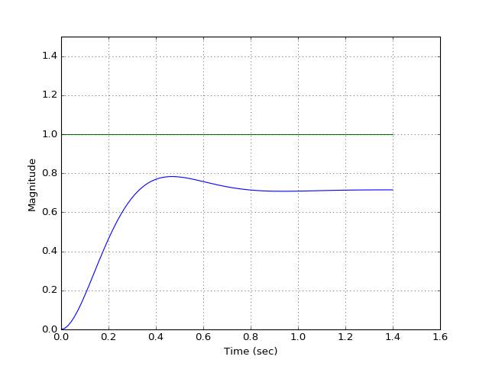
Proportional Control

Slide 27
Integral Control

Slide 28
Integral Control
Error_Sum = Error_Sum + Error
50 = 0 + 50
95 = 50 + 45
115 = 95 + 20
115 = 115 + 0
75 = 115 + -40
25 = 75 + -50
-35 = 25 + -60
-85 = -35 + -50
Motor = I * Error_Sum
25 = 0.5 * 50
48 = 0.5 * 95
56 = 0.5 * 115
56 = 0.5 * 115
38 = 0.5 * 75
13 = 0.5 * 25
-17 = 0.5 * -35
-43 = 0.5 * -85
0
Error
Notes:
You may never reach it, or overshoot it
VERY system dependent ^
P term would be target distance dependent

Slide 29
Integral Control
Error_Sum = Error_Sum + Error
50 = 0 + 50
95 = 50 + 45
115 = 95 + 20
115 = 115 + 0
75 = 115 + -40
25 = 75 + -50
-35 = 25 + -60
-85 = -35 + -50
Motor = I * Error_Sum
25 = 0.5 * 50
48 = 0.5 * 95
56 = 0.5 * 115
56 = 0.5 * 115
38 = 0.5 * 75
13 = 0.5 * 25
-17 = 0.5 * -35
-43 = 0.5 * -85
0
Error
Notes:
You may never reach it, or overshoot it
VERY system dependent ^
P term would be target distance dependent

Slide 30
Integral Control
Error_Sum = Error_Sum + Error
50 = 0 + 50
95 = 50 + 45
115 = 95 + 20
115 = 115 + 0
75 = 115 + -40
25 = 75 + -50
-35 = 25 + -60
-85 = -35 + -50
Motor = I * Error_Sum
25 = 0.5 * 50
48 = 0.5 * 95
56 = 0.5 * 115
56 = 0.5 * 115
38 = 0.5 * 75
13 = 0.5 * 25
-17 = 0.5 * -35
-43 = 0.5 * -85
0
Error
Notes:
You may never reach it, or overshoot it
VERY system dependent ^
P term would be target distance dependent

Slide 31
Integral Control
Error_Sum = Error_Sum + Error
50 = 0 + 50
95 = 50 + 45
115 = 95 + 20
115 = 115 + 0
75 = 115 + -40
25 = 75 + -50
-35 = 25 + -60
-85 = -35 + -50
Motor = I * Error_Sum
25 = 0.5 * 50
48 = 0.5 * 95
56 = 0.5 * 115
56 = 0.5 * 115
38 = 0.5 * 75
13 = 0.5 * 25
-17 = 0.5 * -35
-43 = 0.5 * -85
0
Notes:
You may never reach it, or overshoot it
VERY system dependent ^
P term would be target distance dependent

Slide 32
Integral Control
Error_Sum = Error_Sum + Error
50 = 0 + 50
95 = 50 + 45
115 = 95 + 20
115 = 115 + 0
75 = 115 + -40
25 = 75 + -50
-35 = 25 + -60
-85 = -35 + -50
Motor = I * Error_Sum
25 = 0.5 * 50
48 = 0.5 * 95
56 = 0.5 * 115
56 = 0.5 * 115
38 = 0.5 * 75
13 = 0.5 * 25
-17 = 0.5 * -35
-43 = 0.5 * -85
0
-Error
Notes:
You may never reach it, or overshoot it
VERY system dependent ^
P term would be target distance dependent

Slide 33
Integral Control
Error_Sum = Error_Sum + Error
50 = 0 + 50
95 = 50 + 45
115 = 95 + 20
115 = 115 + 0
75 = 115 + -40
25 = 75 + -50
-35 = 25 + -60
-85 = -35 + -50
Motor = I * Error_Sum
25 = 0.5 * 50
48 = 0.5 * 95
56 = 0.5 * 115
56 = 0.5 * 115
38 = 0.5 * 75
13 = 0.5 * 25
-17 = 0.5 * -35
-43 = 0.5 * -85
0
-Error
Notes:
You may never reach it, or overshoot it
VERY system dependent ^
P term would be target distance dependent

Slide 34
Integral Control
Error_Sum = Error_Sum + Error
50 = 0 + 50
95 = 50 + 45
115 = 95 + 20
115 = 115 + 0
75 = 115 + -40
25 = 75 + -50
-35 = 25 + -60
-85 = -35 + -50
Motor = I * Error_Sum
25 = 0.5 * 50
48 = 0.5 * 95
56 = 0.5 * 115
56 = 0.5 * 115
38 = 0.5 * 75
13 = 0.5 * 25
-17 = 0.5 * -35
-43 = 0.5 * -85
0
-Error
Notes:
You may never reach it, or overshoot it
VERY system dependent ^
P term would be target distance dependent

Slide 35
Integral Control
Error_Sum = Error_Sum + Error
50 = 0 + 50
95 = 50 + 45
115 = 95 + 20
115 = 115 + 0
75 = 115 + -40
25 = 75 + -50
-35 = 25 + -60
-75 = -35 + -40
Motor = I * Error_Sum
25 = 0.5 * 50
48 = 0.5 * 95
56 = 0.5 * 115
56 = 0.5 * 115
38 = 0.5 * 75
13 = 0.5 * 25
-17 = 0.5 * -35
-38 = 0.5 * -75
0
-Error
Notes:
You may never reach it, or overshoot it
VERY system dependent ^
P term would be target distance dependent

Slide 36
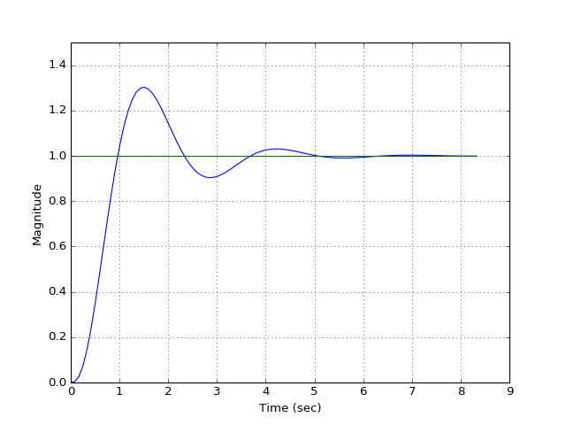
Integral Control

Slide 37
Derivative Control

Slide 38
Derivative Control
Motor = D* (Error – Last_Error)
= 0.5 * (50 – 0)
0
Error
Notes:
You may never reach it, or overshoot it
VERY system dependent ^
P term would be target distance dependent

Slide 39
Derivative Control
Motor = D* (Error – Last_Error)
25 = 0.5 * (50 – 0)
-5 = 0.5 * (40 – 50)
0
Error
Notes:
You may never reach it, or overshoot it
VERY system dependent ^
P term would be target distance dependent

Slide 40
Derivative Control
Motor = D* (Error – Last_Error)
25 = 0.5 * (50 – 0)
-5 = 0.5 * (40 – 50)
-2.5 = 0.5 * (35 – 40)
0
Error
Notes:
You may never reach it, or overshoot it
VERY system dependent ^
P term would be target distance dependent

Slide 41
Derivative Control
Motor = D* (Error – Last_Error)
25 = 0.5 * (50 – 0)
-5 = 0.5 * (40 – 50)
-2.5 = 0.5 * (35 – 40)
0 = 0.5 * (35 – 35)
0
Error
Notes:
You may never reach it, or overshoot it
VERY system dependent ^
P term would be target distance dependent

Slide 42
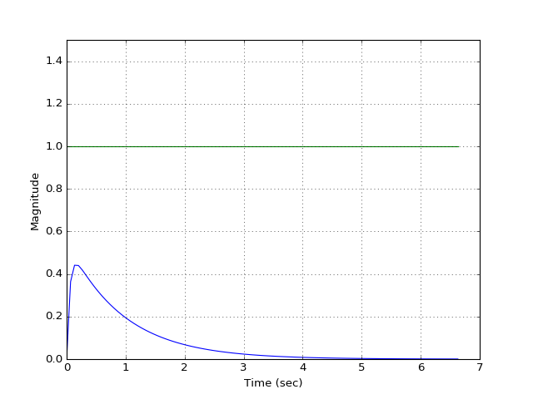
Derivative Control

Slide 43
PID Plot Terminology

Slide 44
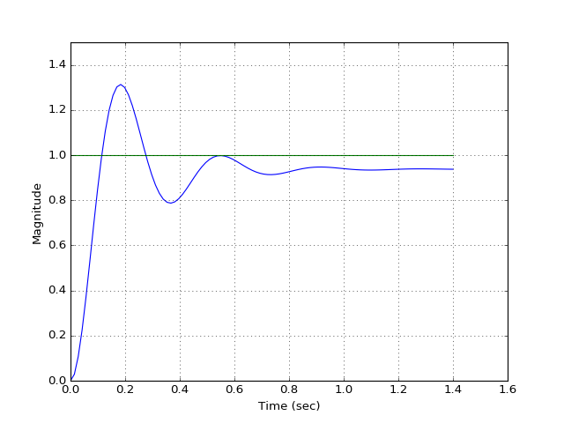
PID Plot Terminology
Overshoot
Steady-State Error
Rise Time
Settling Time

Slide 45
P = 50

Slide 46
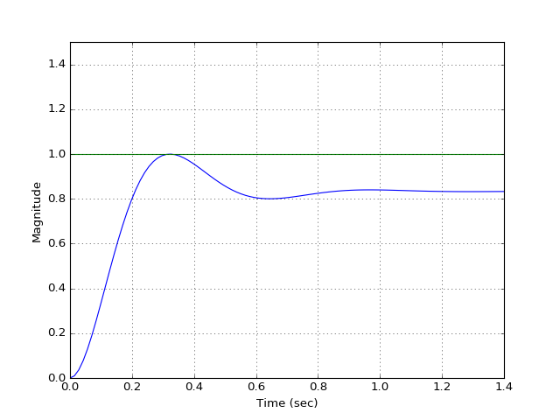
P = 100

Slide 47
P = 300

Slide 48
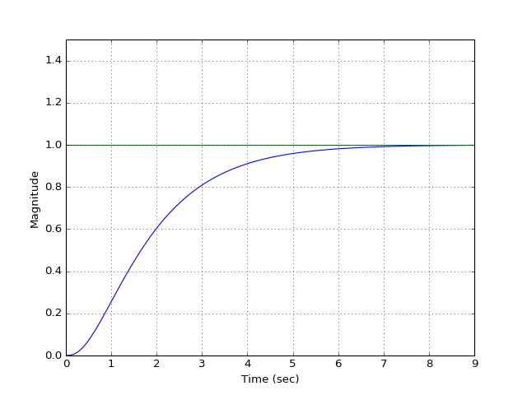
I = 10

Slide 49
I = 50

Slide 50
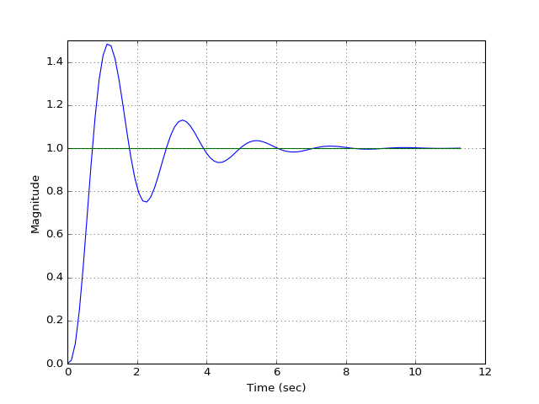
I = 80

Slide 51
D = 10

Slide 52
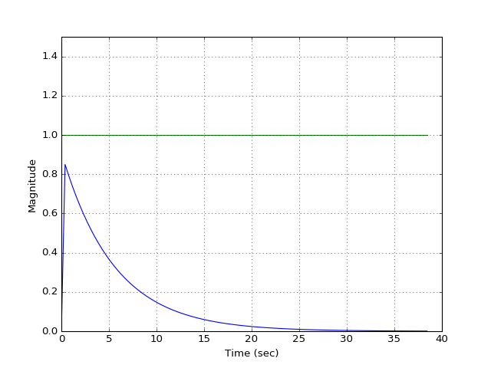
D = 100

Slide 53
PID Tuning Methods

Slide 54
PID Plot Terminology
Overshoot
Steady-State Error
Rise Time
Settling Time

Slide 55
PID Tuning Methods
Parameter Increase | Rise Time | Overshoot | Settling Time | Steady-State Error
Kp |  |  | Small Change
Ki
Kd | Small Change |  |  | Small Change

Slide 56
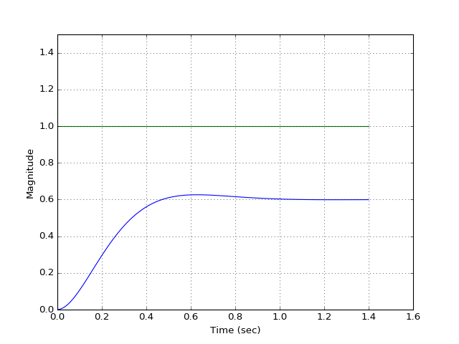
P = 30, I = 0, D = 0

Slide 57
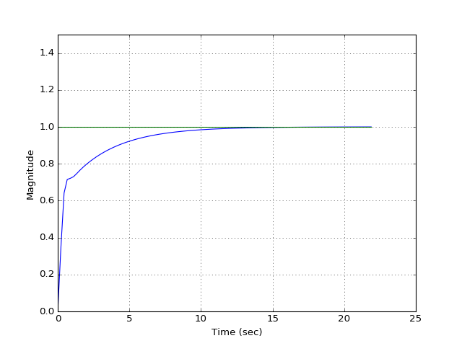
P = 30, I = 15, D = 0

Slide 58
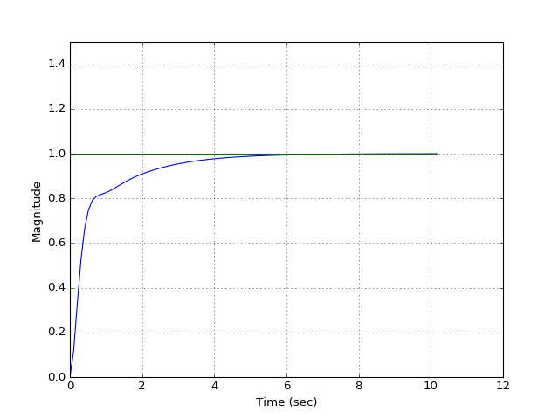
P = 30, I = 30, D = 0

Slide 59
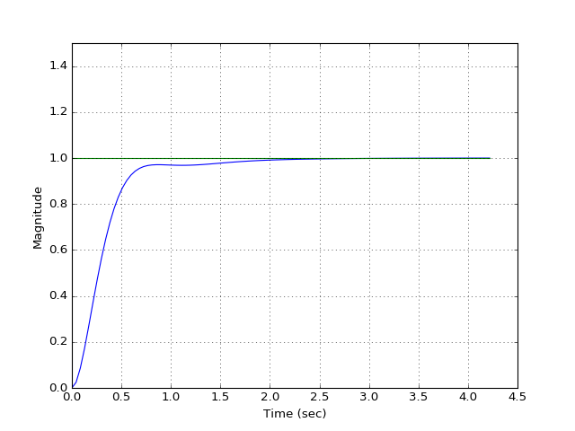
P = 30, I = 60, D = 0

Slide 60
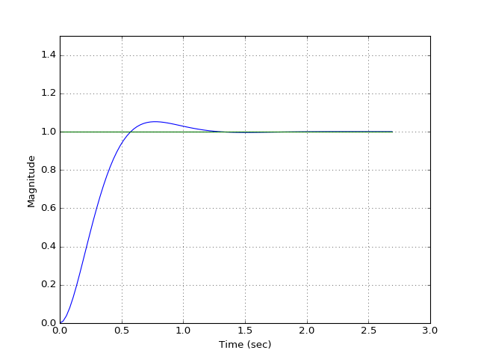
P = 30, I = 80, D = 0

Slide 61
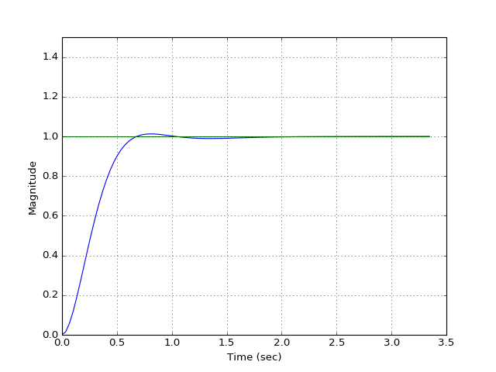
P = 30, I = 70, D = 0

Slide 62
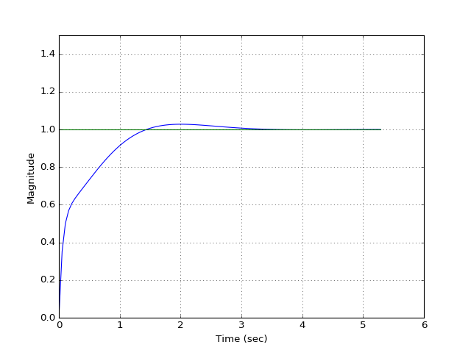
P = 30, I = 70, D = 10

Slide 63
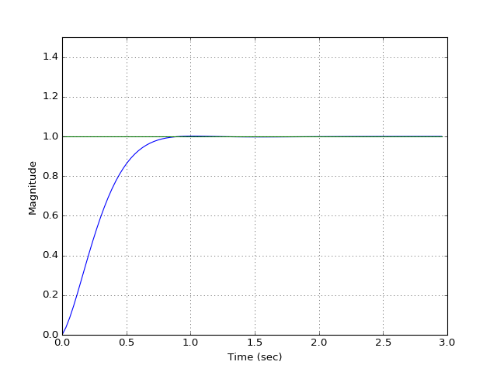
P = 30, I = 70, D = 1

Slide 64
“The Right Way” (beyond our scope)

Slide 65
Model
Digital
Motor Speed
Or
Digital
Motor Position
Physical
Motor Speed
Or
Physical
Motor Position
+
Controller
Plant
Σ
-

Slide 66
Model
Digital
Motor Speed
Or
Digital
Motor Position
Physical
Motor Speed
Or
Physical
Motor Position
+
Controller
Plant
Σ
-

Slide 67
Model
Digital
Motor Speed
Or
Digital
Motor Position
Physical
Motor Speed
Or
Physical
Motor Position
+
Controller
Plant
Σ
-
PID Control Loop
Physical Motor & Wheel

Slide 68
Model
Encoder
Digital
Motor Speed
Or
Digital
Motor Position
Physical
Motor Speed
Or
Physical
Motor Position
+
Controller
Plant
Σ
-
PID Control Loop
Physical Motor & Wheel

Slide 69
Time and S Domain
Mass:
Damper:
Spring:
M
M*s^2
D*s
K

Slide 70
Physical Motor & Wheel
Gearbox
+
Ea
-
MOTOR
Wheel
θm

Slide 71
Physical Motor & Wheel
Motor
Gearbox
+
Ea
-
Ra
Wheel
La
Vemf
- +
Ja
Da
θm
Kt
Kb

Slide 72
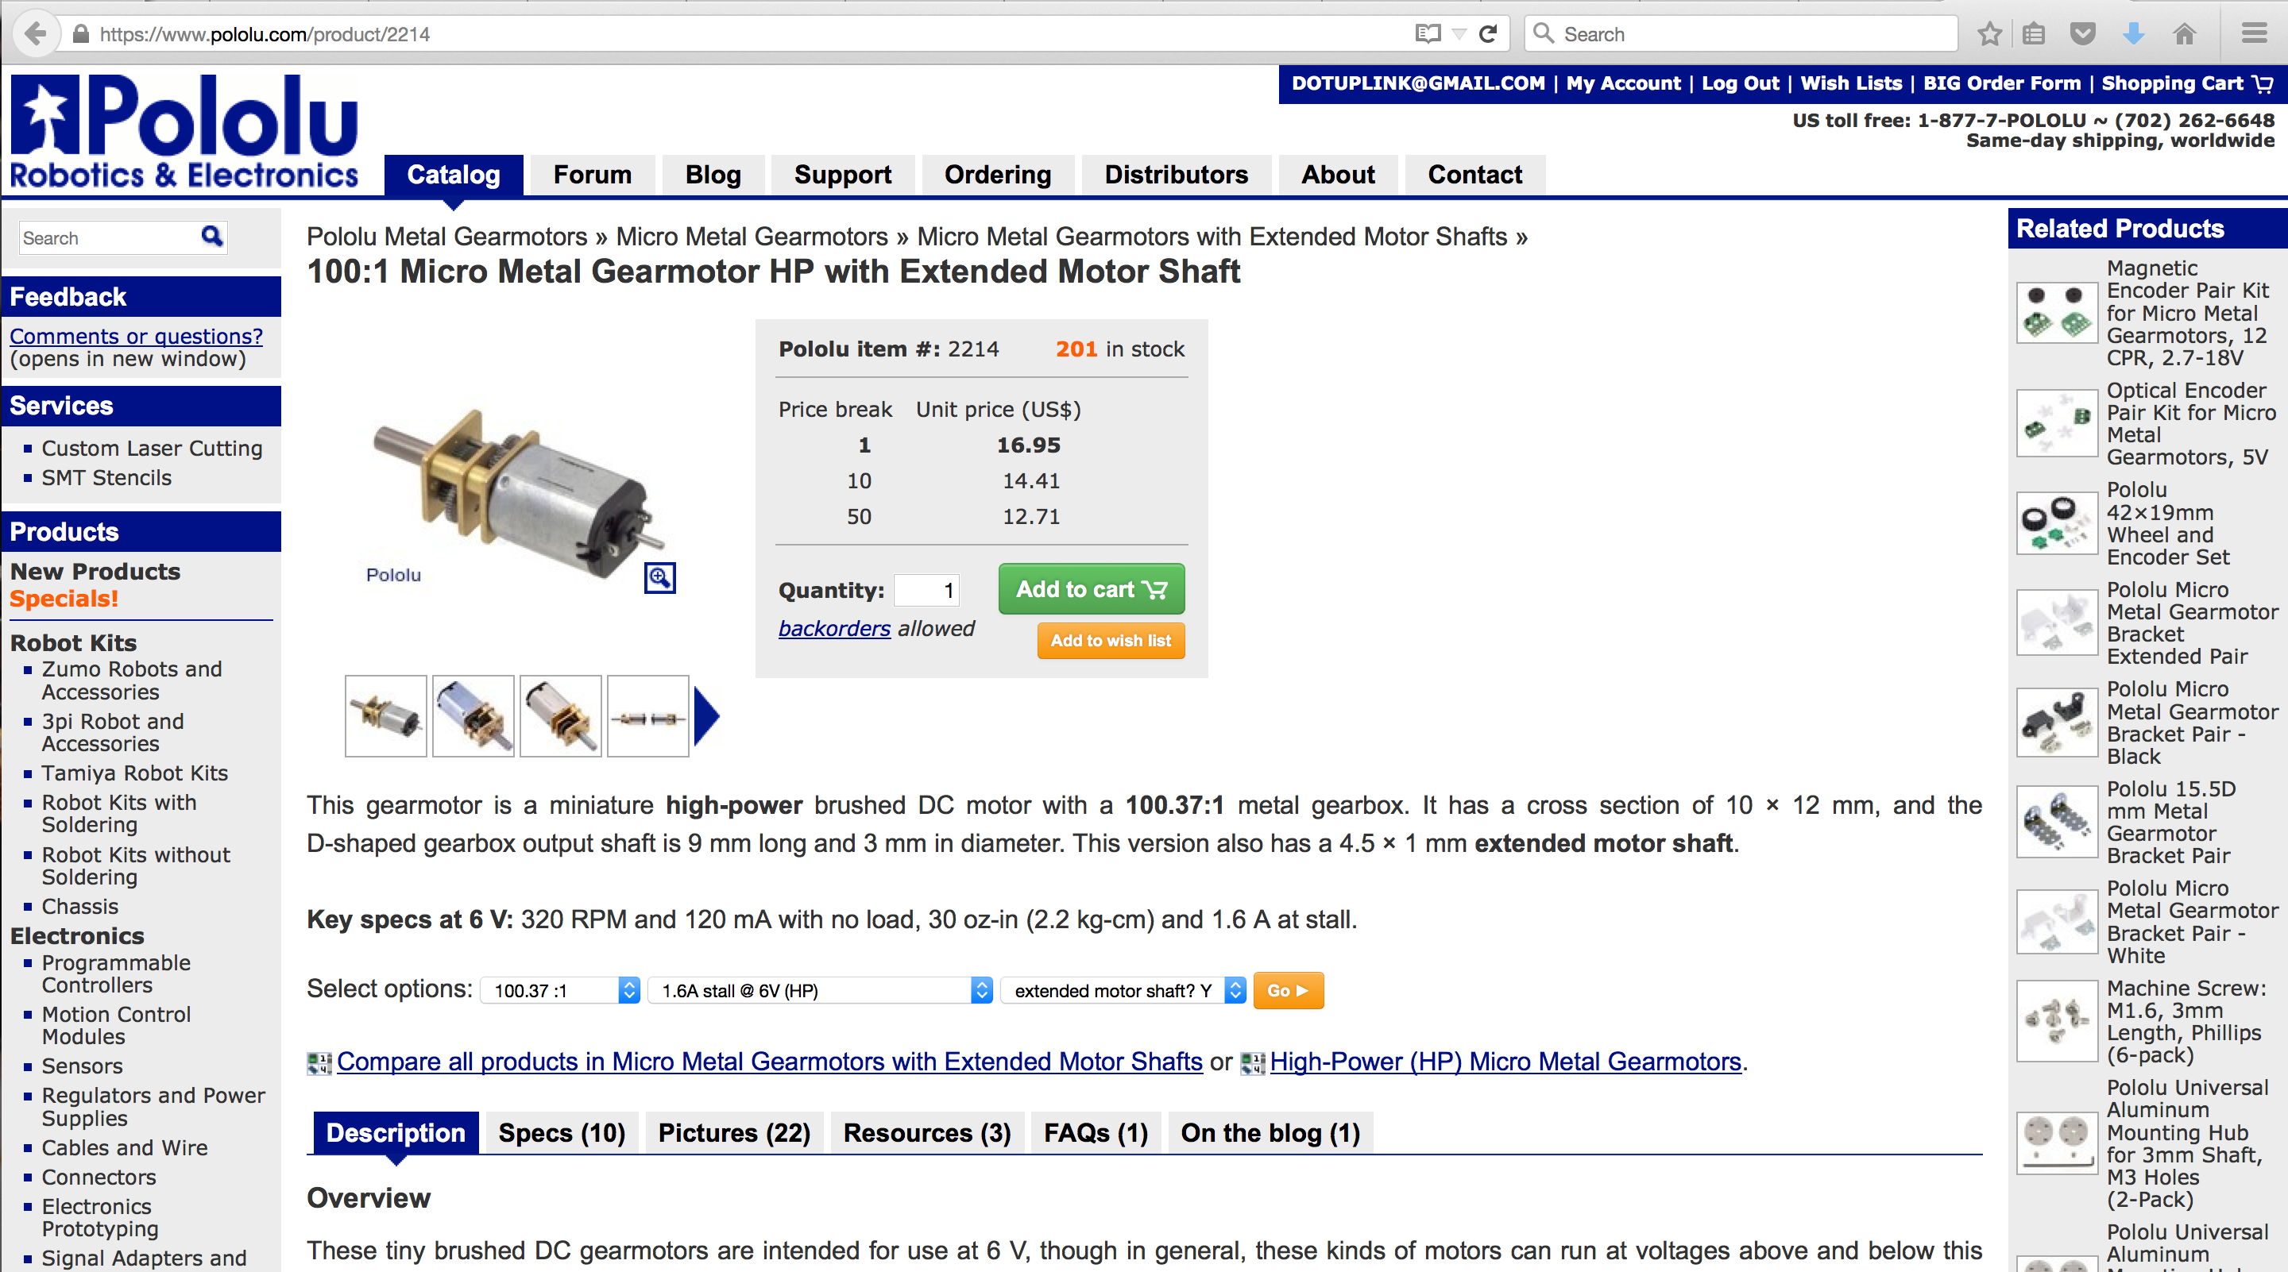
Spec'ing Motors

Slide 73
Spec'ing Motors
No Load Speed: 320 RPM -> 33.51 rad/sec
τ (N-m)
Stall Torque: 30 oz-in -> 0.2118 N-m
0.2118 N-m
(1.6A)
ω (rad/sec)
33.51 rad/sec
(6V)

Slide 74
Physical Motor & Wheel
Motor
La =
0.005H
Gearbox
+
Ea
-
Ra = 1Ω
θa
Wheel
Vemf
- +
Ja = 0
Da = 0
θm

Slide 75
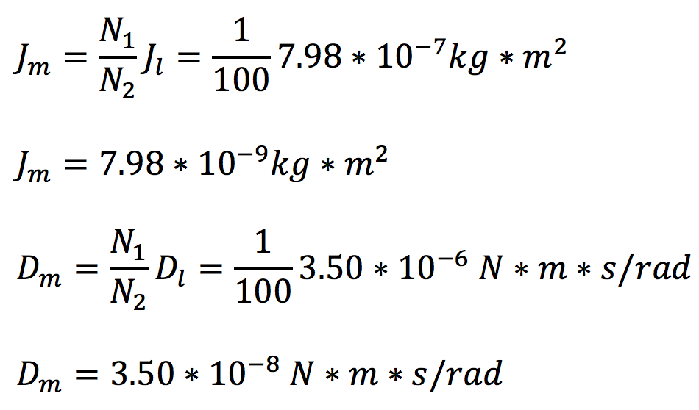
Physical Motor & Wheel
Motor
Gearbox
La =
0.005H
N1 = 1
+
Ea
-
Ra = 1Ω
Wheel
Vemf
- +
θm
N2 = 100

Slide 76
Physical Motor & Wheel
Motor
Gearbox
La =
0.005H
N1 = 1
+
Ea
-
Ra = 1Ω
Wheel
Vemf
- +
θm
N2 = 100

Slide 77
Physical Motor & Wheel
Motor
Gearbox
+
Ea
-
Wheel
- +
θm

Slide 78
Design
Digital
Motor Speed
Or
Digital
Motor Position
Physical
Motor Speed
Or
Physical
Motor Position
+
Controller
Σ
-

Slide 79
Controller
ACTION =
NOW
+
PAST
+
FUTURE

Slide 80
Model
Digital
Motor Speed
Or
Digital
Motor Position
Physical
Motor Speed
Or
Physical
Motor Position
+
Σ
-
1

Slide 81
Controller
Kp
Ki
Kd

Slide 82
DEMO!

Slide 83
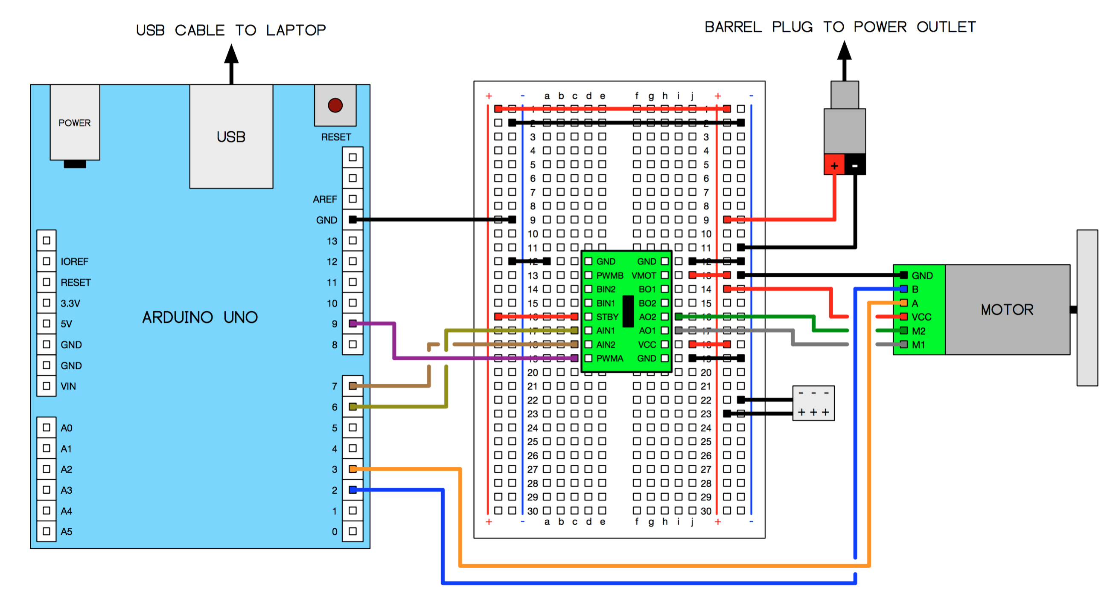
Hardware

Slide 84
Common Mistakes
PID loop in non timer based interrupt
void loop()
{ // Update the angle using the gyro as often as possible.
updateAngleGyro(); // Every 20 ms (50 Hz), correct the angle using the
// accelerometer, print it, and set the motor speeds.
static byte lastCorrectionTime = 0;
byte m = millis();
if ((byte)(m - lastCorrectionTime) >= 20)
{
lastCorrectionTime = m;
correctAngleAccel();
printAngles();
setMotors(); // PID Loop
}
}

Slide 85
Common Mistakes
PID loop in non timer based interrupt
Why is this such a bad thing to do?
Holding up the system kills the PID controller
Variation in execution time means changing dt in integration and derivative terms
What does this mean?
No longer meeting timing/control authority constraints
Possibly unstable system

Slide 86
Common Mistakes
Not recording & plotting e(t) and c(t) during the tuning process
You’re left to visually observe systems response
There maybe more going on than what’s visible
Time wasted trying different gain values without quantitatively knowing how it effects the response time
Not recording & plotting the P, I, D terms individually
Not knowing how each term is contributing to c(t)
Hard to work back where noise/problems are coming from

Slide 87
Common Mistakes
Not methodically tuning
Doing random P, I, D term tuning can be a HUGE time sink
Solution?
Follow a method
Understand the response
Make educated changes to your gain values
Not knowing which terms you need
PID? PI? PD?
I.E. – using D term on a noisy accelerometer

Slide 88
Common Mistakes
Not normalizing/mapping
P = 2432, I = 1693, D = 303… wat
Normalize/Unity Gain: 0.0 – 1.0 (assuming FPU)
Using floating point variables
Dangerous to do floating point math on embedded systems without FPU

