Slide 1
PID
Ara Kourchians

Slide 2
Physical
World
Control
Desired
World

Slide 3
Open Loop
Physical
World
Control
Desired
World
Notes:
Simple autonomous mode that follows a script
Sprinkler system on a timer
Motor + battery
You “trust” that it works and assume ideal conditions

Slide 4
Closed Loop
Physical
World
Control
Sensing
Desired
World
Notes:
Air Conditioners
Airplanes auto-pilot
Drones

Slide 5
??? Loop
Notes:
- Based on the previous definition, is this a closed or open loop system?

Slide 6
Closed Loop
X
Sensing

Slide 7
Closed Loop
X
Sensing
Control
Notes:
- Explain how the students observe where the robot is and come up with a control command to give the robot, but this has a problem….

Slide 8
Closed Loop
X
Sensing
Control
Notes:
This requires training, learning, ‘piloting’
Robot might not drive perfectly straight
Might slip, or be going uphill and will require the driver to manually add more power
So far, the driver has had to learn each robot.. and every robot is different

Slide 9
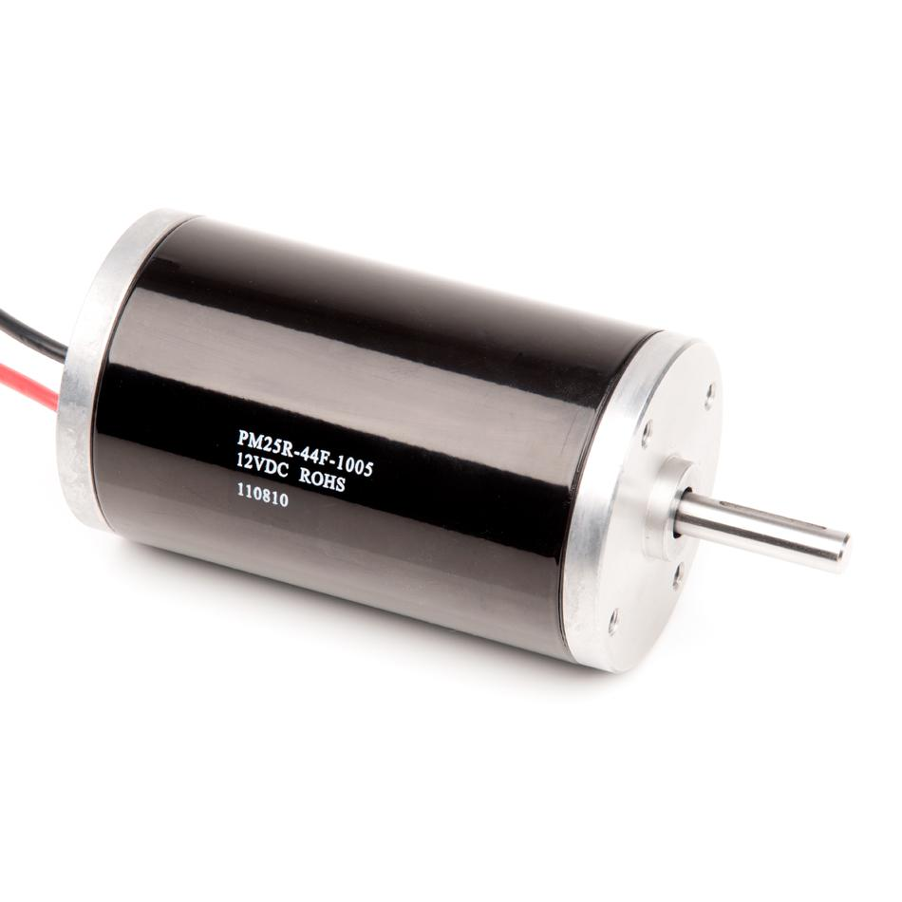
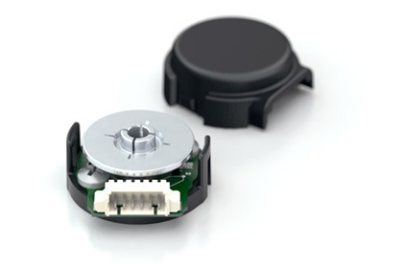
Some terminology
Motor
Encoder
State
Target
Error
Notes:
The story is different for autonomous mode

Slide 10
Autonomous Mode
State
Target
X
Error
Notes:
The story is different for autonomous mode

Slide 11
Autonomous Mode
autonomous.c
State
Target
X
Error

Slide 12
Autonomous Mode
autonomous.c
0
void go()
{
..
robot.drive(X);
..
}
X
Notes:
How do you actually write this in terms of motors and sensors?

Slide 13
Autonomous Mode
autonomous.c
0
void go()
{
..
robot.motors(100);
wait(1_SEC);
robot.motors(0); ..
}
X
Error
X+Error

Slide 14
Autonomous Mode
autonomous.c
0
void go()
{
..
robot.motors(100);
while(encoder < 1000)
{
encoder = robot.read();
}
robot.motors(0);
..
}
X
Error
X+Error
Notes:
You’re going to overshoot when you get to your goal (100% to 0%)

Slide 15
PID Control
0
Error

Slide 16
PID Control
Proportional
Present
P*Error
Integral
Past
I*Sum_of_Errors
Derivative
Future
D*(Error- Last_Error)
+
+
5
2
1
5
1
2
Notes:
PID controllers run in a loop, it’s iterative
Weights of each term depend on the system!
The P, I, and D terms are summed and used as the controller output

Slide 17
Position Control Using PID

Slide 18
PID Block Diagram
P
Error
I
+
Motor
Output
Target
+
+
Σ
-
+
State
D

Slide 19
PID Block Diagram
P
Error
I
+
Motor
Output
Target
+
+
Σ
-
+
State
D
Encoder

Slide 20
Proportional Control

Slide 21
Proportional Control
Motor = P * Error
0
Error

Slide 22
Proportional Control
Motor = P * Error
100 = 2 * 50
0
Error

Slide 23
Proportional Control
Motor = P * Error
20 = 2 * 10
0
Error

Slide 24
Proportional Control
Motor = P * Error
1 = 2 * 1
0
Error
Notes:
You may never reach it, or overshoot it
VERY system dependent ^
P term would be target distance dependent

Slide 25
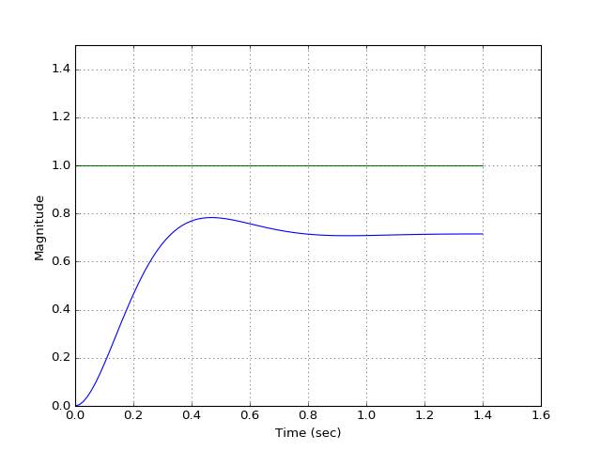
Proportional Control

Slide 26
Integral Control

Slide 27
Integral Control
Error_Sum = Error_Sum + Error
50 = 0 + 50
95 = 50 + 45
115 = 95 + 20
115 = 115 + 0
75 = 115 + -40
25 = 75 + -50
-35 = 25 + -60
-85 = -35 + -50
Motor = I * Error_Sum
25 = 0.5 * 50
48 = 0.5 * 95
56 = 0.5 * 115
56 = 0.5 * 115
38 = 0.5 * 75
13 = 0.5 * 25
-17 = 0.5 * -35
-43 = 0.5 * -85
0
Error
Notes:
You may never reach it, or overshoot it
VERY system dependent ^
P term would be target distance dependent

Slide 28
Integral Control
Error_Sum = Error_Sum + Error
50 = 0 + 50
95 = 50 + 45
115 = 95 + 20
115 = 115 + 0
75 = 115 + -40
25 = 75 + -50
-35 = 25 + -60
-85 = -35 + -50
Motor = I * Error_Sum
25 = 0.5 * 50
48 = 0.5 * 95
56 = 0.5 * 115
56 = 0.5 * 115
38 = 0.5 * 75
13 = 0.5 * 25
-17 = 0.5 * -35
-43 = 0.5 * -85
0
Error
Notes:
You may never reach it, or overshoot it
VERY system dependent ^
P term would be target distance dependent

Slide 29
Integral Control
Error_Sum = Error_Sum + Error
50 = 0 + 50
95 = 50 + 45
115 = 95 + 20
115 = 115 + 0
75 = 115 + -40
25 = 75 + -50
-35 = 25 + -60
-85 = -35 + -50
Motor = I * Error_Sum
25 = 0.5 * 50
48 = 0.5 * 95
56 = 0.5 * 115
56 = 0.5 * 115
38 = 0.5 * 75
13 = 0.5 * 25
-17 = 0.5 * -35
-43 = 0.5 * -85
0
Error
Notes:
You may never reach it, or overshoot it
VERY system dependent ^
P term would be target distance dependent

Slide 30
Integral Control
Error_Sum = Error_Sum + Error
50 = 0 + 50
95 = 50 + 45
115 = 95 + 20
115 = 115 + 0
75 = 115 + -40
25 = 75 + -50
-35 = 25 + -60
-85 = -35 + -50
Motor = I * Error_Sum
25 = 0.5 * 50
48 = 0.5 * 95
56 = 0.5 * 115
56 = 0.5 * 115
38 = 0.5 * 75
13 = 0.5 * 25
-17 = 0.5 * -35
-43 = 0.5 * -85
0
Notes:
You may never reach it, or overshoot it
VERY system dependent ^
P term would be target distance dependent

Slide 31
Integral Control
Error_Sum = Error_Sum + Error
50 = 0 + 50
95 = 50 + 45
115 = 95 + 20
115 = 115 + 0
75 = 115 + -40
25 = 75 + -50
-35 = 25 + -60
-85 = -35 + -50
Motor = I * Error_Sum
25 = 0.5 * 50
48 = 0.5 * 95
56 = 0.5 * 115
56 = 0.5 * 115
38 = 0.5 * 75
13 = 0.5 * 25
-17 = 0.5 * -35
-43 = 0.5 * -85
0
-Error
Notes:
You may never reach it, or overshoot it
VERY system dependent ^
P term would be target distance dependent

Slide 32
Integral Control
Error_Sum = Error_Sum + Error
50 = 0 + 50
95 = 50 + 45
115 = 95 + 20
115 = 115 + 0
75 = 115 + -40
25 = 75 + -50
-35 = 25 + -60
-85 = -35 + -50
Motor = I * Error_Sum
25 = 0.5 * 50
48 = 0.5 * 95
56 = 0.5 * 115
56 = 0.5 * 115
38 = 0.5 * 75
13 = 0.5 * 25
-17 = 0.5 * -35
-43 = 0.5 * -85
0
-Error
Notes:
You may never reach it, or overshoot it
VERY system dependent ^
P term would be target distance dependent

Slide 33
Integral Control
Error_Sum = Error_Sum + Error
50 = 0 + 50
95 = 50 + 45
115 = 95 + 20
115 = 115 + 0
75 = 115 + -40
25 = 75 + -50
-35 = 25 + -60
-85 = -35 + -50
Motor = I * Error_Sum
25 = 0.5 * 50
48 = 0.5 * 95
56 = 0.5 * 115
56 = 0.5 * 115
38 = 0.5 * 75
13 = 0.5 * 25
-17 = 0.5 * -35
-43 = 0.5 * -85
0
-Error
Notes:
You may never reach it, or overshoot it
VERY system dependent ^
P term would be target distance dependent

Slide 34
Integral Control
Error_Sum = Error_Sum + Error
50 = 0 + 50
95 = 50 + 45
115 = 95 + 20
115 = 115 + 0
75 = 115 + -40
25 = 75 + -50
-35 = 25 + -60
-75 = -35 + -40
Motor = I * Error_Sum
25 = 0.5 * 50
48 = 0.5 * 95
56 = 0.5 * 115
56 = 0.5 * 115
38 = 0.5 * 75
13 = 0.5 * 25
-17 = 0.5 * -35
-38 = 0.5 * -75
0
-Error
Notes:
You may never reach it, or overshoot it
VERY system dependent ^
P term would be target distance dependent

Slide 35
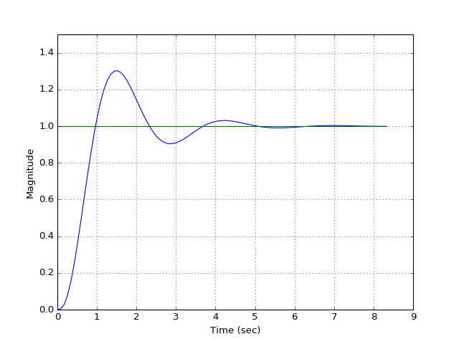
Integral Control

Slide 36
Derivative Control

Slide 37
Derivative Control
Motor = D* (Error – Last_Error)
= 0.5 * (50 – 0)
0
Error
Notes:
You may never reach it, or overshoot it
VERY system dependent ^
P term would be target distance dependent

Slide 38
Derivative Control
Motor = D* (Error – Last_Error)
25 = 0.5 * (50 – 0)
-5 = 0.5 * (40 – 50)
0
Error
Notes:
You may never reach it, or overshoot it
VERY system dependent ^
P term would be target distance dependent

Slide 39
Derivative Control
Motor = D* (Error – Last_Error)
25 = 0.5 * (50 – 0)
-5 = 0.5 * (40 – 50)
-2.5 = 0.5 * (35 – 40)
0
Error
Notes:
You may never reach it, or overshoot it
VERY system dependent ^
P term would be target distance dependent

Slide 40
Derivative Control
Motor = D* (Error – Last_Error)
25 = 0.5 * (50 – 0)
-5 = 0.5 * (40 – 50)
-2.5 = 0.5 * (35 – 40)
0 = 0.5 * (35 – 35)
0
Error
Notes:
You may never reach it, or overshoot it
VERY system dependent ^
P term would be target distance dependent

Slide 41
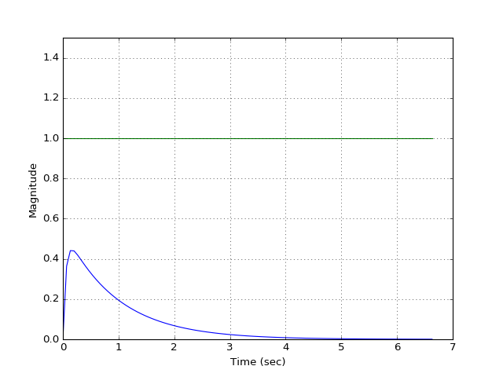
Derivative Control

Slide 42
PID Plot Terminology

Slide 43
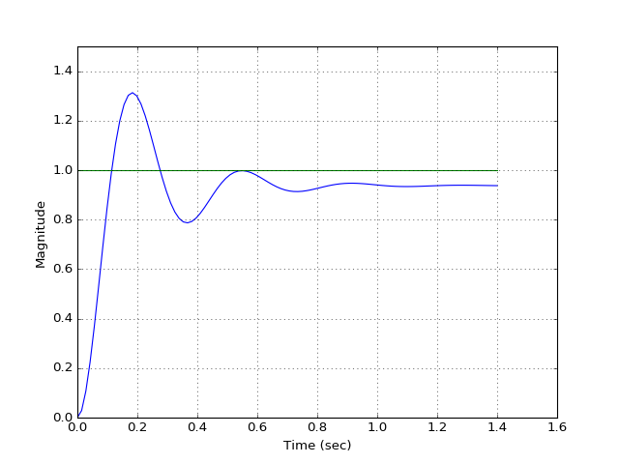
PID Plot Terminology
Overshoot
Steady-State Error
Rise Time
Settling Time

Slide 44
P = 50

Slide 45
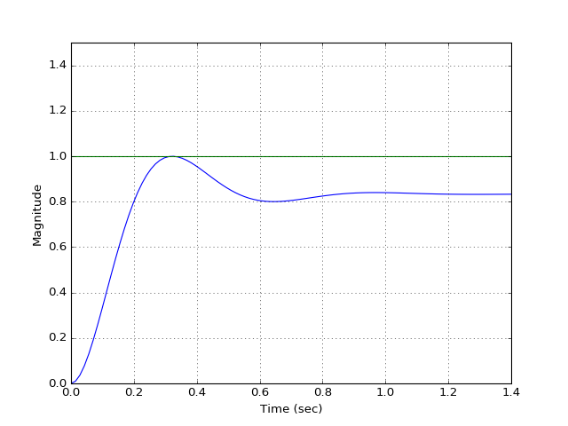
P = 100

Slide 46
P = 300

Slide 47
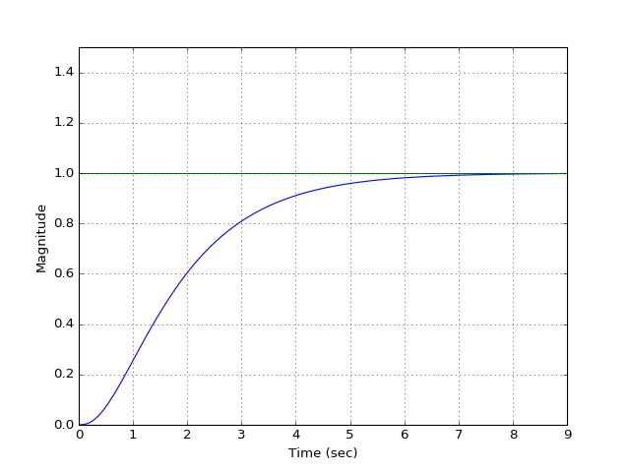
I = 10

Slide 48
I = 50

Slide 49
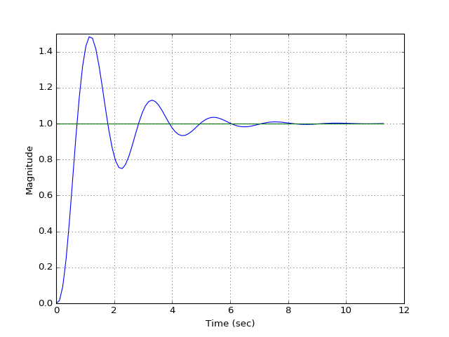
I = 80

Slide 50
D = 10

Slide 51
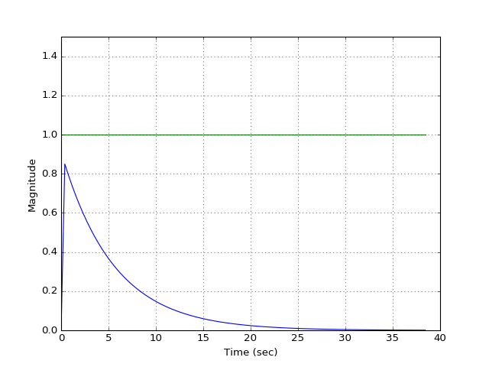
D = 100

Slide 52
PID Tuning Methods

Slide 53
PID Plot Terminology
Overshoot
Steady-State Error
Rise Time
Settling Time

Slide 54
PID Tuning Methods
Parameter Increase | Rise Time | Overshoot | Settling Time | Steady-State Error
Kp |  |  | Small Change
Ki
Kd | Small Change |  |  | Small Change

Slide 55
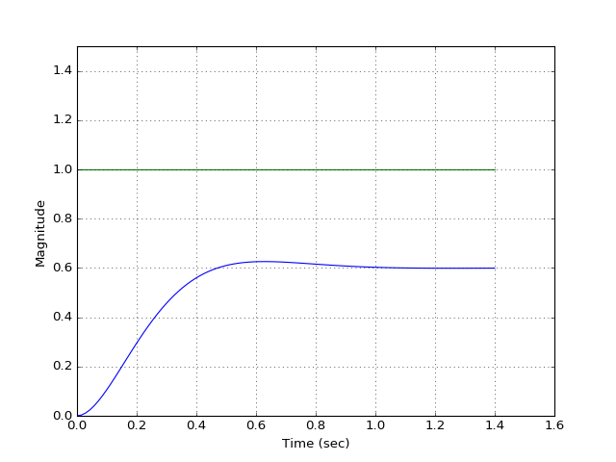
P = 30, I = 0, D = 0

Slide 56
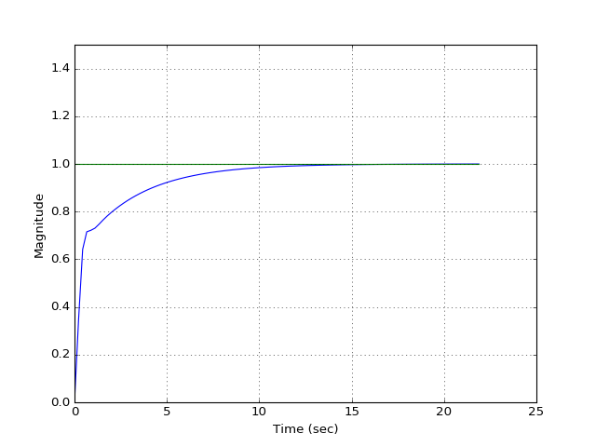
P = 30, I = 15, D = 0

Slide 57
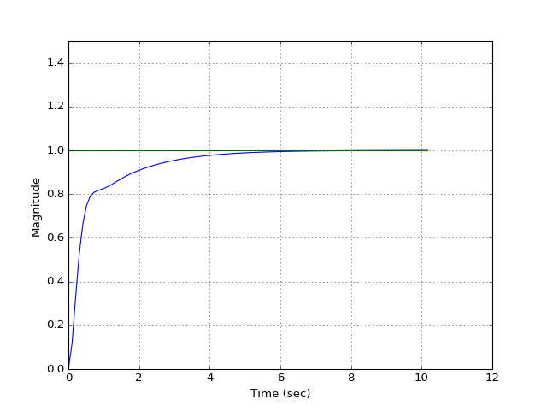
P = 30, I = 30, D = 0

Slide 58
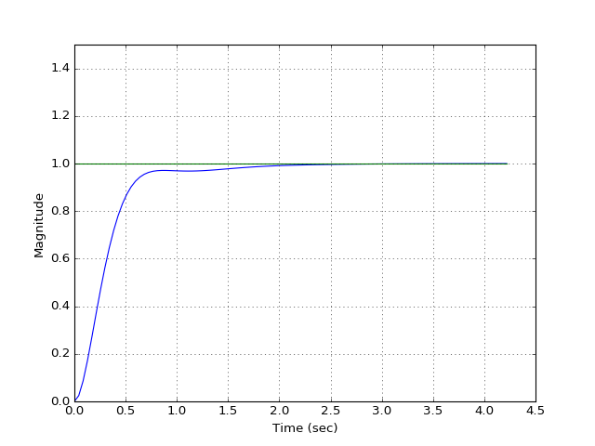
P = 30, I = 60, D = 0

Slide 59
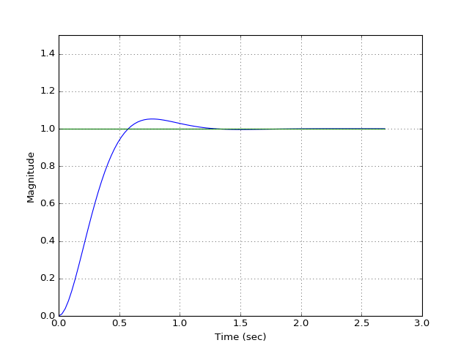
P = 30, I = 80, D = 0

Slide 60
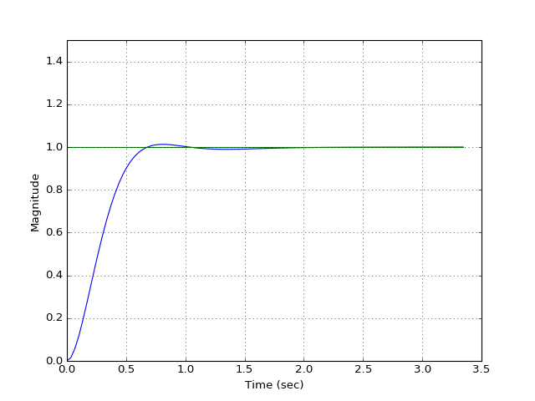
P = 30, I = 70, D = 0

Slide 61
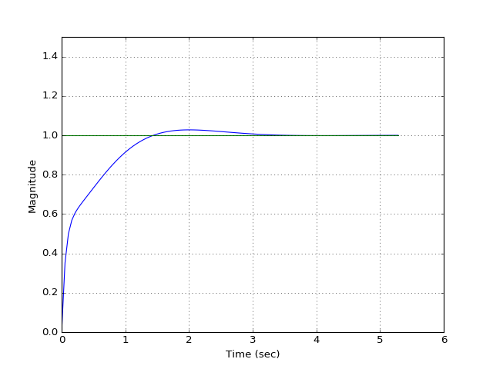
P = 30, I = 70, D = 10

Slide 62
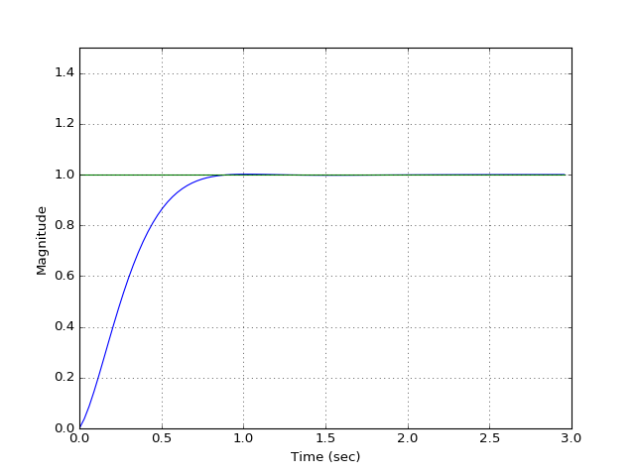
P = 30, I = 70, D = 1

Slide 63
DEMO!

Slide 64
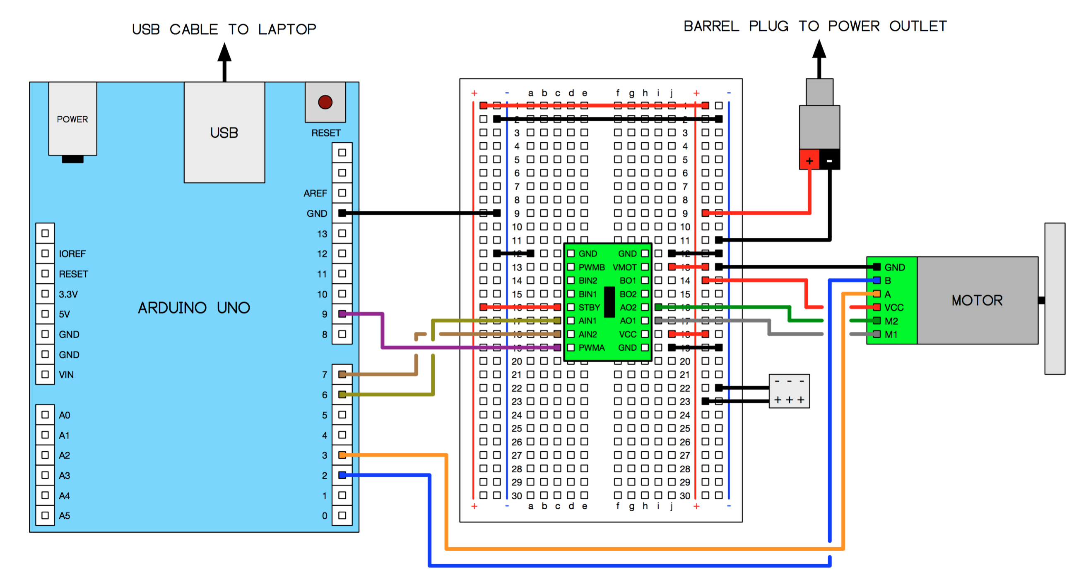
Hardware

